Slide 1
#remap Renewables Prospectivity Mapping
George Richardson
Rachel White
Laura Hinkelman
Sam Hooper
Julia King
With a lot of help from:
Catherine Kuhn
Google Earth Engine Users

Slide 2
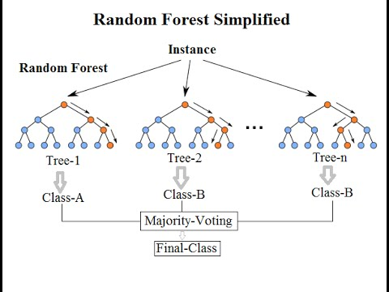

Slide 5
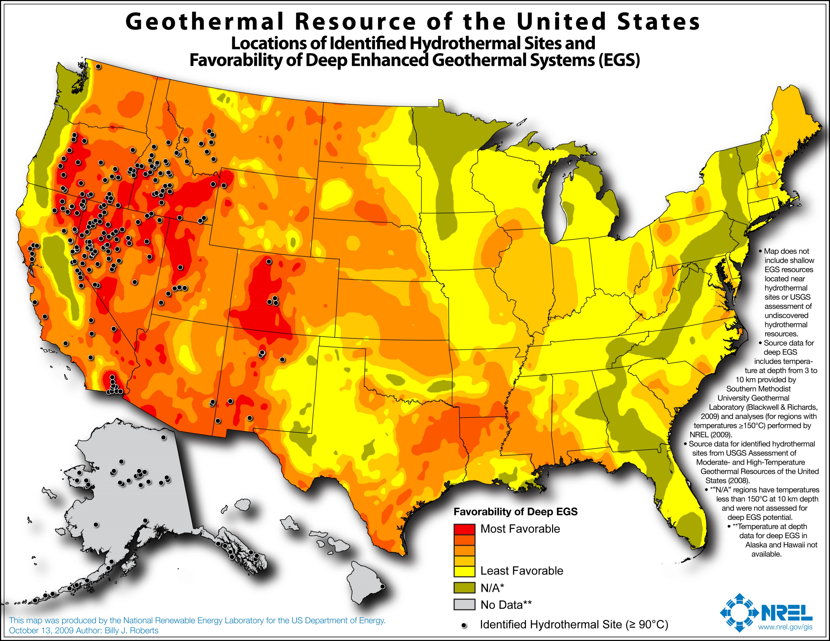
Existing Geothermal Prospectivity Map
Our Geothermal Prospectivity Map
http://www.nrel.gov/gis/data_geothermal.html

