Slide 1


Generating Performance Portable Code using Rewrite Rules
From High-Level Functional Expressions
to High-Performance OpenCL Code
Michel Steuwer
Christian Fensch
Sam Lindley
Christophe Dubach

Slide 2
The Problem(s)
CPU
Parallel processors everywhere
Many different types: CPUs, GPUs, …
Parallel programming is hard
Optimising is even harder
Problem: No portability of performance!
GPU
FPGA
Accelerator

Slide 3
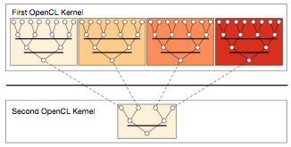
Case Study: Parallel Reduction in OpenCL
Summing up all values of an array
Comparison of 7 implementations by Nvidia
Investigating complexity and efficiency of optimisations

Slide 4
Unoptimised Implementation Parallel Reduction
kernel void reduce0(global float* g_idata, global float* g_odata,
unsigned int n, local float* l_data) {
unsigned int tid = get_local_id(0);
unsigned int i = get_global_id(0);
l_data[tid] = (i < n) ? g_idata[i] : 0;
barrier(CLK_LOCAL_MEM_FENCE);
// do reduction in local memory
for (unsigned int s=1; s < get_local_size(0); s*= 2) {
if ((tid % (2*s)) == 0) {
l_data[tid] += l_data[tid + s];
}
barrier(CLK_LOCAL_MEM_FENCE);
}
// write result for this work-group to global memory
if (tid == 0) g_odata[get_group_id(0)] = l_data[0];
}

Slide 5
OpenCL Programming Model
kernel void reduce0(global float* g_idata, global float* g_odata,
unsigned int n, local float* l_data) {
unsigned int tid = get_local_id(0);
unsigned int i = get_global_id(0);
l_data[tid] = (i < n) ? g_idata[i] : 0;
barrier(CLK_LOCAL_MEM_FENCE);
// do reduction in local memory
for (unsigned int s=1; s < get_local_size(0); s*= 2) {
if ((tid % (2*s)) == 0) {
l_data[tid] += l_data[tid + s];
}
barrier(CLK_LOCAL_MEM_FENCE);
}
// write result for this work-group to global memory
if (tid == 0) g_odata[get_group_id(0)] = l_data[0];
}
Multiple work-items (threads) execute the same kernel function
Work-items are organised for execution in work-groups

Slide 6
Avoid Divergent Branching
kernel void reduce1(global float* g_idata, global float* g_odata,
unsigned int n, local float* l_data) {
unsigned int tid = get_local_id(0);
unsigned int i = get_global_id(0);
l_data[tid] = (i < n) ? g_idata[i] : 0;
barrier(CLK_LOCAL_MEM_FENCE);
for (unsigned int s=1; s < get_local_size(0); s*= 2) {
// continuous work-items remain active
int index = 2 * s * tid;
if (index < get_local_size(0)) {
l_data[index] += l_data[index + s];
}
barrier(CLK_LOCAL_MEM_FENCE);
}
if (tid == 0) g_odata[get_group_id(0)] = l_data[0];
}

Slide 7
Avoid Interleaved Addressing
kernel void reduce2(global float* g_idata, global float* g_odata,
unsigned int n, local float* l_data) {
unsigned int tid = get_local_id(0);
unsigned int i = get_global_id(0);
l_data[tid] = (i < n) ? g_idata[i] : 0;
barrier(CLK_LOCAL_MEM_FENCE);
// process elements in different order
// requires commutativity
for (unsigned int s=get_local_size(0)/2; s>0; s>>=1) {
if (tid < s) {
l_data[tid] += l_data[tid + s];
}
barrier(CLK_LOCAL_MEM_FENCE);
}
if (tid == 0) g_odata[get_group_id(0)] = l_data[0];
}

Slide 8
Increase Computational Intensity per Work-Item
kernel void reduce3(global float* g_idata, global float* g_odata,
unsigned int n, local float* l_data) {
unsigned int tid = get_local_id(0);
unsigned int i = get_group_id(0) * (get_local_size(0)*2)
+ get_local_id(0);
l_data[tid] = (i < n) ? g_idata[i] : 0;
// performs first addition during loading
if (i + get_local_size(0) < n)
l_data[tid] += g_idata[i+get_local_size(0)];
barrier(CLK_LOCAL_MEM_FENCE);
for (unsigned int s=get_local_size(0)/2; s>0; s>>=1) {
if (tid < s) {
l_data[tid] += l_data[tid + s];
}
barrier(CLK_LOCAL_MEM_FENCE);
}
if (tid == 0) g_odata[get_group_id(0)] = l_data[0];
}

Slide 9
Avoid Synchronisation inside a Warp
kernel void reduce4(global float* g_idata, global float* g_odata,
unsigned int n, local volatile float* l_data) {
unsigned int tid = get_local_id(0);
unsigned int i = get_group_id(0) * (get_local_size(0)*2)
+ get_local_id(0);
l_data[tid] = (i < n) ? g_idata[i] : 0;
if (i + get_local_size(0) < n)
l_data[tid] += g_idata[i+get_local_size(0)];
barrier(CLK_LOCAL_MEM_FENCE);
# pragma unroll 1
for (unsigned int s=get_local_size(0)/2; s>32; s>>=1) {
if (tid < s) { l_data[tid] += l_data[tid + s]; }
barrier(CLK_LOCAL_MEM_FENCE); }
// this is not portable OpenCL code!
if (tid < 32) {
if (WG_SIZE >= 64) { l_data[tid] += l_data[tid+32]; }
if (WG_SIZE >= 32) { l_data[tid] += l_data[tid+16]; }
if (WG_SIZE >= 16) { l_data[tid] += l_data[tid+ 8]; }
if (WG_SIZE >= 8) { l_data[tid] += l_data[tid+ 4]; }
if (WG_SIZE >= 4) { l_data[tid] += l_data[tid+ 2]; }
if (WG_SIZE >= 2) { l_data[tid] += l_data[tid+ 1]; } }
if (tid == 0) g_odata[get_group_id(0)] = l_data[0]; }

Slide 10
Complete Loop Unrolling
kernel void reduce5(global float* g_idata, global float* g_odata,
unsigned int n, local volatile float* l_data) {
unsigned int tid = get_local_id(0);
unsigned int i = get_group_id(0) * (get_local_size(0)*2)
+ get_local_id(0);
l_data[tid] = (i < n) ? g_idata[i] : 0;
if (i + get_local_size(0) < n)
l_data[tid] += g_idata[i+get_local_size(0)];
barrier(CLK_LOCAL_MEM_FENCE);
if (WG_SIZE >= 256) {
if (tid < 128) { l_data[tid] += l_data[tid+128]; }
barrier(CLK_LOCAL_MEM_FENCE); }
if (WG_SIZE >= 128) {
if (tid < 64) { l_data[tid] += l_data[tid+ 64]; }
barrier(CLK_LOCAL_MEM_FENCE); }
if (tid < 32) {
if (WG_SIZE >= 64) { l_data[tid] += l_data[tid+32]; }
if (WG_SIZE >= 32) { l_data[tid] += l_data[tid+16]; }
if (WG_SIZE >= 16) { l_data[tid] += l_data[tid+ 8]; }
if (WG_SIZE >= 8) { l_data[tid] += l_data[tid+ 4]; }
if (WG_SIZE >= 4) { l_data[tid] += l_data[tid+ 2]; }
if (WG_SIZE >= 2) { l_data[tid] += l_data[tid+ 1]; } }
if (tid == 0) g_odata[get_group_id(0)] = l_data[0]; }

Slide 11
Fully Optimised Implementation
kernel void reduce6(global float* g_idata, global float* g_odata,
unsigned int n, local volatile float* l_data) {
unsigned int tid = get_local_id(0);
unsigned int i = get_group_id(0) * (get_local_size(0)*2)
+ get_local_id(0);
unsigned int gridSize = WG_SIZE * get_num_groups(0);
l_data[tid] = 0;
while (i < n) { l_data[tid] += g_idata[i];
if (i + WG_SIZE < n)
l_data[tid] += g_idata[i+WG_SIZE];
i += gridSize; }
barrier(CLK_LOCAL_MEM_FENCE);
if (WG_SIZE >= 256) {
if (tid < 128) { l_data[tid] += l_data[tid+128]; }
barrier(CLK_LOCAL_MEM_FENCE); }
if (WG_SIZE >= 128) {
if (tid < 64) { l_data[tid] += l_data[tid+ 64]; }
barrier(CLK_LOCAL_MEM_FENCE); }
if (tid < 32) {
if (WG_SIZE >= 64) { l_data[tid] += l_data[tid+32]; }
if (WG_SIZE >= 32) { l_data[tid] += l_data[tid+16]; }
if (WG_SIZE >= 16) { l_data[tid] += l_data[tid+ 8]; }
if (WG_SIZE >= 8) { l_data[tid] += l_data[tid+ 4]; }
if (WG_SIZE >= 4) { l_data[tid] += l_data[tid+ 2]; }
if (WG_SIZE >= 2) { l_data[tid] += l_data[tid+ 1]; } }
if (tid == 0) g_odata[get_group_id(0)] = l_data[0]; }

Slide 12
Case Study Conclusions
kernel
void reduce6(global float* g_idata,
global float* g_odata,
unsigned int n,
local volatile float* l_data) {
unsigned int tid = get_local_id(0);
unsigned int i =
get_group_id(0) * (get_local_size(0)*2)
+ get_local_id(0);
unsigned int gridSize =
WG_SIZE * get_num_groups(0);
l_data[tid] = 0;
while (i < n) {
l_data[tid] += g_idata[i];
if (i + WG_SIZE < n)
l_data[tid] += g_idata[i+WG_SIZE];
i += gridSize; }
barrier(CLK_LOCAL_MEM_FENCE);
if (WG_SIZE >= 256) {
if (tid < 128) {
l_data[tid] += l_data[tid+128]; }
barrier(CLK_LOCAL_MEM_FENCE); }
if (WG_SIZE >= 128) {
if (tid < 64) {
l_data[tid] += l_data[tid+ 64]; }
barrier(CLK_LOCAL_MEM_FENCE); }
if (tid < 32) {
if (WG_SIZE >= 64) {
l_data[tid] += l_data[tid+32]; }
if (WG_SIZE >= 32) {
l_data[tid] += l_data[tid+16]; }
if (WG_SIZE >= 16) {
l_data[tid] += l_data[tid+ 8]; }
if (WG_SIZE >= 8) {
l_data[tid] += l_data[tid+ 4]; }
if (WG_SIZE >= 4) {
l_data[tid] += l_data[tid+ 2]; }
if (WG_SIZE >= 2) {
l_data[tid] += l_data[tid+ 1]; } }
if (tid == 0)
g_odata[get_group_id(0)] = l_data[0];
}
Optimising OpenCL is complex
Understanding of target hardware required
Program changes not obvious
Is it worth it? …
kernel
void reduce0(global float* g_idata,
global float* g_odata,
unsigned int n,
local float* l_data) {
unsigned int tid = get_local_id(0);
unsigned int i = get_global_id(0);
l_data[tid] = (i < n) ? g_idata[i] : 0;
barrier(CLK_LOCAL_MEM_FENCE);
for (unsigned int s=1;
s < get_local_size(0); s*= 2) {
if ((tid % (2*s)) == 0) {
l_data[tid] += l_data[tid + s];
}
barrier(CLK_LOCAL_MEM_FENCE);
}
if (tid == 0)
g_odata[get_group_id(0)] = l_data[0];
}
Unoptimized Implementation
Fully Optimized Implementation

Slide 13
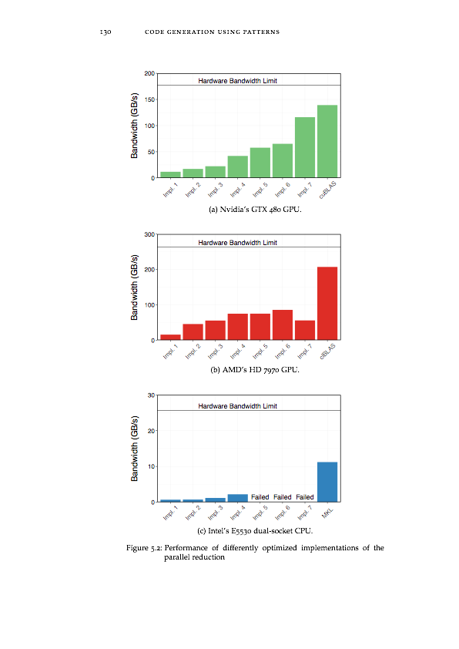
Performance Results Nvidia
… Yes! Optimising improves performance by a factor of 10!
Optimising is important, but …

Slide 14
Performance Results AMD and Intel
… unfortunately, optimisations in OpenCL are not portable!
Challenge: how to achieving portable performance?

Slide 15
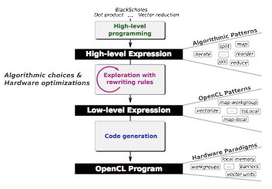
Generating Performance Portable Code using Rewrite Rules
Goal: automatic generation of Performance Portable code

Slide 16
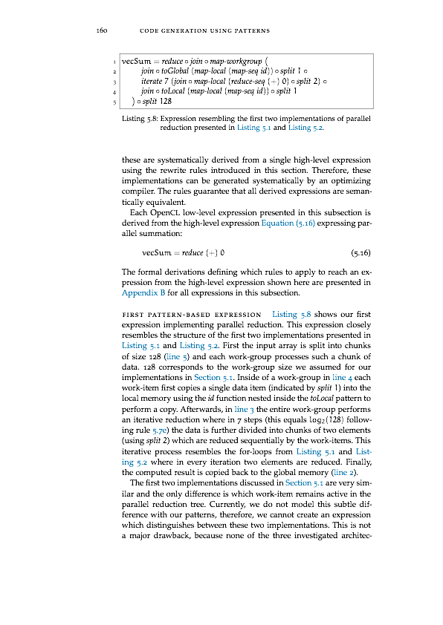
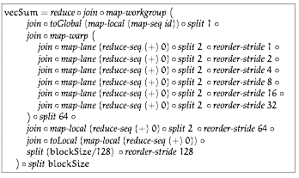
Example Parallel Reduction
③
kernel
void reduce6(global float* g_idata,
global float* g_odata,
unsigned int n,
local volatile float* l_data) {
unsigned int tid = get_local_id(0);
unsigned int i =
get_group_id(0) * (get_local_size(0)*2)
+ get_local_id(0);
unsigned int gridSize =
WG_SIZE * get_num_groups(0);
l_data[tid] = 0;
while (i < n) {
l_data[tid] += g_idata[i];
if (i + WG_SIZE < n)
l_data[tid] += g_idata[i+WG_SIZE];
i += gridSize; }
barrier(CLK_LOCAL_MEM_FENCE);
if (WG_SIZE >= 256) {
if (tid < 128) {
l_data[tid] += l_data[tid+128]; }
barrier(CLK_LOCAL_MEM_FENCE); }
if (WG_SIZE >= 128) {
if (tid < 64) {
l_data[tid] += l_data[tid+ 64]; }
barrier(CLK_LOCAL_MEM_FENCE); }
if (tid < 32) {
if (WG_SIZE >= 64) {
l_data[tid] += l_data[tid+32]; }
if (WG_SIZE >= 32) {
l_data[tid] += l_data[tid+16]; }
if (WG_SIZE >= 16) {
l_data[tid] += l_data[tid+ 8]; }
if (WG_SIZE >= 8) {
l_data[tid] += l_data[tid+ 4]; }
if (WG_SIZE >= 4) {
l_data[tid] += l_data[tid+ 2]; }
if (WG_SIZE >= 2) {
l_data[tid] += l_data[tid+ 1]; } }
if (tid == 0)
g_odata[get_group_id(0)] = l_data[0];
}
①
rewrite rules
code generation
②

Slide 17
Example Parallel Reduction
③
kernel
void reduce6(global float* g_idata,
global float* g_odata,
unsigned int n,
local volatile float* l_data) {
unsigned int tid = get_local_id(0);
unsigned int i =
get_group_id(0) * (get_local_size(0)*2)
+ get_local_id(0);
unsigned int gridSize =
WG_SIZE * get_num_groups(0);
l_data[tid] = 0;
while (i < n) {
l_data[tid] += g_idata[i];
if (i + WG_SIZE < n)
l_data[tid] += g_idata[i+WG_SIZE];
i += gridSize; }
barrier(CLK_LOCAL_MEM_FENCE);
if (WG_SIZE >= 256) {
if (tid < 128) {
l_data[tid] += l_data[tid+128]; }
barrier(CLK_LOCAL_MEM_FENCE); }
if (WG_SIZE >= 128) {
if (tid < 64) {
l_data[tid] += l_data[tid+ 64]; }
barrier(CLK_LOCAL_MEM_FENCE); }
if (tid < 32) {
if (WG_SIZE >= 64) {
l_data[tid] += l_data[tid+32]; }
if (WG_SIZE >= 32) {
l_data[tid] += l_data[tid+16]; }
if (WG_SIZE >= 16) {
l_data[tid] += l_data[tid+ 8]; }
if (WG_SIZE >= 8) {
l_data[tid] += l_data[tid+ 4]; }
if (WG_SIZE >= 4) {
l_data[tid] += l_data[tid+ 2]; }
if (WG_SIZE >= 2) {
l_data[tid] += l_data[tid+ 1]; } }
if (tid == 0)
g_odata[get_group_id(0)] = l_data[0];
}
①
rewrite rules
code generation
②

Slide 18

① Algorithmic Primitives

Slide 19

① High-Level Programs

Slide 20
Example Parallel Reduction
③
kernel
void reduce6(global float* g_idata,
global float* g_odata,
unsigned int n,
local volatile float* l_data) {
unsigned int tid = get_local_id(0);
unsigned int i =
get_group_id(0) * (get_local_size(0)*2)
+ get_local_id(0);
unsigned int gridSize =
WG_SIZE * get_num_groups(0);
l_data[tid] = 0;
while (i < n) {
l_data[tid] += g_idata[i];
if (i + WG_SIZE < n)
l_data[tid] += g_idata[i+WG_SIZE];
i += gridSize; }
barrier(CLK_LOCAL_MEM_FENCE);
if (WG_SIZE >= 256) {
if (tid < 128) {
l_data[tid] += l_data[tid+128]; }
barrier(CLK_LOCAL_MEM_FENCE); }
if (WG_SIZE >= 128) {
if (tid < 64) {
l_data[tid] += l_data[tid+ 64]; }
barrier(CLK_LOCAL_MEM_FENCE); }
if (tid < 32) {
if (WG_SIZE >= 64) {
l_data[tid] += l_data[tid+32]; }
if (WG_SIZE >= 32) {
l_data[tid] += l_data[tid+16]; }
if (WG_SIZE >= 16) {
l_data[tid] += l_data[tid+ 8]; }
if (WG_SIZE >= 8) {
l_data[tid] += l_data[tid+ 4]; }
if (WG_SIZE >= 4) {
l_data[tid] += l_data[tid+ 2]; }
if (WG_SIZE >= 2) {
l_data[tid] += l_data[tid+ 1]; } }
if (tid == 0)
g_odata[get_group_id(0)] = l_data[0];
}
①
rewrite rules
code generation
②

Slide 21
Example Parallel Reduction
③
kernel
void reduce6(global float* g_idata,
global float* g_odata,
unsigned int n,
local volatile float* l_data) {
unsigned int tid = get_local_id(0);
unsigned int i =
get_group_id(0) * (get_local_size(0)*2)
+ get_local_id(0);
unsigned int gridSize =
WG_SIZE * get_num_groups(0);
l_data[tid] = 0;
while (i < n) {
l_data[tid] += g_idata[i];
if (i + WG_SIZE < n)
l_data[tid] += g_idata[i+WG_SIZE];
i += gridSize; }
barrier(CLK_LOCAL_MEM_FENCE);
if (WG_SIZE >= 256) {
if (tid < 128) {
l_data[tid] += l_data[tid+128]; }
barrier(CLK_LOCAL_MEM_FENCE); }
if (WG_SIZE >= 128) {
if (tid < 64) {
l_data[tid] += l_data[tid+ 64]; }
barrier(CLK_LOCAL_MEM_FENCE); }
if (tid < 32) {
if (WG_SIZE >= 64) {
l_data[tid] += l_data[tid+32]; }
if (WG_SIZE >= 32) {
l_data[tid] += l_data[tid+16]; }
if (WG_SIZE >= 16) {
l_data[tid] += l_data[tid+ 8]; }
if (WG_SIZE >= 8) {
l_data[tid] += l_data[tid+ 4]; }
if (WG_SIZE >= 4) {
l_data[tid] += l_data[tid+ 2]; }
if (WG_SIZE >= 2) {
l_data[tid] += l_data[tid+ 1]; } }
if (tid == 0)
g_odata[get_group_id(0)] = l_data[0];
}
①
rewrite rules
code generation
②

Slide 22
② Algorithmic Rewrite Rules
Provably correct rewrite rules
Express algorithmic implementation choices
Split-join rule:
Map fusion rule:
Reduce rules:

Slide 23
② OpenCL Primitives
Primitive
OpenCL concept
Work-items
Work-groups
Sequential implementations
,
Memory areas
,
Vectorization
,

Slide 24
② OpenCL Rewrite Rules
Express low-level implementation and optimisation choices
Map rules:
Local/ global memory rules:
Vectorisation rule:
Fusion rule:

Slide 25
Example Parallel Reduction
③
kernel
void reduce6(global float* g_idata,
global float* g_odata,
unsigned int n,
local volatile float* l_data) {
unsigned int tid = get_local_id(0);
unsigned int i =
get_group_id(0) * (get_local_size(0)*2)
+ get_local_id(0);
unsigned int gridSize =
WG_SIZE * get_num_groups(0);
l_data[tid] = 0;
while (i < n) {
l_data[tid] += g_idata[i];
if (i + WG_SIZE < n)
l_data[tid] += g_idata[i+WG_SIZE];
i += gridSize; }
barrier(CLK_LOCAL_MEM_FENCE);
if (WG_SIZE >= 256) {
if (tid < 128) {
l_data[tid] += l_data[tid+128]; }
barrier(CLK_LOCAL_MEM_FENCE); }
if (WG_SIZE >= 128) {
if (tid < 64) {
l_data[tid] += l_data[tid+ 64]; }
barrier(CLK_LOCAL_MEM_FENCE); }
if (tid < 32) {
if (WG_SIZE >= 64) {
l_data[tid] += l_data[tid+32]; }
if (WG_SIZE >= 32) {
l_data[tid] += l_data[tid+16]; }
if (WG_SIZE >= 16) {
l_data[tid] += l_data[tid+ 8]; }
if (WG_SIZE >= 8) {
l_data[tid] += l_data[tid+ 4]; }
if (WG_SIZE >= 4) {
l_data[tid] += l_data[tid+ 2]; }
if (WG_SIZE >= 2) {
l_data[tid] += l_data[tid+ 1]; } }
if (tid == 0)
g_odata[get_group_id(0)] = l_data[0];
}
①
rewrite rules
code generation
②

Slide 26
Example Parallel Reduction
③
kernel
void reduce6(global float* g_idata,
global float* g_odata,
unsigned int n,
local volatile float* l_data) {
unsigned int tid = get_local_id(0);
unsigned int i =
get_group_id(0) * (get_local_size(0)*2)
+ get_local_id(0);
unsigned int gridSize =
WG_SIZE * get_num_groups(0);
l_data[tid] = 0;
while (i < n) {
l_data[tid] += g_idata[i];
if (i + WG_SIZE < n)
l_data[tid] += g_idata[i+WG_SIZE];
i += gridSize; }
barrier(CLK_LOCAL_MEM_FENCE);
if (WG_SIZE >= 256) {
if (tid < 128) {
l_data[tid] += l_data[tid+128]; }
barrier(CLK_LOCAL_MEM_FENCE); }
if (WG_SIZE >= 128) {
if (tid < 64) {
l_data[tid] += l_data[tid+ 64]; }
barrier(CLK_LOCAL_MEM_FENCE); }
if (tid < 32) {
if (WG_SIZE >= 64) {
l_data[tid] += l_data[tid+32]; }
if (WG_SIZE >= 32) {
l_data[tid] += l_data[tid+16]; }
if (WG_SIZE >= 16) {
l_data[tid] += l_data[tid+ 8]; }
if (WG_SIZE >= 8) {
l_data[tid] += l_data[tid+ 4]; }
if (WG_SIZE >= 4) {
l_data[tid] += l_data[tid+ 2]; }
if (WG_SIZE >= 2) {
l_data[tid] += l_data[tid+ 1]; } }
if (tid == 0)
g_odata[get_group_id(0)] = l_data[0];
}
①
rewrite rules
code generation
②

Slide 27
③ Pattern based OpenCL Code Generation
Generate OpenCL code for each OpenCL primitive
for (int g_id = get_global_id(0); g_id < n;
g_id += get_global_size(0)) {
output[g_id] = f(xs[g_id]);
}
T acc = z;
for (int i = 0; i < n; ++i) {
acc = f(acc, xs[i]);
}

Slide 28
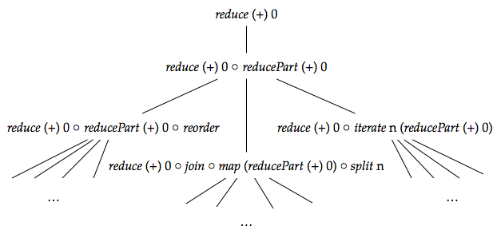
Rewrite rules define a space of possible implementations

Slide 29
Rewrite rules define a space of possible implementations

Slide 30
Rewrite rules define a space of possible implementations

Slide 31
Rewrite rules define a space of possible implementations

Slide 32
Rewrite rules define a space of possible implementations
Fully automated search for good implementations possible

Slide 33
Search Strategy
For each node in the tree:
Apply one rule and randomly sample subtree
Repeat for node with best performing subtree
①
apply rule
②
generate code execute measure performance

Slide 34
Search Strategy
For each node in the tree:
Apply one rule and randomly sample subtree
Repeat for node with best performing subtree
①
apply rule
②
generate code execute measure performance

Slide 35
Search Strategy
For each node in the tree:
Apply one rule and randomly sample subtree
Repeat for node with best performing subtree
①
apply rule
②
generate code execute measure performance

Slide 36
Search Strategy
For each node in the tree:
Apply one rule and randomly sample subtree
Repeat for node with best performing subtree
highest performance

Slide 37
Search Strategy
For each node in the tree:
Apply one rule and randomly sample subtree
Repeat for node with best performing subtree
③
repeat process

Slide 38
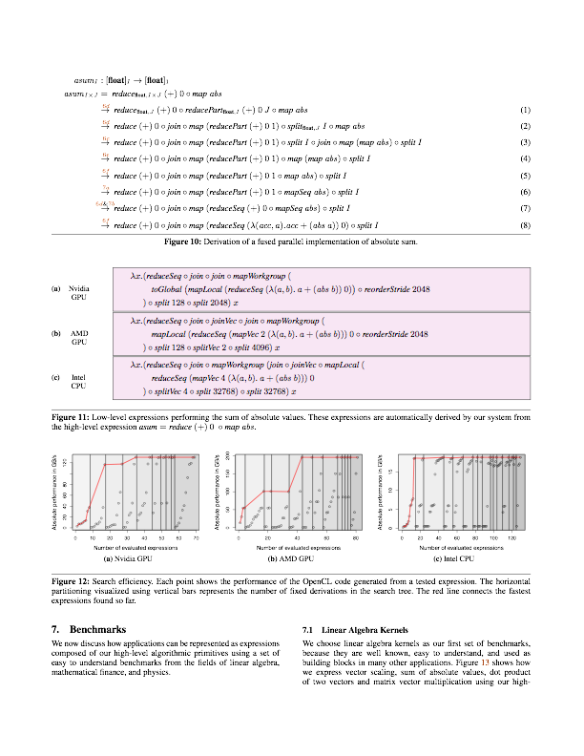
Search Results Automatically Found Expressions
Search on: Nvidia GTX 480 GPU, AMD Radeon HD 7970 GPU, Intel Xeon E5530 CPU

Slide 39
Search Results Search Efficiency
Overall search on each platform took < 1 hour
Average execution time per tested expression < 1/2 second

Slide 40
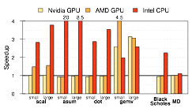
Performance Results vs. Portable Implementation
Up to 20x speedup on fairly simple benchmarks vs. portable clBLAS implementation

Slide 41
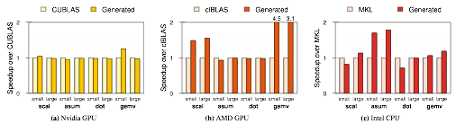
Performance Results vs. Hardware-Specific Implementations
Automatically generated code vs. expert written code
Competitive performance vs. highly optimised implementations
Up to 4.5x speedup for gemv on AMD

Slide 42
Summary
OpenCL code is not performance portable
Our approach uses
functional high-level primitives,
OpenCL-specific low-level primitives, and
rewrite-rules to generate performance portable code.
Rewrite-rules define a space of possible implementations
Performance on par with specialised, highly-tuned code
Michel Steuwer — michel.steuwer@ed.ac.uk

