Slide 1



Planning and Estimation
Ramhari Narayanan
Business Analyst

Slide 2
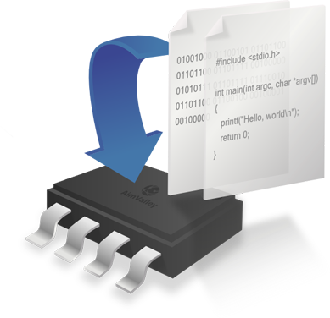

What is a project?
A Project is a temporary undertaking to create a unique product or service with a defined start and end point and specific objectives that, when attained, signify completion

Slide 3
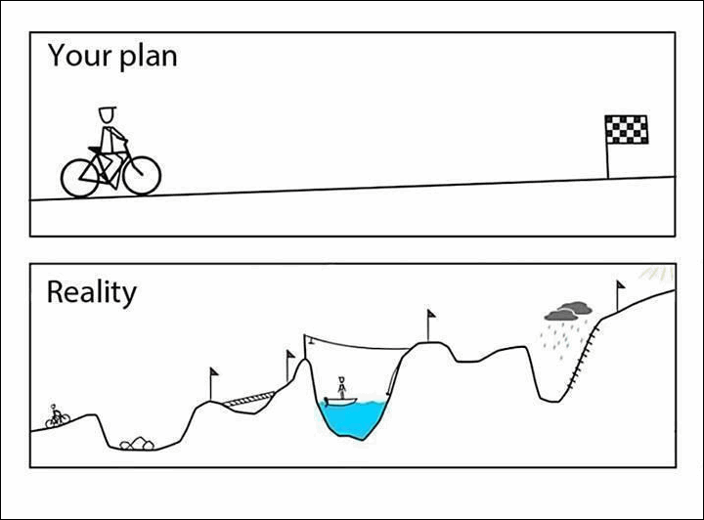
Project Planning

Slide 4
Project Planning

Slide 5
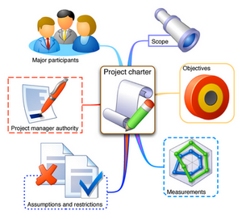
Why Project Planning?
Software project planning encompasses five major activities
Estimation, scheduling, risk analysis, quality management planning, and change management planning
Estimation determines how much money, effort, resources, and time it will take to build a specific system or product
The software team first estimates
The work to be done
The resources required
The time that will elapse from start to finish
Then they establish a project schedule that
Defines tasks and milestones
Identifies who is responsible for conducting each task
Specifies the inter-task dependencies

Slide 6

What is an estimate?
According to Webster,
“the act of appraising or valuing”
“a statement of the cost of work to be done”
PMO defines an estimate as,
a rough calculation of the costs and the amount of work prior to the commencement of work
“The single most important task of a project is setting realistic expectations. Unrealistic expectations based on inaccurate estimates are the single largest cause of software failure.”
Futrell, Shafer and Shafer, “Quality Software Project Management”

Slide 7

Why Estimation is important?
Globally, program development of large software systems normally experience 200-300% cost overruns and a 100% schedule slip
15% of large projects deliver…Unexpected Results only!
Key reasons…poor management and inaccurate estimations of development cost and schedule
If not meeting schedules, developers often pay the price!

Slide 8

Why do we need to estimate?
To get an idea of the costs of a project
To get an idea of the time needed to complete the project
To identify resource needs
To identify ongoing costs and resource needs

Slide 9

How do we estimate? Estimation techniques
Single Point Estimate - PMO currently uses a single point estimate
We take a single estimate per task

Slide 10

How do we estimate? Estimation techniques
Three point Estimate (PERT)* - Triangular Distribution
We take three estimates per task
Optimistic Estimate – Best Case Scenario
Pessimistic Estimate – Worst Case Scenario
Most Likely Estimate
Average the three estimates to get a three point estimate
Example:
Optimistic = 6 hours
Pessimistic = 10 hours
Most Likely = 8 hours
The three point estimate is (6+10+8)/3 = 8 hours
* Program Evaluation and Review Technique

Slide 11
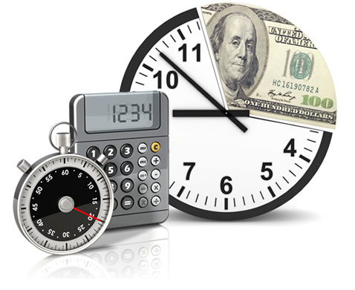
How do we estimate? Estimation techniques
Three point Estimate (PERT)*- Beta Distribution
We take three estimates per task
Optimistic Estimate – Best Case Scenario
Pessimistic Estimate – Worst Case Scenario
Most Likely Estimate
Multiply the Most Likely estimate by 4, add to the Optimistic and Pessimistic estimates and divide by 6
Example:
Optimistic = 6 hours
Pessimistic = 10 hours
Most Likely = 8 hours
The three point estimate is (6+10+4x8)/6 = 8 hours
* Program Evaluation and Review Technique

Slide 12
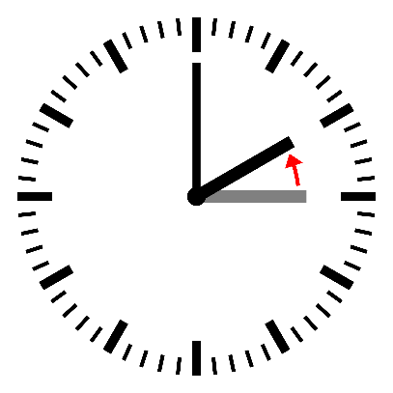
When do we estimate?
An estimate can be calculated during initiation
An estimate can also be calculated during planning but before project plan is created
The later the estimate is done the more accurate it is.
Initiation
Planning
Execution
Closure
Project Lifecycle
Start of a project
Very Little information is available
Requirements are defined
Tasks are defined
Project Schedule and plan is created
A lot more information is available
Main body of work is performed here
Coding, Testing, Installation et al.
We say Goodbye and Good Luck
Formally change product or service state to “in production” and “in maintenance” mode
Lessons learnt

Slide 13

Best Practices
Split tasks into smaller.
Track your working time.
Keep in mind each stage (testing, code review, and etc.).
Each Team has own velocity
Let whole Team estimate.
Estimation also takes time.
Definition of Done.

Slide 14

Remember!
Estimations are guesses.
No two projects are alike and context plays a big part in estimates.
Always find a Knowledge Expert for a task and obtain their estimate.
With a process our guesses can improve by measuring Actual for every project.

Slide 15


** All images are taken from GOOGLE.

