Slide 1
Performance
Testing

Slide 2
Performance & Load Testing Basics
  Introduction to Performance Testing
  Difference between Performance, Load and Stress Testing
  Why Performance Testing?
  When is it required?
  What should be tested?
  Performance Testing Process
  Load Test configuration for a web system
  Practice Questions

Slide 3
Introduction to Performance Testing
Performance testing is the process of determining the speed or effectiveness of a computer, network, software program or device.
Before going into the details, we should understand the factors that governs Performance testing:
  Throughput
  Response Time
  Tuning
  Benchmarking

Slide 4
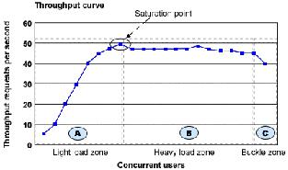
Throughput
Capability of a product to handle multiple transactions in a given period.
Throughput represents the number of requests/business transactions processed by the product in a specified time duration.
As the number of concurrent users increase, the throughput increases almost linearly with the number of requests. As there is very little congestion within the Application Server system queues.

Slide 5
Throughput
Capability of a product to handle multiple transactions in a given period.
Throughput represents the number of requests/business transactions processed by the product in a specified time duration.
As the number of concurrent users increase, the throughput increases almost linearly with the number of requests. As there is very little congestion within the Application Server system queues.

Slide 6
Throughput
In the heavy load zone or Section B, as the concurrent client load increases, throughput remains relatively constant.
In Section C (the buckle zone) one or more of the system components have become exhausted and throughput starts to degrade. For example, the system might enter the buckle zone when the network connections at the Web server exhaust the limits of the network adapter or if the requests exceed operating system limits for file handles.

Slide 7
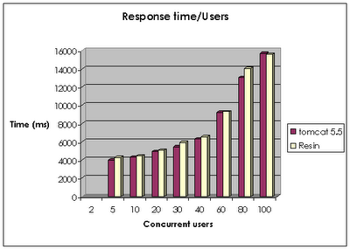
Response Time
It is equally important to find out how much time each of the transactions took to complete.
Response time is defined as the delay between the point of request and the first response from the product.
The response time increases proportionally to the user load.

Slide 8
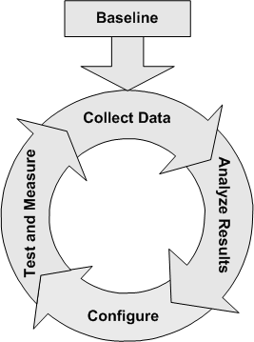
Tuning
Tuning is the procedure by which product performance is enhanced by setting different values to the parameters of the product, operating system and other components.
Tuning improves the product performance without having to touch the source code of the product.

Slide 9
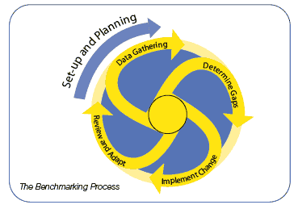
Benchmarking
A very well-improved performance of a product makes no business sense if that performance does not match up to the competitive products.
A careful analysis is needed to chalk out the list of transactions to be compared across products so that an apple-apple comparison becomes possible.

Slide 10
Performance Testing- Definition
The testing to evaluate the response time (speed), throughput and utilization of system to execute its required functions in comparison with different versions of the same product or a different competitive product is called Performance Testing.
Performance testing is done to derive benchmark numbers for the system.
Heavy load is not applied to the system
Tuning is performed until the system under test achieves the expected levels of performance.

Slide 11
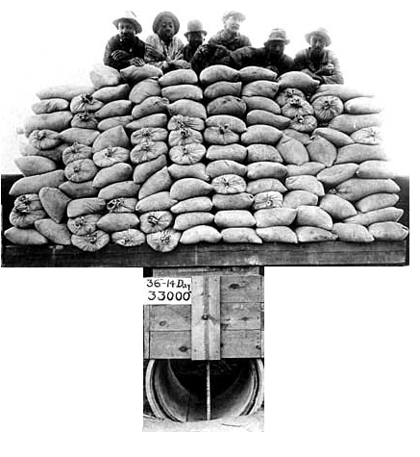
Difference between
Performance, Load and Stress Testing
Load Testing
Process of exercising the system under test by feeding it the largest tasks it can operate with.
Constantly increasing the load on the system via automated tools to simulate real time scenario with virtual users.
Examples:
Testing a word processor by editing a very large document.
For Web Application load is defined in terms of concurrent users or HTTP connections.

Slide 12
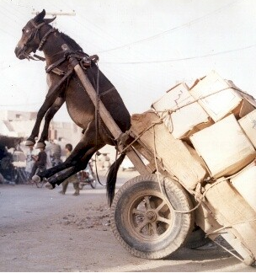
Difference between
Performance, Load and Stress Testing
Stress Testing
Trying to break the system under test by overwhelming its resources or by taking resources away from it.
Purpose is to make sure that the system fails and recovers gracefully.
Example:
Double the baseline number for concurrent users/HTTP connections.
Randomly shut down and restart ports on the network switches/routers that connects servers.

Slide 13
Why Performance Testing?
The week of Feb 6, 2000:
Hackers delivered over 1-Billion transactions concurrently to each one of these sites.
      Yahoo
      eBay
      Buy.com
      Amazon
      eTrade
How did you think they performed ?

Slide 14
Why Performance Testing
Identifies problems early on before they become costly to resolve.
Reduces development cycles.
Produces better quality, more scalable code.
Prevents revenue and credibility loss due to poor Web site performance.
Enables intelligent planning for future expansion.
To ensure that the system meets performance expectations such as response time, throughput etc. under given levels of load.
Expose bugs that do not surface in cursory testing, such as memory management bugs, memory leaks, buffer overflows, etc.

Slide 15
When is it required?
Design Phase:
Pages containing lots of images and multimedia for reasonable wait times. Heavy loads are less important than knowing which types of content cause slowdowns.
Development Phase:
To check results of individual pages and processes, looking for breaking points, unnecessary code and bottlenecks.
Deployment Phase:
To identify the minimum hardware and software requirements for the application.

Slide 16
What should be tested?
High frequency transactions: The most frequently used transactions have the potential to impact the performance of all of the other transactions if they are not efficient.
Mission Critical transactions: The more important transactions that facilitate the core objectives of the system should be included, as failure under load of these transactions has, by definition, the greatest impact.
Read Transactions: At least one READ ONLY transaction should be included, so that performance of such transactions can be differentiated from other more complex transactions.
Update Transactions: At least one update transaction should be included so that performance of such transactions can be differentiated from other transactions.

Slide 17
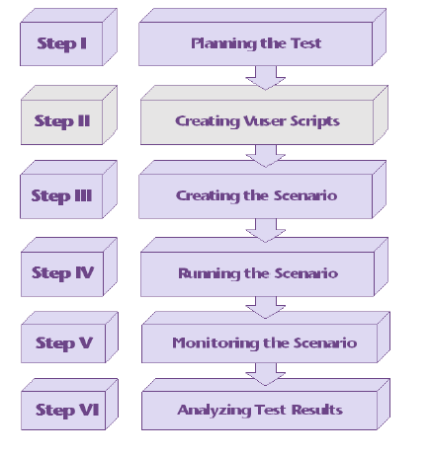
Performance Testing Process

Slide 18
1.Planning
Determine the performance testing objectives
Describe the application to test using a application model
  Describe the Hardware environment
  Create a Benchmark (Agenda) to be recorded in Phase 2.
    Define what tasks each user will perform
    Define (or estimate) the percentage of users per task.

Slide 19
1.Planning
2.Record
3.Modify
Record
  Record the defined testing activities that will be used as a foundation for your load test scripts.
  One activity per task or multiple activities depending on user task definition
Modify
  Modify load test scripts defined by recorder to reflect more realistic Load test simulations.
  Defining the project, users
  Randomize parameters (Data, times, environment)
  Randomize user activities that occur during the load test

Slide 20
4. Execute
Virtual Users (VUs): Test Goals
Start: 5 Max Response Time <= 20 Sec
Incremented by: 5
Maximum: 200
Think Time: 5 sec
Test Script:
One typical user from login through completion.

Slide 21
5.Monitor
6. Analyze
Monitoring the scenario: We monitor scenario execution using the various online runtime monitors.
Analysing test results: During scenario execution, the tool records the performance of the application under different loads. We use the graphs and reports to analyse the application’s performance.

Slide 22
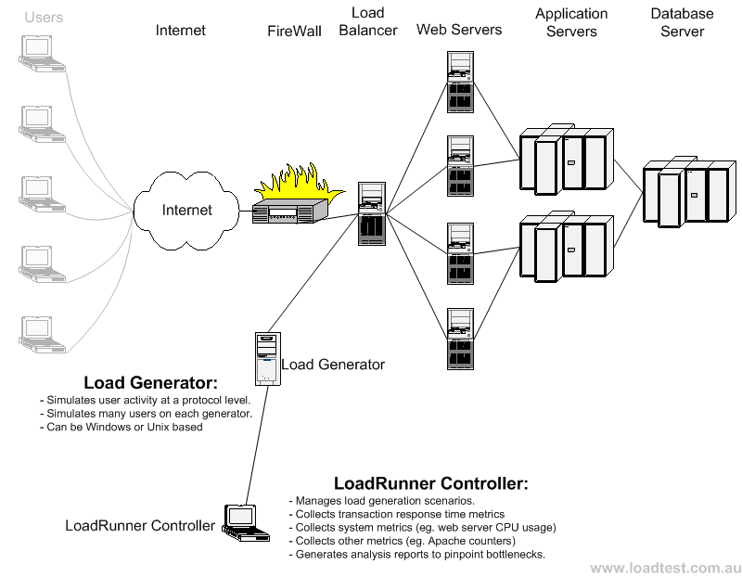
Load Test configuration for a web system

Slide 23
Thank You

