Slide 1
CO2 Emissions and
Fuel Consumption by Cars
Final Project
2022-11-2
Keming Sun
Yongbin Kang

Slide 2
PT1.
APP FUNCTION

Slide 3
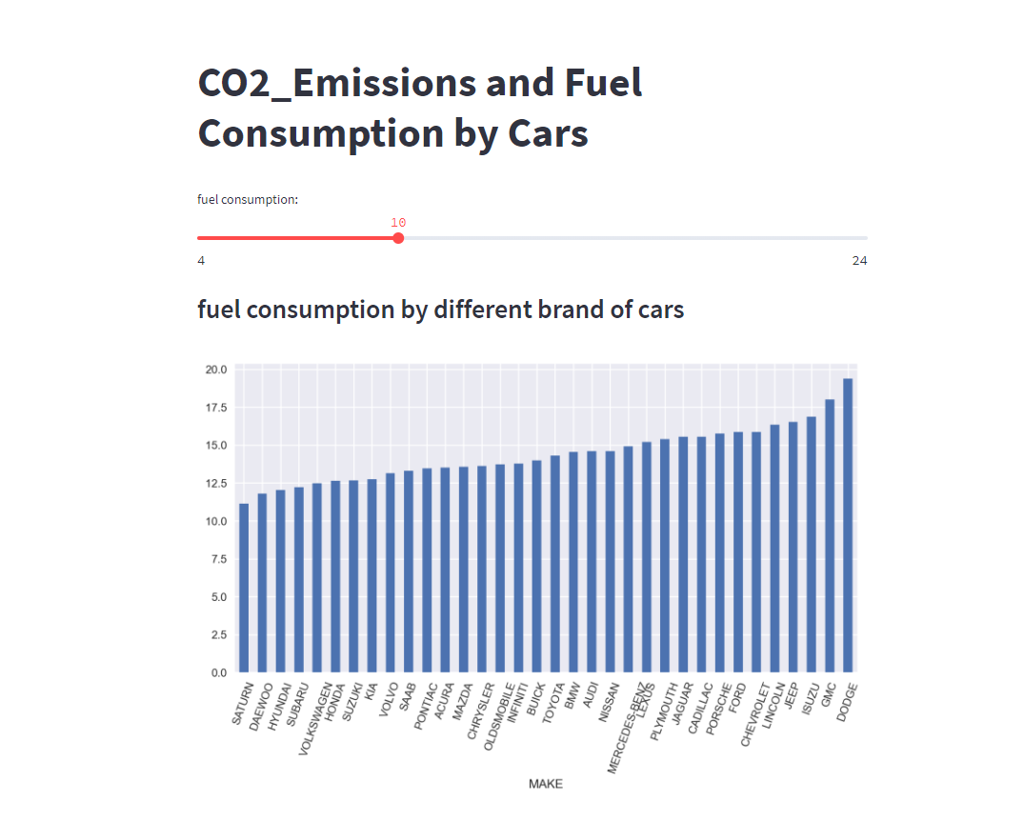
APP FUNCTION
This app helps people better choose the car they want based on their fuel consumption and CO2 emission.

Slide 4
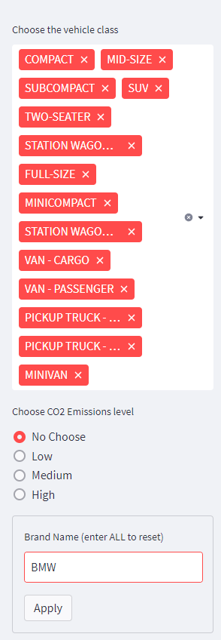
APP FUNCTION
Here you can select:
1. the vehicle class
2. the C02 Emissions level
3. the Brand Name

Slide 5
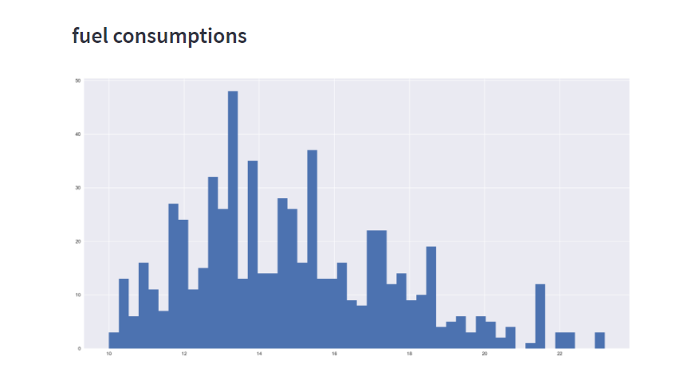
APP FUNCTION
This shows the fuel consmptions of the selected type of cars.

Slide 6
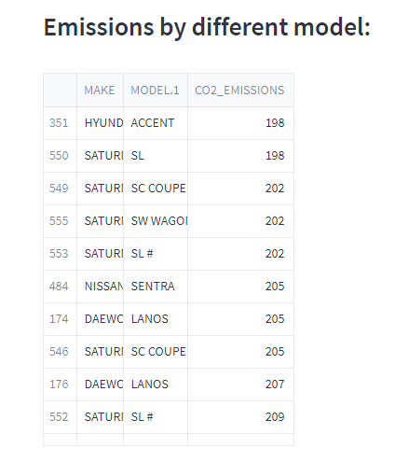
APP FUNCTION
This chart shows the C02 emissions of selected brand cars.

Slide 7
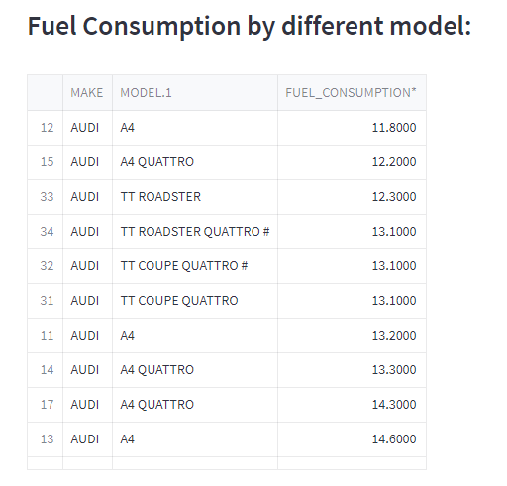
APP FUNCTION
This chart shows the fuel consumption of selected cars.

Slide 8
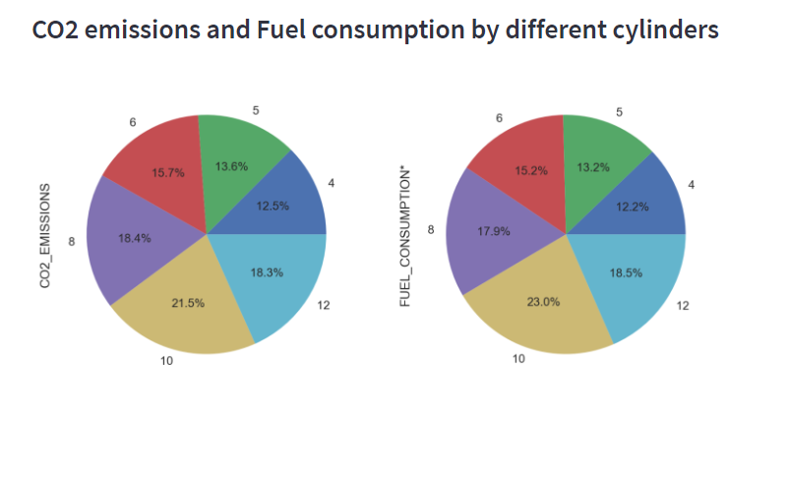
APP FUNCTION
This pie chart shows the carbon dioxide emissions and fuel consumption of vehicles with different numbers of cylinders. The larger the ratio, the more emissions and consumption.

Slide 9
PT2.
QUESTIONS

Slide 10
QUESTION 1
Generally, consumers think that more cylinders means more fuel consumption and more CO2 emissions, does the truth really match up?

Slide 11
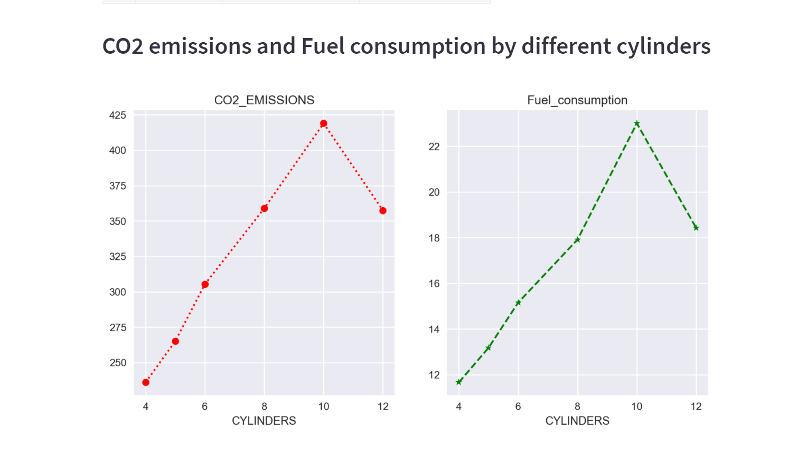
QUESTION 1
Let me show it more intuitively.

Slide 12
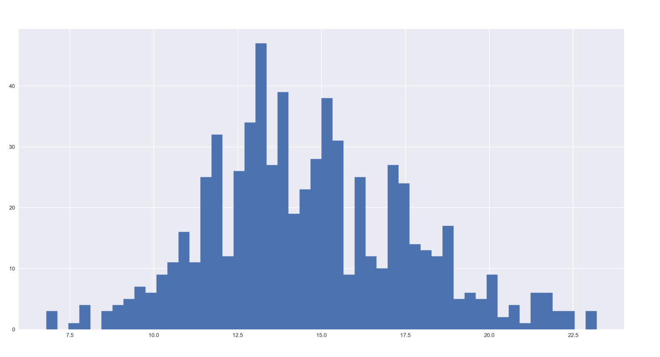
QUESTION 2
What number range is the fuel consumption of the car concentrated in?

Slide 13
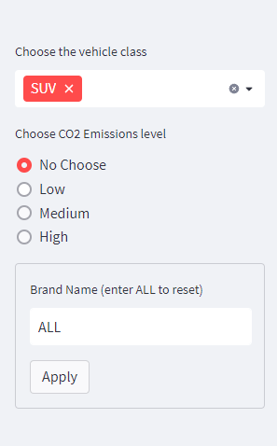
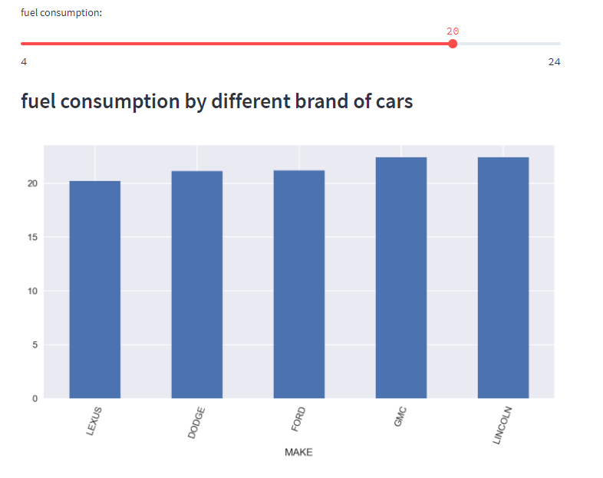
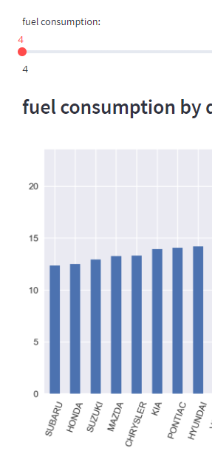
QUESTION 3
Compared with the fuel consumption of different brands, which brand of SUV is the most fuel-efficient and which consume the most among mainstream car brands?

Slide 14
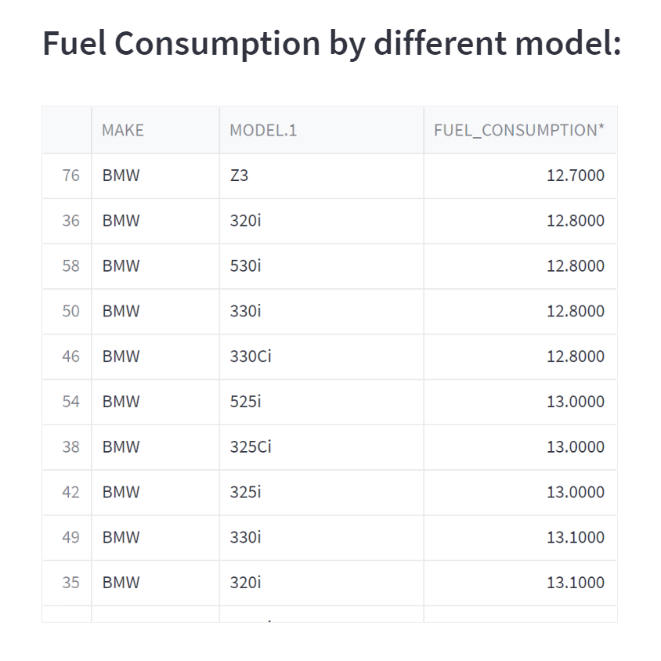
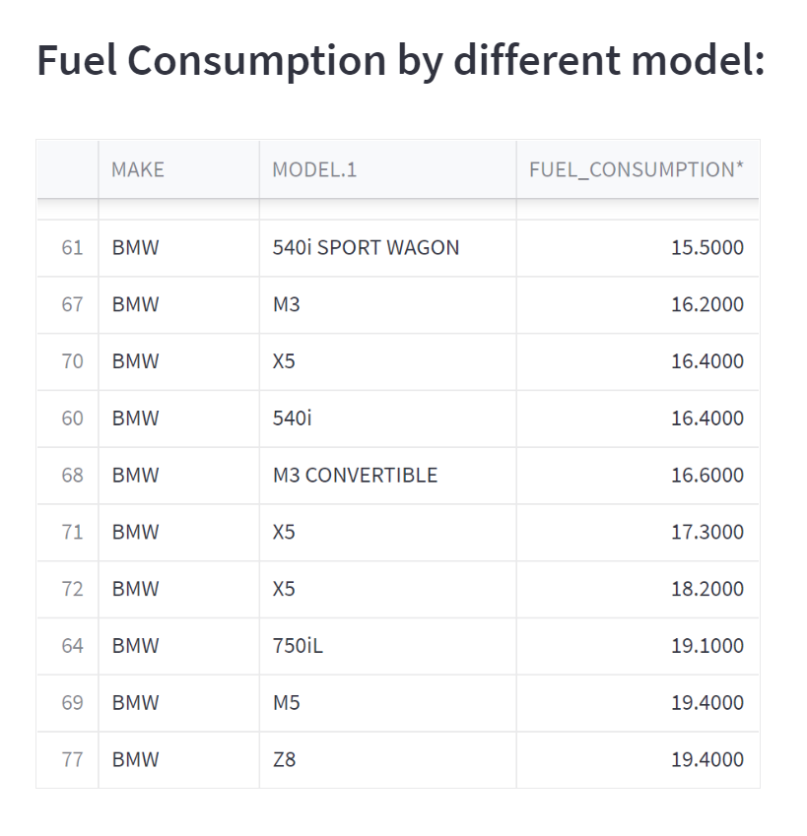
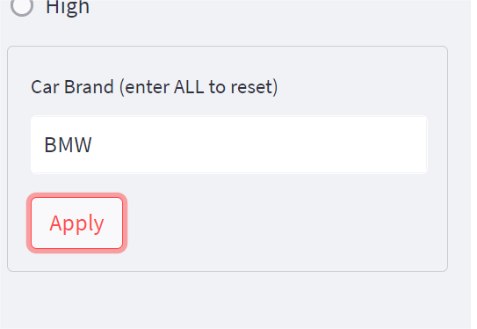
QUESTION 4
If a consumer want to buy a specific brand of car but have no idea which model to buy. How can this app help?

Slide 15
PT3.
Q&A

Slide 16
Thank you

