Slide 1
Permutation entropy (PE) to detect motor unit presence

Slide 2
Need for single channel MU detection
Personalise physiotherapeutic treatments to better suit patient needs
Speed up rehabilitation – useful due to short rehabilitation timeframe
Benefits of single channel:
Less material, less computation:
Cheaper production cost of equipment
Faster sEMG data preparation and algorithm computation
Simplicity allows for greater transparency in methods and results

Slide 3
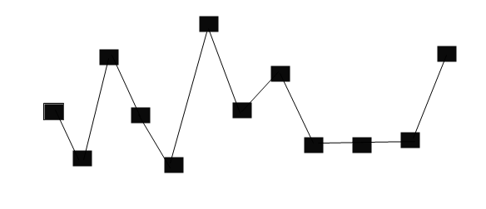
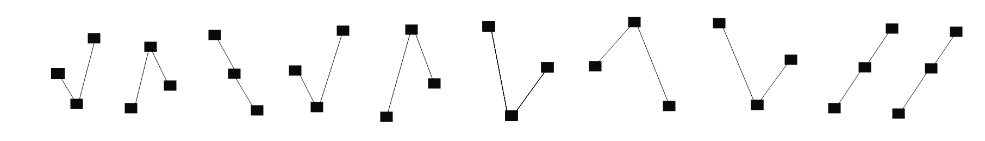
Calculation and normalisation of PE (1)
Sliding window of a time-series:
1 2 3 1 2 4 5 4 6 6
Motifs labelled (number order arbitrary)
For a bin size of m (= 3 here), there are m! distinct motif permutations
– causes the requirement that all heights in a motif are unique

Slide 4
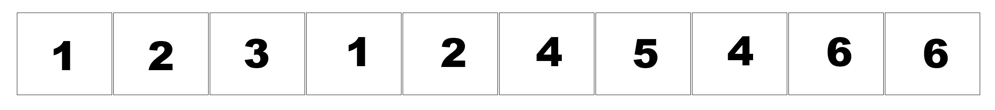

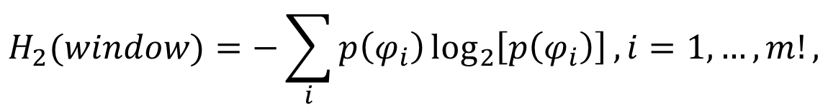






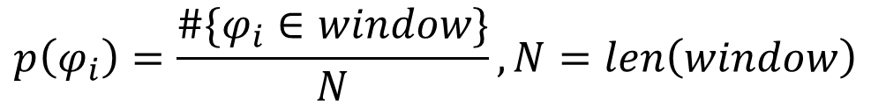
Calculation and normalisation of PE (2)
List of motif numbers for the sliding window:
$$φ_{1}$$
$$φ_{2}$$
$$φ_{3}$$
$$φ_{1}$$
$$…$$
Shannon (permutation) entropy defined as:
$$H_{2}(window)=−\sum_{i}{p\left(φ_{i}\right)\log_{2}\left[p\left(φ_{i}\right)\right],i=1,…,m!},$$
$$p\left(φ_{i}\right)=\frac{\#\{φ_{i}∈window\}}{N}, N=len\left(window\right)$$
(Repeat for each window in time-series)
Less ordered time-series = more uniform distribution = maximise entropy
(and vice versa)
$$\hat{H_{2}}=\frac{H_{2}}{\log_{2}\left(m!\right)}$$
$${ 0≤H}_{2}≤\log_{2}{(m!)}$$
Normalisation: so normalise to:

Slide 5
Methods

Slide 6
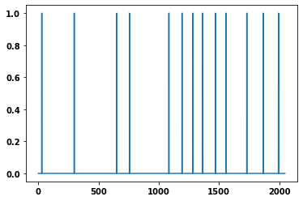
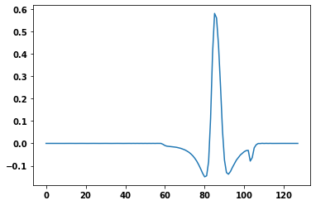
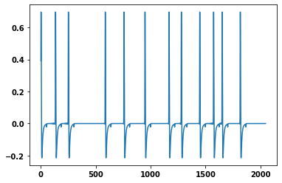


Time-series extraction
Binary spike trains produced using Poisson distribution:
Each MU has a firing rate, λ (between 25 and 30 Hz), that produces the time-stamps for that MUs spike train of values 1 (fired) and 0 (not fired)
Templates for the MUAPs convolved with binary spike trains: (a single MU firing:)
$$∗$$
$$=$$
Note: dissimilarity between plots here is just due to taking the plots on different runs –
both firing rate and template choice are random (see shuffling next slide)

Slide 7
Quick comment: Shuffling templates
In reality, MUAP shape varies significantly, but in the model the templates do not
change between runs. Therefore the templates are shuffled between runs to counter this.
Note: in order to randomly choose templates of similar amplitudes, the templates are first
sorted by amplitude, and the MUs then chosen from a restricted sample of the 50
largest amplitude templates.

Slide 8
PE simulation methods
Sliding window analysis: more accurate for changing signals
Mean and standard deviation of PE for all windows obtained for each measurement, and compared to the equivalent pure noise signals
10 repeats then taken of each measurement and the PE averaged to pick up anomalous results
Fixed window analysis: computationally faster, only for constant signals
A single window chosen from centre of signal and its PE calculated
Measurement repeated 10 times and the mean and standard deviation found
Parameters tested: SNR, MU number, sampling frequency, window size
‘On/Off’ simulation, where the number of MUs were varied in a single signal

Slide 9
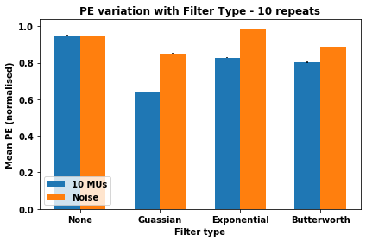
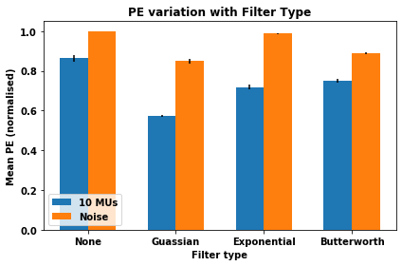
Signal Filtering
SNR = 30 dB, fs = 2048 Hz, T = 5 sec, PE bin size = 3
Gaussian filter: kernel width = 9, sigma = 3
Exponential smoothing: kernel width = 9, order = 1, alpha = 0.4
Butterworth bandpass: frequency range 20-500 Hz, order = 4
Sliding window analysis
Fixed window analysis

Slide 10
Results from simulations

Slide 11
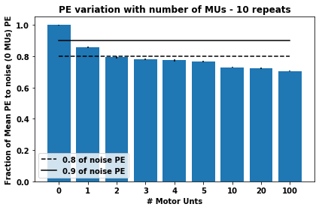
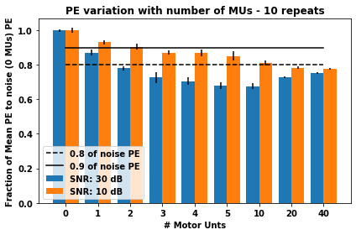
Variation with MU number
Sampling frequency = 2048 Hz, T = 5 sec, PE bin size = 3
SNR = 30 dB
Trend between increasing MU number and decreasing PE.
However, after 10 MUs, rate of decrease of PE decreases – therefore 10 MUs chosen here on through.

Slide 12
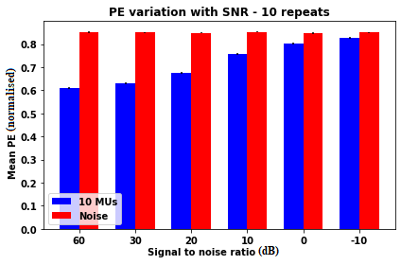
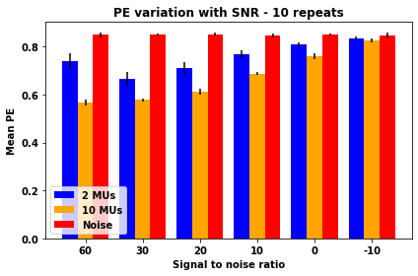
How effectively PE copes with noise
Sampling frequency = 2048 Hz, T = 5 sec, PE bin size = 3
Use of PE seems able to effectively differentiate from noise for as long as
noise amplitude less than signal amplitude.

Slide 13
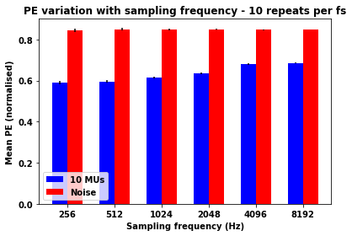
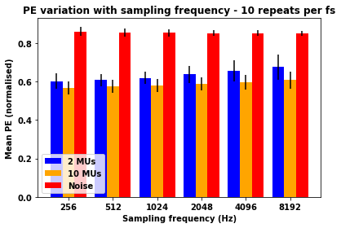
Variation with sampling frequency
SNR = 30 dB, T = 5 sec, PE bin size = 3
In general, increasing sampling frequency = increased PE, but decreasing sampling frequency = increased SD.
2048 Hz seems a good middle-ground.

Slide 14
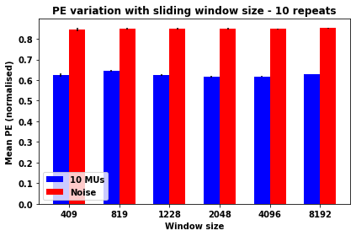
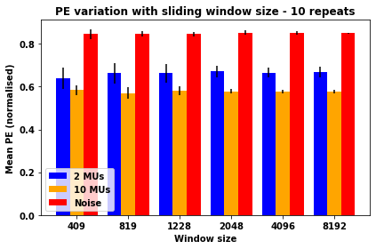
Varying window size
SNR = 30 dB, T = 5 sec, PE bin size = 3
It seems that window size has little influence on the mean PE, but that a greater window size results
in a lower SD and thus greater confidence in MU presence vs noise.

Slide 15
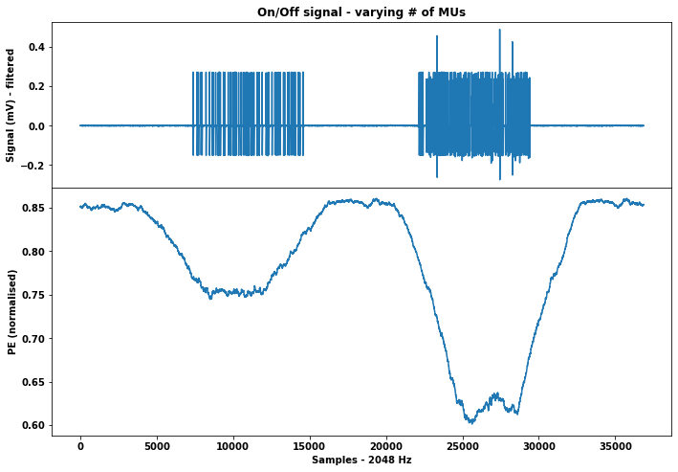
An ‘On/Off’ motor unit simulation
Simulated as:
30 dB Gaussian noise (4 sec)
1 MU present with 30 dB noise (4 sec)
30 dB noise (4 sec)
2 MUs present with 30 dB noise (4 sec)
30 dB noise (4 sec)

Slide 16
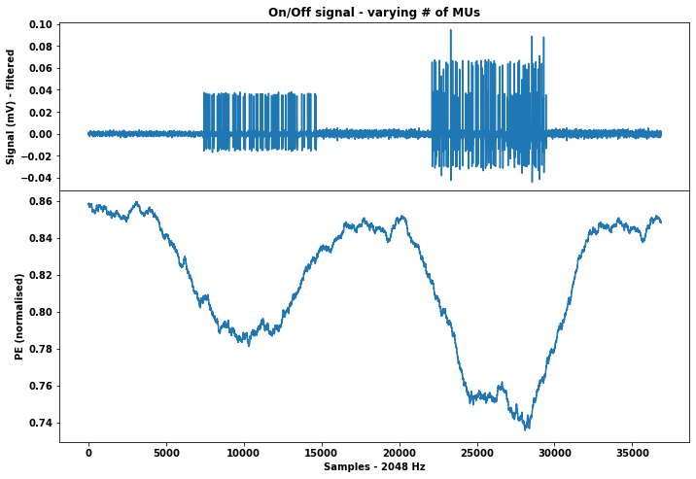
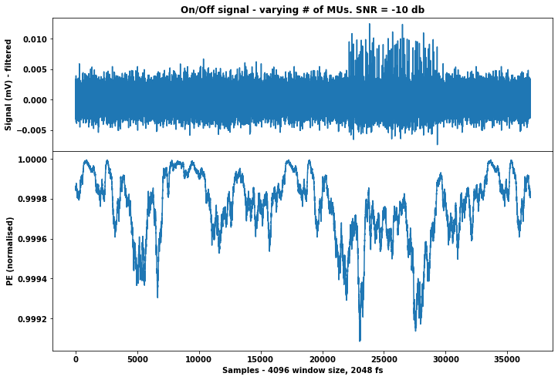
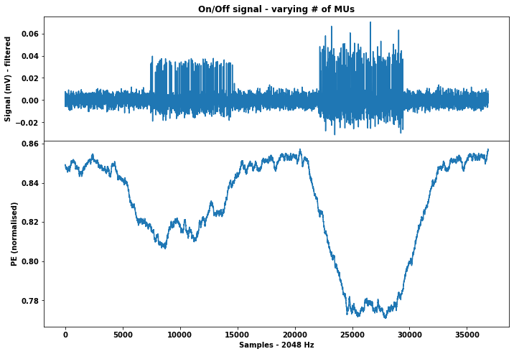
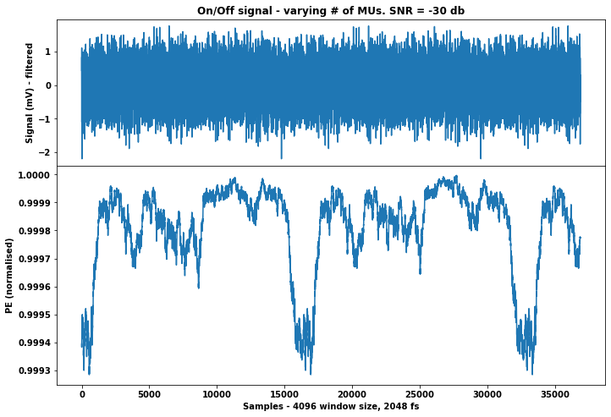
1 MU
1 MU
2 MUs
2 MUs
SNR = 10 dB
SNR = -10 dB
1 MU
2 MUs
1 MU
2 MUs
SNR = 0 dB
SNR = -30 dB

Slide 17
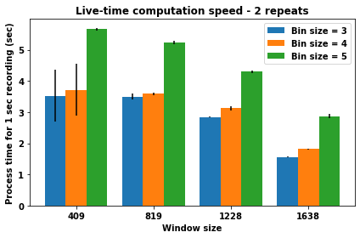
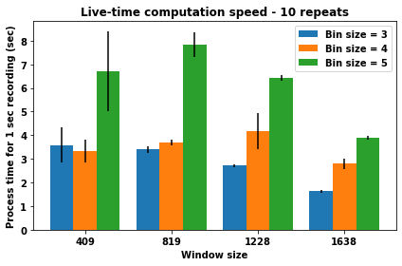
Possibility of live-time recording:
2 MUs simulated, with SNR = 30, but results generalise –
PE computation time independent of signal properties other than time.
For larger window size, and bin width of 3 or 4, PE computation speed means that a running PE sliding window
analysis could be done in live-time, perhaps for continuous monitoring of patients or smart devices.

Slide 18
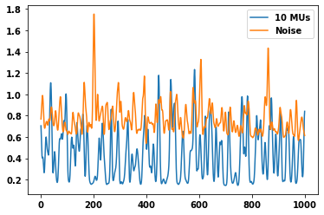
Next Steps
Sample entropy for 1 second signal - GF
Run the algorithms on real datasets rather than simulated spike trains
Sample entropy:
Try using sample entropy as an alternative entropy measure (Costa et al. 2005) (shown on right)
Potentially less noise sensitive for large r values
(see next slides)
Sample Entropy
Time (ms)

Slide 19
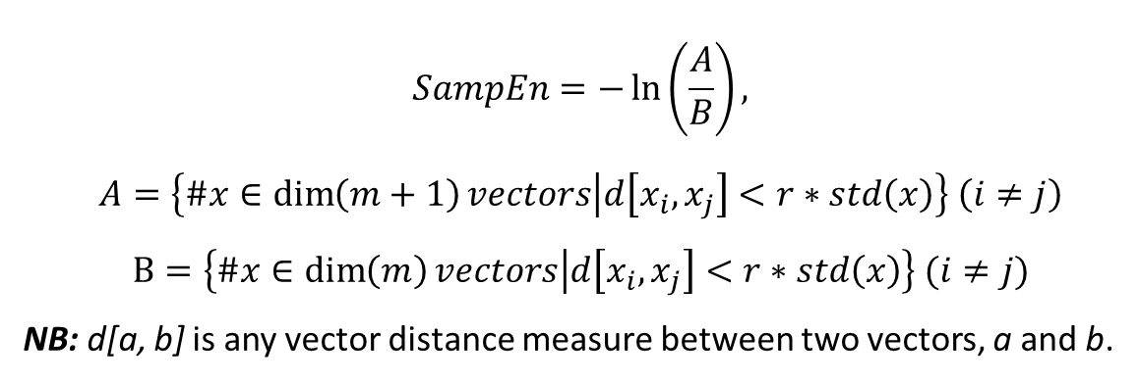
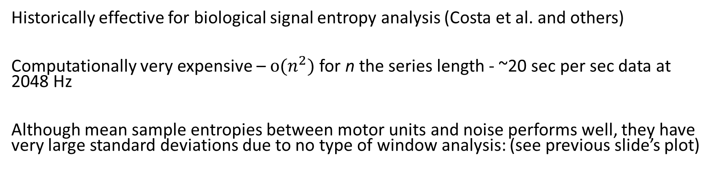
Sample Entropy
$$SampEn=−\ln\left(\frac{A}{B}\right),$$
$$A=\left\{\#x∈\dim\left(m+1\right)vectors | d\left[x_{i},x_{j}\right]<r∗std\left(x\right)\right\} \left(i≠j\right)$$
$$B=\left\{\#x∈\dim\left(m\right)vectors | d\left[x_{i},x_{j}\right]<r∗std\left(x\right)\right\} (i≠j)$$
NB: d[a, b] is any vector distance measure between two vectors, a and b.
Historically effective for biological signal entropy analysis (Costa et al. and others)
Computationally very expensive – $o(n^{2})$ for n the series length - ~20 sec per sec data at 2048 Hz
Although mean sample entropies between motor units and noise performs well, they have very large standard deviations due to no type of window analysis: (see previous slide’s plot)

Slide 20
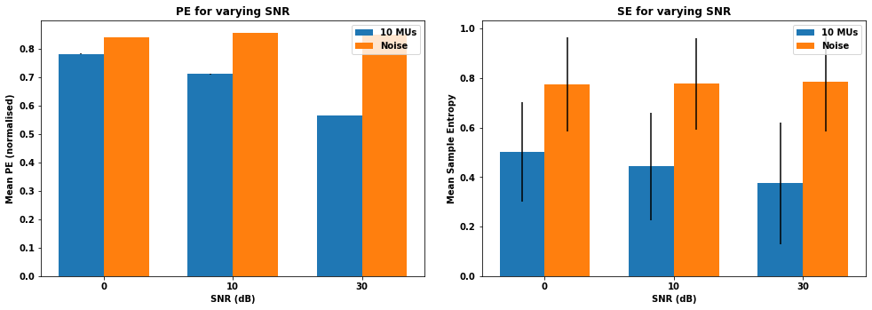
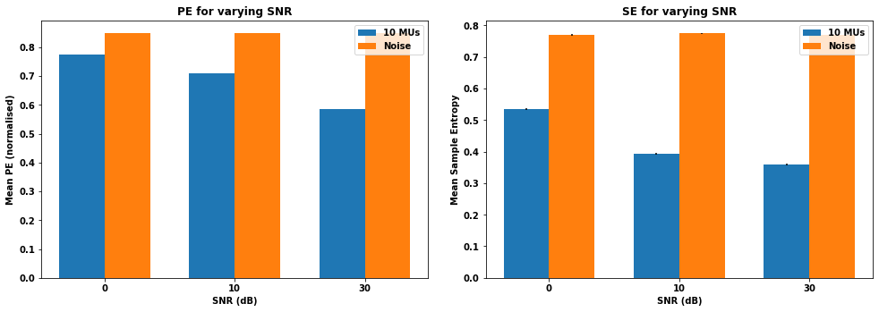
Sample Entropy VS PE
Embedding dimension, m = 2
Distance coefficient, r = 0.3
Distancing method, Chebyshev distance
Above: a single run
Right: averaged over 10 repeats

Slide 21
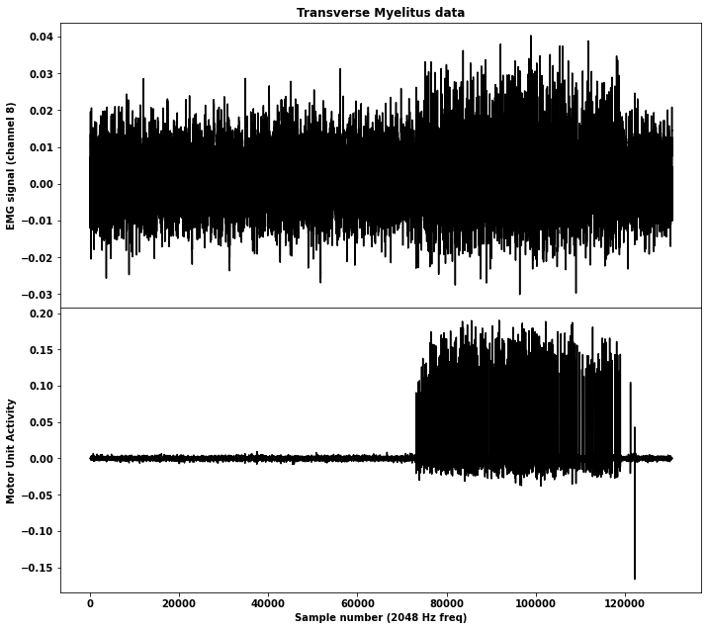
Using Transverse Myelitis data

Slide 22
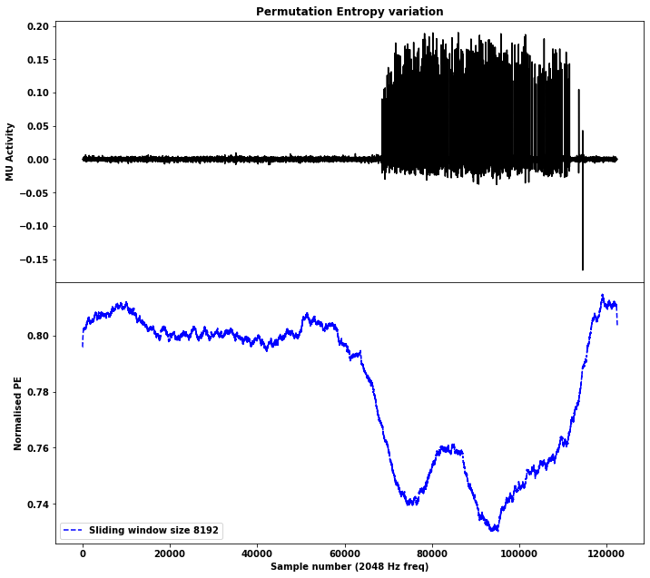
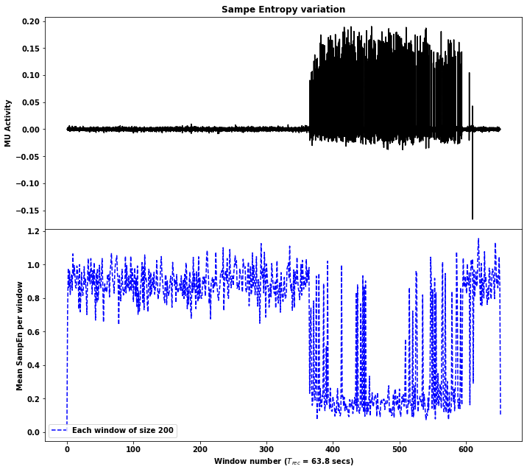
Running the PE and SampEn algorithms
SampEn algorithm adapted to sliding window for speed
(no overlap)

Slide 23
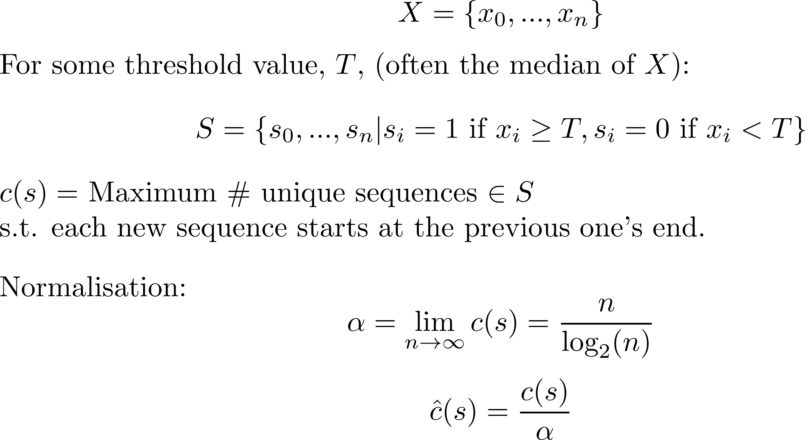
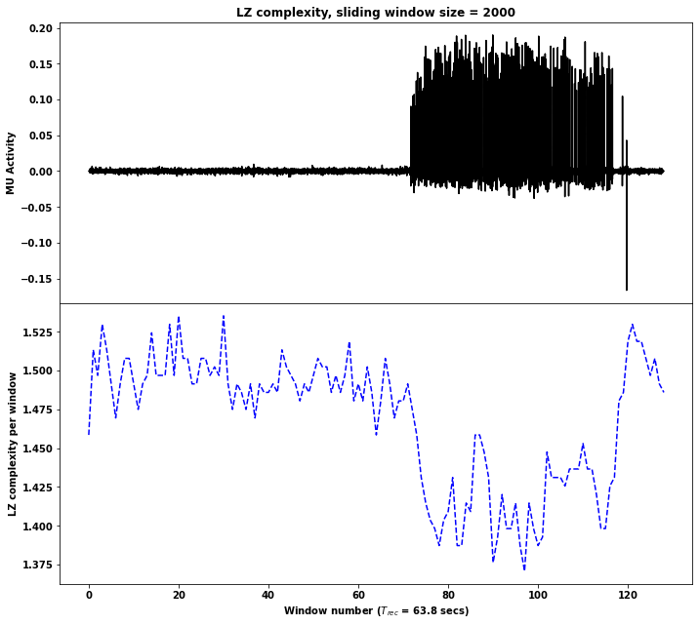
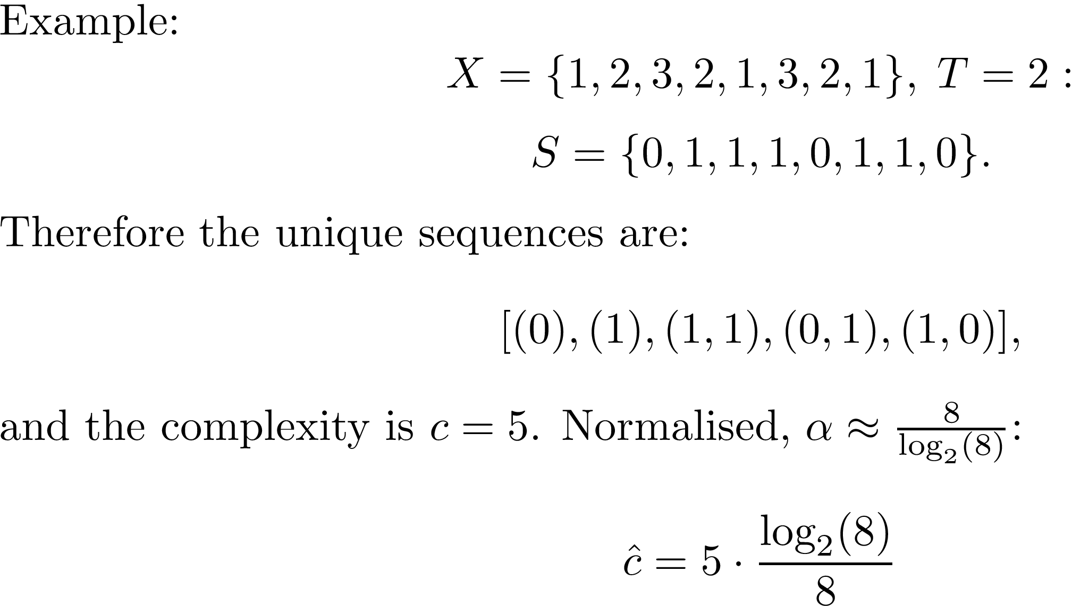
A new measure – Lempel-Ziv complexity

Slide 24
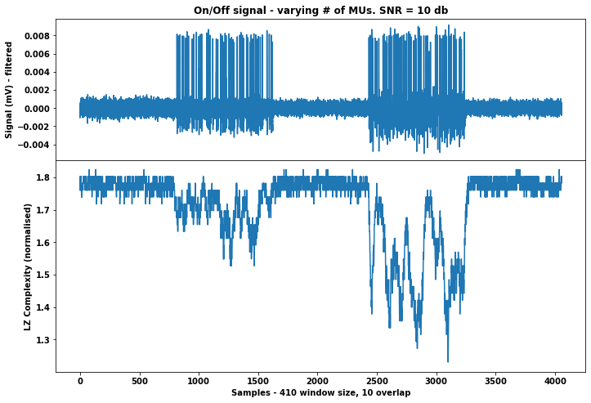
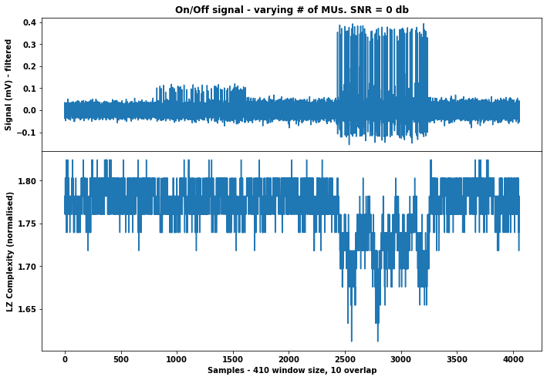
Poor performance as noise increases (compared to PE)

Slide 25
Summary
Permutation Entropy remains the best middle-ground between computational speed and ability to differentiate between motor unit activities
E.g. Lempel-Ziv is computationally very fast, but breaks down rapidly with noise, and Sample Entropy copes well with noise but is computationally very expensive, particularly as repeats are required due to large standard deviation
The algorithms proved effective on the model, and appear to be transferrable to real patient data also
For large window sizes, PE would be suitable for live-time observations of a patient’s motor responses

