Slide 1

Tracing the arc
A Glimpse into the Past, Present, and Future of Artificial Intelligence
Dr. Edward Brash
A Lecture Series for the CNU Lifelong Learning Society
Fall 2023

Slide 2
Main Ideas for Today’s Discussion
There is a monumental difference between creating a system that can MIMIC human intelligence and creating a truly artificially intelligent machine:
Narrow AI (Weak AI) vs. General AI (Strong AI)
Even within Weak AI, artificially intelligent system are already making many incredible positive contributions to our world!
A large part of our “fear” about AI may come from the fact that when AI gets it wrong, it gets it REALLY wrong, and in a manner that is not consistent with our expectations for what “normal” expert performance should look like!
How did we get here? When we look at a more detailed history of the development of AI, it would appear that the desire and drive to create artificially intelligent machines is something that is ingrained in the human spirit ☺

Slide 3
Applications of AI in Our World

Slide 4
Modern Approaches and Subfields of AI
Machine Learning (ML): A subset of AI that allows systems to learn from data, improve from experience, and make predictions or decisions.
Example: classification systems – Captcha!
Deep Learning: A type of ML that utilizes neural networks with many layers (deep neural networks) to analyze various factors of data.
Example: understanding the stock market
Robotics: Design, construction, and operation of robots to perform tasks autonomously or semi-autonomously.
Examples: self-driving cars, drones
Natural Language Processing (NLP): Enabling machines to understand, interpret, generate, and respond to human language in a valuable way.
Examples: Siri, Alexa
Computer Vision: Allowing machines to interpret and make decisions based on visual data, i.e., images and videos.
Examples: Facial recognition systems

Slide 5
Applications of AI in Our World
Healthcare:
Diagnostic Aid: AI algorithms can analyze medical images, such as X-rays and MRIs, assisting in the early detection of conditions like cancer, diabetes, and cardiac diseases.
Treatment Personalization: AI facilitates personalized medicine by predicting patient responses to various treatments based on their medical history and genetic makeup.
Drug Development: AI accelerates the drug discovery process by analyzing complex biochemical interactions.

Slide 6
Applications of AI in Our World
Education:
Personalized Learning: AI can tailor educational experiences to meet individual student needs, adapting content and learning pathways to enhance knowledge acquisition.
Administrative Tasks: Automating administrative duties, such as grading assignments, allows educators to devote more time to teaching and student interaction.
Intelligent Tutoring Systems: AI tutors can offer additional support to students, guiding them through challenging topics outside classroom hours.

Slide 7
Applications of AI in Our World
Finance:
Algorithmic Trading: Employing algorithms to analyze market trends and execute trades at high speeds, optimizing financial outcomes.
Fraud Detection: AI systems can detect unusual patterns and activities within financial data, providing alerts related to potential fraud.
Customer Service: Chatbots and virtual assistants cater to customer inquiries and perform tasks like managing accounts and processing transactions.

Slide 8
Applications of AI in Our World
Manufacturing:
Quality Control: AI-driven systems monitor production lines, identifying and correcting imperfections, ensuring product quality.
Supply Chain Optimization: AI analyzes data to optimize inventory management and streamline supply chains, reducing operational costs.
Predictive Maintenance: Utilizing AI to predict when machinery is likely to fail or require maintenance, minimizing downtime.

Slide 9
Applications of AI in Our World
Retail:
Customer Experience: AI empowers retailers to offer personalized shopping experiences through recommendation engines and personalized marketing.
Inventory Management: Automating inventory control ensures optimal stock levels, reducing carrying costs, and preventing stockouts.
Virtual Try-Ons: Augmented Reality (AR) and AI enable customers to virtually try on products, enhancing online shopping experiences.

Slide 10
Applications of AI in Our World
Transportation and Automotive:
Autonomous Vehicles: Self-driving cars utilize AI to interpret sensor data, make decisions, and navigate roads with minimal human intervention.
Traffic Management: AI algorithms optimize traffic flow through smart signal control, reducing congestion and enhancing mobility.
Predictive Maintenance: AI predicts vehicle maintenance needs, enhancing reliability and reducing unexpected breakdowns.

Slide 11
Applications of AI in Our World
Agriculture:
Precision Farming: AI-driven technologies enable precise application of fertilizers and pesticides, optimizing yield while minimizing environmental impact.
Crop Monitoring: Employing drones and AI to monitor crop health, detect diseases, and predict yields.
Automated Harvesting: Developing autonomous machinery for tasks like harvesting, reducing labor needs, and enhancing efficiency.

Slide 12
Applications of AI in Our World
Environment and Climate Change:
Wildlife Preservation: Utilizing AI to monitor wildlife, predict threats, and develop conservation strategies.
Climate Modeling: Employing AI to enhance the predictive accuracy of climate models, aiding in the development of mitigation and adaptation strategies.
Resource Optimization: AI aids in optimizing resource utilization in various industries, contributing to sustainability and reducing environmental footprints.

Slide 13
Applications of AI in Our World
Legal:
Document Review: Automating the review of legal documents, AI can identify relevant materials, reducing manual labor and enhancing efficiency.
Legal Research: AI can streamline legal research, rapidly retrieving relevant case law and statutory provisions.
Contract Analysis: Employing AI to review and analyze contracts, identifying potential issues and providing insights.

Slide 14
So, why do we fear AI so much?????? Why do we not trust AI??????
We will get into this question a LOT more in the coming lectures, but for now, I would like to consider an analogy that I think illustrates nicely one aspect of human psychology that is a big part of answering these questions.
Consider the sport of archery …
Imagine an archer launching 1000 arrows towards a standard archery target … what might the “distribution” look like?

Slide 15

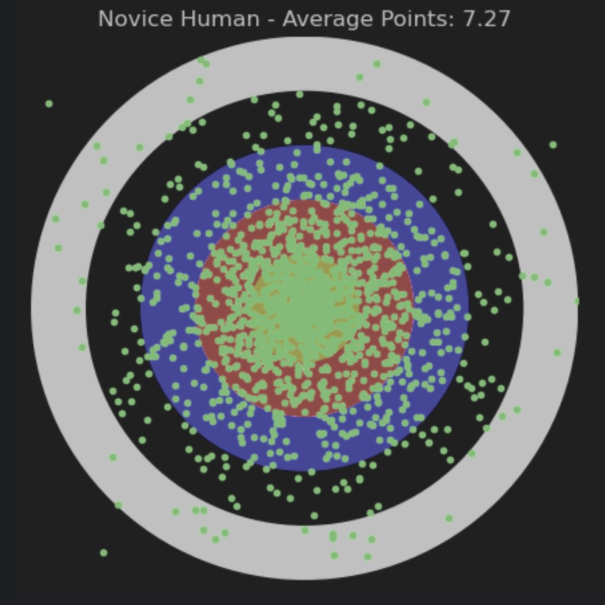
Novice Human Archer
Mehwish Mazari – 14 years old
2 years archery experience

Slide 16
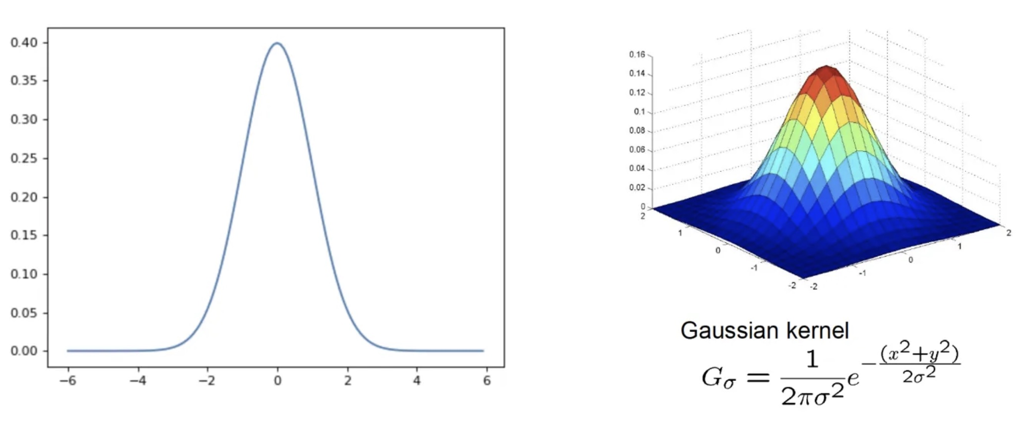
The Gaussian Distribution
“Bell Curve”, or, the NORMAL distribution
It is called the normal distribution, because it is “normally” what happens in natural systems

Slide 17
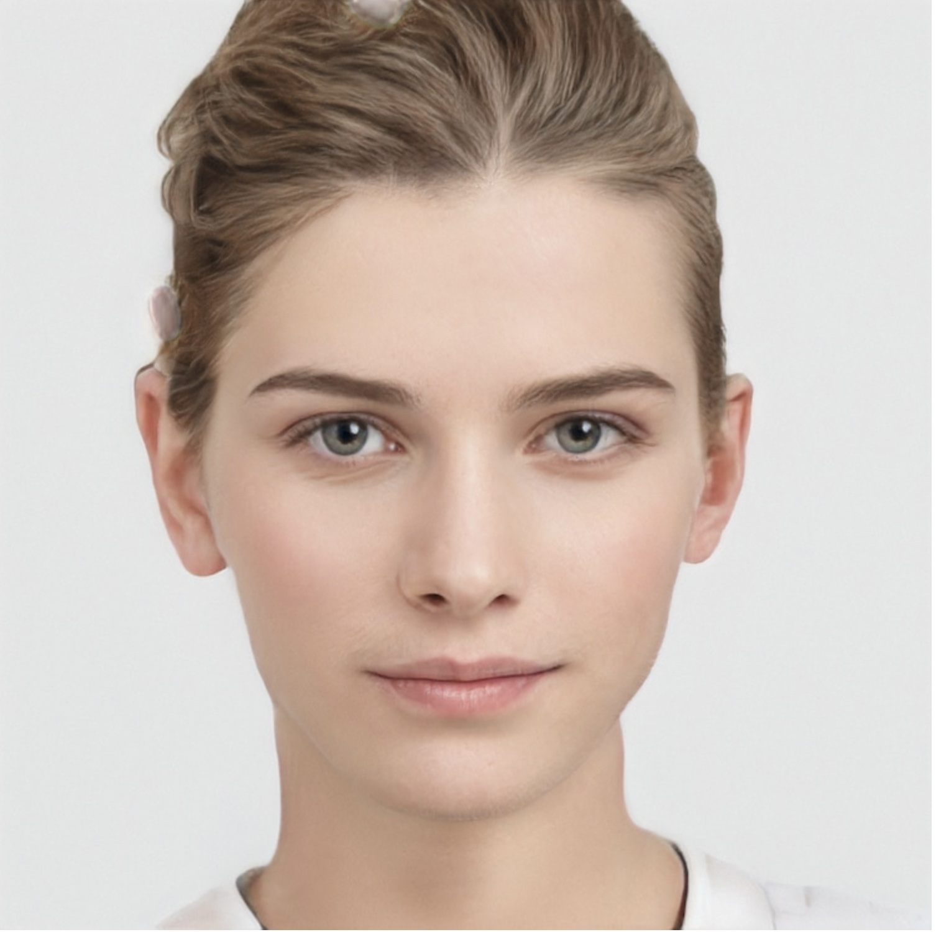
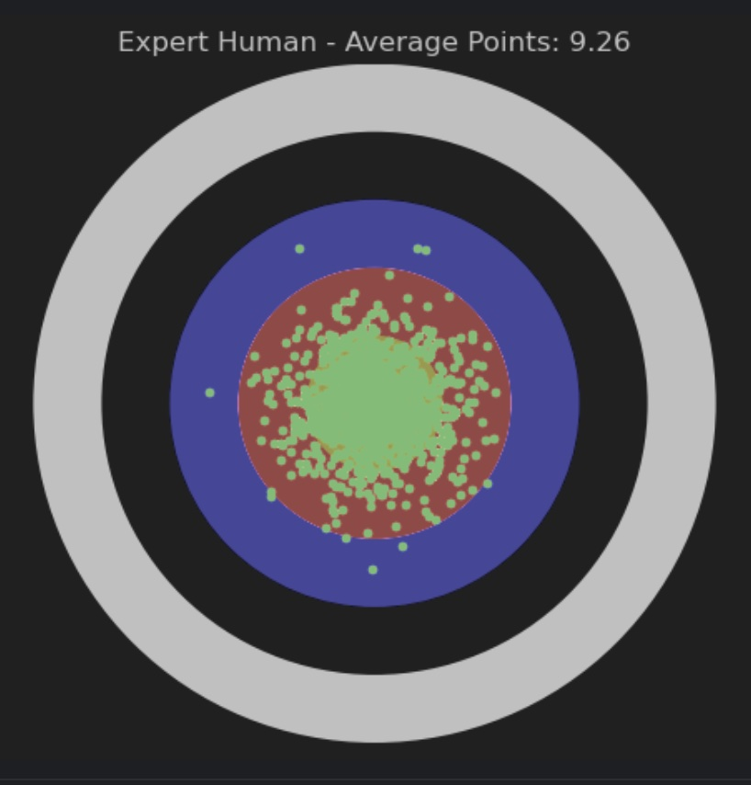
Expert Human Archer
Kristina Larsson
Swedish Olympic Archery Team - 2000

Slide 18
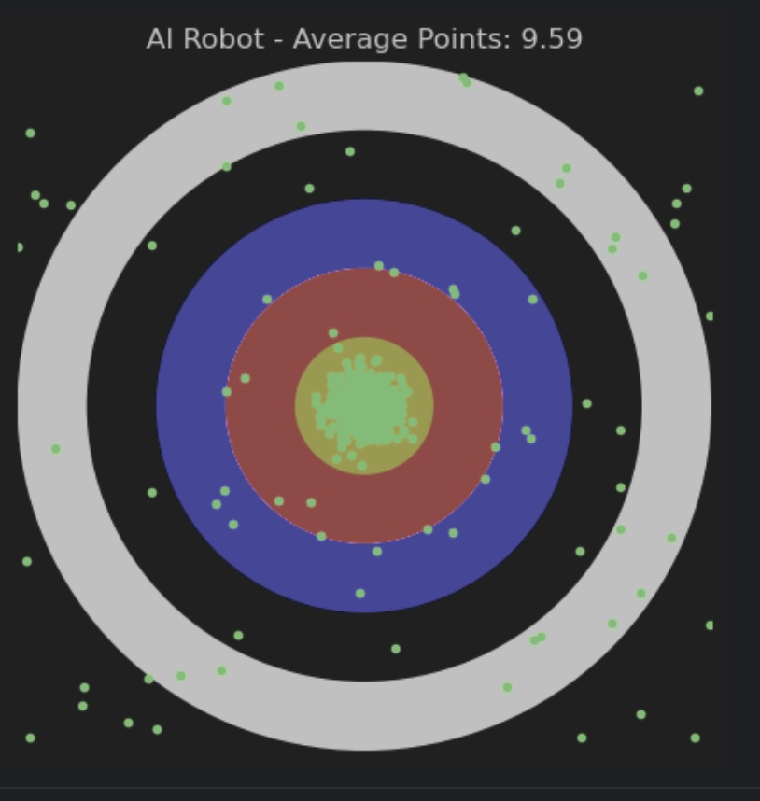
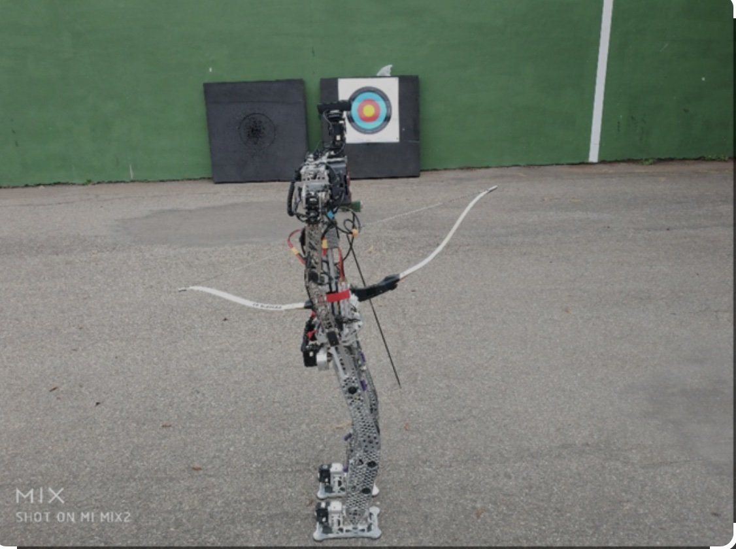
AI Robot Archer

Slide 19
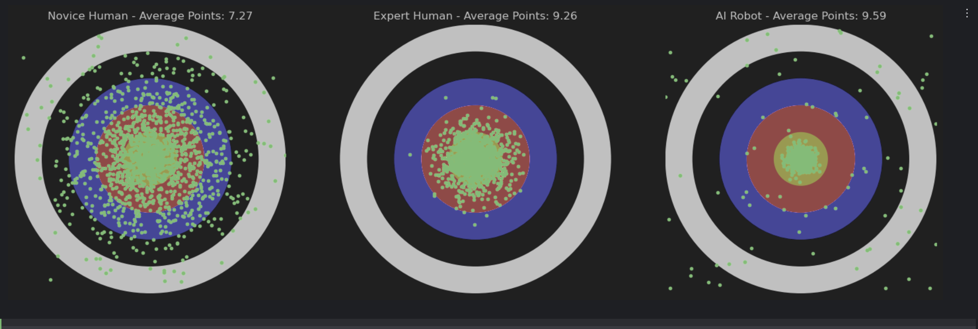
Archery Analogy

Slide 20
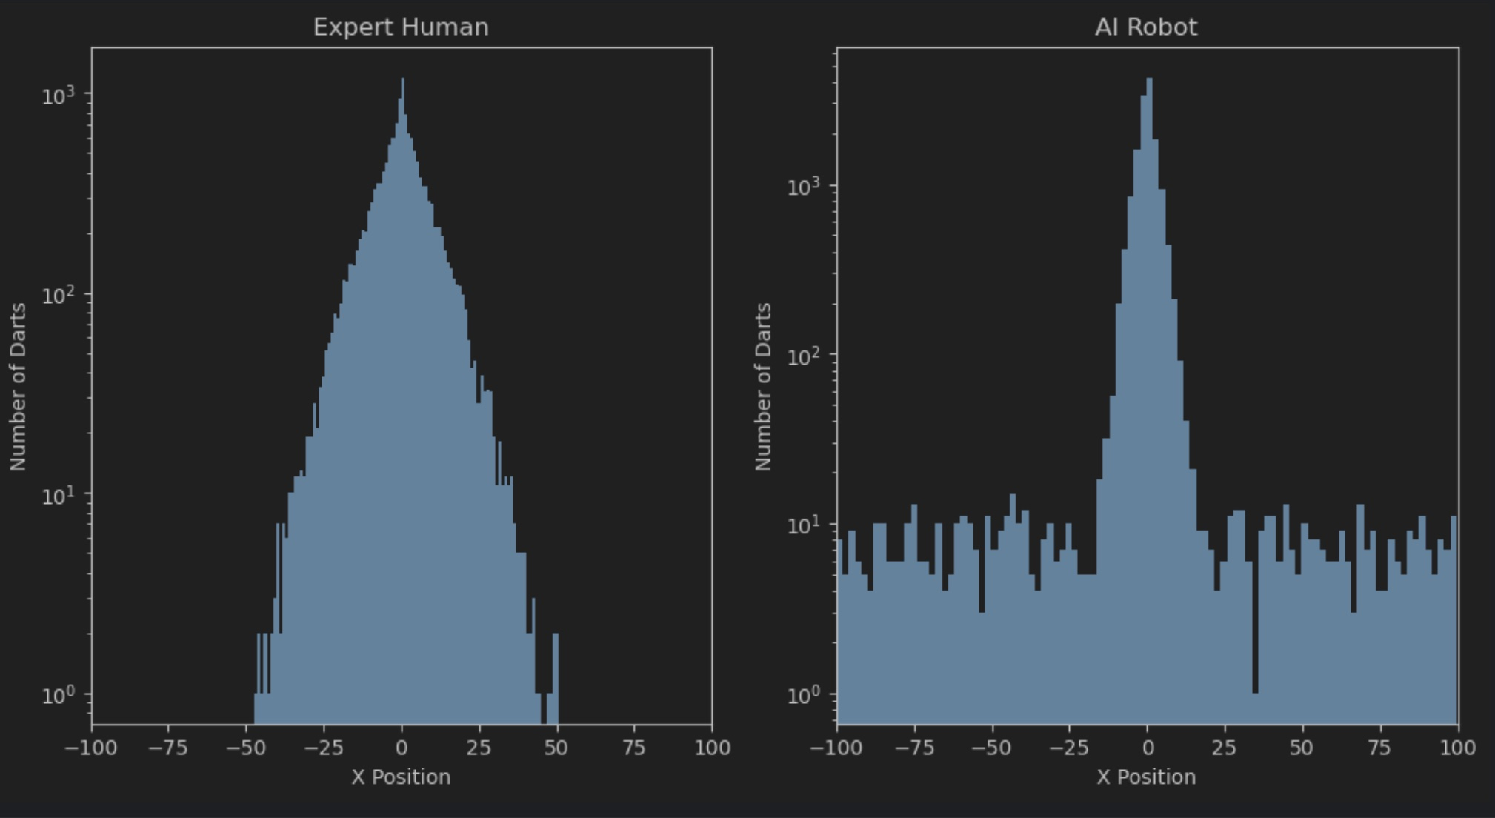
Human vs. AI Distributions

Slide 21
A More Detailed History of AI
The conceptualization of artificial intelligent entities has been embedded in human thought and culture for millennia.
Ancient myths, legends, and stories from various civilizations have contemplated the creation of non-biological entities that exhibit forms of intelligence or life-like attributes.
Much like the idea that “exploration” drives humans to go beyond their natural habitat (NASA Space Progam!), it seems that the concept of developing forms of artificial intelligence is ingrained into the human experience.
Greek Mythology: Talos and Automata
Talos: In Greek mythology, Talos was a giant bronze automaton created by Hephaestus, the god of blacksmiths and invention, to protect the island of Crete. Talos would patrol the island, throwing rocks at intruding ships and heating himself red-hot to burn invaders.
Automata: Ancient Greeks also imagined elaborate automata. Notably, Hephaestus was said to have created mechanical servants that assisted in his forge, demonstrating an ancient fascination with automating labor and crafting mechanical life.

Slide 22

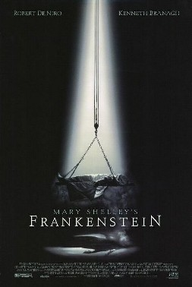
A More Detailed History of AI
Jewish Mythology: The Golem
The Golem is a creature from Jewish folklore, formed from clay or mud and animated through mystical means. The most famous tale is of the Golem of Prague, created by Rabbi Judah Loew ben Bezalel to protect the Jewish community from persecution. The golem was brought to life through kabbalistic rituals and could follow basic commands, reflecting an early conceptual exploration of creating and controlling artificial beings.
Chinese Legends: The Automata of King Mu
King Mu of Zhou, who reigned in China during the 10th century BC, is said to have encountered an artificer, Yan Shi, who presented him with a life-sized automaton. The automaton could sing, act, and perform various actions. Though apocryphal, this tale symbolizes ancient imaginations of crafting beings that mimic human abilities.

Slide 23
A More Detailed History of AI
Indian Epics: The Legend of Ghatotkacha
Arabic Tales: The Mechanical Organisms of Al-Jazari
Egyptian Mythology: The Statue of Hephaestus
These tales, spanning various cultures and epochs, showcase humanity’s long-standing fascination with creating life or life-like attributes through artificial means.
Though technologically unattainable in their respective eras, these myths and legends planted seeds of curiosity and aspiration that have, in some form, manifested in the pursuit of artificial intelligence and robotics in the modern era.
They symbolize early dialogues about creation, control, morality, and the blurry boundaries between the animate and inanimate, themes that continue to pervade discussions on artificial intelligence and synthetic biology today.

Slide 24
Philosophical Underpinnings of AI
René Descartes: Mind-Body Dualism and Mechanistic Biology
Descartes, a 17th-century philosopher, introduced a pivotal concept known as Cartesian Dualism, which distinguishes between the mind (res cogitans) and the body (res extensa).
The body, including the brain, was considered a machine by Descartes, subject to physical laws and mechanistic explanations. However, the mind, embodying thought and consciousness, was considered non-material and inherently separate from the body.
The nature of thought and consciousness (whether it is a physical or spiritual entity) is STILL a massive topic in modern philosophy (Sam Harris, Christopher Hitchens, Jordan Petersen, Stephen Fry, and many more on YouTube)

Slide 25
Philosophical Underpinnings of AI
Key Considerations from Descartes' Perspective:
Animacy and Automation: Descartes conceded that machines might be able to emulate certain human behaviors but fundamentally denied the possibility of machines possessing minds or consciousness.
Innate Ideas and True Understanding: Descartes posited that certain ideas and capacities are innate to the human mind and cannot be replicated by or instilled into machines, as genuine understanding and consciousness are non-mechanistic phenomena.
In terms of the ETHICS of artificial intelligence, this is an extremely important idea – if an artificially intelligent being carries out an act that society considers to be immoral or unethical, it would then follow that this ”behavior” is either random or comes somehow from the human that created/programmed her. I mean programmed IT.
So, how could we tell if an artificially intelligent machine was truly intelligent (as opposed to just mimicking its creator???

Slide 26
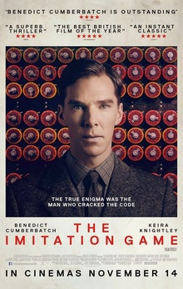
The Imitation Game
Alan Turing provided a contrasting perspective, suggesting that machines might emulate, if not genuinely possess, forms of intelligence. Turing introduced the Imitation Game (now known as the Turing Test) as a criterion to assess machine intelligence.
Key Considerations from Turing's Perspective:
Behavioural Indicators of Intelligence: Turing proposed that if a machine could interact in a manner indistinguishable from a human (in a text-based communication), it could be considered intelligent, focusing on observable behavior as an indicator of intelligence rather than underlying consciousness or understanding.
Learning Machines: Turing speculated on the possibility of machines learning and adapting, evolving their capacities, and thereby enhancing their ability to exhibit intelligent behavior.

Slide 27
Big Questions
Does mimicking intelligence equate to genuine intelligence?
Is the conscious experience a necessary component of intelligence?
Can a machine that behaves intelligently be considered a mind, even in the absence of conscious experience or understanding?
In this sense, the philosophical viewpoints of Descartes and Turing are divergent from one another!

Slide 28
Synergy and Disparity: Integrating and Diverging Views
While Descartes and Turing come from vastly different epochs and intellectual landscapes, their views engage in an implicit dialogue that continues to permeate contemporary debates in artificial intelligence:
Consciousness and Machine: Is consciousness necessary for intelligence, and can machines possess or emulate consciousness?
Ethics of Creation: If machines can think or feel, what ethical considerations emerge in their creation and treatment?
Identity and Agency: Can a machine have a sense of self, and what constitutes genuine understanding and agency?
The discussions deriving from the perspectives of Descartes and Turing continue to influence philosophical, ethical, and practical considerations in the realms of artificial intelligence, cognitive science, and robotics.

Slide 29
The Turing Test (1950)
Concept and Mechanism
The Turing Test, initially called the Imitation Game by Turing, involves a human interrogator engaging in a natural language conversation with an unseen interlocutor, which could be either a human or a machine. The interrogator's task is to determine which is which, based solely on their responses to questions. If the interrogator is unable to reliably tell the machine from the human, the machine is said to have passed the test.
Philosophical and Practical Implications
Turing’s Imitation Game is profound not merely as a proposed test for machine intelligence but also in the philosophical questions it raises about the nature of cognition, consciousness, and communication:
Behaviorism in Intelligence: The test leans into a behaviorist perspective, implying that intelligence can be deduced and defined by external, observable behavior rather than internal consciousness or cognitive processes.
Functionalism: It suggests a functionalist approach to understanding the mind, positing that if something acts intelligently, it can be considered intelligent without considering underlying structures or processes.

Slide 30
Impacts and Critiques
Impacts on Early AI Development
Machine Learning: Turing's speculations about learning machines encouraged developments in machine learning, directing researchers towards creating algorithms capable of adapting and improving from experience.
Natural Language Processing (NLP): The test emphasized the importance of language understanding, stimulating research in NLP to enable machines to comprehend and generate human language effectively.
Cognitive Computing: Turing's reflections on thinking machines fueled explorations into cognitive computing, intending to emulate human cognitive processes within computational models.

Slide 31
Impacts and Critiques
Critiques and Limitations
While the Turing Test has been immensely influential, it has also been critiqued:
Depth of Understanding: Critics argue that merely mimicking human-like responses doesn’t equate to understanding or consciousness. Searle’s Chinese Room Argument is a notable critique, suggesting that syntactic manipulation (as in computer programs) doesn’t necessarily imply semantic understanding.
Ethical Implications: Some critique it from an ethical standpoint, suggesting that a machine mimicking human communication could be deceptive and mislead regarding its capabilities and understanding.

Slide 32
Searle’s Chinese Room Argument
Imagine that AI research has advanced to a point where there is a computer that can take Chinese characters as input, and produce other Chinese characters as output (in response to the input), with such high reliability that it easily passes the Turing Test. It convinces a human Chinese speaker that it is, in fact, a human Chinese speaker.
Does the machine literally “understand” Chinese (i.e. strong AI)? Or, is it merely simulating the ability to understand Chinese (i.e. weak AI)? The answer depends upon your philosophical point of view, and thus is unanswerable at this point.
Now, imagine that you are an English-speaking HUMAN that has been provided with an English book that explains the entire implementation of the computer program used above, along with as many pencils, erasers, paper, and filing cabinets that you need. The English book does NOT contain information on the rules/syntax/semantics of the Chinese language – just the rules of the computer program.
Searle asserts that you will pass the Turing Test as well, simply by following the rules of the book, without understanding Chinese. YOU would not understand the conversation but would still pass the Turing Test!

Slide 33
Turing Test Conclusions
Alan Turing’s development of the Turing Test has reverberated through the decades, shaping foundational concepts and debates in artificial intelligence, stimulating research into machine learning, language processing, and cognitive computing, and prompting continual reflections on the nature, possibilities, and ethical dimensions of machine intelligence.
The test has served as a catalyst, provoking explorations into the capacities and limits of machines in emulating human intelligence and interaction, framing an ongoing dialogue that intertwines technological, philosophical, and ethical considerations in the evolutionary journey of AI.
Despite this, the Turing Test may be inadequate to answer the deeper philosophical questions surrounding AI and consciousness.

Slide 34
How Does Machine Learning Work?
Imagine the following data from a newly invented coin-flipping game:
Heads, Heads -> Win
Tails, Heads -> Lose
Heads, Heads -> Win
Heads, Tails -> Lose
Tails, Tails, Heads -> Lose
Heads, Heads -> Win
Heads, Tails -> Lose
Tails, Heads ->Lose
Heads, Tails -> Lose
Tails, Tails, Tails -> Win
Heads, Heads -> Win
Heads, Tails -> Lose
Tails, Heads -> Lose
Heads, Heads -> Win
Tails, Heads -> Lose
Tails, Tails, Heads ->Lose

Slide 35
Rules of the Game
Flip a coin twice:
If you get two heads, you win
If you get one head and one tail, in either order, you lose
If you get two tails, flip the coin a third time:
If you get tails on the third flip, you win, otherwise you lose.

Slide 36
Traditional Computer Programming
Program the RULES of the game!!!!!!!!!!!!!!!!!!!!!!!!!!!
define flip():
choose a random number (0 = Tails or 1=Heads)
X = flip()
Y = flip()
Z = X + Y
X | Y | Z
0 | 0 | 0
1 | 0 | 1
0 | 1 | 1
1 | 1 | 2

Slide 37
Traditional Computer Programming
If Z = 2:
print(“You win!”)
If Z = 1:
print(“You lose!”)
If Z = 2:
V = flip()
If V = 0:
print(“You win!”)
Else:
print(“You lose!”)

Slide 38



Machine Learning Approach
Mimic the way that humans learn/think/process/synthesize data!!!!!!!!!!!

Slide 39
What does the AI “Engine” Look Like?
It’s complicated … unless you have taken linear algebra, some calculus, matrix manipulation … that is, second-year university mathematics.
Next day, I will develop some “cartoons” to help us understand this, without having to teach all of this mathematics.
But, please understand, it IS just well-known, well-establish mathematics that can easily solve this problem!

Slide 40
“Traditional” Mathematical Modeling in AI
Assign numerical values to data and results as necessary:
Heads = 1
Tails = 0
Win = 1
Lose = 0
Use the form of the input data to posit a very general model of how the results could depend on the data!

Slide 41
“Traditional” Mathematical Modeling in AI
The W0, W1, …. , W6 are called “weights”, and are not known until we use the input data to determine the best possible values.
We use a selection of input data where the results are known (i.e. TRUTH values) to figure out the best value of the weights to use. This is called “training” the AI model!
We then ”test” the model by using an additional input data set where the results are known to see how well we did! This is called the testing phase!

Slide 42
Results
10 input data sets with known results
W0 = 1.0000, W1 = -0.2500, W2 = -1.0000, W3 = -0.7500, W4 = 1.2500, W5 = 0.0000, W6 = 0.7500
Testing:
x y v Result Predicted Result
H H H Win Win
H H T Win Win
H T H Lose Win
H T T Lose Lose
T H T Lose Lose
T H T Lose Lose
T T H Lose Lose
T T T Win Win

Slide 43
Results
100 input data sets with known results
W0 = 0.8601, W1 = -0.7063, W2 = -0.7418, W3 = -0.7502, W4 = 1.4480, W5 = 0.4780, W6 = 0.5220
Testing:
x y v Result Predicted Result
H H H Win Win
H H T Win Win
H T H Lose Lose
H T T Lose Lose
T H T Lose Lose
T H T Lose Lose
T T H Lose Lose
T T T Win Win

Slide 44
Conclusions
The more input data one has for training the model, the better!
Most AI models are based on determining an appropriate set of mathematical WEIGHTS that will be determined from the input data
The underlying mathematical models in AI often do not contain ANY sense of what the rules of the game are! They are very generic.
In fact, we could come up with a game that had a totally different set of rules and use exactly the same AI model for that game, but just with different WEIGHTS!!!!

