Slide 1

Chaos: The Intersection of Physics, Computer Science, and Mathematics
Dr. Edward Brash
PCSE 699 Mini-Talk
September 1, 2018

Slide 2
Physics
Everything in the Natural Universe

Slide 3
Physics
Calculus
Algebra
Geometry
Tensors
Group Theory
Mathematics

Slide 4
Physics
Mod/Sim
Data Vis.
Quantum Comp.
Computer Science

Slide 5
Physics
?
Mathematics
Computer Science

Slide 6
The Logistic Map
The logistic map is a polynomial mapping (i.e. a recurrence relation) of degree 2:
x_{n+1} = λ x_{n} (1 – x_{n})
- Popularized in a 1976 paper by biologist Robert May
It is a discrete time series closely related to the logistic equation, first created by mathematician Pierre Francois Verhulst (1825 - research in number theory)
The interest in biological systems is to describe (simply) population growth and decay in systems that can be potentially resource limited

Slide 7
The Logistic Map
x_{n+1} = λ x_{n} (1 – x_{n})
x_{n} is the current fractional occupation of the available resource space (between 0 and 1)
λ is a reproductive growth rate between time steps
(1 – x_{n} ) represents a “death rate” term which becomes more severe as the resource space becomes fully occupied

Slide 8
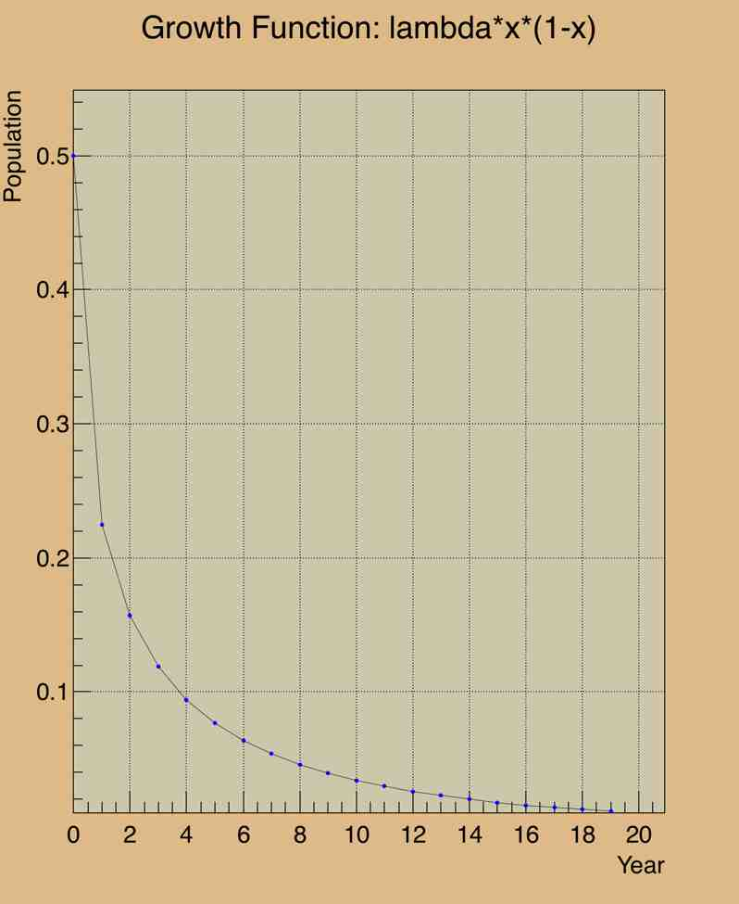
Limiting Values of λ
Choose a starting point:
x₀ = 0.5
Clearly, if the growth rate is less than 1, the population will eventually die out

Slide 9
Limiting Values of λ
Choose a starting point:
x₀ = 0.5
Clearly, if the growth rate is less than 1, the population will eventually die out
This is true for all 0 < λ < 1, and all x₀

Slide 10
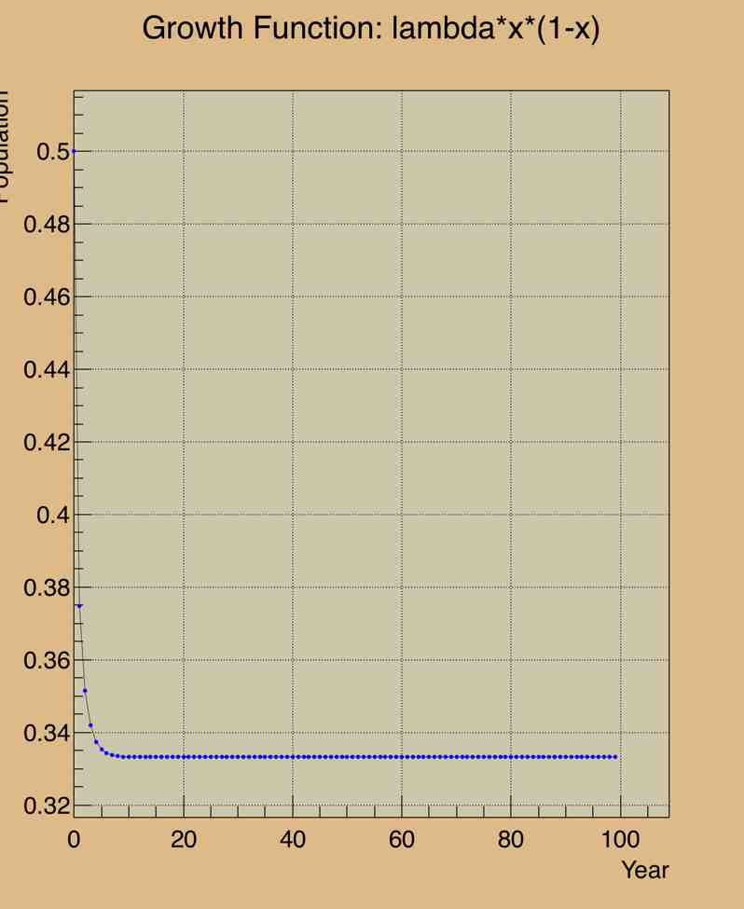
Limiting Values of λ
Choose a starting point:
x₀ = 0.5
Clearly, if the growth rate is less than 1, the population will eventually die out
This is true for all 0 < λ < 1 , and all x₀
For λ > 1, one starts to see a trend of reaching an equilibrium population … the increase due to growth is exactly balanced by the death factor
Equilibrium: x_{n+1} = x_{n}
Solve to get x_{large} = 1 – 1/λ

Slide 11
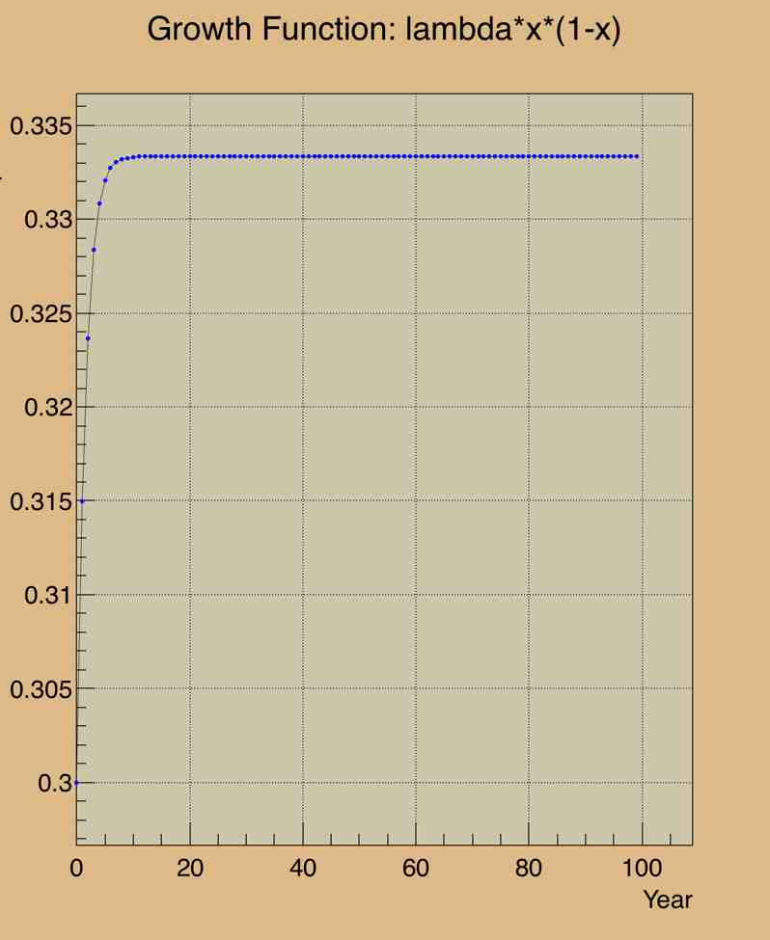
Limiting Values of λ
Choose a starting point:
x₀ = 0.5
Clearly, if the growth rate is less than 1, the population will eventually die out
This is true for all 0 < λ < 1 , and all x₀
For λ > 1, one starts to see a trend of reaching an equilibrium population … the increase due to growth is exactly balanced by the death factor
Equilibrium: x_{n+1} = x_{n}
Solve to get x_{large} = 1 – 1/λ
Independent of starting value

Slide 12
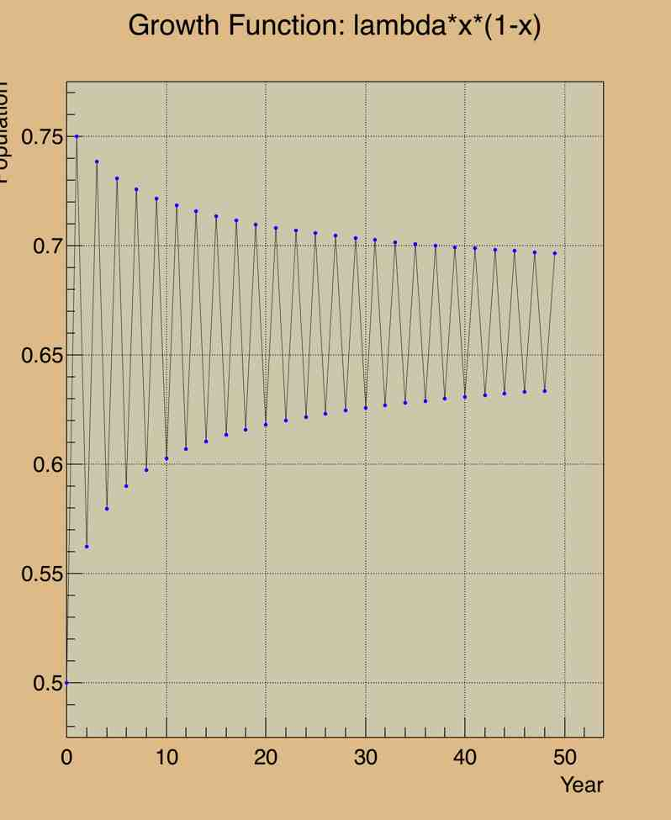
Limiting Values of λ
For larger values of λ, interesting things start to happen … try λ = 3.0

Slide 13
Limiting Values of λ
For larger values of λ, interesting things start to happen … try λ = 3.0
Oscillations, but still approaching a single equilibrium value
Now … try λ = 3.2

Slide 14
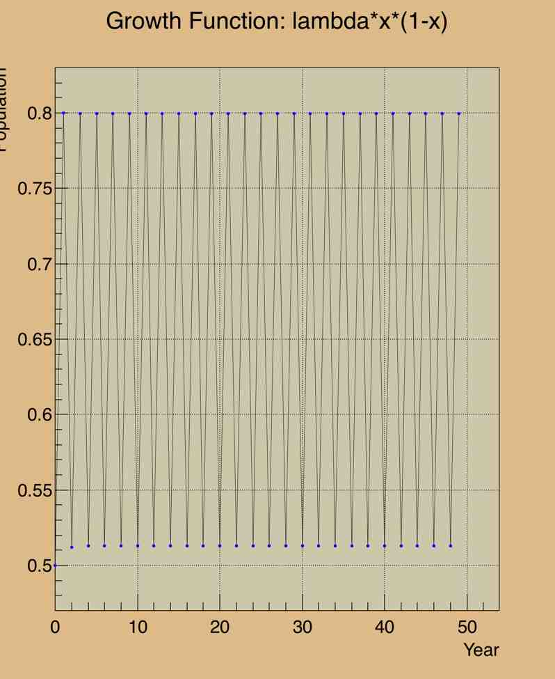
Limiting Values of λ
For larger values of λ, interesting things start to happen … try λ = 3.0
Oscillations, but still approaching a single equilibrium value
Now … try λ = 3.2
We see now TWO possible equilibrium values!!!
The population oscillates from one time period to the next between these two values … FOREVER!!

Slide 15
Limiting Values of λ
For larger values of λ, interesting things start to happen … try λ = 3.0
Oscillations, but still approaching a single equilibrium value
Now … try λ = 3.2
We see now TWO possible equilibrium values!!!
The population oscillates from one time period to the next between these two values … FOREVER!!

Slide 16
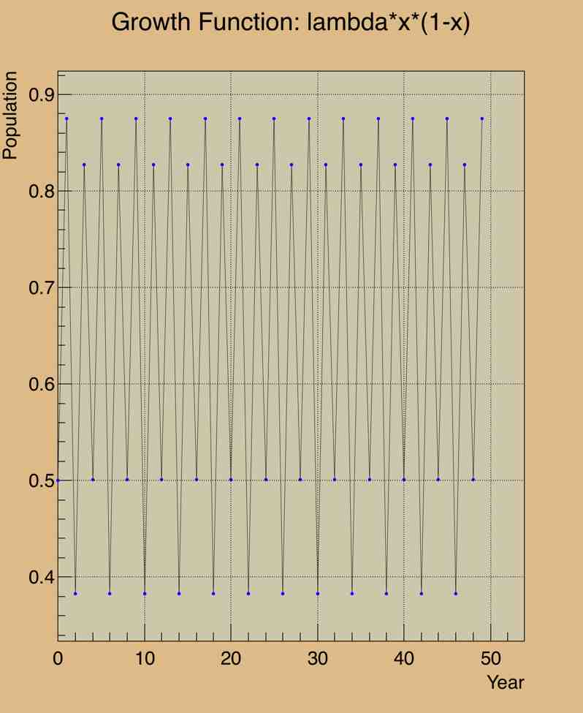
Limiting Values of λ
For larger values of λ, interesting things start to happen … try λ = 3.0
Oscillations, but still approaching a single equilibrium value
Now … try λ = 3.2
We see now TWO possible equilibrium values!!!
The population oscillates from one time period to the next between these two values … FOREVER!!
Now … try λ = 3.5
FOUR possible equilibrium values!!!

Slide 17
Limiting Values of λ
For larger values of λ, interesting things start to happen … try λ = 3.0
Oscillations, but still approaching a single equilibrium value
Now … try λ = 3.2
We see now TWO possible equilibrium values!!!
The population oscillates from one time period to the next between these two values … FOREVER!!
Now … try λ = 3.5
FOUR possible equilibrium values!!!
The values are independent of x₀!!!

Slide 18
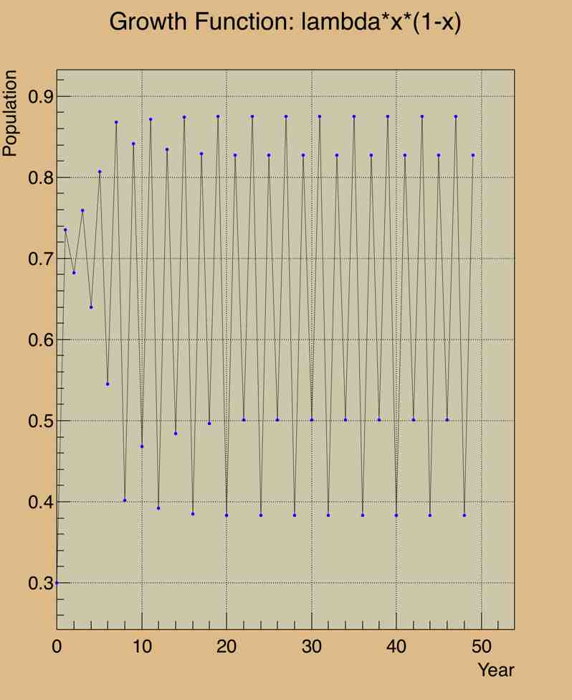
Limiting Values of λ
For larger values of λ, interesting things start to happen … try λ = 3.0
Oscillations, but still approaching a single equilibrium value
Now … try λ = 3.2
We see now TWO possible equilibrium values!!!
The population oscillates from one time period to the next between these two values … FOREVER!!
Now … try λ = 3.5
FOUR possible equilibrium values!!!
The values are independent of x₀!!!

Slide 19
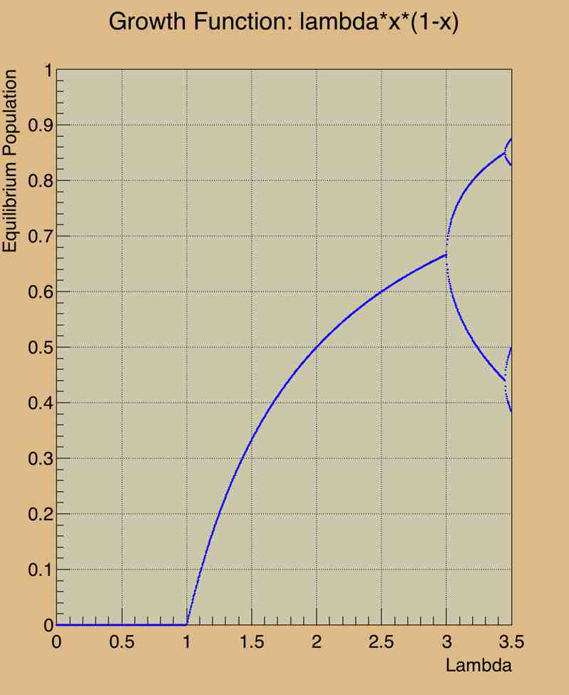
λ Dependence
The final outcome (equilibrium) is extremely sensitive to the initial conditions of the system (λ)
This is, in many senses, the definition of chaotic behavior in physical systems
“butterfly effect”
Fractals
Self-organizing systems
Feedback loops
Many applications in cryptography, robotics, and other areas

Slide 20
λ Dependence
The points where the curve “branches” are called bifurcation points

Slide 21
λ Dependence
The points where the curve “branches” are called bifurcation points
For x_{n+1} = f(x_{n}, λ), a bifurcation will occur at (x₀, λ₀) if the Jacobian matrix Df(x₀, λ₀) has an eigenvalue with zero real part!
- Henri Poincaré

Slide 22
λ Dependence
But what happens if we push this a bit further?
Do we see continued “doubling” of the number of final equilibrium values?

Slide 23
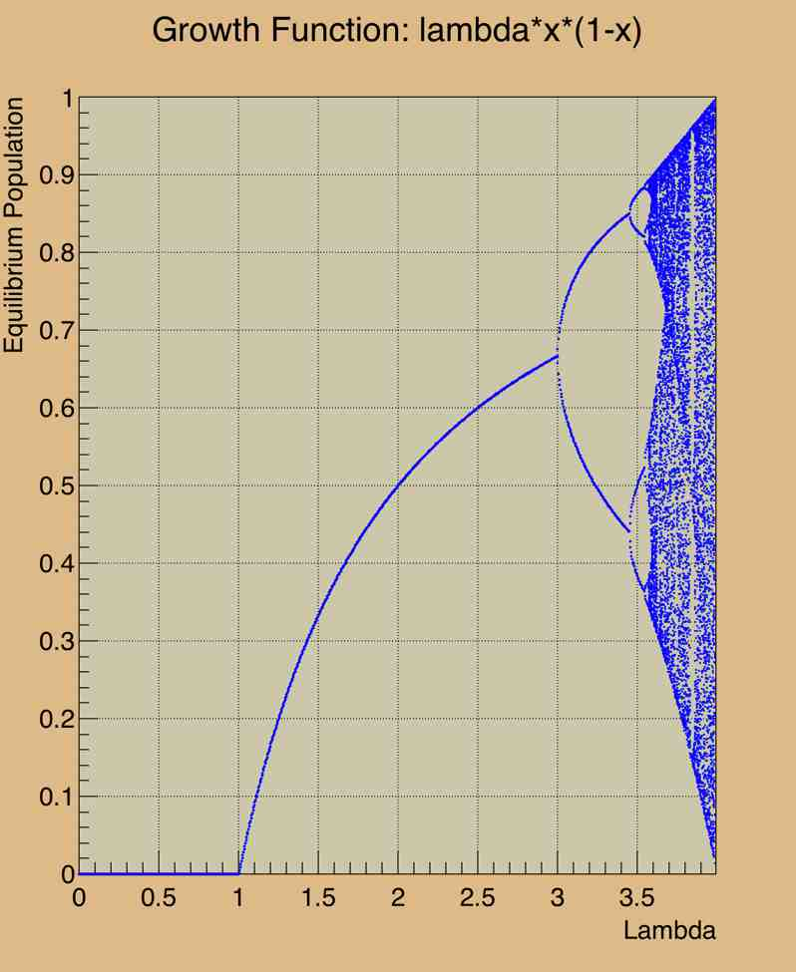
λ Dependence
But what happens if we push this a bit further?
Do we see continued “doubling” of the number of final equilibrium values?
Uhh … yes and no.
At some point, we get very bizarre behavior indeed!
Remember, this is a REALLY simple recurrence relation!!

Slide 24
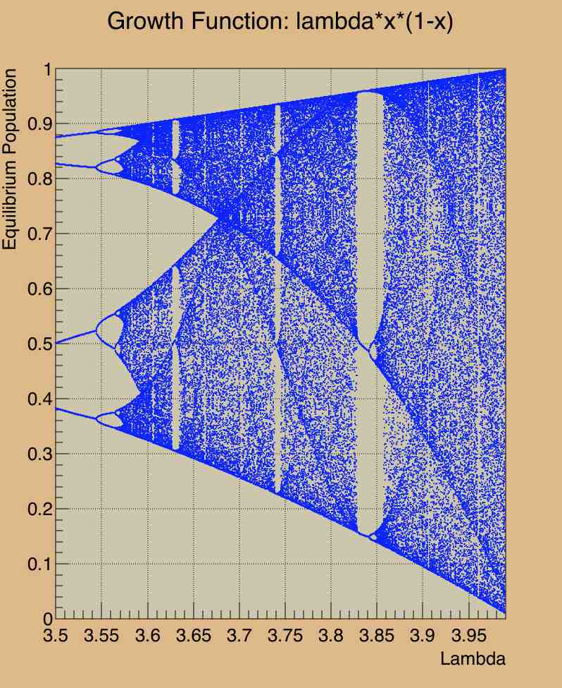
Distribution of Attractors
For a given λ, the possible values of the series at large n are called “attractors”.
E.g. at λ = 3.5, there are four possible attractors
What about at λ ~ 3.99, 3.999, 3.9999, etc.?

Slide 25
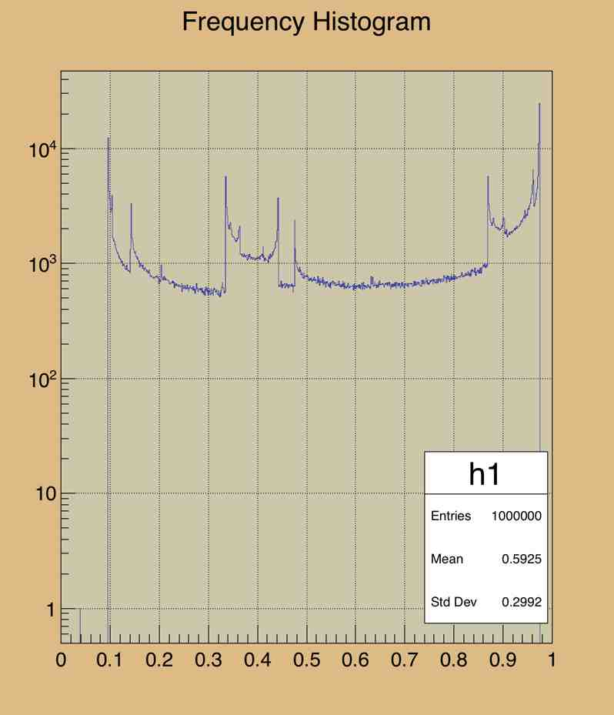
Distribution of Attractors
For a given λ, the possible values of the series at large n are called “attractors”.
E.g. at λ = 3.5, there are four possible attractors
What about at λ ~ 3.9, 3.99, 3.999, 3.9999, etc.?

Slide 26
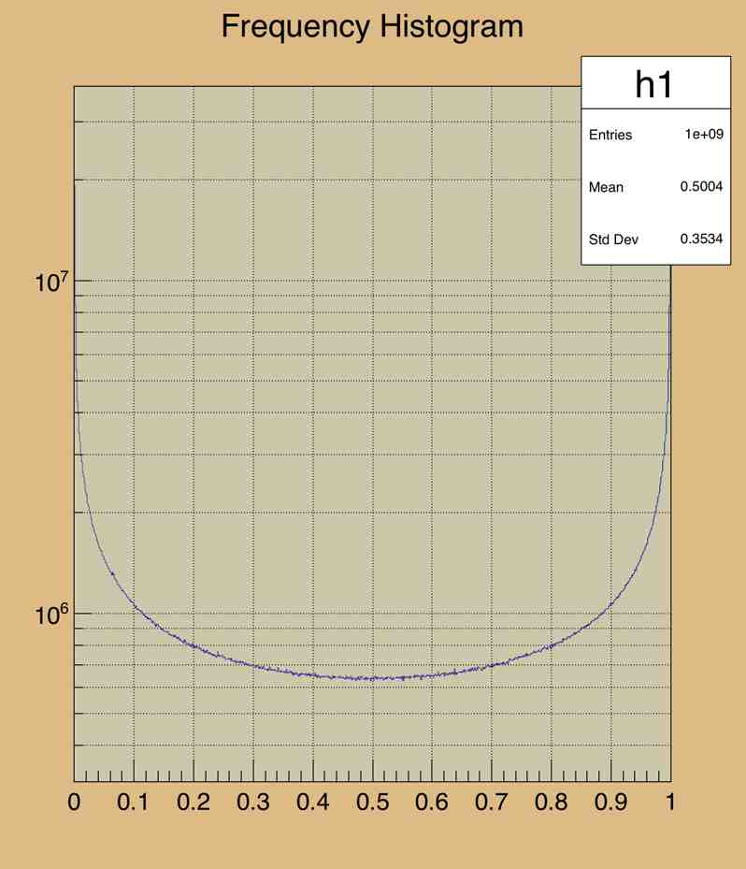
Distribution of Attractors
For a given λ, the possible values of the series at large n are called “attractors”.
E.g. at λ = 3.5, there are four possible attractors
What about at λ ~ 3.9, 3.99, 3.999, 3.9999, etc.?
At λ = 3.999999, the distribution is quite well-behaved (although of course not uniform)
On the up side, it is SUPER fast (because the generating function is so incredibly simple)!

Slide 27
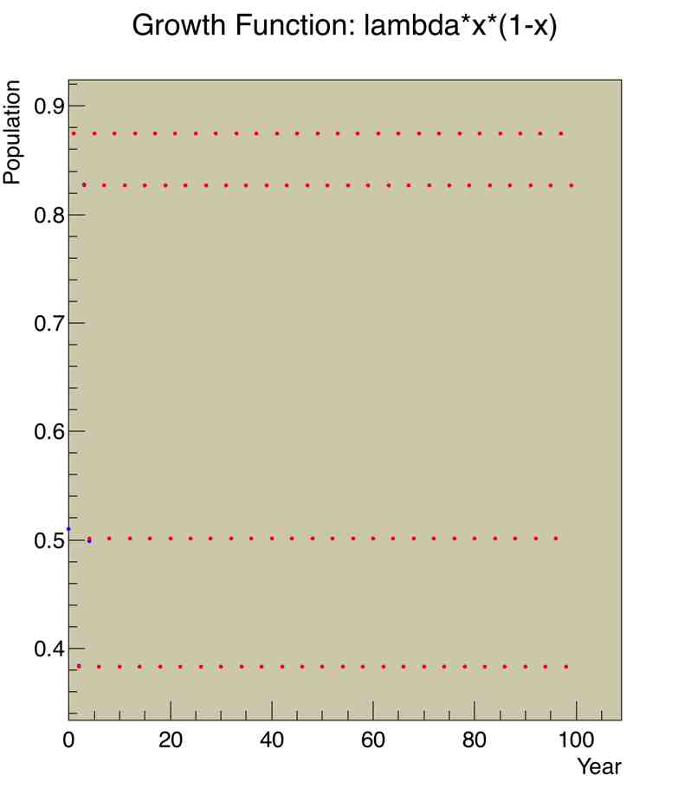
X₀ dependence
What if we compared the results of x₀ = 0.50 and x₀ = 0.51 in more detail.
For the more well-behaved values of λ, we get more or less what we expect – the final values are independent of x₀

Slide 28
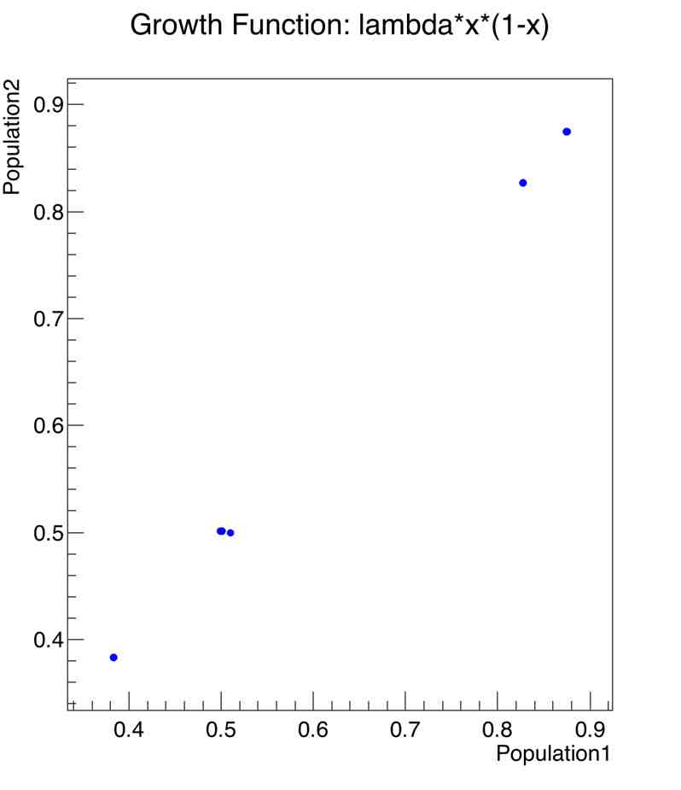
X₀ dependence
What if we compared the results of x₀ = 0.50 and x₀ = 0.51 in more detail.
For the more well-behaved values of λ, we get more or less what we expect – the final values are independent of x₀

Slide 29
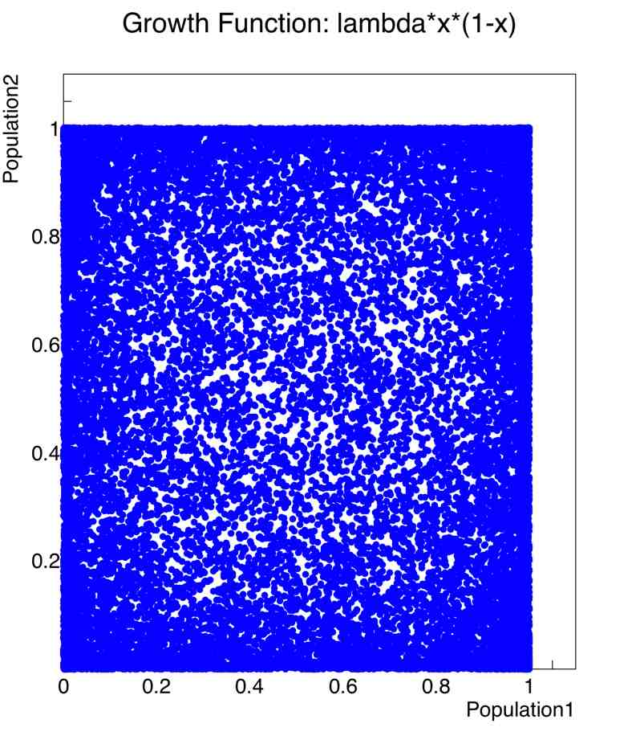
X₀ dependence
What if we compared the results of x₀ = 0.50 and x₀ = 0.51 in more detail.
For the more well-behaved values of λ, we get more or less what we expect – the final values are independent of x₀
However, for larger values of l, the final values of the two similar initial start values are highly uncorrelated!!!

Slide 30

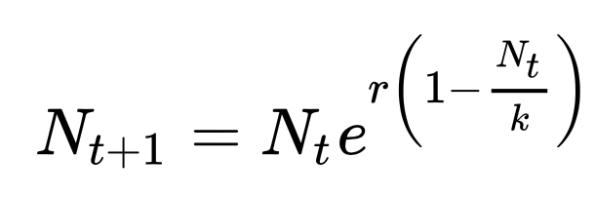
But wait, that generating function is too simple … it’s not realistic!
Maybe that’s true
Another generating function that has been shown to describe biological systems very accurately is the Ricker series:
Here, r is the birthrate, and k is the “carrying capacity” of the system
We can normalize this function by choosing x_{n} = N_{t} / k

Slide 31
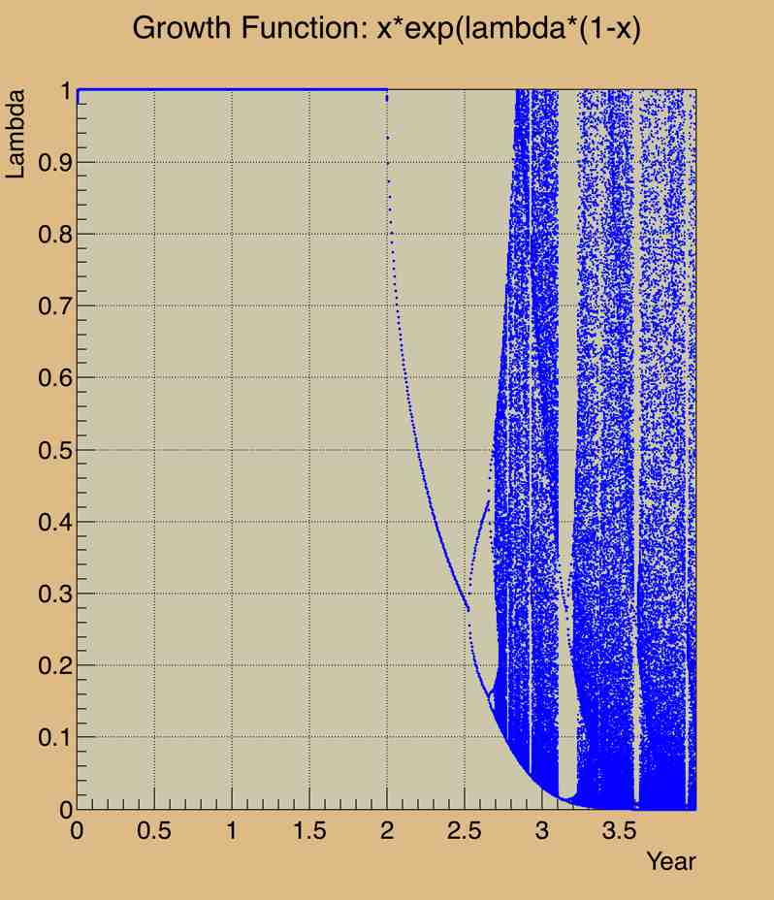
Ricker Series – λ dependence
For small values of λ, the equilibrium population is equal to the carrying capacity of the ecosystem (k = 1 here due to normalization)
However, at larger values of λ, we observe chaotic behavior!!!
Thus, the chaotic behavior is NOT at artifact of a simplistic generating function!!!

Slide 32
Random Number Generation in the ”Real World”
One of the most important considerations for PRNGs is the period after which the series repeats itself
The modern standard for PRNGs uses something called the Mersenne Twister algorithm
The period of repeatability in this algorithm is chosen to be a Mersenne prime number: 2¹⁹⁹³⁷ -1 is the most common
This algorithm is used by:
MS Excel, Common LISP, Maple, MATLAB, PHP, Ruby, Python, Apache Commons, GNU C++ (after C++-11), and SPSS, among many others
N.B. It’s not cryptographically secure – 624 observations allows one to predict all future values … but, there is a version called CryptMT that fixes this.

Slide 33
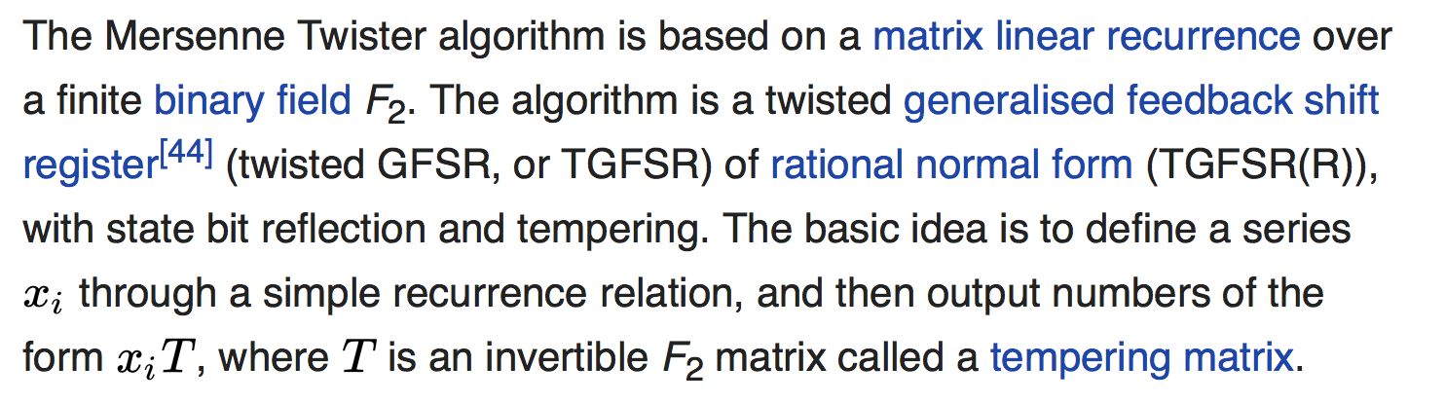
Mersenne Twister Algorithm

Slide 34
Conclusions
Chaotic behavior is observed in simple recurrence relations for some values of the initial conditions (MATHEMATICS)
This chaotic behavior is naturally occurring, and is observed in many dynamical systems (PHYSICS)
The chaotic behavior can be exploited for applications in cryptography and large system complex simulations, among many others (COMPUTER SCIENCE)

