Slide 1
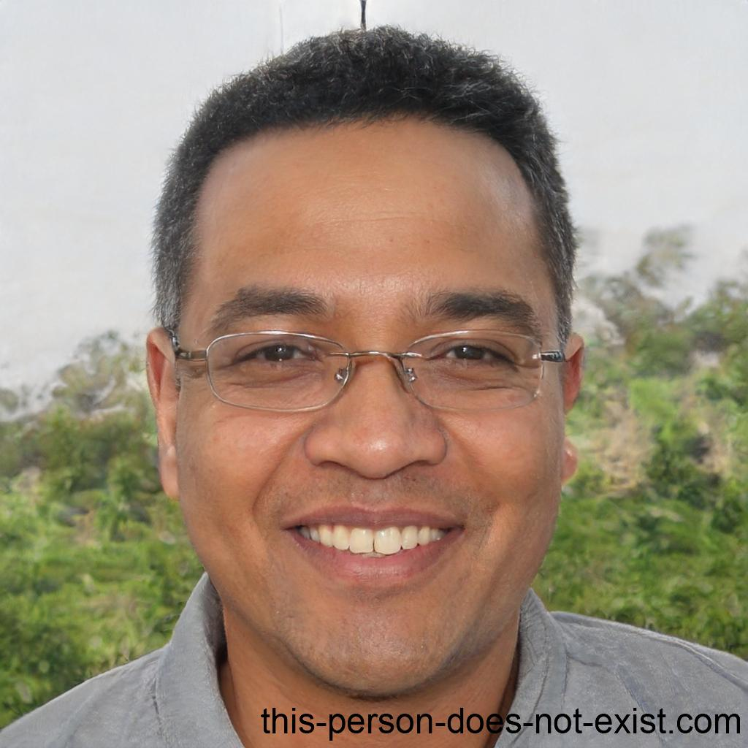
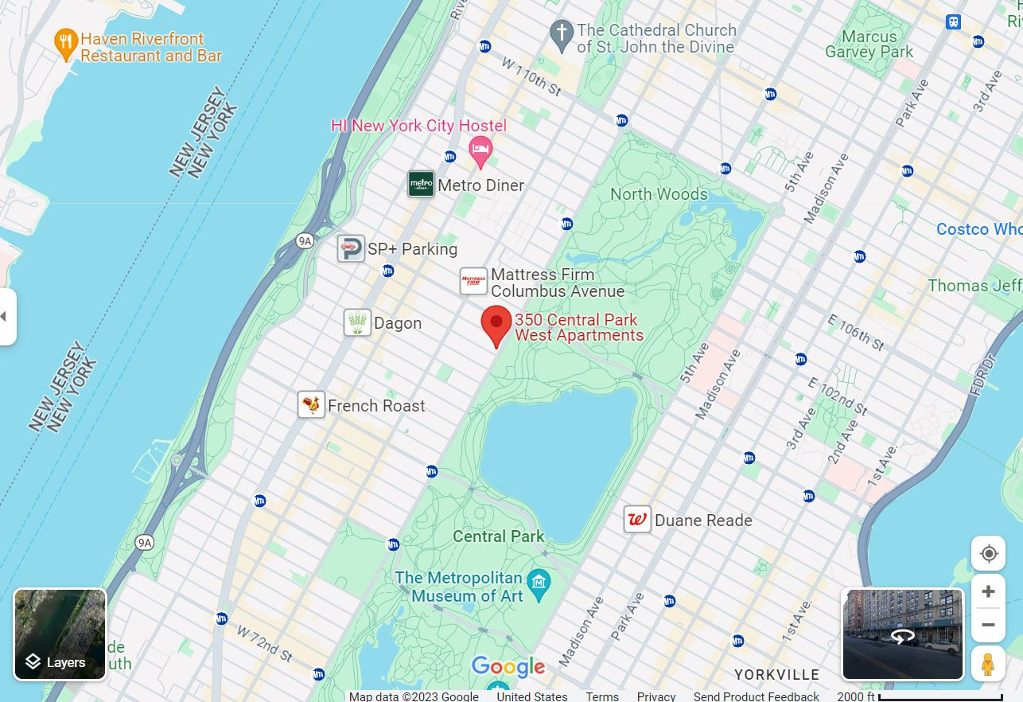
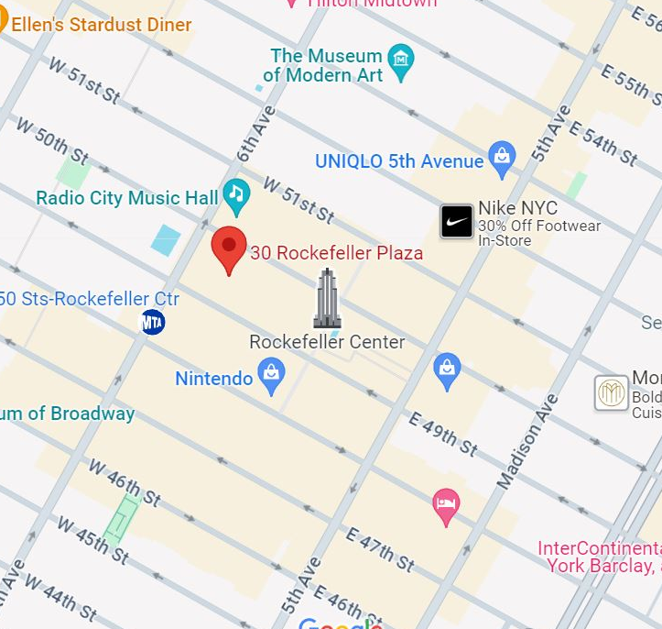
Subject likely lives and works in New York City, New York based on social media including pictures and check-ins. Follower/following relationships on social media platforms indicate a connection with Austin, Texas-based Kevin Ellison. Research on social engineering forums revealed usernames that were traced back to email addresses with a common web domain which has been separately flagged for malicious activity. Additional research on the emails suggests Gaines and Ellison are the probable end users.
Arron Gaines
mglanman@mycbt(.)me
+1472-217-7096
+1(202)-918-2132
No previous criminal convictions
Phishing victims include:
Elsie Graves
Wilfredo Goodman
Jan Jackson

Slide 2
Subject likely lives and works in New York City, New York based on social media including pictures and check-ins. Follower/following relationships on social media platforms indicate a connection with Austin, Texas-based Kevin Ellison. Research on social engineering forums revealed usernames that were traced back to email addresses with a common web domain which has been separately flagged for malicious activity. Additional research on the emails suggests Gaines and Ellison are the probable end users.
Arron Gaines
mglanman@mycbt(.)me
+1472-217-7096
+1(202)-918-2132
No previous criminal convictions
Phishing victims include:
Elsie Graves
Wilfredo Goodman
Jan Jackson

Slide 3
Subject likely lives and works in New York City, New York based on social media including pictures and check-ins. Follower/following relationships on social media platforms indicate a connection with Austin, Texas-based Kevin Ellison. Research on social engineering forums revealed usernames that were traced back to email addresses with a common web domain which has been separately flagged for malicious activity. Additional research on the emails suggests Gaines and Ellison are the probable end users.
Arron Gaines
mglanman@mycbt(.)me
+1472-217-7096
+1(202)-918-2132
No previous criminal convictions
Phishing victims include:
Elsie Graves
Wilfredo Goodman
Jan Jackson

