Slide 1
FedScope Separations Data
Ben Lagnese

Slide 2
What is the data?
Separations refers to federal employees leaving federal agencies for any reason
Each row is one separation, containing employment data
Agency, Date, Education, Age, Work Schedule, etc.
Fiscal Years 2020-2022

Slide 3
What can we glean from the data?
Can’t determine likelihood of separation of a group; mainly exploratory
Single dimension trends
Spread of separations over agencies
Common ages of separated employees
Correlations
What separations are more common for certain salary types?
What are common education levels for different groups?

Slide 4
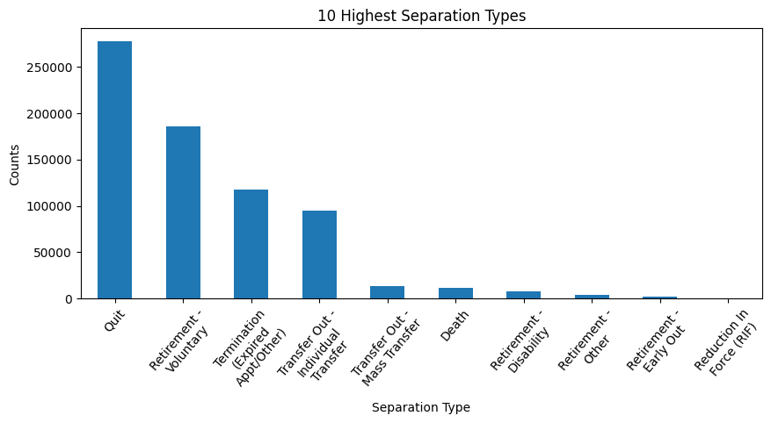
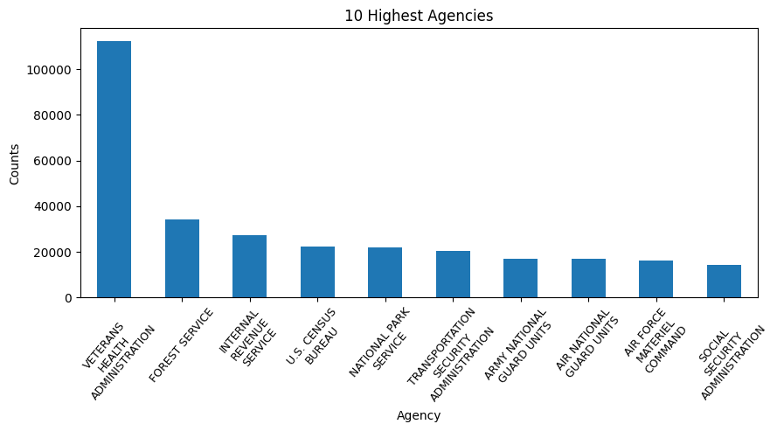
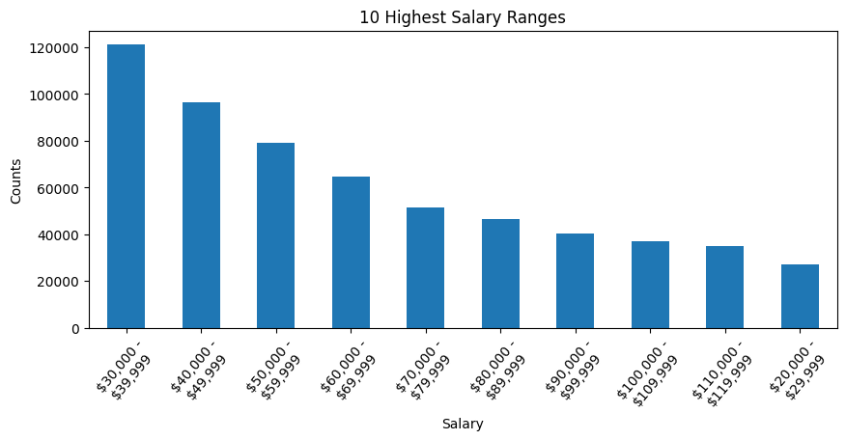
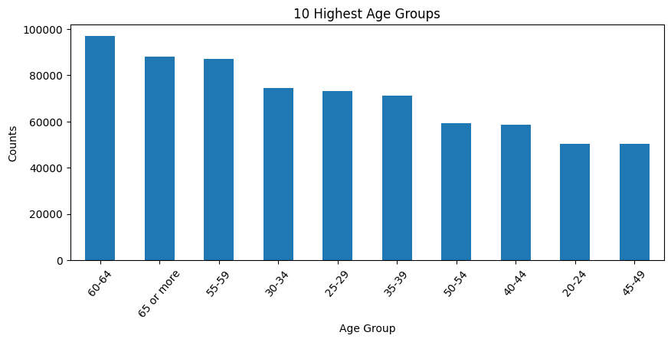
1D Graphs

Slide 5
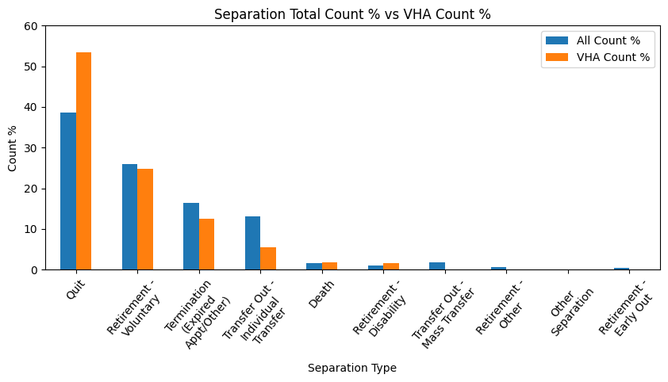
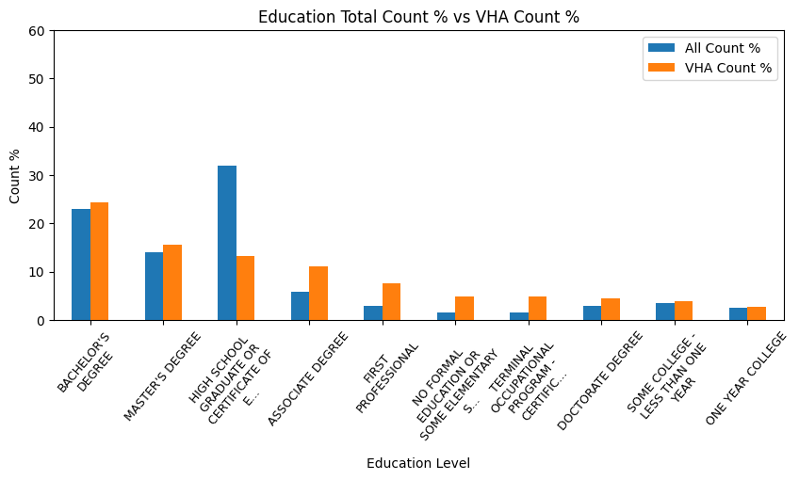
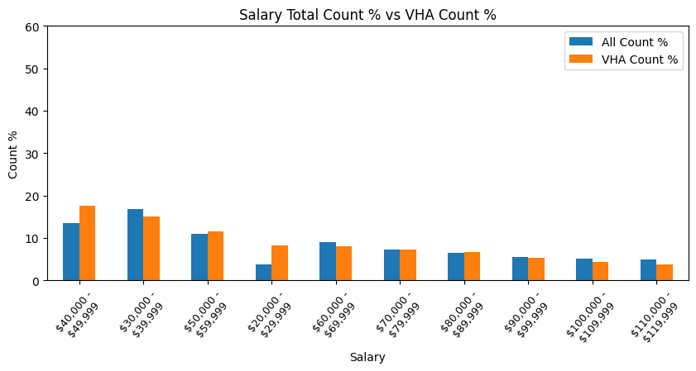
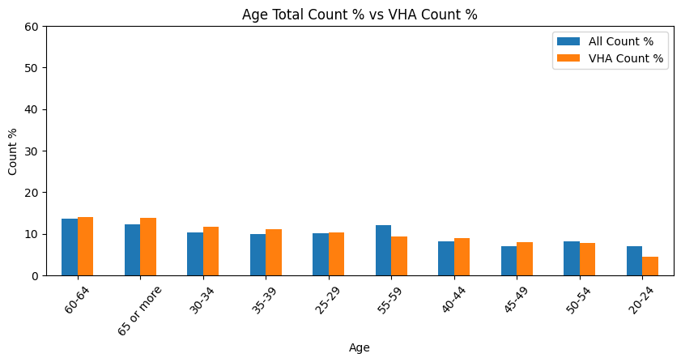
Veteran’s Health Administration

Slide 6
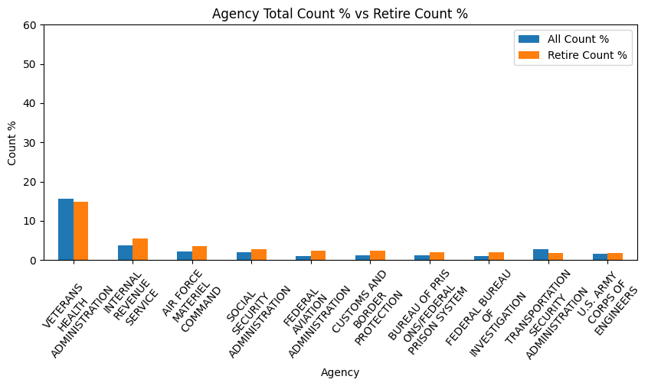
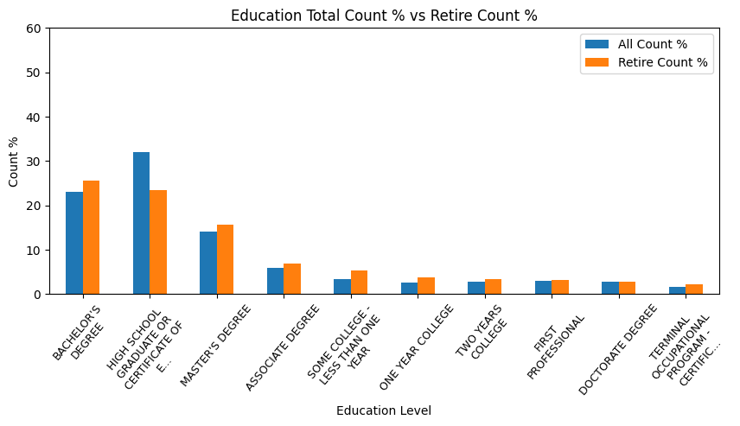
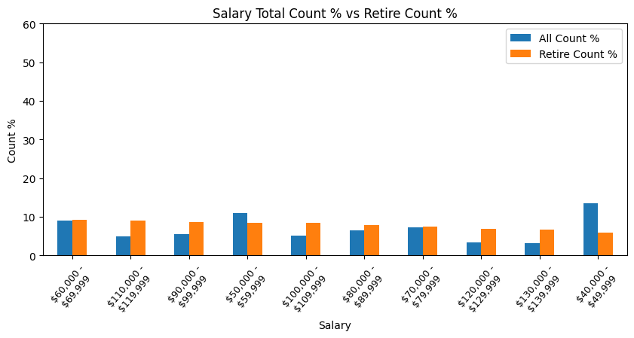
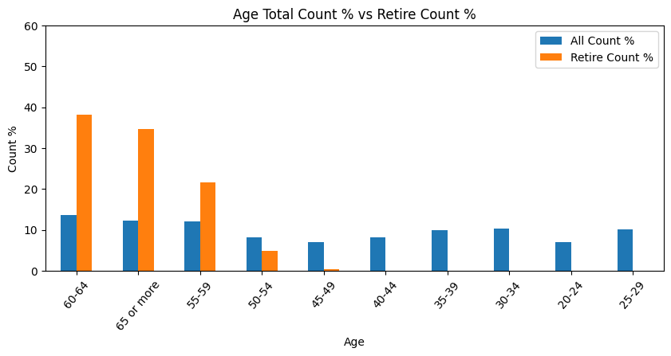
Retirement (Voluntary)

Slide 7
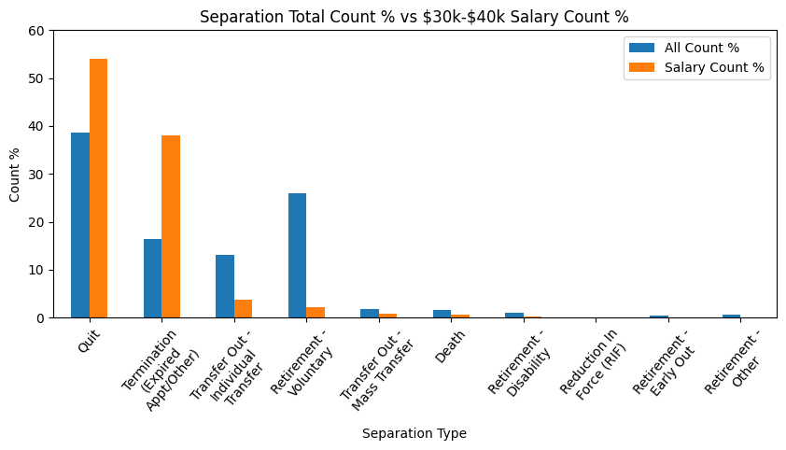
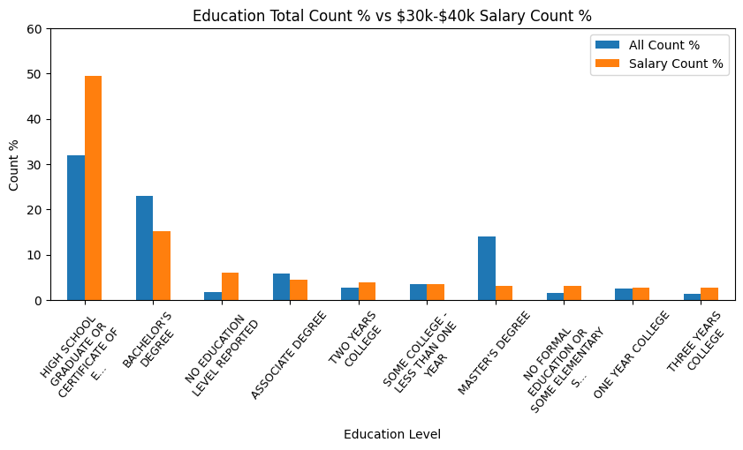
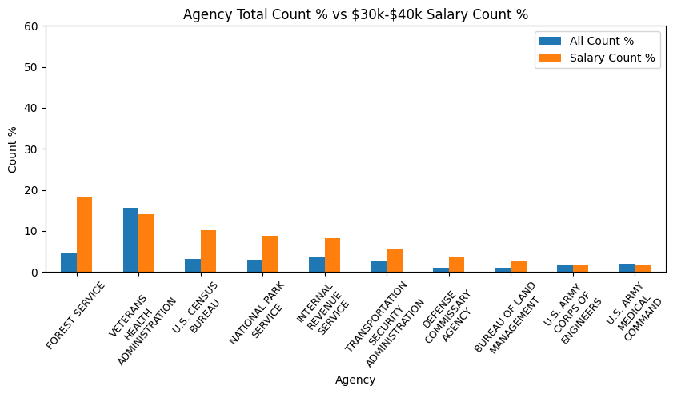
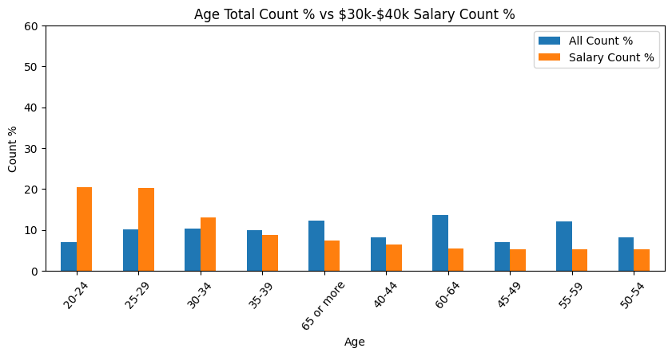
$30k-40k Salary

Slide 8
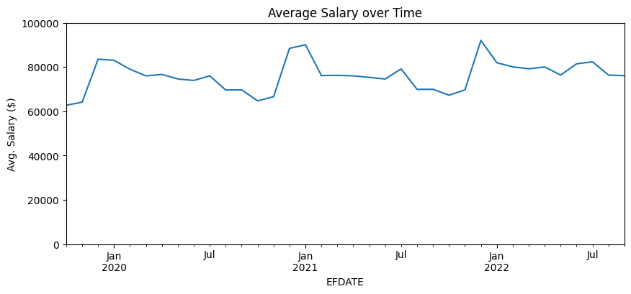
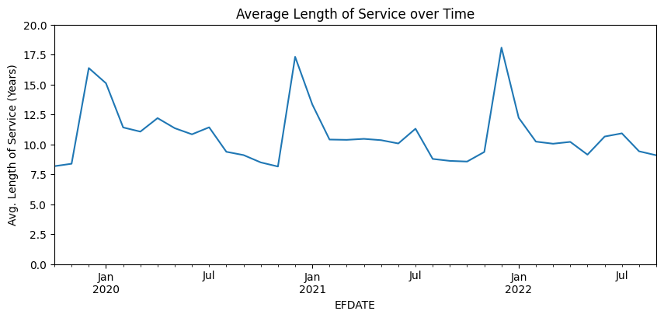
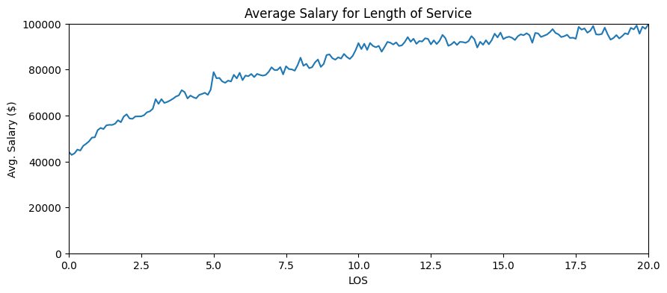
Average Salary & Length of Service

