Slide 1
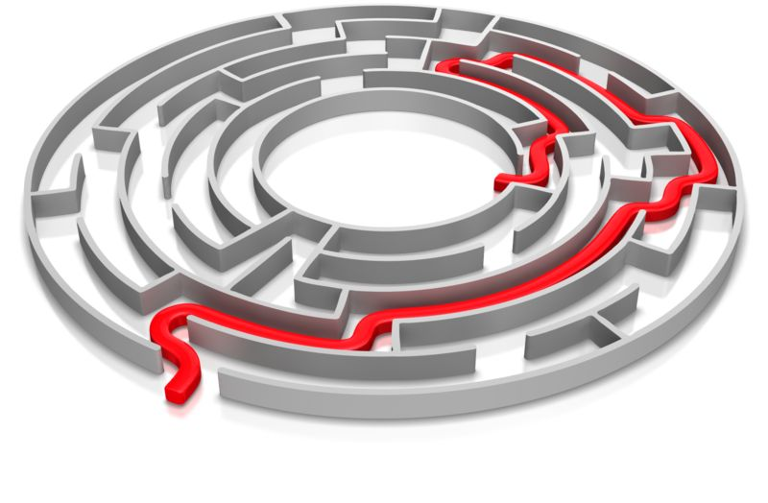
Maze Solver
Project By
Kirk Parillon
&
Ben Lee

Slide 2
Problem Definition
A maze is a two-dimensional structure divided into rows and columns representing cells of equal size. All cells are filled with a wall and empty spaces that represent a possible path to the endpoint. Only two cells are known, one as a starting point and one as an endpoint. Only open squares of the maze can be passed through. If a wall is meet when trying to go through the maze, a different direction has to be taken. Using computer vision techniques to detect the walls of a maze, the goal is to make a computer program to solve a maze by implementing algorithms and techniques learnt from OpenCV. The program will use video capture as input and output the same maze with lines drawn to show the solution.

Slide 3
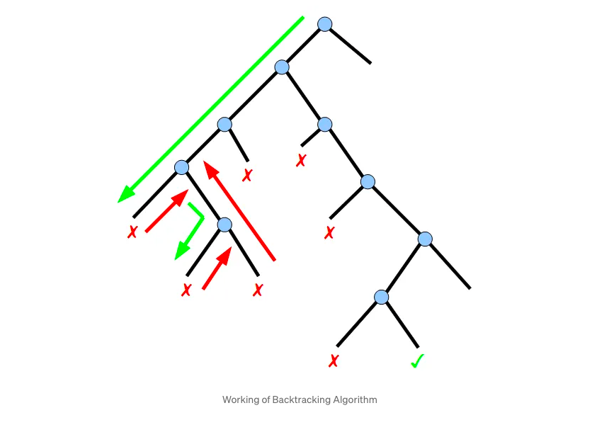
Quick Overview
Om Rastogi
https://omrastogi.medium.com/maze-finder-using-opencv-python-7dc5023ccd02
Maze Solver used an array to store the values of all edges within the maze

Slide 4
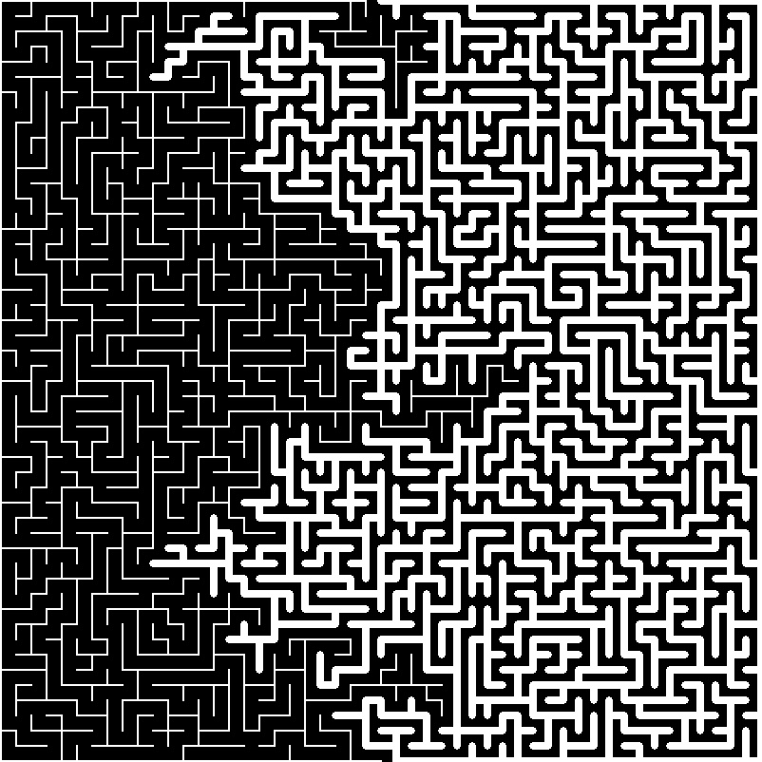
Quick Overview
Ahnv
https://github.com/ahnv/MazeSolver
Maze Solver uses a combination of contours, dilation and erosion

Slide 5
Contributions
Solving the maze after pre-processing input
Improved code by removing unnecessary statements and calculations to solve the maze after pre-processing the input of the maze
De-coupled the maze solving code into three(3) separate methods (get_maze_contours, get_maze_path, build_output)

Slide 6
Computer Vision Components
Contours – To understand the walls in the maze, we need to find its shape that is determined by its contour. This is the boundary that marks the outline of an object in an image.
Dilation – This is a morphological operation that s used to expand or add pixels to the boundaries of an object in an image. This operation is applied after contours.
Erosion - This is a morphological operation that is used to erode the border/outermost layer of pixels from foreground objects. This operation is used after the dilation of the maze image.

Slide 7
Learning Outcome
Applying different techniques and algorithms learnt from labs into a project that can add value to people lives

