Slide 1
Evaluating Hybrid Deep Learning Architectures for Day-Ahead Electricity Price Forecasting in the German Spot Market
Benjamin Leidig
Hyoeun Lee, PhD
05/06/2026

Slide 2
Presentation Overview
Introduction
Motivation, Problem, Approach
Methods
Data Overview
Framework Overview
Alternative Frameworks
Results
Signal Decomposition Frequency Analysis
Comparative Model Error Evaluations
Discussion
Strengths, Limitations, Future Work
DEPARTMENT OF STATISTICS, UNIVERSITY OF ILLINOIS URBANA-CHAMPAIGN

Slide 3
Introduction
DEPARTMENT OF STATISTICS, UNIVERSITY OF ILLINOIS URBANA-CHAMPAIGN

Slide 4
Motivation & Problem Context
Motivation
High socioeconomic & geopolitical dependence on electricity production in Germany
Increasing electricity prices:
Positive correlation with consumer prices
Negative correlation with GDP growth [1]
Knowing prices beforehand allows for more accurate purchasing / budgeting
Problem
Frequent regime changes from socioeconomic instability
COVID-19 pandemic [2]
Russo-Ukraine War [3]
Inherent extreme shocks [2]
Dependent on a multitude of unforeseeable variables
e.g., environmental, logistical, regulatory [4]
Highly non-linear dependencies [2]
Solution
Two-step hybrid framework
Signal decomposition to simplify signals
Deep learning to model each subsignal separately
Specialized artificial neural network (ANN) architecture to learn both local and long-term dependencies
DEPARTMENT OF STATISTICS, UNIVERSITY OF ILLINOIS URBANA-CHAMPAIGN

Slide 5
Methods
DEPARTMENT OF STATISTICS, UNIVERSITY OF ILLINOIS URBANA-CHAMPAIGN

Slide 6
Methodological Roadmap
1) | Data Collection
2) | Data Overview
3) | Two-Step Hybrid Framework
4) | Proposed Network Architecture
5) | Alternative Frameworks
6) | Model Tuning & Validation
DEPARTMENT OF STATISTICS, UNIVERSITY OF ILLINOIS URBANA-CHAMPAIGN

Slide 7
Overview of the German Day-Ahead Electricity Spot Market Data
Feature | Units
Precipitation | mm
Temperature | ºC
Humidity | %
Generation from Renewables | MW
Load | MW
Load from Renewables | MW
Cross-Border Electricity Trade Volume | GW
Daily / Weekly / Monthly Rolling Price Mean | EUR
Daily / Weekly / Monthly Rolling Price Variance | EUR²
Sources
Weather data from Bright Sky API [5]
Electricity-related data from Energy-Charts API [6]
Scope
Collected hourly data from 2019 through 2024
Averaged weather data across Berlin, Hamburg, Munich, and Cologne
Constraints
Prices for each hour of next day set at noon the day before [7]
00:00
06:00
12:00
18:00
00:00
06:00
12:00
18:00
00:00
DEPARTMENT OF STATISTICS, UNIVERSITY OF ILLINOIS URBANA-CHAMPAIGN

Slide 8
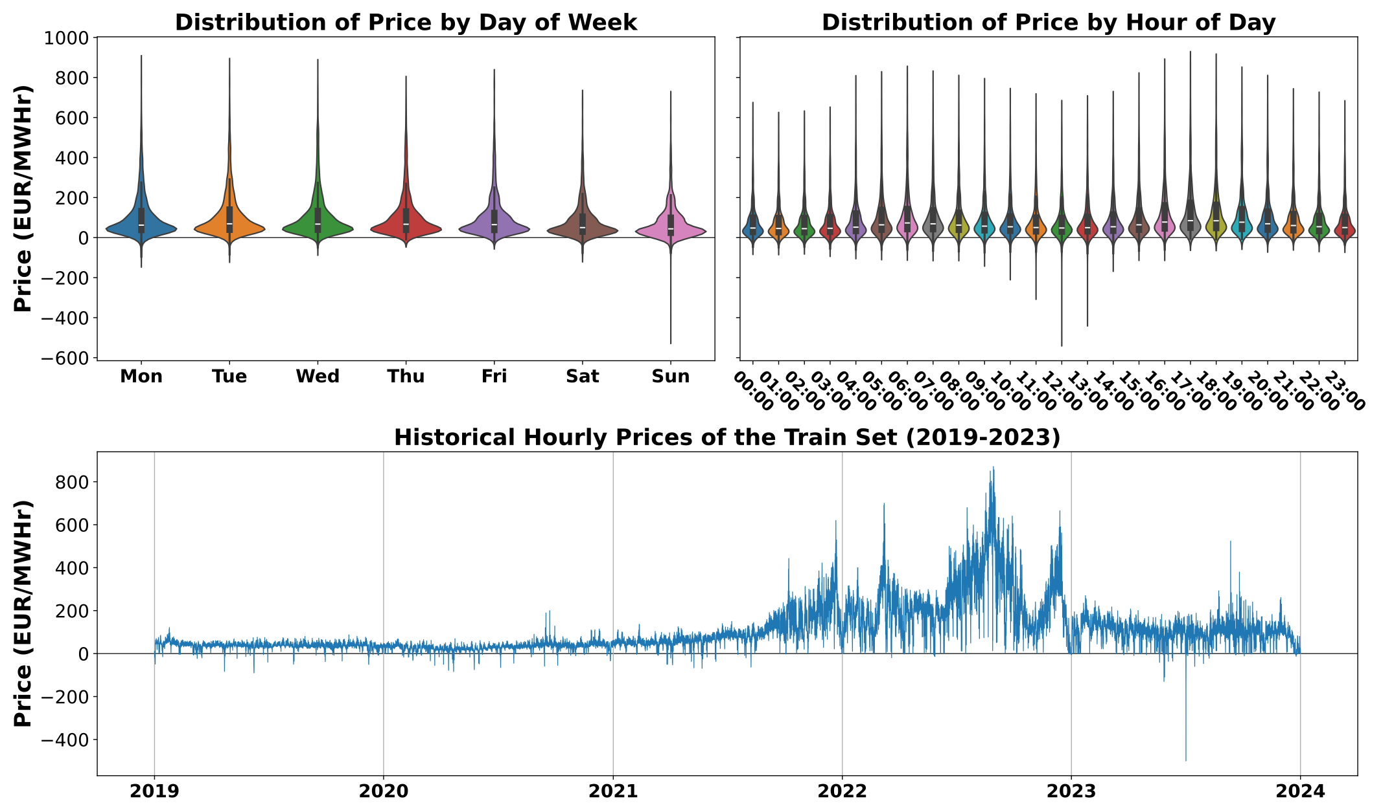
Distributional Characteristics & Temporal Dynamics of Historical Electricity Prices
Seasonality
Inter-day seasonality
Mon—Wed have peak price
Sat—Sun have the lowest price
Intra-day seasonality
Morning / evening have the highest prices throughout the day
Historical Behavior
Extreme shocks in price apparent
Frequent regime changes
Regime switches during the Russo-Ukraine War
General upward trend
Increased variability over time
DEPARTMENT OF STATISTICS, UNIVERSITY OF ILLINOIS URBANA-CHAMPAIGN

Slide 9
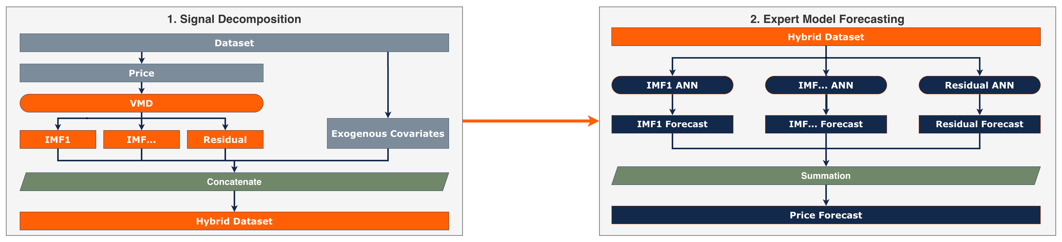
Proposed Hybrid Forecasting Framework
Signal Decomposition
Decompose using Intrinsic Mode Functions (IMFs) using Variational Mode Decomposition (VMD) [8]
Each IMF represents a different level of frequency, complexity, and seasonality of price [9]
Improved learning of complex, multi-seasonality [10]
Frequency separation analysis to preselect the number of IMFs for VMD to produce [11]
Expert Model Forecasting
A different ANN is trained on each IMF, learning behaviors specific to that frequency [9]
Expert ANNs forecast their own IMFs
IMF forecasts are summed for the price forecast
The residual (the difference between the raw signal and the summed IMFs) is also modeled
DEPARTMENT OF STATISTICS, UNIVERSITY OF ILLINOIS URBANA-CHAMPAIGN

Slide 10
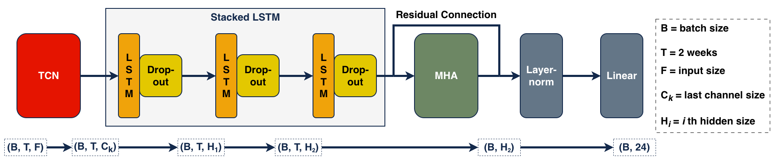
Proposed TCN-LSTM-MHA Network Architecture
Temporal Convolutional Network (TCN)
Capture local, seasonal, and sub-seasonal dependencies within the data [12]
Acts as a feature extractor for stacked LSTM
Allows LSTM stack to learn long-term patterns [13]
Stacked Long Short-Term Memory (LSTM)
Learns longer-term relationships and structure [14]
Gated unit structure aids in handling nonstationarity and regime-shifting structure [15]
Multi-Head Attention (MHA)
Heads learn lagged correlations [16]
Provides robustness for irregular events [17]
DEPARTMENT OF STATISTICS, UNIVERSITY OF ILLINOIS URBANA-CHAMPAIGN

Slide 11
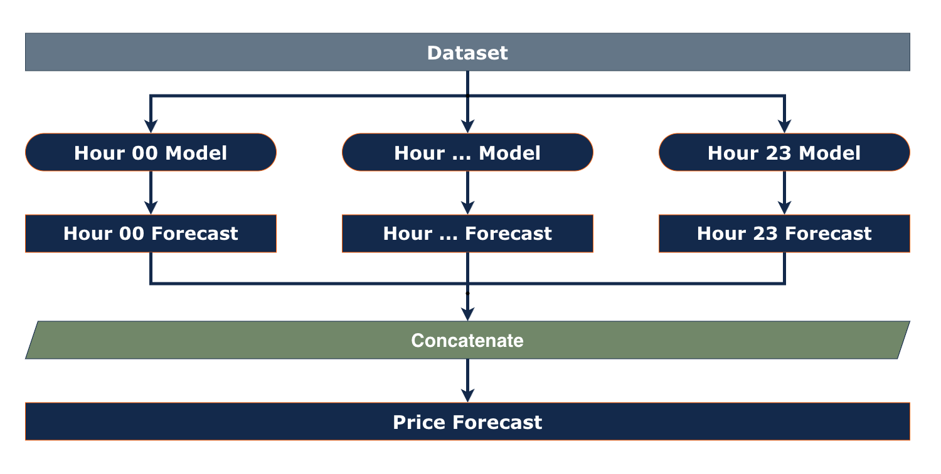
Benchmark & Alternative Forecasting Frameworks
Class | Model
DMF | Elastic Net (EN) Light Gradient Boosting Machine (LGBM) Linear Regression (LR) Random Forest Regressor (RFR) Support Vector Regression (SVR) EXtreme Gradient Boosting Regressor (XGBR)
Stand-alone ANN | TCN-LSTM-MHA TCN-MHA LSTM-MHA TCN-LSTM TCN LSTM
Hybrid | VMD-TCN-LSTM-MHA (VTLM) VMD-TCN-MHA (VTM) VMD-LSTM-MHA (VLM) VMD-TCN-LSTM (VTL) VMD-TCN (VT) VMD-LSTM (VL)
Direct Multi-Step Forecasting (DMF)
Individual machine learning (ML) models learn and forecast each hour of the next day, separately
Effectively allows sequence-to-sequence forecasts
DMF models are provided with data from noon of the previous day to noon of the current day
DEPARTMENT OF STATISTICS, UNIVERSITY OF ILLINOIS URBANA-CHAMPAIGN

Slide 12
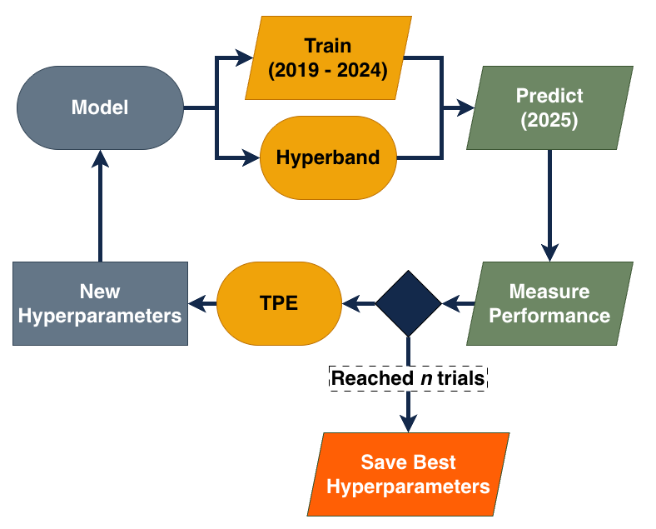
Hyperparameter Optimization & Temporal Validation
Hyperparameter Tuning
Bayesian Optimization (BO) framework using Tree-Structured Parzen Estimator (TPE)
TPE is nonparametric and searches high-dimensional, conditional parameter spaces better than alternatives [18]
Hyperband pruning discards unpromising trials early during training (ANNs only) [19]
Early stopping terminates training after unimproved validation performance for 5 epochs (ANNS only) [20]
Cross-Validation (CV)
Rolling window temporal CV with 5 folds was used in the hyperparameter tuning pipeline for DMF models
No CV used for ANNs due to computational constraints
DEPARTMENT OF STATISTICS, UNIVERSITY OF ILLINOIS URBANA-CHAMPAIGN

Slide 13
Results
DEPARTMENT OF STATISTICS, UNIVERSITY OF ILLINOIS URBANA-CHAMPAIGN

Slide 14
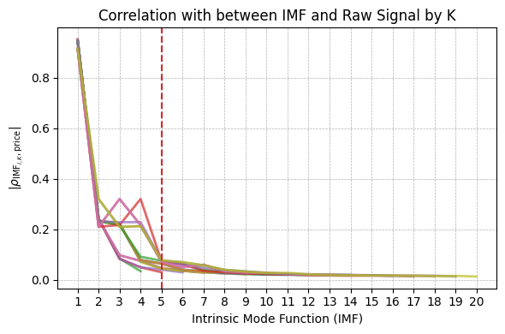
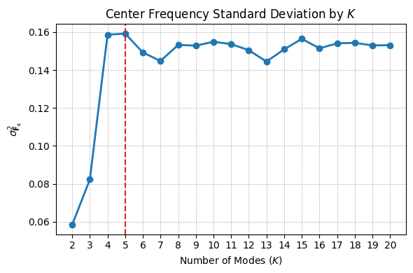
Frequency-Based Analysis for VMD Hyperparameter Selection
Tested many mode numbers, $k∈\{2,3,...,20\}$
The highest standard deviation of center frequencies was found at $k=5$, $α=4,000$
Correlation tended to dip after IMF5 for all values of $k$
Overall, IMFs tended to represent different frequencies
IMF1 captured the general trend of historical prices
Substantial mode mixing present, although this was common across all tested decompositions
DEPARTMENT OF STATISTICS, UNIVERSITY OF ILLINOIS URBANA-CHAMPAIGN

Slide 15
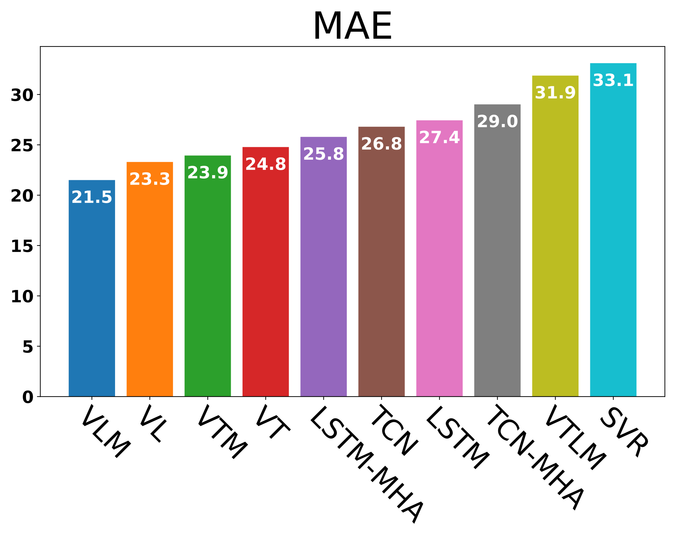
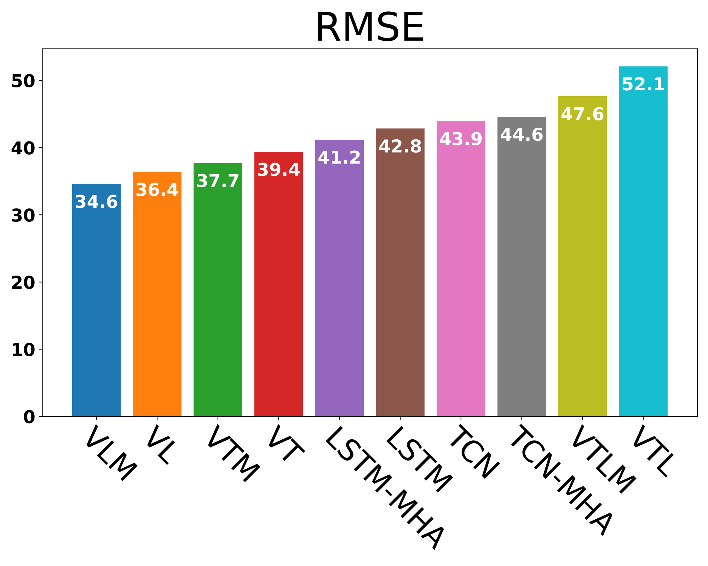
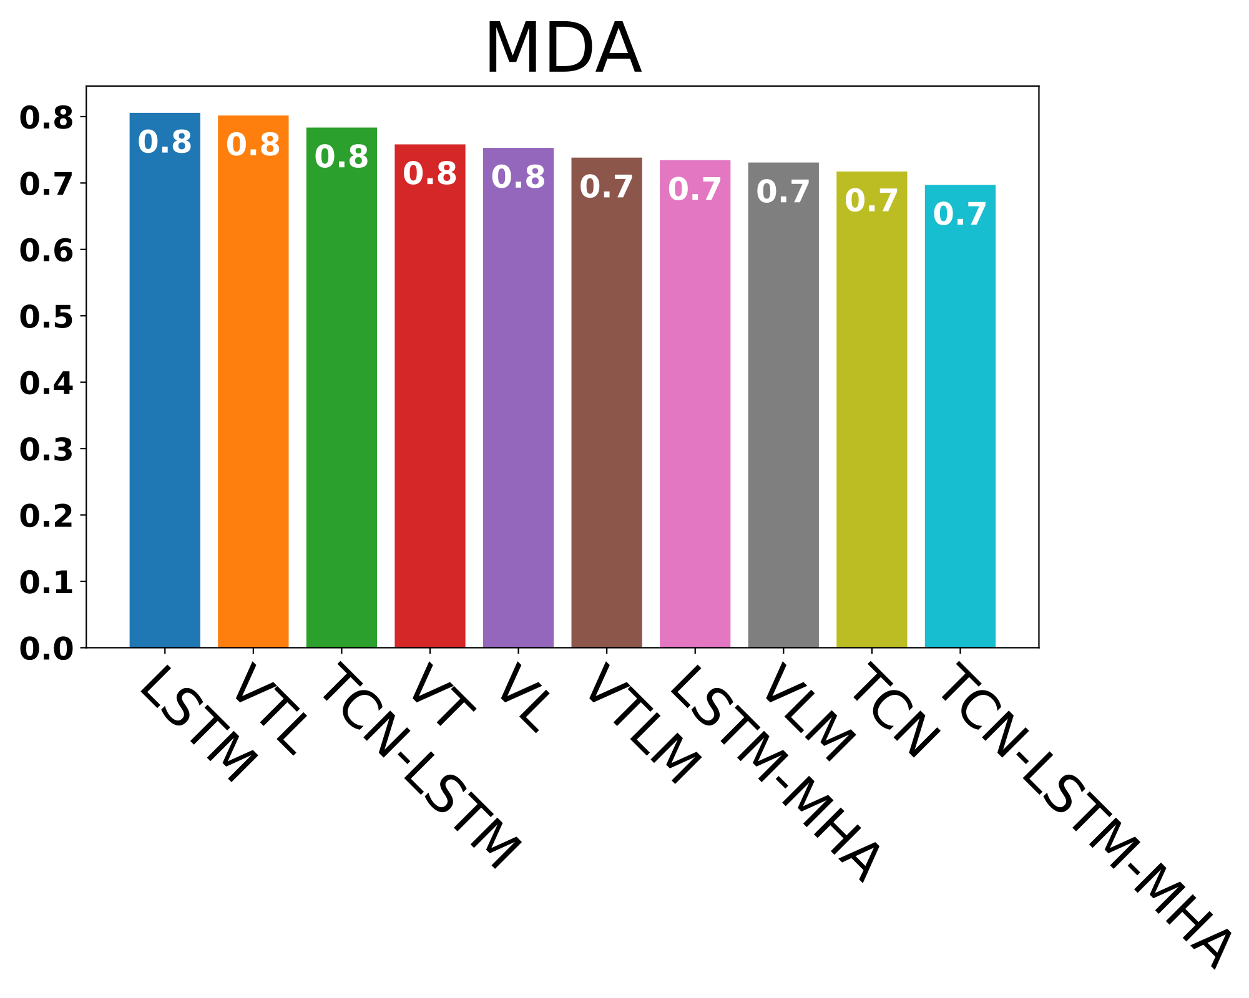
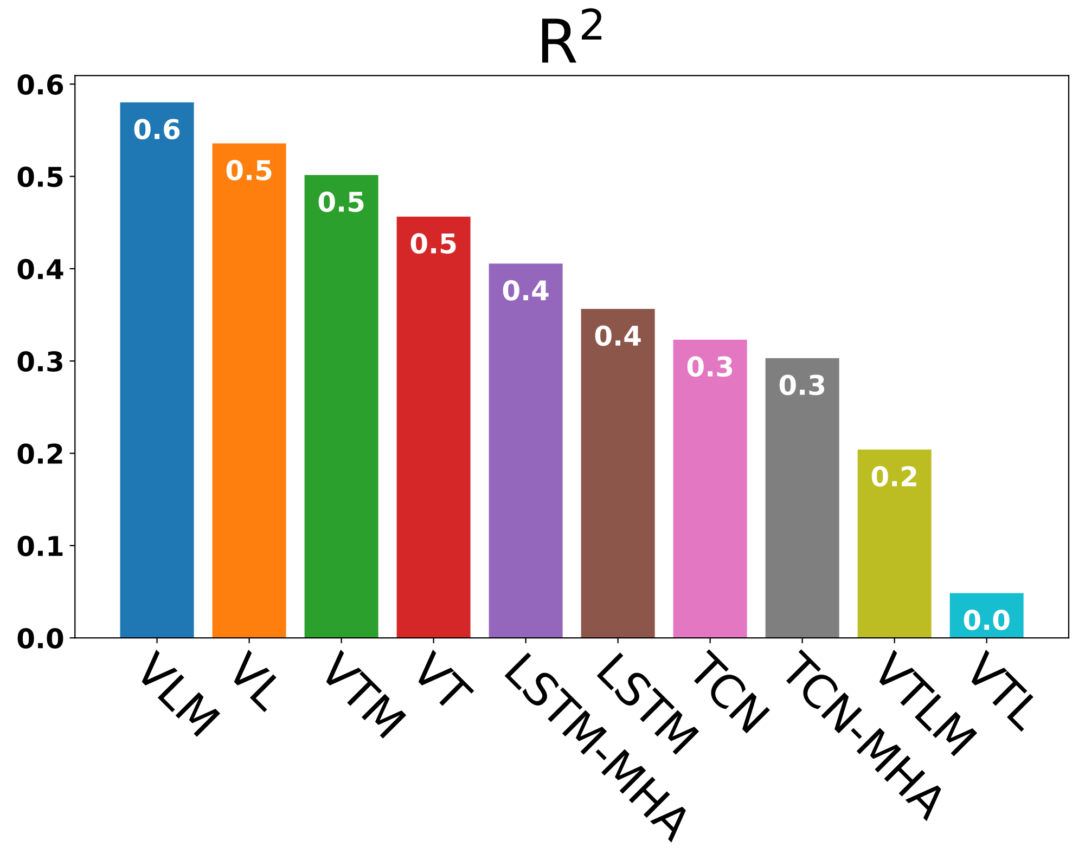
Test Set Forecast Accuracy Metrics
Mean Absolute Error (MAE)
$$\text{MAE}=\frac{1}{n}\overset{n}{\underset{i=1}{∑}}|y_{i}-{\overset{̂}{y}}_{i}|$$
Mean Directional Accuracy (MDA)
$$\text{MDA}=\frac{1}{n-1}\overset{n}{\underset{i=2}{∑}}1_{\{(y_{i}-y_{i-1})({\overset{̂}{y}}_{i}-y_{i-1})>0\}}$$
Root Mean Squared Error (RMSE)
$$\text{RMSE}=\sqrt{\frac{1}{n}\overset{n}{\underset{i=1}{∑}}(y_{i}-{\overset{̂}{y}}_{i})^{2}}$$
Coefficient of Determination (R²)
$${\text{R}}^{2}=1-\frac{∑_{i=1}^{n}(y_{i}-{\overset{̂}{y}}_{i})^{2}}{∑_{i=1}^{n}(y_{i}-\overline{y})^{2}}=\frac{∑_{i=1}^{n}({\overset{̂}{y}}_{i}-\overline{y})^{2}}{∑_{i=1}^{n}(y_{i}-\overline{y})^{2}}$$
(Only the top ten models are shown for each metric.)
VMD-LSTM-MHA (VLM) architecture demonstrated the lowest MAE, RMSE and the greatest MDA, R²
$$\text{MAE}=21.502\text{EUR}$$
$$\text{RMSE}=34.604\text{EUR}$$
$$\text{MDA}=0.731=73.1\%$$
$${\text{R}}^{2}=0.580=58\%$$
DEPARTMENT OF STATISTICS, UNIVERSITY OF ILLINOIS URBANA-CHAMPAIGN

Slide 16
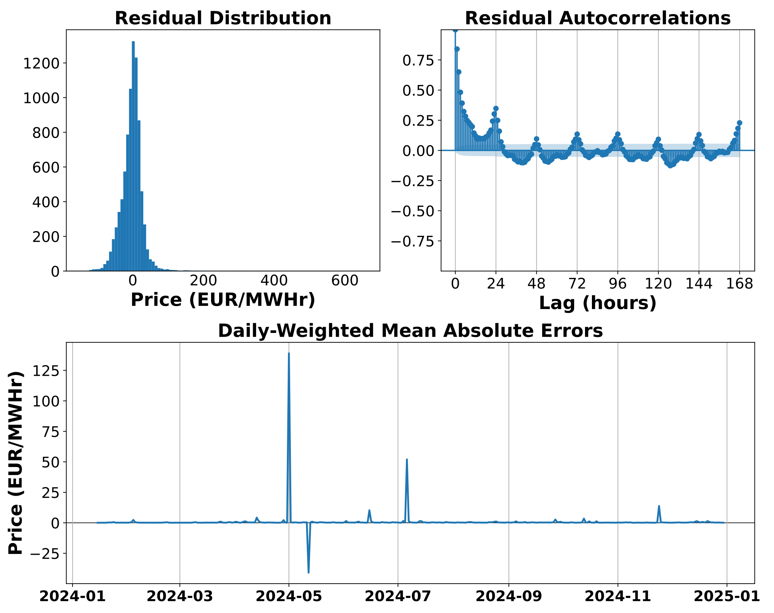
Test Set Forecast Accuracy of the VMD-LSTM-MHA Model
Residual Distribution
Residuals are approximately centered around zero
Long right skew implies rare but drastic under-prediction
Residual Autocorrelation Function
Significant autocorrelation in residuals
Implies a large amount of accounted lagged feature importance in network weights
Daily-Weighted Mean Absolute Errors
$\text{DMAE}=\frac{1}{24}\overset{24}{\underset{i=1}{∑}}\frac{|y_{i}-{\overset{̂}{y}}_{i}|}{{\overline{y}}_{24}}$, i.e. ${\overline{y}}_{24}$ is the daily mean
Demonstrates performance relative to daily market conditions, or difficulty-adjusted error [7]
~5 days of extremely poor relative forecast accuracy
DEPARTMENT OF STATISTICS, UNIVERSITY OF ILLINOIS URBANA-CHAMPAIGN

Slide 17
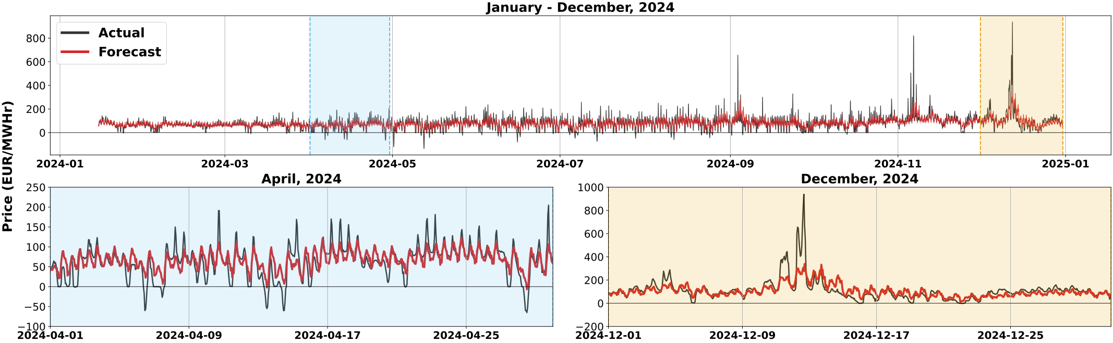
Actual vs. Forecasted Prices for the VMD-LSTM-MHA Model (2024)
The VMD-LSTM-MHA network tends to follow intra-day and inter-day seasonality well
Consistent under-prediction during regular periods
Under-prediction of extremity of shocks, although some indication of increased price variance is present
Diebold-Mariano test rejects the null hypothesis; forecasts are more accurate than 2nd best model’s [21]
DEPARTMENT OF STATISTICS, UNIVERSITY OF ILLINOIS URBANA-CHAMPAIGN

Slide 18
Discussion
DEPARTMENT OF STATISTICS, UNIVERSITY OF ILLINOIS URBANA-CHAMPAIGN

Slide 19
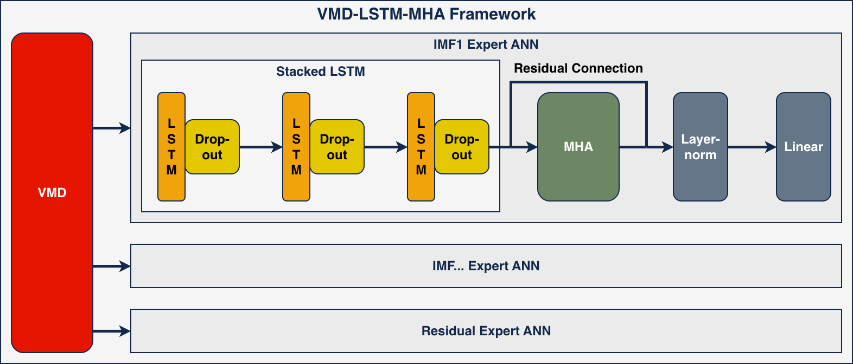
Key Findings from the VMD-LSTM-MHA Model
Best performing model (lowest MAE, RMSE and highest R², MDA) was chosen to be VMD-LSTM-MHA
Excludes TCN, suggesting a substantial amount of local, sub-seasonal noise in day-ahead electricity price data
VMD was shown to deconstruct the complex, original price signal into significantly more interpretable IMFs
MHA significantly improved model performance, likely due to the inherent irregularities of electricity prices
DEPARTMENT OF STATISTICS, UNIVERSITY OF ILLINOIS URBANA-CHAMPAIGN

Slide 20
Strengths, Limitations, & Future Work
Strengths
Highly structured, intentional neural network design
Tested most combinations of network layers for robustness
Robust analysis of frequency separation to guide VMD [11]
VMD-LSTM-MHA bypasses the need for lagged feature selection [16]
Model frameworks completely abide by real-time, day-ahead trading constraints [7]
Limitations
Biased, optimistic final model performance
Mode mixing between IMFs could signify still imperfect separation
The test set largely includes only one price regime
Residual ACF shows lagged correlation structure not accounted for by MHA
Expert DMF models miss the hourly covariance structure
Expert DMF models may struggle during fitting due to high dimensionality
Future Work
Attain new holdout set for unbiased final model evaluation
Incorporate automated feature selection for DMF models
Ordinary Least Squares (OLS) regression on expert hybrid model forecasts to correct forecasts
Exploration of transformer-based architectures (e.g., Temporal Fusion Transformer (TFT))
Further exploration of probabilistic forecasting methods (e.g., Conformal Predictions (CP))
DEPARTMENT OF STATISTICS, UNIVERSITY OF ILLINOIS URBANA-CHAMPAIGN

Slide 21
References (I)
C. Lutz and L. Becker, “Effects of Energy Price Shocks on Germany’s Economy and Private Households,” Springer eBooks, pp. 11–28, Jan. 2023, doi: https://doi.org/10.1007/978-3-031-35684-1_2.
R. A. De Santis and T. Tornese, “Macroeconomic regime change and the size of supply chain disruption and energy supply shocks,” European Economic Review, vol. 178, p. 105077, Sep. 2025, doi: https://doi.org/10.1016/j.euroecorev.2025.105077.
D. Sarwar and S. Rye, “The impact of the Russia-Ukraine war on global supply chains: a systematic literature review,” Frontiers in Sustainable Food Systems, vol. 9, Sep. 2025, doi: https://doi.org/10.3389/fsufs.2025.1648918.
d'Artis Kancs, “Uncertainty of Supply chains: Risk and Ambiguity,” World economy, vol. 47, no. 5, Nov. 2023, doi: https://doi.org/10.1111/twec.13534.
“Bright Sky API Documentation,” Brightsky.dev, 2026. https://brightsky.dev/docs/#/
“Energy-Charts,” www.energy-charts.info. https://www.energy-charts.info/index.html?l=en&c=DE
‌R. Weron, “Electricity price forecasting: A review of the state-of-the-art with a look into the future,” International Journal of Forecasting, vol. 30, no. 4, pp. 1030–1081, Oct. 2014, doi: https://doi.org/10.1016/j.ijforecast.2014.08.008.
K. Dragomiretskiy and D. Zosso, “Variational Mode Decomposition,” IEEE Transactions on Signal Processing, vol. 62, no. 3, pp. 531–544, Feb. 2014, doi: https://doi.org/10.1109/tsp.2013.2288675.
N. E. Huang et al., “The empirical mode decomposition and the Hilbert spectrum for nonlinear and non-stationary time series analysis,” Proceedings of the Royal Society of London. Series A: Mathematical, Physical and Engineering Sciences, vol. 454, no. 1971, pp. 903–995, Mar. 1998, doi: https://doi.org/10.1098/rspa.1998.0193.
DEPARTMENT OF STATISTICS, UNIVERSITY OF ILLINOIS URBANA-CHAMPAIGN

Slide 22
References (II)
S. Smyl, “A hybrid method of exponential smoothing and recurrent neural networks for time series forecasting,” International Journal of Forecasting, vol. 36, no. 1, Jul. 2019, doi: https://doi.org/10.1016/j.ijforecast.2019.03.017.
S. Wu, F. Feng, J. Zhu, C. Wu, and G. Zhang, “A Method for Determining Intrinsic Mode Function Number in Variational Mode Decomposition and Its Application to Bearing Vibration Signal Processing,” Shock and Vibration, vol. 2020, pp. 1–16, May 2020, doi: https://doi.org/10.1155/2020/8304903.
‌S. Bai, J. Zico Kolter, and V. Koltun, “An Empirical Evaluation of Generic Convolutional and Recurrent Networks for Sequence Modeling,” arXiv (Cornell University), Jan. 2018, doi: https://doi.org/10.48550/arxiv.1803.01271.
C. Lea, M. D. Flynn, R. Vidal, A. Reiter, and G. D. Hager, “Temporal Convolutional Networks for Action Segmentation and Detection,” 2017 IEEE Conference on Computer Vision and Pattern Recognition (CVPR), Jul. 2017, doi: https://doi.org/10.1109/cvpr.2017.113.
‌S. Hochreiter and J. Schmidhuber, “Long Short-Term Memory,” Neural Computation, vol. 9, no. 8, pp. 1735–1780, Nov. 1997, doi: https://doi.org/10.1162/neco.1997.9.8.1735.
‌F. A. Gers, J. Schmidhuber, and F. Cummins, “Learning to Forget: Continual Prediction with LSTM,” Neural Computation, vol. 12, no. 10, pp. 2451–2471, Oct. 2000, doi: https://doi.org/10.1162/089976600300015015.
‌A. Vaswani et al., “Attention is all you need,” in Proc. 31st Int. Conf. Neural Information Processing Systems (NeurIPS), Long Beach, CA, USA, 2017, pp. 6000–6010.
DEPARTMENT OF STATISTICS, UNIVERSITY OF ILLINOIS URBANA-CHAMPAIGN

Slide 23
References (III)
H. Zhou et al., “Informer: Beyond Efficient Transformer for Long Sequence Time-Series Forecasting,” Proceedings of the AAAI Conference on Artificial Intelligence, vol. 35, no. 12, pp. 11106–11115, May 2021, doi: https://doi.org/10.1609/aaai.v35i12.17325.
J. Bergstra, R. Bardenet, and B. Kégl, “Algorithms for hyper-parameter optimization,” Advances in Neural Information Processing Systems (NeurIPS), 2011.
A. R. Moya and S. Ventura, “Speeding up hyperparameter optimization of deep neural networks: A review of multi-fidelity-based methods,” ACM Computing Surveys, 2026, doi: 10.1145/3815108.
L. Prechelt, “Early Stopping - But When?,” Lecture Notes in Computer Science, vol. 1524, pp. 55–69, 1998, doi: https://doi.org/10.1007/3-540-49430-8_3.
F. X. Diebold and R. S. Mariano, “Comparing Predictive Accuracy,” Journal of Business & Economic Statistics, vol. 13, no. 3, p. 253, Jul. 1995, doi: https://doi.org/10.2307/1392185.
DEPARTMENT OF STATISTICS, UNIVERSITY OF ILLINOIS URBANA-CHAMPAIGN

Slide 24
Thank You
Questions?
Contact:
bleidig2@illinois.edu
Benjamin Leidig
DEPARTMENT OF STATISTICS, UNIVERSITY OF ILLINOIS URBANA-CHAMPAIGN

Slide 25


