Slide 1
Machine Learning and Deep Learning Methods for Electricity Day-Ahead Price Forecasting
Benjamin Leidig, Yihan Lin, Jaehyung Kim
Mentor: Hyoeun Lee

Slide 2
Agenda
I. | Introduction | Motivation Literature Review Data Overview
II. | Approach | Preprocessing Modeling
III. | Findings | Reduced Dataset Effect of Target Transformations Model Evaluations
IV. | Discussion | Strengths Limitations Future Work
Machine Learning and Deep Learning Methods for Electricity Day-Ahead Price Forecasting

Slide 3
Introduction
Motivation
Literature Review
Data Overview
Machine Learning and Deep Learning Methods for Electricity Day-Ahead Price Forecasting

Slide 4
Motivation
Future power production is uncertain due to:
Environmental factors
Energy source variability
Knowing electricity costs beforehand helps:
Anticipate shortages to avoid blackouts
Identify locations for infrastructural investment
Accurate electricity price forecasts are essential to maintain social and economic stability
Machine Learning and Deep Learning Methods for Electricity Day-Ahead Price Forecasting

Slide 5
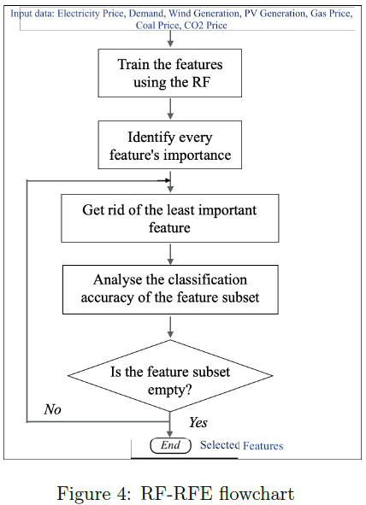
Literature Review
Traditional Approaches to Electricity Price Forecasting:
Short-term electricity price forecasting (EPF) has traditionally relied on statistical and econometric models (e.g., ARX, LASSO, regime-switching) frameworks
Machine learning and deep learning models improve performance by capturing nonlinear and volatile price dynamics
Feature Selection:
RF-RFE ranks feature importance using Random Forest and iteratively removes the least important features to select an informative subset
Based on: Ben Amor, S., Möbius, T., & Müsgens, F. (2024). Bridging an energy system model with an ensemble deep-learning approach for electricity price forecasting.
Machine Learning and Deep Learning Methods for Electricity Day-Ahead Price Forecasting

Slide 6
Literature Review
Limitations:
Purely data-driven models do not explicitly capture physical and economic market mechanisms
While hybrid approaches improve forecasting accuracy, they rely on complex energy system models and increased computational cost → limits scalability and practical deployment
Positioning of Our Project:
Aligns closely with the literature by adopting the same market (German EPEX SPOT), forecasting horizon (hourly day-ahead), and core price drivers
Acknowledges the limitations of purely data-driven models, as highlighted in recent hybrid electricity price forecasting studies
Focus on practical, scalable deep learning and boosting models
Machine Learning and Deep Learning Methods for Electricity Day-Ahead Price Forecasting

Slide 7
Data Overview
Machine Learning and Deep Learning Methods for Electricity Day-Ahead Price Forecasting

Slide 8
Data Overview
Time Range: Hourly electricity prices from January 1, 2019 to December 31, 2024
Target Variable:
Day-Ahead Electricity Price (EUR/MWH) from the German EPEX SPOT market
Raw Data Sources:
Bright Sky API → Weather data
Energy Charts API → power system and price data
Collected Variables:
Weather: precipitation, cloud cover, temperature, relative humidity
Power System:
Load: actual grid load (MW), recorded at the end of the following hour
CBET: total cross-border electricity trading (MW)
Market Price: day-ahead hourly electricity price (target variable)
Machine Learning and Deep Learning Methods for Electricity Day-Ahead Price Forecasting

Slide 9
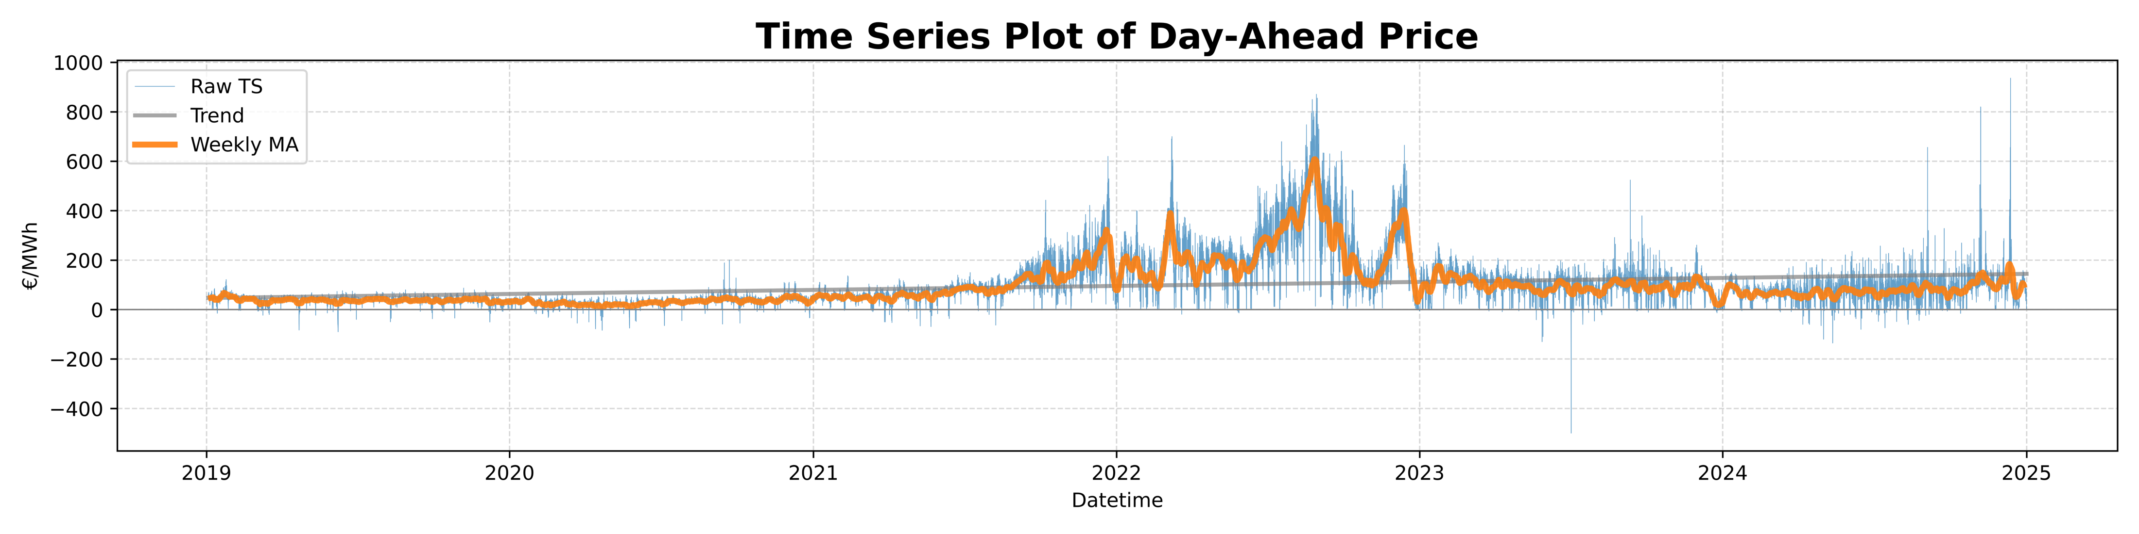
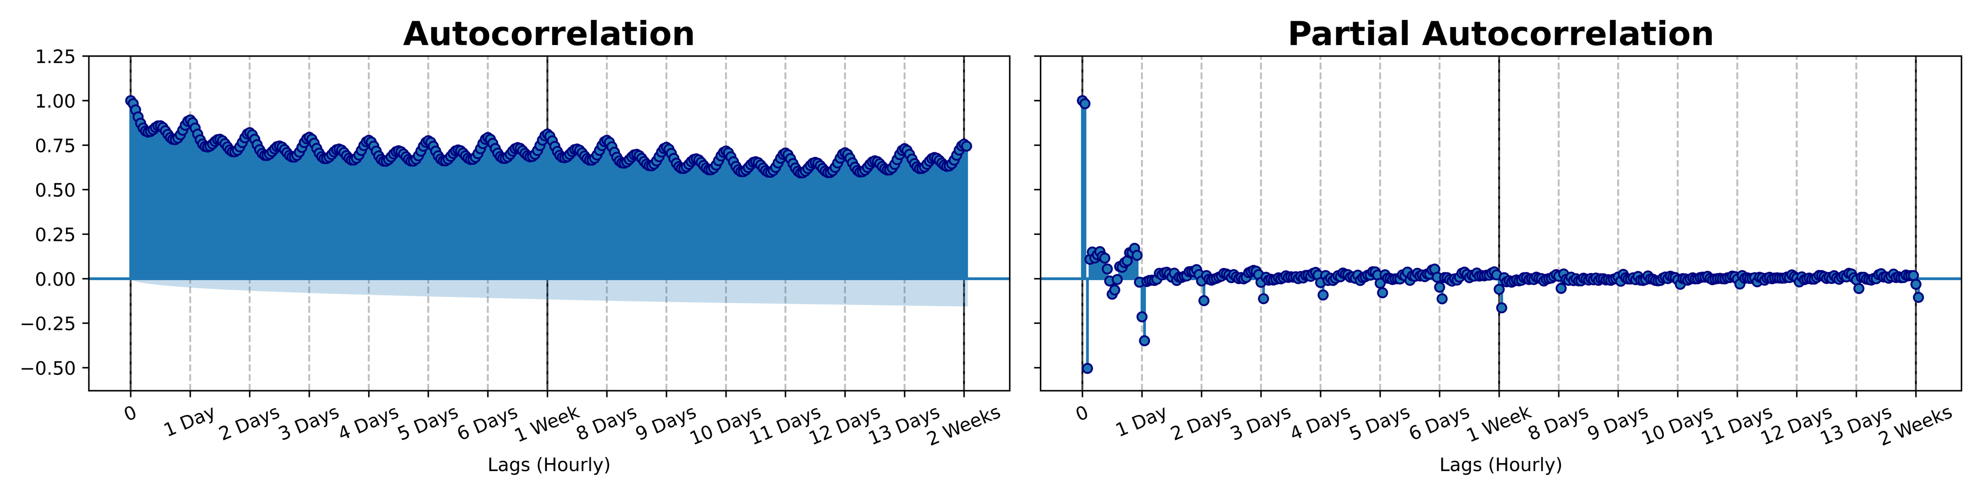
Data Overview
Day-ahead price is stationary
Clear periods of high volatility
Autocorrelation Function Plot (ACF):
Daily (24-hour) seasonality
Potential weekly (168-hour) seasonality
Partial Autocorrelation Function (PACF):
Daily seasonality diminishes after ~8 days
Weekly seasonality diminishes after ~2 weeks
Last day is most correlated
Last week is next most correlated
Machine Learning and Deep Learning Methods for Electricity Day-Ahead Price Forecasting

Slide 10
Approach
Preprocessing
Modeling
Machine Learning and Deep Learning Methods for Electricity Day-Ahead Price Forecasting

Slide 11
Preprocessing
Machine Learning and Deep Learning Methods for Electricity Day-Ahead Price Forecasting

Slide 12
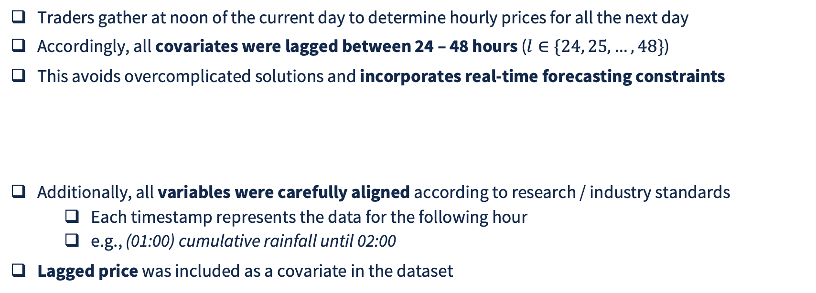
Feature Engineering
00:00
06:00
12:00
18:00
00:00
06:00
12:00
18:00
00:00
Traders gather at noon of the current day to determine hourly prices for all the next day
Accordingly, all covariates were lagged between 24 – 48 hours ($l∈\{24, 25,…,48\}$)
This avoids overcomplicated solutions and incorporates real-time forecasting constraints
Additionally, all variables were carefully aligned according to research / industry standards
Each timestamp represents the data for the following hour
e.g., (01:00) cumulative rainfall until 02:00
Lagged price was included as a covariate in the dataset
01:00
01:30
02:00
Machine Learning and Deep Learning Methods for Electricity Day-Ahead Price Forecasting

Slide 13
Recursive Feature Elimination (RFE)
Start
Feature set
Train model
Rank features by importance
Remove the two least importance features
End
CV RMSE decreases
Otherwise
Dimensionality reduction technique
Cycle recursively eliminates features based on internal model feature importance rankings
Light Gradient Boosting Machine (LGBM) with default hyperparameters was used for ranking
Cross-validation (CV) was used for stopping
2 splits
90% train, 10% test
Machine Learning and Deep Learning Methods for Electricity Day-Ahead Price Forecasting

Slide 14
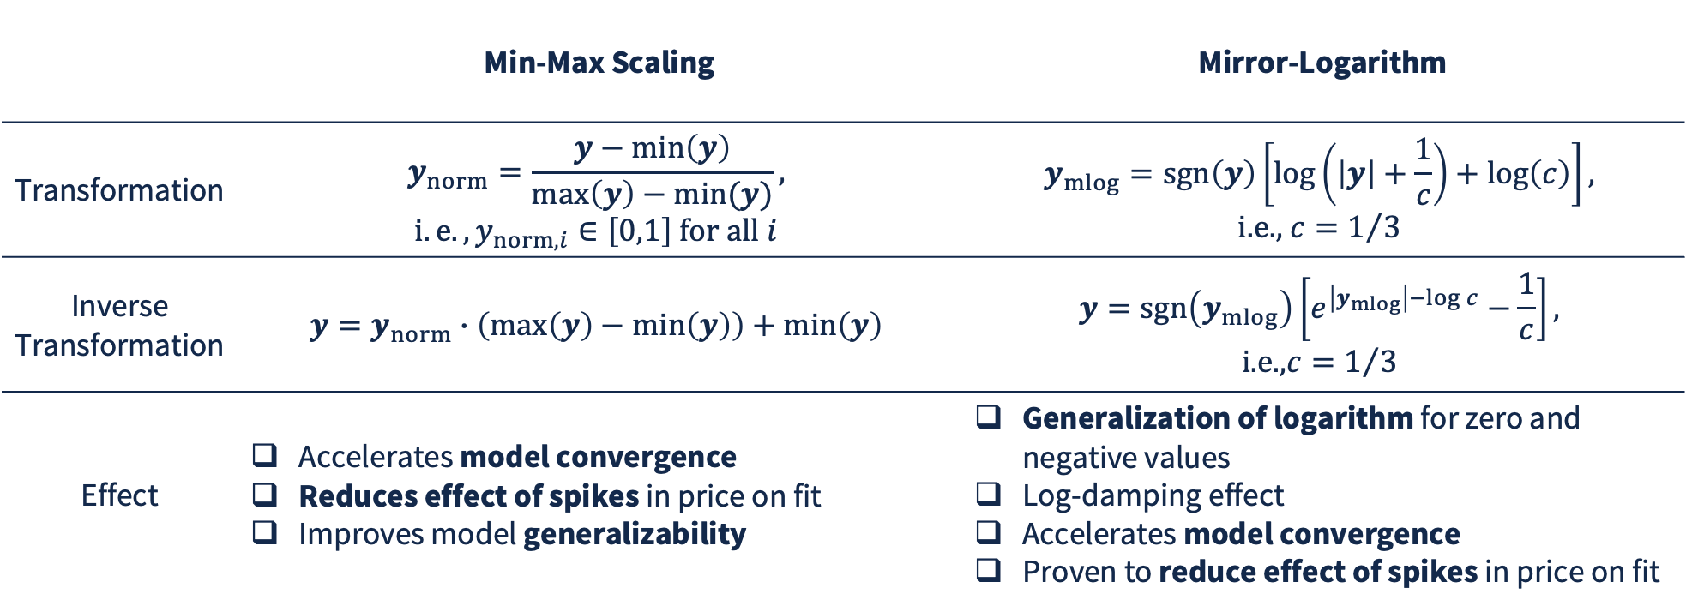
Target Transformations
 | Min-Max Scaling | Mirror-Logarithm
Transformation | $$y_{norm}=\frac{y−\min\left(y\right)}{\max\left(y\right)−min⁡(y)},$$ $$i.e., y_{norm, i}∈\left[0,1\right] \text{for} \text{all} i$$ | $$y_{mlog}=sgn⁡\left(y\right)\left[\text{log}\left(\left|y\right|+\frac{1}{c}\right)+\text{log}\left(c\right)\right],$$ $$\text{i}\text{.}\text{e}\text{., }c=1/3$$
Inverse Transformation | $$y=y_{norm}∙\left(\max\left(y\right)−\min\left(y\right)\right)+\min\left(y\right)$$ | $$y=\operatorname{sgn}\left(y_{mlog}\right)\left[e^{\left|y_{mlog}\right|−\log{c}}−\frac{1}{c}\right],$$ $$\text{i}\text{.}\text{e}\text{.,} c=1/3$$
Effect | Accelerates model convergence Reduces effect of spikes in price on fit Improves model generalizability | Generalization of logarithm for zero and negative values Log-damping effect Accelerates model convergence Proven to reduce effect of spikes in price on fit
Machine Learning and Deep Learning Methods for Electricity Day-Ahead Price Forecasting

Slide 15
Train-Validation-Test Split
Train-Validation Set
Test Set
Validation Set
Fold 1 Train Set
Val.
Fold 2 Train Set
Val.
3-fold CV
Fold 3 Train Set
Val.
72% – 18% – 10% split (train – validation – test)
3-fold temporal CV for hyperparameter optimization
Rolling window method:
Preserves time order
Prevents data leakage during CV
Machine Learning and Deep Learning Methods for Electricity Day-Ahead Price Forecasting

Slide 16
Modeling
Machine Learning and Deep Learning Methods for Electricity Day-Ahead Price Forecasting

Slide 17
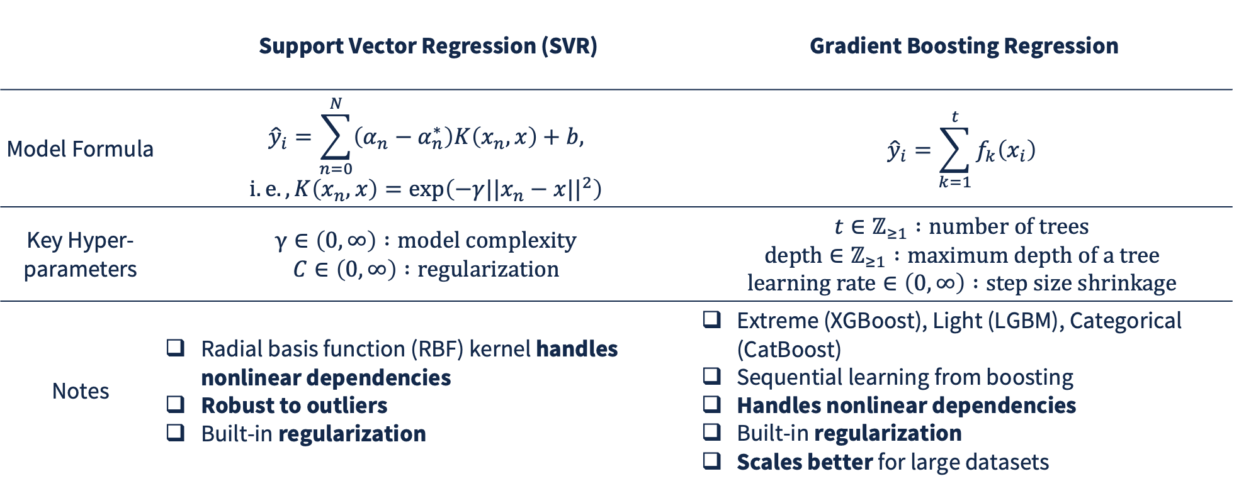
Machine Learning Models
 | Support Vector Regression (SVR) | Gradient Boosting Regression
Model Formula | $${\hat{y}}_{i}=\sum_{n=0}^{N}{\left(α_{n}−α_{n}^{∗}\right)K\left(x_{n},x\right)}+b,$$ $$i.e.,K\left(x_{n},x\right)=\text{exp}\left(−γ||x_{n}−x||^{2}\right)$$ | $${\hat{y}}_{i}=\sum_{k=1}^{t}{f_{k}\left(x_{i}\right)}$$
Key Hyper-parameters | $$γ∈\left(0,∞\right) :model complexity$$ $$C∈\left(0,∞\right) :regularization$$ | $$t∈ℤ_{≥1} :number of trees$$ $$\text{depth}∈ℤ_{≥1} :\text{maximum} \text{depth} \text{of} \text{a} \text{tree}$$ $$\text{learning} \text{rate}∈\left(0,∞\right) :\text{step} \text{size} \text{shrinkage}$$
Notes | Radial basis function (RBF) kernel handles nonlinear dependencies Robust to outliers Built-in regularization | Extreme (XGBoost), Light (LGBM), Categorical (CatBoost) Sequential learning from boosting Handles nonlinear dependencies Built-in regularization Scales better for large datasets
Machine Learning and Deep Learning Methods for Electricity Day-Ahead Price Forecasting
Notes:
Note from Prof: don’t go too in-depth into model explanations

Slide 18
Deep Learning Models
Long Short-Term Memory (LSTM) Model | Gated Recurrent Unit (GRU) Model | Convolutional Neural Network (CNN) + LSTM Model
3 gates per cell: input, forget, output Good for long temporal dependencies Captures nonlinear relationships | 2 gates per cell: update, reset Simplified LSTM Faster training & fewer parameters Good for moderately-long temporal dependencies | Compress / extract local patterns before LSTM Capture short-term temporal dependencies (CNN) alongside long-term ones (LSTM)
Simplified process within an LSTM cell | Simplified process within a GRU cell | Simplified process within a 1D CNN layer
w₁ | w₂ | w₃
X
+
X
+
tanh
X
X
X
-1
X
x₁ | x₂ | x₃ | x₄ | … | … | … | … | x_{p}
sig
sig
sig
tanh
sig
sig
tanh
c₁ | c₂ | c₃ | c₄ | … | c_{s}
Machine Learning and Deep Learning Methods for Electricity Day-Ahead Price Forecasting

Slide 19
Hyperparameter Tuning
 | Grid Search CV | Random Search CV | Bayesian Optimization (BO) CV + Early Stopping
Notes | Inefficient for large, high dimensional search spaces Iteratively develop accurate search ranges for future BO on SVR | Inefficient for large, high-dimensional search spaces Iteratively develop accurate search ranges for future BO on boosted models | Tree-structured Parzen Estimator (TPE) as sampler Supports many types of spaces Non-parametric & directly models good / bad regions Hyperband as pruner Reduces runtime drastically Reduces wasteful trials
Models Tuned | SVR | XGBoost, LGBM, CatBoost | SVR, XGBoost, LGBM, CatBoost, LSTM, GRU, CNN-LSTM
Machine Learning and Deep Learning Methods for Electricity Day-Ahead Price Forecasting

Slide 20
Findings
Reduced Dataset
Effect of Target Transformations
Model Evaluations
Machine Learning and Deep Learning Methods for Electricity Day-Ahead Price Forecasting

Slide 21
Reduced Dataset
Covariate | Lags (Hourly) | Units
Price | 24, 31, 37, 41, 43, 45, 47, 48 | € / MWh
Temperature | 24, 28, 33, 40, 46 | ºC
Humidity | 29, 36, 48 | %
Load | 24, 28, 30, 34, 36, 42, 48 | MW
CBET | 24, 28, 32, 36, 43, 48 | GW
29 total covariates
Machine Learning and Deep Learning Methods for Electricity Day-Ahead Price Forecasting

Slide 22
Effect of Target Transformations
Min-Max Scaling | Mirror-Logarithm
Reduces effect of high variances price periods on model fit Faster model convergence (especially for complex neural network models) Stable gradients during neural network training | Explosion of several point transformations Unsure origin, but likely due to floating point error Rendered unusable for modeling
Min-Max scaling was chosen as the target transformation method
Machine Learning and Deep Learning Methods for Electricity Day-Ahead Price Forecasting

Slide 23
Model Evaluations
Machine Learning and Deep Learning Methods for Electricity Day-Ahead Price Forecasting

Slide 24
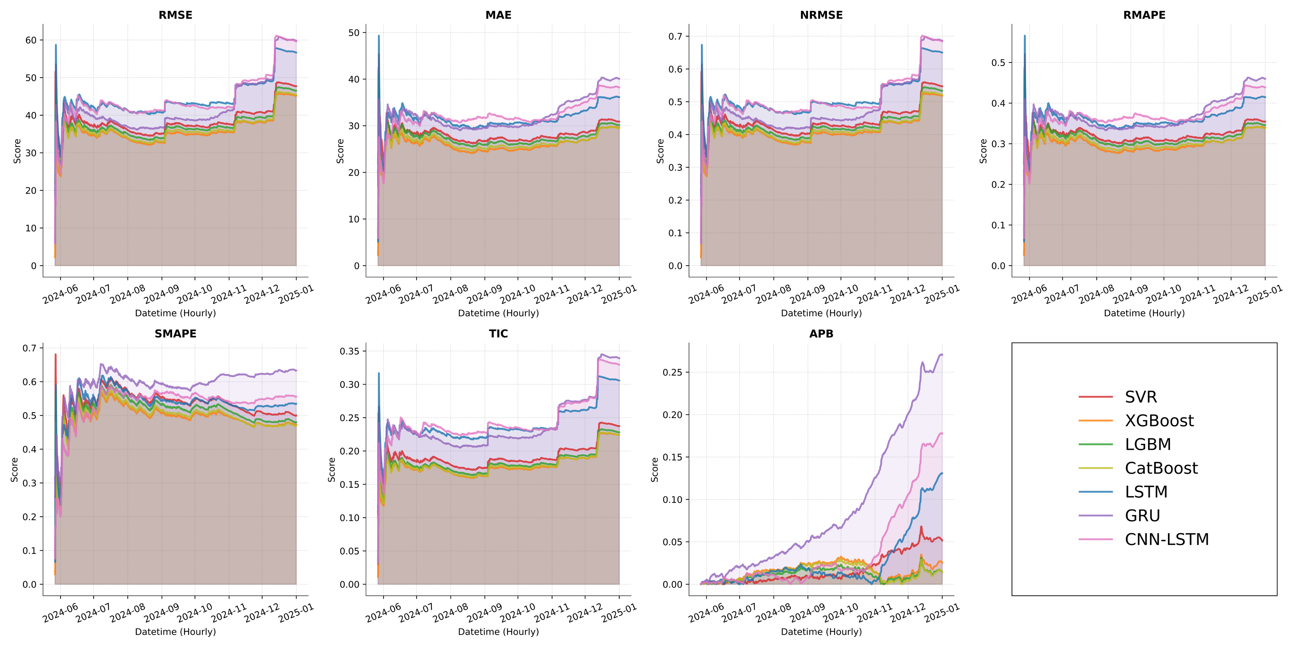
Bias Evaluations
Accumulative bias metrics on test set:
Descending order of average bias: ANNs, SVR, boosting
Similar metric scores among boosted models, with XGBoost often showing best performance
Sections of high price volatility causing spikes in bias over time across all models
Volatility spikes are higher for ANNs
Machine Learning and Deep Learning Methods for Electricity Day-Ahead Price Forecasting
Notes:
Note from Prof: try to reduce text on this slide

Slide 25
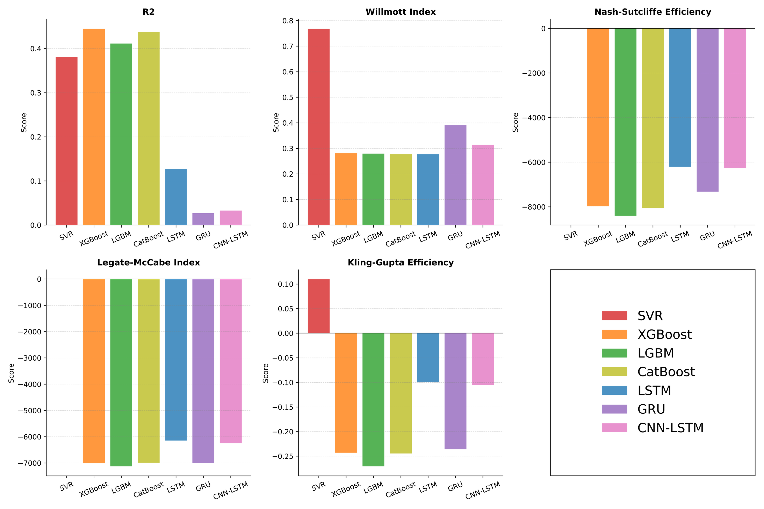
Variance Evaluations
Overall variance metrics on test set:
XGBoost has best R², although comparable to other boosted models
SVR accounts for most variance in all metrics other than R² by far
Both SVR and boosted models tend to follow inherent variance structure moderately well in the test set
ANN models capture least amount of variance structure in the test set
Deep learning models tend to underestimate spikes in price, causing them to lose predictive power during volatile periods.
Machine Learning and Deep Learning Methods for Electricity Day-Ahead Price Forecasting

Slide 26
Discussion
Strengths
Limitations
Future Work
Machine Learning and Deep Learning Methods for Electricity Day-Ahead Price Forecasting

Slide 27
Strengths
Well-Designed Data Pipeline
Applied consistent preprocessing, including mirror-log transformation and Min–Max normalization, reducing volatility and stabilize model training.
Structured Feature Engineering
Applied systematic feature selection using LGBM to eliminate redundant inputs and streamline the modeling dataset.
Verified that all engineered features adhered to the day-ahead auction timing (no look-ahead leakage).
Robust and Fair Model Comparison
Used rolling-window evaluation to simulate real forecasting conditions and reduce overfitting.
Evaluated seven distinct modeling approaches under the same preprocessing and validation framework.
Machine Learning and Deep Learning Methods for Electricity Day-Ahead Price Forecasting

Slide 28
Limitations
Limited Covariates:
Dataset includes only weather variables, grid load, and cross-border flows (CBET)
Modeling Limitations:
Limited hyperparameter optimization for deep networks due to time and compute constraints
Feature Engineering Limitations:
Lag features capture short term patterns but miss long-range structure (lack of weekly, monthly, yearly seasonality)
Evaluation & Validation Limitations:
Rolling validation depth is limited, validation folds do not span all major structural changes (COVID, energy crisis, Russia-Ukraine conflict)
Lack of regime-specific evaluation, models are not separately evaluated under normal, volatile, and extreme-price conditions
Machine Learning and Deep Learning Methods for Electricity Day-Ahead Price Forecasting

Slide 29
Future Work
Broaden Covariates:
Add fuel prices, CO₂ prices, average solar radiation, and wind speed
Include market sentiment or macroeconomic indicators that affect energy demand
Adopt More Advanced Temporal Models:
Explore Transformer-Based Architectures (e.g., Informer, Temporal Fusion transformer)
Explore multi-resolution models combining hourly, daily, weekly and seasonal patterns
Enhance Data Transformations:
Use dynamic scaling windows (e.g., rolling normalization) to reduce distribution shifts
Model price differences or returns rather than absolute prices to reduce non-stationary
Incorporate Signal Processing:
Include signal decomposition techniques (e.g., Empirical Mode Decomposition, Variational Mode Decomposition) into the data processing pipeline
Forecast decomposed signals separately and recombine to produce the final forecast
Machine Learning and Deep Learning Methods for Electricity Day-Ahead Price Forecasting

Slide 30
Appendix
Machine Learning and Deep Learning Methods for Electricity Day-Ahead Price Forecasting

Slide 31
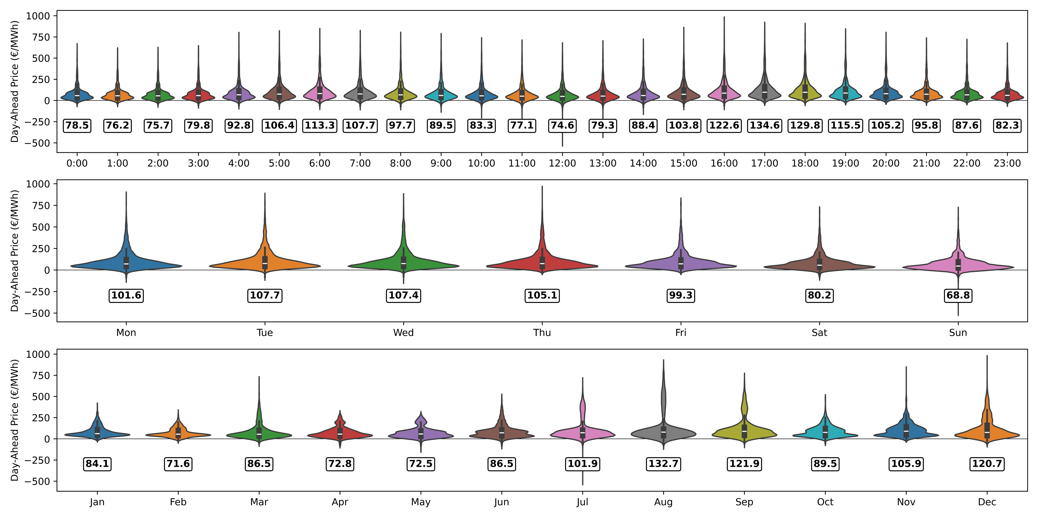
Data Overview
Hourly:
No strong differences
Slightly higher prices in evening time
Daily:
Little to no difference in price distribution
Monthly:
Small differences in distribution by month
Greatest variability in Summer & Winter
Machine Learning and Deep Learning Methods for Electricity Day-Ahead Price Forecasting

Slide 32
Thank You!
Questions?
Machine Learning and Deep Learning Methods for Electricity Day-Ahead Price Forecasting

Slide 33

Illinois Blue

