Slide 1
Analysis of Total Daily Revenue at the iHotel
STAT 429
Benjamin Leidig, Harmony Pham, Monte Thomas

Slide 2
Introduction

Slide 3
Background
iHotel - University of Illinois and Research Park: 125 rooms and 70,000+ ft² of event space
Occupancy Rate (2024): 82% | U.S. average: 65.1% | Chicago: 67.6%
Room rates:
Average: $162 / night
High season: $425 (full deposit 60 days prior)
Low season: $80
GR3 | Benjamin Leidig | Harmony Pham | Monte Thomas

Slide 4
Research Goal
Main Objective: Develop a reliable time series forecasting model to predict daily hotel revenue at iHotel
Purpose:
Support operational planning, pricing strategies, and resource allocation
Provide actionable short-term revenue forecasts for hotel management
Approach: Use historical revenue data to capture key patterns
Trends
Weekly seasonality
Volatility and demand spikes
GR3 | Benjamin Leidig | Harmony Pham | Monte Thomas

Slide 5
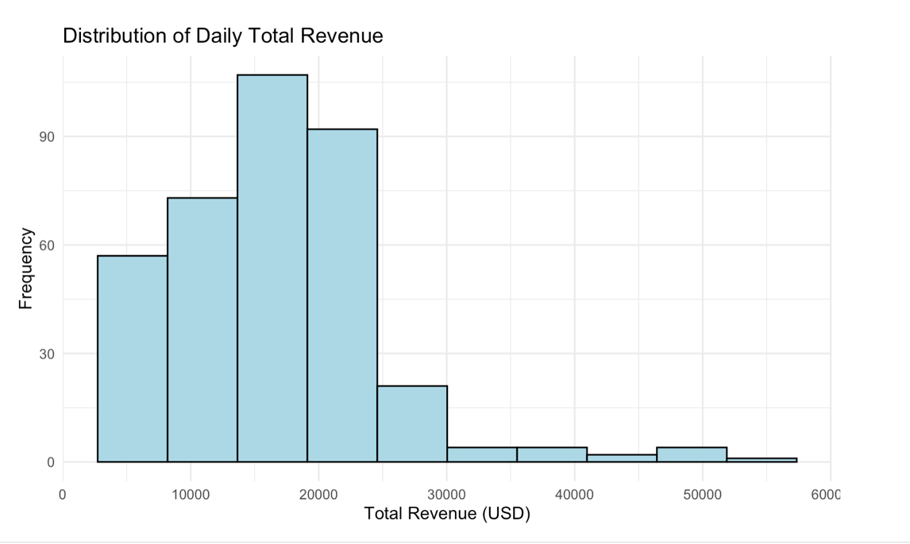
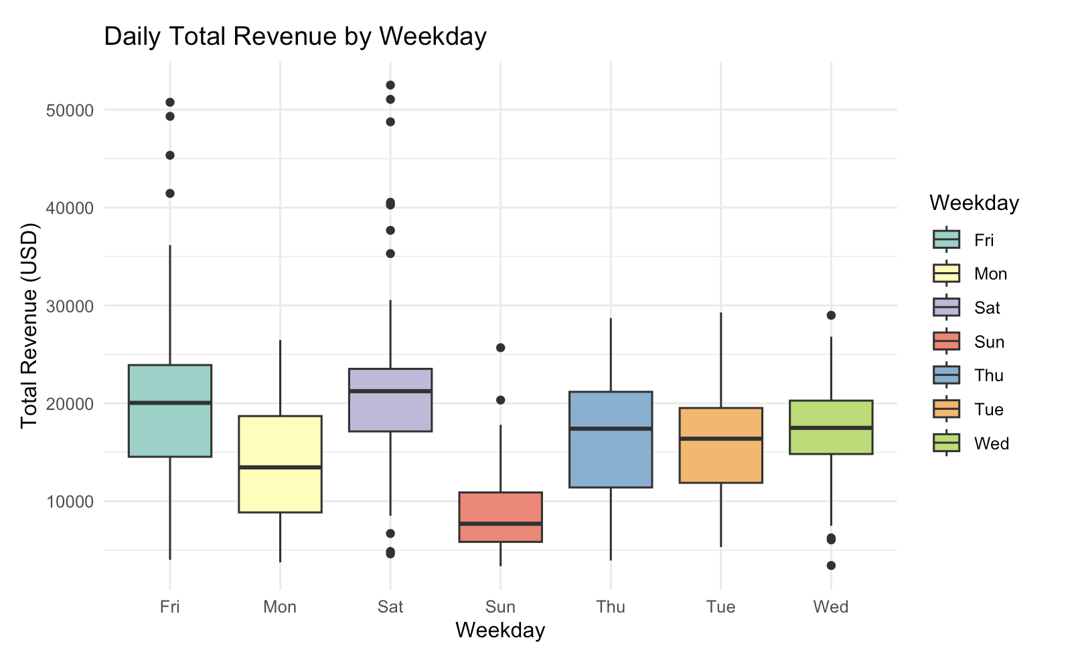
Dataset Overview
Data: 365 daily revenue values
(Mar 28, 2024 – Mar 27, 2025)
Key Stats:
Mean: $16,466 | Median: $16,688
Range: $3,364 – $52,518
Right-skewed distribution
Strong weekly seasonality
GR3 | Benjamin Leidig | Harmony Pham | Monte Thomas

Slide 6
Approach
Examine nature of time series
Model screening
Residual analysis
Forecast five future models
Use GARCH to model heteroskedasticity
GR3 | Benjamin Leidig | Harmony Pham | Monte Thomas

Slide 7
Analysis

Slide 8
Simple Methods
Seasonal Autoregressive Integrated Moving Average

Slide 9
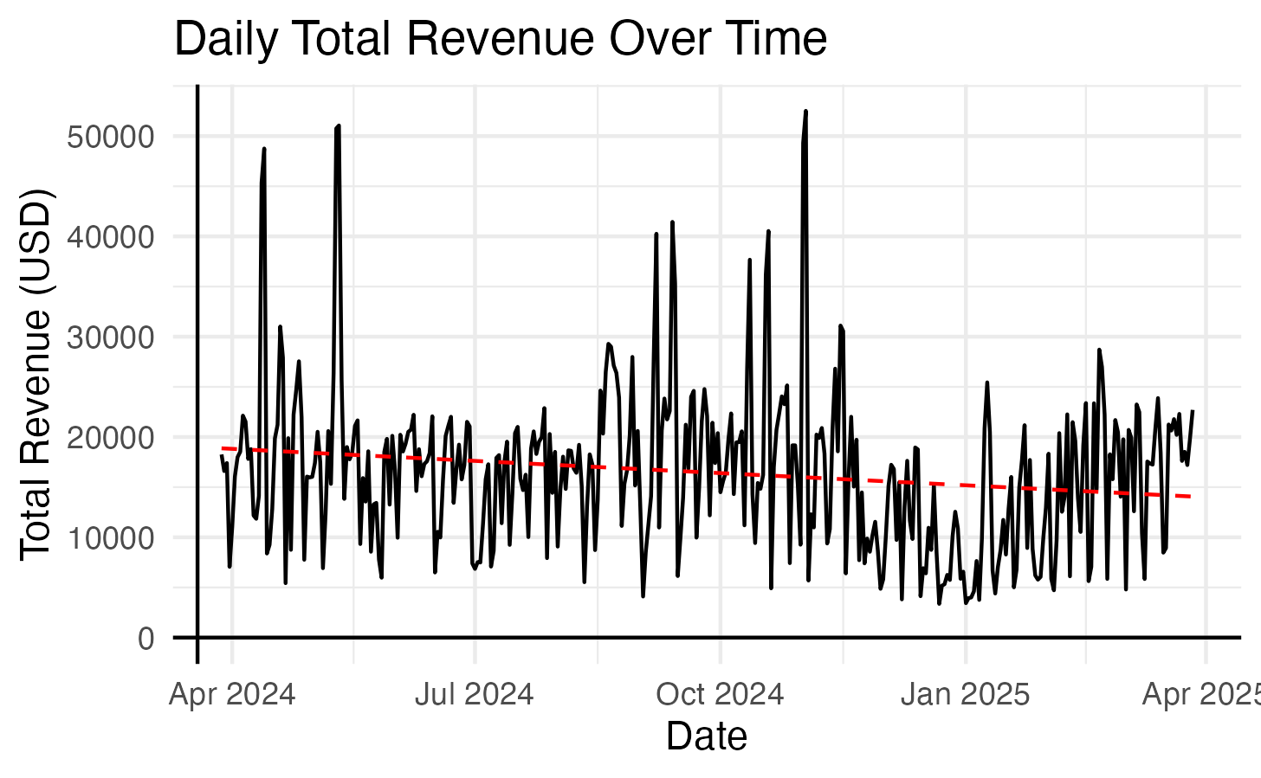
Descriptive Overview
Constant mean
Non-constant variance
Potential seasonality
ADF p-value of 0.01
Conclude stationarity
No differencing ( d = 0 )
GR3 | Benjamin Leidig | Harmony Pham | Monte Thomas

Slide 10
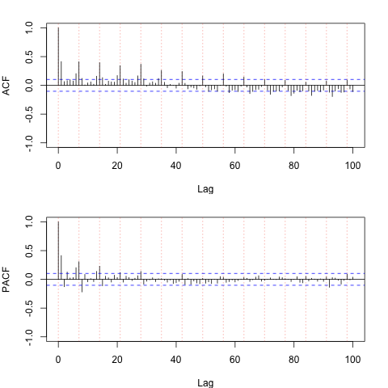
Interpretation of ACF & PACF
Significant spikes at multiples of 7
Seasonal lags tails off for ACF & PACF
No seasonal persistence ( D = 0 )
Non-seasonal interpretations:
ACF & PACF tail off
or
ACF cuts out after lag 1, PACF tails off
GR3 | Benjamin Leidig | Harmony Pham | Monte Thomas

Slide 11
Model Screening
Fit many models of different orders
Rejected models with insignificant parameters
Selected lowest AIC / AICc / BIC model
SARMA( (1, 2) × (1, 1) ₇ )
Comparative Model Performance
Rank | Orders | AIC | AICc | BIC
1 | (1,2)×(1,1)₇ | 20.28 | 20.28 | 20.36
2 | (0,1)×(1,1)₇ | 20.31 | 20.31 | 20.37
3 | (1,1)×(1,1)₇ | 20.31 | 20.31 | 20.37
GR3 | Benjamin Leidig | Harmony Pham | Monte Thomas

Slide 12
Final Model
Parameter | Estimate | SE | t-value | p-value
φ | 0.9699 | 0.02 | 48.96 | ≈ 0
θ₁ | -0.4487 | 0.05 | -8.65 | ≈ 0
θ₂ | -0.4131 | 0.05 | -8.60 | ≈ 0
Φ | 0.9983 | 0.003 | 289.50 | ≈ 0
Θ | -0.9583 | 0.04 | -23.87 | ≈ 0
GR3 | Benjamin Leidig | Harmony Pham | Monte Thomas

Slide 13
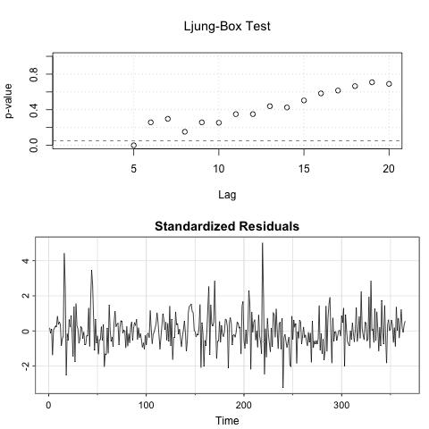
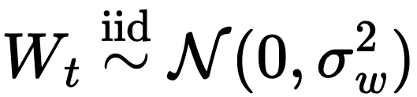
Residual Analysis
Ljung-Box test generally > 0.05
Uncorrelated errors
Constant zero mean of residuals
ADF test p-value < 0.05
Constance of variance
Residuals are WN ~ iid N(0, σ²_{w})
GR3 | Benjamin Leidig | Harmony Pham | Monte Thomas

Slide 14
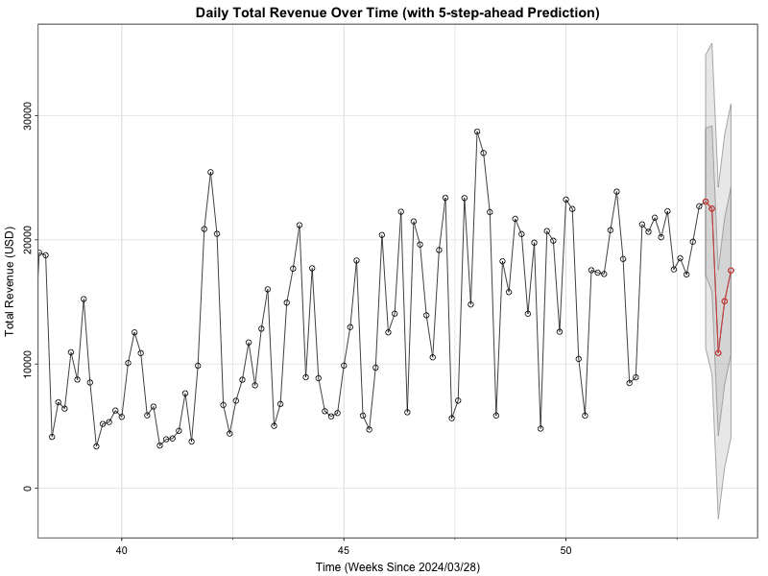
Forecasting
Forecasting Results
Date | Forecast | SE
2025/03/28 | $23,079.84 | 5,905.31
2025/03/29 | $22,511.09 | 6,659.04
2025/03/30 | $10,885.84 | 6,681.28
2025/03/31 | $15,057.93 | 6,702.13
2025/04/01 | $17,524.90 | 6,721.68
GR3 | Benjamin Leidig | Harmony Pham | Monte Thomas

Slide 15
Advanced Methods
Generalized Autoregressive Conditional Heteroskedasticity

Slide 16
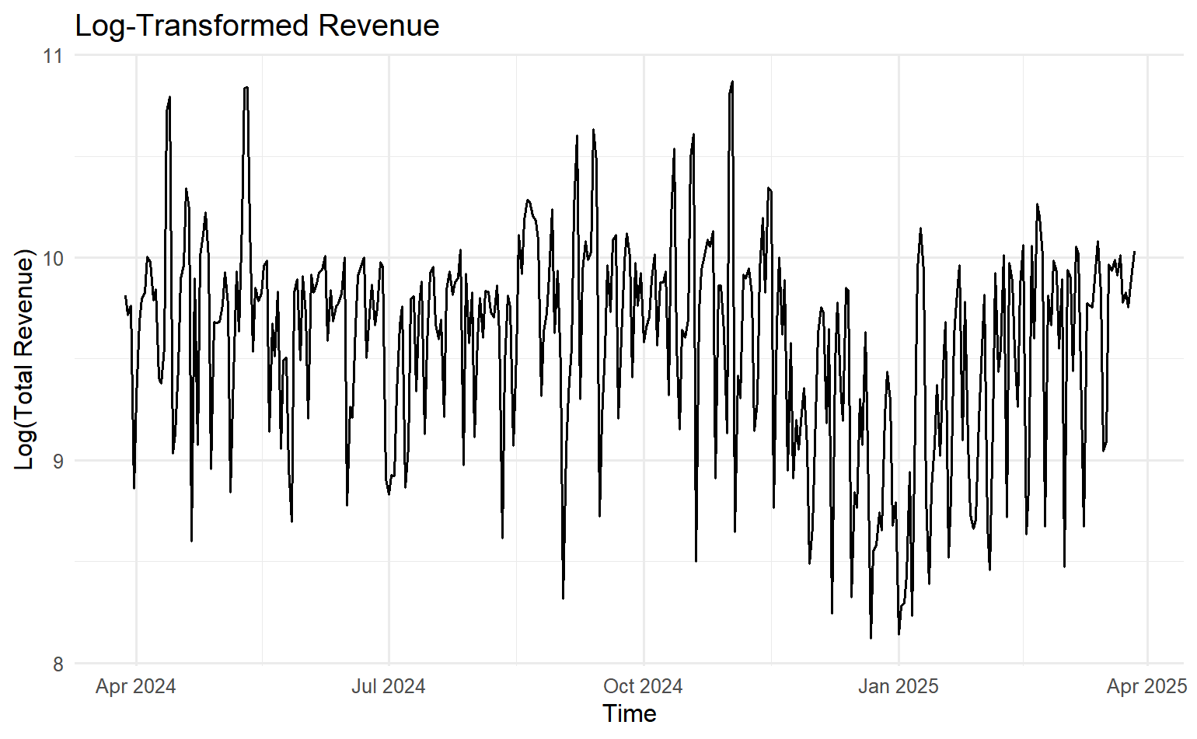
GARCH Visualization
Large Spikes
Stabilize Variance
Transformation
Volatility Clustering
GR3 | Benjamin Leidig | Harmony Pham | Monte Thomas

Slide 17
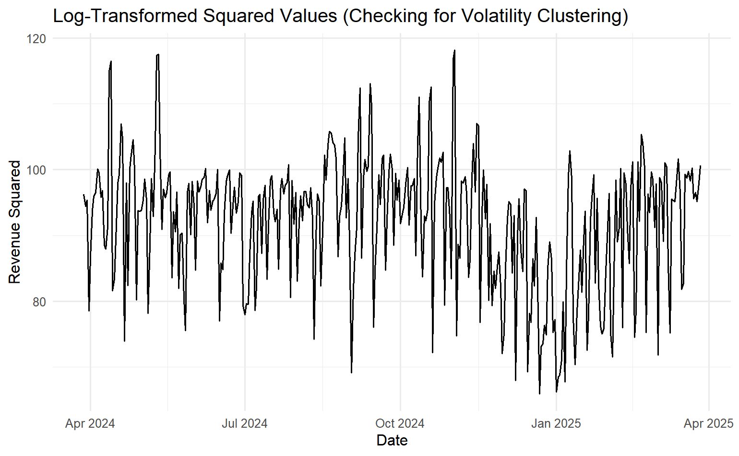
Volatility Clustering
GARCH Motivation
Conditional Variance
Volatility Clusters
Revenue Spikes
GR3 | Benjamin Leidig | Harmony Pham | Monte Thomas

Slide 18
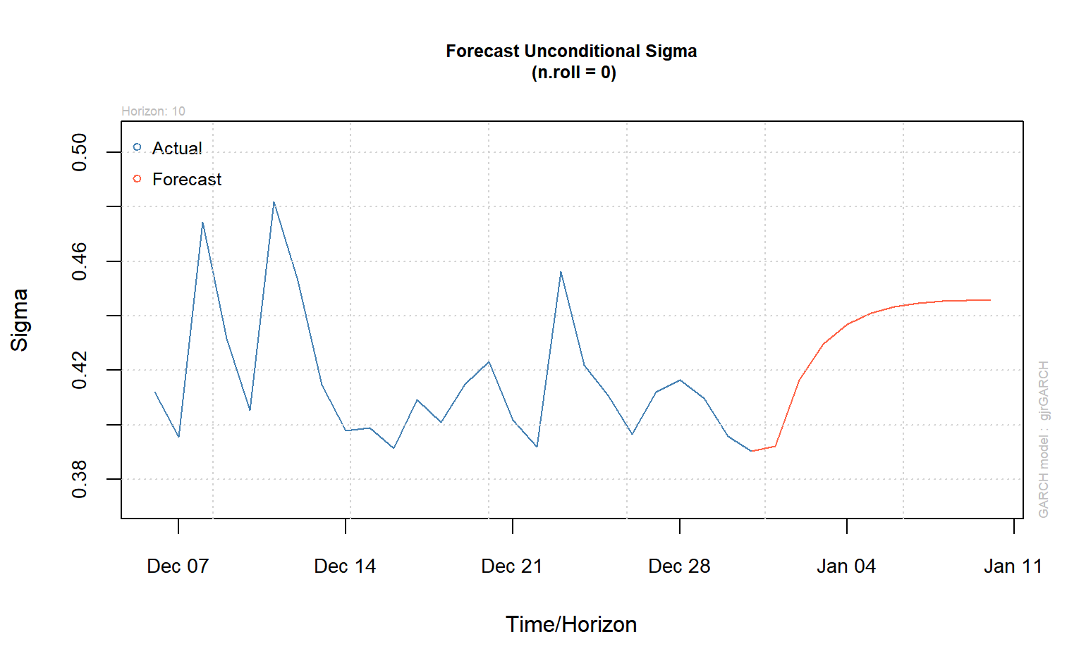
GARCH Forecasting
Volatility Forecast
Conditional Sigma
Future Risk
GJR-GARCH
GR3 | Benjamin Leidig | Harmony Pham | Monte Thomas

Slide 19
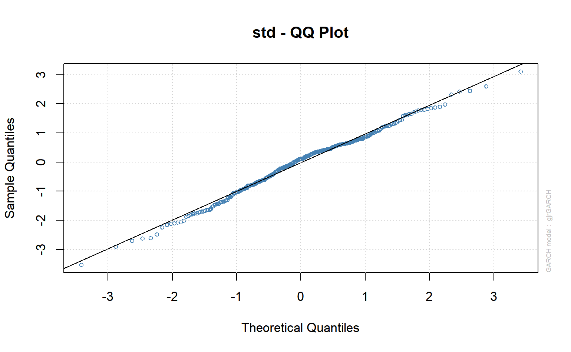
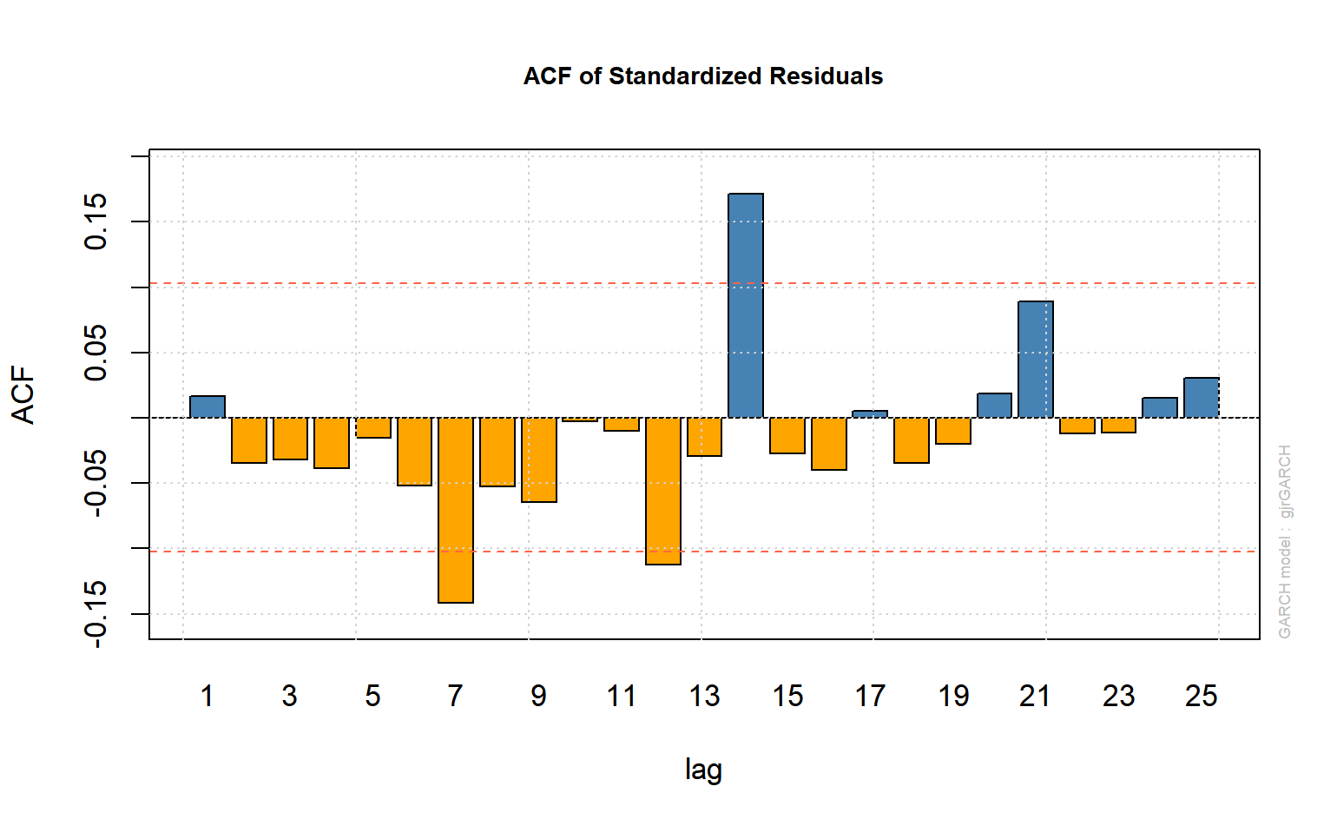
GARCH Diagnostic Plots
GR3 | Benjamin Leidig | Harmony Pham | Monte Thomas

Slide 20
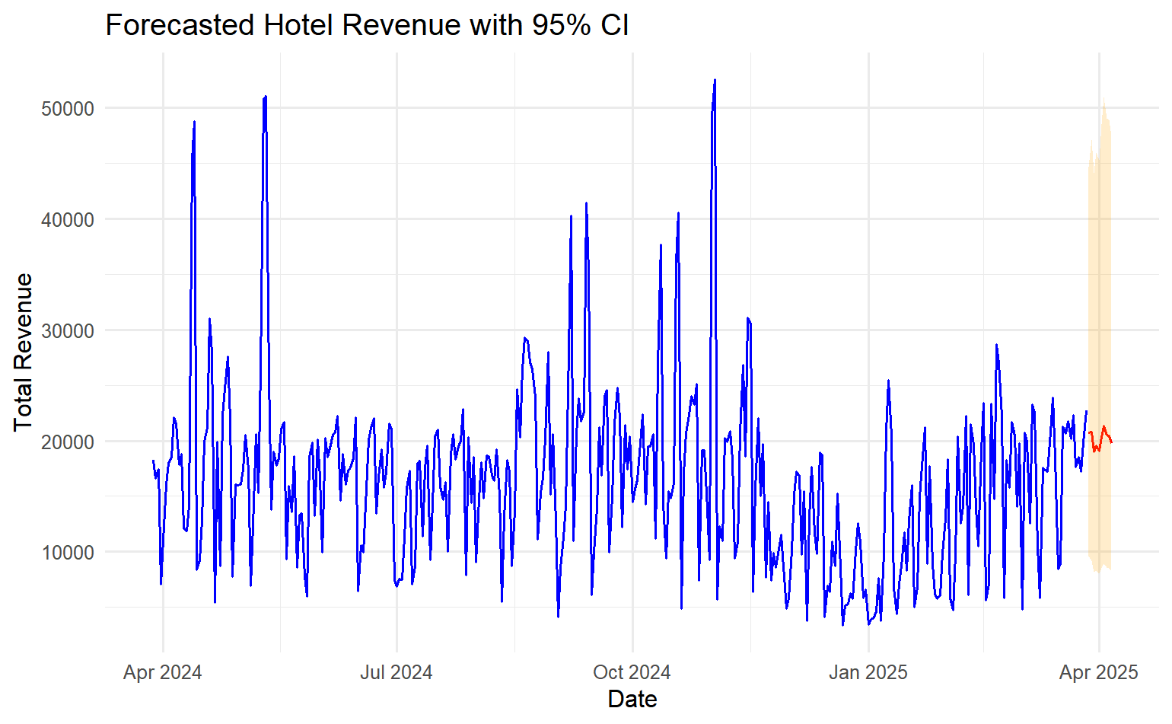
GARCH Forecast Visualization
Revenue Forecast
95% Confidence
Uncertainty
Future Trends
GR3 | Benjamin Leidig | Harmony Pham | Monte Thomas

Slide 21
Discussion

Slide 22
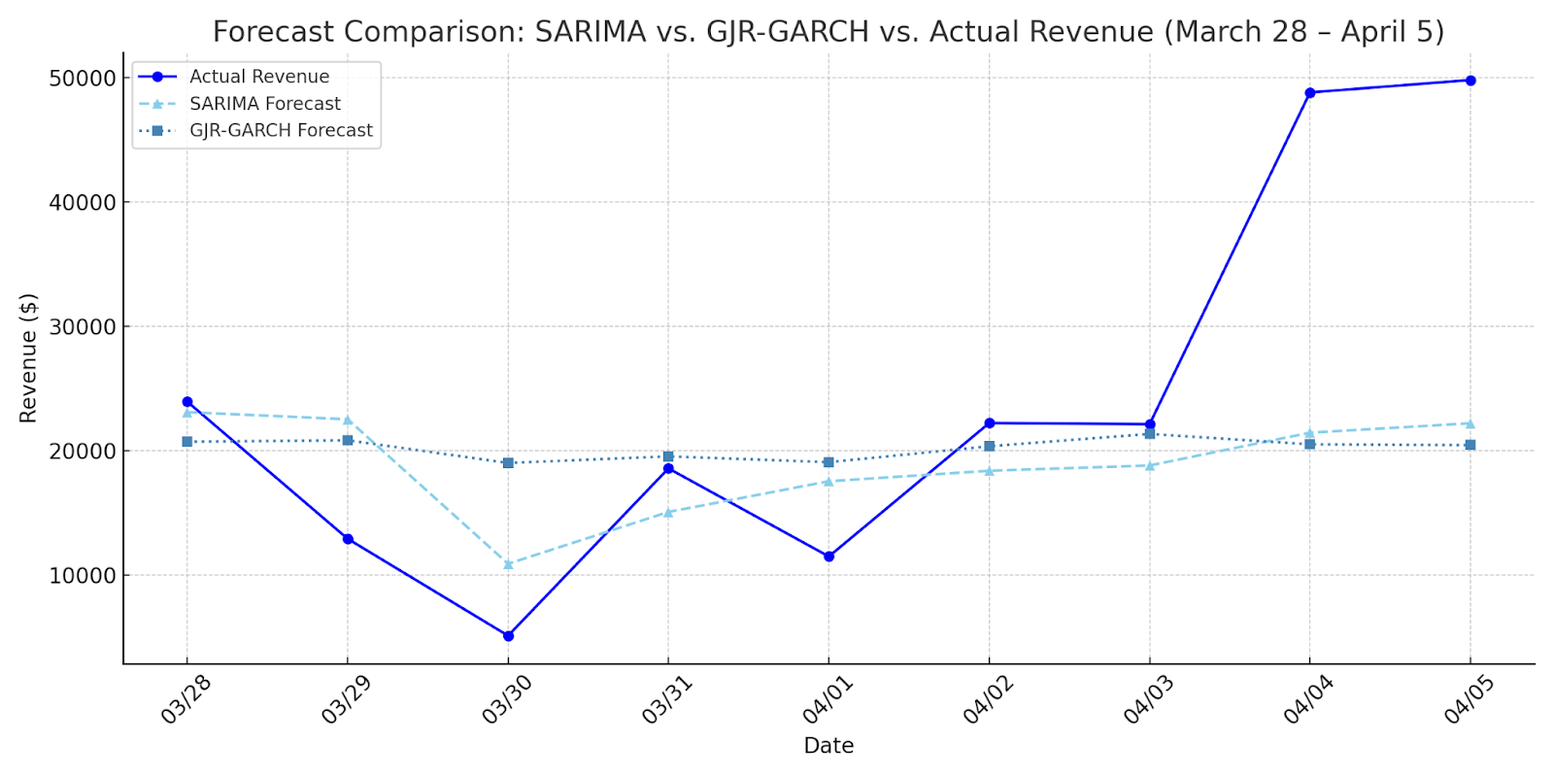
Model Evaluation
SARMA((1,2) × (1,1)₇):
Captured trend & 7-day seasonality
Strong fit, no residual autocorrelation
Underperformed on high-revenue spikes
GJR-GARCH(1,1)-AR(7):
Modeled volatility & heavy tails
Passed diagnostics (sign bias, autocorr.)
Better at forecasting revenue shocks
GR3 | Benjamin Leidig | Harmony Pham | Monte Thomas

Slide 23
Model Comparison
Feature | SARMA((1,2) × (1,1)₇) | GJR-GARCH(1,1)
Strengths | Captures weekly trend & short-term patterns | Models volatility & uncertainty effectively
Weaknesses | Underestimates revenue spikes | Slight underprediction at peaks
High-Demand Days (Apr 4–5) | Missed spikes ($48,798 & $49,795 actual) | Captured within wide prediction intervals
Forecast Range | $10,592 – $23,080 (95% CI: –$2,803 – $35,563) | $18,996 – $21,331 (95% CI: $8,028 – $50,996)
Prediction Intervals | Narrow; missed extremes | Wide; covered true values
Best Use Case | Stable periods & regular demand | Volatile periods & sudden demand changes
GR3 | Benjamin Leidig | Harmony Pham | Monte Thomas

Slide 24
Limitations
Limited Variable Scope
Only total daily revenue was modeled
Key variables like ADR, occupancy rate, special events, and holidays were excluded
Limits the model's ability to account for external demand drivers
Short Time Frame
Dataset covers only one year (365 days)
Inadequate for detecting long-term patterns
No Out-of-Sample Validation
Model was evaluated only on in-sample data
Reduces confidence in its ability to generalize to new, unseen periods
Forecast reliability under different conditions remains untested
GR3 | Benjamin Leidig | Harmony Pham | Monte Thomas

Slide 25
Conclusion
SARMA: Best for trend and stable periods
GARCH: Best for capturing volatility in demand
Future works:
Combine both or explore SARIMAX/Prophet for better accuracy
Data Collection:
Collect at least 3–5 years of historical daily revenue data
Add event calendars: university events, holidays, local festivals, game days
Break down total revenue by purposes: conference, walk-in, holiday, …
GR3 | Benjamin Leidig | Harmony Pham | Monte Thomas

Slide 26
Thank You

Slide 27
References
Shumway, R. H., & Stoffer, D. S. (2000). Time series analysis and its applications. Springer.
Taylor, S. J., & Letham, B. (2017). Forecasting at scale. PeerJ Preprints. https://doi.org/10.7287/peerj.preprints.3190v2
HospitalityNet. (2024, March 11). STR: U.S. hotel results for week ending 2 March. HospitalityNet. https://www.hospitalitynet.org/news/4127014.html
iHotel & Conference Center. (2025). iHotel and Illinois Conference Center. https://stayatthei.com/
Saputra, M. W. N., Adikara, I. N. G., & Wirawan, D. G. A. (2023). Forecasting hotel occupancy rates in Bali province using the SARIMAX method with tourist data as an exogenous variable. ResearchGate. https://www.researchgate.net/publication/385675519
Srivastava, P., Chandrakala, D. P., & Suresh, N. (2022). GARCH model for determining COVID-19 pandemic effect on hospitality stock returns. In Proceedings of the 2nd Indian International Conference on Industrial Engineering and Operations Management (pp. 970–973).
Ampountolas, A. (2021). Modeling and forecasting daily hotel demand: A comparison based on SARIMAX, neural networks, and GARCH models. Forecasting, 3(3), 580–595. https://doi.org/10.3390/forecast3030037
Tang, J., Ramos, V., Cang, S., & Sriboonchitta, S. (2017). An empirical study of inbound tourism demand in China: A copula-GARCH approach. Journal of Travel & Tourism Marketing, 34(9), 1235–1246. https://doi.org/10.1080/10548408.2017.1330726
GR3 | Benjamin Leidig | Harmony Pham | Monte Thomas

