Slide 1

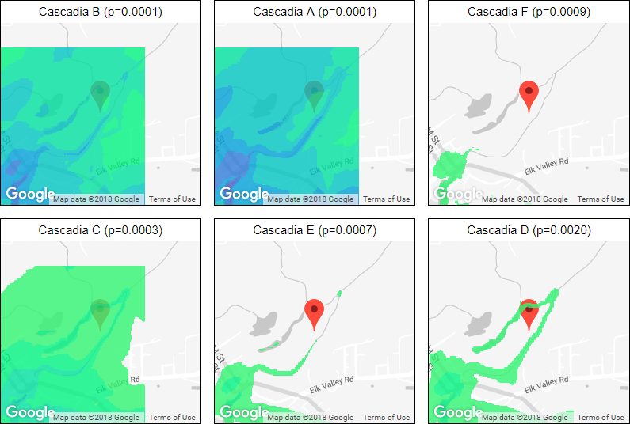
Tsunami Inundation Maps
Brian de Silva, Kellie MacPhee, Abe Engel, Benjamin Liu
Background
Approach
Results
Coastal cities along the west coast are susceptible to damage caused by tsunamis. In order to improve tsunami preparedness, researchers use numerical simulations to predict the impact of tsunamis caused by different seismological events. Researchers at the University of Washington model the impact of tsunamis on Crescent City, a coastal city in California which has a history of extreme damage from tsunamis. By estimating the probability of occurrence of each simulated tsunami, the annual probability of exceeding a given level of inundation (flooding) can be estimated for every point in the landscape, giving rise to a hazard map. There are multiple sources of uncertainty that feed into hazard maps:
Estimation of the annual likelihood of seismic events
Error in the numerical simulation of tsunamis
Variance due to the relatively small number of events
Error due to the assumption that the seismic events are independent
Furthermore, the hazard maps plot complicated hazard functions at every point, which describes the probability of inundation at every depth. Properly interpreting this map can be difficult for people without a technical background.
Text
Text
Flipbook
Text
Future Work
Text
Problem
Small Multiples
Our project seeks to address the following problems:
Hazard maps and the data used to produce them contain multiple sources of uncertainty. It is challenging to communicate this uncertainty alongside or as part of hazard maps in an intuitive way.
Hazard maps are inherently complex and nuanced and can therefore be difficult for non-experts to decipher.
We use small multiples to convey that there are many possible scenarios.
Figure 1. Small multiples of flooding under simulated tsunamis. Colors indicate shallow flooding (green) to deep flooding (purple).
References
[3] Edward Segel and Jeffrey Heer. Narrative visualization: Telling stories with data. IEEE transactions on visualization and computer graphics, 16(6):1139–1148, 2010.
Narrative
To make the visualizations more digestible we embed them within a larger narrative structure. In particular, we adopt the “magazine style” approach of Segel and Heer [3].

