Slide 1

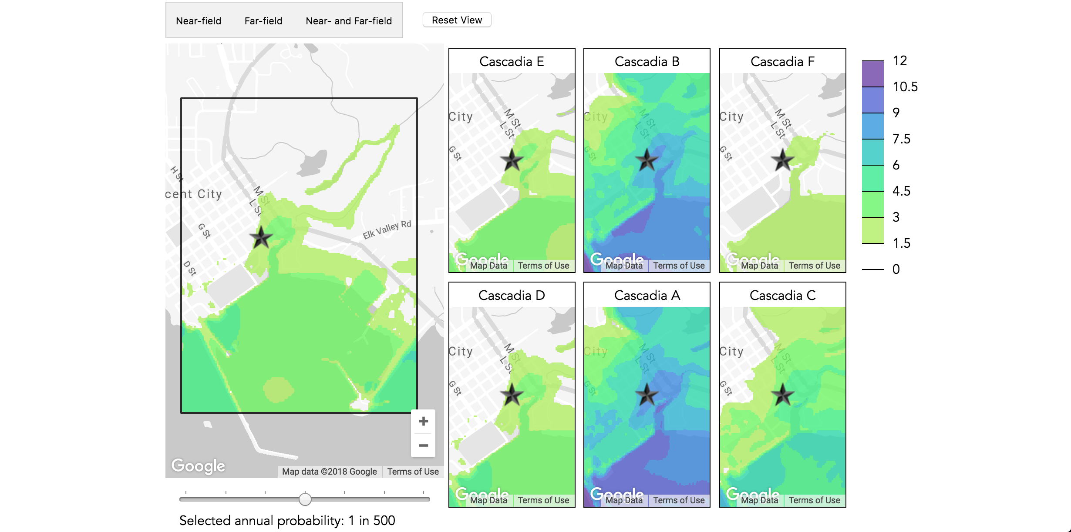
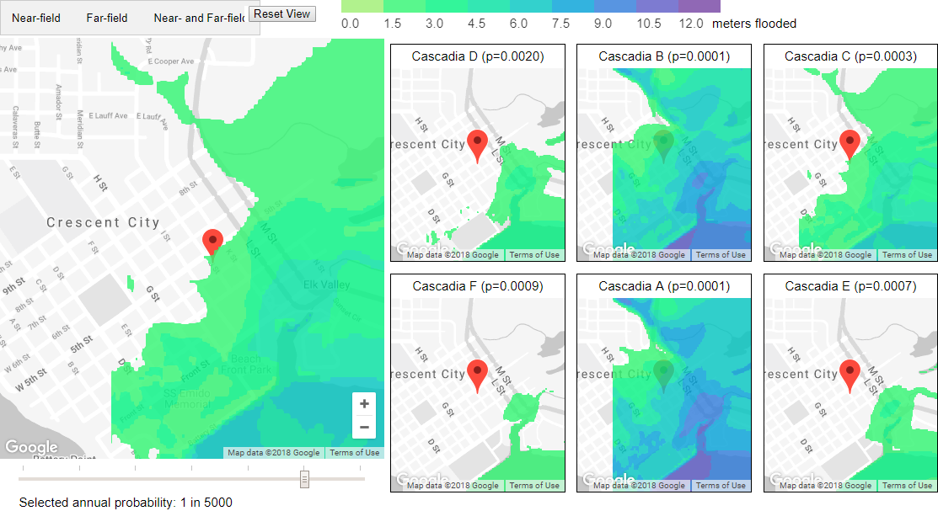
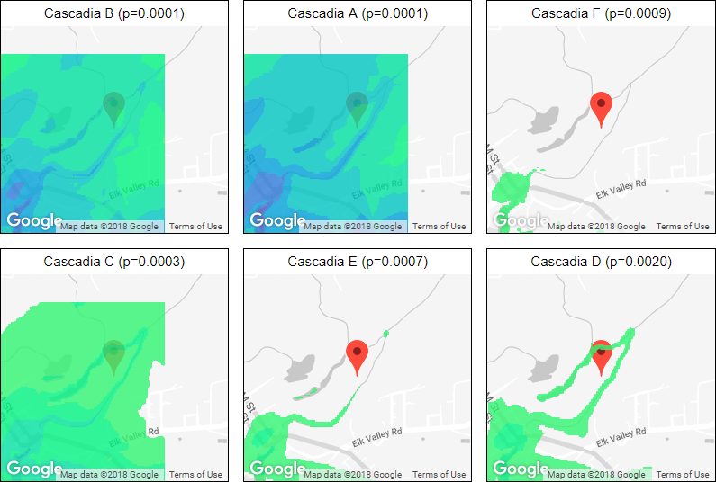
Tsunami Inundation Maps: Visualizing Uncertainty for a General Audience
Brian de Silva, Abe Engle, Benjamin Liu, and Kellie MacPhee
Background
Visualization
Aggregate Probabilities
Coastal cities along the west coast are susceptible to damage caused by tsunamis. In order to improve tsunami preparedness, researchers use numerical simulations to predict the impact of possible tsunamis caused by different seismological events. Researchers at the University of Washington model the impact of tsunamis on many cities; for the scope of this project, we focus on Crescent City, a coastal city in California which has a history of extreme damage from tsunamis.
By estimating the probability of occurrence of each simulated tsunami, the annual probability of exceeding a given level of inundation (flooding) can be estimated for every point in the landscape, giving rise to a hazard map. There are multiple sources of uncertainty ([A]leatoric and [E]pistemic) that feed into hazard maps:
[A] Estimation of the annual likelihood of seismic events
[A] Variance due to the small number of events
[A] Error due to the assumption that the seismic events are independent
[E] Error in the numerical simulations of tsunamis
Narrative
The results of individual simulations are combined into an aggregated hazard map.
To make the visualizations more digestible we embed them within a larger narrative structure. In particular, we adopt the “magazine style” approach of Segel and Heer [1].
We begin with an anecdote that emphasizes the importance of probabilistic estimates. We then present a flipbook, showing the variety of flooding levels present in different simulations.
Flipbook
Text
Figure 1. The interactive aggregate map and small multiples. Color encodes inundation depth.
Users can interact with the aggregate map by panning, zooming, and selecting areas of interest. Selecting an area pans and centers the small multiples plots to to the same location.
Interactive Probability Explorer
Goals
Text
Small Multiples
The hazard maps correspond to complicated hazard functions at every point on the map, which describe the probability of inundation at every depth. Properly interpreting this map can be difficult for people without a technical background.
[ zeta picture here ] + [ an example hazard function ]
Our project seeks to address the following problems:
Hazard maps and the data used to produce them contain multiple sources of uncertainty. It is challenging to communicate this uncertainty alongside or as part of hazard maps in an intuitive way.
Hazard maps are inherently complex and nuanced and can therefore be difficult for non-experts to decipher.
We use small multiples to convey that there are many possible outcomes in the event of a tsunami. Showing a small number of specific events highlights the variety of possible outcomes and allows the reader to make direct comparisons.
We implement small multiples as replicated displays of a small geographic region of interest. The multiples are positioned opposite the large hazard map. Clicking the hazard map focuses the multiples on a specific region. Each multiple overlays the inundation depth of particular events as shaded contour plots.
Figure 1. Small multiples of flooding under simulated tsunamis. Colors indicate shallow flooding (green) to deep flooding (purple).
Future Work
References
Greater spatial extent
Larger number of simulations
Alternate expressions of uncertainty
[1] Edward Segel and Jeffrey Heer. Narrative visualization: Telling stories with data. IEEE transactions on visualization and computer graphics, 16(6):1139–1148, 2010.
[2] Gonzalez, Frank I., Randall J. LeVeque, and Loyce M. Adams. Probabilistic Tsunami Hazard Assessment (PTHA) for Crescent City, CA. Final Report for Phase I. University of Washington Department of Applied Mathmatics, 2013.
[3] LeVeque, R.J., Waagan, K., González, F.I. et al. Pure Appl. Geophys. (2016) 173: 3671. https://doi.org/10.1007/s00024-016-1357-1

