Slide 1

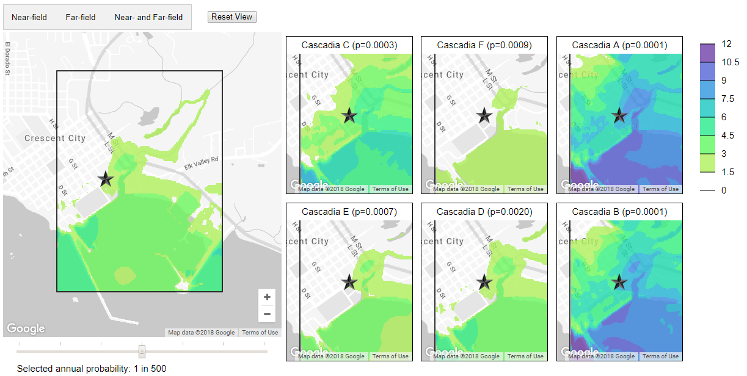
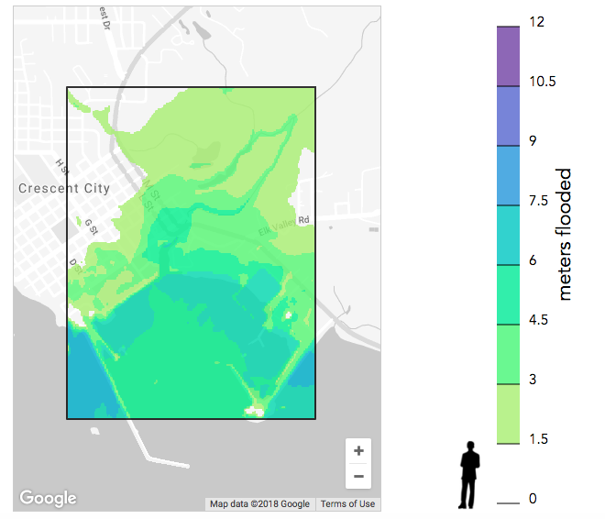
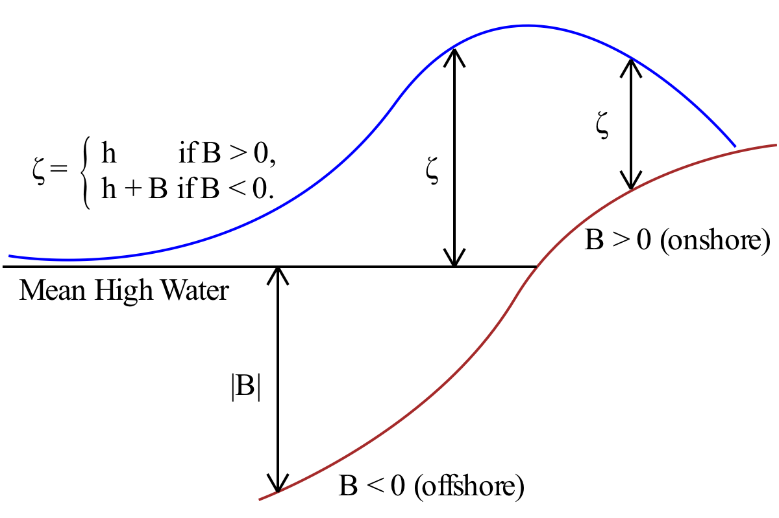
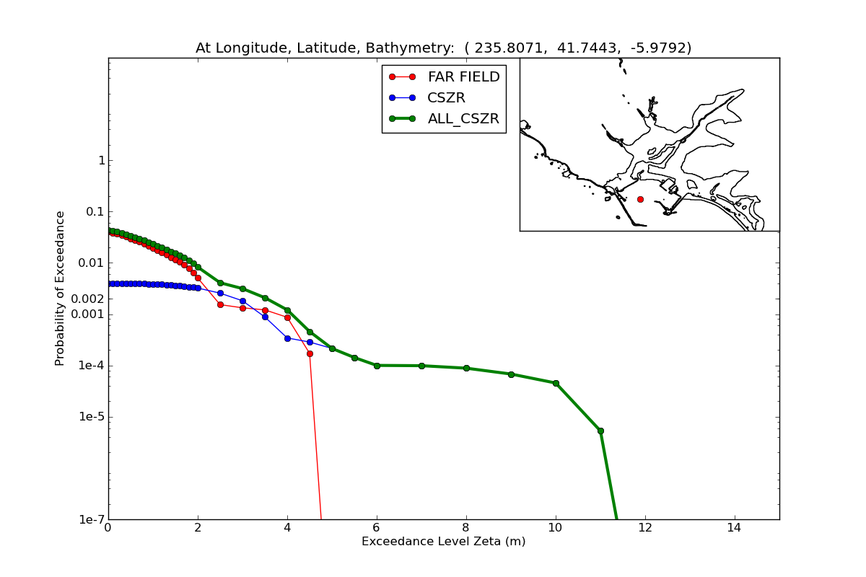
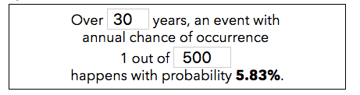
Tsunami Inundation Maps: Visualizing Uncertainty for a General Audience
Brian de Silva, Abe Engle, Benjamin Liu, and Kellie MacPhee
Background
Visualization
Visualization (continued)
Coastal cities along the West Coast are susceptible to damage caused by tsunamis. In order to improve tsunami preparedness, researchers use numerical simulations to predict the impact of possible tsunamis caused by different seismological events. Researchers at the University of Washington model the impact of tsunamis on many cities; for the scope of this project, we focus on Crescent City, a coastal city in California which has a history of extreme damage from tsunamis.
By estimating the probability of occurrence of each simulated tsunami, the annual probability of exceeding a given level of inundation (flooding) can be estimated for every point in the landscape, giving rise to a hazard map. There are multiple sources of uncertainty ([A]leatoric and [E]pistemic) that feed into hazard maps:
[E] Estimation of annual likelihood of seismic events;
[A] Variability of outcomes over a small number of events;
[E] Error due to the assumption that the seismic events are independent;
[E] Error in the numerical simulations of tsunamis.
Our visualizations are implemented in HTML and JavaScript with the D3 framework. The maps in our visualization are built using the Google Maps API. Throughout, inundation levels are overlaid on the maps as shaded contour plots, with color encoding water depth (meters).
Small Multiples
We use small multiples to simultaneously convey a broad range of possible outcomes in the event of a tsunami. Showing specific events highlights the variety of possible outcomes, ensuring that extreme events are not lost in the aggregate map. The small multiples also allow the reader to make direct comparisons between simulations, which is difficult with the flipbook.
Narrative
To make the visualizations more digestible, we embed them within a larger narrative structure. In particular, we adopt the “magazine style” approach of Segel and Heer [1]. We begin with an anecdote that emphasizes the importance of probabilistic estimates, and continue to provide details and context for the visualizations throughout.
Flipbook
The flipbook animates through the full set of 13 simulations, showing each on the map. The flipbook was inspired by the sampling-based visualizations of uncertainty at the Interactive Data Lab at the University of Washington [4], and gives the viewer an introduction to the variability inherent in the data .
Figure 2. A single flipbook slide.
Figure 3. The interactive aggregate map and small multiples. Color encodes inundation depth, from shallow flooding (green) to deep flooding (purple).
We have a relatively small number of simulations, and the likelihood of each event can vary by orders of magnitude. In order to show a range of possible events including the most extreme simulations, we postpone considerations of the likelihood of each event for the aggregate maps and probability explorer to follow.
Future Work
Goals
There are a number of ways in which the current work could be extended:
With additional simulations, the map could cover a greater geographic region, including additional cities
Additional simulations also reduce uncertainty and give a better sense of possible outcomes
By using alternative encodings of uncertainty, results may be made more readily interpretable.
In addition, it would be interesting to evaluate the usefulness of the interactive probability explorer in a study with human subjects.
The hazard maps correspond to complicated hazard functions at every point on the map, which describe the probability of inundation at every depth. Properly interpreting this map can be difficult for people without a technical background.
Our project seeks to address the following concerns:
Hazard maps and the data used to produce them contain multiple sources of uncertainty. It is difficult to communicate this uncertainty in an intuitive way.
Hazard maps are inherently complex and nuanced and can therefore be difficult for non-experts to decipher.
Interactive Probability Explorer
To mitigate user confusion about annual probabilities, we provide an interactive probability calculator allowing them to explore outcome likelihoods.
Aggregate Probabilities
The results of individual simulations are combined into the aggregated hazard map, to the left in the dashboard. The aggregate map shows expected inundation level over all simulated events. Users can interact with this map by panning, zooming, and selecting areas of interest. Selecting an area pans and centers the small multiples plots to to the same location.
For the aggregate map and small multiples, users can also choose between two types of simulations: near-field (Cascadia) and far-field (other origin) events, which vary in severity and likelihood.
References
Figure 1. The data we are visualizing: (a) inundation level zeta is the height of water above normal, (b) an example hazard function.
[1] Edward Segel and Jeffrey Heer. Narrative visualization: Telling stories with data. IEEE transactions on visualization and computer graphics, 16(6):1139–1148, 2010.
[2] Gonzalez, Frank I., Randall J. LeVeque, and Loyce M. Adams. Probabilistic Tsunami Hazard Assessment (PTHA) for Crescent City, CA. Final Report for Phase I. University of Washington Department of Applied Mathmatics, 2013.
[3] LeVeque, R.J., Waagan, K., González, F.I. et al. Pure Appl. Geophys. (2016) 173: 3671. https://doi.org/10.1007/s00024-016-1357-1 [4] Hullman, Jessica, et al. Imagining Replications: Graphical Prediction & Discrete Visualizations Improve Recall & Estimation of Effect Uncertainty. IEEE transactions on visualization and computer graphics 24.1: 446-456, 2018.

