Slide 1
Sage 300 2019.0 Web SDK Overview
John Thomas (JT)
August 2018

Slide 2
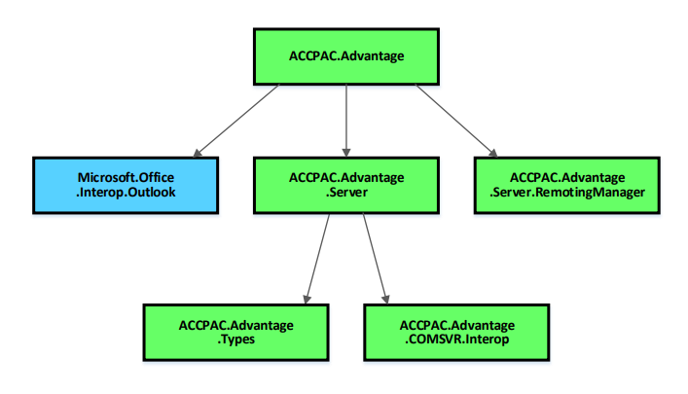
Version Change
Accpac.Advantage and Accpac.Advantage.Types versions are now 6.6.0.0
AccpacDotNetVersion.props files have been updated for samples and source
Version in Code Generation Wizard is now 66A
Going forward, any changes to the version will be made in ALL the 5 core libraries
No more will the Types library be at a different version
No more repeat of 2018.2 issue!

Slide 3



Web Screen Development
Wizard manifests ONLY include Visual Studio 2017 as a targeted IDE
Visual Studio 2013 and Visual Studio 2015 as targeted IDEs have been deprecated
X
X
2013
2015
2017

Slide 4
Solution Wizard
New ‘ExternalContent’ Folder
Creates a location in the web project for external content folders and files
Areas\{module}\ExternalContent
bg_menu_{module}.jpg and icon_{module}.png will be created here.
Formerly named menuBackGroundImage.jpg and menuIcon.png
{module}menuDetails.xml to reference the new location
../../../../Areas/{module}/ExternalContent/bg_menu_{module}.jpg
../../../../Areas/{module}/ExternalContent/icon_{module}.png
MergeISVProject to copy ExternalFolder to Staging, Compiled, and __READYTODEPLOY__ folders
Upgrade Wizard to upgrade partner web project with changes
Note: Partner installations must be modified to reflect new deployment folder
Old location: ..\Online\Web\External\Content\Images\nav\{partnername}
New location: ..\Online\Web\Areas\{module}\ExternalContent
Global Files updated to 2019

Slide 5
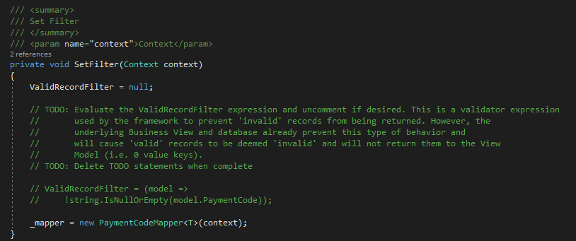
Code Generation Wizard
Global Files updated to 2019
Defects Corrected
Replaced invalid character ‘%’, if discovered, in property naming algorithm
Add property name to user message if invalid, duplicate or blank properties discovered on Save action
ValidRecordFilter in Repository
Where a zero value key is legitimate, this filter may prevent proper CRUD
Filter is still generated by wizard, but now commented with TODO statement for review

Slide 6
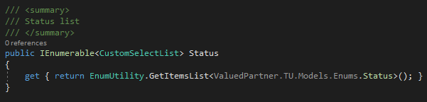
Code Generation Wizard
Defects Corrected
Duplicate entries created in Web Bootstrapper class
Corrected!
Enums in ViewModel must be manually changed to IEnumerable<CustomSelectList> for Kendo binding
Wizard now generates proper statement
Note: Existing partner code will not be modified to reflect this change

Slide 7
Customization Wizard
Global Files updated to 2019

Slide 8
Upgrade Wizard
Global Files updated to 2019

Slide 9
Inquiry Configuration Wizard
Delayed until 2019.1
Wizard allows for the creation of metadata to drive generic inquiry and adhoc inquiry displays

Slide 10
Samples
Added kendo.all.min.js to samples instead of requiring manual addition
Renamed web projects to include module in namespace
Defect Corrected
In Receipt sample, renamed ‘YesNoValue’ property for optional fields to be ‘YesOrNoValue’
Note: This field name is expected by the Optional Fields JavaScript framework (…Common.OptionalFields)

Slide 11
Documentation
Updated Upgrade Instructions for 2018.2 to 2019 in docs\upgrades
New Sage300SDK_2019WebSDKOverview.pptx in docs\presentations
Updated Sage300SDK_MergeISVProject_Utility.docx in docs\utilities
Updated section for deployment of ExternalContent folder
New Sage300SDK_GlobalSearch.docx in docs\development
KB:91472
Using Visual Studio 2017 with Sage 300 2019 SDK
KB:91473
Writing SDK apps that do not require “Run As Administrator”

Slide 12
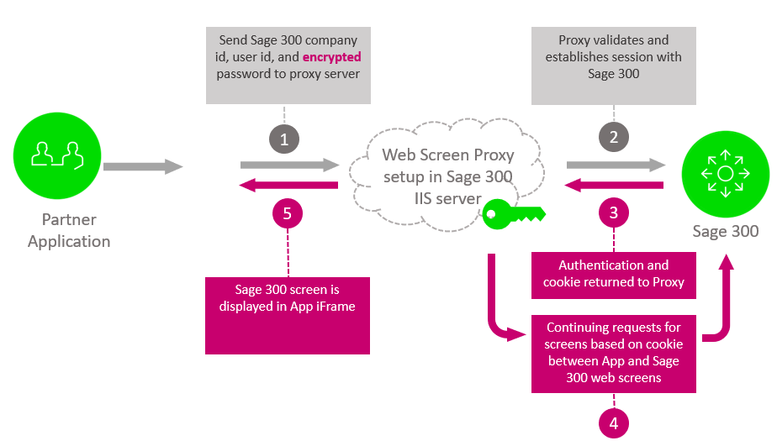
New!
Web Screen Proxy
Installed with Sage 300 Web Screens
Accepts Sage 300 credentials and URL
URL does not contain base (protocol, server, etc.)
Password is encrypted
Cookie for performance and caching
CRM is the first consumer of this service

Slide 13
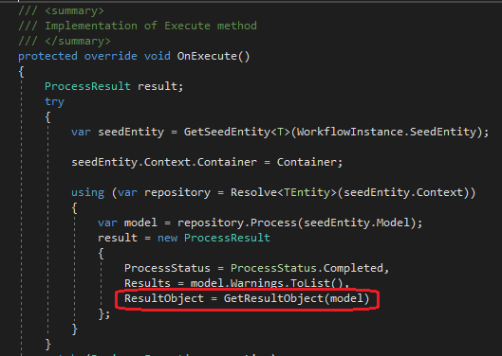
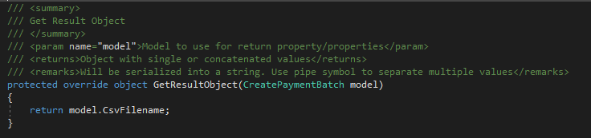
Unit of Work Enhancement
ProcessUow base class’ OnExecute() method needed to be overridden to be able to set ResultObject
Partner’s unable to see base class method without peeking into object to override
Even 10 Sage process screens did this!
New GetResultObject(T model) method can simply be implemented and no longer have to override OnExecute()

Slide 14
In-Progress Items – Non-Committed Items
Global Search
Documentation on metadata
Wizard/Utility to create partner metadata for participation in Global Search
Looking forward to Orchid’s RMA screens for CRM integration whenever they are ready to undertake development!
Partner Menus
Recently Opened partner menu items missing from list (D-37872) since 2018.2 install
Solution Wizard, Customization Wizard, Upgrade Wizard, Samples Enhancement
Get majority of global files and packages from local install instead of delivering and synching
Big change to the project (csproj) file for Web Project
Still evaluating impact on Upgrade Wizard
In-Progress

Slide 15
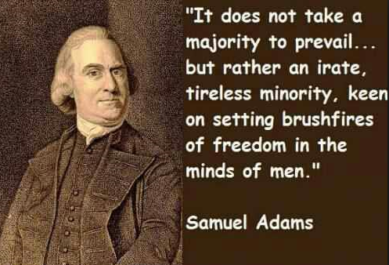
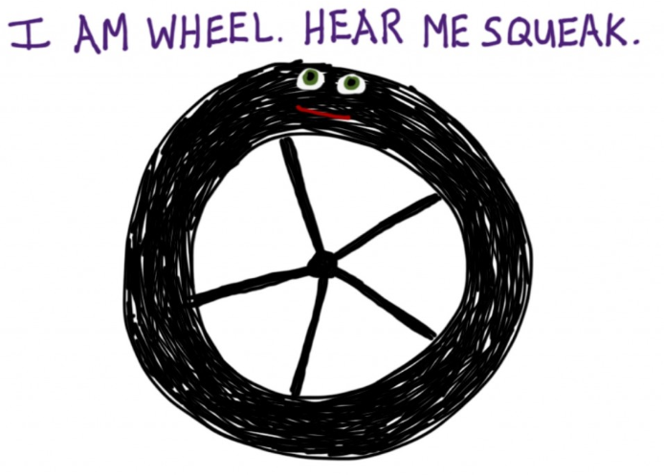
Who Needs to Hear Partner Requests?
Sage 300 Product Manager
Allocates capacity per release and sets roadmap for product
Contact him regarding functionality, documentation, tutorials, enhancements, etc. not in the SDK that should be there to better assist with efficient development practices
Architecture/Development capacity requests
We will advise, address and allocate resources within our capacity
Tracking requests on high, medium, low priority basis
The partner’s voice and feedback resounds the loudest!

Slide 16
GitHub Repository
Open Source
https://github.com/SageNADev/Sage300-SDK
2019 is available in the “master” branch
2019.1 is available in the “develop” branch (in-progress)
2018.2 is available in the “release-2018.2” branch (archive)
2018.1 is available in the “release-2018.1” branch (archive)
2018.0 is available in the “release-2018” branch (archive)
2017.2 is available in the “release-2017.2” branch (archive)
2017.1 is available in the “release-2017.1” branch (archive)
2017 is available in the “release-2017” branch (archive)

