Slide 1
Sage 300 Web SDK
2022.0 Overview
August 2021

Slide 2

“The goal of the Web SDK is to get developers up and running quickly and easily.”

Slide 3
Versions

Slide 4
Versions
68A → 69A
6.8.0.0 → 6.9.0.0
Wizards will only be supported in Visual Studio 2019
Wizard support for Visual Studio 2017 has been dropped
JQuery 3.4.1 → 3.6.0
Kendo UI 2019.1.115 → 2021.1.224

Slide 5
Corrected Issues

Slide 6
Corrected Issues
Misc
Post-build merge utility upgraded to use Terser instead of WebGrease for JavaScript minification Requires node.js Removed company namespace from bundle name
Update receipt sample to support multiple views Samples retrofitted to use new composite helpers
Customization package no longer requiring module Restrict punctuation in company name
Samples
Custom

Slide 7
Wizards

Slide 8
Wizards
Solution
Sync global files New login.aspx to replace hardcoded global.asax.cs logic New Terser minification process Requires node.js
Sync global files Generates new composite html helpers New UI Layout Wizard Step New Finder Generator
Sync global files Replace hardcoded global.asax.cs credentials with login.aspx for login UI Deprecate “old” web finders New Terser minification process
Custom
Standalone N/A
Plug-in N/A
Sync resource files
Code
Upgrade
Language

Slide 9
Samples

Slide 10
Samples
Sync global files
Modified to use new login.aspx for developer credentials
Refactored to leverage new composite helpers
Refactored to use new web finders

Slide 11
Documentation and Tutorials

Slide 12
Documentation and Tutorials
Updated upgrade instructions 2021.2 → 2022.0
Updated wizards, samples and tutorials documents with correct text, images, and instructions
Updated CommonCore.chm
Updated Finder document with recent changes and enhancements
Updated Grid Client and Server documents for available and new functionality
Updated Global Search document with port configurations and requirements
Added new document for Html Helpers
Added new document for Web Help with example
Added new documents for UI Layout Wizard and Finder Generator

Slide 13
Noteworthy

Slide 14
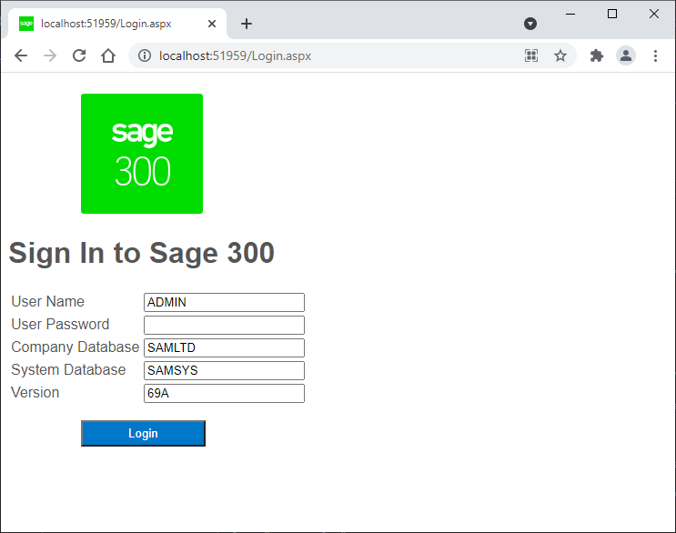
Credentials in Global.asax
New Login.aspx screen for user credentials when debugging solution or samples
Will store values in cookies (except password)
Note: Right-click on Login.aspx in Solution Explorer and select “Set as Start Page”
Note: Failure to set start page will result in re-direction to “real” Sage 300 login screen and solution/sample is now bypassed

Slide 15
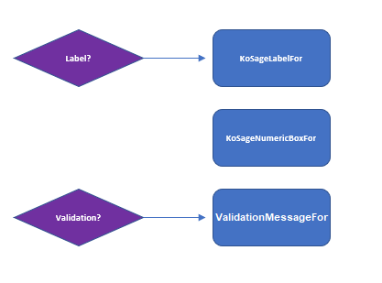


Composite Html Helpers
SgNumericFor, SgTextFor, SgFinderFor, SgPasswordFor, SgDropdownFor, SgDatepickerFor, SgTimerpickerFor, SgCheckboxFor, SgRadioButtonFor
Consolidates multiple html helpers into a single helper for better assignment of default properties, encapsulation and simplification
See document in SDK for information on helpers including flow, interface, parameters, and examples

Slide 16
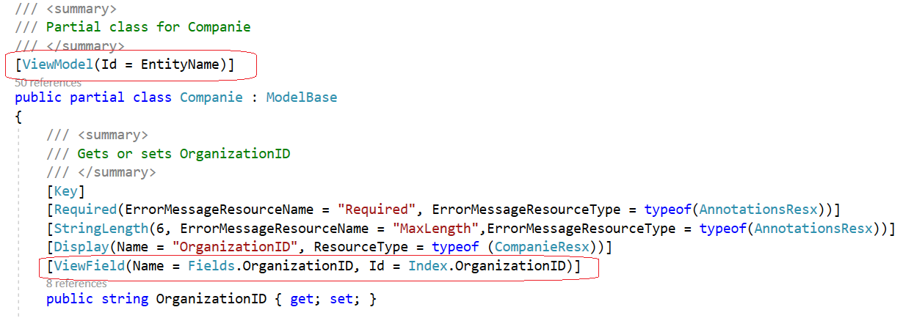
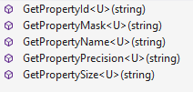
New attributes and helpers
Available for models
New helpers will provide making assignments to properties from JavaScript simpler and part of the framework
ViewFieldHelper
ViewModelHelper
Attributes are assigned in new models using Code Generation Wizard and can be assigned manually to existing models
View Field Helper
View Model Helper

Slide 17
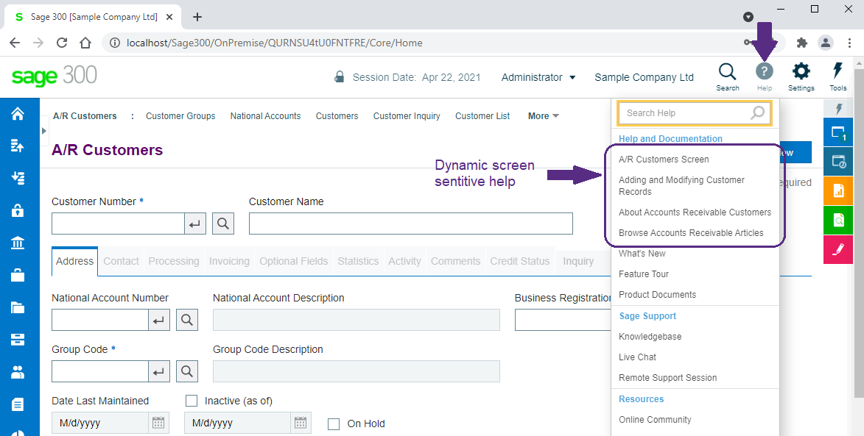
External Web Help for Partners
Participation in Help and Doc section
Seamless integration
Partner or customer hosted
XML discovered and items injected into help
Can even add to Sage 300 screen’s help topics
See document in SDK for details and example

Slide 18

JavaScript Minification
ES6 is not supported by IE11
Web Screens do not support IE11
Developers are free to use ES6 syntax
https://www.w3schools.com/js/js_es6.asp
Minification tool, Terser, used by post-build utility now supports ES6 syntax
Note: Requires node.js on developer machine

Slide 19
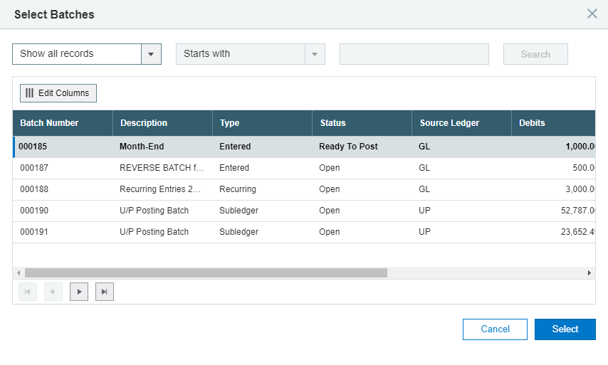
Finder Enhancements
All “old” web finders are deprecated
Manual steps
Generate definitions using new Finder Generator
Update logic in JavaScript
Delete code in Bootstrapper
Delete old finder controller definitions
See Upgrade document in SDK for details

Slide 20
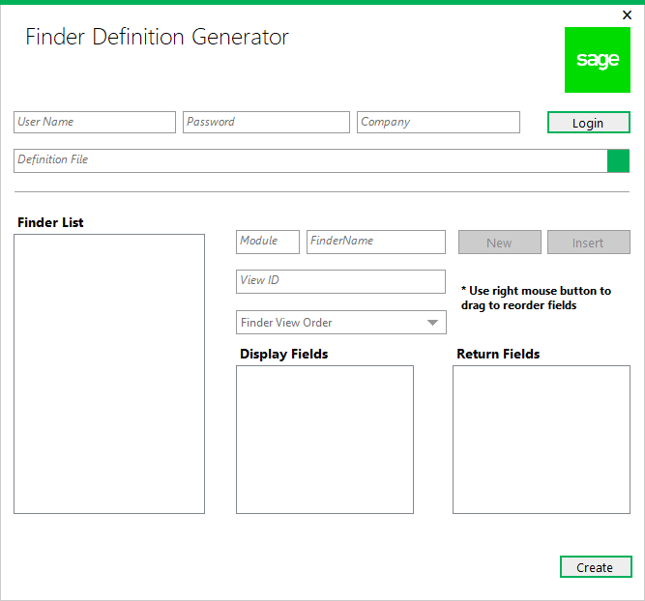
New Finder Definition Generator
New wizard for finder definitions
Internal developers define finders in ..ViewFinderProperties.js
External developers define their finders in their version of ..ViewFinderProperties.js to be included in partner bundle
Used by new UI Layout Wizard where a finder is defined first
Define once and use in many places
See document in SDK
Notes:
There is a new step coming to the Code Generation wizard to optionally layout the UI elements, but before I get to that, we will be introducing the new Finder Definition Generator (the UI is still being finalized) which will allow for the creation of finder definitions. Finders can either be defined in a static JavaScript file or be dynamically created. For finders that are used in multiple places, a common definition is ideal. The new UI Layout Wizard will require that fields being specified as requiring a finder have a definition predefined. This wizard will be available from within Visual Studio as a plugin.
Note that this August our “old” web finders are being entirely replaced with our new web finders that are simpler, faster, and more robust than our previous implementation. Therefore, all finders must be defined either ahead of time or created dynamically.

Slide 21
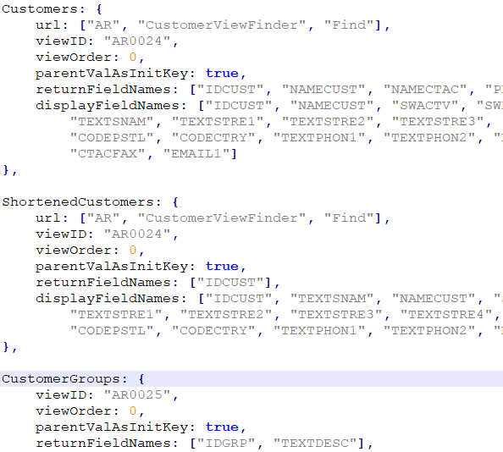
Finder Definitions
ViewFinderProperties.js
The Finder Generator will create definitions
See finder document in the SDK for URL property (not created by Finder Generator)
Notes:
And here is a look at some finder definitions. Pretty simple and succinct. And, you may have heard if you have attended the What’s new in Sage 300 session, for our August release all of the web finders will be based upon this implementation and there will no longer be a mix of “old” and “new” web finders.

Slide 22
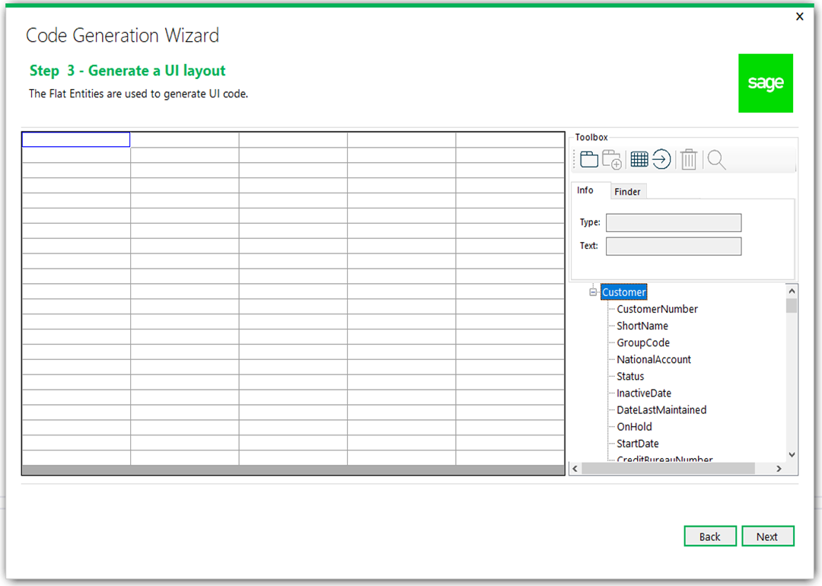
New UI Layout Wizard
New wizard for generating UI widgets
Drag and drop model properties on palette
Create tabs and buttons and grids
Only available for Flat, Header-Detail code types in 2022 release
Generates labels, textboxes, checkboxes, dropdowns, radio buttons, finders, etc.
See document in SDK
Notes:
As mentioned, the UI Layout Wizard is a new step that is being added to the Code Generation Wizard. Once a view or views have been specified for creation, there will be an extra step before generation which will give the developer the opportunity to roughly layout the UI. The properties in the new model can be dropped onto a palette indicating their basic placement and their underlying data type will dictate in most cases the widget that will be used, but this can be overridden in some cases. For example, you might want a dropdown control for a list, or you might want radio buttons. The wizard will allow this type of assignment based upon the data type of the property. Additionally, the developer will be able to create tabs and grids and buttons too.
Let’s look at leveraging this new step to layout a screen

Slide 23
GitHub Repository

Slide 24
GitHub Repository
Open Source
https://github.com/SageNADev/Sage300-SDK
2022.0 is available in the “master” branch
2022.1 is available in the “develop” branch
Archives
2021.2 available in “release-2021.2”
2021.0 available in “release-2021.0”
2020.2 available in “release-2020.2”
2020.1 available in “release-2020.1”
2020.0 available in “release-2020.0”
2019.2 available in “release-2019.2”
2019.1 available in “release-2019.1”
2019.0 available in “release-2019.0”
2018.2 available in “release-2018.2”
2018.1 available in “release-2018.1”
2018.0 available in “release-2018”
2017.2 available in “release-2017.2”
2017.1 available in “release-2017.1”
2017.0 available in “release-2017”

Slide 25
Partner Requests

Slide 26
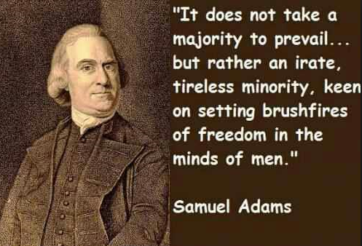
Partner Requests
Bring these to the Sage 300 Product Manager
Add these to the Sage 300 Ideas Site
Sage 300 Ideas Forum
Your voice and feedback resounds the loudest!

Slide 27
Thank you
©2021 The Sage Group plc or its licensors. All rights reserved. Sage, Sage logos, and Sage product and service names mentioned herein are the trademarks of Sage Global Services Limited or its licensors. All other trademarks are the property of their respective owners.

