Slide 1
Sage 300 2019.0 Web SDK Overview
John Thomas (JT)
June 2018

Slide 2
Defects Corrected
Code Generation Wizard
Replaced invalid character ‘%’, if discovered, in property naming algorithm
Add property name to user message if invalid, duplicate or blank properties discovered on Save action

Slide 3
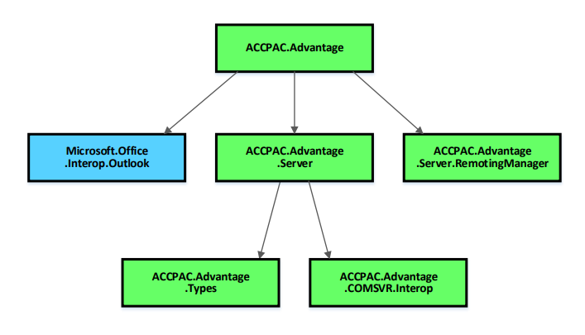
Version Change
Accpac.Advantage and Accpac.Advantage.Types versions are now 6.6.0.0
AccpacDotNetVersion.props files have been updated in samples and source
Version in Code Generation Wizard is now 66A
Going forward, any changes to the version will be made in ALL the 5 core libraries
No more will the Types library be at a different version
No more repeat of 2018.2 issue!

Slide 4



Web Screen Development
Wizard manifests include Visual Studio 2017 as a targeted IDE
Visual Studio 2013 and Visual Studio 2015 as targeted IDE MIGHT be deprecated
Survey sent to certain partners with overwhelming support for VS 2017 as IDE and okay with deprecation of VS 2013/2015 as IDE for web screen development
Still in discussions with PM
X
X

Slide 5
Documentation
Upgrade Instructions for 2018.2 to 2019 in docs\upgrades
In-progress
New Sage300SDK_2019WebSDKOverview.pptx in docs\presentations
Updated Sage300SDK_MergeISVProject_Utility.docx in docs\utilities
Added sections with detailed explanations of output folders
Assists with identifying artifacts and locations for creating a partner installation
KB:91472
Using Visual Studio 2017 with Sage 300 2019 SDK
KB:91473
Writing SDK apps that do not require “Run As Administrator”

Slide 6
Global Files Updated to 2019
Solution Wizard
Code Generation Wizard
Customization Wizard
Upgrade Wizard

Slide 7
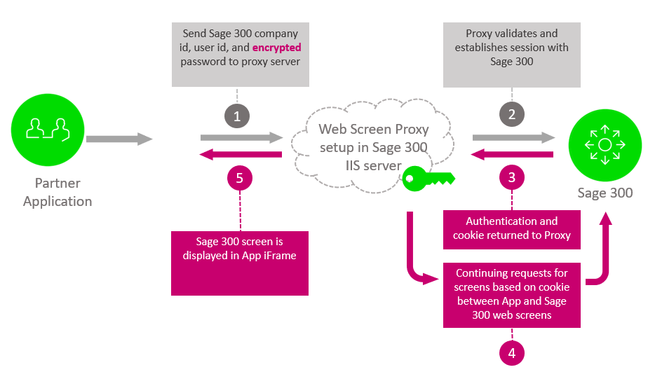
New!
Web Screen Proxy
Installed with Sage 300 Web Screens
Accepts Sage 300 credentials and URL
URL does not contain base (protocol, server, etc.)
Password is encrypted
Cookie for performance and caching
CRM is the first consumer of this service

Slide 8
New!
Inquiry Wizard
Used to create generic inquiry and adhoc inquiry metadata
Global Search Wizard
TBD

Slide 9
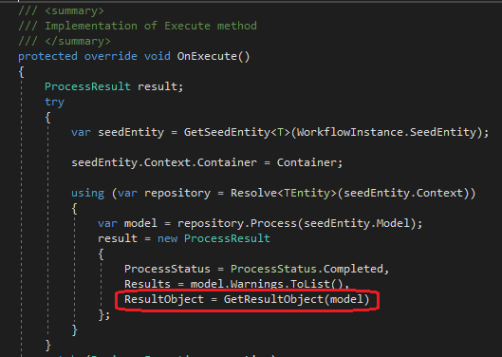
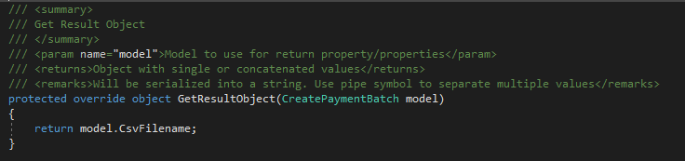
Unit of Work Enhancement
ProcessUow base class’ OnExecute() method needed to be overridden to be able to set ResultObject
Partner’s unable to see base class method without peeking into object to override
Even 10 Sage process screens did this!
New GetResultObject(T model) method can simply be implemented and no longer have to override OnExecute()

Slide 10
In-Progress Items – Non-Committed Items
Global Search
Documentation on metadata
Wizard/Utility to create partner metadata for participation in Global Search
Looking forward to Orchid’s RMA screens for CRM integration whenever they are ready to undertake development!
Partner Menus
Recently Opened partner menu items missing from list (D-37872) since 2018.2 install
Solution Wizard, Customization Wizard, Upgrade Wizard, Samples Enhancement
Get majority of global files and packages from local install instead of delivering and synching
Big change to the project (csproj) file for Web Project
Still evaluating impact on Upgrade Wizard
In-Progress

Slide 11


Who Needs to Hear Partner Requests?
Sage 300 Product Manager
Allocates capacity per release and sets roadmap for product
Contact him regarding functionality, documentation, tutorials, enhancements, etc. not in the SDK that should be there to better assist with efficient development practices
Architecture/Development capacity requests
We will advise, address and allocate resources within our capacity
Tracking requests on high, medium, low priority basis
The partner’s voice and feedback resounds the loudest!

Slide 12
GitHub Repository
Open Source
https://github.com/SageNADev/Sage300-SDK
2019 is available in the “master” branch
2019.1 is available in the “develop” branch (in-progress)
2018.2 is available in the “release-2018.2” branch (archive)
2018.1 is available in the “release-2018.1” branch (archive)
2018.0 is available in the “release-2018” branch (archive)
2017.2 is available in the “release-2017.2” branch (archive)
2017.1 is available in the “release-2017.1” branch (archive)
2017 is available in the “release-2017” branch (archive)
In-Progress

