Slide 1

Sage 300 Technical Session After The Basics
John Thomas (JT)
Principal Software Architect
June 2023
Notes:
Welcome to the Sage 300 Technical Session which will cover information and topics after the basic's presentation.
I am John Thomas, also known as JT, and I’m the Architect on the Sage 300 product.
Let’s get started.

Slide 2
Table of contents
What’s New
Application and SDK
Declarative Report Framework
Explained
Upcoming Items
Overview
Information Sharing
Tips, How To’s, etc.
Notes:
I am excited to bring you this session on After the Basics.
You are familiar with the basics of the Web API and the Web SDK. This session will quickly review The Basics session, present what’s new in the Sage 300 application from a technical perspective, what’s new in our 2023 release of the Web SDK, review and highlight some upcoming changes to the Web API and Web SDK, share some relevant information on tips, tricks, and How To's in the code, and present our new Declarative Report Framework for simple reports.
And questions, suggestions and feedback are valuable for delivering an API and an SDK that meets as many needs, and requirements of the developer community as possible. So, please let your voice be heard!

Slide 3
What’s New
Application and SDK

Slide 4
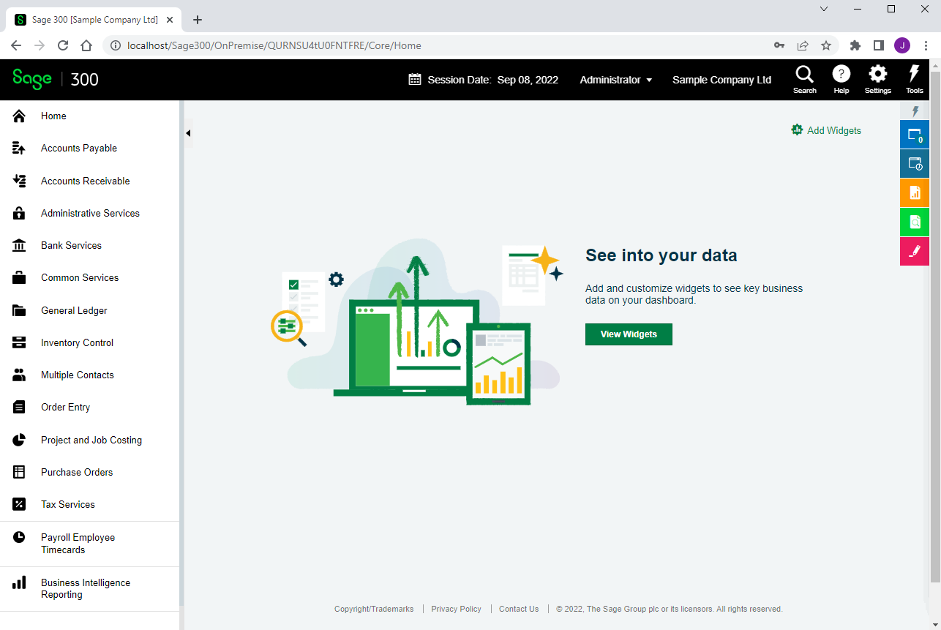
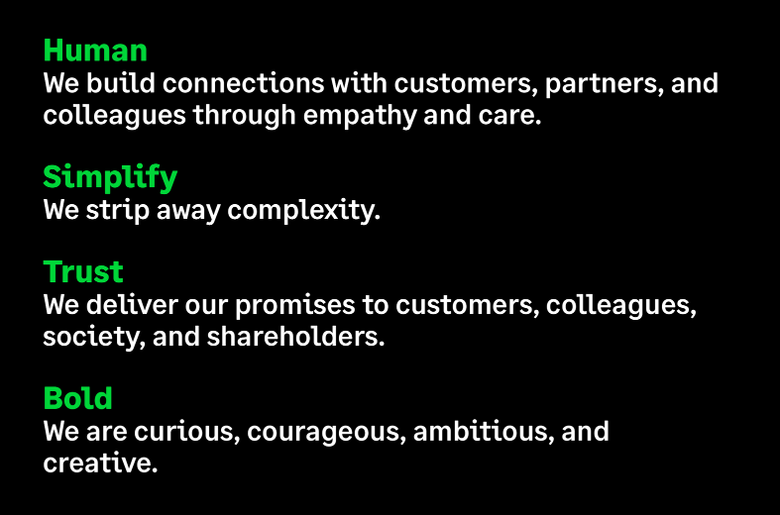
What’s New
Rebranding
Web Screens
New color schemes, styles, and icons
No code changes required
Upgrade Wizard upgrades all styles and icons
No developer work involved

Slide 5
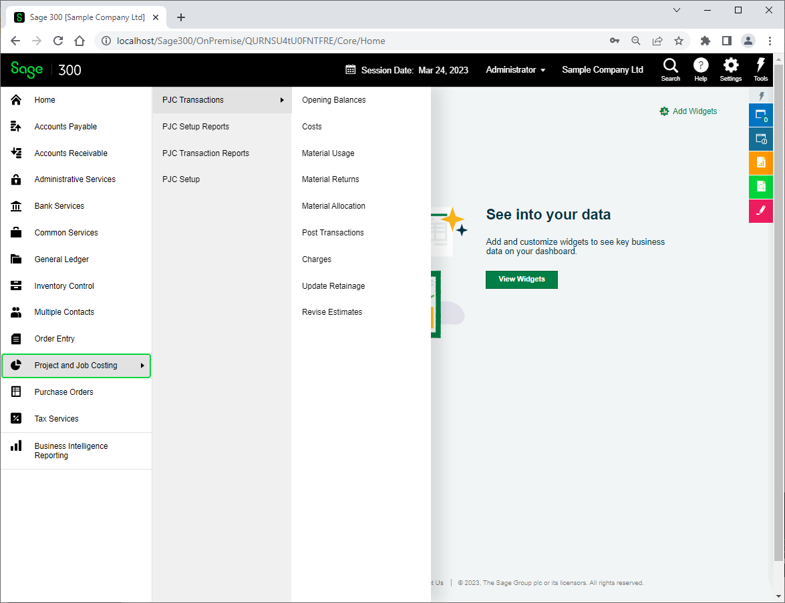
What’s New
Declarative Reports and PJC
Reports for Setup UIs
100+ created for 2023.1 using new Declarative Framework
Database setup separated from desktop
Important for parity
Close to 30 PJC screens and reports complete

Slide 6
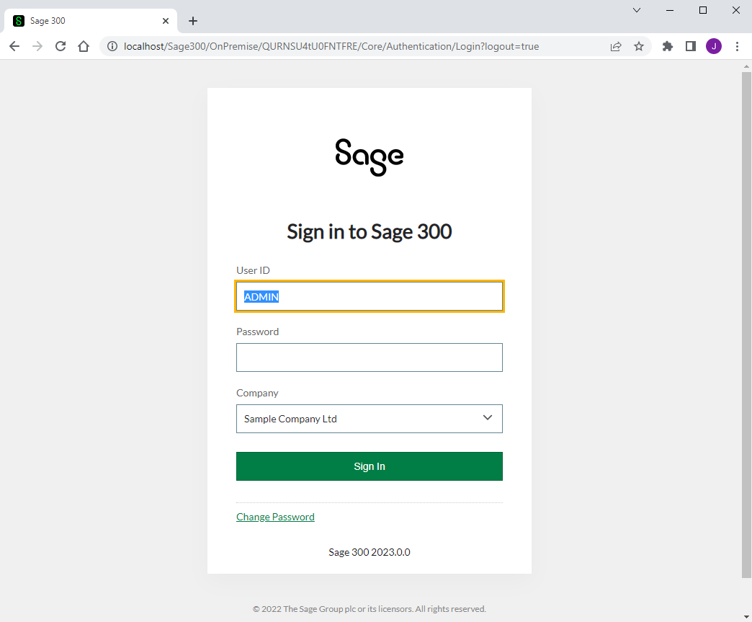
What’s New
Complex Passwords
Web Screens
Minimum 8 characters
1 upper and 1 lower alpha character
1 numeric and 1 special character
Special checkbox to enable this complexity has been removed in the Database Setup screen
Case matters
Code forcing case has been removed from all UI
For non-complex passwords, backend will know to force case to upper since UI case statements have been removed
Partner UI’s will require similar changes

Slide 7

What’s New
Enhanced Credentials Security
Elimination of certain ISM files containing user credentials
Leveraging MS SQL Server’s authentication features
Elimination of numerous security configurations and features in Sage 300
Now administered by MS SQL Server and local machine policies
Keeping high-level integration points or access points intact
Coming in a controlled release April 27 (2023 PU2) and a full release August 2023

Slide 8

What’s New
Azure Components
Web Screens
Removing these components from Web Screens
Target in 2013 was Azure
Target in 2015 changed to On-Premise
Kept around for compatibility and change of direction
Recent changes to Azure Components makes keeping compatibility without usage is unrealistic
No developer changes required
Simply a heads up
Note: ConfigurationHelper.IsOnPremise flag removed and if partner code uses, then modify is resolve to true value

Slide 9
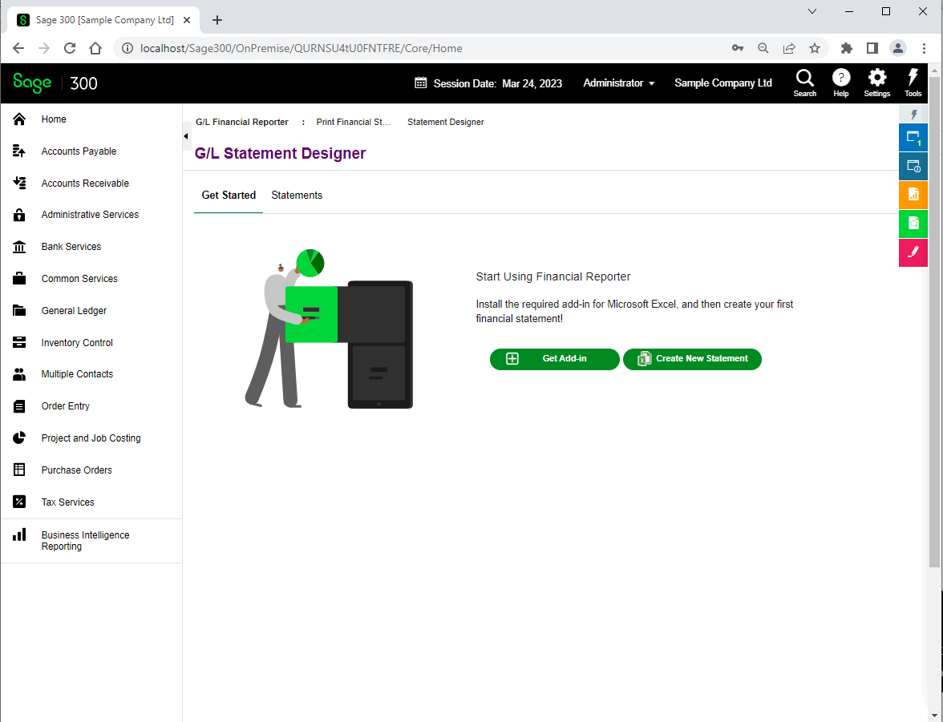
What’s New
G/L Financial Reporter
Bringing FR to the web
No loss of investment on FR reports and configurations from desktop
Will replace SIRC

Slide 10
What’s New
Customization Cleanup
Completed – 2023.1
Enhancement to delete customization files from file system
Currently when a customization is deleted, it is removed from the database but not the file system.
The desire is to remove the customization completely when deleted.

Slide 11
What’s New
Suppression of Debug Messages
Completed – 2023.1
Suppression of Debug Messages
During the debug session of a solution, the debug output window is filled with numerous messages from the Sage Business Layers thus making it difficult to see developer debug messages to the console.
The desire is to allow developers to enable or disable debug messages from the business layers.

Slide 12
What’s New
Drilldown Framework
Completed – 2023.2
Drilldown Framework Requires Global Implementation
The drilldown framework in the desktop has a global implementation which the web screens utilize. However, the drilldown framework in the web screens is module specific.
The desire is to have a global implementation in the web screens that can be implemented and invoked in any web screen where applicable.

Slide 13
Upcoming Items
Overview

Slide 14




Upcoming Items
Planned Web API and SDK work
Subject to change
Target – 2024.0
Singapore IRAS Tax Reporting
Singapore Tax module to upload
Upload to Sage CE
IRAS receives payload

Slide 15
Upcoming Items
Planned Web API and SDK work
Subject to change
Target – 2024.x
Customization “Before ID” logic is Incorrect
When creating a customization and determining widget placement, if a widget is required, does not respond to this property.
The desire is to properly react to placement of a widget either before or after a target widget.

Slide 16
Upcoming Items
Planned Web API and SDK work
Subject to change
Target – 2024.x
Web API Error Messages are not Specific
Error messages in the Web API do not raise the specific error message from the server which leads to frustration when attempting to diagnose failure.
The desire is to have specific error messages from server exposed while some messages will continue to remain generic (i.e., authentication, etc.).

Slide 17
Upcoming Items
Planned Web API and SDK work
Subject to change
Target – 2024.x
Customization API
The administration of web screen customizations are performed by the Customization Administration screen.
The desire is to provide a UI-less API for the import and maintenance of web screen customizations.

Slide 18
Upcoming Items
Planned Web API and SDK work
Subject to change
Target – 2024.x
Web Finder Compatibility with AS0020
The web screen finder is not compatible with business view AS0020.
The desire is to allow a finder definition to be successful with this business view.

Slide 19
Upcoming Items
Planned Web API and SDK work
Subject to change
Target – 2024.x
Numeric Composite Helper has hide/show issue.
The numeric composite helper hides the label and input widget successfully, but un-hiding only displays the label. This is due to a layering issue in the supporting helpers.
The desire is to be able to successfully hide and un-hide widgets as expected.
Note: A workaround is to place the hide/un-hide check on the <DIV> element as opposed to using the composite helper property.

Slide 20
Upcoming Items
Planned Web API and SDK work
Subject to change
Target – 2024.x
Finder Composite Helper does not Implement a Hamburger Label
The finder composite helper has the interface properties to create a hamburger label; however, the composite helper does not have the supporting logic.
The desire is to implement this functionality for the exposed interface.

Slide 21
Upcoming Items
Planned Web API and SDK work
Subject to change
Target – 2024.x
Solution Generation Wizard to create {XX}CommonResx file
Internal Sage solutions have a common resource file per module, and this should also be done for partner solutions.
The desire is to provide this feature for partner solutions.

Slide 22
Upcoming Items
Planned Web API and SDK work
Subject to change
Target – 2024.x
Visual Studio 2022 for Development
The Sage 300 Web SDK Wizards are compatible with Visual Studio 2019. With the recent release of Visual Studio 2022, the desire is to have these wizards be compatible with 2022.
Note: This was attempted for the recent release of Sage 300 2023; however, with the new Visual Studio 2022 format, the 2019 wizards are not compatible with 2022 and this could not be overcome for 2023. Work with Microsoft is on-going.

Slide 23
Upcoming Items
Planned Web API and SDK work
Subject to change
Target – 2024.0
Encrypt
Request Screen
Web Screen Proxy
Currently Sage 300 web screens can be invoked and displayed within an iFrame in Sage CRM. However, this proxy has specific Sage CRM bits. With the upcoming development of Sage 300 Payroll web screens and the integration with Sage HRMS, this proxy will be modified to allow generic access.
The desire is to the display a Sage 300 web screen from any caller by leveraging the proxy.
Request
Response
200
Request
Response
200, 401
Public Key
Sage 300 Proxy
Decrypt with Private Key
Validate & Redirect

Slide 24
Upcoming Items
Planned Web API and SDK work
Subject to change
Target – 2024.0
Encrypt
Request Screen
Public – Private Key Encryption for Proxy
Currently Sage 300 web screen proxy is only utilized by CRM integration. New proxy will remove CRM logic and offer a public key for consumer to encrypt before entering.
The desire is to allow any caller to encrypt credentials before accessing proxy.
Request
Response
200
Request
Response
200, 401
Public Key
Sage 300 Proxy
Decrypt with Private Key
Validate & Redirect

Slide 25
Upcoming Items
Planned Web API and SDK work
Subject to change
Target – 2024.0
Wizard Enhancements for Grid
Currently Sage 300 Code Generation Wizard makes “assumptions” for generation of code for grids.
The desire is to remove some of these assumptions during code generation.

Slide 26

Upcoming Items
Planned Web API and SDK work
Subject to change
Target – 2024.x
Subclassing
Currently Sage 300 web screens cannot surface any subclassed fields in the underlying business view.
The desire is to be able to access any subclassed fields for the customization strategy to interact with these fields for inclusion in the UI or for simply data access.

Slide 27
Upcoming Items
Planned Web API and SDK work
Subject to change
Target – 2024.x
AOM to be included in Web SDK
Currently AOM is delivered via DPP.
The desire is to deliver the AOM in the Web SDK and make the source code and project available for partners to generate an AOM for their views.

Slide 28
Upcoming Items
Planned Web API and SDK work
Subject to change
Target – 2024.x
Enhanced Flow in Customization Wizard
Currently the flow in the Customization Wizard is not ideal or efficient.
The desire is to deliver an enhanced flow during the customization creation process.

Slide 29
Upcoming Items
Planned Web API and SDK work
Subject to change
Target – 2025.x
Moving Away from Knockout
Knockout is used for two-way binding in the web screens. We have performed a POC with using Kendo MVVM for two-way native binding.
The desire is to eliminate Knockout in-lieu of a more native implementation.

Slide 30
Information Sharing
Tips, How To’s, etc.

Slide 31
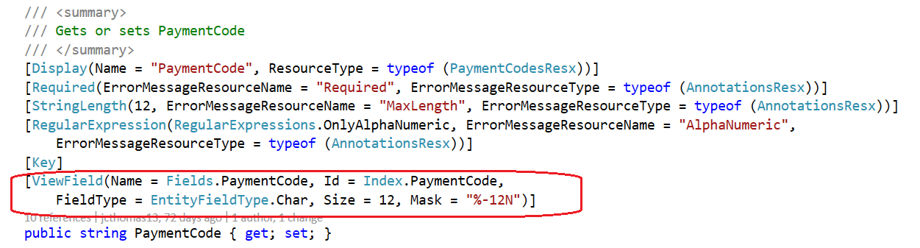
Information Sharing
ViewField Attribute
What is it?
An attribute assigned to every public property of an MVC model containing relevant information from the underlying business view
Why is it needed?
Not all business logic requires this attribute, but for those that do, it simplifies the managed code when the property is being assigned from JavaScript
Will be leveraged by future HTML Helpers to simplify CSHTML code
Do all model properties have this attribute?
Yes, as of Sage 300 2023 (whether they require it or not) via the new Sage 300 View Field Attribute Wizard. See Web SDK for more information.
Web Screens
ViewFieldHelper
GetPropertyId
GetPropertyName, GetPropertyFieldType
GetPropertySize, GetPropertyPrecision
GetPropertyMask, GetPropertyNumberDomain
return typeof(U).GetCustomAttributeValue<ViewFieldAttribute, string>(attr => attr.Mask, property);

Slide 32
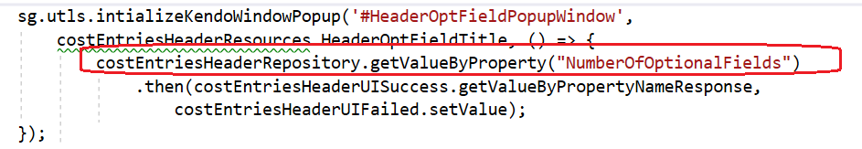
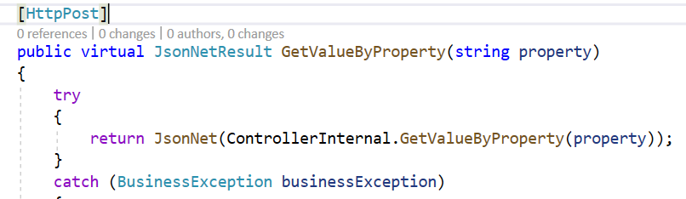
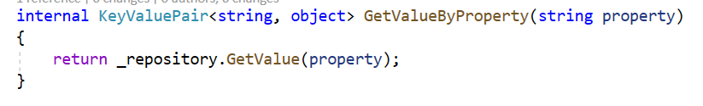
Information Sharing
ViewField Attribute Example 1
Web Screens
Gets access to business layer property without having to know Index or Name
Base Repositories have methods that already use helpers today
GetValuesByProperty
return GetValue<U>(ViewFieldHelper.GetPropertyId<U>(property));
SetValueByProperty

Slide 33
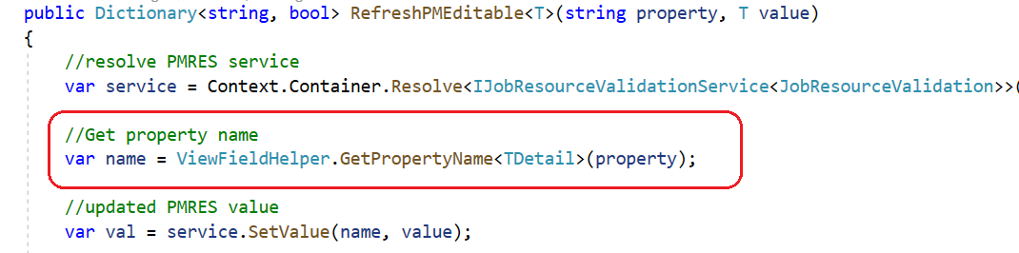
Information Sharing
ViewField Attribute Example 2
Web Screens

Slide 34
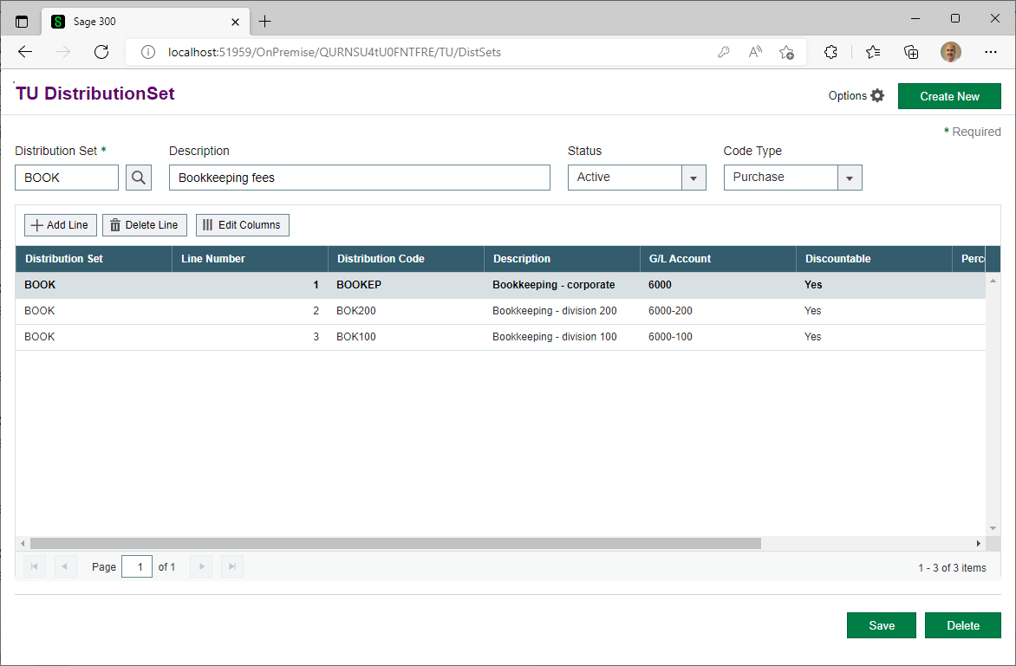
Information Sharing
Create and Sync a Header Grid to the Detail Grid
Web Screens
Can you create a grid in the header?
Yes!
Can the Code Generation Wizard create a grid in the header?
Yes!
What needs to be added to sync the grids?
Let’s see!

Slide 35
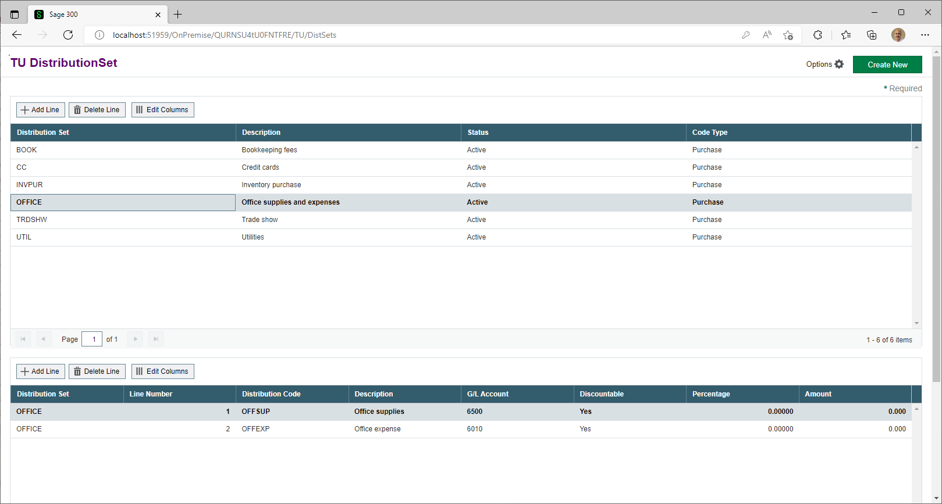
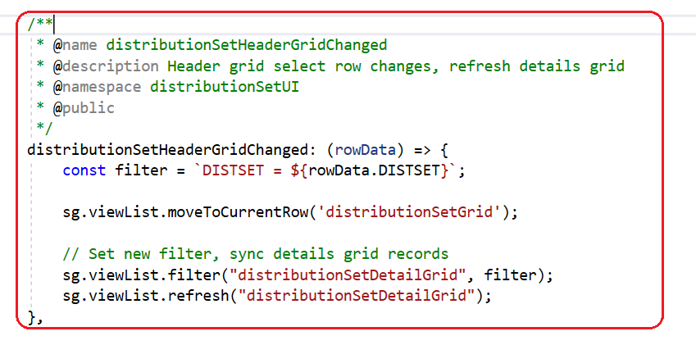
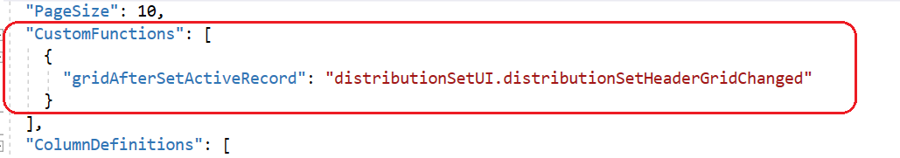
Information Sharing
Create and Sync a Header Grid to the Detail Grid
Behaviour JavaScript File
Note: Case of grid name is important!
Web Screens
Grid Header JSON File

Slide 36
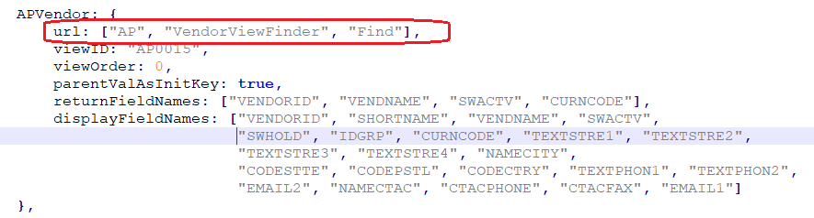
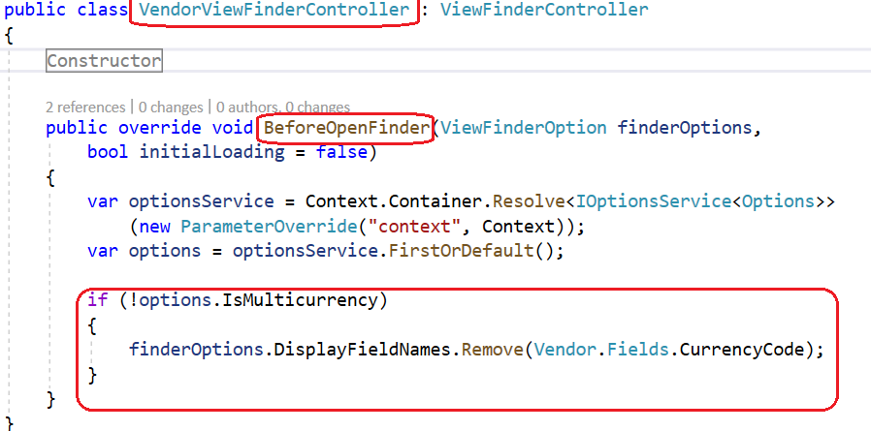
Information Sharing
Explain the Optional URL Property in a Finder Definition
The URL is an optional array that sets a path to override the default entry point of a finder
It is used when a finder requires logic before the initial load (i.e., showing or hiding a column depending on some logic)
Shown on the top left is our finder definition for a Vendor
Shown on the bottom left is the VendorViewFinder class/controller that is invoked prior to the finder controller (framework) being invoked
If multicurrency is not enabled, it removes the CurrenyCode field from the definition/display
Encapsulates logic in a single location instead of having multiple definitions or distributed logic
Web Screens

Slide 37
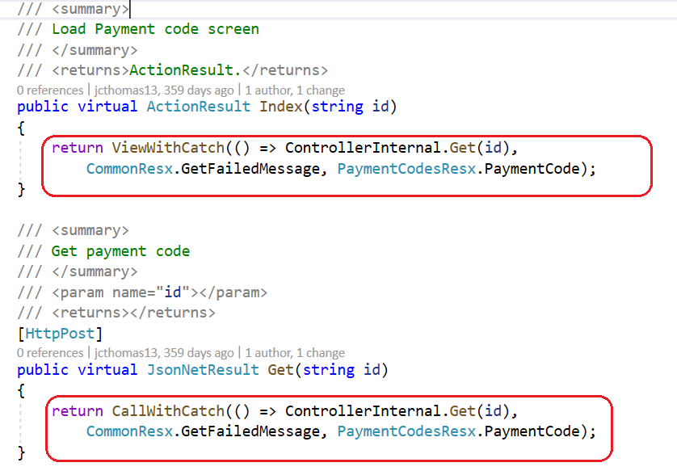
Information Sharing
Controller’s ViewWithCatch, CallWithCatch, Better Encapsulation
Public controller methods introduced a couple of releases ago that allow consistent and encapsulated error trapping of public methods
Code Generation Wizard generates this code
Still lots of boilerplate code that can be pushed down into a base class
Public and Internal controller’s for a simple screen contain over 300 lines of code
AR Payment Code
Public controller has 161 lines
Internal controller has 163 lines
That’s 324 lines for a simple screen
What if the 324 lines can be reduced to 106?
Let’s see how
Web Screens

Slide 38
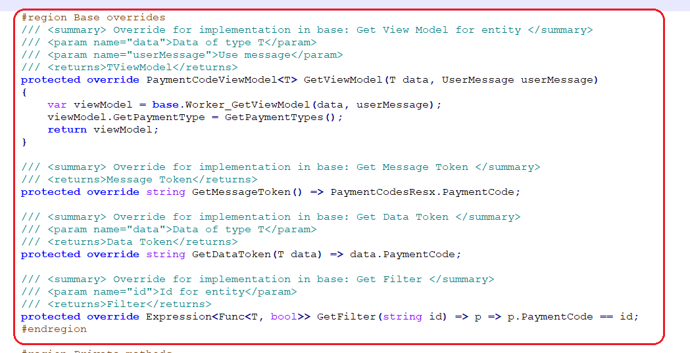
Information Sharing
Controller’s ViewWithCatch, CallWithCatch, Better Encapsulation and the Future
New controller inheritance
Eliminate internal controller
Public methods pushed down to base class
Overrides in derived class for common token replacements and usage
3 minimum overrides
Any base method may be overridden
Reduces code by 68%
Reduces developer error by eliminating redundancy
Still in POC but super excited
Web Screens

Slide 39
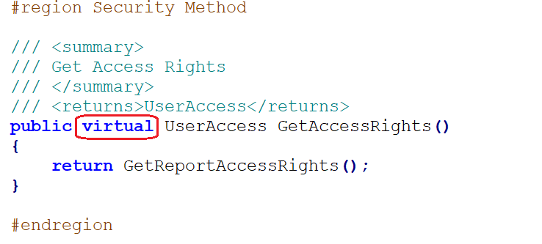
Information Sharing
Adding or Altering a Report’s Access Rights
Web Screens
GetAccessRights() in BaseReportRepository not virtual
Overriding can be accomplished by implementing own method
Discovered recently!
Base class changed for 2023.1 release

Slide 40
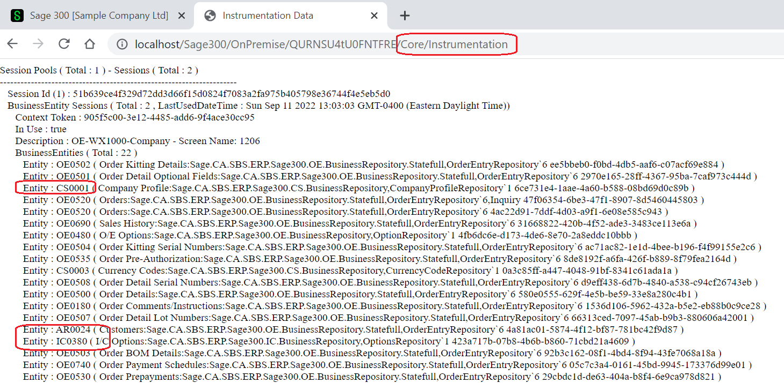
Information Sharing
Instrumentation Page and Caching
Look at opened sessions and views
Access the …/Core/Instrumentation endpoint in a separate browser tab
Any stateless screen will not show any opened views as only stateful screens are cached
Notice how Order Entry Screen also caches any view opened by Order Entry endpoint
Caching of stateful screens
Achieved by NOT wrapping repository in Using statement
Session destroyed upon screen closure
Non-stateful sessions are reused or marked as not in use when processing is complete
Web Screens

Slide 41
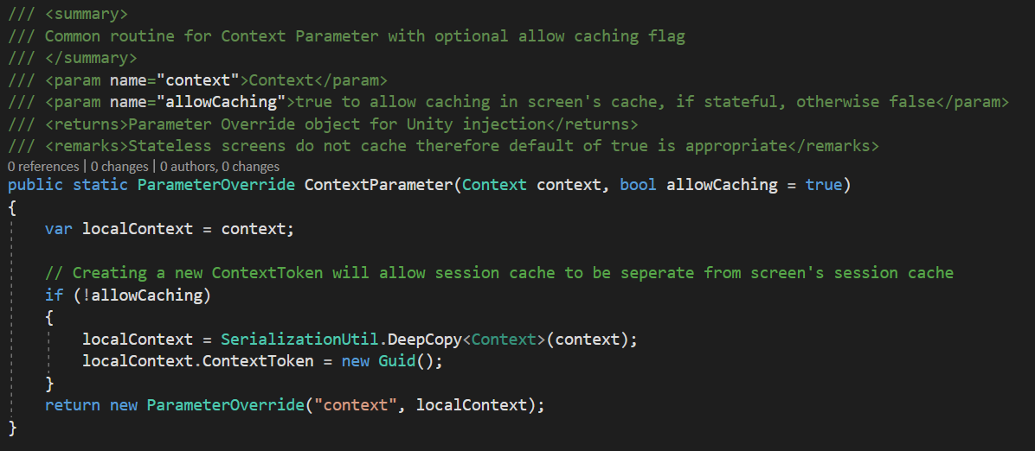
Information Sharing
Caching of Stateful Entities
Caching of any view opened by Order Entry endpoint, i.e., in controller, may be told NOT to cache
Change coming in 2024.0 release
Web Screens
Sage 300 Screen
Context Token Assigned
Controller
Optionally Generate
New Context Token
Worker
Repository
Sage 300 Repository belonging to screen
OpenEntity

Slide 42
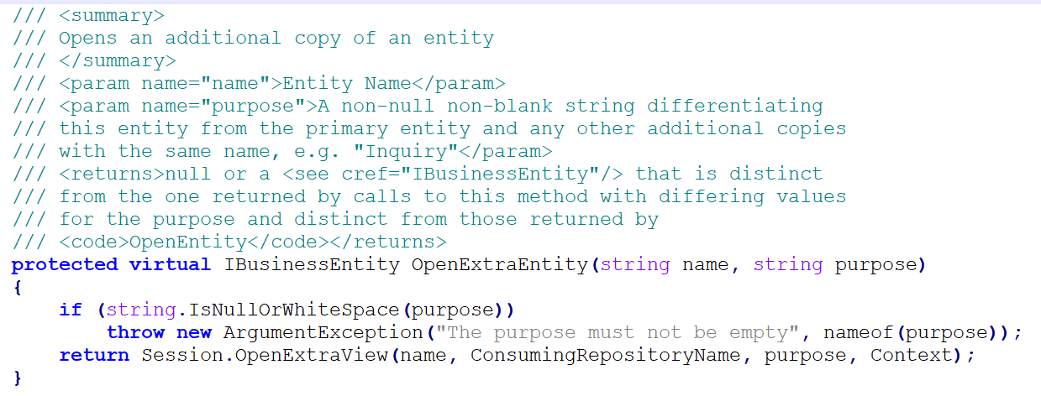
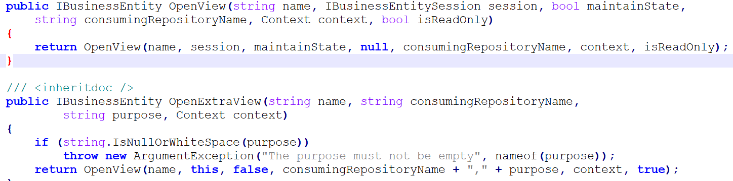
Information Sharing
How to Open a Business View as Read-Only
Business Views are opened and inherit rights assigned to user
What if you have a need for a worker view or read-only view?
OpenExtraEntity method in the business repository allows you to open a view in read-only mode
Invokes session’s OpenExtraView with read-only parameter set
But what if you want to open an extra entity but not have it be read only?
The session’s OpenExtraView has an interface that allows the read-only parameter to be specified
Web Screens

Slide 43
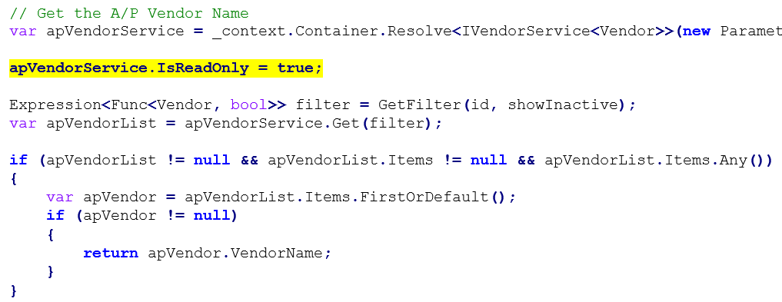
Information Sharing
How to Open a Service as Read-Only
Prior to the “new” finders in the web screens, all finders leveraged existing services and repositories
We set these to be read-only for better performance
This framework ability still exists
After getting service, set read-only bit before invoking method
Note: Once set for that instance of the service, all method calls will be read-only
Web Screens

Slide 44
Information Sharing
Enhanced AND OR Logic added to Menu XML File’s Security Property
Web Screens
Comma character is “AND”
Dash character is “OR”
XXMATRQINQ-XXMATRQMTN,XXMTMATREQ-XXMTPURREQ
A or B and C or D does not evaluate properly
Changing to the following with revised supporting logic will evaluate properly
XXMATRQINQ,XXMTMATREQ-XXMATRQINQ,XXMTPURREQ-XXMATRQMTN,XXMTMATREQ-XXMATRQMTN,XXMTPURREQ
(A and C) or (A and D) or (B and C) or (B and D)

Slide 45
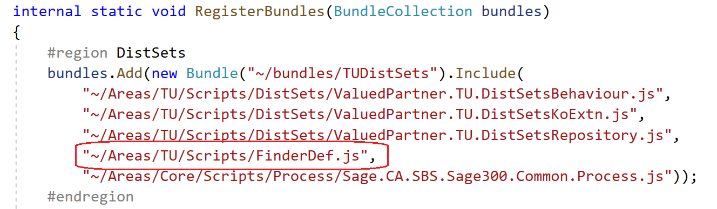
Information Sharing
Partner Finder Definition File
Sage Finder definitions in ViewFinderProperties.js
Partners can create their own definition file for their finder definitions
By default, wizard names file as FinderDef.js regardless of partner file name
If name is not FinderDef.js, modify the RegisterBundles routine in the BundleRegistration,cs file
Web Screens

Slide 46
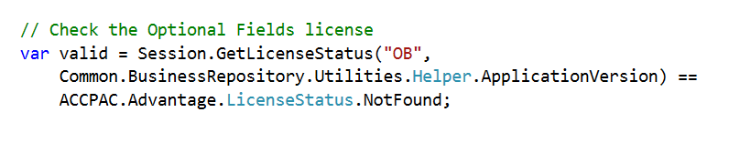
Information Sharing
How to Check for Licenses
Web Screens
You are in your repository
You need to see if a license exists
Invoke the GetLicenseStatus routine

Slide 47
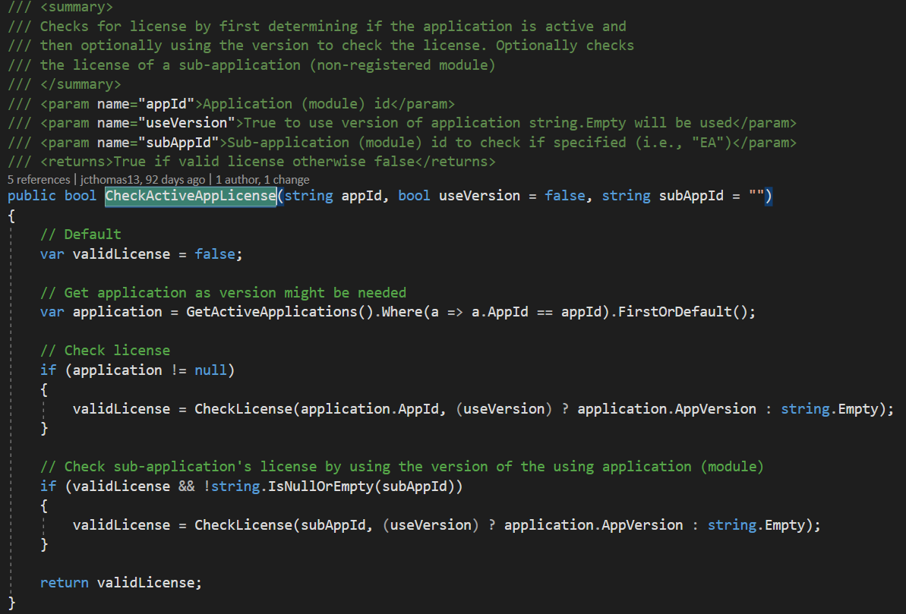
Information Sharing
How to Check for Licenses for Non-Registered Modules
Web Screens
While creating the Payroll Web Screens, we realized that in addition to checking the license for a module, we also need to specify the version and version for non-registered modules like EFT
Coming in 2024.0 release

Slide 48
Information Sharing
How to Deal with Nullable Dates not Defaulting to 1/1/2001
Web Screens
Non-Nullable dates can be decorated with ValidateDateFormat with the data type of DateTime
Mapper must use the same type in GetValue calls
Value will be 01/01/2001 if value is null
Nullable dates can be decorated with ValidateDateFormatAllowNull with the data type of DateTime?
Mapper must use the same type in GetValue calls
Value will be null if value is null

Slide 49
Declarative Report Framework
Explained

Slide 50
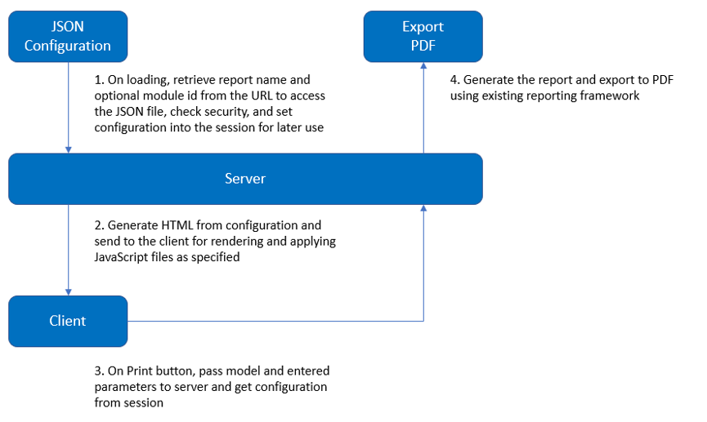
Declarative Report Framework
Explained
Web Screens

Slide 51
Declarative Framework for Simple Reports
Sample Configuration and Example
{
"ReportNames": [ "APACCT01"],
"ReportName": "APACCT01",
"EntityName": "AP0006",
"ScreenNameText": "TPAC Report for Account Sets",
"Module": "AP",
"SecurityResource": "APCOMUI",
"Parameters": [
{
"Name": "FROMCODE",
"Length": "6",
"ControlType": "Finder",
"FinderDefinition": "sg.viewFinderProperties.AP.AccountSet",
"LabelText": "Account Set From",
"ID": "txtFromAcct",
"ButtonID": "btnFromAcct",
"HtmlAttrs": [
{
"Key": "formattextbox",
"Value": "alphaNumeric"
}
]
},
{
"Name": "TOCODE",
"Length": "6",
"ControlType": "Finder",
"FinderDefinition": "sg.viewFinderProperties.AP.AccountSet",
"LabelText": "Account Set To",
"ID": "txtToAcct",
"ButtonID": "btnToAcct",
"DefaultValue": "ZZZZZZ",
"HtmlAttrs": [
{
"Key": "formattextbox",
"Value": "alphaNumeric"
}
]
}
]
}
Simple reports
A few user inputs
Note: Coming in the 2024.0 release we have added support for an optional field grid
Note: We have used framework where up to 30 inputs are on the report
Localization capabilities!
Create JSON definition
Use text editor to create JSON file
Web Screens

Slide 52
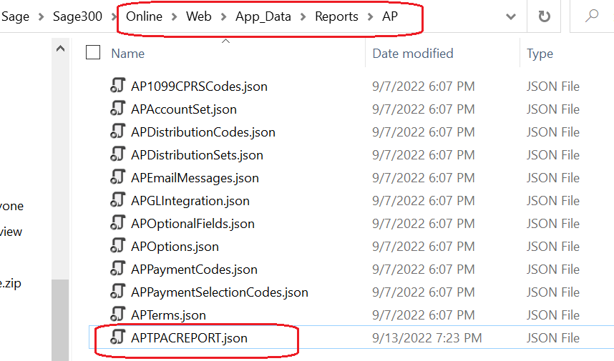
Declarative Framework for Simple Reports
Sample Configuration and Example
Place JSON in Online\Web\App_Data\Reports\{module}
Framework location for definitions
Web Screens

Slide 53
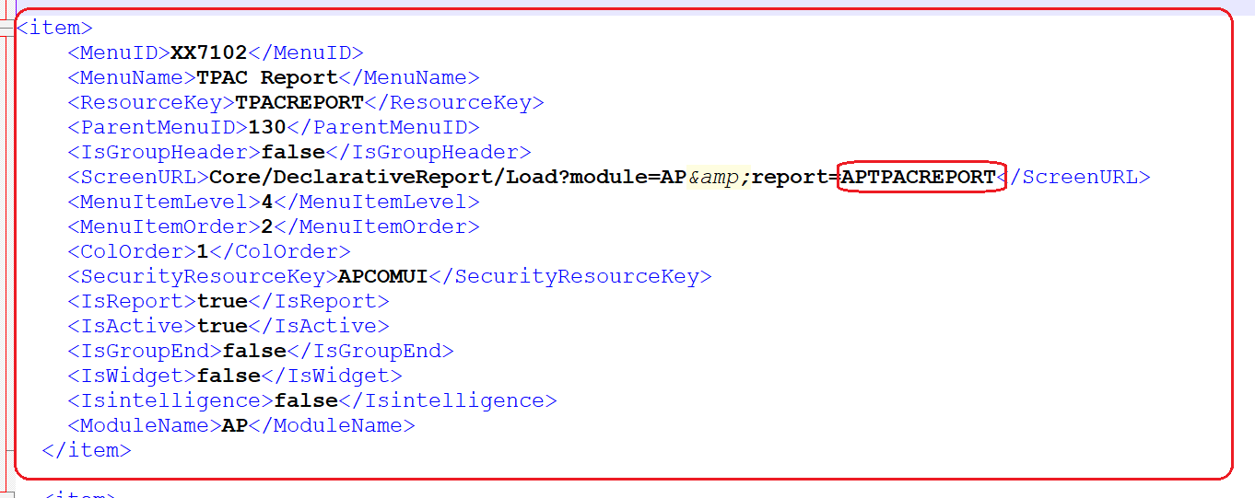
Declarative Framework for Simple Reports
Sample Configuration and Example
Modify {module}MenuDetails.XML in App_Data\MenuDetails folder
Web Screens

Slide 54
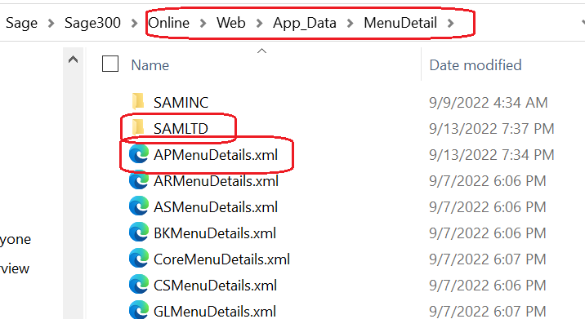
Declarative Framework for Simple Reports
Sample Configuration and Example
Re-start application
Application caches menu and therefore needs restarting
Note: Modify {module}MenuDetails.XML in root and delete {company} folder
Web Screens

Slide 55
Thank you!

