Slide 1
Sage 300 Web SDK
2021.2 Overview
March 18, 2021

Slide 2

“The goal of the Web SDK is to get developers up and running quickly and easily.”

Slide 3
Versions

Slide 4
Versions
No changes from 2021.0
Note: Sage 300 2021.1 did not require a Web SDK version

Slide 5
Corrected Issues

Slide 6
Corrected Issues
Misc
Post-build merge utility not minifying all JavaScript files due to ES6 syntax Resource Lock Test method failing in Accpac layer Import/Export user identified in as correct user in Accpac layer from Web
Order Entry’s height of grid Receipt’s data-binding for drop box Segment Code’s grid with no data Source Journal Profile Report not printing
Admin screen not displaying enabled/disabled properly Increased size of package field in Manage tab
Samples
Custom

Slide 7
Wizards

Slide 8
Wizards
Solution
Sync global files
Sync global files
Sync global files Add files for support of Print to PDF
Custom
Standalone Removed “module” requirement XML generated even if no UI elements New JavaScript namespace Comp+Name+Screen+”CustomizationUI” Samples refactored
Plug-in “module” area is now “Customization” Sample refactored
Sync resource files
Code
Upgrade
Language

Slide 9
Samples

Slide 10
Samples
Known defects addressed
Updated JDOC in JavaScript files
Customization samples refactored to adhere to new Module, Area and JavaScript changes

Slide 11
Documentation and Tutorials

Slide 12
Documentation and Tutorials
Updated upgrade instructions 2021.0 → 2021.2
Updated wizards, samples and tutorials documents with correct text, images, and instructions
Updated CommonCore.chm
Updated Finder document with recent changes and enhancements
Updated Grid Client and Server documents for available and new functionality
Added new document for new Options Menu interface with examples
Added new document for Server-Side Reporting Callback Feature with examples

Slide 13
Noteworthy

Slide 14
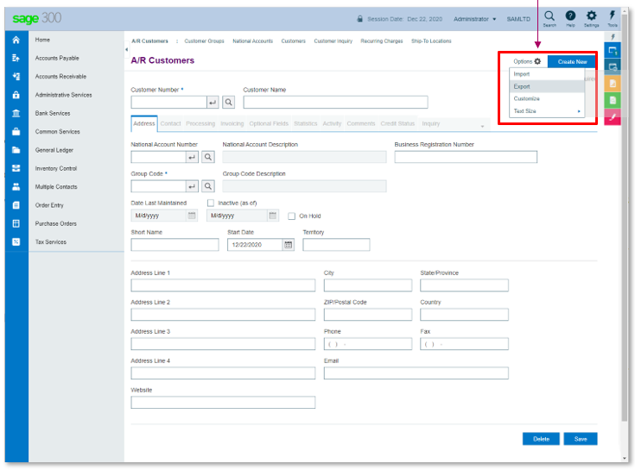
Options Menu JavaScript
Easily add, remove, and otherwise manage the available options in the OptionsMenu
Areas\Shared\Scripts\..OptionsMenu.js
No longer allows only if Import, Export, etc. security is in place
New interface eliminates DOM interaction
All menu items assigned an id
See documentation for usage
Note: disable method coming in August

Slide 15
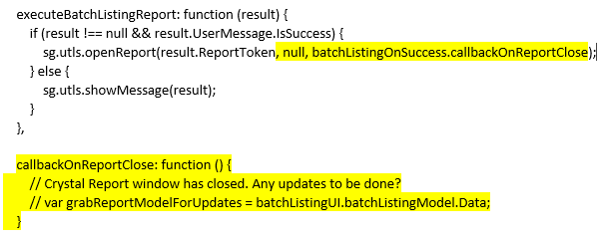
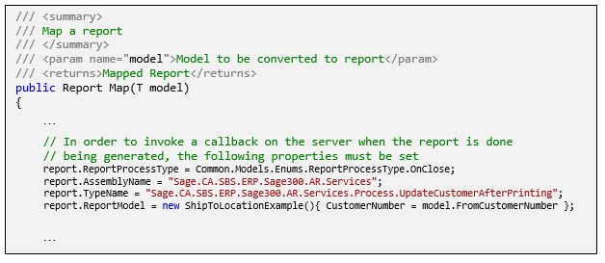
Server-Side Report Callback
Easily invoke functionality when report is complete
Replaces previous client callback functionality on sg.utls.openReport call when report was closed
Print to PDF feature requires this change
Note: New functionality is when report has completed as opposed to closed
See documentation for usage

Slide 16
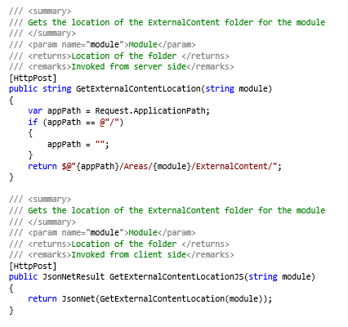
External Content Location
Easily invoke a new endpoint for the location of the ExternalContent folder
Added to the Core\Common controller
Method for JavaScript and C#

Slide 17
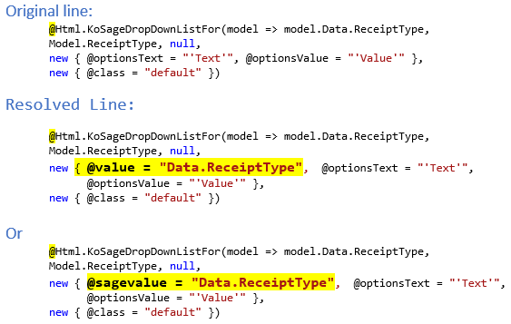
Two-Way Binding for Dropdown
Partners have reported having to manual bind dropdown controls
KoSageDropDownListFor interface is fine
A missing supplied attribute is the cause
See highlighted text
Adding this attribute allow manual code to be removed
Any affected samples have been updated

Slide 18
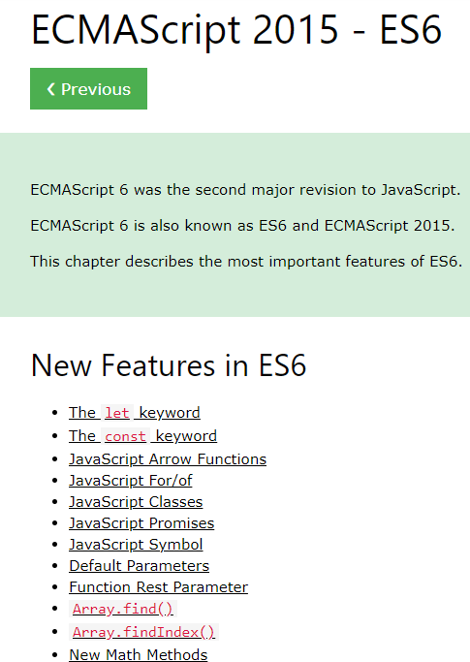
JavaScript ES6
ES6 is not supported by IE11
Web Screens do not support IE11
Developers are free to use ES6 syntax
https://www.w3schools.com/js/js_es6.asp
Note: Minification tool used by post-build utility does not support ES6 and therefore JavaScript files containing ES6 will not be minified
Note: New minification tool coming in August

Slide 19
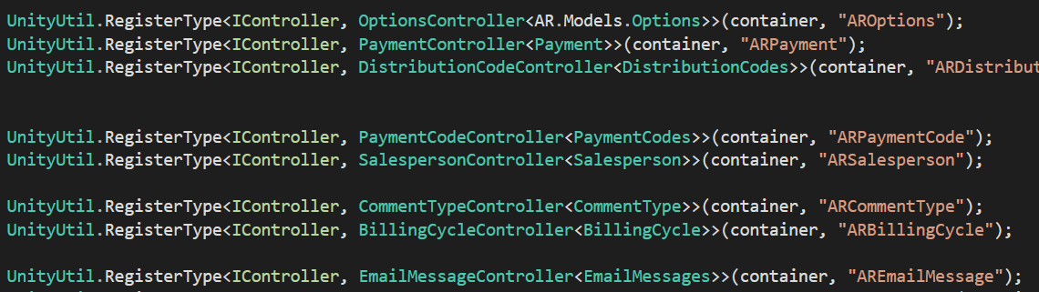
Controller Factory
Performance issue discovered
18% of Sage screens did not prefix module in bootstrapper registration
Any entries in XXBootstrapper.cs needs prefix for efficient lookup and to avoid collisions with other modules
Code Generation Wizard generates correctly
Partners not affected unless manual entries do not specify prefix

Slide 20
Coming in August

Slide 21
Versions
Accpac.Advantage and Accpac.Advantage.Types
6.8.0.0 → 6.9.0.0
JQuery
3.4.1 → 3.5.2
Kendo UI
2019.1.115 → 2021.1.224
Visual Studio 2019 support only
Deprecating support for Wizards using Visual Studio 2017

Slide 22
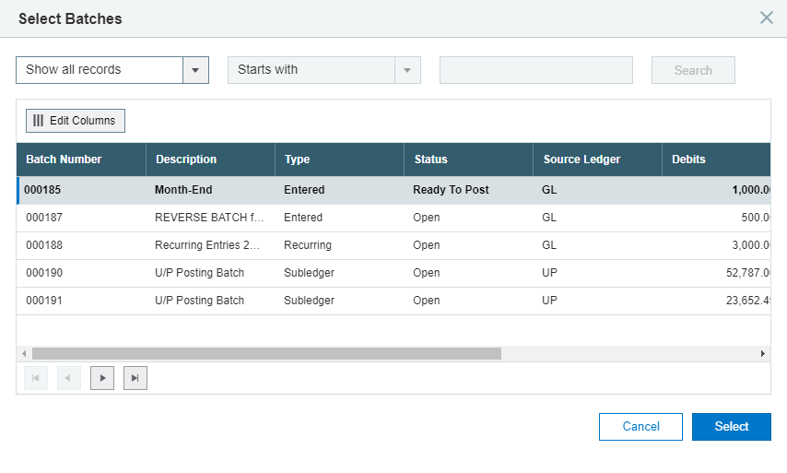
Finder Enhancements
All “old” finders to be deprecated
Enhancements in:
Data Handling
Persistence and Filtering
Resizing and expanding the grid
Sorting
Keyboard Navigation
Reordering of columns
More like the desktop finder!

Slide 23

Minification Enhancement
Terser - Minification tool
JavaScript parser, mangler, optimizer and beautifier toolkit for ES6+
A plugin of WebPack to minify
A fork of uglify-es which was widely used
Command line
Basic syntax check
65% compression rate
~ 5-minute run for 1600+ files

Slide 24
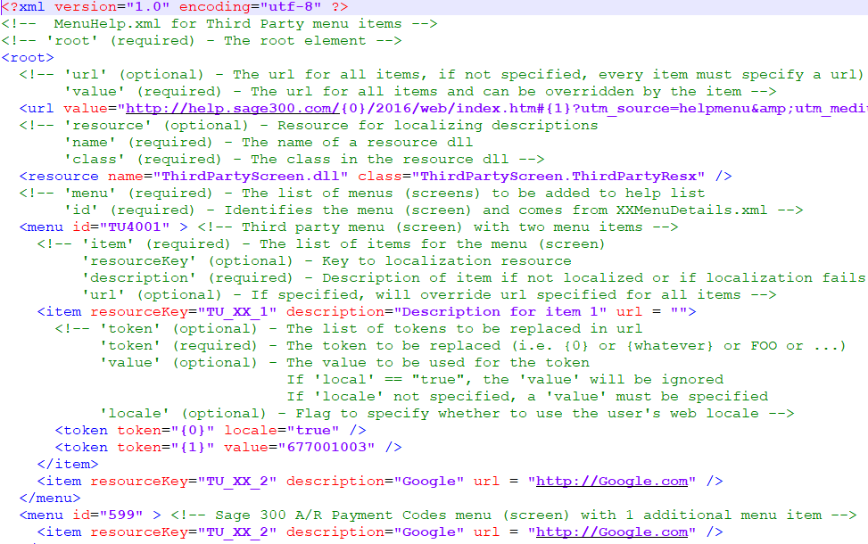
External Web Help for Partners
Add web help to Sage 300’s Help section for screen sensitive help
Partner or other hosts
Partner supplies tokenized URL
Partner supplies a MenuHelp.xml for inclusion in the Web Help
Partner supplies an optional resource for localization
Bonus - Add context sensitive help for our screens too!

Slide 25
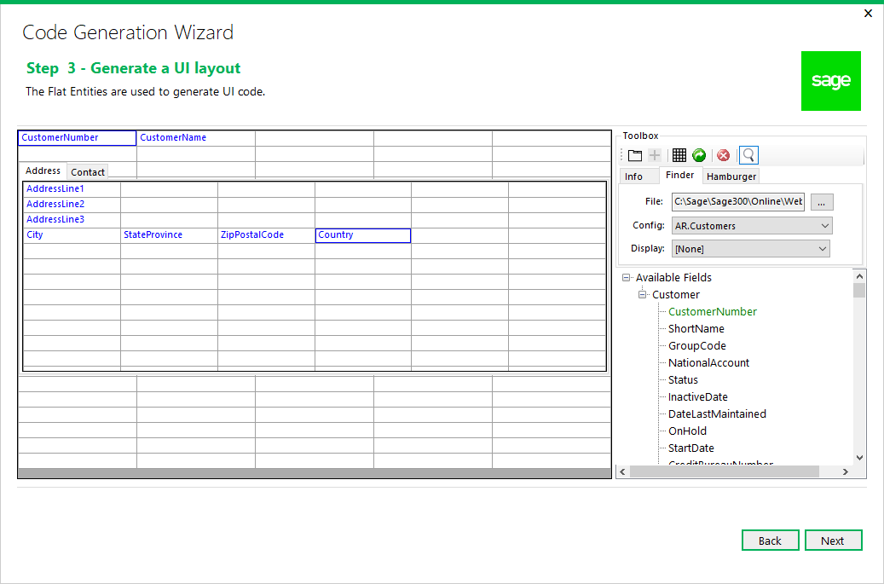
UI Layout Wizard
Use properties being generated for a screen to layout widgets for screen generation
Textboxes, Finders, Grids, Labels, Buttons, Checkboxes, Radio Buttons, Tabs, etc.
Supporting JavaScript stubs and active code for data binding, event handling, initialization, etc.
Note: still in development

Slide 26
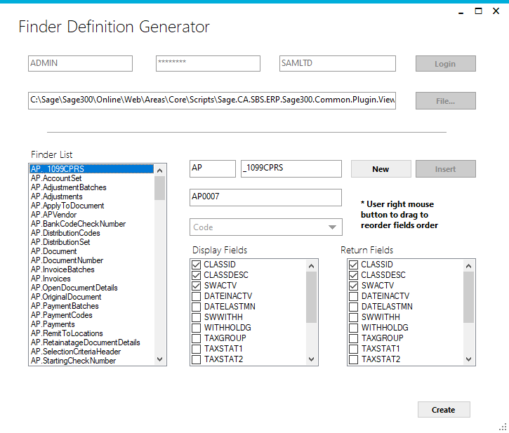
Finder Definition Generator
Internal developers define finders in ..ViewFinderProperties.js
External developers define their finders in their version of ..ViewFinderProperties.js
To be included in partner bundle
Define a file before usage in Code Generation Wizard
Plugin available in Visual Studio
Note: still in development

Slide 27
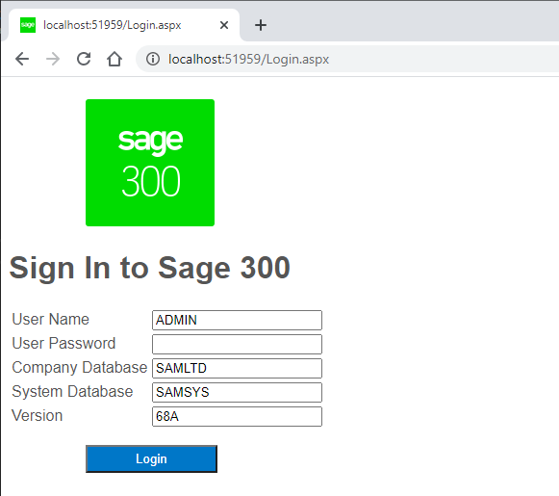
Debug Solution Credentials
Current debug credentials are supplied/hardcoded in partner global.asax.cs
Hardcoding is not optimal, secure, and not efficient for multiple developers
New Login.aspx to be included in solution for dynamic assignment of credentials for debug
Note: still in development

Slide 28
GitHub Repository

Slide 29
GitHub Repository
Open Source
https://github.com/SageNADev/Sage300-SDK
2021.2 is available in the “master” branch
2022.0 is available in the “develop” branch
Archives
2021.0 available in “release-2021.0”
2020.2 available in “release-2020.2”
2020.1 available in “release-2020.1”
2020.0 available in “release-2020.0”
2019.2 available in “release-2019.2”
2019.1 available in “release-2019.1”
2019.0 available in “release-2019.0”
2018.2 available in “release-2018.2”
2018.1 available in “release-2018.1”
2018.0 available in “release-2018”
2017.2 available in “release-2017.2”
2017.1 available in “release-2017.1”
2017.0 available in “release-2017”

Slide 30
Partner Requests

Slide 31

Partner Requests
Bring these to the Sage 300 Product Manager
Add these to the Sage 300 Ideas Site
Sage 300 Ideas Forum
You voice and feedback resounds the loudest!

Slide 32
Thank you
©2021 The Sage Group plc or its licensors. All rights reserved. Sage, Sage logos, and Sage product and service names mentioned herein are the trademarks of Sage Global Services Limited or its licensors. All other trademarks are the property of their respective owners.

