Slide 1
Sage 300 2019.1 Web SDK Overview
John Thomas (JT)
December 2018

Slide 2
Version Change
Accpac.Advantage and Accpac.Advantage.Types versions are now 6.6.0.10
AccpacDotNetVersion.props files have been updated for samples and source
Version in Code Generation Wizard is still 66A

Slide 3
Solution Wizard
Global Files updated to 2019.1

Slide 4
Code Generation Wizard
Global Files updated to 2019.1
Defects Corrected
Generating a report project failed IF the {module}rpt.ini file contains a blank line
Added optional parameters (, null, true) to sg.finderhelper.setFinder JavaScript method to force finder to fetch record
All Samples updated with correction as well
Changing of key field column name created error condition during generation
Create correct C# data types from VB data types (i.e. Long → Int, etc.)

Slide 5
Customization Wizard
Global Files updated to 2019.1
Added modules TA and TS for allowed customizations

Slide 6
Upgrade Wizard
Global Files updated to 2019.1
No 2019.1 specific changes for this release

Slide 7
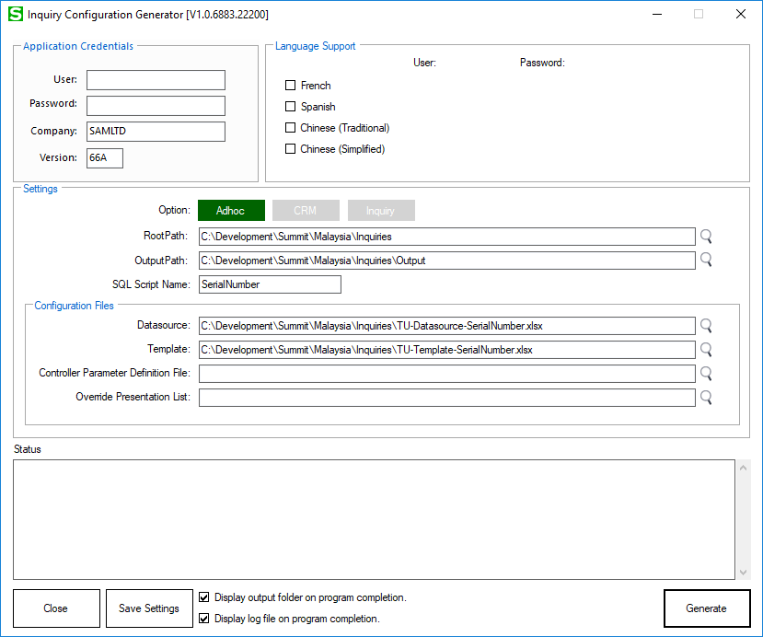
Inquiry Configuration Utility
New utility located in bin\utilities\Sage300InquiryConfigurationGenerator
Utility allows for the creation of metadata to drive generic inquiry and adhoc inquiry displays
Documentation in docs\utilities
Tutorial in docs\development
Source in src\utilities
Metadata samples in samples\inquiries\metadata

Slide 8
Samples
Global Files updated to 2019.1
Added optional parameters (, null, true) to sg.finderhelper.setFinder JavaScript method to force finder to fetch record
Added new sample metadata for Inquiry Configuration Generator

Slide 9
Merge ISV Project
Removed web.config file(s) from deployment folders

Slide 10
Documentation
Updated Upgrade Instructions for 2019 to 2019.1 in docs\upgrades
New Sage300SDK_20191WebSDKOverview.pptx in docs\presentations
Updated Sage300SDK_CodingPatterns.docx in docs\patterns
New docs for Inquiry Configuration Generator
docs\utilities\Sage300SDK-InquiryConfigurationGeneratorUtility.docx
docs\development\Sage300SDK-GenericInquiryConfigurationTutorial.docx

Slide 11
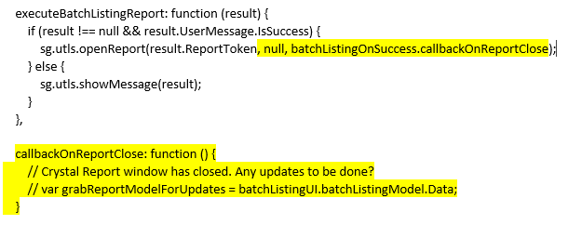
Open Report Enhancement
Partners have requested the ability to know when a report, opening a Crystal Report in a separate window, is closed
A third parameter has been added to the “openReport” method, which is located in the Global.js file, to pass in a callback event
Note: The second parameter is to be NULL unless a different report name is required
Using the A/R Batch Listing Report as an example, the …Behaviour.js is modified as follows:

Slide 12
Partner Defects in the Application

Slide 13

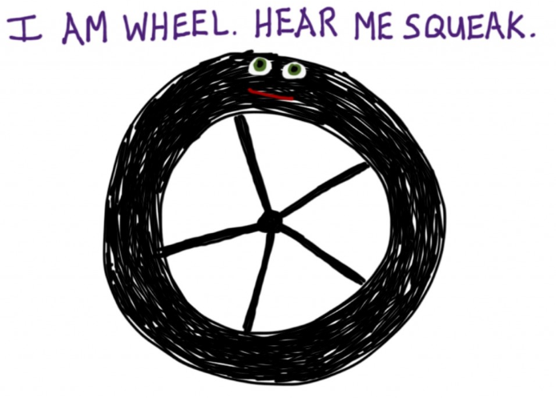
Who Needs to Hear Partner Requests?
Sage 300 Product Manager
Allocates capacity per release and sets roadmap for product
Contact him regarding functionality, documentation, tutorials, enhancements, etc. not in the SDK that should be there to better assist with efficient development practices
Architecture/Development capacity requests
We will advise, address and allocate resources within our capacity
Tracking requests on high, medium, low priority basis
The partner’s voice and feedback resounds the loudest!

Slide 14
GitHub Repository
Open Source
https://github.com/SageNADev/Sage300-SDK
2019.1 is available in the “master” branch
2019.2 is available in the “develop” branch (in-progress)
2019.0 is available in the “release-2019.0” branch (archive)
2018.2 is available in the “release-2018.2” branch (archive)
2018.1 is available in the “release-2018.1” branch (archive)
2018.0 is available in the “release-2018” branch (archive)
2017.2 is available in the “release-2017.2” branch (archive)
2017.1 is available in the “release-2017.1” branch (archive)
2017 is available in the “release-2017” branch (archive)

