Slide 1
Sage 300 2019.2 Web SDK Overview
John Thomas (JT)
May 2019

Slide 2
Versions
Accpac.Advantage and Accpac.Advantage.Types versions are still 6.6.0.10
Version in Code Generation Wizard is still 66A
Kendo has been upgraded to 2019.1.115
.NET Framework has been updated to 4.7.2
SDK.BuildTasks updated to 14.0.14.9.23

Slide 3
Solution Wizard
Global Files updated to 2019.2
Target Framework 4.7.2
Kendo has been upgraded to 2019.1.115
Defects Corrected
None

Slide 4
Code Generation Wizard
Global Files updated to 2019.2
Target Framework 4.7.2
Defects Corrected
Wizard properly generates check for ViewModel.UserAccess == null and invokes GetAccessRights()
Generates new code for Finder
No more Finder Controller, BootStrapper, JavaScript code
Replaced with simple finder definition in JavaScript code
Generates new code for Grid on Header/Detail type if option selected
Creates JSON Grid Definition file and the necessary code to display a grid

Slide 5
Customization Wizard
Global Files updated to 2019.2
Target Framework 4.7.2
Defects Corrected
None

Slide 6
Upgrade Wizard
Global Files updated to 2019.2
Target Framework 4.7.2
All projects in solution upgraded to target Microsoft .NET Framework 4.7.2
Defects Corrected
None

Slide 7
Samples
Global Files updated to 2019.2
Target Framework 4.7.2
All samples upgraded to use new Finder
Receipt sample upgraded to use new Grid

Slide 8
Merge ISV Project
Defects Corrected
Removed web.config file(s) from deployment folders

Slide 9
Documentation
Updated Upgrade Instructions for 2019.1 to 2019.2 in docs/upgrades
New Sage300SDK_20192WebSDKOverview.pptx in docs/presentations
Updated Sage300SDK_WorkerProcessing.docx in docs/development
New Sage300SDK_GridClientInterface.docx in docs/development
New Sage300SDK_GridServerInterface.docx in docs/development
New Sage300SDK_FinderArchitecture.docx in docs/development
Updated docs for copyrights, screenshots, etc.

Slide 10
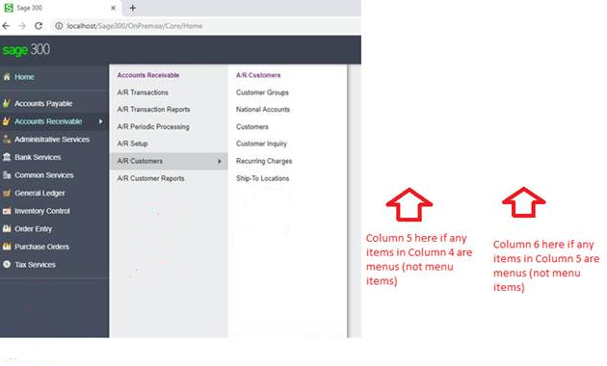
Partner Defects/Enhancements in the Application
PageUrl.txt extension
Can have multiple lines in the pageurl.txt file for developer efficiency
Deserialization of model from JavaScript to C#
An error is likely if Resx entries for the model attributes are missing
Extended number of menu columns on Home Page to 6 if needed
Worker Service stops in under 2 seconds now (removed wait 60!)

Slide 11
Worker Process Enhancement
Debugging a Process Type screen just got easier
Difficulty
Part of the Process is in the Web Role while another part is in the Worker Role
Must debug with Logger statements or attaching to process running in IIS
Solution
Workflow Manager Class has been modified to determine if running in IDE
Instead of offloading work to MSMQ to deliver to Worker Role, Worker Processor will be accessed
Message payload manually handed off to processor instead of via queue
Results
Put debug statements in your UOW Service or Business repository classes
No longer need to shutdown worker service and build in Release mode to get artifacts to Worker folder
Documentation
See updated Sage300SDK_WorkerProcessing.docx in docs\development

Slide 12

Finder - Motivation
Too much code
Lots of code in the internal finder controller just to configure
Too much complex and redundant code
Finder definition info can be found/gathered elsewhere
Customization
Can’t add a partner finder to a Sage 300 screen
Inefficient
Designed to re-use Controller→Service→Repository classes
Maps Accpac view to model for all properties
Dynamic or on-the-fly finders are not possible

Slide 13

Finder – New Design
Minimal Code
Specify a definition in 1 line of code or use one of our definitions
Eliminate complex and redundant code
Grid and column definitions will be discovered
Customization
Put a partner finder on a Sage 300 screen and visa-versa
Ability to create dynamic finders
Efficiency
Access Accpac View directly
No more inefficient mapping of all properties

Slide 14
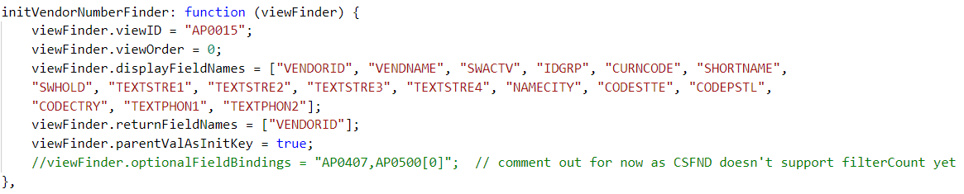
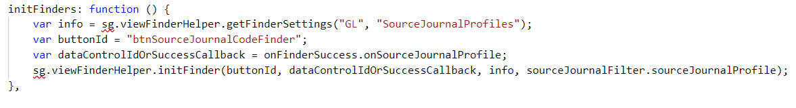
Finder – New Interface
Documentation
Sage300SDK-FinderArchitecture.docx
Define your own
Use one of ours

Slide 15
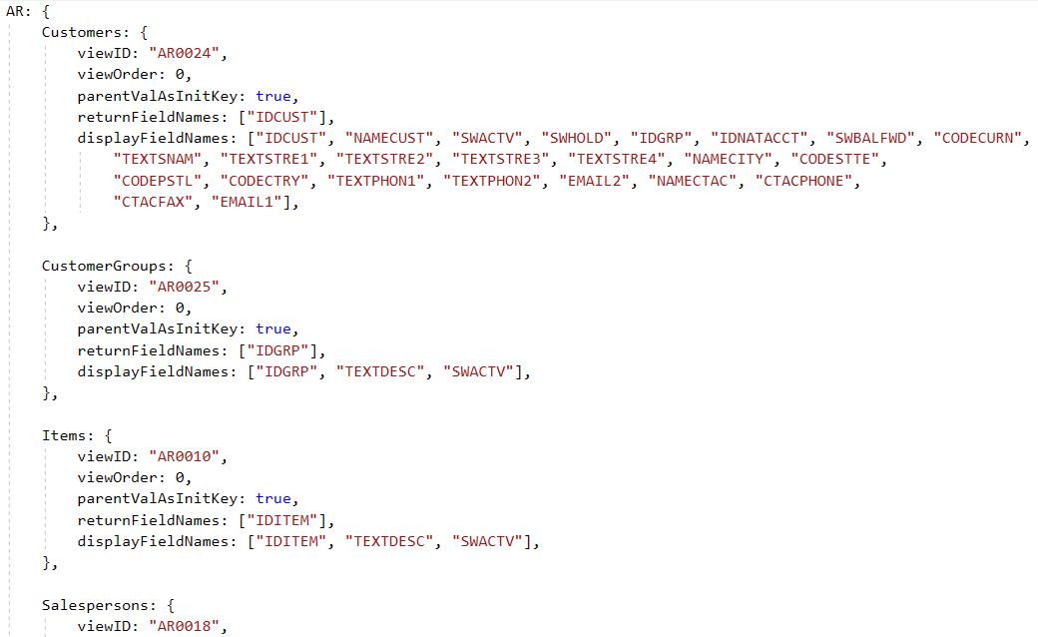
Finder – Finder Properties
Sage.CA.SBS.ERP.Sage300.Common.Plugin.ViewFinderProperties.js
Minimal definitions for 2019.2
More definitions coming in 2020

Slide 16
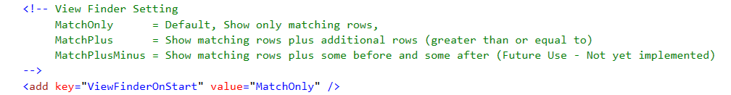
Finder – Old Vs. New Finder
Old finders will continue to work
Upgrade wizard will not replace existing old finders
Code Generation wizard will generate new finder logic
Web.config setting for controlling display of new finder
NOTE: This is for future use to present a display similar to the desktop. However, only the “MatchOnly” behavior is supported and changes to the other behaviors are not supported and are at your own risk

Slide 17
Web Grid - Motivation
Overly complex framework and implementation
Lots of setup, lots of code for every screen with a grid
Repository pattern (entire screen UI as one repository)
Unlike the desktop where every grid has its own data source
No generic grid control
No “standard” implementation, interface, events
Usability issues
Differences from screen to screen
Selecting multiple lines
Editing inside a cell can be finicky

Slide 18
Web Grid – New Design
Addresses the motivation points
Complexity, bundled with UI payload, generic control, usability issues
New pattern for header-detail type repository on server
Elimination of fixed header-detail pattern
Common repository interfaces directly with Business Views
Code Generation Wizard generates entities and compositions
New generic grids on the client
View List (the most common grid which supports CRUD operations)
Optional Fields Control (setup or edit of optional fields)
Only setup for 2019.2 release
Other (i.e. Tax Authorities type grid)
Not in 2019.2 release

Slide 19
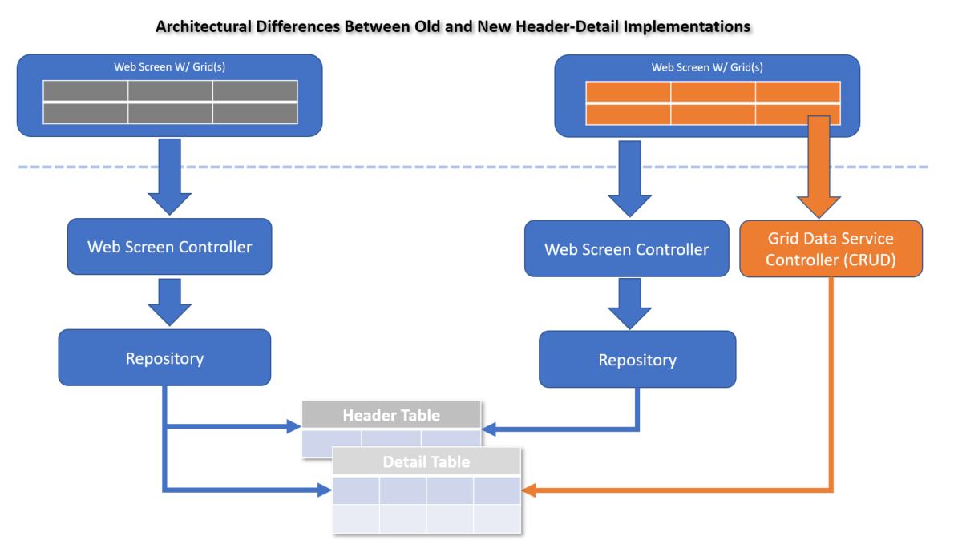
Web Grid – Architecture
Header-Detail Differences
Generic grid and controller manages the CRUD operations
Compartmentalizing the grid with backend Business Views
Simplifies the payload for the UI
More responsive and better performing
Less developer code
Extensible
Grid defined in JSON file
Client interface
Server interface
Extend JSON to participate in events and methods

Slide 20
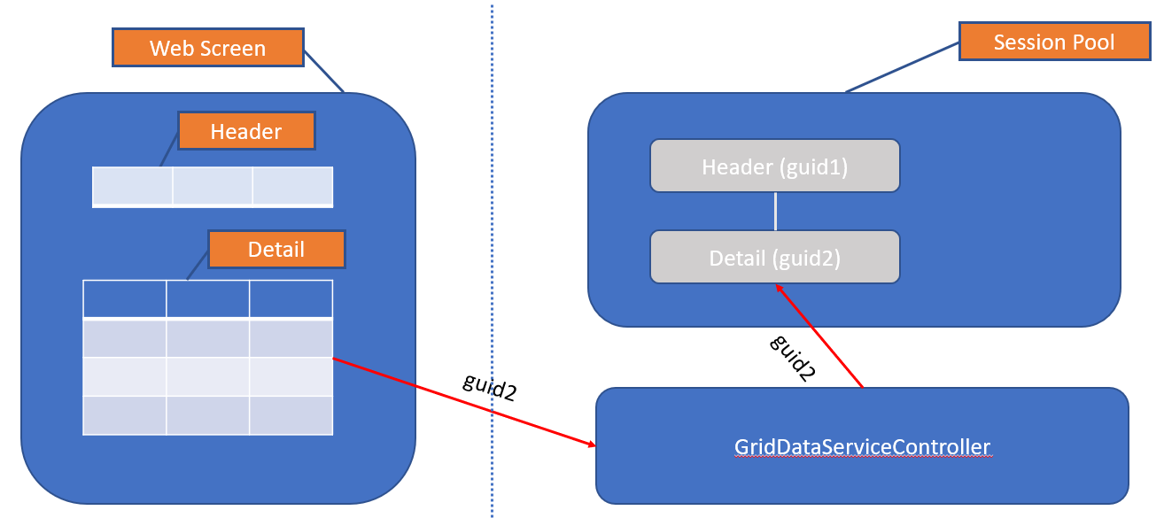
Web Grid – Interactions with Business Entity
Added a “guid” property to each Business Entity
Grid DOM object has “guid” attribute
Grid library sends the “guid” to the GridDataServiceController for every interaction
GridDataServiceController looks up the Business Entity in the session pool using “guid”
GridDataServiceController performing CRUD operations on the Business Entity

Slide 21
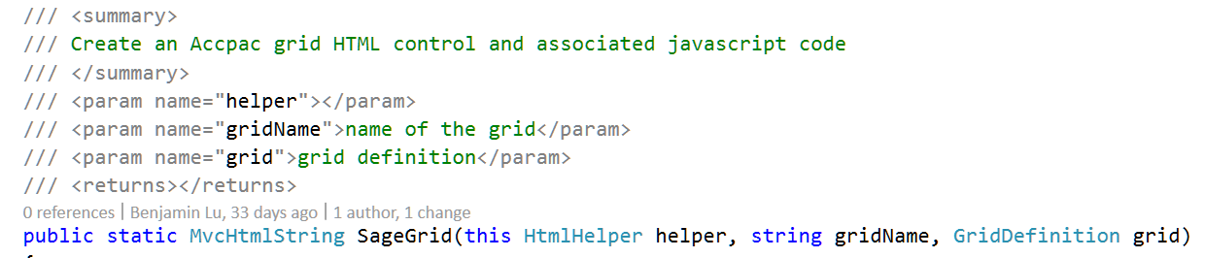
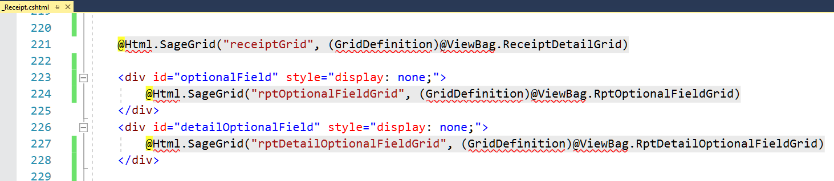
Web Grid – Grid HTML Helper

Slide 22
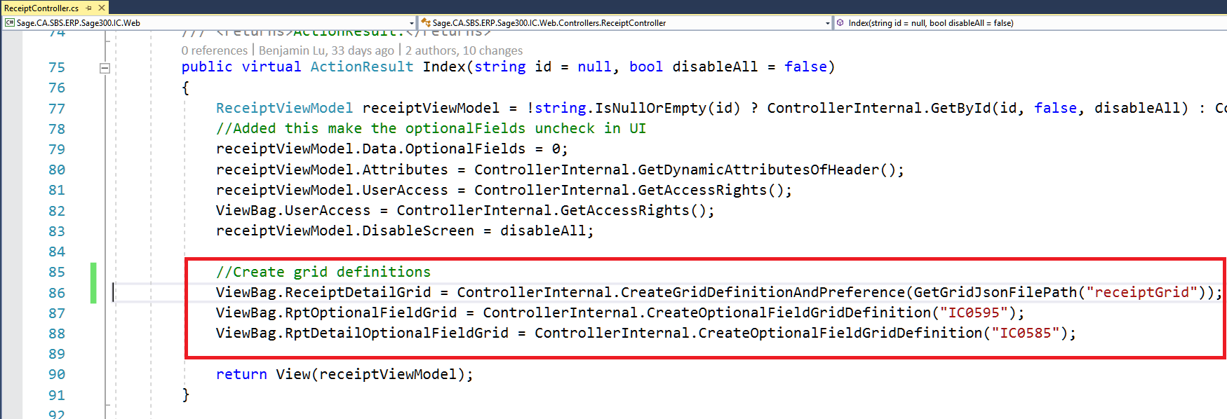
Web Grid – Grid HTML Helper

Slide 23
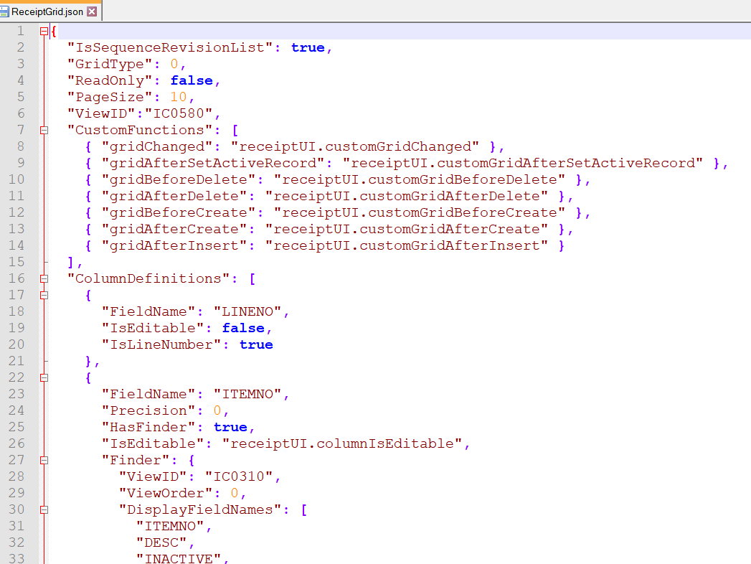
Web Grid – JSON Configuration File
Config is now in a file
Can be generated by the wizard
Customization / Extension

Slide 24
Web Grid – Client Interface
Documentation
Sage300SDK-GridClientInterface.docx
Assumptions
Client and server are always synchronized
All columns must be defined in the JSON file
Control is created using an HTML helper
Configuration
init
Methods
refresh, commit, dirty, allowsInsert, allowsDelete, showColumn, columnTemplate, currentRecord, filter, readOnly, columnCount, fieldName, columnTitle, columnEditable, setValue
Events (grid and column level)
columnChanged, gridChanged, gridAfterSetActiveRecord, gridBeforeDelete, gridAfterDelete, gridBeforeCreate, gridAfterCreate, gridAfterInsert, columnBeforeDisplay, columnDoubleClick, columnBeforeFinder, columnBeforeEdit, columnStartEdit, columnEndEdit

Slide 25
Web Grid – Server Interface
Documentation
Sage300SDK-GridServerInterface.docx
Customization
Server side only
CRUD routed to the GridDataServiceController
Create your controller to inherit and override as needed
Register your controller in the bootstrapper
Define your controller in the grid’s JSON file (i.e. GridDataServiceController : MyGridDataServerController)
Customization Methods
Read, Create, Insert, Update, MoveTo, Delete

Slide 26
Web Grid – Web SDK
Code Generation Wizard
Generates working grid for header-detail type UI
Select “Generate Grid” in options tab
Generates new Finder (dynamic, extensible, faster, less code, …)
Samples
All refactored to use new finder
Receipt refactored to use new grid
Documentation
Grid Client Interface Definition
Grid Server Interface Definition

Slide 27


Who Needs to Hear Partner Requests?
Sage 300 Product Manager
Allocates capacity per release and sets roadmap for product
Contact him regarding functionality, documentation, tutorials, enhancements, etc. not in the SDK that should be there to better assist with efficient development practices
Architecture/Development capacity requests
We will advise, address and allocate resources within our capacity
Tracking requests on high, medium, low priority basis
The partner’s voice and feedback resounds the loudest!

Slide 28
GitHub Repository
Open Source
https://github.com/SageNADev/Sage300-SDK
2019.2 is available in the “master” branch
2020 is available in the “develop” branch (in-progress)
Archives
2019.1 available in “release-2019.1”
2019.0 available in “release-2019.0”
2018.2 available in “release-2018.2”
2018.1 available in “release-2018.1”
2018.0 available in “release-2018”
2017.2 available in “release-2017.2”
2017.1 available in “release-2017.1”
2017.0 available in “release-2017”

