Slide 1
Sage 300 2019.1 Web SDK Overview
John Thomas (JT)
October 2018

Slide 2
Version Change
Accpac.Advantage and Accpac.Advantage.Types versions are now 6.6.0.10
AccpacDotNetVersion.props files have been updated for samples and source
Version in Code Generation Wizard is still 66A

Slide 3
Solution Wizard
Global Files updated to 2019.1

Slide 4
Code Generation Wizard
Global Files updated to 2019.1
Defects Corrected

Slide 5
Customization Wizard
Global Files updated to 2019.1

Slide 6
Upgrade Wizard
Global Files updated to 2019.1

Slide 7
Inquiry Configuration Wizard
TBD
Wizard allows for the creation of metadata to drive generic inquiry and adhoc inquiry displays

Slide 8
Samples

Slide 9
Merge ISV Project

Slide 10
Documentation
Updated Upgrade Instructions for 2019 to 2019.1 in docs\upgrades
New Sage300SDK_20191WebSDKOverview.pptx in docs\presentations

Slide 11
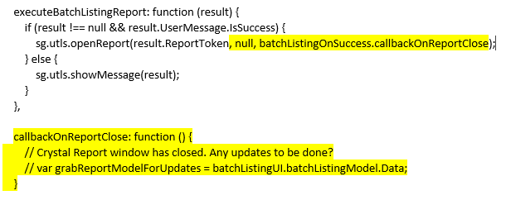
Open Report Enhancement
Partners have requested the ability to know when a report, opening a Crystal Report in a separate window, is closed
A third parameter has been added to the “openReport” method, which is located in the Global.js file, to pass in a callback event
Note: The second parameter is to be NULL unless a different report name is required
Using the A/R Batch Listing Report as an example, the …Behaviour.js is modified as follows:
See blog:

Slide 12
Partner Defects in the Application

Slide 13


Who Needs to Hear Partner Requests?
Sage 300 Product Manager
Allocates capacity per release and sets roadmap for product
Contact him regarding functionality, documentation, tutorials, enhancements, etc. not in the SDK that should be there to better assist with efficient development practices
Architecture/Development capacity requests
We will advise, address and allocate resources within our capacity
Tracking requests on high, medium, low priority basis
The partner’s voice and feedback resounds the loudest!

Slide 14
GitHub Repository
Open Source
https://github.com/SageNADev/Sage300-SDK
2019.1 is available in the “master” branch
2019.2 is available in the “develop” branch (in-progress)
2019.0 is available in the “release-2019.0” branch (archive)
2018.2 is available in the “release-2018.2” branch (archive)
2018.1 is available in the “release-2018.1” branch (archive)
2018.0 is available in the “release-2018” branch (archive)
2017.2 is available in the “release-2017.2” branch (archive)
2017.1 is available in the “release-2017.1” branch (archive)
2017 is available in the “release-2017” branch (archive)

