Slide 1
Sage 300 2018.2 Web SDK Overview
John Thomas (JT)
April 2018

Slide 2
Defects Corrected
Code Generation Wizard
Simplified and corrected Expression in Finder generated code
Validation for “EntityName” as a generated property
…Behavior JavaScript file on successful return from finder to invoke controller’s Get method
“Type” enumeration used to be generated as {entityname}Type.cs
Caused issues with global Optional Fields implementation
“Type” is now generated as “Type” but avoid conflict with System.Type with $companynamespace$.$moduleId$.Models.Enums prefix

Slide 3
Version Change
Accpac.Advantage.Types version is now 6.5.0.20
AccpacDotNetVersion.props files have been updated in samples and source
New settings folder in Web SDK contains a single file that the samples reference
Generated solutions will still get their own copy

Slide 4


Images for Partner Menus
Added IconName element to {module}MenuDetails.xml
Defaults to “puzzle piece” image if not specified (menuIcon.png)
Added as $companynamespace$/menuIcon.png
Added MenuBackGroundImage element to {module}MenuDetails.xml
Defaults to “discussion” image if not specified (menuBackGroundImage.jpg)
Added as $companynamespace$/menuBackGroundImage.jpg
MergeISVProject copies from Web project’s Content\Images\Nav folder to External\Content\Images\Nav\$companynamespace$ folder
This is where you will deploy your images, if any, with these names:
menuIcon.png
menuBackGroundImage.jpg

Slide 5
MergeISVProject Executable
Used by various wizards as well as partners projects
Existing functionality when partner project is in Release mode:
Pre-compiles razor views
Deploys assets to local Sage 300 installation folders for testing
New for 2018.2 when the partner project is in Release mode:
Minifies JavaScript files
Takes the compiled assets and bundles them up for deployment
New informative messages in Visual Studio output window

Slide 6
Sage300Utilities Executable
New for 2018.2
Prebuild utility for the Sage 300 UI Wizard project
Facilitates the building of the template files in the src\templates folder
Note: Only relevant if Wizard package is built in Visual Studio

Slide 7



Visual Studio 2017
Wizard manifests now include Visual Studio 2017 as a targeted IDE
Visual Studio 2013 and Visual Studio 2015 still supported

Slide 8
Documentation
Upgrade Instructions for 2018.1 to 2018.2 in docs\upgrades
Wizard and Tutorial documents modified with updated …Behaviour JavaScript change
New Sample4_AR_Invoice_Entry_Customization.docx in samples\customization\Sample4_AR_Invoice_Entry_Customization
New Sage300SDK_2018.2WebSDKOverview.pptx in docs\presentations
Updated Sage300SDK_MergeISVProject_Utility.docx in docs\utilities
New Sage300SDK_Sage300Utilities_Utility.docx in docs\utilities

Slide 9
Global Files Updated to 2018.2
Solution Wizard
Code Generation Wizard
Customization Wizard
Upgrade Wizard

Slide 10
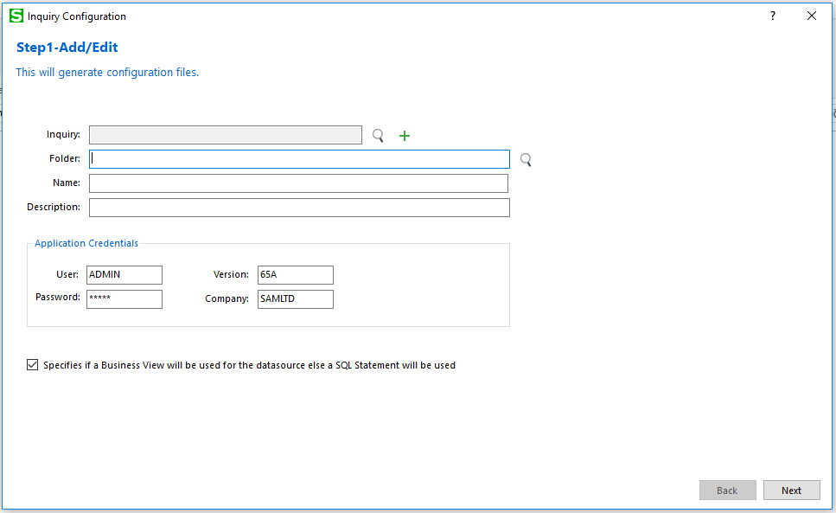
Inquiry Configuration Wizard
Creates JSON configuration files
To be used by the new Inquiry Engine in 2019
Generic Inquiry
Adhoc Inquiry
Data sources are Business Views or SQL Statements
Fast Grid display!
NOTE: In 2018.2 Web SDK but not used in the application until 2019!
Preview

Slide 11
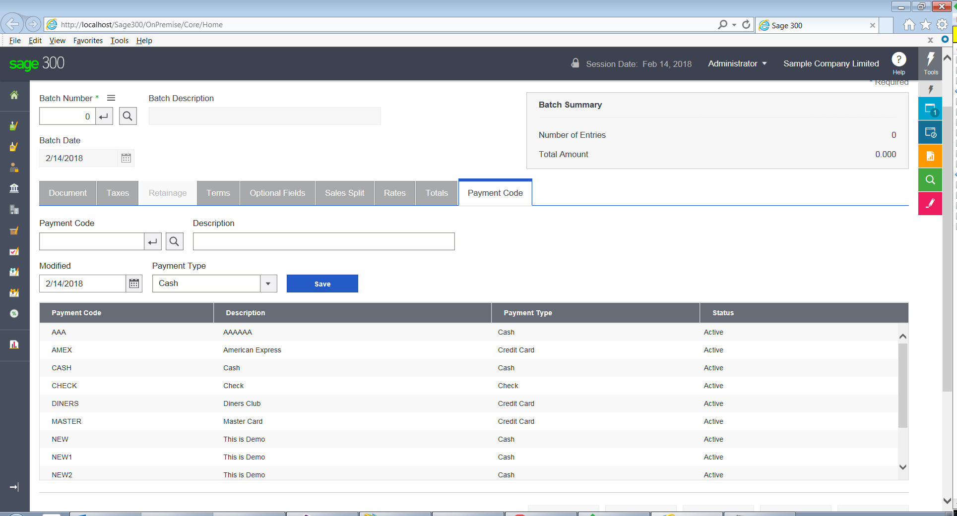
AR Invoice Entry Customization Sample
Add Payment Code screen functionality to new tab page
Highlights
Add a tab control
Enhance display via CSS
Populate dropdown list
Populate grid with Finder method
Save, Delete, Update, Grid Refresh

Slide 12
GitHub Repository
Open Source
https://github.com/SageNADev/Sage300-SDK
2018.2 is available in the “master” branch
2018.1 is available in the “release-2018.1” branch (archive)
2018.0 is available in the “release-2018” branch (archive)
2017.2 is available in the “release-2017.2” branch (archive)
2017.1 is available in the “release-2017.1” branch (archive)
2017 is available in the “release-2017” branch (archive)
2019 is available in the “develop” branch (in-progress)

