Slide 1
Sage 300 Web SDK
2022.2 Overview
April 2022

Slide 2

“The goal of the Web SDK is to get developers up and running quickly and easily.”

Slide 3
Corrected Issues

Slide 4
Corrected Issues
Misc
Post-build merge utility modified to detect if JavaScript files are in a folder path containing a space Code Generation wizard modified to detect object name in third-party’s ViewFinderProperties file as opposed to assuming hardcoded “sg.ViewFinderProperties” object name Code Generation wizard modified to properly detect if the developer changed the suggested name of an enumeration property prior to generation “height: auto !important” syntax causing display issues in some partner grids Change of session date restriction removed and replaced with a simple warning message Added extra param to OpenExtraView in repository for ability to set view to Read Only
N/A
N/A
Samples
Custom

Slide 5
Wizards

Slide 6
Wizards
Solution
Sync global files
Sync global files Enhance JavaScript generation for additional ES6 syntax Removed case statement in login screen to accommodate complex password enhancement
Sync global files
Custom
Standalone N/A
Plug-in N/A
Sync resource files
Code
Upgrade
Language

Slide 7
Samples

Slide 8
Samples
Sync global files
Update public controllers with expression body methods and implement CallWithCatch(), ViewWithCatch()
Enhanced JavaScript files with additional ES6 syntax
Removed case statement in login screens to accommodate complex password enhancement
Added POReceipt_WithPONumber sample payload to demonstrate enhanced POReceipts endpoint of posting an AP Receipt with a PO Number in the payload

Slide 9
Web API

Slide 10
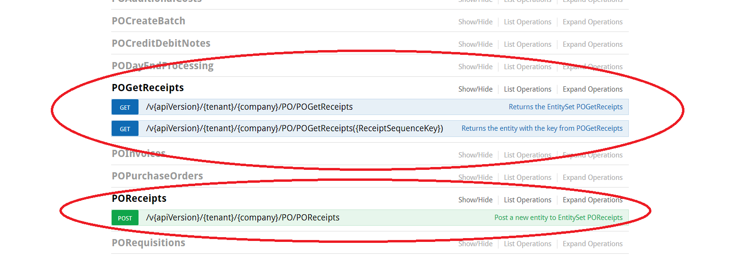
Web API
In order to accommodate a POST of AP Receipts from single purchase orders, the existing PO Receipts endpoint has been split into 2:
POReceipts for POST only
POGetReceipts for GET only

Slide 11
Documentation and Tutorials

Slide 12
Documentation and Tutorials
Updated upgrade instructions 2022.1 → 2022.2
Updated CommonCore.chm
Added Sage300SDK_IntegratingNavigationControl.docx
Illustrates how to had navigation controls (VCR buttons) to a finder property

Slide 13
GitHub Repository

Slide 14
GitHub Repository
Open Source
https://github.com/SageNADev/Sage300-SDK
2022.2 is available in the “master” branch
2023.0 is available in the “develop” branch
Archives
2022.1 available in “release-2022.1”
2022.0 available in “release-2022.0”
2021.2 available in “release-2021.2”
2021.0 available in “release-2021.0”
2020.2 available in “release-2020.2”
2020.1 available in “release-2020.1”
2020.0 available in “release-2020.0”
2019.2 available in “release-2019.2”
2019.1 available in “release-2019.1”
2019.0 available in “release-2019.0”
2018.2 available in “release-2018.2”
2018.1 available in “release-2018.1”
2018.0 available in “release-2018”
2017.2 available in “release-2017.2”
2017.1 available in “release-2017.1”
2017.0 available in “release-2017”

Slide 15
Partner Requests

Slide 16

Partner Requests
Bring these to the Sage 300 Product Manager
Add these to the Sage 300 Ideas Site
Sage 300 Ideas Forum
Your voice and feedback resounds the loudest!

Slide 17
Looking Forward

Slide 18

Looking Forward
For the Sage 300 2023 release (August 2022) we are contemplating only supporting the Wizards in Visual Studio 2022
Development may still be done in Visual Studio 2019, or even 2017, but there are fundamental changes in Visual Studio 2022 for plug-ins that will require significant changes to support both Visual Studio 2019 and Visual Studio 2022
Therefore, in addition to staying current, it also simplifies the plug-ins!

Slide 19
Thank you
©2022 The Sage Group plc or its licensors. All rights reserved. Sage, Sage logos, and Sage product and service names mentioned herein are the trademarks of Sage Global Services Limited or its licensors. All other trademarks are the property of their respective owners.

