Slide 1

Sage 300 Technical Session Hands On
John Thomas (JT)
Principal Software Architect
February 2024
Notes:
Welcome to the Sage 300 Technical Session for our hands on portion!.
I am John Thomas, also known as JT, and I’m the Architect on the Sage 300 product.
Let’s get started.

Slide 2
Table of contents
Web API
Working with Swagger
Generate Screen
Complex
Standalone Sample
Debugging
Customization
Create and Apply
Generate Screen
Simplistic

Slide 3
Snippets
Snippets (because this is not a typing session ☺)
https://www.dropbox.com/scl/fi/icn6pzz5qp6oinih5twg5/Snippets.txt?rlkey=6c949eamwexc92530ftmspsio&dl=0

Slide 4
Web API
Working with Swagger

Slide 5
Web API
Working with Swagger
Launch Chrome browser and enter “localhost/sage300webapi”
Click “Open Swagger UI” button
Click on “ARCustomers” endpoint to expand Actions
Click on “Get” action
Click on “Try it out!” button
Enter “ADMIN” for Username, specify password (if required), and click “Sign in” button
Success or did you get “Insufficient security rights for user.”?
ADMIN needs to be approved for Web API!
Edit web.config in both c:\{Sage300}\Online\Web and c:\{Sage300}\Online\WebApi folders
Search for “AllowWebApiAccessforAdmin” and change value to “true”
Restart IIS
Close Swagger tab and Refresh Sage 300 Web API Landing page
Retry and notice that it now works!!!
Web Screens

Slide 6
Web API
Working with Swagger
Play with the Swagger interface:
Enter “10” in $skip field to skip the first 10 rows
Enter “3” in $top field to return only the first 3 rows
Enter in $filter field “ShortName” i.e., ‘BLACK’
Depress Ctl key while selecting fields you want back in the $select field
You are a Swagger expert!
Web Screens

Slide 7
Standalone Sample
Debugging

Slide 8
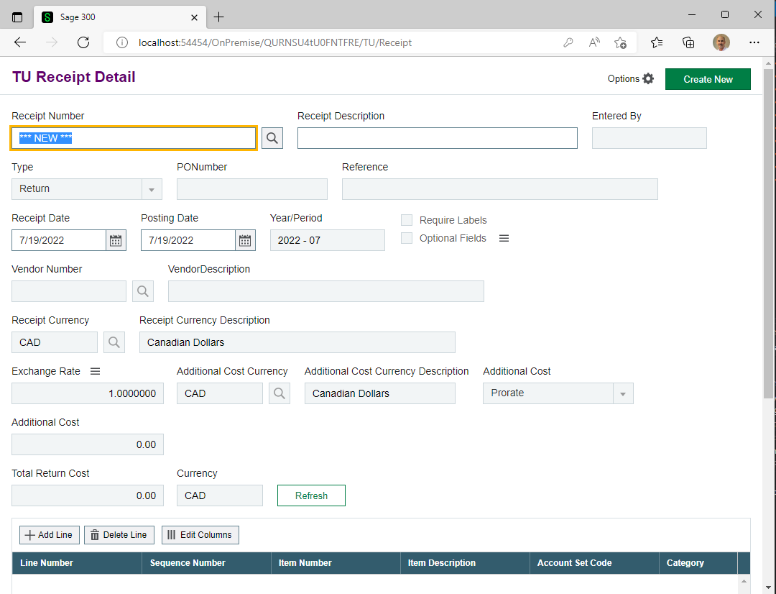
Standalone Sample
Debugging
Web Screens

Slide 9
Standalone Sample
Debugging
Load Receipt.sln from c:\{Sage300WebSDK}\samples\receipt folder by dropping receipt.sln onto desktop Visual Studio 2019 shortcut (loads as Administrator)
Select Tools/Nuget Package Manager/Manage Nuget Packages for Solution… and select “Restore” button
Select “Build/Build Solution”
Success or did you get lots of compiler errors?
Let’s look at a *.csproj file to see environment var usage
Environment variable not established?
Close Visual Studio
Open README.md file in samples folder and follow instructions to create Sage300WebDir environment variable
Reload Receipt.sln and select “Build/Build Solution”
Notice that it now compiles as expected!
Web Screens

Slide 10
Standalone Sample
Debugging
Click on green arrow to start debug
Login and screen now displays!
Switch back to Visual Studio and let’s create some breakpoints
In the Web project, select the Areas/TU/Controllers/ReceiptController.cs file
Put a breakpoint on the GetById function
In the BusinessRepository project, select the ReceiptRepository.cs file
Put a breakpoint on the GetById method
Switch back to the browser and display the finder and select a record
Breakpoint hit in the controller. Press F11 to debug
Watch debug steps and at some point hit F5 to continue without debug
You are now a debug expert!
Web Screens

Slide 11
Generate Screen
Simplistic

Slide 12
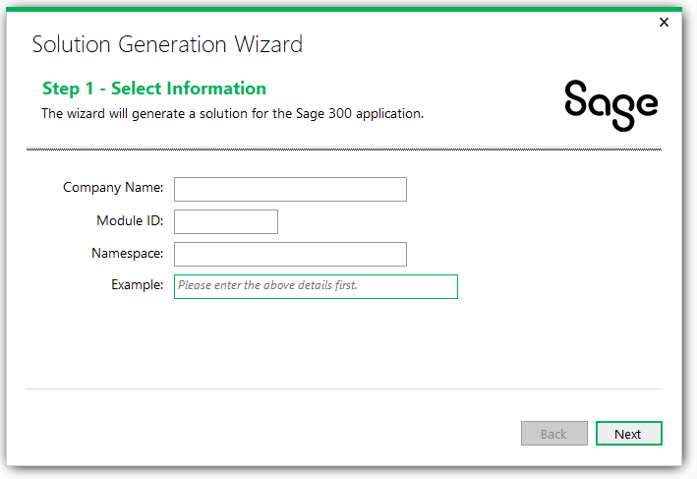
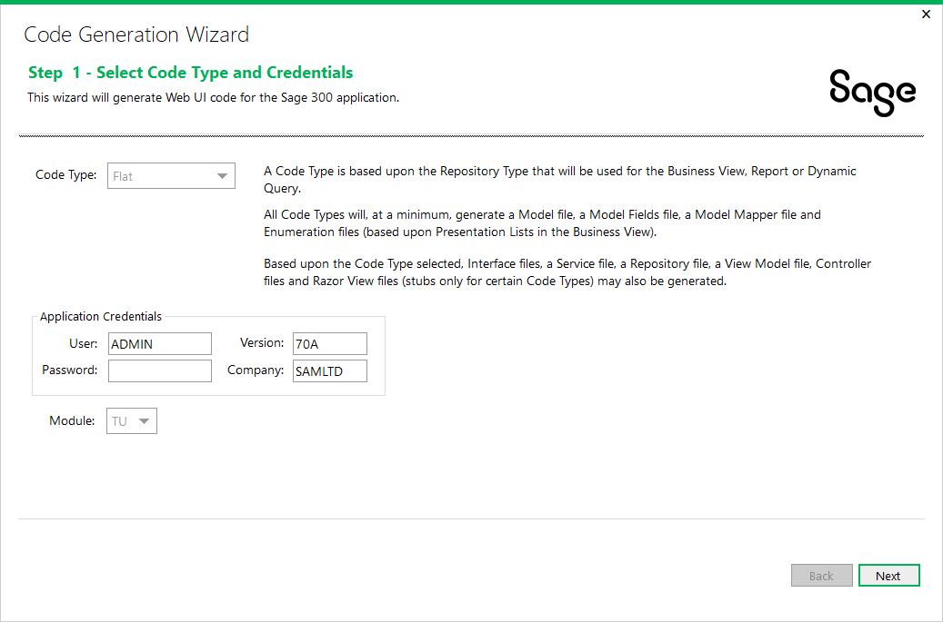
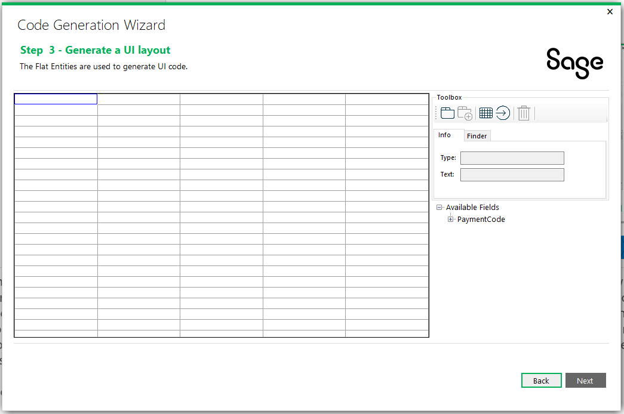
Generate Screen
Simplistic
Web Screens

Slide 13
Generate Screen
Simplistic
Access Visual Studio
Select “Continue without code”
Select File – New – Project
Select the “Sage 300 Solution Wizard” and press “Next” button
Enter “HandsOn” for project name, enter “C:\HandsOn” for Location
Solution Wizard
Enter “Valued Partner” for Company Name, “TU” for Module ID and press “Next” button
Check “Purchased Kendo UI…” and press “Next”
Only select the “English” resource and press “Next”
Press the “Generate” button and solution with projects will be created
Now that solution is created, select Tools – Nuget Package Manager – Manage Nuget Packages for Solution…” and press “Restore”
Web Screens

Slide 14
Generate Screen
Simplistic
Solution is now created and packages downloaded
Right click solution in solution explorer to invoke context menu and select “Sage 300 Code Generation Wizard”
Enter password field, if needed, and press “Next”
Right click “entities” and select “Add Entity”
Enter “AR0012” in the View ID field and press tab
Change Model Name to “PaymentCodes” and click on other tabs to evaluate and press “Save” when done and then press “Next”
Web Screens

Slide 15
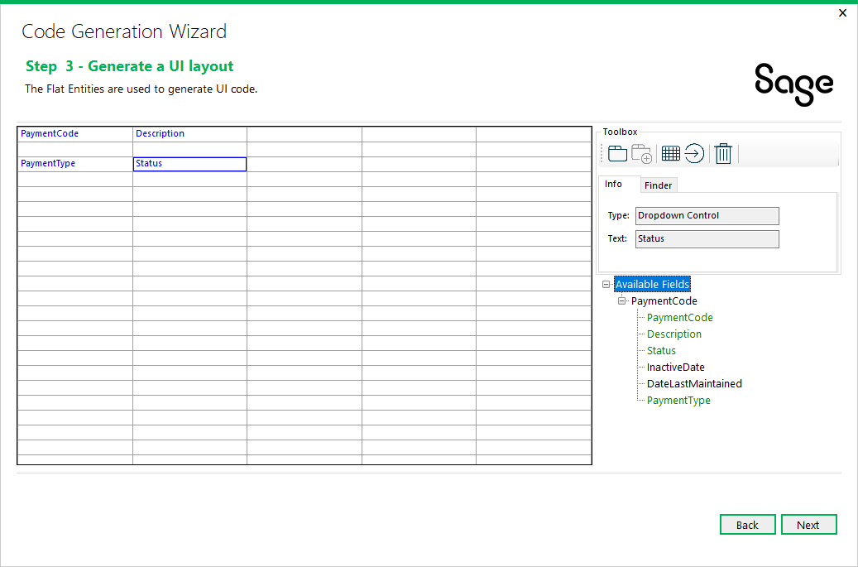
Generate Screen
Simplistic
Expand “Available Fields” tree for “PaymentCode” and it’s time to design the screen
Drag and drop PaymentCode, Description, PaymentType and Status fields to palette
Web Screens

Slide 16
Generate Screen
Simplistic
Right click on “PaymentCode” cell and select “Finder”
Finder tab on right is now active and it’s time to associate a finder with this field
Select “Finder” tab, click “…”, and select “…ViewFinderProperties.js”,and press “Open”
Select dropdown for “Config” field and scroll down and select “AR.PaymentCodes”
Press “Next”
Review assignments and press “Generate”
Notice projects in background being updated
Press “Finish” button
Select “Build/Build Solution”
Press green arrow to debug
Web Screens

Slide 17
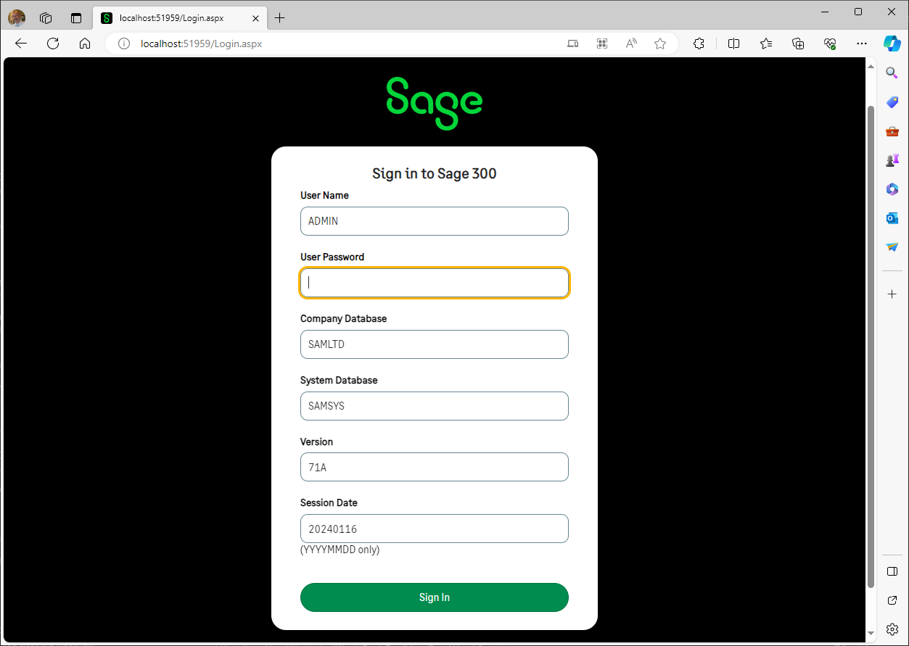
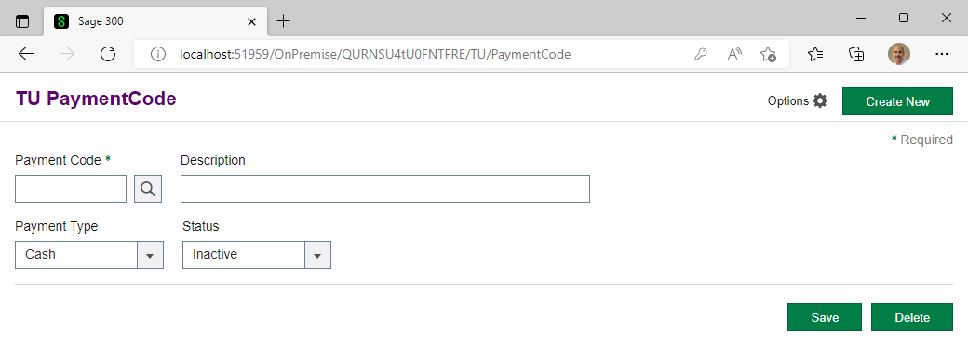
Generate Screen
Simplistic
Login by entering required credentials
Press the “finder” button
Enter a code manually
Press “Save”
Retrieve “CASH” and press “Delete”
Fully functional screen without any code!
Web Screens

Slide 18
Generate Screen
Complex

Slide 19
Generate Screen
Complex
We will use the same solution and simply add another screen
Right click on the solution in the Solution Explorer and select “Sage 300 Code Generation Wizard”
Select “HeaderDetail” from Code Type field
Enter password, if required, and press “Next”
Right click on “entities” and select “Edit container name”
Enter “DistSets” in Container Name field and press “Save”
Right click on “entities” and select “Add Entity” (this is for the header)
In the View ID field, enter “AP0009” and press tab
Change Model Name to “DistributionSets”, evaluate and press “Save”
Right click on the “DistributionSet” entity and select “Add Entity” (this is for the detail)
Enter “AP0008” for the View ID field and press tab, evaluate and press “Save” and press “Next”
Web Screens

Slide 20
Generate Screen
Complex
Expand “Available Fields” tree for “DistributionSet” and “DistributionSetDetail”
It’s time to design the screen
Drag and drop DistributionSet and Description fields to palette from the “DistributionSet” tree (header)
Right click the “DistributionSet: cell and select “Finder”
Select “Finder” tab, click “…”, and select “…ViewFinderProperties.js”, and press “Open”
Select “AP.DistributionSet”
Drag and Drop a grid from the toolbar to the palette
Drag and Drop fields from the “DistrubutionSetDetail” tree to the grid in the palette in the order in which columns are to appear (detail)
Press “Next”
Web Screens

Slide 21
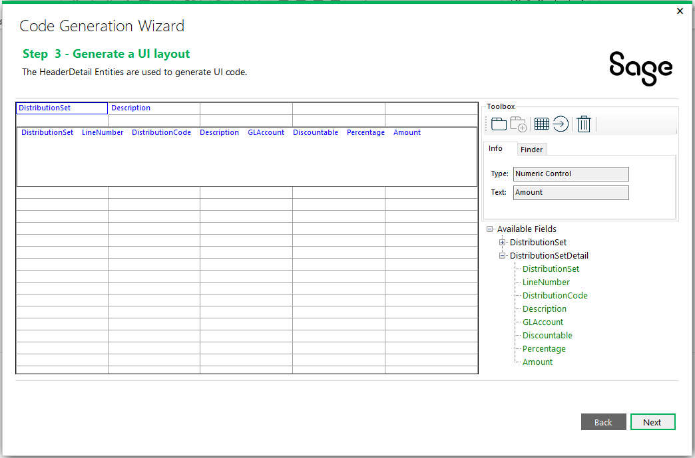
Generate Screen
Complex
Web Screens

Slide 22
Generate Screen
Complex
Evaluate settings and press “Generate”
Press “Finish”
Select “Build/Build Solution”
Press green arrow to debug
Enter credentials to login and notice AP Distribution Sets comes up with grid
Select “Finder” button and select a record
Grid populates!
In address bar, the first payment code screen can be select to by changing “DistSets” to “PaymentCode”
Switch back to “DistSets” by changing “PaymentCode” back to “DistSets”
Web Screens

Slide 23
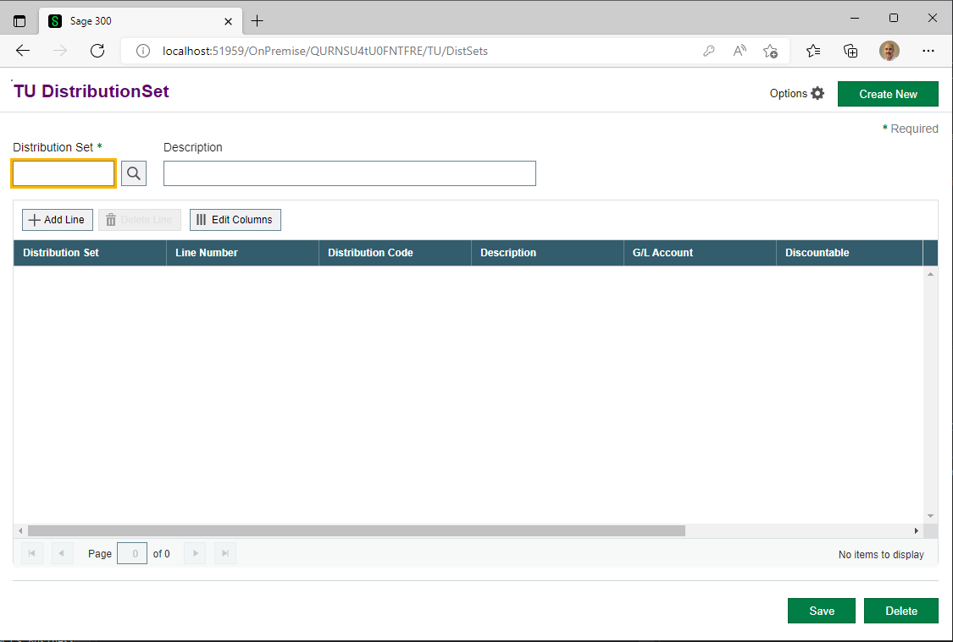
Generate Screen
Complex
Web Screens

Slide 24
Generate Screen
Complex
Let’s now add a finder to the Distribution Code cell in the grid
In the web project, select the Areas/TU/Views/DistSets/Partials/DistributionSetDetailGrid.json file
Scroll to the “Distribution Code” cell and add finder definition to the config
,"Finder": {
"viewID": "AP0005",
"viewOrder": 0,
"displayFieldNames": ["DISTID", "TEXTDESC", "SWACTV", "IDGLACCT"],
"returnFieldNames": ["DISTID", "TEXTDESC", "SWACTV", "IDGLACCT", "SWDISCABL"],
"initKeyFieldNames": []
}
Press green arrow to debug
Web Screens

Slide 25
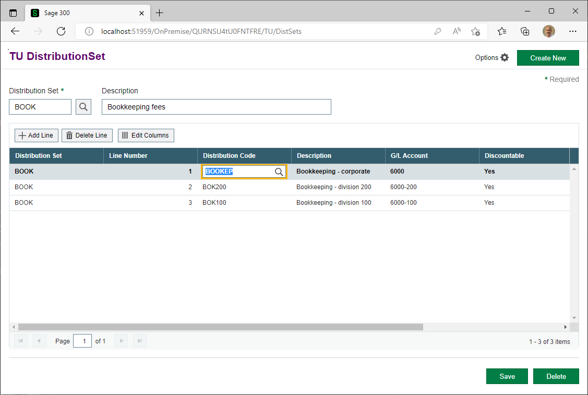
Generate Screen
Complex
Web Screens

Slide 26
Generate Screen
Complex
Let’s now change the description of a column in the grid (ColumnName, no ColumnName, Custom Function)
In the web project, select the Areas/TU/Views/DistSets/Partials/DistributionSetDetailGrid.json file
Scroll to the “Distribution Code” cell and delete the ColumnName property
Delete the ColumnName property
Add the following Custom Function
,"CustomFunctions": [
{ "columnBeforeDisplay": "distributionSetUtility.setColumnTitle" }
]
Add the following Custom Function
/**
* set the custom column title
* @param {any} e event
* @param {any} column current column
*/
setColumnTitle: (e, column) => {
column.ColumnName = "D Code";
// Can be localized like this
// column.ColumnName = distributionSetResources[column.FieldName];
}
Press green arrow to debug. You are now a complex screen expert!
Web Screens

Slide 27
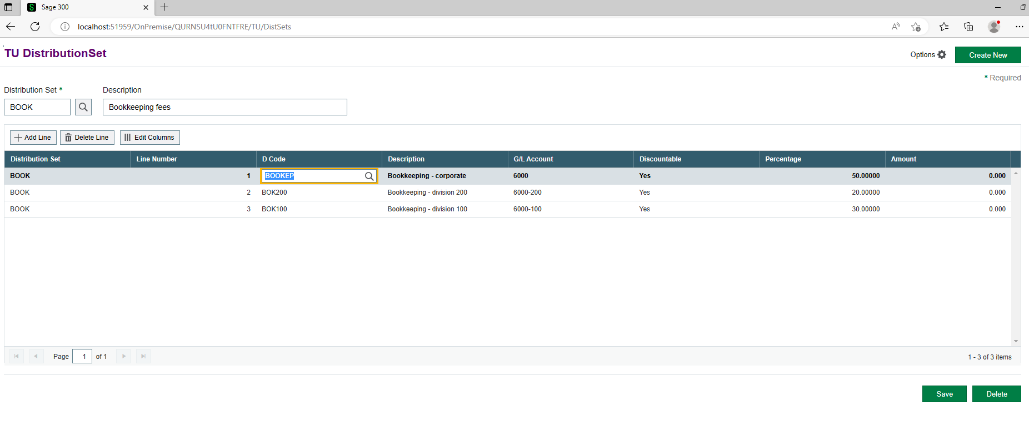
Generate Screen
Complex
Web Screens

Slide 28
Customization
Create and Apply

Slide 29
Customization
Create and Apply
Create a new customization and apply it to the AP Distribution Sets screen
Click on an Edge browser to invoke the web screens (localhost/sage300)
Navigate to the AP Distribution Sets screen where we will be adding a button before the “Save” button called “btnHello”, which will display the message “Hello World”.
Right-click the “Save” button and select “Inspect”
Click on the “Save” button to see that its name is or id is “btnAdd”
In a file explorer, navigate to the c:\{Sage300WebSDK}\bin\wizards folder
Right click on the Sage.CA.SBS.ERP.Sage300.CustomizationWizard.exe and select “properties”
Select the “Unblock” checkbox if there is this option (internet clone safety)
Press “OK”
Double click the Sage.CA.SBS.ERP.Sage300.CustomizationWizard.exe
Web Screens

Slide 30
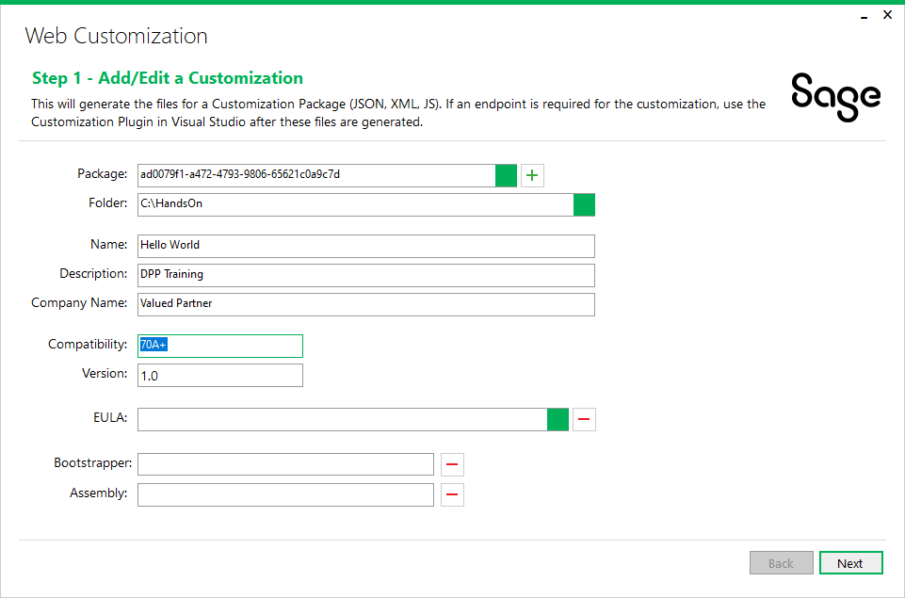
Customization
Create and Apply
The Customization wizard appears
Press “+” for a new package
Click the ellipse field for the folder and select the “C:\HandsOn” folder
Enter “Hello World” for the Name field
Enter “DPP Training” for the Description field
Enter “Valued Partner” for the Company Name field
Press the “Next” button
Web Screens

Slide 31
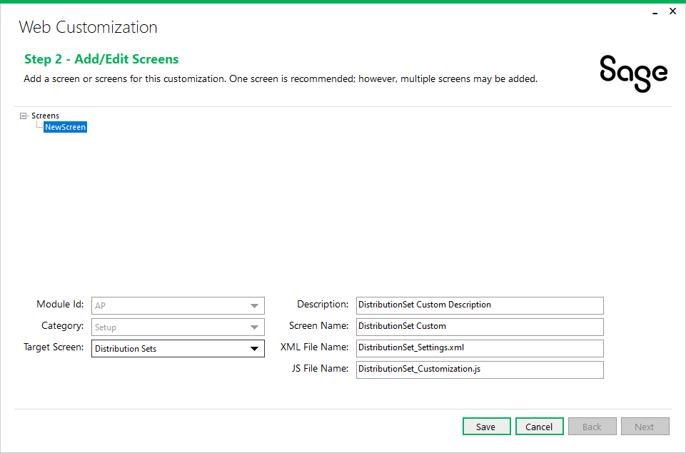
Customization
Create and Apply
Specify which Sage 300 web screen is to be customized
Right click on “screens” and select “Add Screen”
Select the “AP” module for the Module Id field
Select “Setup” for the Category field
Select “Distribution Sets” for the Target Screen field
Press “Save”
Press “Next”
Web Screens

Slide 32
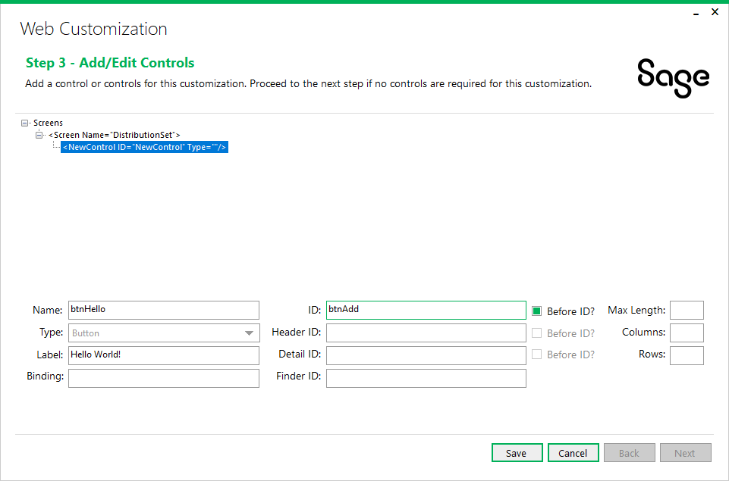
Customization
Create and Apply
Specify the controls to be added to the Distribution Sets screen
Right click on the “Distribution Set” screen name and select “Add Control”
Select “Button” for the Type field
Enter “btnHello” for the Name field
Enter “Hello World!” for the Label field
Enter “btnAdd” for the ID field
Press “Save”
Press “Next”
Evaluate the settings and press “Generate”
Press “Finish”
Web Screens

Slide 33
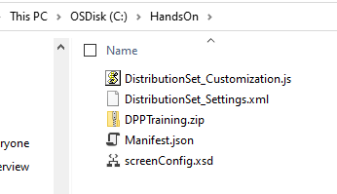
Customization
Create and Apply
The customization files have been created and navigate to the C:\HandsOn folder to view
There will be a JavaScript file, an XML file, an XSD file and a JSON file
Edit the JavaScript file to handle the click even for the btnHello button
Navigate to the initButtons routine and enter the alert statement for the btnHello click event
$("#btnHello").on('click', () => {
alert("Hello World!");
});
Save changes to file
Zip these 4 files into a zip file called “DPPTraining”
Web Screens

Slide 34
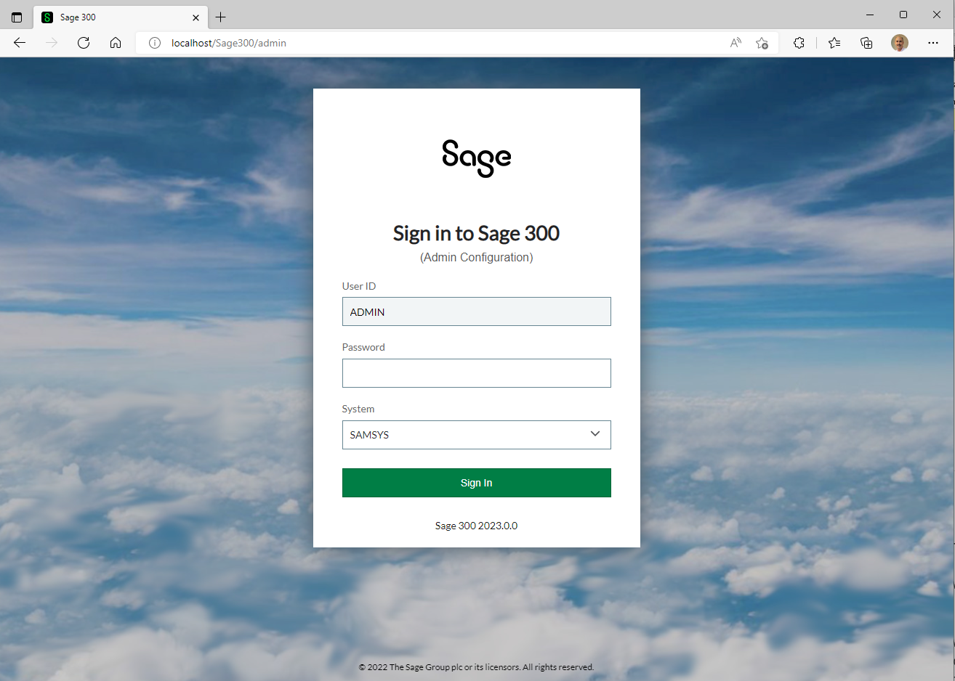
Customization
Create and Apply
The customization package is ready to be imported
Click on an Edge browser and navigate to localhost/sage300/admin
Login to the system database with “ADMIN” password (ADMIN123)
Web Screens

Slide 35
Customization
Create and Apply
The customization package is ready to be imported
Press the “Browse” button and navigate to the customization package zip file just created
Press the “Import” button
Press the “Assign” button at the bottom of the screen
Select the “SAMLTD” company and press “OK”
Sign out of the admin screen and log into sage 300 (localhost/sage300) (SAMLTD company)
Navigate to the AP Distribution Sets screen to see and test the customization
You are now a customization expert!
Web Screens

Slide 36
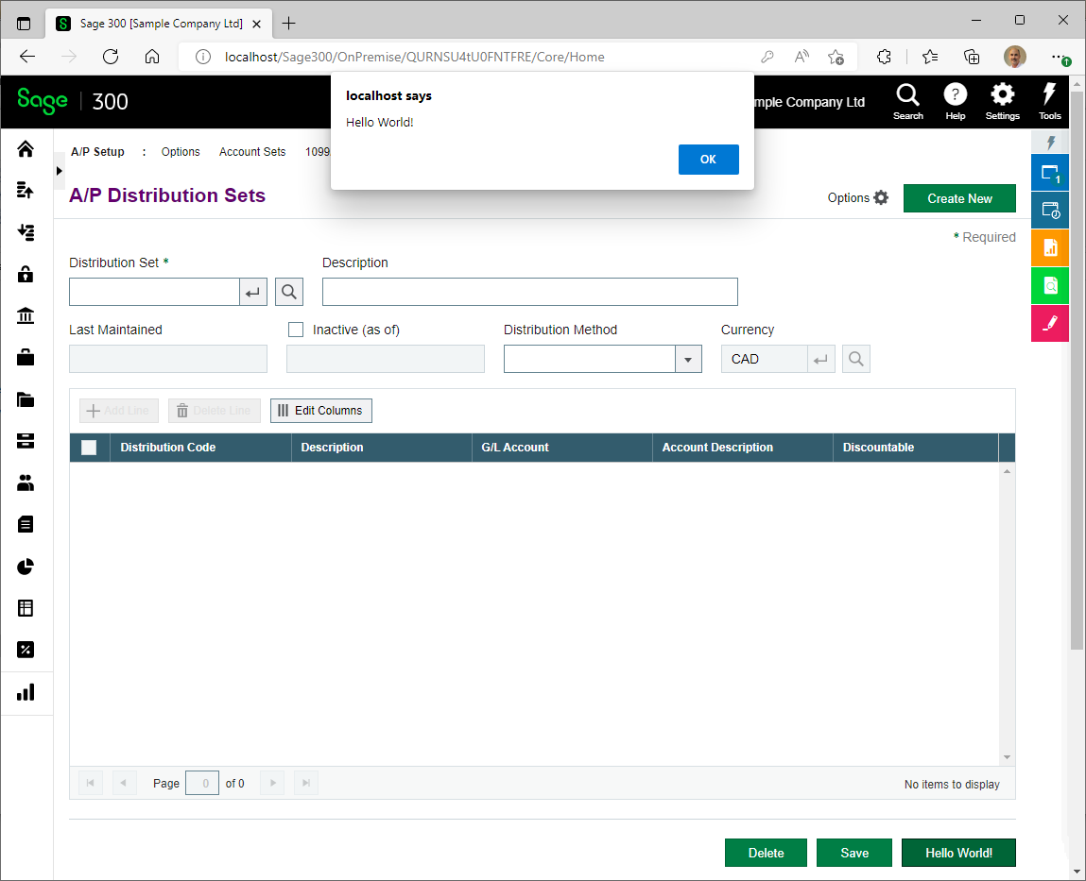
Customization
Create and Apply
Web Screens

Slide 37
Thank you!

