Slide 1
Sage 300 2018.2 Web SDK Overview
John Thomas (JT)
February 2018

Slide 2
Defects Corrected
Code Generation Wizard
Simplified and corrected Expression in Finder generated code
Validation for “EntityName” as a generated property
…Behavior JavaScript file on successful return from finder to invoke controller’s Get method
“Type” enumeration used to be generated as {entityname}Type.cs
Caused issues with global Optional Fields implementation
“Type” is now generated as “Type” but avoid conflict with System.Type with $companynamespace$.$moduleId$.Models.Enums prefix
TimeSpan vs. DateTime and Nullable Types – In-Progress February
Segment Codes Sample
CSS issue with checkbox and textbox alignment – In-Progress February
GridInfo
Documentation corrections, Dropdown lists and suggestions for enhancements – In-Progress Feburary

Slide 3
Version Change
Accpac.Advantage.Types version is now 6.5.0.20
AccpacDotNetVersion.props files have been updated in samples and source
New settings folder in Web SDK to contain single file that samples now reference
Generated solutions will still get it’s own copy

Slide 4


Images for Partner Menus
Added IconName element to {module}MenuDetails.xml
Defaults to “puzzle piece” image if not specified (menuIcon.png)
Added as $companynamespace$/menuIcon.png
Added MenuBackGroundImage element to {module}MenuDetails.xml
Defaults to “discussion” image if not specified (menuBackGroundImage.jpg)
Added as $companynamespace$/menuBackGroundImage.jpg
MergeISVProject copies from Web project’s Content\Images\Nav folder to External\Content\Images\Nav\$companynamespace$ folder
This is where you will deploy your images, if any
menuIcon.png
menuBackGroundImage.jpg

Slide 5
Minification
TBD
New Doc
Explain process

Slide 6



Visual Studio 2017
Wizard Manifests now include Visual Studio 2017 as a targeted IDE
Visual Studio 2013 and Visual Studio 2015 still supported

Slide 7
Documentation
Upgrade Instructions for 2018.1 to 2018.2 in docs\upgrades
Wizard and Tutorial documents modified with updated …Behaviour javaScript change
New Sage300SDK_InquiryConfigurationWizard.docx in docs\wizards
New Sample4_AR_Invoice_Entry_Customization.docx in samples\customization\Sample4_AR_Invoice_Entry_Customization
New Sage300SDK_2018.2WebSDKOverview.pptx in docs\presentations

Slide 8
Global Files Updated to 2018.2
Solution Wizard
Code Generation Wizard
Customization Wizard

Slide 9
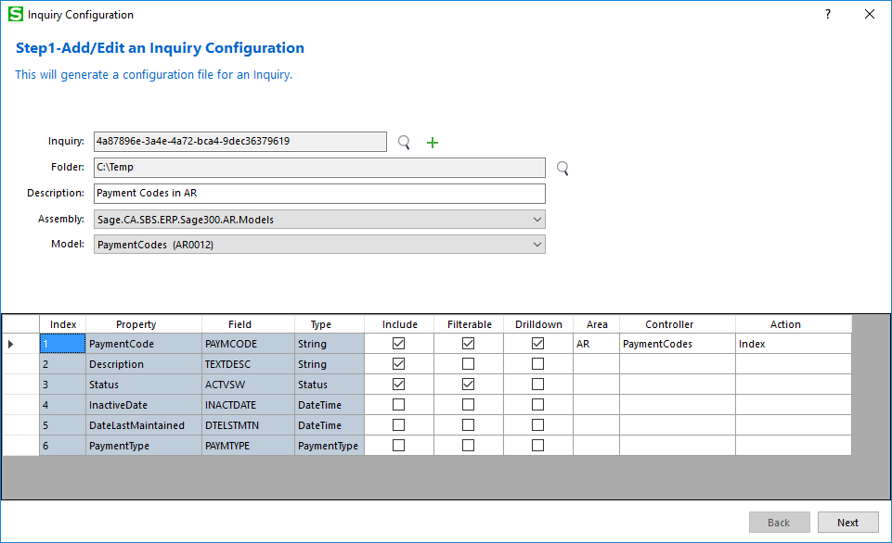
Inquiry Configuration Wizard
Creates JSON configuration file
Used by Generic Inquiry Grid
Discovers partner models as well
Fast Grid display!

Slide 10
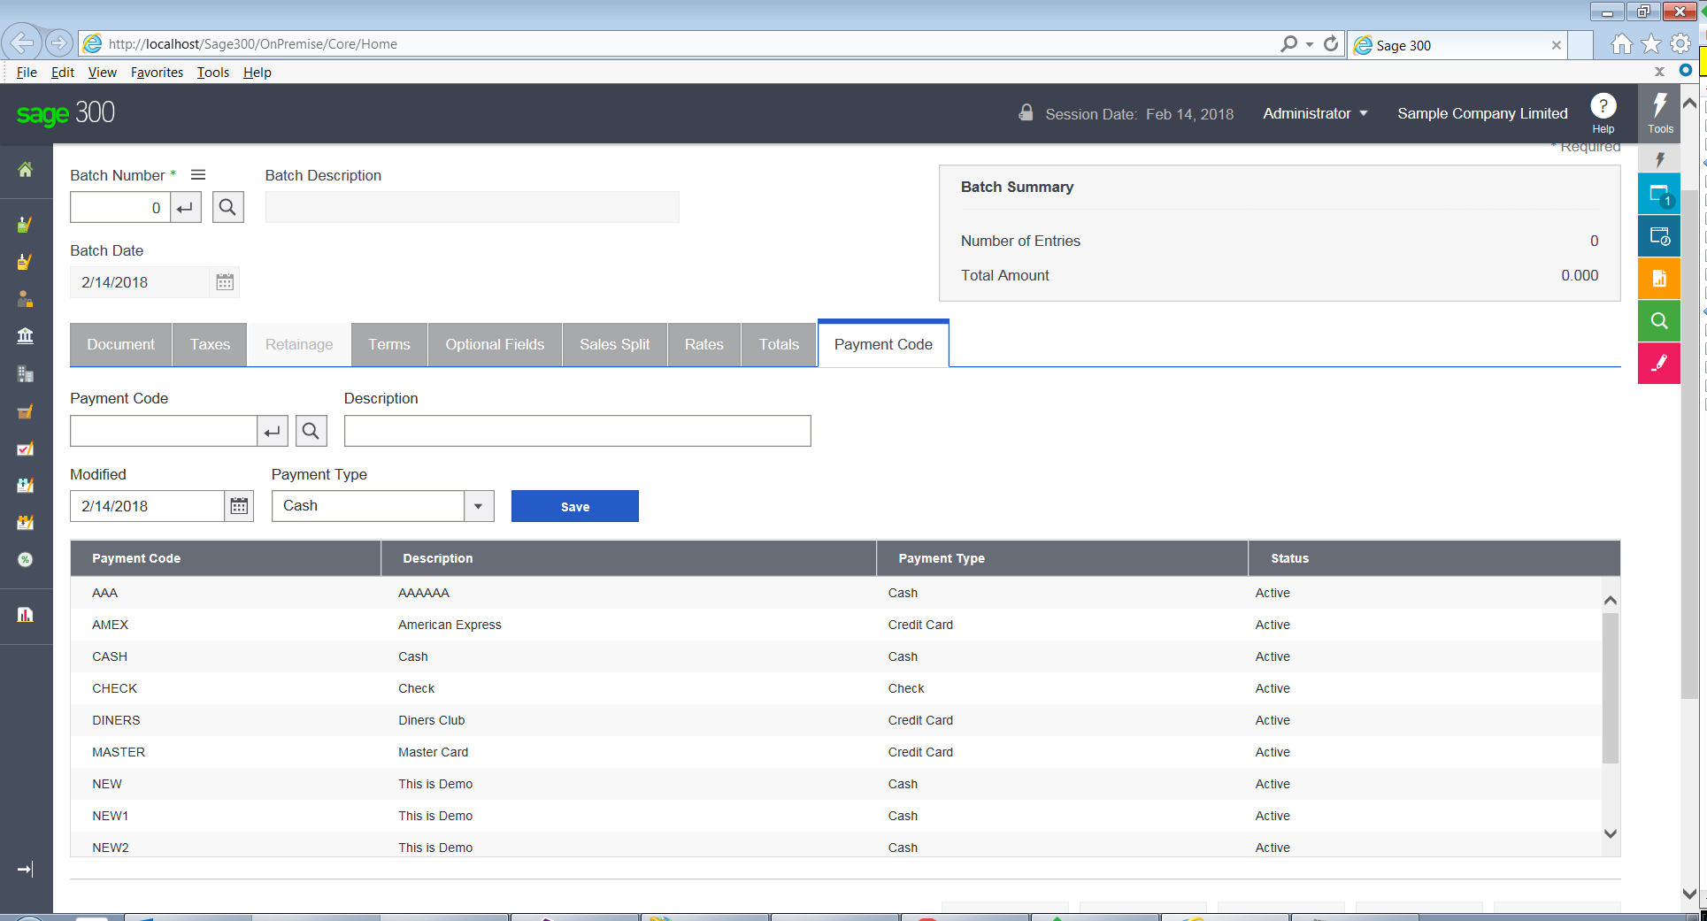
AR Invoice Entry Customization Sample
Add Payment Code screen functionality to new tab page
Highlights
Add a tab control
Enhance display via CSS
Populate dropdown list
Populate grid with Finder method
Save, Delete, Update, Grid Refresh

Slide 11
Upgrade Wizard
Upgrades Projects and Solution
Upgrade files from 2018.1 to 2018.2

Slide 12
GitHub Repository
Open Source
https://github.com/SageNADev/Sage300-SDK
2018.2 is available in the “master” branch
2018.1 is available in the “release-2018.1” branch (archive)
2018.0 is available in the “release-2018” branch (archive)
2017.2 is available in the “release-2017.2” branch (archive)
2017.1 is available in the “release-2017.1” branch (archive)
2017 is available in the “release-2017” branch (archive)
2019 is available in the “develop” branch (in-progress)

