Slide 1


Jason Corriveau, Ben Matase,
Eric Marshall, Alexander Murph

Slide 2
Our Project
We’ve decided to recreate the classic childhood game: Pokemon!
Pokemon is a great example of object oriented programming.
We have decided to customize the game with a Bucknell theme.
Users are able to create their own team of Pokemon and battle against computer science professors and then the Elite Four.

Slide 3
Background
Pokemon is a role-playing game in which users acquire Pokemon and fight against other trainers in battle.
Trainers can hold up to six Pokemon and a battle ends when the user or enemy trainer runs out of Pokemon.
Pokemon can hold up to four moves that a user selects in battle.
Both Pokemon and moves have specific types.
Type advantages and Pokemon stats impact move damage
Gym Leaders are like the bosses of the game that you must to beat to continue in the story. In our game, these are the professors.

Slide 4
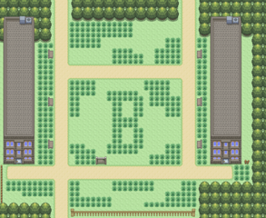
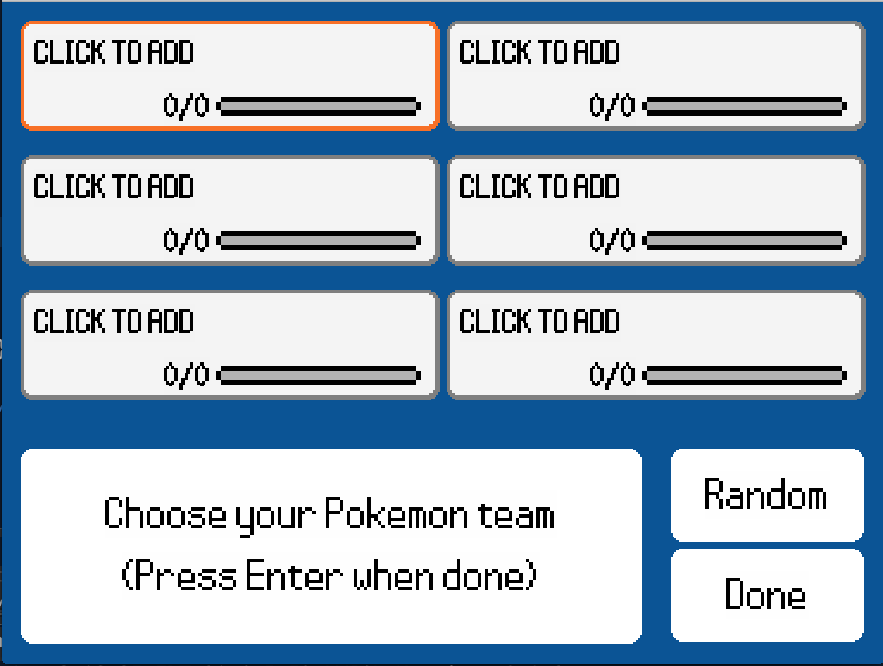
Motivation
Each of us has enjoyed playing Pokemon in our youth, so we wanted to recreate Pokemon in a way that allows users to select their favorite Pokemon and battle right away.
We originally wanted users to be able to explore Bucknell’s campus, creating a new immersive environment in Pokemon familiar to Bucknellians.
Experienced users can select their favorite Pokemon, while new users can select random teams to start playing right away!

Slide 5
Scrum
Key User Stories
As a player, I want to have a Pokemon battle GUI, so that I can battle Pokemon.
As a player, I want a variety of pokemon options that work in the battle GUI, so that I can have fun using different Pokemon.
As a player, I want trainers to battle and have them named after CS professors, so that I can battle professors like gym leaders.
As a player, I want the abiltiy to choose starting Pokemon from a database of Pokemon, so that I can choose my favorites and personalize the game.
As a player, I want AI for all non-player trainers, so that I can be challenged when battling them.
As a player, I want the ability to lose/faint, so that I can be challenged by the game.
We completed all of these, but we had a lot more user stories that we made but couldn’t get to
We used just Google Drive/Sheets/Slides. We originally were using Asana but didn’t see its utility

Slide 6
Scrum Strengths/Weaknesses
Strengths
Keeping us organized and knowing what we need to do
Having us meet often and have good organization
Weaknesses
Seemed like too much overhead for the little bit of utility it had for this small of a project
Projecting the number of hours for a task is very difficult
Do differently
Wouldn’t even try Asana
Find a better, dedicated program to manage Scrum

Slide 7
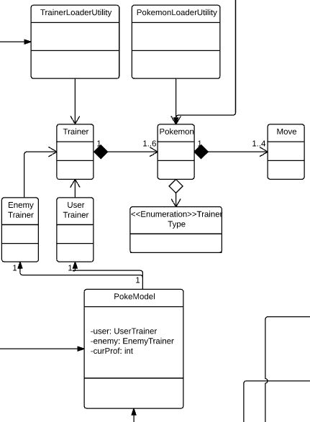
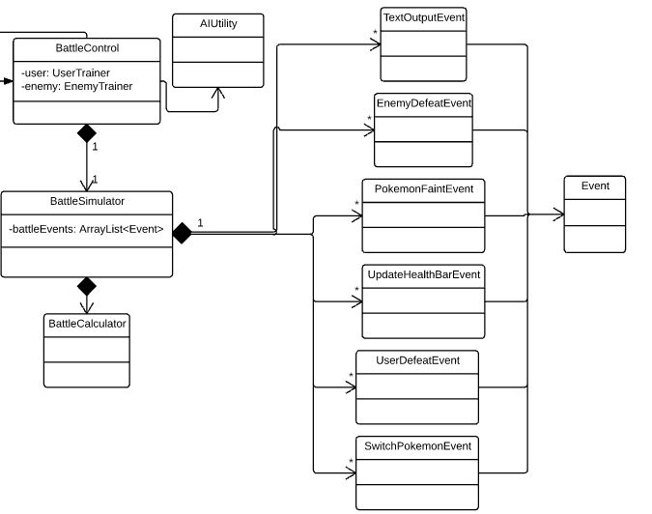
UML

Slide 8
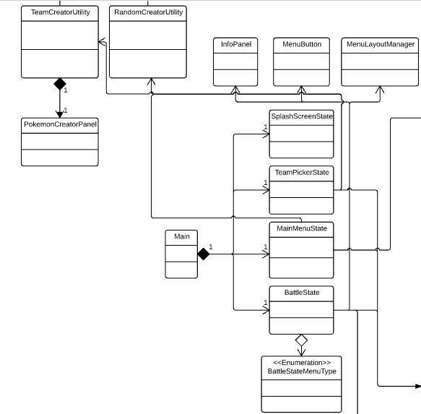
UML Continued

Slide 9
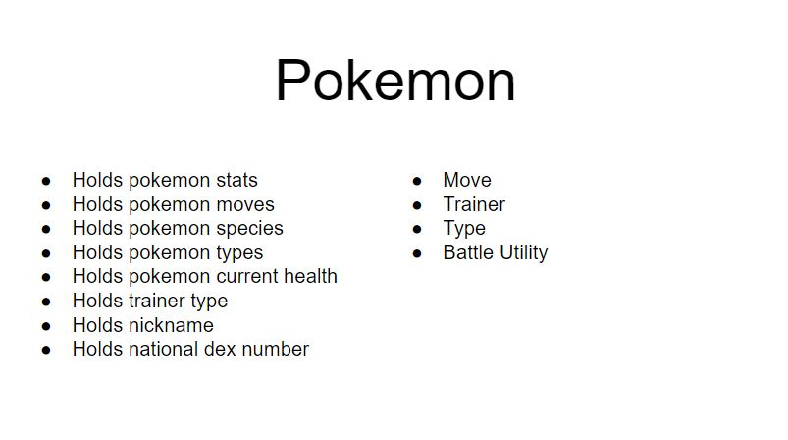
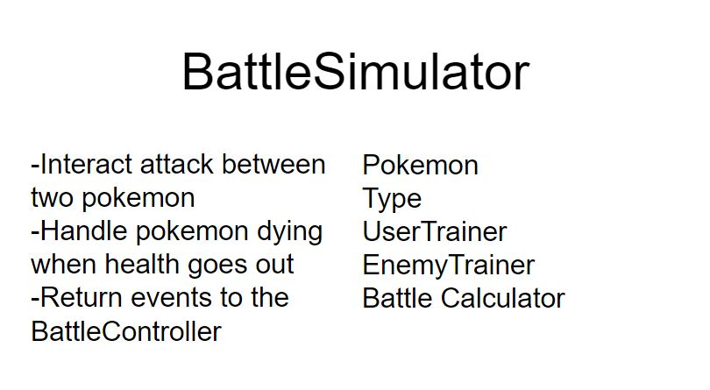
CRC Cards
The cards we created at the start of the project proved to be useful and helped us straighten out what classes we would need and how they would need to interact.

Slide 10
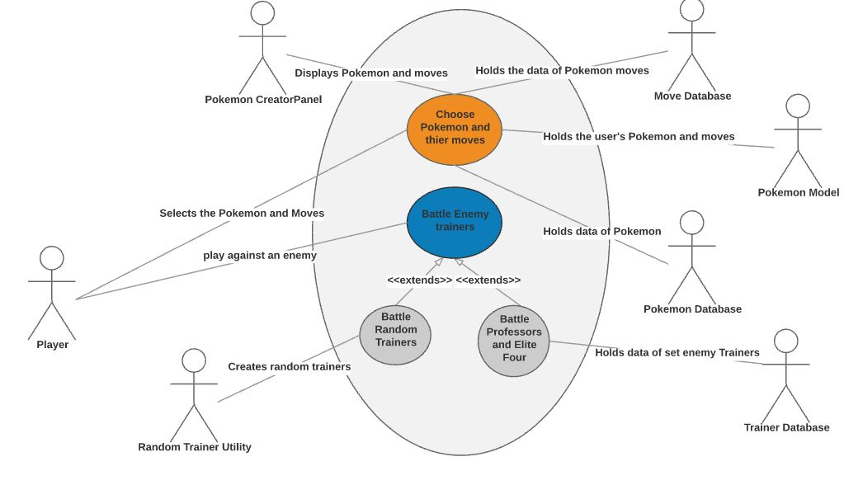
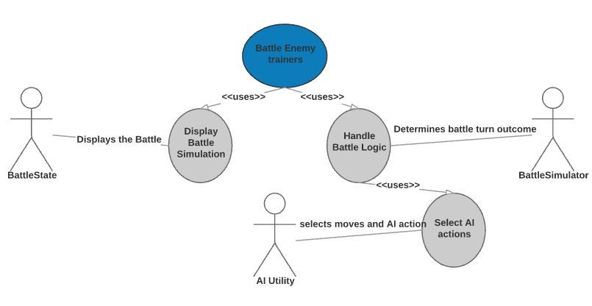
UML Use Case Diagram

Slide 11
Major Classes: BattleSimulator, BattleControl, BattleCalculator
BattleCalculator does the baseline calculations of damage and accuracy for a single pokemon attack. Considers Pokemon stats and gives a small chance for a critical hit.
BattleSimulator simulates one whole round of a pokemon battle. Takes in two pokemon and what moves they chose (if any). Accounts for which pokemon moves first, whether any pokemon faint, and when a user switches out.
BattleControl is the abstraction of the entire battle. Holds the player and enemy trainers. Handles win conditions and interacts with the AIUtility to figure out the actions of the enemy trainer.

Slide 12
Events
To communicate to the GUI what happened in a battle, we used an Event abstraction. Each specific event implemented the abstract class Events.
Battle Control return an ArrayList of Events to the GUI. The GUI puts those events in an Event Queue where it processes them one-by-one in order.
Events include:
EnemyDefeatEvent - passed when you defeat the enemy trainer
PokemonFaintEvent - passed when either pokemon faints
SwitchPokemonEvent - passed when trainer swaps a pokemon out for another
TextOutputEvent - passes message for the GUI to display on the screen
UpdateHealthBarEvent - passed after a pokemon loses health, GUI updates to match health in pokemon object
UserDefeatEvent - passed when the player loses a battle

Slide 13
Major Classes: Pokemon, Trainer, Moves
Pokemon holds all of the information about a Pokemon such as Species, National Dex Number (ID), Nickname, Stats (HP, ATT, DEF, SPATT, SPDEF, SPD), TrainerType (whether User or Enemy Pokemon), and between 1 and 4 Moves
Trainer is the parent class to UserTrainer and EnemyTrainer who both have a Name, and between 1 and 6 Pokemon, and the currently selected Pokemon
Moves holds Name, Base Damage, Accuracy, Type, AttackType (Physical / Special)

Slide 14
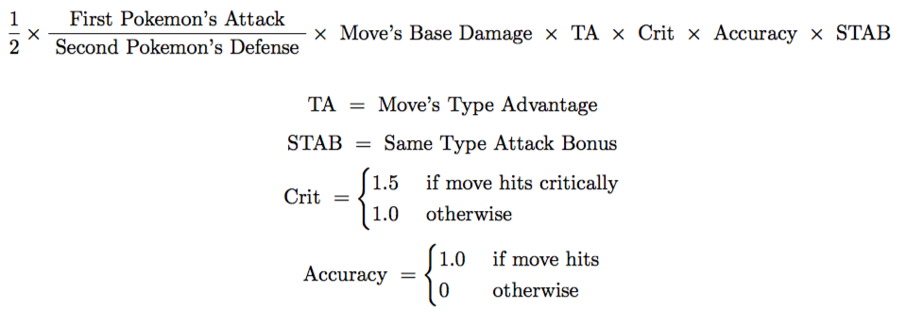
Algorithms/Damage Calculator
Damage Calculator
Enemy AI
Calculates damage each move would do and then uses that damage as a weight in a random choice of move
Ex. Thunderbolt does 50 damage and Tackle does 25. There would be 50/(50+25) = 66.6% probability of the enemy using Thunderbolt and 25/(50+25) = 33.3% probability for Tackle.

Slide 15
Database/Sprites
Found XML files with all Pokemon up to Arceus and most moves that Pokemon can learn
Has all information to make any of those Pokemon and moves very easily
Loads this information using jDom
Also created a Professors.xml to store all the information for the professors/Elite Four
Found sprites for all Pokemon front and back and reused trainer images from games for professors. This made our lives much easier

Slide 16
User Interface
Slick2D
Uses game states to make our lives easier
Handles a lot so that we could focus on the making parts of the game instead of smaller details that go into making a game
Button Manager
Holds an array of buttons and handles the highlighting and movement of buttons with the arrow keys.
We used this for a lot of aspects of the game including the 2x3 Pokemon chooser in the beginning, the HP bars in the Battle scene, the switching Pokemon screen, and the bottom menus when in a battle

Slide 17
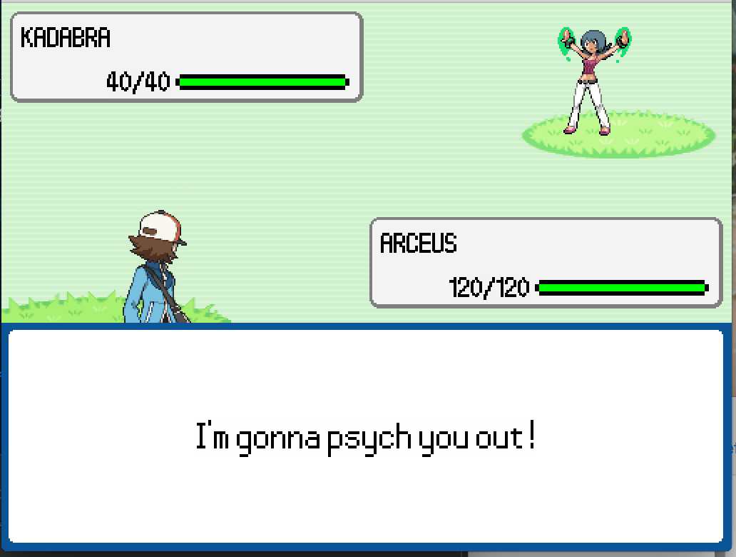
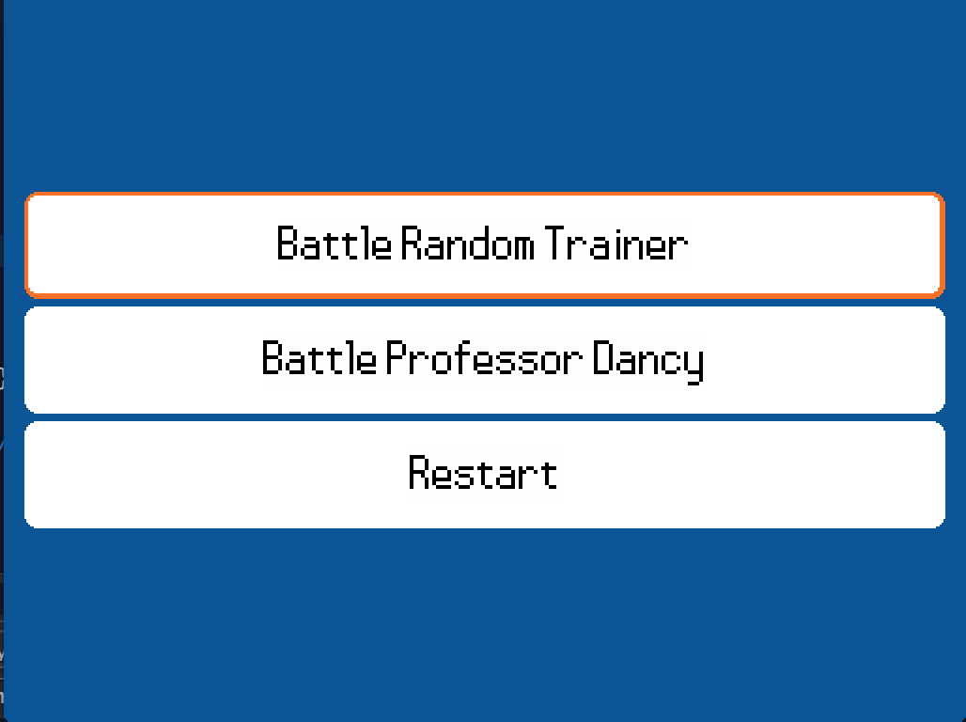
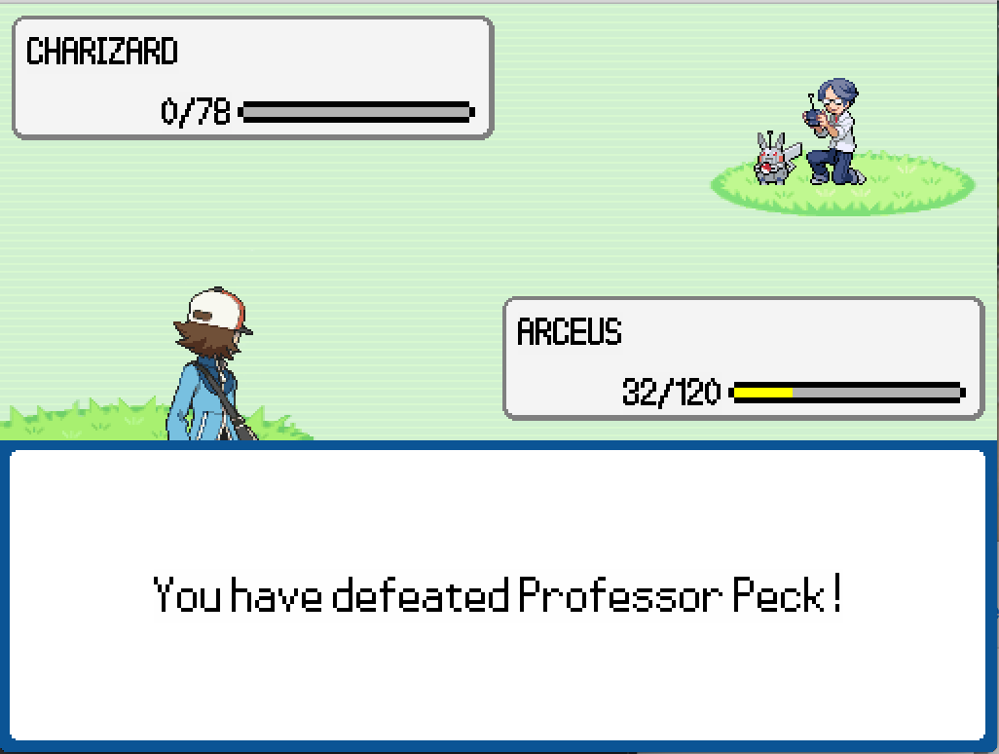
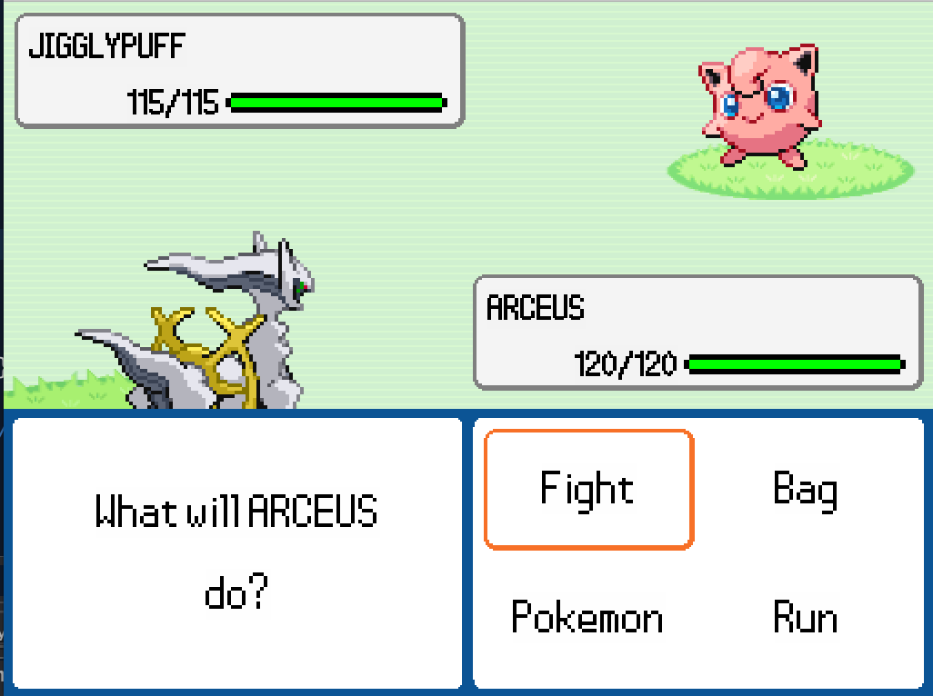
GUI

Slide 18










Professors and the Elite Four
Dancy
Mir
Peck
Razet
Meng
Marchori
King
Eric
Jason
Murph
Ben

Slide 19
Future Work
We created some overworld art, but we simply ran out of time before being able to allow players to explore Bucknell. If we decide to work more on this project, our first goal would be to make a virtual Bucknell to explore.
We took out all status effect and stat changing moves to avoid that level of complexity. We would like to put those back in.
We also wanted to have experience and leveling functionality so that your Pokemon got stronger as the game progressed.
We also want the user to catch Pokemon so that they can’t just choose any Pokemon.
More recent Pokemon since we have the sprites, but not the information in the XMLs.
In the future, we would implement the ability to select a nickname for a Pokemon in the PokemonChooser jOptionPane.

Slide 20
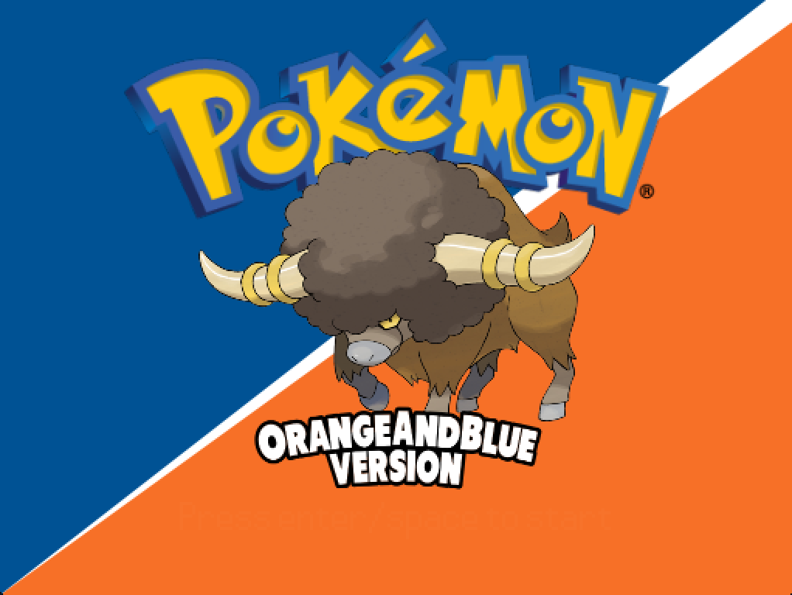
Demonstration

