Slide 1
Professional Studies 1
Benjamin Scott
DUE DATE: 9 April

Slide 2
Introduction
Introduction:
This assessment will cover the process of planning actions that could further your career goals and then undertaking actions that move you forward on a career pathway.
The assessment will include:
Nominating career goal.
Listing and undertaking short-term actions
Planning long term actions
Collect feedback on the actions you plan and undertake
Evaluate your processes and actions
The assessment instructions:
All sections marked in green must be edited/filled out by you.
Screen cap images are requested for some information. This is to ensure information is not lost due to internet hyperlinks becoming broken. Please ensure you screen capture information clearly so it can be read and assessed.

Slide 3














Introduction
Introduction:
This assessment will cover the process of planning actions that could further your career goals and then undertaking actions that move you forward on a career pathway.
Conclusion – 33
Self Evaluation – 4 - 7
Occupations – 16 - 17
Networks 2 – 24 -25
Soft skills – 8 - 11
Tech skills – 18 - 19
Information – 26 - 28
Financials – 29 - 30
Hero reference – 12 - 13
Studios – 20 - 21
Cool tools – 14 - 15
Networks 1 – 22 - 23
Job Adverts – 31 - 32

Slide 4
Self Evaluation|Self Introduction
What are your goals? What are the right goals for you? What do you need to do to achieve your goals?
The questions below are designed to give you an overview of yourself to help plan where you should focus your time and energy. This will give you better insight to choose goals and plan how to achieve them.
Take some time to answer these questions (and consider others like them).
 | Self Introduction
Why are you studying at AIE? | Learn new skills. my passion of gaming. Being able to create games as my job has been a dream of mine and AIE offered exactly what I was after.
What hobbies do you have that are closely related to your AIE course work. | Some hobbies that are related to my course work is Gaming, I also play board games with my friends all the time.
Do you have hobbies that are not at all related to your course work? | Heaps!, the major ones are footy and skating, every time I'm not gaming I try to skate.
Do you think you have an “artistic” side to your character? | I believe I am very artistic because I’m very creative and imaginative.
Do you think you have an “technical” side to your character? | I can struggle to understand really complicated tasks so I wouldn’t say I'm a technical person but I do have a technical side. Programming has shown me a technical side of myself.

Slide 5
Self Evaluation|Self Introduction
 | Self Introduction
Do you feel you are a creative person? How can you be sure? | I know I am a creative person, when brainstorming for ideas I can come up with some wacky and crazy things. When playing certain games my creative side comes out.
What job role specialisation do you find most interesting, right now? Why? | Right now a role I find the most interesting is programming Physics because depending on how you set the Physics to be can completely make the game serious or wacky, it could be what the game is based around or just something to improve the game.
What software is the most interesting to you, right now? Why? | GitHub, using it to backdate work if I mess up and even just using it to save my work for easy transfer. It has a class so the teacher can see my work and making projects all these things make it so much easier to program.
Can you describe a strength that might serve you well whilst studying to become a professional? | A strength I can say I have is Strive, I’m driven to push myself in class because I really want to program, I’m passionate and more focused then I was in school.
Can you describe one weakness relevant to your study you feel might need some improvement? | A Weakness right now is playing games as a break from studying instead of making my break something like 5 minutes to relax so I can get back into it.

Slide 6
Self Evaluation|Self Introduction
 | Self Introduction
Describe one of your strengths that might give you an advantage in the workplace? | One strength I have is I'm very adaptable, I can listen to feedback and take on the constructive criticism.
Describe one of your weaknesses that might give you trouble in the workplace? | One weakness I have is I tend to be insecure about the work I create. Its not that I don’t love the feedback I get good or bad, its more I want it to be perfect. It could mean I spend to much time on something little where I don’t need to possibly missing a deadline.
Do you think you are an introvert or an extrovert? | Introvert, I definitely prefer sitting inside on a rainy day then go to a party.
Do you find it difficult or easy to communicate concepts and ideas to other individuals? If not why? | I find it easy to communicate my concepts and ideas to other individuals as long as I understand the task or objective I am trying to explain.

Slide 7
Self Evaluation|Self Introduction
 | Self Introduction
Do you like to express your self in writing? Do you feel you write well? | I do like to express myself in writing but I don’t feel I can communicate that well through my writing.
Do you feel you are good with math and numbers? Could you write, read or use a math formula? (Eg: F=ma or S=d/t or C=2πr) | I feel like I'm good at maths, I might need to practice a little but I really enjoyed it at school, I 100% can read, write and use those formulas. Force = mass x acceleration, speed = distance / time and circumference = 2 x pie x radius. we are also using all of this in programming.
Do you have any coding, scripting or programming skills? | Not before starting the programming course.
Do you have traditional or digital art skills? (Eg: drawing, illustration or painting skills?) | I love to draw but I wouldn’t say it can qualify as a skill. Apart from using photoshop and video editing no.

Slide 8
Soft skills|Definition
Research what is meant by the term “Soft skills”.
In your own words write a short, accurate description of what the term “Soft Skills” means in the context of a workplace.
The meaning of the term Soft Skills in a work context.
Answer here Soft skills are a characters personality trait and or habit that allows someone to effectively communicate and interact with others. an example in a workplace can be communication skills, having good teamwork and lastly good work ethic.

Slide 9
Soft skills|List of skills and meanings
What are common soft skills? What do they mean?
Compile a list of different but common types of soft skills (approx. 7).
Write in your own words a description of each soft skill
Types of soft skills | Different words used describe the same type of soft skill
Soft Skill #1 | Time Management, taking necessary breaks and finish projects before deadlines.
Soft Skill #2 | Work ethic, going an extra mile and staying committed to your work, staying back a couple hours to finish work
Soft Skill #3 | Problem solving, When problems arise the ability to deal with them the best way possible.
Soft Skill #4 | Resourcefulness, Able to create quick and clever ways to deal with problems/difficulties.
Soft Skill #5 | Adaptability, being able to learn new skills and behaviours really quickly in response to different circumstances.
Soft Skill #6 | Teamwork. The ability to work / cooperate effectively with multiple people in many ways.
Soft Skill #7 | Creativity, Having great imagination and original ideas, ability to generate great ideas.

Slide 10
Soft skills|Personal vs Team
Research soft skills that have a team focus and ones that have a personal focus.
In your own words make 2 lists.
One list of soft skills that are largely personal
One list of soft skills focused around teams in a workplace context.
Soft Skills – Personal focus | Soft Skills – Team focus
Openness to Criticism – Being able to accept Criticism, instead of ignoring it or getting hurt by, actually be able to improve yourself from it. Capable to work under pressure – When deadlines are coming close you can keep a cool head and still work and not breaking down or procrastinate. Positive Personality – People who are optimistic can look on a bad situation and still be ok. Good work Ethic – being Reliable and able to do the work right the first time, not needing someone to waste time/ resources trying to babysit them. | Communication – can be broken down in multiple soft skills like verbal, written, body language etc. all of these can help in a team. Leadership – being able to motivate a group of people, being able to direct/disperse work around evenly making the work load easier. Collaboration – being able to share different perspectives and experiences, treating each team member with respect and willingness to explore there approach. Listening – Being able to listen to their ideas, hearing multiple sides to a view.

Slide 11
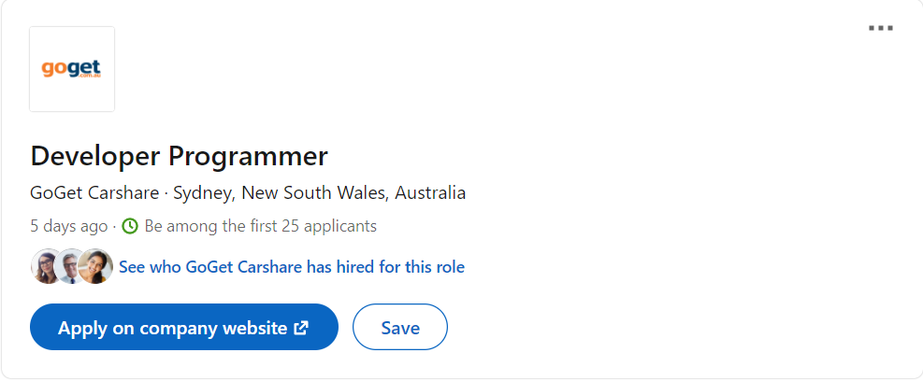
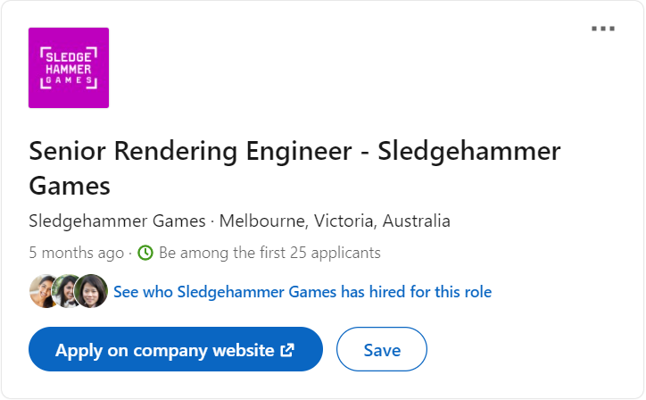
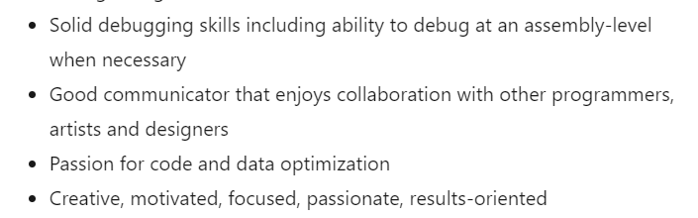

Soft skills|Identify
Take a screen shot of a 2 job adverts.
Identify and highlight some of the soft skills listed in each advert.
Job advertisement #1 | Job advertisement #2
Post screenshot here

Slide 12
Hero Reference|Cool people
Research professionals currently working in industry.
Find 2 professionals who's work you find inspirational.
Post a link to their portfolio or examples of their work and explain what inspires you.
List of cool pros | Name | Link to work examples | Why are you inspired?
Cool pro #1 | Josh Caratelli | https://www.joshcaratelli.com/ | Josh not only has skills in many soft where, he has worked some major games I've played.
Cool pro #2 | Santiago Alverez | https://santiagoalvarez.me/ | He has worked with major companies like Disney as well as small ones to creates games.

Slide 13
Hero Reference|Pro Skills
What skills do your chosen pros have? What soft skills do you think they might need to have?
What software do they use? If you don’t know the software, they use what software do you expect they use?
What job roles do they have? What job roles could they have?
In your own word write a short description of the skills these people have and the software they use. Also describe you job title they actually hold or what job title you think they could hold.
List of cool pros | Tech skills and soft skill set | Software knowledge | Actual or Possible Job title.
Cool pro #1 | Adaptability, Great Teamwork, Good verbal communication, problem solving, recognises weaknesses | Visual studio, Unreal Engine 3/4, FMOD studio | Software Engineer for sledgehammer games
Cool pro #2 | Adaptability, Leadership, Teamwork, resourcefulness, work ethic and creativity. | Git, Visual studio, photoshop | Software Engineer for Timba Games

Slide 14
Cool tools|Software
List 2 pieces of software you think are really cool.
In your own words explain what the software actually does.
Explain what about the software interests you?
List of cool software tools | Name | What does it do? | Why does it interest you?
Software #1 | Git | Stores files for easy transfer and allows you to backdate your work if you need to. Project management tool. | Git interests me because I'm using it in class, its helped me transfer files to and from different pc’s and I'm finding that awesome.
Software #2 | Visual studio | Provides tools like c++ and c# etc, visual studio provides debugging and aids in coding. | Visual studio is interesting because you can use it for coding, I'm enjoying it for the help it provides when I make an error and it explains how I can improve my code.

Slide 15
Cool tools|Software developers
Who develops the software?
Does the developer provide support to the user base? For example do they post tutorials on their website? Do they have forums for discussions? Does the developer post videos on YouTube?
Does the developer have some type of active social media?
List of software tools devs | Name | What training support is offered? | Are official forums available? | Do they have an active social media presence?
Software developer #1 | Linus Torvalds | There are Online training called ‘Pro Git’ which is free to read online | Yes, they want people to get involved, you can chat report bugs etc | Loads, major companies like google Facebook all use git.
Software developer #2 | Microsoft | Microsoft provides many online training videos | Yes they provide forums to chat with if you need extra help. | Loads, being as big as they are they have a massive social media presence.

Slide 16
Occupation|Job Roles
Research 3 studio job roles.
Identify 3 actual job titles use by professionals and studios.
In your own words give a brief description of what that job role is.
Job Title | Description of job role
Rendering Engineer | Work with other rendering engineers in developing the games “look”, they do architect, refactor and maintain the rendering pipelines and features as well as Design, write, debug and refine rendering systems, features tools and infrastructures.
Physics programmer | Creates software that enable things in games like gravity, collision these can lead into events like crashing and other things to move. They have to write code based on the laws of physics making it realistic.
Sound Engineer | Uses Machinery and equipment to record, synchronize, mix or reproduce music, voices and or sound effects, in video games they are responsible for having the character talk, object making noises when they clash etc.

Slide 17
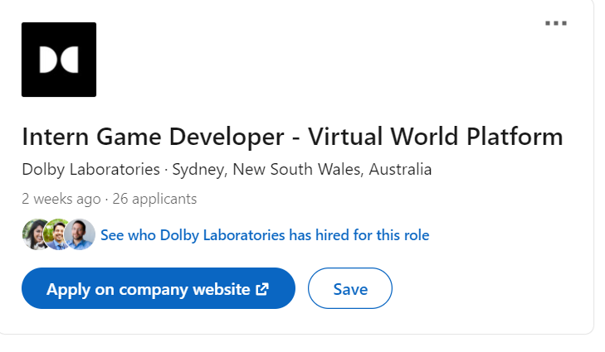
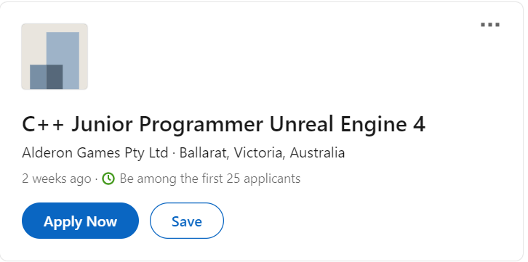
Occupation|Job Roles
Find 2 job advertisements you'd be interested in, each from a different source.
Highlight the source and paste a screen shot of each job advertisement below.
Also post a link to the source of the job adverts
Job advertisement #1 | Job advertisement #2
https://au.linkedin.com/jobs/view/intern-game-developer-virtual-world-platform-at-dolby-laboratories-2461504431?refId=0737537b-03f8-4e8a-9fdf-9db50290304d&trackingId=XhrtrsyrINVVw0GO3dHcGA%3D%3D&trk=public_jobs_topcard_title | https://au.linkedin.com/jobs/view/c%2B%2B-junior-programmer-unreal-engine-4-at-alderon-games-pty-ltd-2475751807?refId=a9a62695-164e-44d6-8b3d-d194d03742bf&trackingId=M7O7b%2BwHlrNAF65i%2BfBcdA%3D%3D&trk=public_jobs_topcard_title

Slide 18
Tech skills|List
Compare 2 of your technical skills. These could be things like animating, modelling, rigging, unwrapping etc.
Discuss one technical skill you feel you are currently “good” at and would find easy to learn more.
Discuss one technical skill you feel you are currently “poor” at and would find it difficult to learn more.
Discuss why one skill is easy for you and the other is difficult.
Easy and confident skill technical skill | Difficult and poor technical skill
What is the skill and why is it easy? I technical skill I believe I find easy is having good Source Control, using git not only do I find easy but I find fun, being able to go back on my code and pull old code that I haven't broken or push new and updated work. | What is the skill and why is it difficult? At the moment my poor skill is being proficient in c# mainly because I'm learning a new programming language.

Slide 19
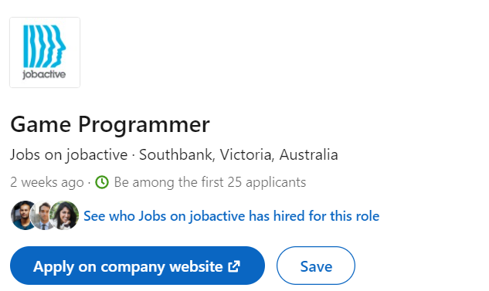
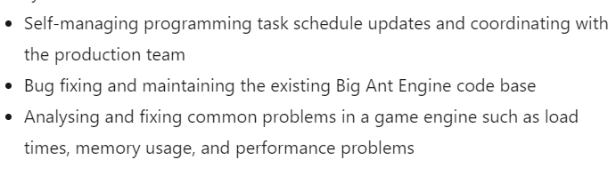
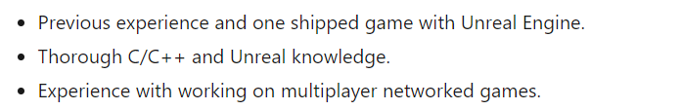
Tech skills|List
Take a screen shot of 2 job adverts.
Identify and highlight some of the technical skills in each advert.
Job advertisement – Tech Skills #1 | Job advertisement – Tech skills #2

Slide 20
Studios|Studio list
Identify a few studios near to you (local studios) and post a link to their website. (3)
Identify some international studios and post a link to their website. (3)
Local studio name | Link to studio website
blowfish | https://www.blowfishstudios.com/
BeamTeamGames | https://www.beamteamgames.com/
BubbleGumInteractive | https://www.bubbleguminteractive.com/
International studio name | Link to studio website
Exploding Kittens | https://www.explodingkittens.com/pages/mobile-games
NinjaKiwi | https://ninjakiwi.com/
RedGamesCo | https://www.redgames.co/

Slide 21
Studio|Studio review
Choose one local and one international studio from your list.
Research them and report on some findings, focusing on what they produce or how they produce it. Ensure you are reporting accurate information.
Find out what software they use?
Find out how many staff they employ?
Find other information about how the studio produces its products?
Studio name | Production trivia
Blowfish Studio | Unity, steam VR, git, visual studio, photoshop, maya, blender, unreal 4, game maker studio 2 middleware engines. Compony size – between 11 and 50 employees. They produce their own IP and Work with clients to develop, design and create media rich interactive experience. You can become a client by going on their LinkedIn. Blowfish provides development services to get the game realise read, they can port to all major platforms.
NinjaKiwi | Adobe flash Platform, git, Steam, maya, Unreal Engine, Compony size – 70 Employees. Apart from Wikipedia there are not many sources that explain how NinjaKiwi accurately Produce their work, the Lead co founder started with flash games by himself and then because of his Work becoming a hit he was able buy into another compony called goldfish who helped produces games with him and his new team.

Slide 22
Network 1|Personal close
Think about your immediate personal network. Think about the people who can offer you advice and feedback.
These are people who you can talk directly with. These people may include family, friends, fellow students, trainers, work colleges, etc.
How many people in your immediate personal network could you:
call on for advice on artistic / technical matters.
call on for advice on soft skills related matters.
call on for advice on employment and job-related matters.
 | Personal close network (approximate size)
Artistic / technical matters | 2
Soft skill related matters | 3
Employment / job related matters | 2

Slide 23
Network 1|Personal Extended
Your personal extended network is made up of people who you are not in direct contact with.
This could include people you don’t know in person, but are a member of a group you are a part of (eg a social media group)
This could also include people you know of. You may need to talk “through” other people to make contact.
These people are “2 steps” away.
In the box below describe the scope and extent of your personal extended network.
Do you “know of” some people who could help you develop as a professional?
Do you have access to a group of people who could potentially support you? (eg a Facebook group)
Do you have some form of extended network you can get feedback or even advice from?
 | Extended network
Describe the extended network you have right now! | I have a close friend in Melbourne Who is studying Programming who can be a massive help scoping out Melbourne for jobs and vice versa. Apart from my class I'm in I follow some Facebook pages where people showcase their work and everyone gives feedback.
Are there any easy steps you could take to expand you current extended network? | Definitely, I can look at social media groups on Facebook, attend events like pax where I can ask questions of professionals already in jobs. Go on forums and ask around. Mainly just try to speak with Others online and extend my personal network.

Slide 24
Network 2|Community close
Look for 2 local communities you could personally interact with that could help you develop professionally. Focus on finding local groups that are near to where you are now, that you could have easy access to.
The community could offer …
A competition
Interaction with like minded people
Networking
Feedback
Answering questions
Describe (and link to) the communities in the box below.
 | Close / local community
Physical community | https://igda.org/chapters/au-sydney/ IGDA Sydney Brings local Dev’s together and including yourself if you want to showcase your game and you play test each others games, give feedback, tips and basically just hang out and play each others games.
Online community | https://stackoverflow.com/ Probably the most used online community for help is stack overflow. You post your code and say exactly what you're trying to do, people will comment the answers or try their best to help you. You can compare code and sometimes be given a better result improving your code.

Slide 25
Network 2|Community Extended
Look for a big external event that would be valuable for you to attend. This could be a conference or expo that hosts industry developers, speakers and community. Write a short description of why it would be valuable to attend.
Find out the basic details of the event.
Link to the website
When is it on this year?
How much would it cost to attend. (approx.) Include ticket prices, travel, accommodation and anything else needed.
event name | Link to website | When is it on | Ticket prices | Travel expenses (approx.) | Accommodation expenses (approx.) | Other expenses (approx.) | Total cost
Supanova comic Con & Gaming | https://www.sydneyshowground.com.au/events/supanova/ | 19-20 June 2012 | 65$ for the weekend, 38$ for 1 day. | 15$ on opal. | None, Train it home. | For food and merch maybe 80$ | Roughly 150$
Why would it be worth attending?
It would be worth attending not only to try and talk to the professionals at booth and try and find out about the industry, but I could extend my network and make friends or just talk to other students that could be attending.

Slide 26
Information|Sources News
Look for 2 information sources on industry news.
Carefully choose your sources to ensure you get industry news that is of good quality.
This could be from the following –
Social media source
Website / news articles
A specific individual
Briefly describe and link to the sources below.
 | Link | Name of source | Describe source | Why is it a “good quality” source?
News source #1 | https://www.gamasutra.com/ | Gamasutra | Website | They Post very often about recent news when it comes to gaming and job opportunities
News source #2 | https://www.facebook.com/groups/SydneyIGDA/ | IGDA Sydney | Social Media source | There are plenty of groups for IGDA on Facebook and they are posting daily, they give good feedback and post jobs that are going up as well as events.

Slide 27
Information|Sources Skills and tools
Choose a skillset and software tool you are interested in. For example Maya and Rendering.
Identify 2 sources of tutorial information for that skill set and software tool combination. Ensure you are choosing a good quality information sources. Link and discuss the source below.
 | Link | Name of source | Describe source | Why is it a “good quality” source?
Skill / tool set #1 | https://www.youtube.com/watch?v=pyb3cKrj1ZE | How to make the Camera follow the Player | The source is a YouTube video Helping you understand and write the code to make the “Camera” follow the player in a 3d Game | The Quality is good because he gave you a quick and easy in site of what is required not only in coding but what to do in unity to make the goal of moving the camera actually work.
Skill / tool set #2 | https://learn.unity.com/ | Official Unity Learning Program | The official unities Learning page, you can take up classes or learn the Essentials. | The quality is amazing because not only does it teach the basic steps but very advance things as well.

Slide 28
Information|Future
Games and VFX for film is a fast-moving industry.
Look for some emerging technologies, software tools, processes, hardware or workflow that interest you.
In the box below describe one emerging technology. Describe a few actions items you might need to take that could move you closer to participating in this new emerging technology.
Technology name | Describe new technology | Action items for participation
PSVR 2 | PlayStation Virtual Reality is where you can immerse yourself in an environment that seems realistic because of its simulated experience. It is constantly improving because its new the gaming world. PlayStation is bringing out a new hardware called PSVR 2. | They might showcase it at an expo and I could attempt to go. GDC might Showcase them and I could attempt to participate

Slide 29
Financial|Costs
Select a small suite of software that could make the core of your professional home studio.
The suite of software should include both 2D and 3D editing tools as well as some additional software for tasks such as sculpting or rendering.
Ensure you are considering software licensing for professional (paid) work.
Software name | Link to website | Cost of professional licence
unity | https://store.unity.com/ | $1800 per year
Visual studio | https://visualstudio.microsoft.com/vs/pricing/ | $45 per month
Perforce | https://www.perforce.com/products/helix-teamhub/pricing | $19 – 29 Per month
Github | https://github.com/pricing | $4 - $21 per month

Slide 30
Financial|Hourly rate
Do some research on hourly rates for freelance 3D artists.
In the box below
Nominate an approximate figure you think is fair as an hourly rate.
Briefly discuss how you arrived at that figure.
 | Answers
Nominate an hourly rate | $28/hourly
Discussion of how you chose that rate | That seems like a fair rate to hire someone it could go higher based on their skill, being a 3d artist you have to create animation for many applications, needing to work with other developers, designers maybe even directors to creates images used in film videos and other media. Not only is skill involved but passion and drive is needed to meet requirements. Because not every person can do it a high rate is 100% right.

Slide 31
Job Adverts|Find and list
Look for 2 information sources that host industry job adverts.
Carefully choose your sources to ensure they are legitimate.
This could be from the following –
Social media source
Website / news articles
A specific individual
Briefly describe and link to the sources below.
 | Link | Name of source | Describe source | Why is it a “good quality” source?
Job advert source #1 | https://www.facebook.com/groups/lookingforgamedevelopers | Looking For Game Developers (Australia and NZ) | A Facebook page dedicated to help you put your name location etc out there. | It’s a good quality source because its very active and is very close to me, ill get a lot of in site on how I should get my name across and what things I need to have in requirements for jobs.
Job advert source #2 | https://www.facebook.com/groups/videogamejobsworldwide | Video Game Jobs – GameDevs, Artists, Producers | A Facebook Page That helps promote your game, get your name out there and show jobs that are going. | It’s a good quality source because its not only very active but you can also showcase your skills and they will promote your game. You can advertise yourself on the page.

Slide 32
Job Adverts|Choose
Select 2 job adverts that you find interesting. Choose an advert for the type of job you’d like to see yourself in the future.
Ensure you are selecting from a good source. Preferably this is an info source you have reviewed and checked for quality before.
Describe why the chosen job adverts are appealing to you.
Identify what you think are the key soft skills and tech skills the job requires
 | Link to job advert | Title of position | Describe why it interests you | Soft skills and Tech skills
Job advert #1 | https://au.linkedin.com/jobs/view/game-developer-at-royal-wins-pty-ltd-2454268578?refId=a7dacf74-f027-4a48-9d09-d558eef48c86&trackingId=QHUEUOnHGegb%2Fj8ckhfDwA%3D%3D&trk=public_jobs_topcard_title | Senior Game Developer | It interests me because eventually id like to have the skills required for the roll. The roll itself is not only high paying but seems like a challenge as well as being enjoyable. | Excellent Written / Verbal communication / Presentation skills “an eye towards quality features”
Job advert #2 | https://au.linkedin.com/jobs/view/mid-senior-game-producer-x2-at-smg-studio-2481675137?refId=17970c08-a976-4277-84e2-32707d40bb9a&trackingId=C8PoM3dZUq6E2ZPRfYD4dQ%3D%3D&trk=public_jobs_topcard_title | Mid/Senior Game Producer | It would be amazing to work for a company being a game producer, I would love to work with a team and manage multiple tasks at once. One day | A good listener, Problem solver, Humble and level Headed, Passion and being Indispensable

Slide 33
Conclusion|Where to next?
This document is designed to help you explore and plan your professional development.
You have added a lot of data to this document. Make use of this data and draw a conclusion.
Review and analyze the information above and summaries into a few key conclusions.
What does the data show? | Link to job advert
What is one weakness you have where you should focus more attention? | One of my weaknesses is I'm being insecure about the work I'm creating, over thinking the level of skill its showing when in reality I'm learning. I need to realise people need to start from some where.
What is one strength you have that will be valuable in the future? | I'm Very Adaptable, I can take feedback good or bad and take it head on. Ill learn from mistakes and always try to improve no matter the situation
What inspires you? | The biggest thing that inspires me is seeing someone's reactions when they play my game, I want to make something that enjoyable that it can make someone play it over and over.
What are your goals? | My first goal is to work in a team and produce something amazing and continue to improve myself to make better and better games.
What is a short term action item you recommend you should do? | Give myself enough time to study at home instead of working as much as I am.
What is a long term action item you recommend you should do? | Make a study room purely for myself so when I'm trying to program or study I don’t have any distractions.

Slide 34
Professional Studies 1|Submission
The following files must be uploaded to Canvas for assessment. All submitted files must adhere to the provided naming conventions.
Workbook:
This Workbook
2021_Professional_Studies_1_BenjaminScott.pptx

