Slide 1


Blockchain – Task 2
No bugs were detected
B) Done all tasks
Bashenga Coin
Ben Mishael – 313580243
Shimon Desta -203670286

Slide 2
Run and Installation instructions
1. First we need to download the external libraries we used in this project.
Open the cmd/bash and run:
npm install
2. After the download we need to open 3 terminals. The first one will be for the full node
that is also the miner and the 2 others will be for the regular nodes.
- For the full-node run this command in the cmd:
node ./p2p-full-nodes.js 3001 3002 3003
- For the full-node run this command in the cmd:
node ./p2p-wallet.js 3002 3003 3001
- For the full-node run this command in the cmd:
node ./p2p-wallet.js 3003 3001 3002

Slide 3
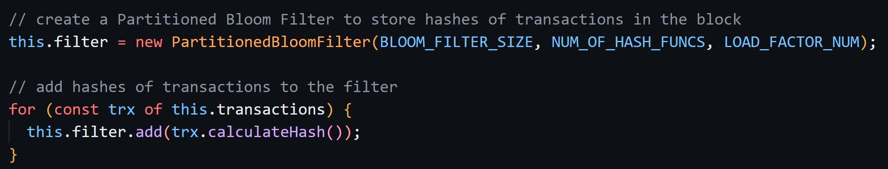
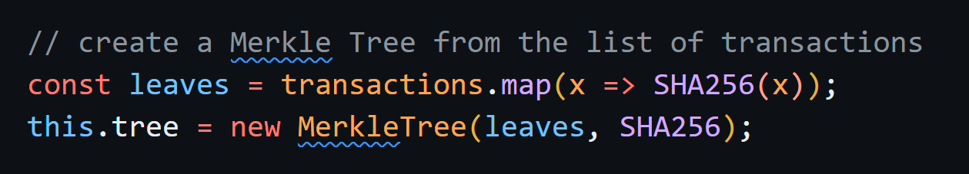
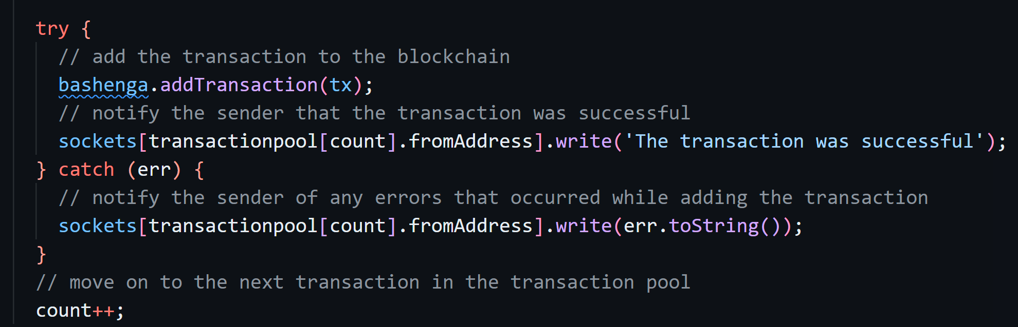
What was Added/Modified?
1. For each block we added a bloom filter:
2. For each Block we added a Merkle Tree that will hold the transactions:
3. Every Transaction is added to the merkle tree in the current block:

Slide 4
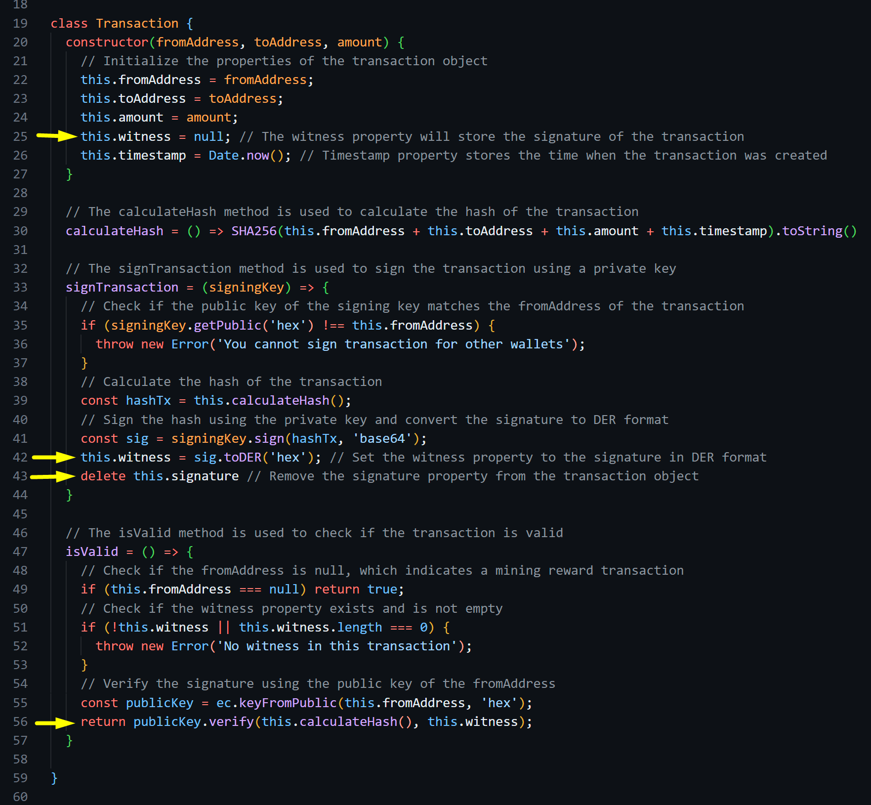
What was Added/Modified?
4. We used the Segregated Witness (SegWit) protocol,
which involves using the witness property of the Transaction
class to store the transaction signature in DER format.
The witnesses property of the Block class stores
the witnesses of all transactions in the block.
At the “Transaction” class used the "witness"
property of the Transaction class to store
the transaction signature in DER format:

Slide 5
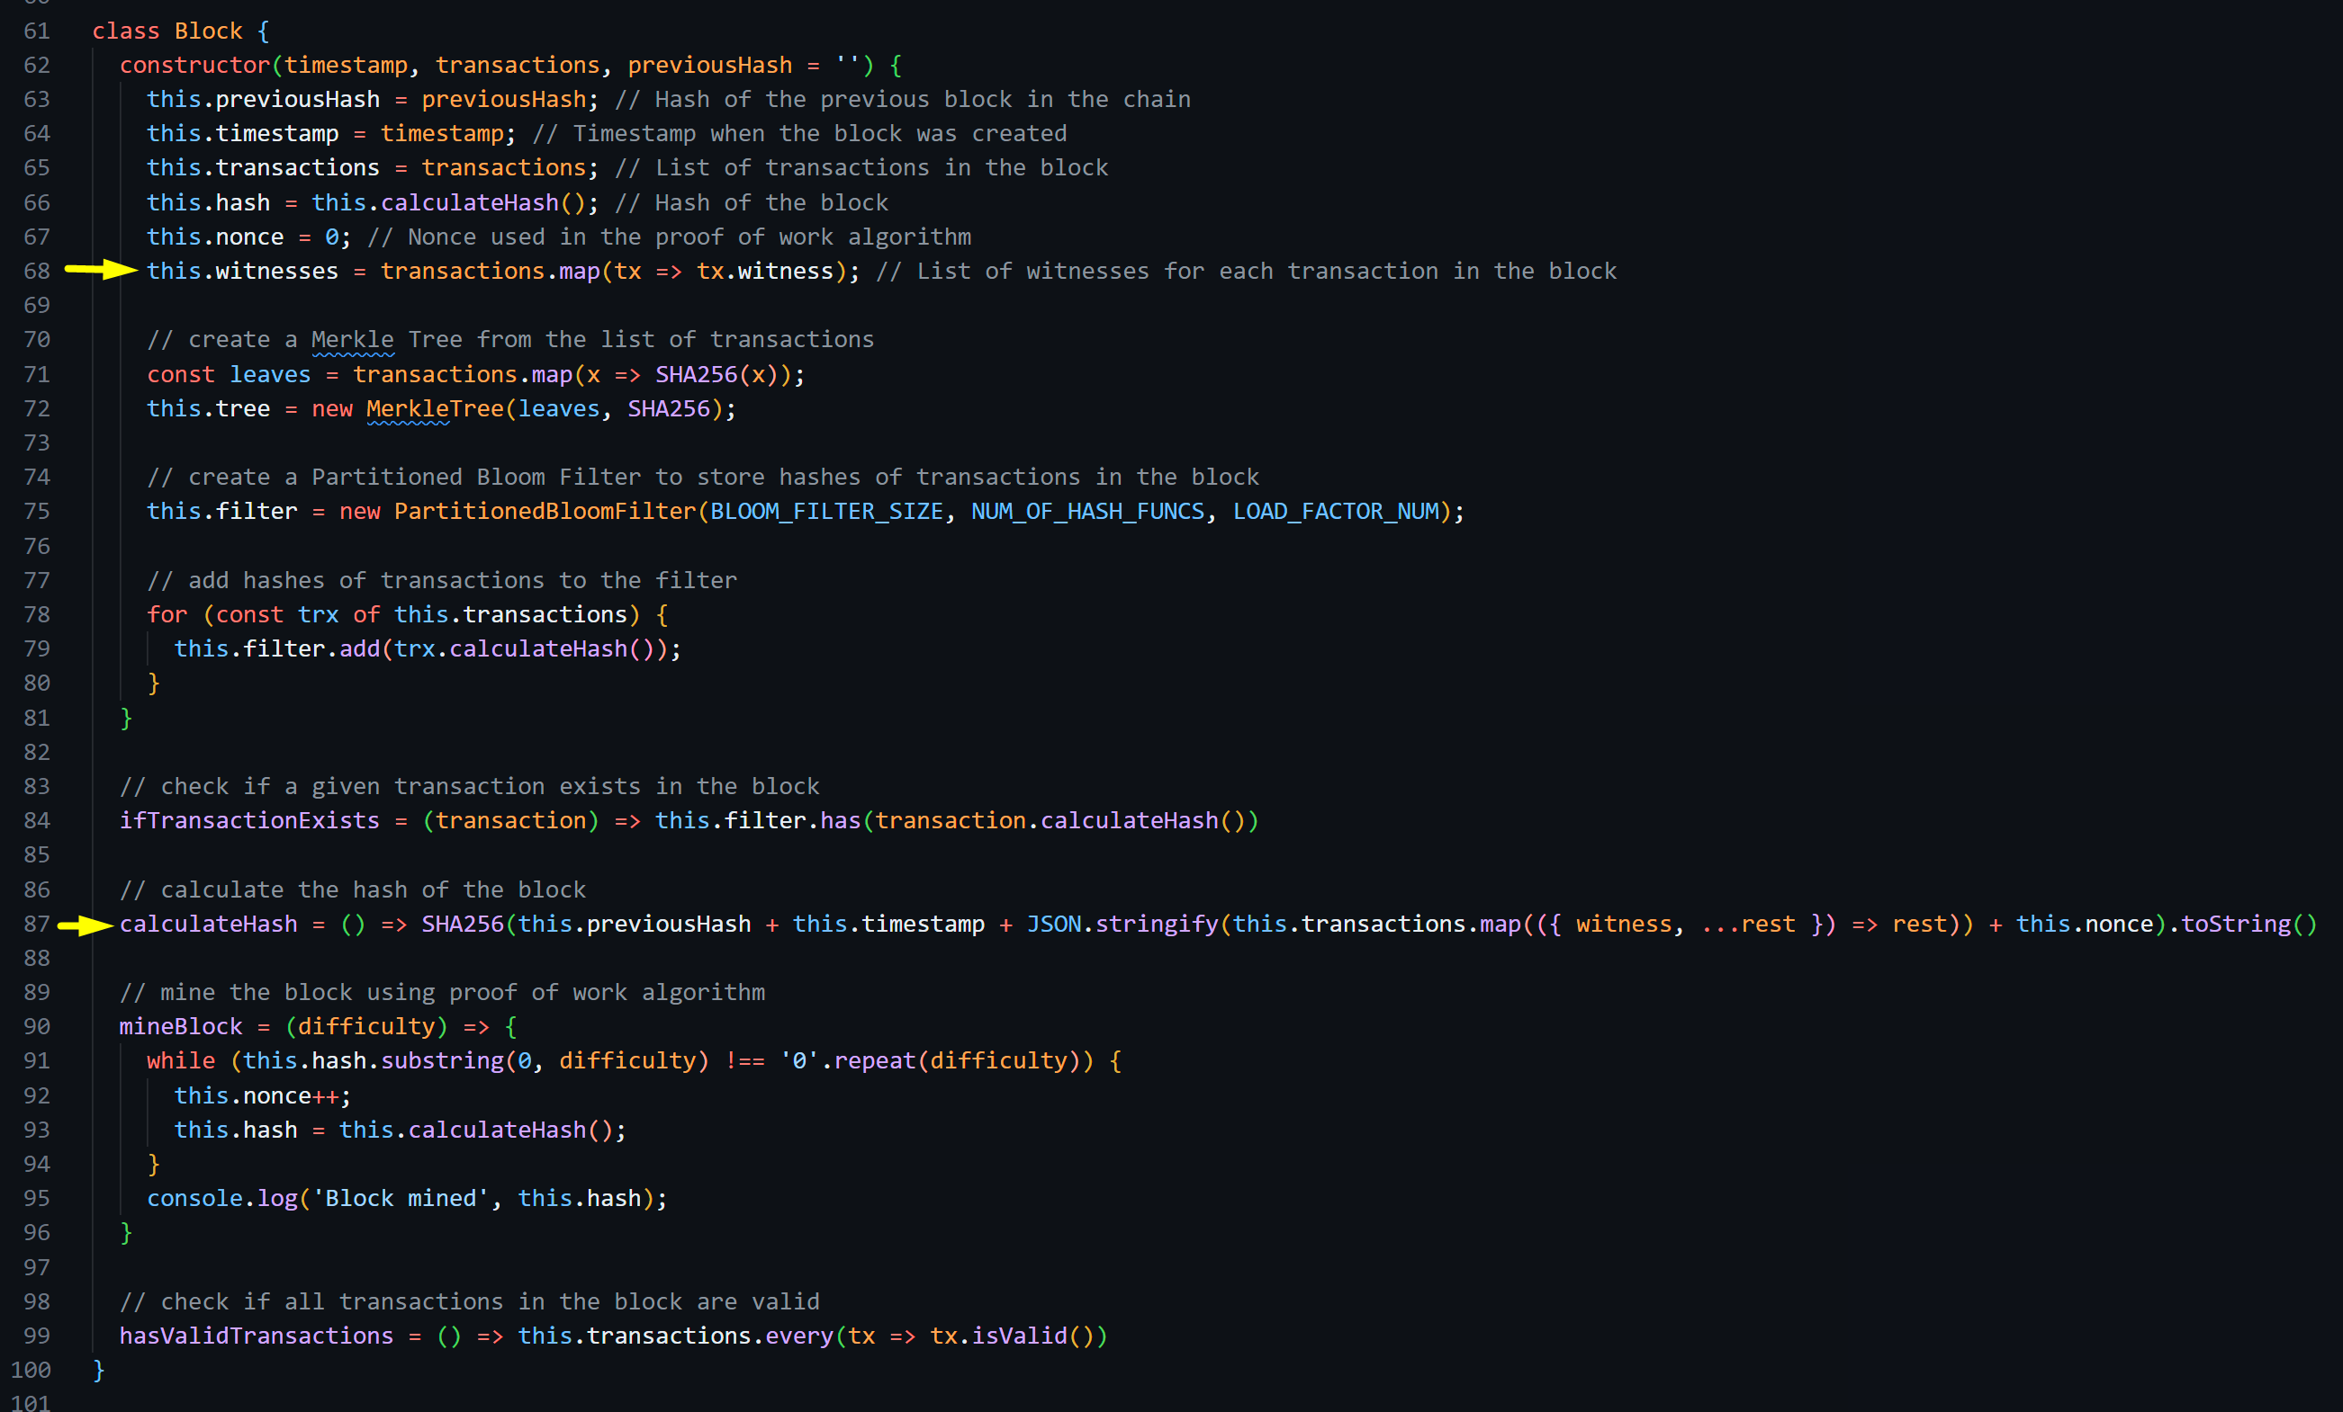
What was Added/Modified?
In the Block Class we used to separate transaction signatures
(witnesses) from transaction data to reduce the
size of transactions and improve scalability of the
blockchain. The witnesses property in the Block
class stores the witnesses of all transactions in
the block, which is a key component of the
SegWit protocol.

Slide 6
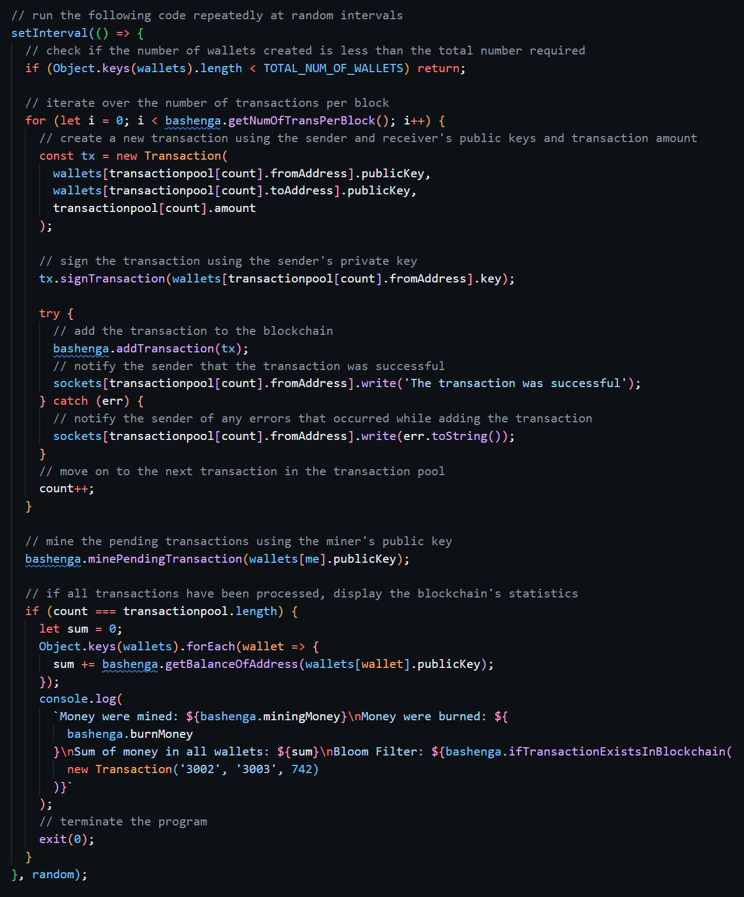
What was Added/Modified?
The program processes all transactions
from the JSON file and prints relevant details
about the blockchain at the end.
We test the bloom filter by searching for
a nonexistent transaction.

