Slide 1
Week 02: Structure Chart
Lab 01 was due on Saturday
Chapter 10 reading is due
Lab 02 is due this Saturday
Review the solution to Lab 01
Answer questions about the reading
Go through the reading quiz
Answer questions about Lab 02
Work through some problems
D&C 6:33
D&C 10:5

Slide 2
Lab 01: Tic-Tac-Toe
Write a program to represent the Tic-Tac-Toe game..
Enter 'q' to suspend your game. Otherwise, enter a number from 1 to 9
where the following numbers correspond to the locations on the grid:
1 | 2 | 3
---+---+---
4 | 5 | 6
---+---+---
7 | 8 | 9
The current board is:
| |
---+---+---
| |
---+---+---
| |
X>
Enter 'q' to suspend your game. Otherwise, enter a number from 1 to 9
where the following numbers correspond to the locations on the grid:
1 | 2 | 3
---+---+---
4 | 5 | 6
---+---+---
7 | 8 | 9
The current board is:
| |
---+---+---
| |
---+---+---
| |
X> 5
| |
---+---+---
| X |
---+---+---
| |
O>

Slide 3
Lab 01: Solution
# The characters used in the Tic-Tac-Too board.
X = 'X'
O = 'O'
Blank = ' '
# A blank Tic-Tac-Toe board.
blank_board = {
"board": [
Blank, Blank, Blank,
Blank, Blank, Blank,
Blank, Blank, Blank ]
}
def read_board(filename):
'''Read the previously existing board from the file if it exists.'''
# Read the file if it exists.
try:
file = open(filename, "r")
board_text = file.read()
board_json = json.loads(board_text)
return board_json['board']
# Generate a blank board otherwise.
except:
return blank_board['board']
def save_board(filename, board):
'''Save the current game to a file.'''
with open(filename, "w") as file:
board_json = {}
board_json['board'] = board
board_text = json.dumps(board_json)
file.write(board_text)
def display_board(board):
'''Display a Tic-Tac-Toe board on the screen in a user-friendly way.'''
# Iterate through each row.
for row in range(3):
# There is a horizontal bar before every row except the first.
if row != 0:
print("---+---+---")
# Display each element in a row.
for col in range(3):
print(' ', board[row * 3 + col], ' ',
sep = '', end = '\n' if col == 2 else '|')
def is_x_turn(board):
'''Determine whose turn it is.'''
num_X = 0
num_O = 0
# Count the number of X's and O’s.
for square in board:
if square == X:
num_X += 1
elif square == O:
num_O += 1
return num_X == num_O
def play_game(board):
'''Play the game of Tic-Tac-Toe.'''
x_turn = is_x_turn(board)
user_input = input("X>" if x_turn else "O>")
square = int(user_input) - 1 if user_input.isdigit() else -1
if 0 <= square <= 8:
if board[square] == Blank:
board[int(user_input) - 1] = X if x_turn else O
else:
print("That square is taken. Try again")
return True
else:
return False
# Read the board if one exists.
board = read_board("board.json")
# Play the game.
print("Enter 'q' to suspend your game. Otherwise, enter a number from 1 to 9")
print("where the following numbers correspond to the locations on the grid:")
print(" 1 | 2 | 3 ")
print("---+---+---")
print(" 4 | 5 | 6 ")
print("---+---+---")
print(" 7 | 8 | 9 \n")
print("The current board is:")
display_board(board)
while play_game(board) and not game_done(board, message=True):
display_board(board)
# Same the board. If the game is done, reset the board.
save_board("board.json", blank_board['board'] if game_done(board) else board)

Slide 4
Lab 02: Calendar Design
Create a calendar for any month of any year from 1753 forward
Enter a month number: 1
Enter year: 1753
Su Mo Tu We Th Fr Sa
1 2 3 4 5 6
7 8 9 10 11 12 13
14 15 16 17 18 19 20
21 22 23 24 25 26 27
28 29 30 31
Your program needs to know two things:
Size of the month
Your program must know the number of days in a given month. This includes February, which is 28 or 29 days depending on whether it is a leap year.
First day of the month
To accomplish this feat, your program must tabulate the number of days between January 1, 1753 and the 1st of the month that you will be displaying. Note that January 1, 1753 was a Monday

Slide 5
Lab 02: Deliverables
Your submission consists of three parts:
A structure chart of the overall design
Pseudocode of one function that is part of the structure chart
Flowchart of one function that is part of the structure chart

Slide 6
Content
Structure Chart Example
Viewpoints
Parts of a Structure Chart
Parts:
Functions
Parts:
Lines
Parts:
Parameters
Designing with Structure Charts

Slide 7
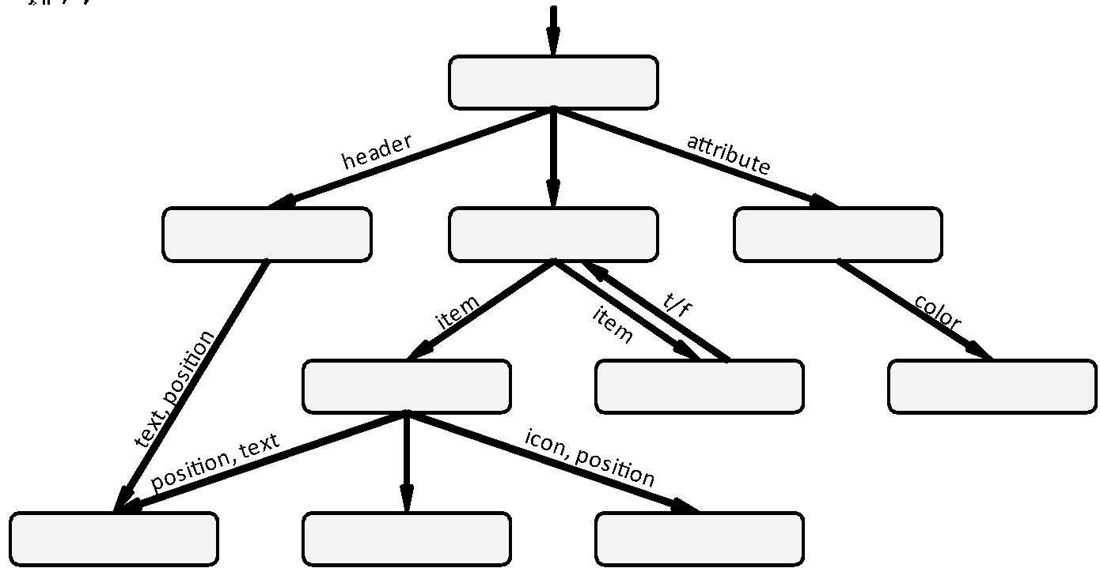
Example of a Structure Chart

Slide 8
Viewpoints
Viewpoints are perspectives on the software design process. They help us look at the program from different angles.
Flowcharts and pseudocode belong here
Viewpoint | Description
Process | The verbs of the system. How algorithms work.
Development | How a program is partitioned and organized.
Logical | The nouns of the system. How data is stored.
Physical | The hardware and physical components.
Structure charts and data flow diagrams are here
Class diagrams are here, something for next unit

Slide 9
Parts of a Structure Chart
There are three parts: the functions, the lines, and the arrows & parameters
Functions
Lines
Params

Slide 10
Parts: Functions
Functions
Functions are represented as ovals or rounded rectangles in structure charts. The name of the function is the text contained therein. We don’t represent variables, processes, or any other program constructs
Lines
Params
Rules
10.1 The nodes of a structure chart are functions
10.2 Structure charts only represent how functions call each other

Slide 11
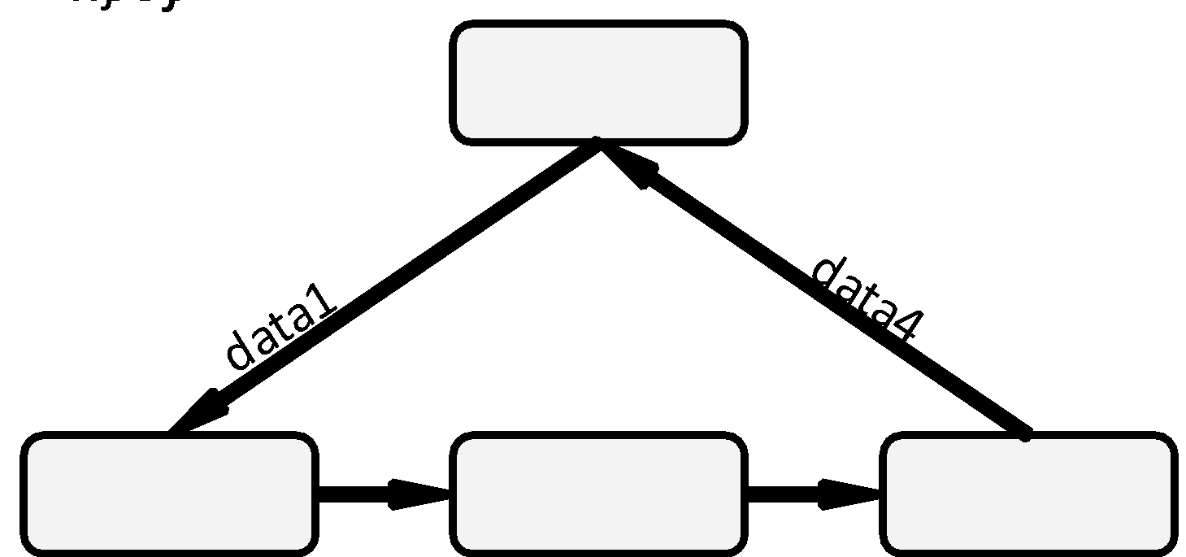
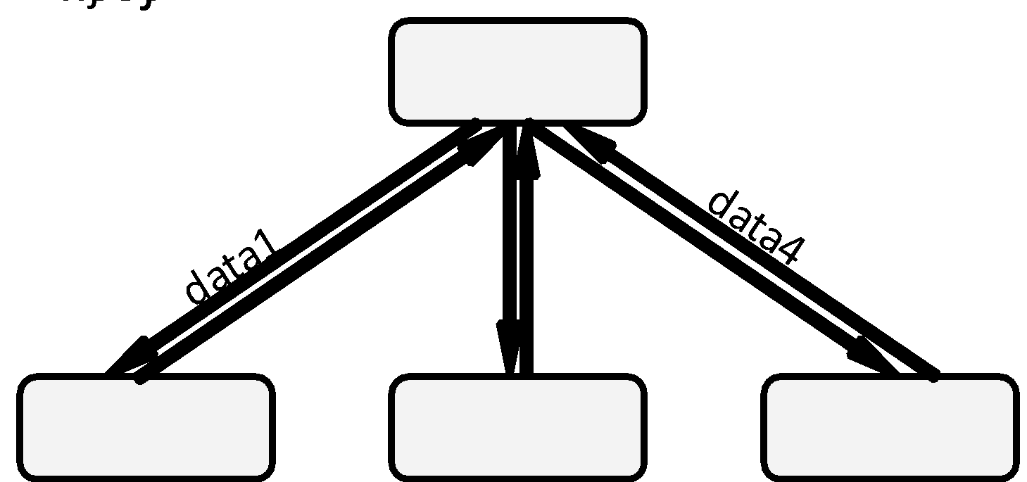
Parts: Lines
Functions
Lines are used in structure charts to indicate that one function calls another. By convention, the caller is on top and the callee is on the bottom.
Lines
Params
Circuits are not possible with structure charts. Control returns to the caller when a function is finished.
Rules
10.3 Program execution starts at the top of the graph
10.4 When a caller invokes a callee, control returns to the caller when finished

Slide 12
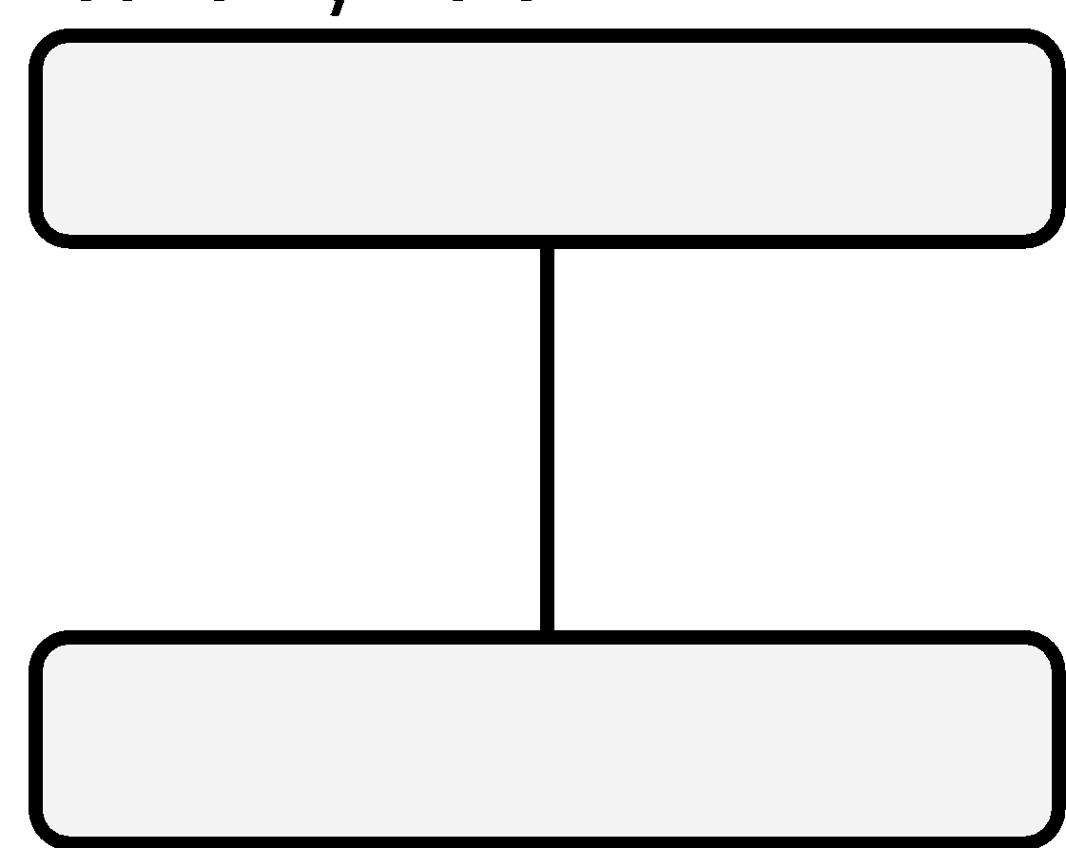
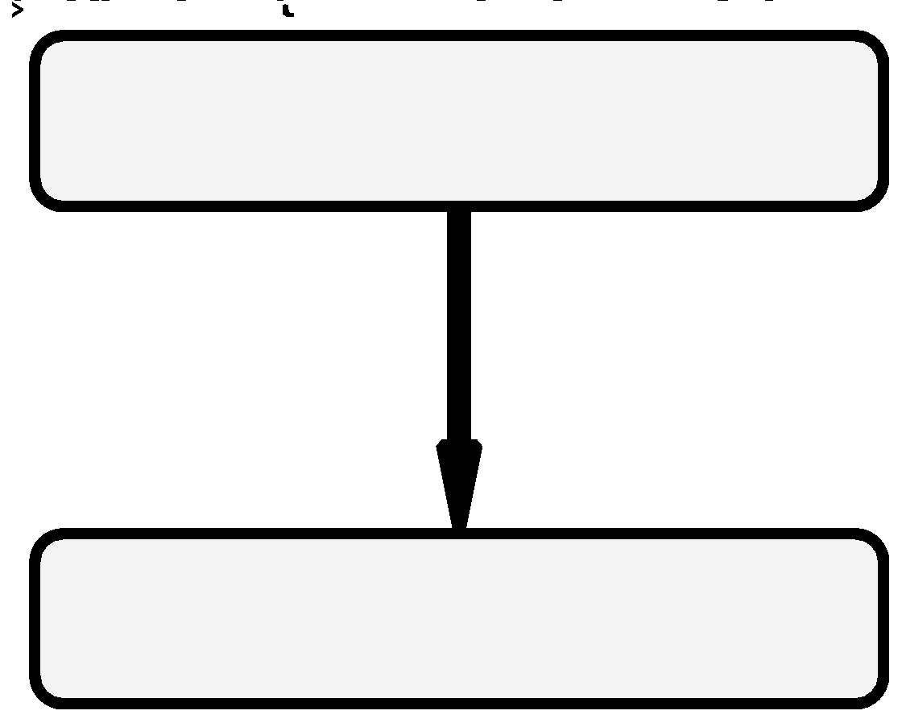
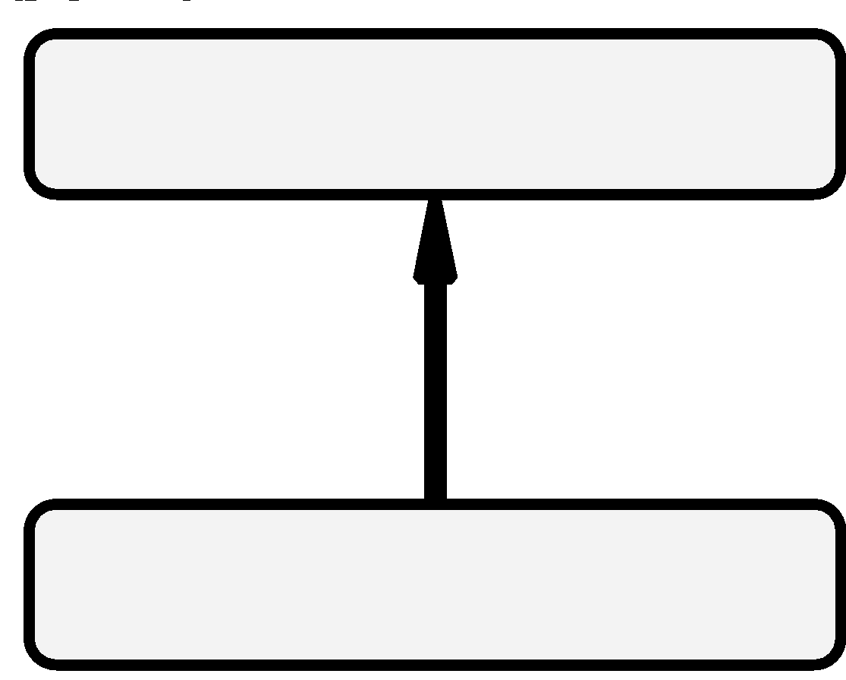
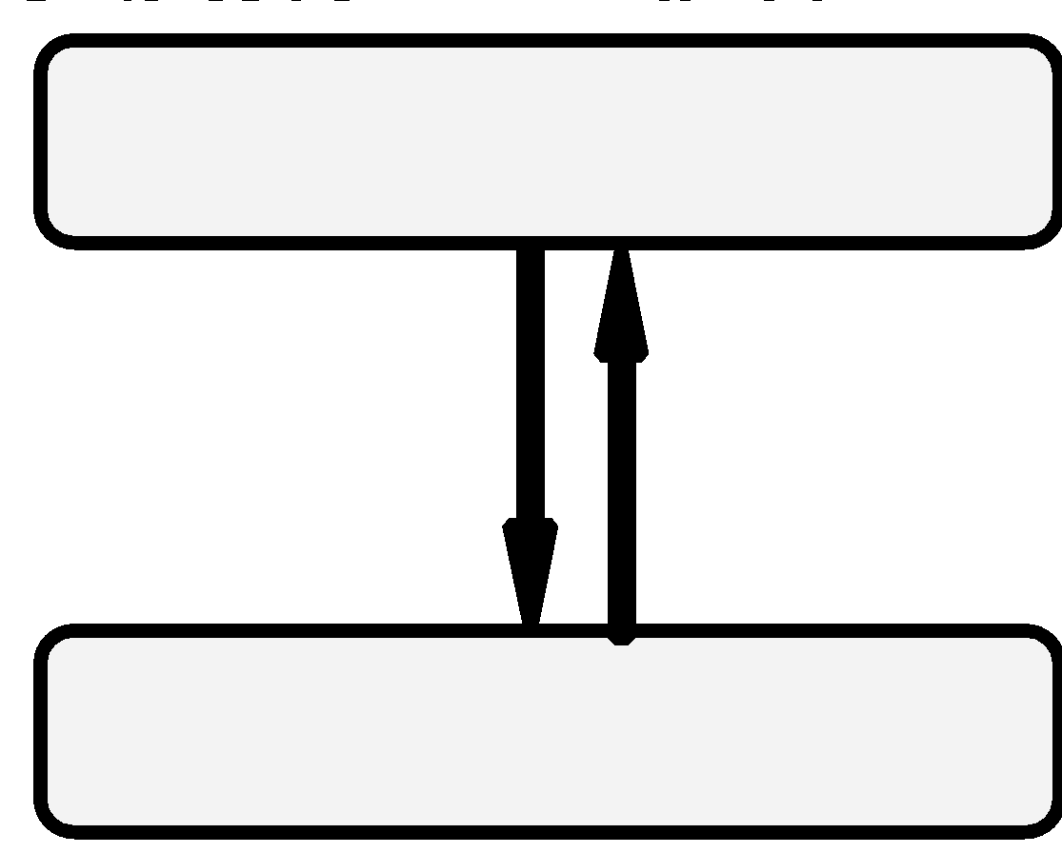
Parts: Parameters and Arrows
Functions
Arrows in structure charts are not used to represent which function is the caller and which is the callee. Instead, it indicates the direction a parameter is passed between functions. If there is no data passed between two functions, then a simple connecting line is used.
Lines
No Parameters | Data only passed | Data only returned | Both passed and returned
Params
Rules
10.5 Every caller must provide the same parameters to a given callee

Slide 13
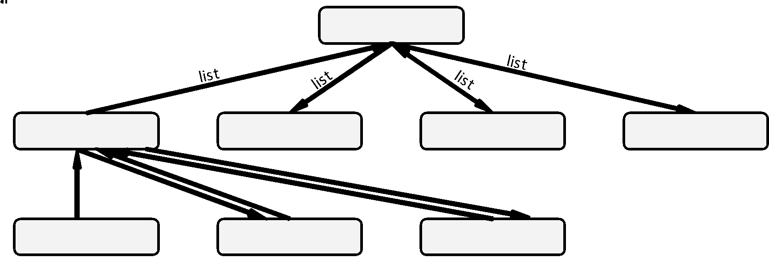
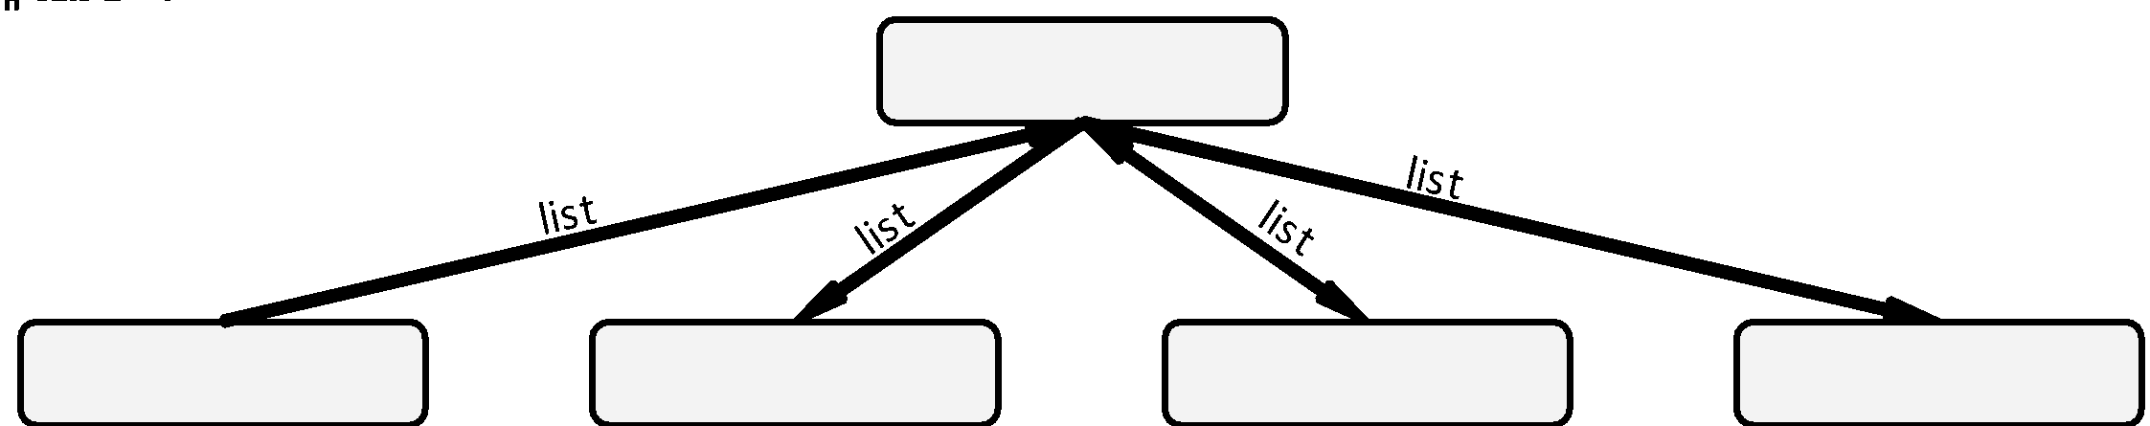
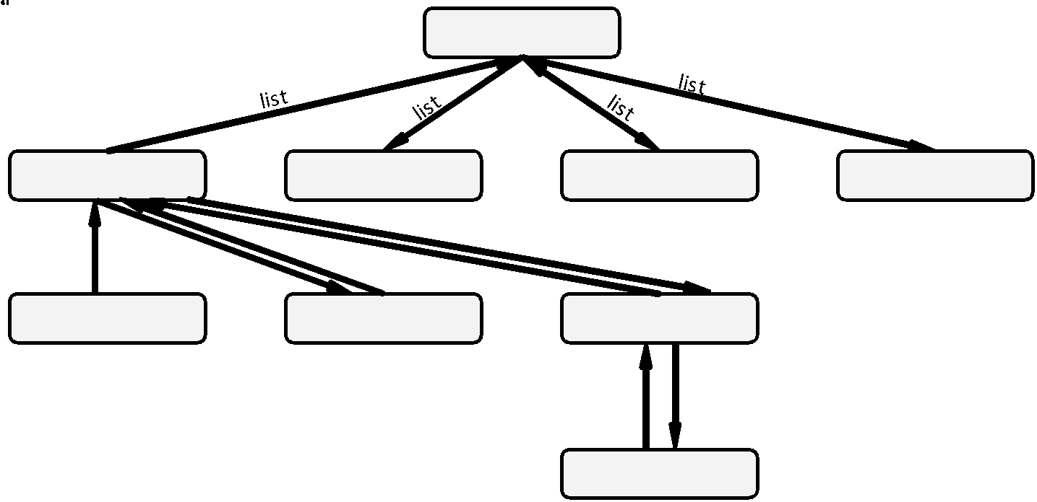
Designing with a Structure Chart
Designing with a structure chart is an iterative process, starting at the top and working the way to the bottom.

Slide 14
Examples
Example 10.1: Modeling Existing Code
Example 10.2: Designing a Program

Slide 15
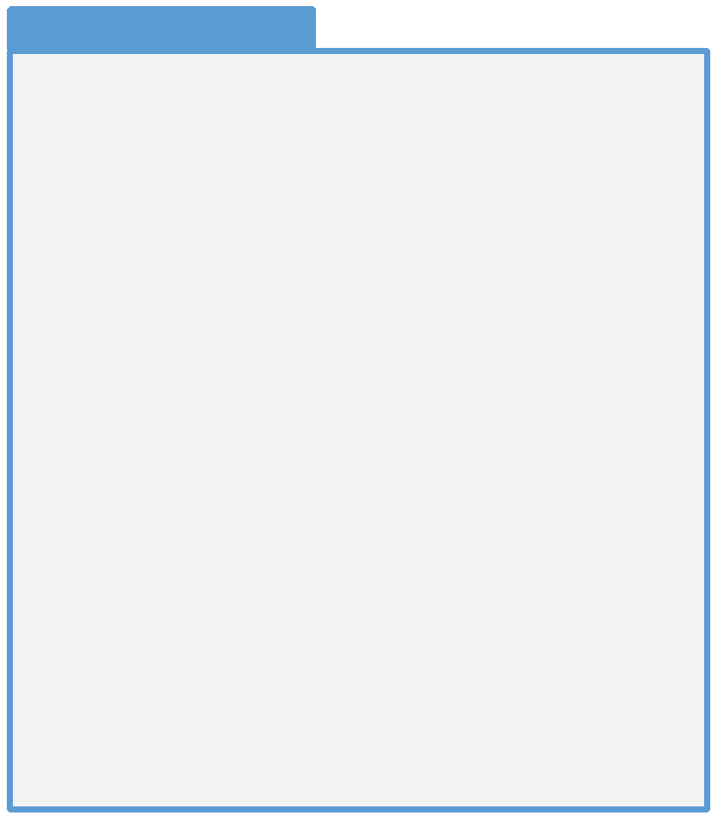
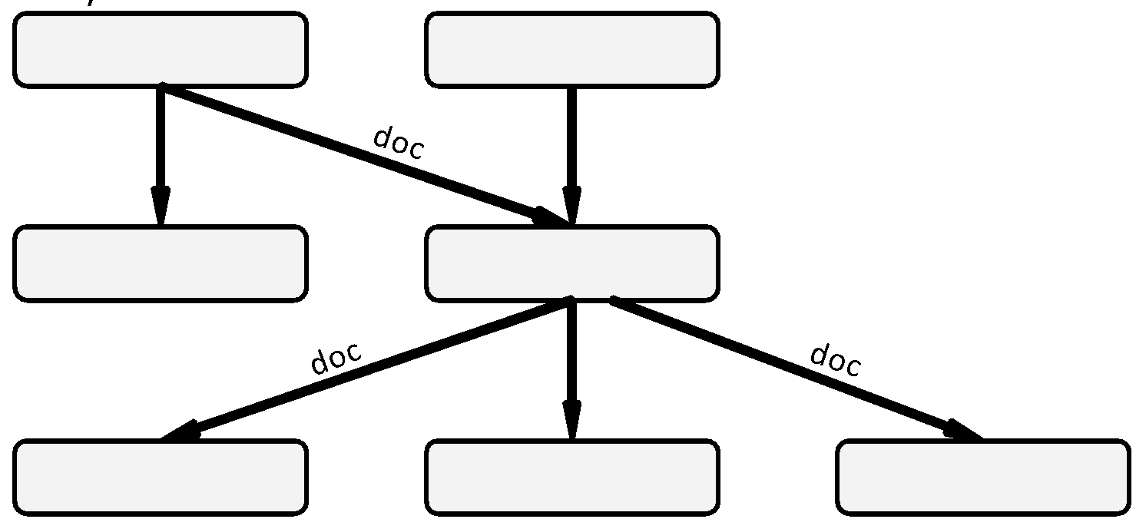
Example 10.1: Modeling Existing Code
Q: Create a structure chart to represent the following code:

Slide 16
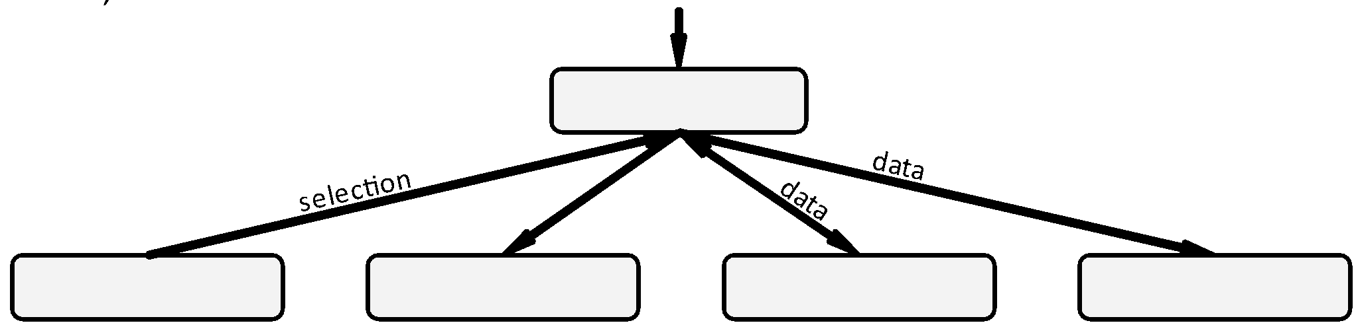
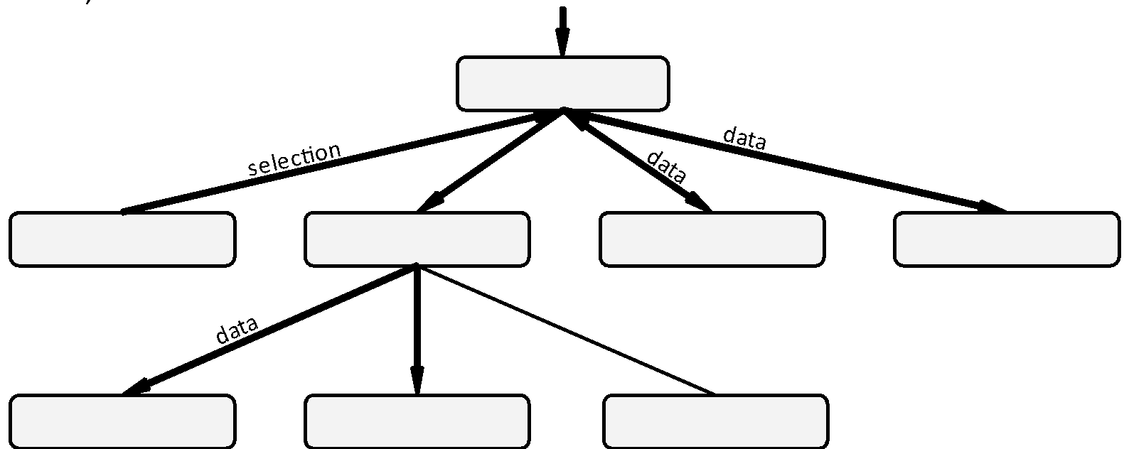
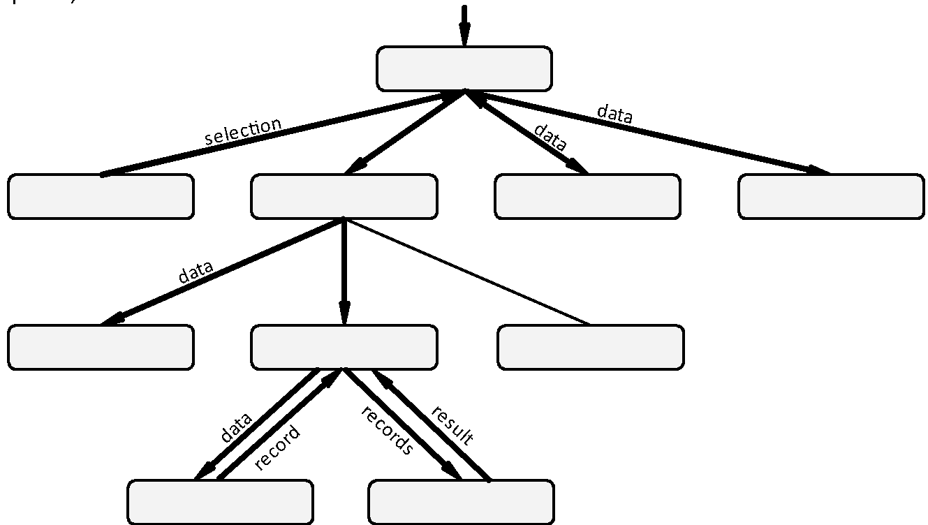
Example 10.2: Designing a Program
Q: Design a program to display one of several financial reports the user

Slide 17
Exercises
Exercise 10.1: Scenario and Tool
Exercise 10.2: Elements
Exercise 10.3: Errors
Exercise 10.4: Fact or Fiction

Slide 18
Exercise 10.1: Scenarios and Tools
For each of the following scenarios, select the best tool for the job
You would like to model the classes in new program
Flowchart
Pseudocode
The business logic for a program is very complex involving many complex decision points
Structure Chart
You would like to figure out which functions are needed and how they call one another
Data Flow Diagram
Class Diagram
The algorithm to organize a collection of items is very complex, needing several loops
Component Diagram
You would like to model how user input flows through the system
Entity Relationship Diagram
Timing Diagram
Who calls this function and with what parameters?
Sequence Diagram

Slide 19
Exercise 10.2: Structure Chart Elements
Draw the various components of a structure chart
Function A calls function B. It passes no parameters but expects a return value
Function A calls function B with no parameters passed between them
Function A calls function B. A passes B a parameter but does not expect a return value
Function A calls function B. A passes a parameter to B and expects a return value.
A
A
A
A
label
label
label
label
B
B
B
B

Slide 20
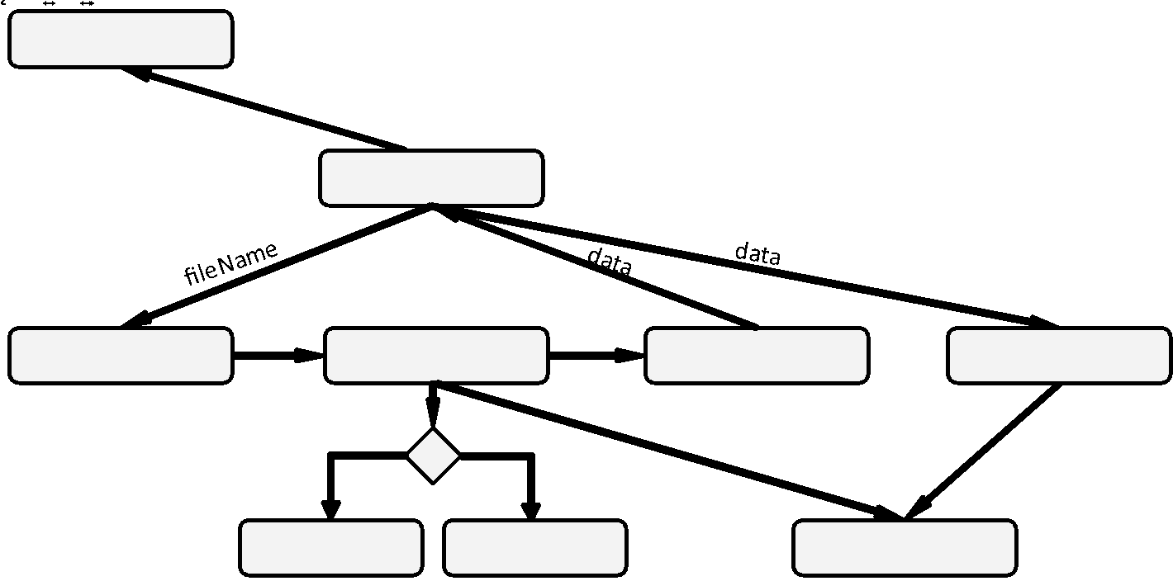
Exercise 10.3: Structure Chart Errors
Identify which rules if any are broken in the following structure chart.
Rule not broken
Rule 10.1: The nodes of a structure chart are functions
Rule 10.2: Structure charts only represent how functions call each other
Rule 10.3: Program execution starts at the top of the graph
Rule 10.4: When a caller invokes a callee, control returns to the caller when finished
Rule 10.5: Every caller must provide the same parameters to a given callee

Slide 21
Exercise 10.4: Fact or Fiction
For each of the following, identify whether it is a fact or whether it is fiction
Fact or Fiction
Lines represent how functions call each other
Ovals represent start/stop locations in the algorithm
Structure charts represent the development viewpoint
The labels next to arrows can represent decision options
Diamonds represent decision points in the algorithm
Fact. Lines are used in structure charts to indicate that one function calls another.
Fiction. On a flowchart, ovals represent the start/stop location. In structure charts, they represent functions.
Fact. Structure charts, data flow diagrams, and component diagrams are development viewpoints
Fiction. With flowcharts, labels next to arrows represent decision options. With structure charts, they represent parameters
Fiction. There are no diamonds in structure charts. They are decision operations in flowcharts

Slide 22
Problems
Problem 10.1: Budget
Problem 10.2: Temperature Conversion
Problem 10.3: MadLib
Problem 10.4: Cost of Car
Problem 10.5: Tic-Tac-Toe
Challenge 10.1: Calendar
Challenge 10.2: Asteroids
Challenge 10.3: Sudoku

Slide 23
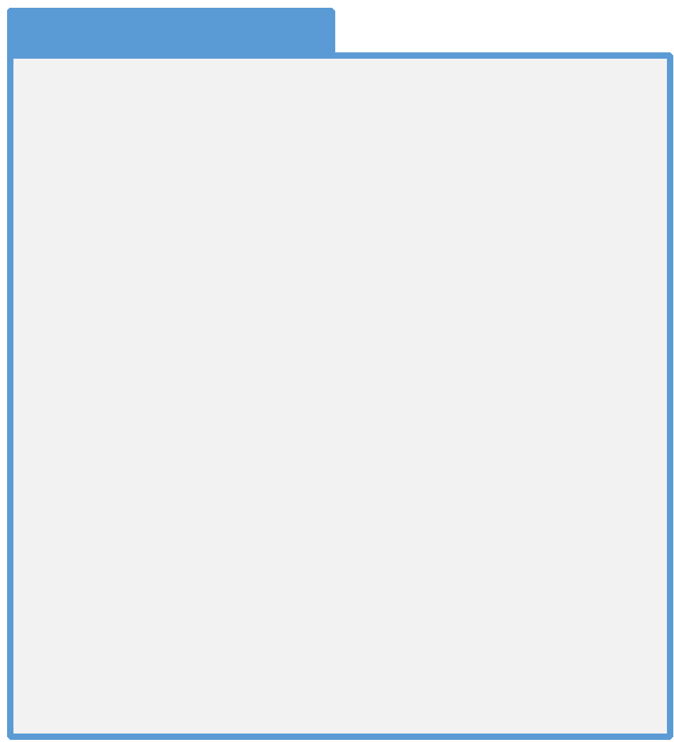
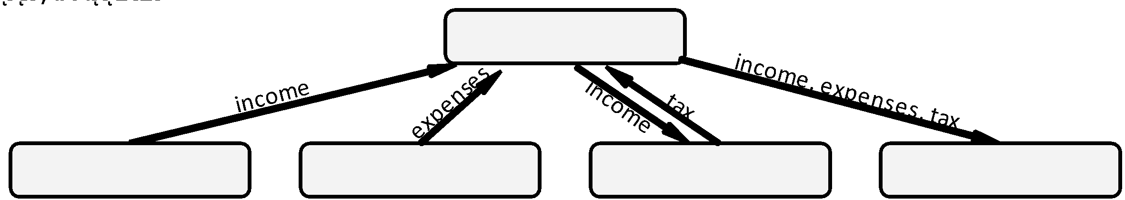
Problem 10.1: Budget
Create a structure chart matching the following draft of a Python program to display a simple monthly budget report:

Slide 24
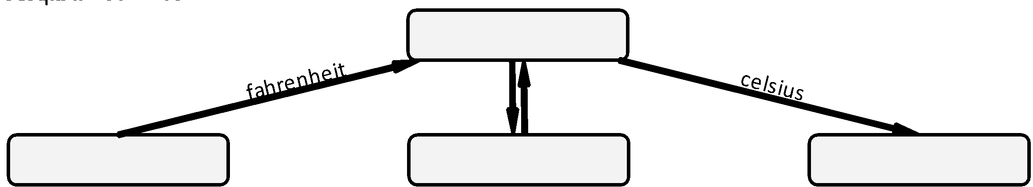
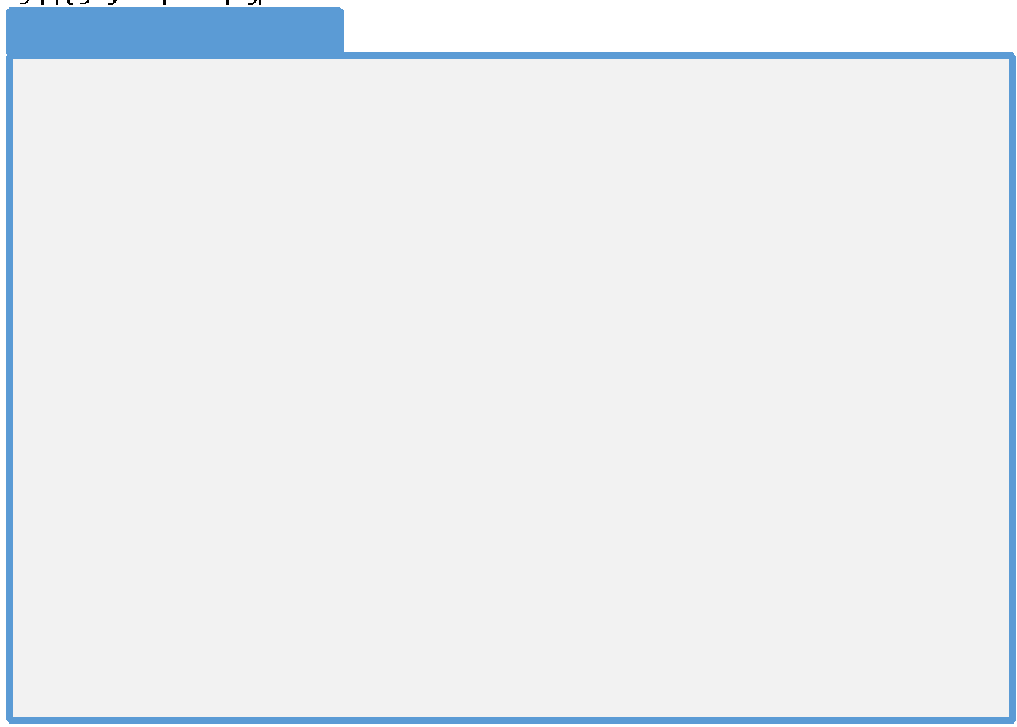
Problem 10.2: Temperature Conversion
In Python, write the code corresponding to the following structure chart

Slide 25
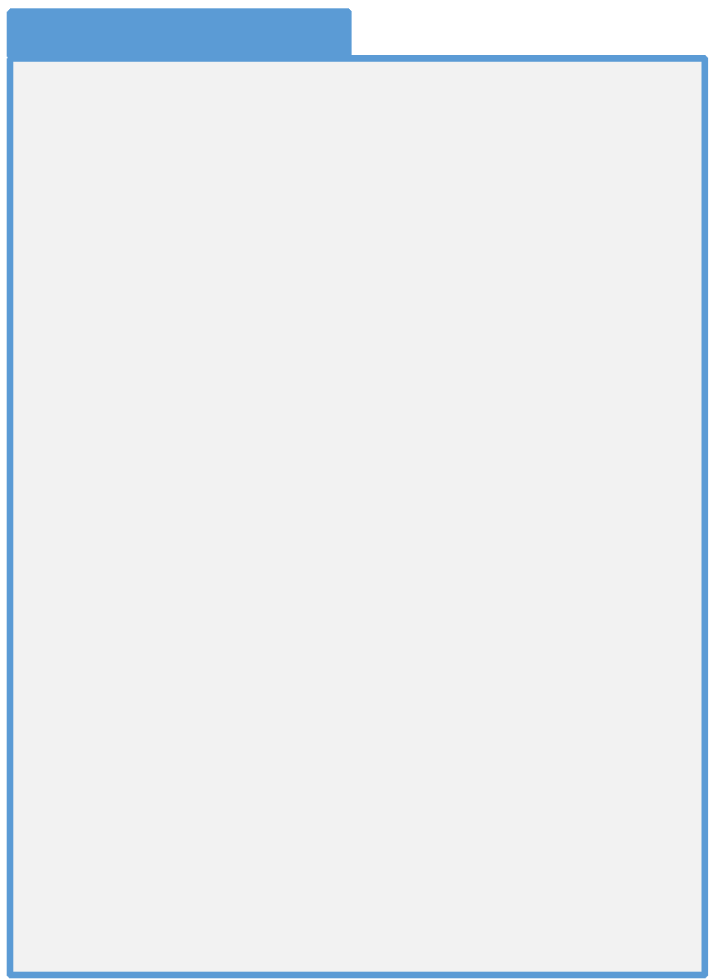
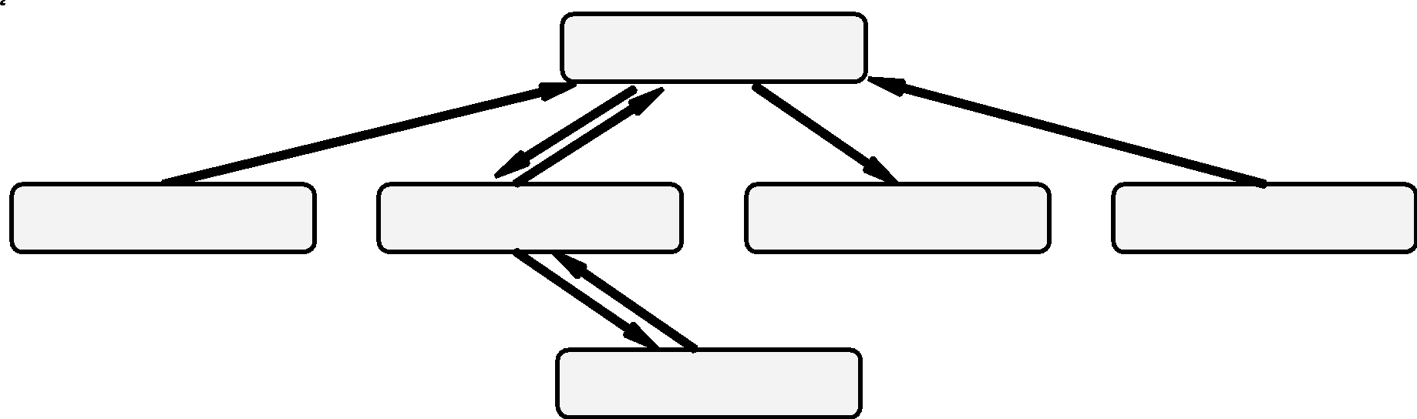
Problem 10.3: MadLib
Create a structure chart matching the following draft of a pseudocode algorithm to play the game MadLib

Slide 26
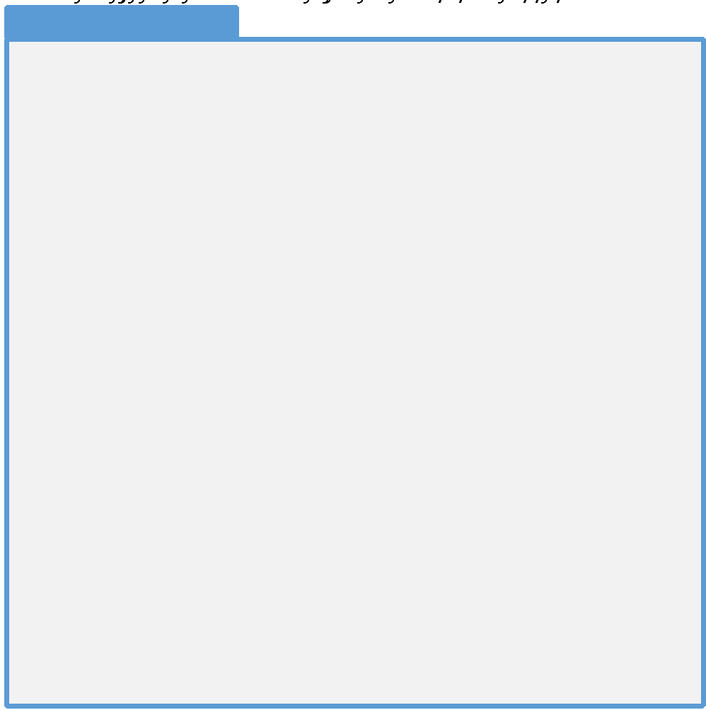
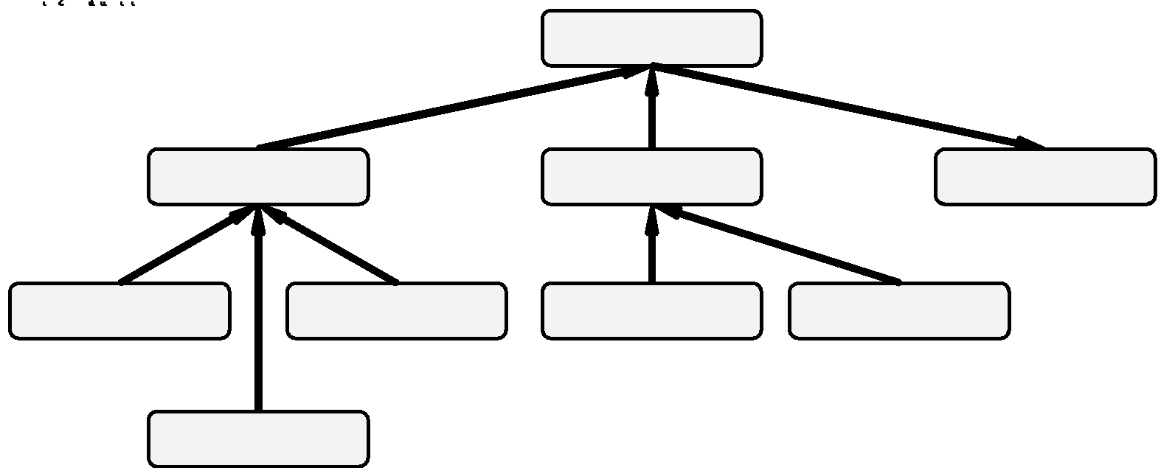
Problem 10.4: Cost of a Car
In the Python, write the code corresponding to the following structure chart

Slide 27
Problem 10.5: Tic-Tac-Toe
Create a structure chart for a program to satisfy the following scenario:
Tic-Tac-Toe, otherwise known as noughts and crosses, is a game played on a 3x3 grid where one player is represented with X's and the other is represented with O's. The X player puts a mark in one of the 9 grid locations. The O player then selects one of the eight remaining grid locations. The game continues until either one player gets 3-in-a-row or 3-diagonally.
This game will read a board from a file, allow the user to play the game, and save a partially-completed game back to a file. The user will be prompted for his or her selection, then the program will then chose the best response to the user’s move. In other words, the user will play the computer.
Hint: What functions will be needed to accomplish this task? What information will each function need in order to accomplish it?

Slide 28
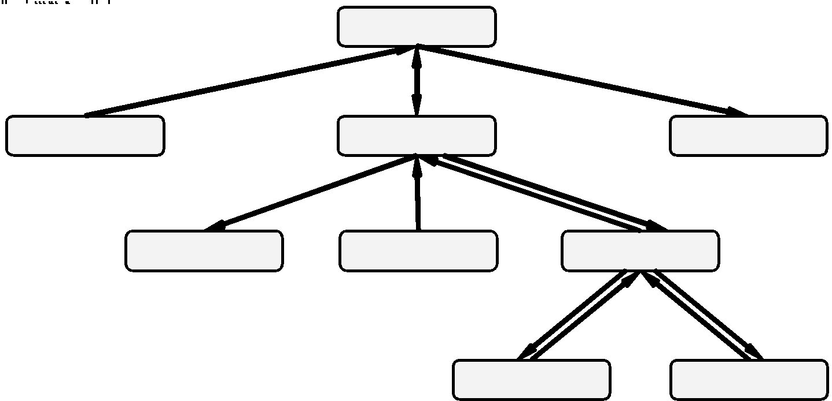
Problem 10.5: Solution

Slide 29
Challenge 10.1: Calendar
Create a structure chart to represent the part of a program which will display a calendar on the screen. The input to the main function will be a month and year, both integer parameters. The output of the function will be a graphical depiction of a calendar.
A personal finance program needs to display a calendar in a dialog from which the user will select the due-date for a bill. You are tasked with writing this code.
Hint: Your program will need to determine the day of the week of the first of the month. This will be determined by counting the days since the 14th of September, 1752 (which was a Thursday) and dividing by 7. It will need to know the number of days in each month, taking leap years into account.

Slide 30
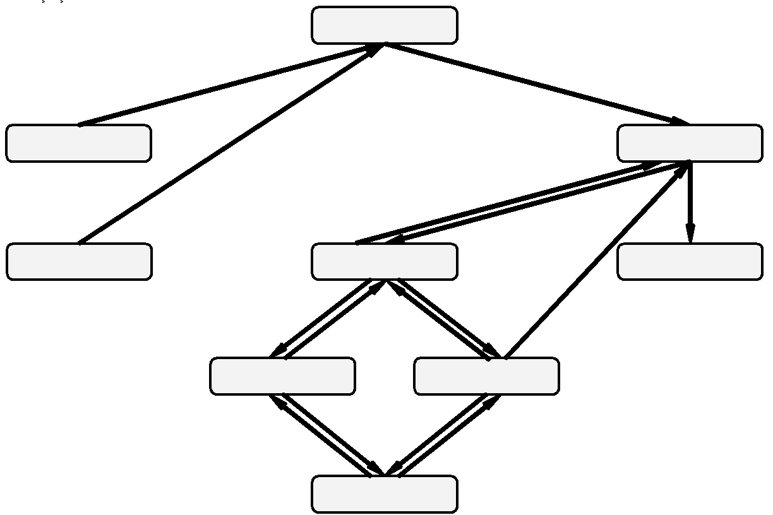
Challenge 10.1: Solution

Slide 31
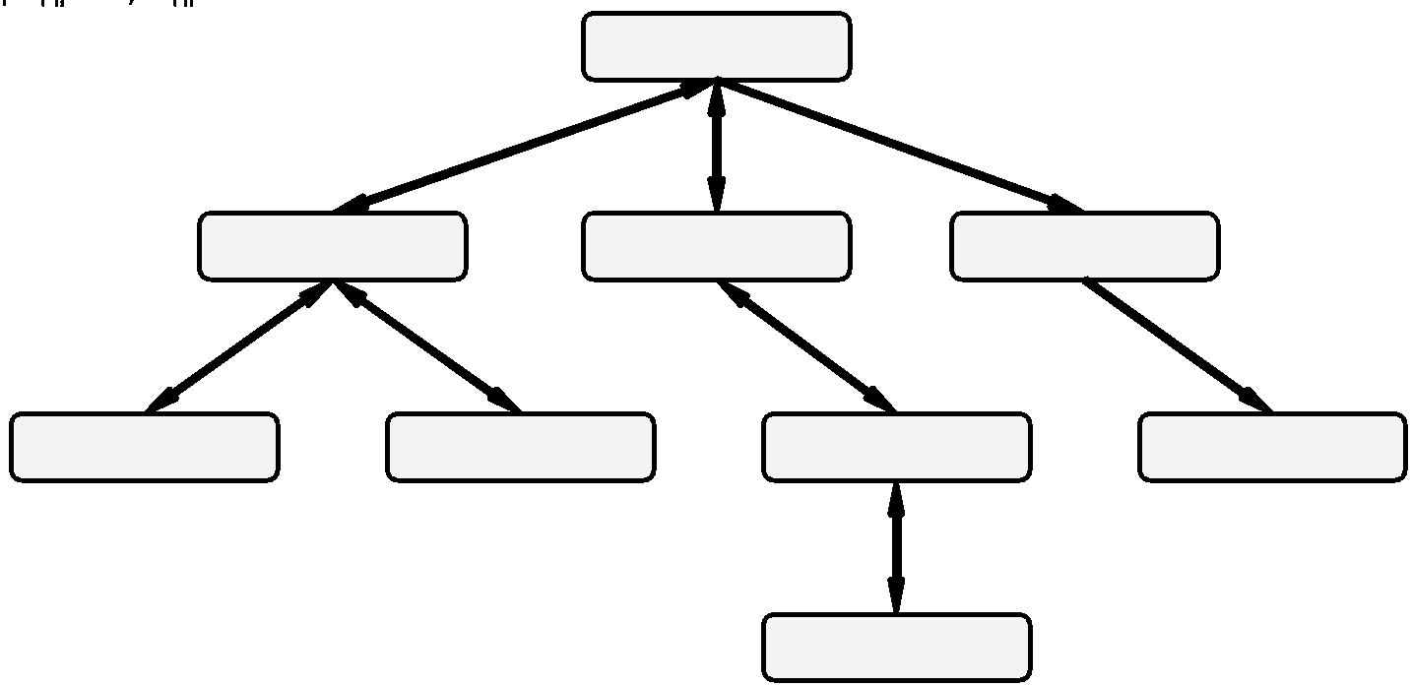
Challenge 10.2: Asteroids
Consider the 1979 Atari game Asteroids. You may need to do some “research” to refresh yourself as to how this program works.
Create a structure chart representing this entire program.

Slide 32
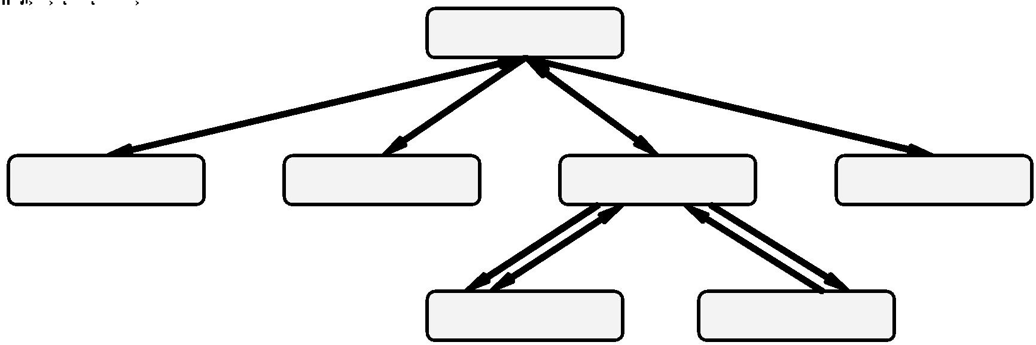
Challenge 10.3: Sudoku
Create a structure chart representing the game of Sudoku:
Sudoku is a numbers game played on a 9x9 grid. The object of the game is to fill in the 9x9 grid while honoring certain constraints. The constraints are: 1) There is no more than one instance of a given number on a given row. 2) There is no more than one instance of a given number on a given column. 3) There is no more than one instance of a given number on an inside square (the 3x3 squares embedded in the 9x9 grid. 4) Every square can consist of a single digit between 1 and 9 exclusively, or can be blank

