Slide 1
Week 03: Data Flow Diagram
Lab 02 was due on Saturday
Chapter 11 reading is due
Lab 03 is due this Saturday
Review the solution to Lab 02
Answer questions about the reading
Go through the reading quiz
Answer questions about Lab 03
Work through some problems
D&C 6:19
D&C 6:13

Slide 2
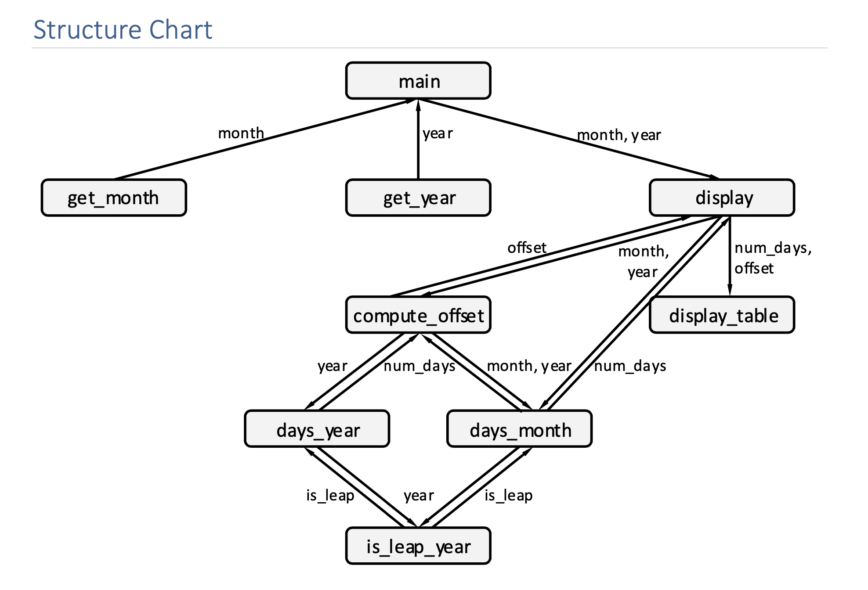
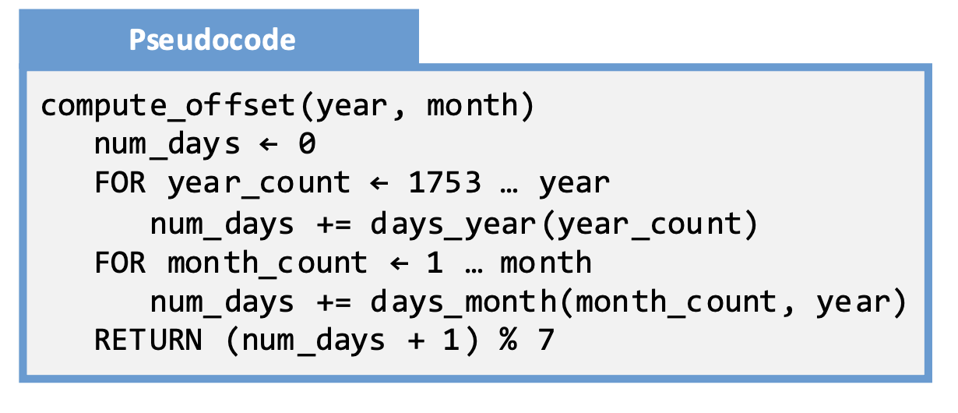
Lab 02: Solution – Structure Chart

Slide 3
Lab 03: Calendar Program
Implement in Python the calendar program we designed last week. The following is needed to turn this in:
Your source code
A demonstration video. Show the following test cases:
January 1753
February 1753
January 1754
February 1756
February 1800
February 2000
Month: "error", 0, 13, 11 Year: "error", -1, 1752, 2019

Slide 4
Content
Data Flow Diagram
When to Use
a DFD
Parts of a DFD
Part:
Interactor
Part: Flow
Part:
Processor
Part: Storage
Part:
Sub-System
Hierarchies

Slide 5
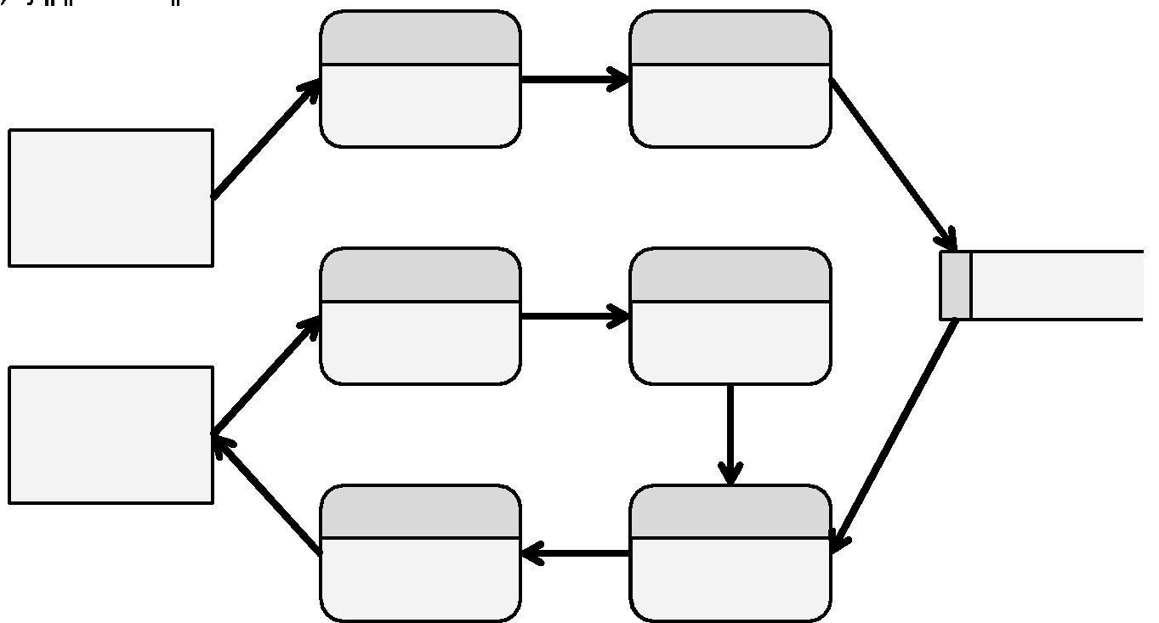
Data Flow Diagram

Slide 6
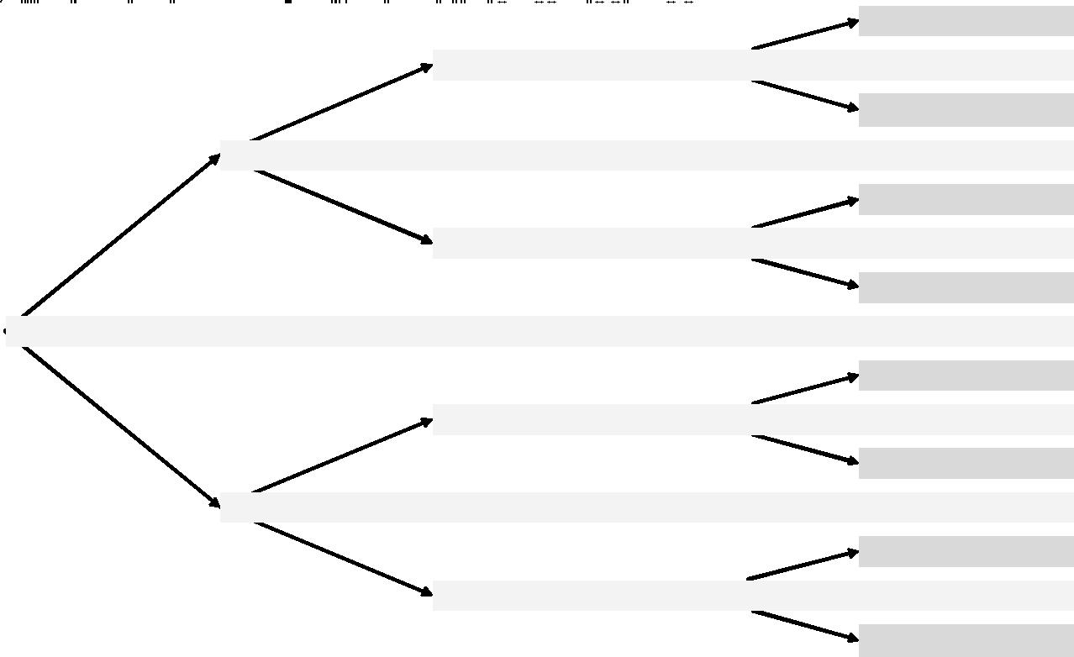
When to Use a DFD

Slide 7
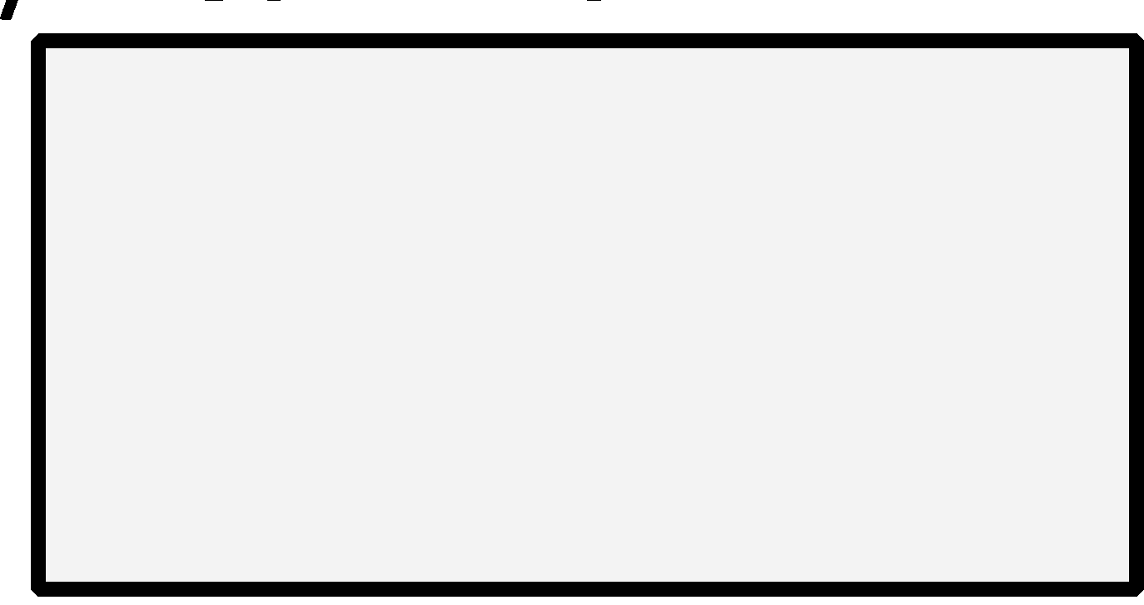
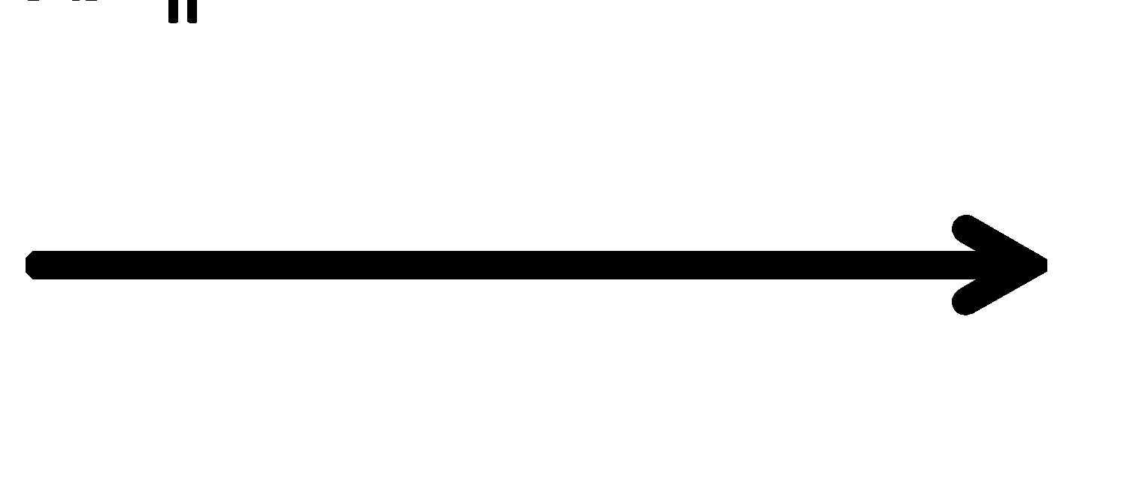
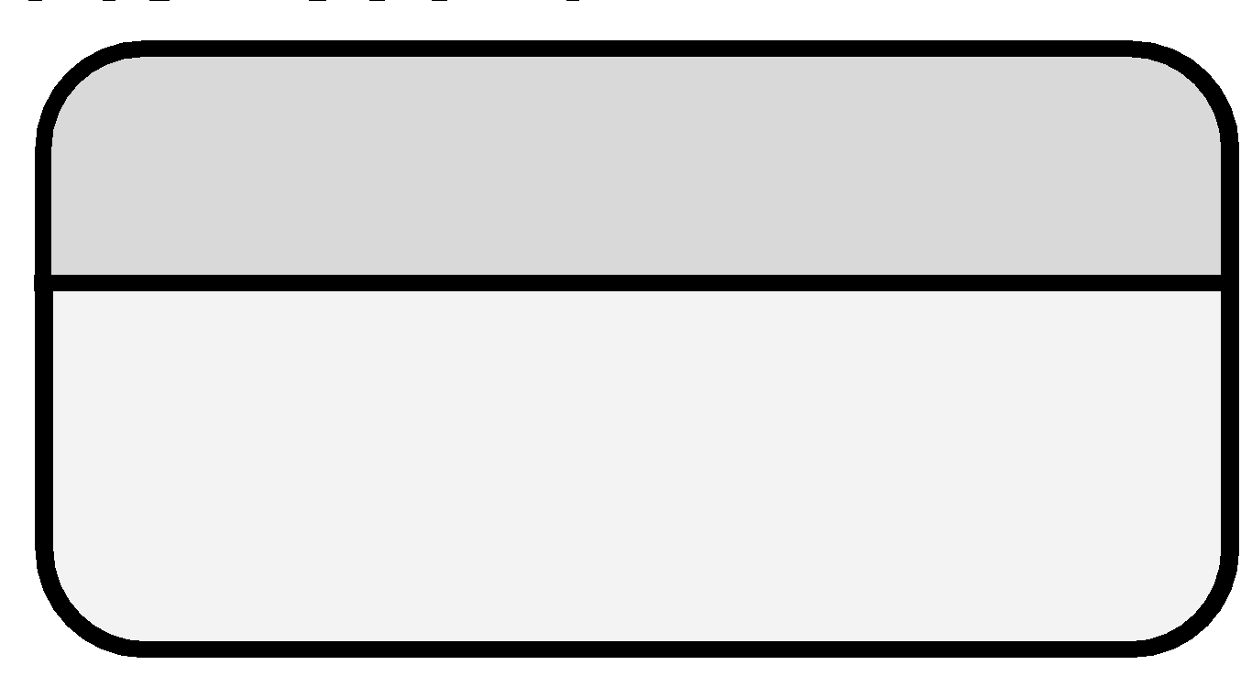
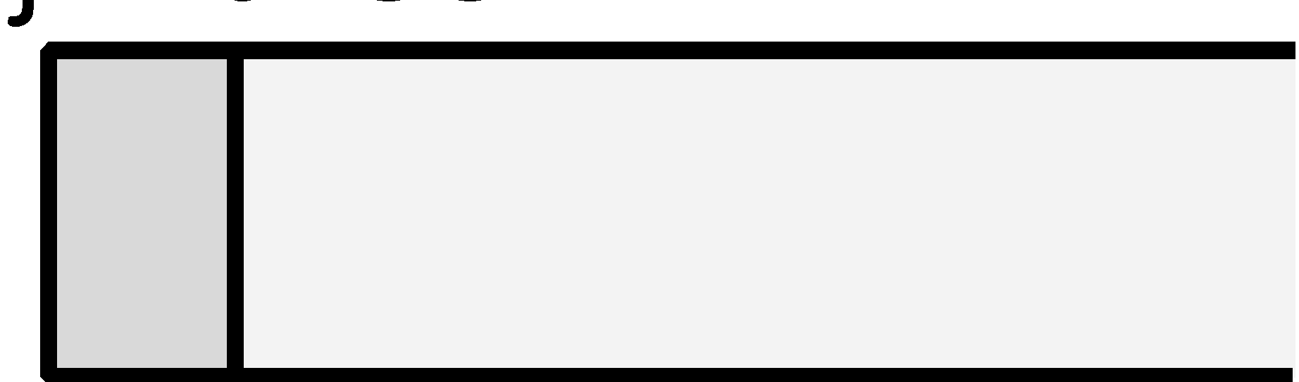
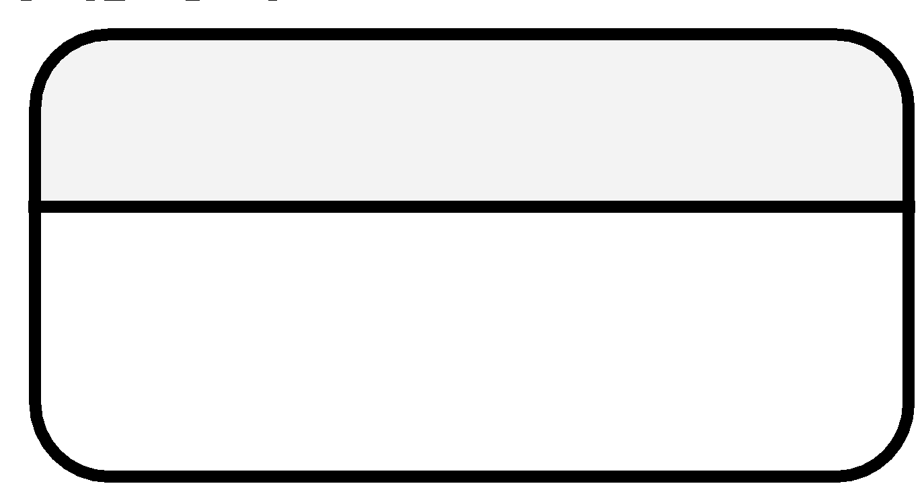
Parts of a DFD
Symbol | Meaning
 | Interactors are elements that create and consume data. They can be users, external systems, or many other things.
 | Flow are arrows representing the movement of data through the system. Flow arrows usually are labeled with the type of data they represent.
 | Processors are things which act on data. They can transform data, set data, look at data, or move data between elements.
 | Storage represents data at rest. This can be in a variable, a file, a database, or in a data structure.
 | A sub-system is a portion of the system which is distinct in some way. It could be in a separate physical location or just be considered a different component.

Slide 8
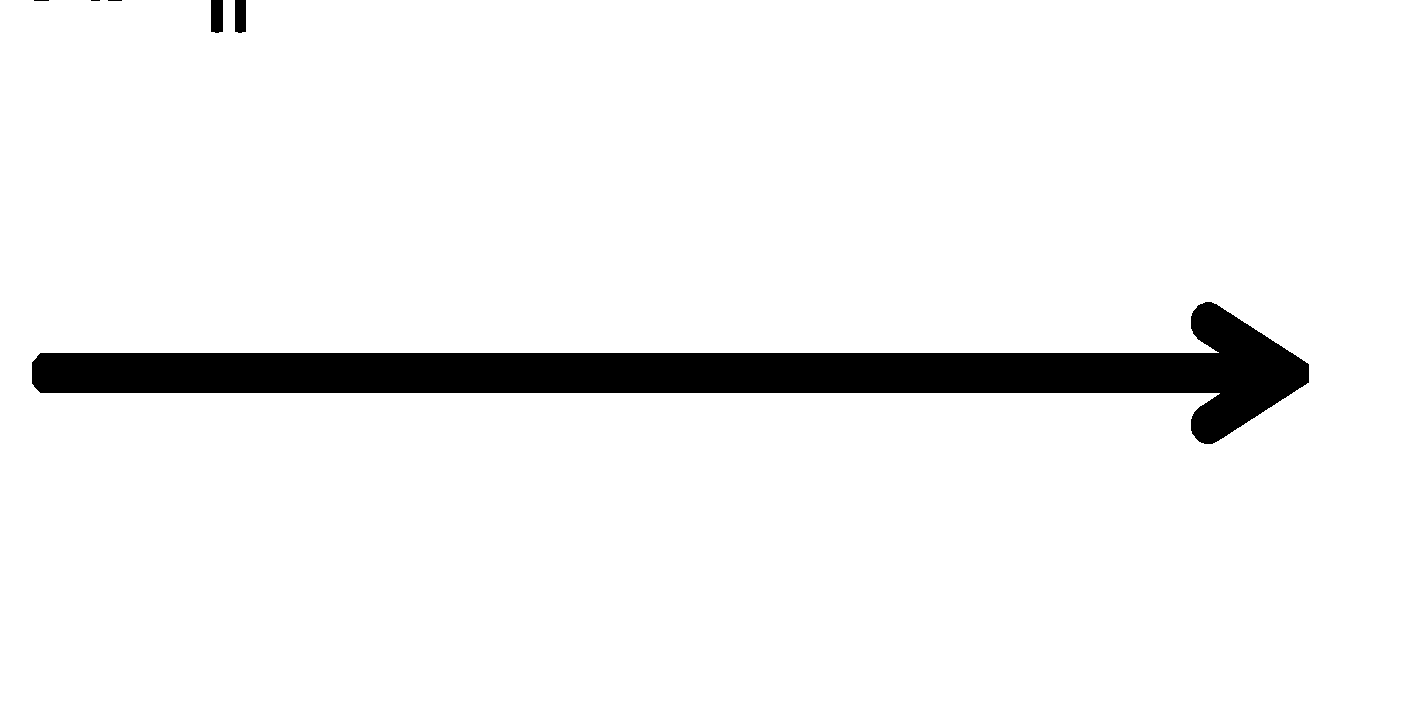
Part: Interactor
Interactors are elements that create and consume data. They are outside the system, providing input and accepting output. Examples of interactors include individual users, groups of people, organizations, other systems, network entities, or even a sensor.
Rules
11.2 Interactors must be nouns
11.3 Interactors are typically drawn on the edge of the DFD
11.4 Interactors connect to processors through flow arrows

Slide 9
Part: Flow
Flow are arrows representing the movement of data through the system. In most applications it is necessary to describe the nature of the flow. This could be a parameter name, the format of the data being moved, or even a rough description of what is being moved
Rules
11.5 There must be at least one processor connecting each flow arrow
11.6 Flow arrows are one-way
11.7 Flow arrows represent data movement
11.8 Flow arrows are labeled

Slide 10
Part: Processor
Processors are things which act on data. They do four tasks:
Task | Description
Transform | Processors convert data from one format to another
Move | Processors facilitate the movement of data from one part of the program to another
View | Processors look at data, typically for the purpose of making a decision
Set | Processors set data, usually resulting from a computation with other data
Rules
11.9 Processors have verb labels
11.10 Processors are numbered
11.11 At least one flow arrow must enter, at least one must leave each processor

Slide 11
Part: Storage
Storage represents data at rest. This can be in a variable, a file, a database, or in a data structure
Rules
11.12 Storage elements are nouns
11.13 There should be an inbound and an outbound flow arrow
11.14 All flow arrows connecting storage elements must go through processors

Slide 12
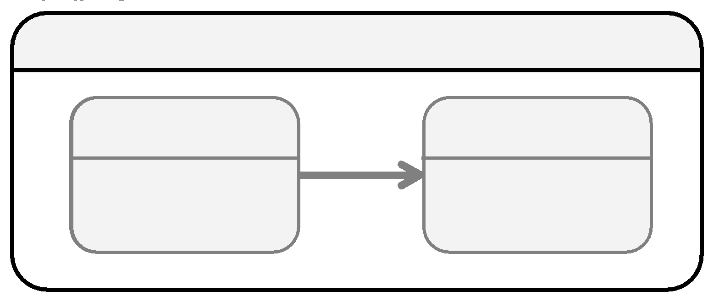
Part: Sub-System
In large and complex systems, it is often helpful to include system boundaries in DFDs. The most common reasons why one would want to include system boundaries are the following:
There are classes in the design and the distinction between private and public is an important consideration in the system design.
The system involves moving data across distinct physical entities, such as more than one program or computer. It is very common to use system boundaries when networks are involved.
There are privacy or security concerns. Here the system boundaries indicate varying levels of trust or access.

Slide 13
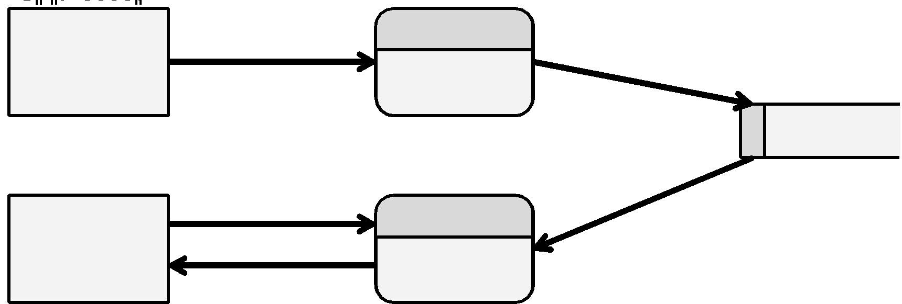
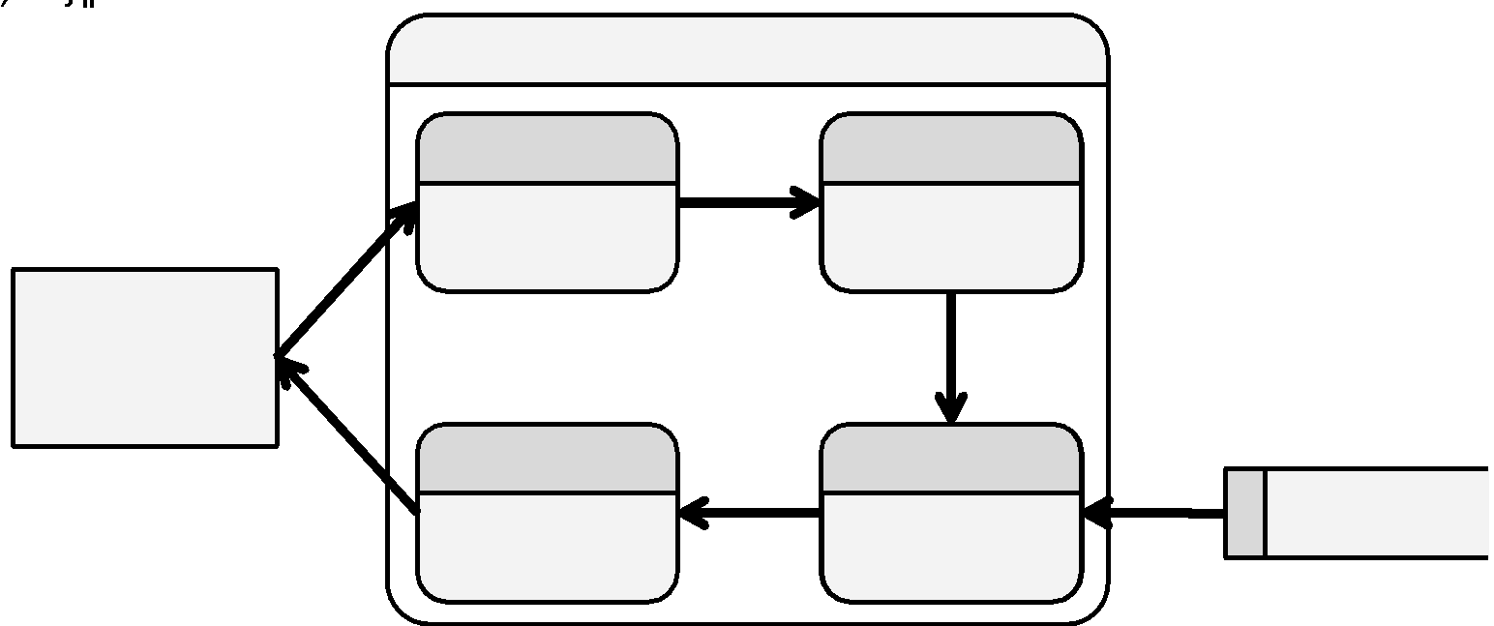
DFD Hierarchies
Large systems are typically represented in a hierarchy of DFDs

Slide 14
Examples
Example 11.1: Taxes
Example 11.2: Mobile Application

Slide 15
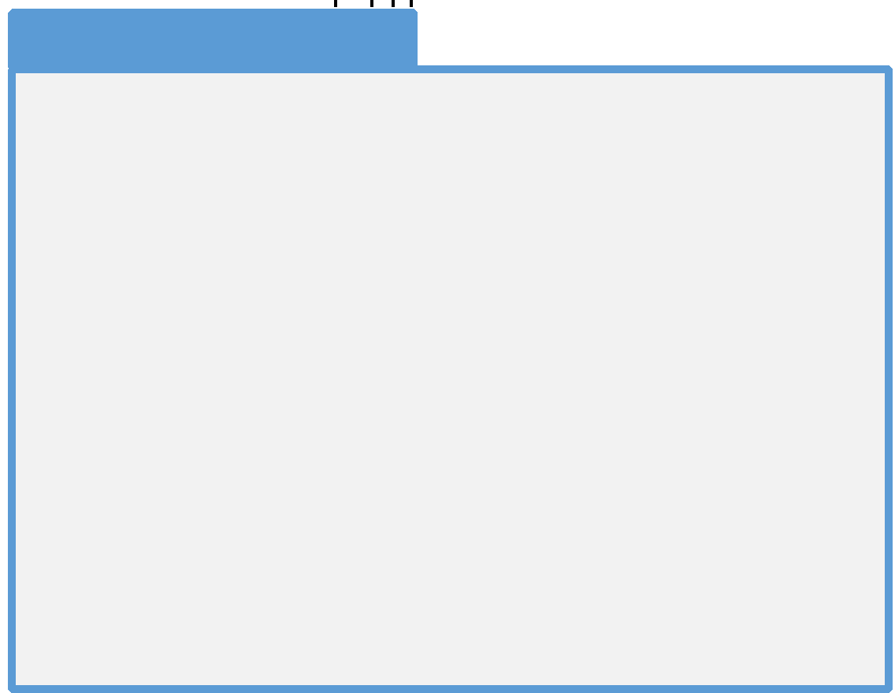
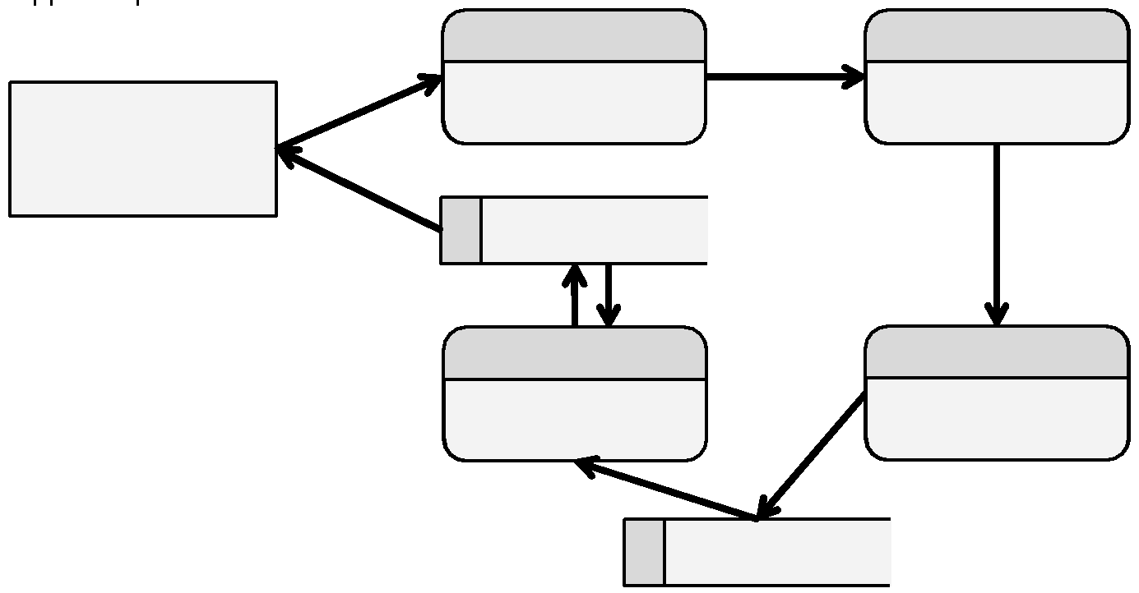
Example 11.1: Taxes
Q: Create a DFD to represent the following pseudocode:

Slide 16
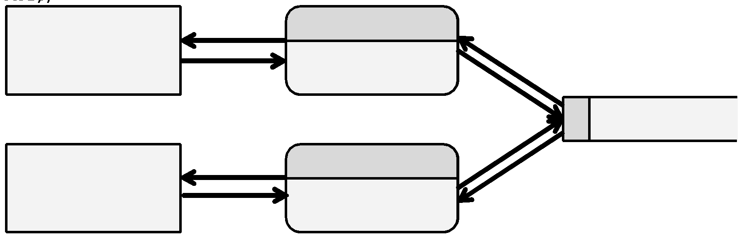
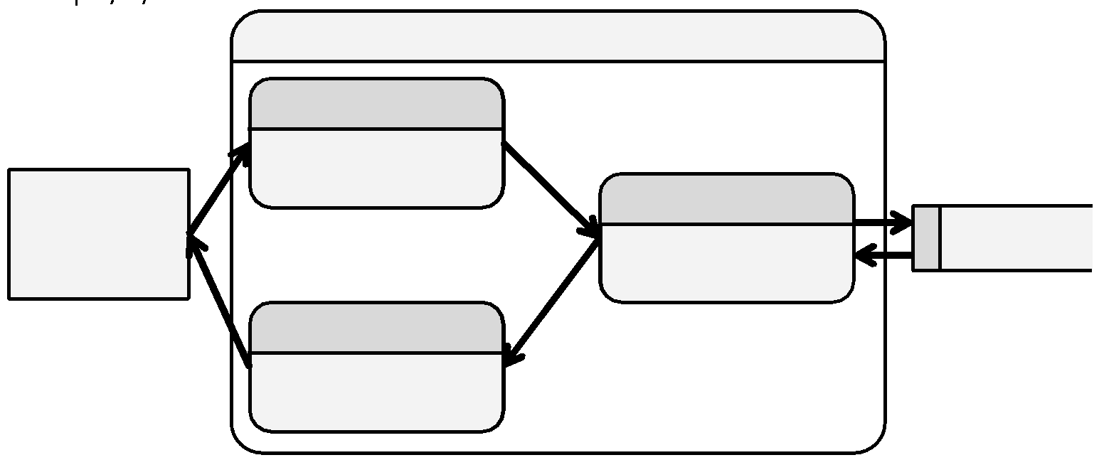
Example 11.2: Mobile List Application
Q: Create a DFD to represent how a to-do list mobile application will manage the user’s data.

Slide 17
Exercises
Exercise 11.1: Symbol and Tool
Exercise 11.2: Parts of a DFD
Exercise 11.3: Fact or Fiction
Exercise 11.4: Errors

Slide 18
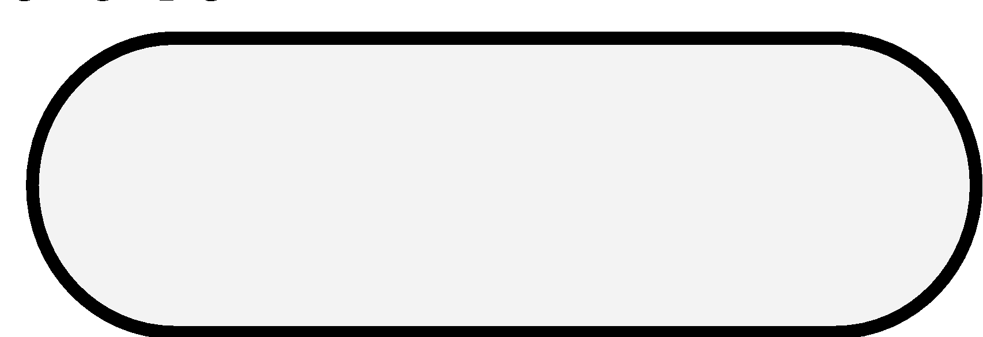
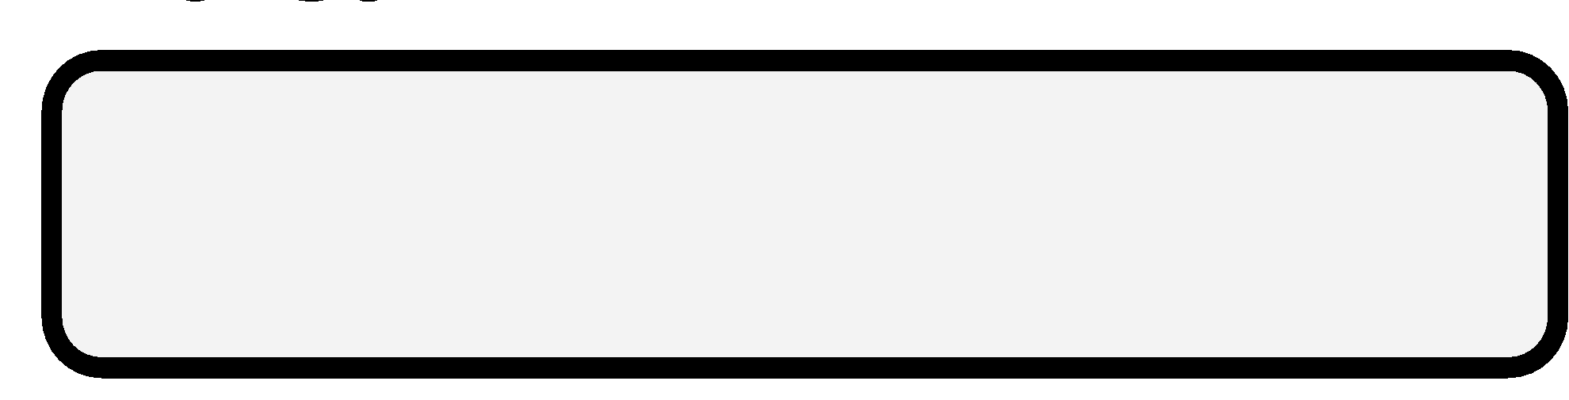

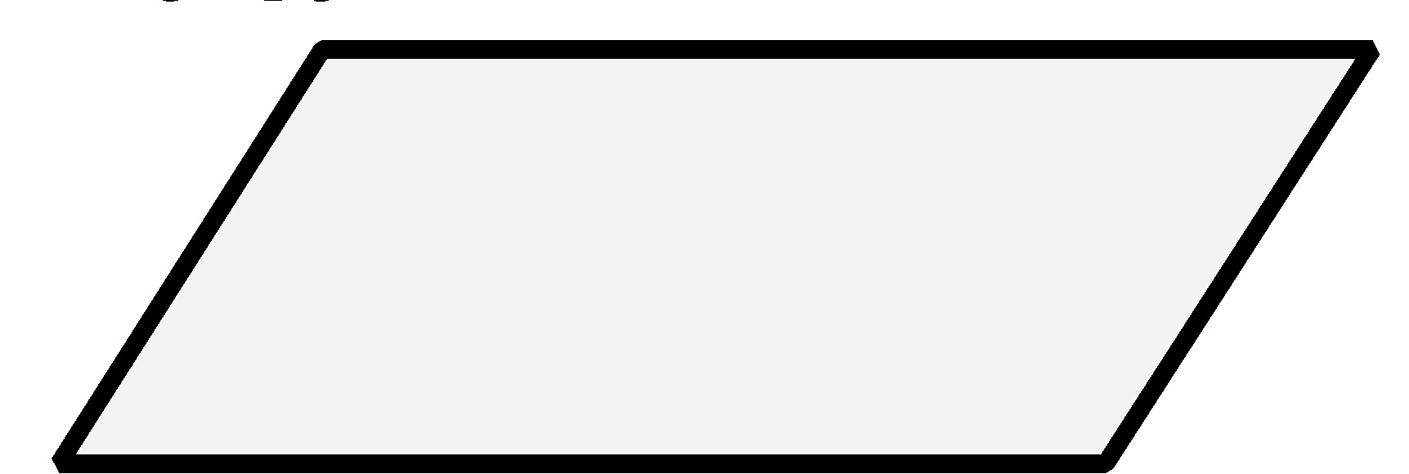
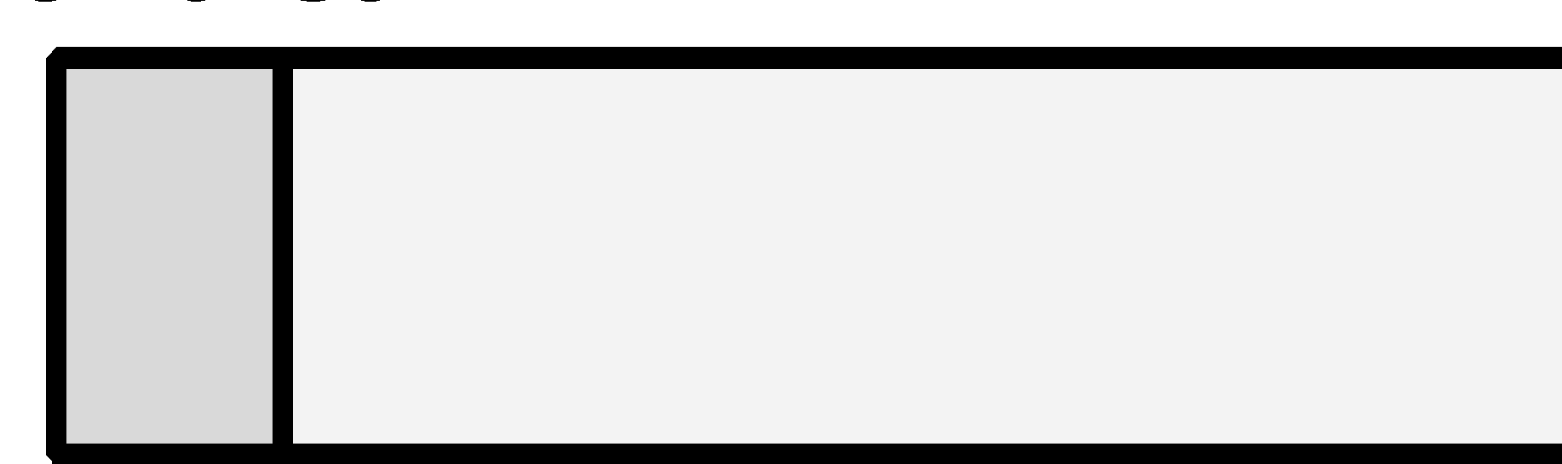
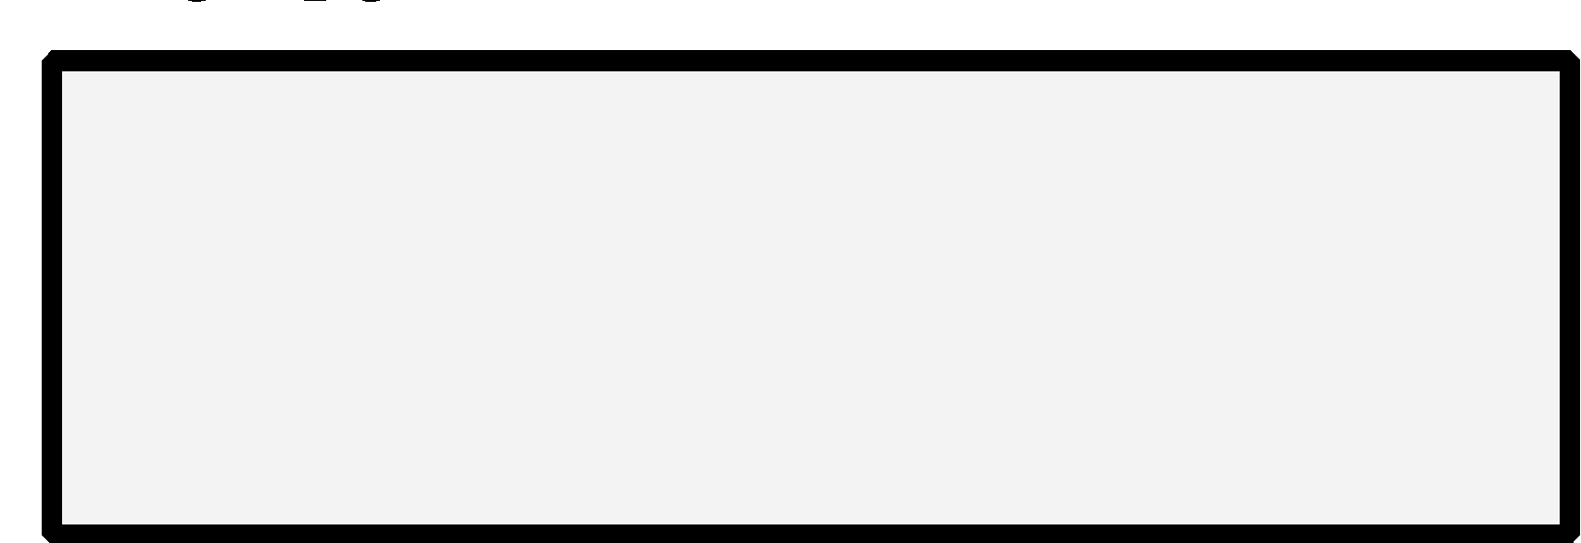
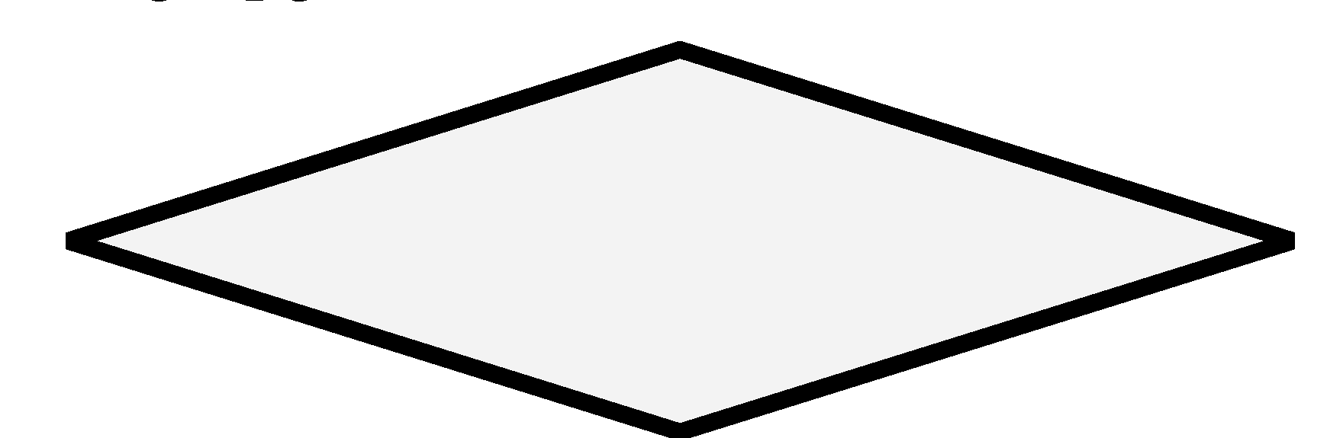
Exercise 11.1: Identify the Symbol and Tool
Identify the design tool symbol by name and by usage
Symbol
Flowchart terminator, usually with the Start or Stop label
Structure chart function symbol. Can be drawn with an oval or box but mostly drawn with a rounded rectangle.
DFD processor
Flowchart input and output parallelogram
DFD storage element
DFD interactor or flowchart processing element
Flowchart decision element

Slide 19
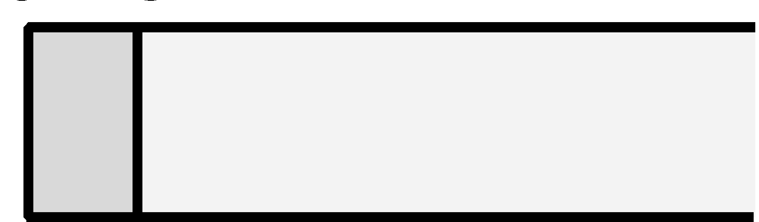
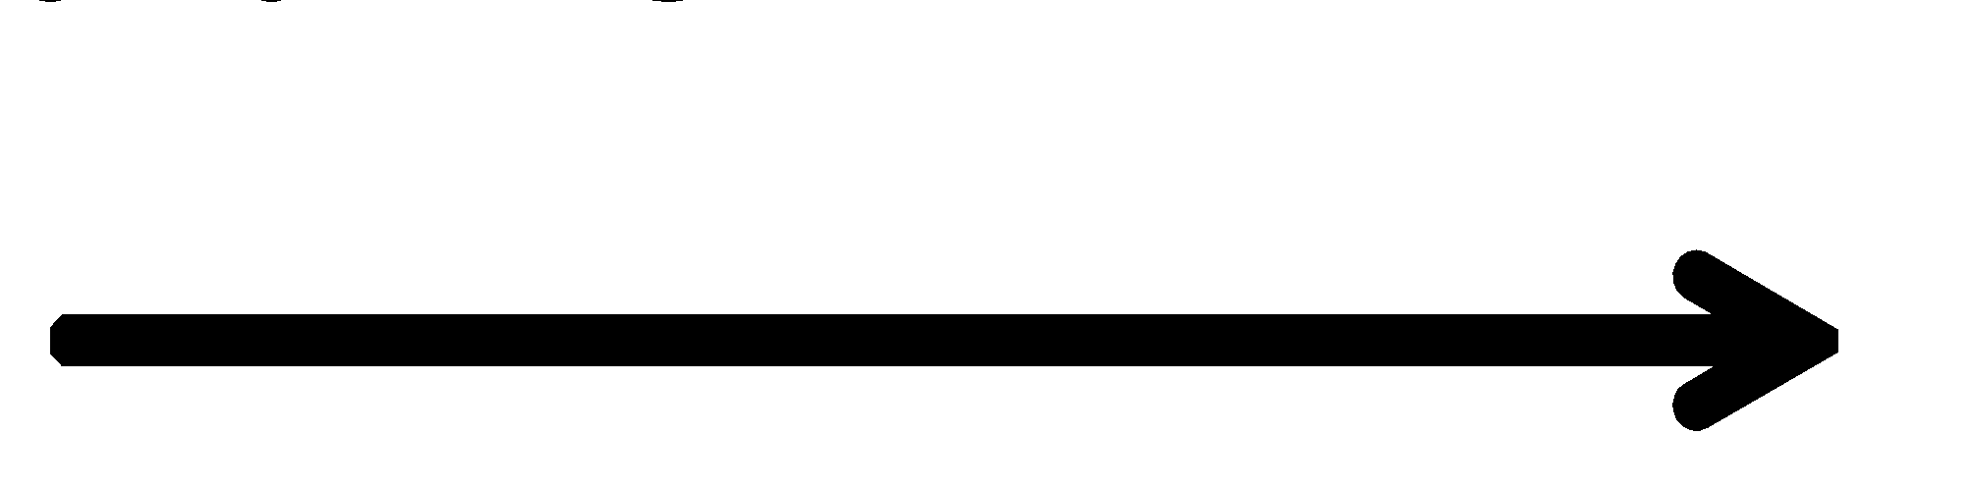
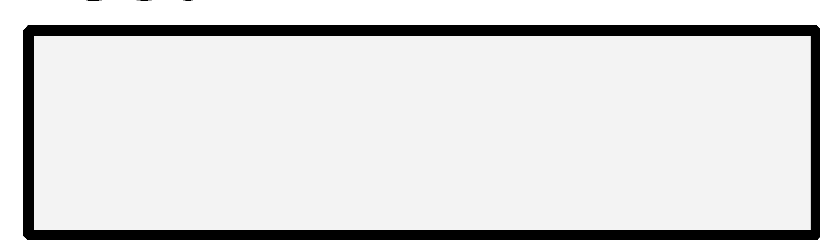
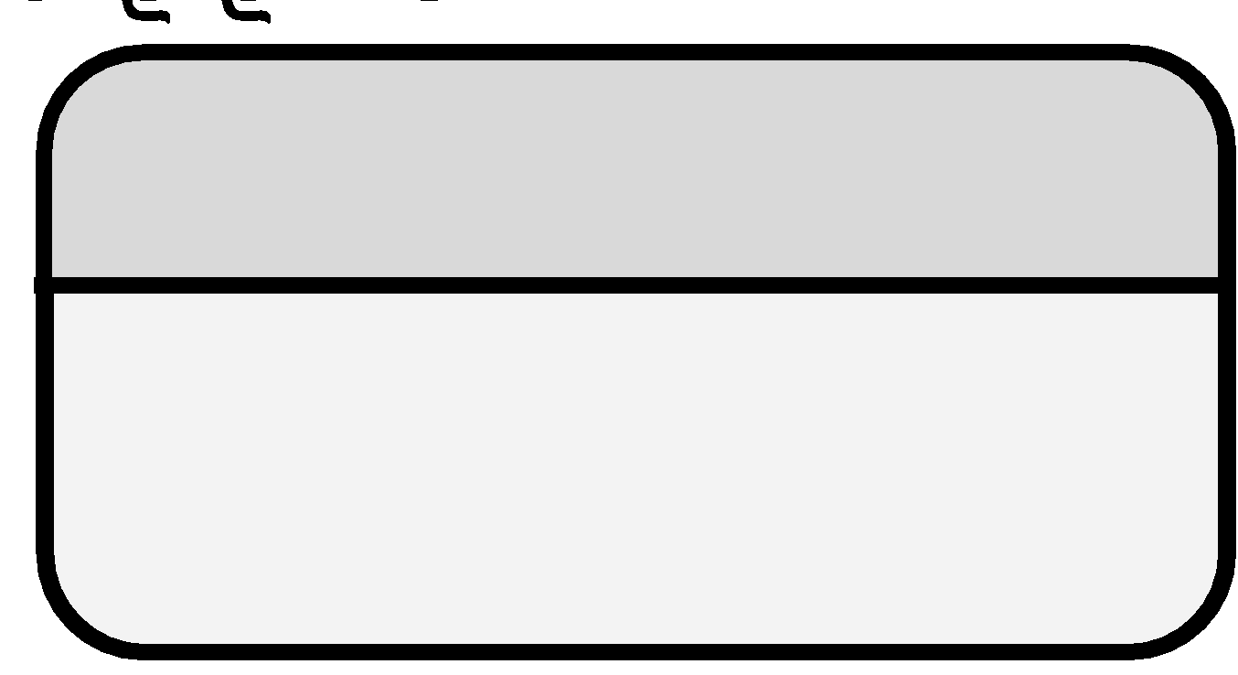
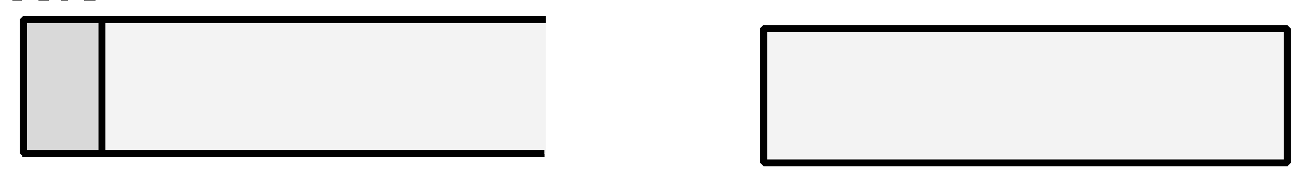

Exercise 11.2: Identify Parts of a DFD
Draw the symbols corresponding to the parts of a DFD:
Description | Symbol
A variable storing the date that a file was saved.
Movement of an account balance from one part of the program to another.
The user of the system.
A function updating the bank account balance once interest is added.
A file containing all the information related to a given user account.
The bank’s server.

Slide 20
Exercise 11.3: Fact or Fiction
For each of the following, identify whether it is fact or fiction.
Fact or Fiction
Processors have verb labels
Interactors can connect to processors through flow arrows
Storage elements can be connected with flow arrows
DFDs represent how control moves through the system
Flow arrows are always one way
Storage elements are nouns
Interactors must be verbs
Flow arrows never contain labels
Processors are numbered
Fact: Rule 11.9 states “Processors have verbs labels”
Fact: The only thing that can connect to an interactor is a flow arrow
Fiction: Rule 11.14 states “All flow arrows connecting storage elements must go through processors”
Fiction: Flowcharts represent how control moves through the system, DFDs represent how data moves through the system
Fact: Rule 11.6 states “Flow arrows are one-way”
Fact: Rule 11.12 states “Storage elements are nouns”
Fiction: Rule 11.2 states “Interactors must be nouns”
Fiction: Rule 11.8 states “Flow arrows are labeled”
Fact: Rule 11.1- states “Processors are numbered”

Slide 21
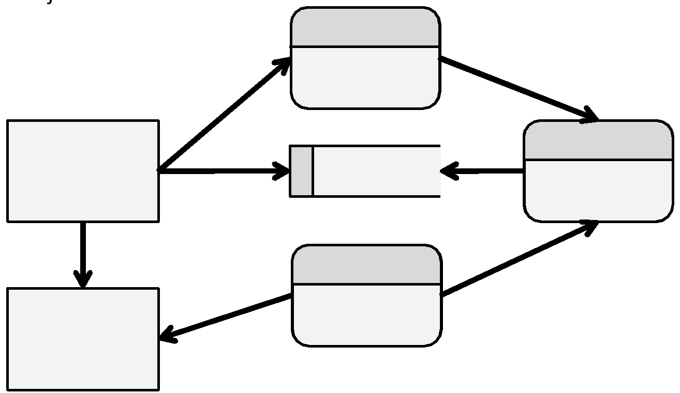
Exercise 11.4: Errors
Identify all the errors in the following DFD
Rule 11.1: The DFD only represents how data moves through the system
Rule 11.2: Interactors must be nouns
Rule 11.3: Interactors are typically drawn on the edge of the DFD
Rule 11.4: Interactors connect to processors through flow arrows
Rule 11.5: There must be a processor connecting each flow arrow
Rule 11.6: Flow arrows are one-way
Rule 11.7: Flow arrows represent data movement
Rule 11.8: Flow arrows are labeled
Rule 11.9: Processors have verbs labels
Rule 11.10: Processors are numbered
Rule 11.11: A flow arrow must enter and leave each processor
Rule 11.12: Storage elements are nouns
Rule 11.13: An inbound and an outbound flow arrow for storage
Rule 11.14: Flow arrows connecting storage go through processors

Slide 22
Problems
Problem 11.1: DFD from Code
Problem 11.2: Code from DFD
Problem 11.3: Budget DFD
Problem 11.4: DFD from Structure Chart
Problem 11.5: MadLib DFD
Problem 11.6: Tic-Tac-Toe Design
Challenge 11.1: Calendar
Challenge 11.2: Asteroids
Challenge 11.3: Sudoku

Slide 23
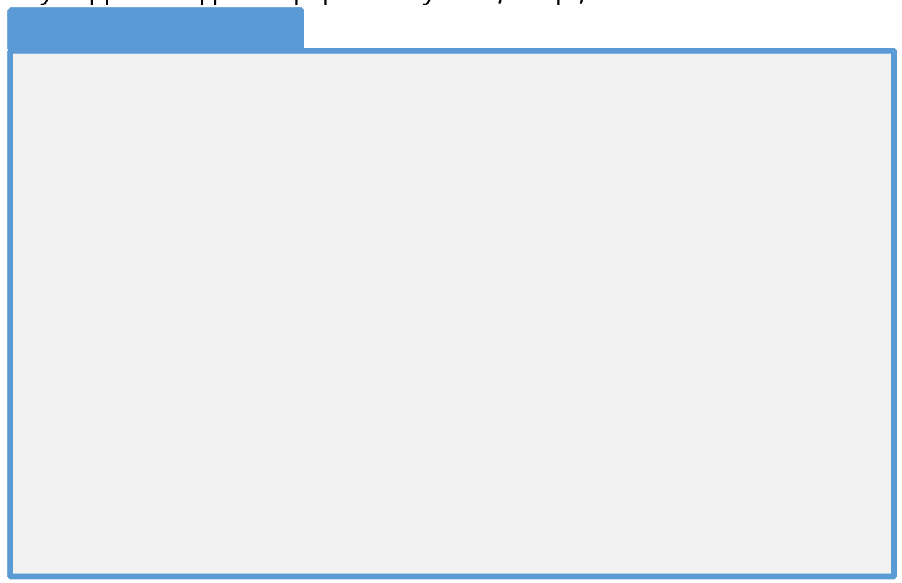
Problem 11.1: DFD from Code
Create a DFD from the following code:

Slide 24
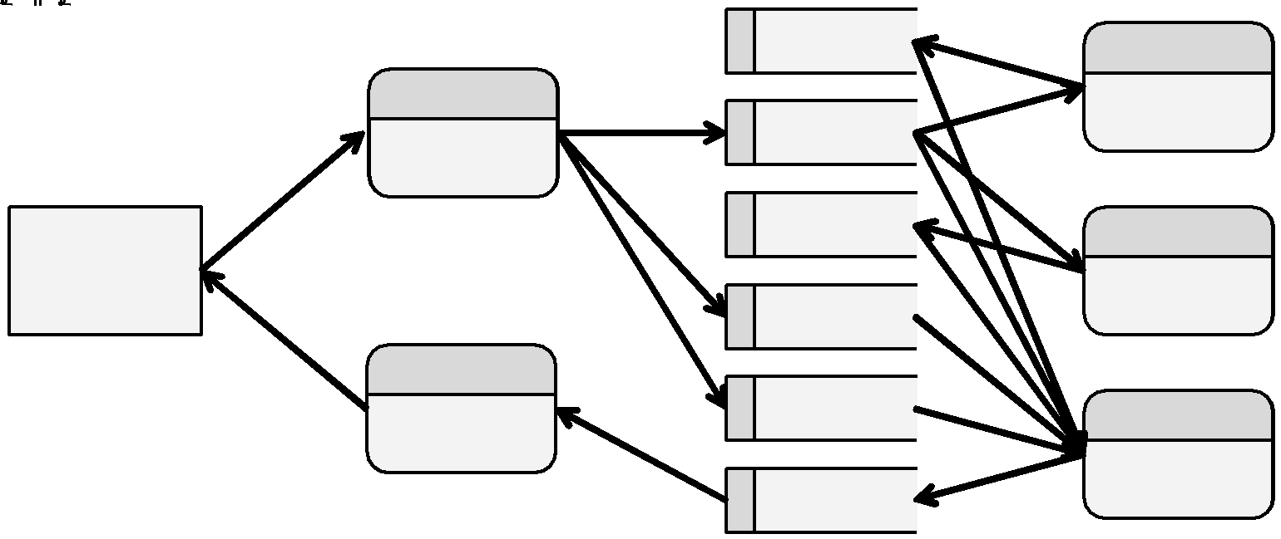
Problem 11.1: Solution

Slide 25
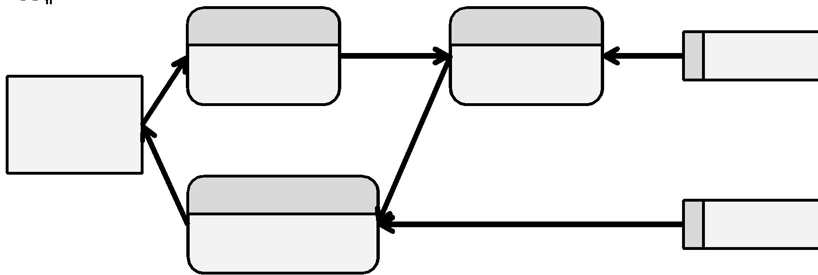
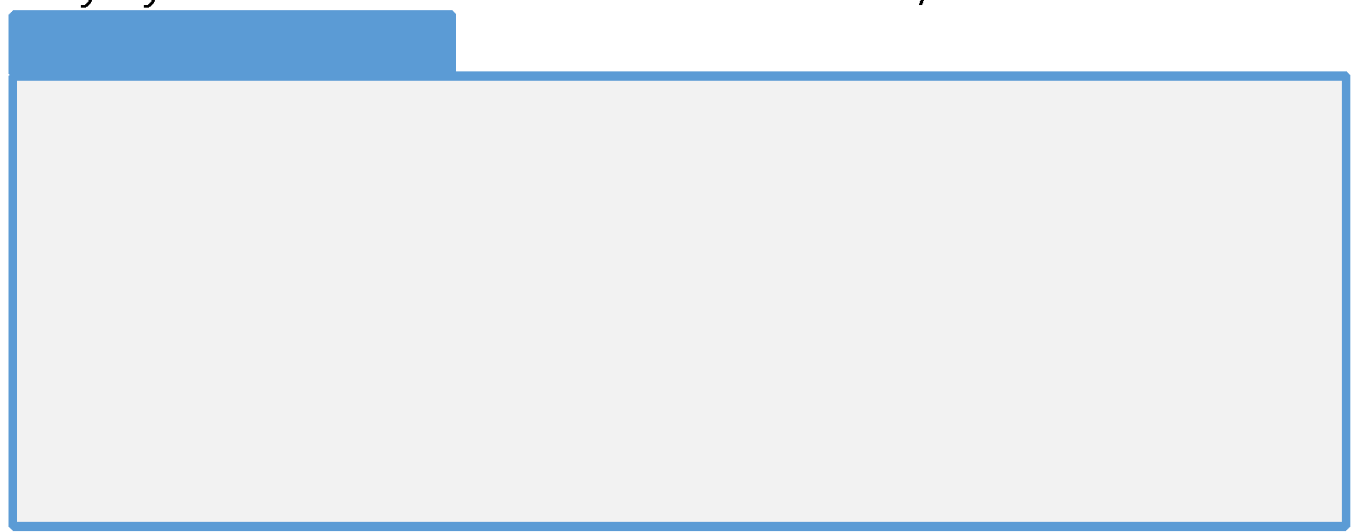
Problem 11.2: Code from DFD
In Python, write the code corresponding to the following DFD:

Slide 26
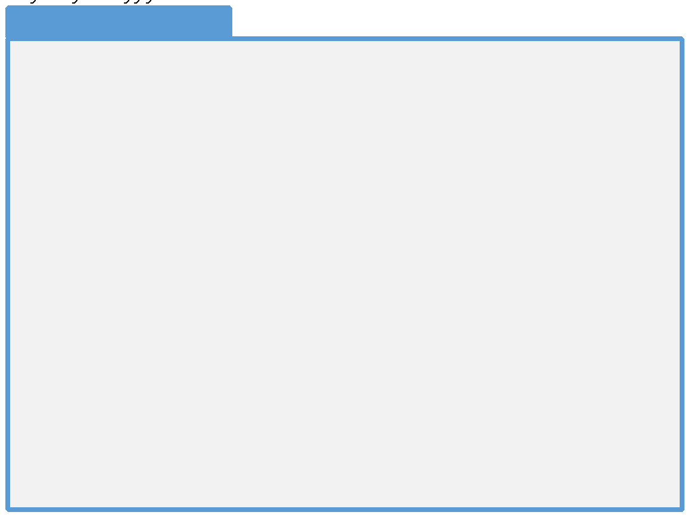
Problem 11.3: Budget DFD
Create a DFD for the following Pseudocode:
Compare the DFD with the structure chart from Problem 10.1

Slide 27
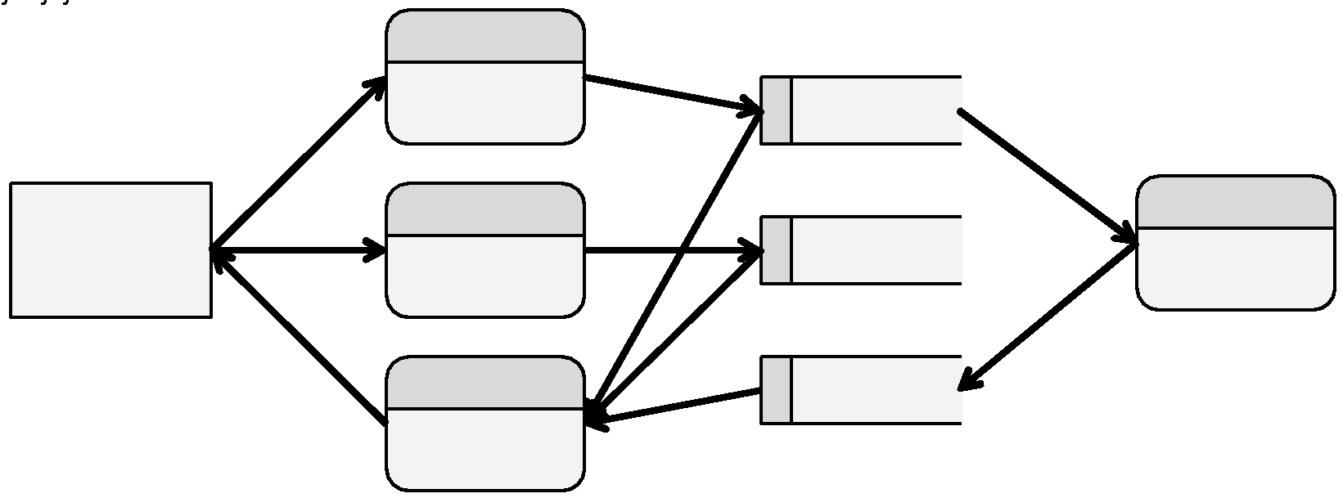
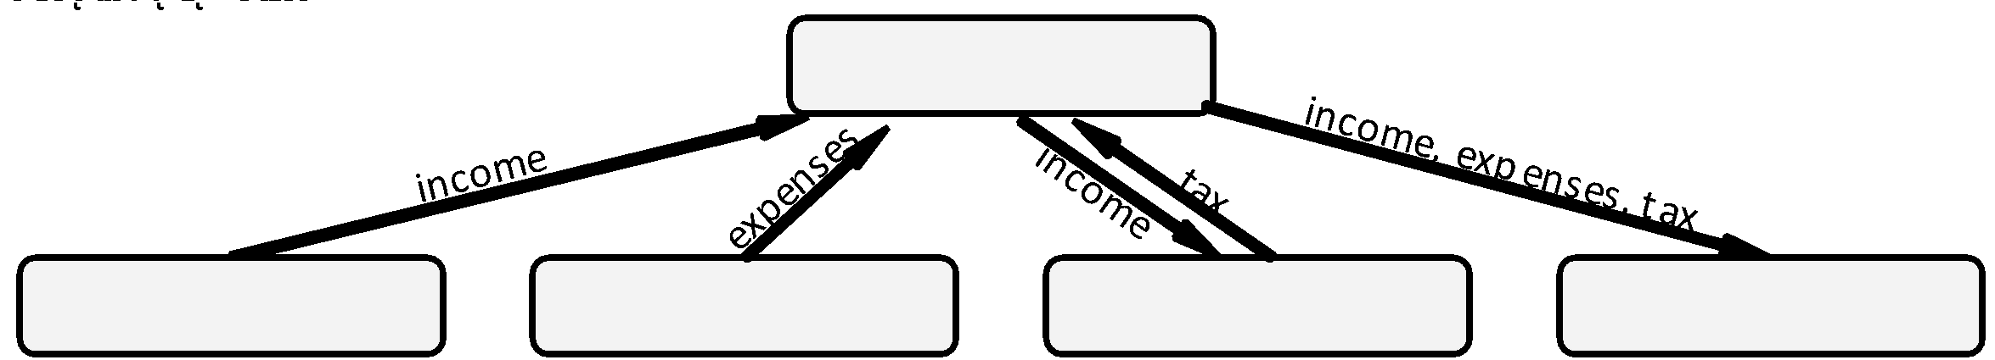
Problem 11.3: Solution
Data Flow Diagram
Structure Chart

Slide 28
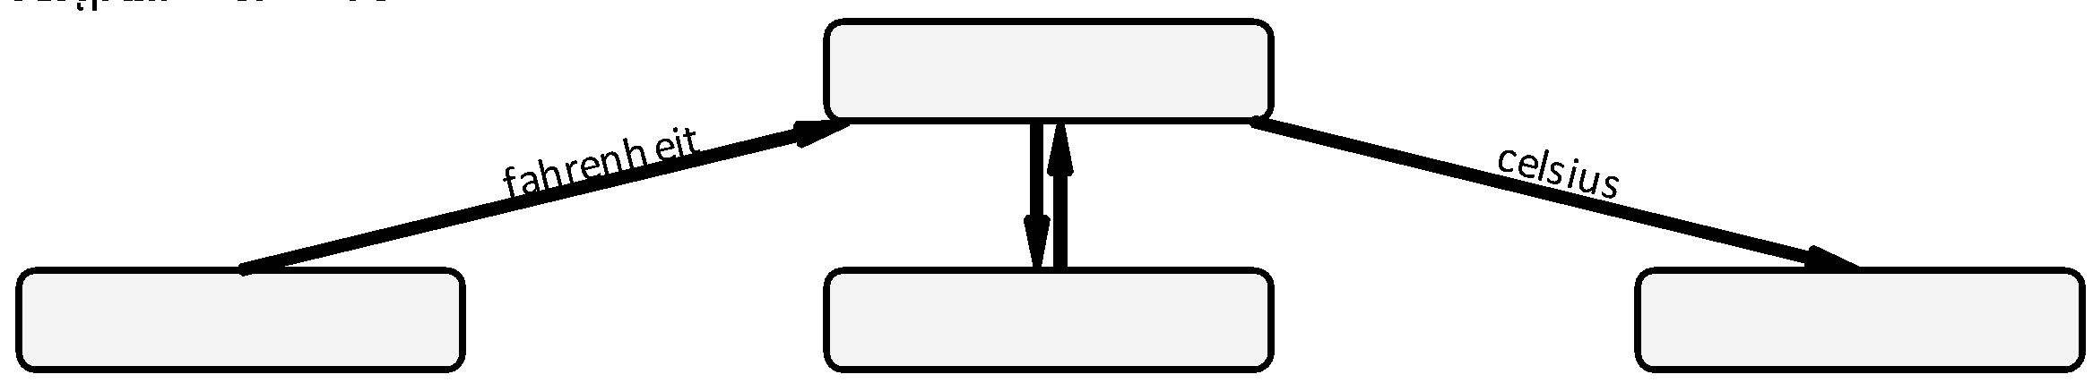
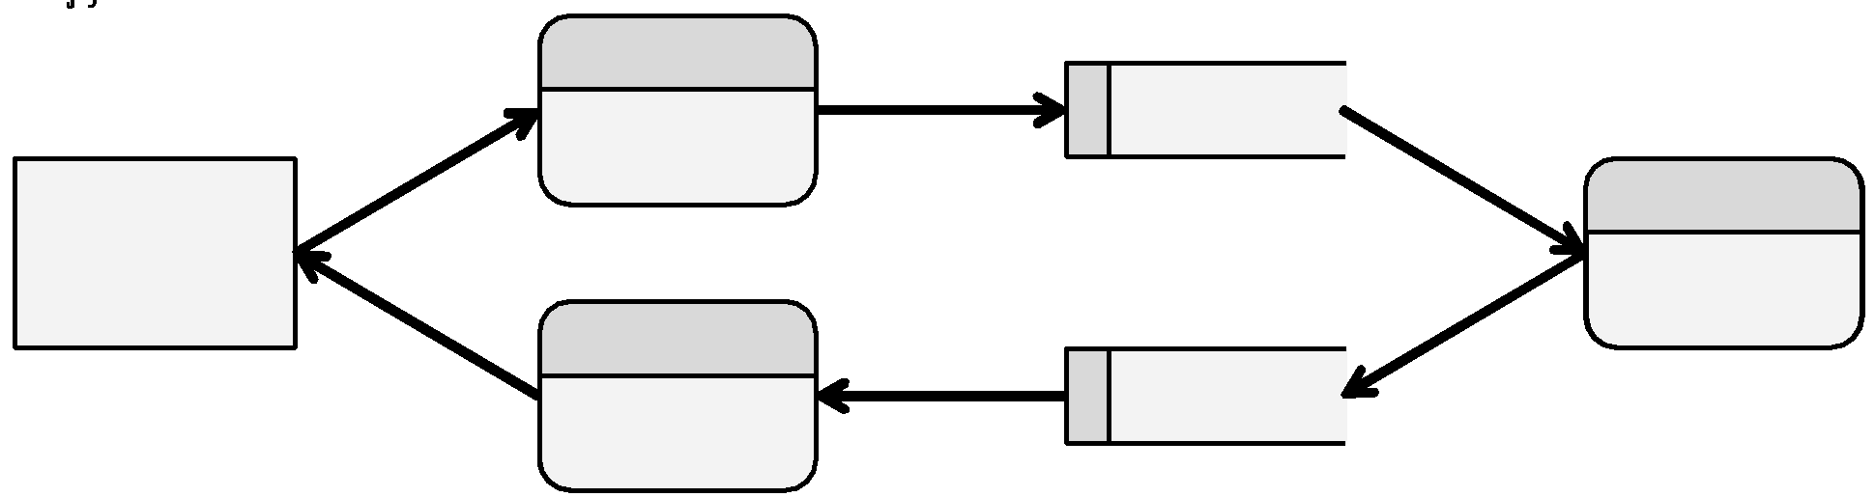
Problem 11.4: DFD from Structure Chart
Q: Create a DFD from the following structure chart:
A:

Slide 29
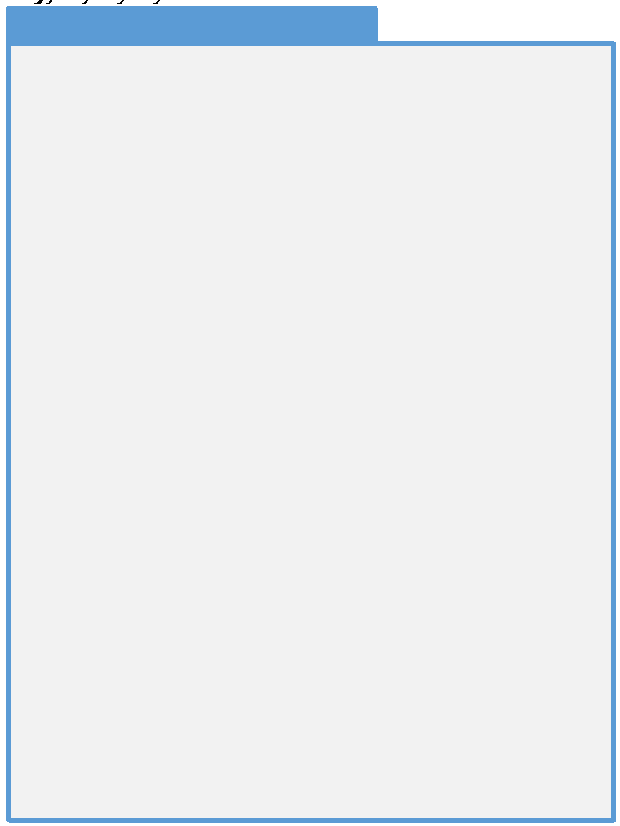
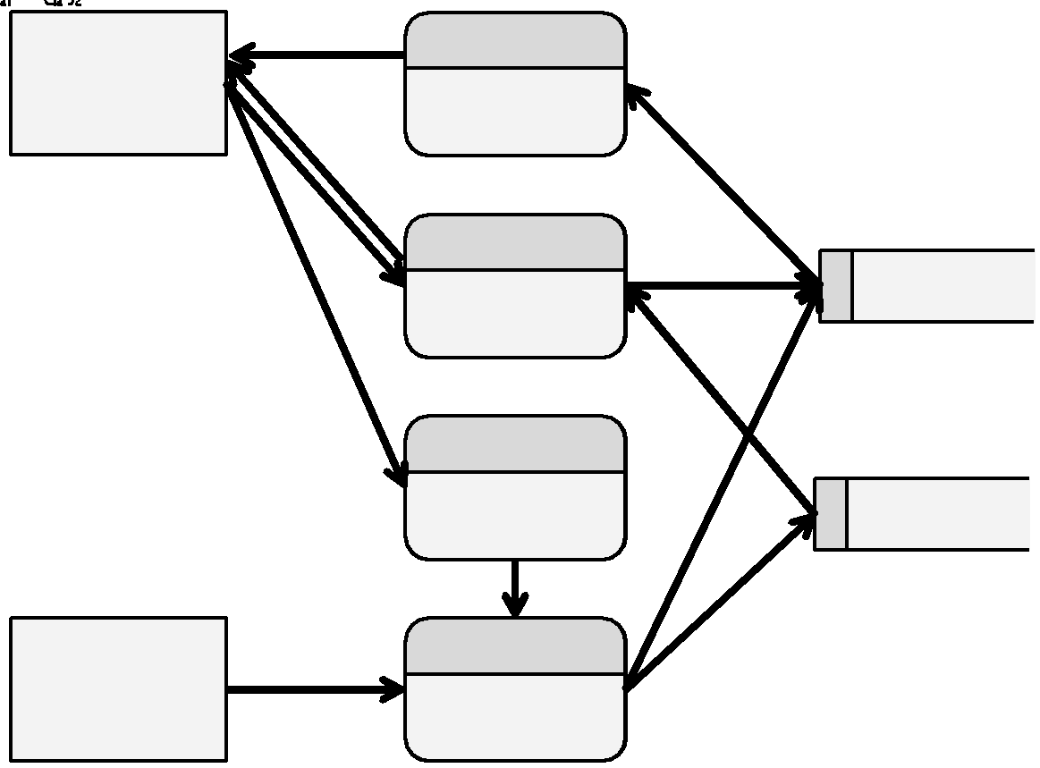
Problem 11.5: MadLib DFD
Create a DFD of the following program which plays the game MadLib

Slide 30
Problem 11.6: Tic-Tac-Toe Design
Create a DFD for a program to satisfy the following scenario:
Tic-Tac-Toe, otherwise known as noughts and crosses, is a game played on a 3x3 grid where one player is represented with X's and the other is represented with O's. The X player puts a mark in one of the 9 grid locations. The O player then selects one of the eight remaining grid locations. The game continues until either one player gets 3-in-a-row or 3-diagonally.
This game will read a board from a file, allow the user to play the game, and save a partially-completed game back to a file. The user will be prompted for his or her selection, then the program will then choose the best response to the user’s move. In other words, the user will play the computer.
Hint: How will data enter the system? How will it be stored? What type of output will the system generate?

Slide 31
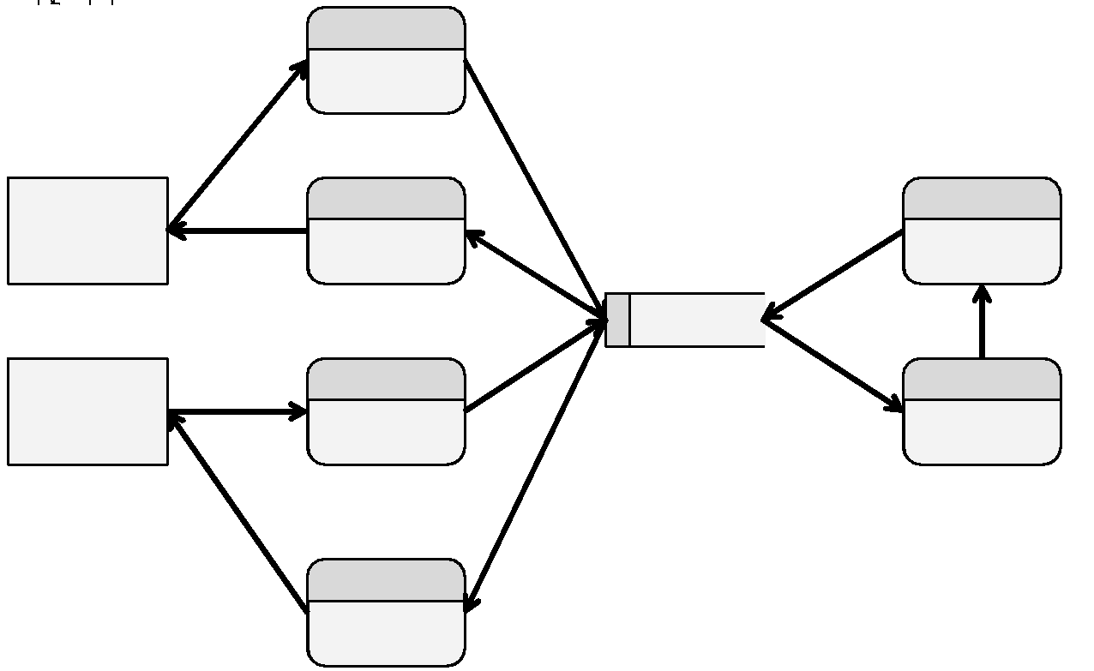
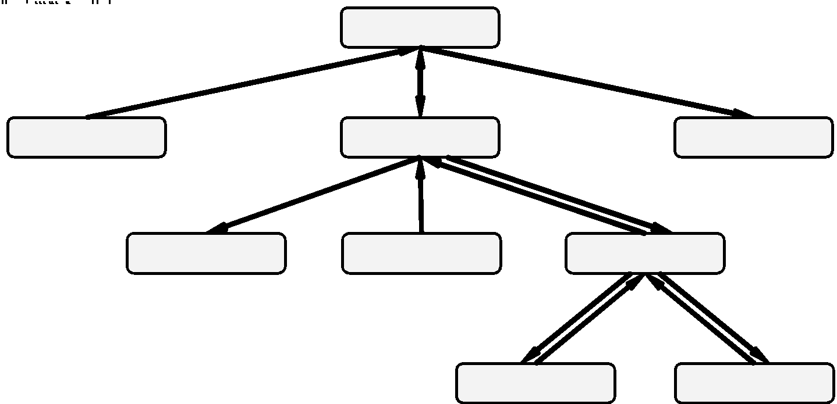
Problem 11.6: Solution
Data Flow Diagram
Structure Chart (for reference)

Slide 32
Challenge 11.1: Calendar
Create a DFD to represent the part of a program which will display a calendar on the screen. The input to the main function will be a month and year, both integer parameters. The output of the function will be a graphical depiction of a calendar.
A personal finance program needs to display a calendar in a dialog from which the user will select the due-date for a bill. You are tasked with writing this code.
Hint: Your program will need to determine the day of the week of the first of the month. This will be determined by counting the days since the 14th of September, 1752 (which was a Thursday) and dividing by 7. It will need to know the number of days in each month, taking leap years into account.

Slide 33
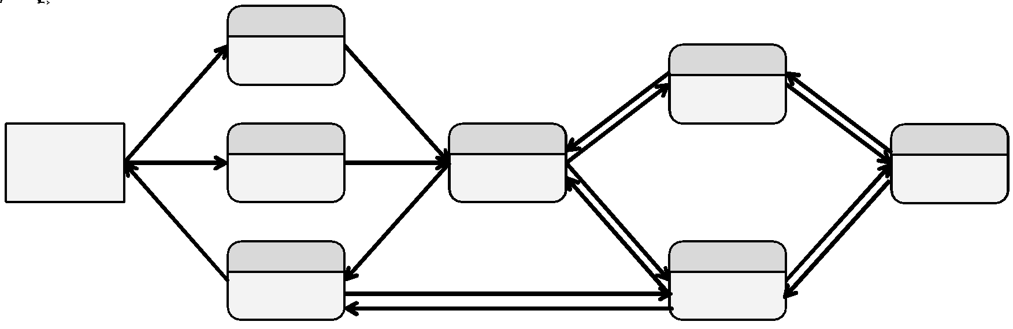
Challenge 11.1: Solution

Slide 34
Challenge 11.2: Asteroids
Consider the 1979 Atari game Asteroids. You may need to do some “research” to refresh yourself as to how this program works.
Create a DFD representing this entire program

Slide 35
Challenge 11.3: Sudoku
Create a structure chart representing the game of Sudoku:
Sudoku is a numbers game played on a 9x9 grid. The object of the game is to fill in the 9x9 grid while honoring certain constraints. The constraints are: 1) There is no more than one instance of a given number on a given row. 2) There is no more than one instance of a given number on a given column. 3) There is no more than one instance of a given number on an inside square (the 3x3 squares embedded in the 9x9 grid. 4) Every square can consist of a single digit between 1 and 9 exclusively, or can be blank

