Slide 1
Week 04: Cohesion
Lab 03 was due on Saturday
Chapter 12 reading is due
Lab 04 is due this Saturday
Review the solution to Lab 03
Answer questions about the reading
Go through the reading quiz
Answer questions about Lab 04
Work through some problems
D&C 19:31
D&C 29:39

Slide 2
Lab 03: Solution
def days_since_1753_slow(month, year):
'''How many days between 1/1/1753 and month/1/year?'''
assert(type(year) == type(month) == type(START_YEAR_GREGORIAN))
assert(year >= START_YEAR_GREGORIAN)
assert(1 <= month <= 12)
# Count the days in the years since 1753.
days = 0
for year_count in range(START_YEAR_GREGORIAN, year):
days += num_days_in_year(year_count)
# Count the days in the months since January.
for month_count in range(1, month):
days += num_days_in_month(month_count, year)
return days
def get_month():
'''Prompt the user for the month number. Only 1..12 are valid options.'''
month_text = input("Enter the month number: ")
# Deal with the errors.
valid = False
while not valid:
# Invalid if not a number.
valid = True
if not month_text.isdigit():
print("Month must be an integer.")
valid = False
month_number = 1
else:
month_number = int(month_text)
# Invalid if not in the right range.
if month_number < 1 or month_number > 12:
print("Month must be between 1 and 12.")
valid = False
# re-prompt as necessary.
if not valid:
month_text = input("Enter the month number: ")
assert(type(month_number) == type(12))
assert(1 <= month_number <= 12)
return month_number
def day_of_week_from_num_days(num_days):
'''Compute the day of week from the number of days since 1/1/1753'''
assert(type(num_days) == type(0))
assert(num_days >= 0)
# Since 1/1/1753 is a Monday, we need to add one extra day.
return (num_days + start_day_gregorian) % 7
#
# Constants
#
# Days in a month: JAN FEB MAR APR MAY JUN JUL AUG SEP OCT NOV DEC
DAYS_IN_MONTH = [0, 31, 28, 31, 30, 31, 30, 31, 31, 30, 31, 30, 31]
# The first full year of the Gregorian calendar.
START_YEAR_GREGORIAN = 1753
# Day of the week for 1/1/1753 where 0 is Sunday.
START_DAY_GREGORIAN = 1
def get_year():
'''Prompt the user for the year. Only years greater than 1752 valid options'''
year_text = input("Enter year: ")
# Deal with the errors.
valid = False
while not valid:
# Invalid if not a number.
valid = True
if not year_text.isdigit():
print("Year must be an integer.")
valid = False
year_number = 2000
else:
year_number = int(year_text)
# Invalid if not in the right range.
if year_number < START_YEAR_GREGORIAN:
print("Year must be", START_YEAR_GREGORIAN, "or later.")
valid = False
# re-prompt as necessary.
if not valid:
year_number = input("Enter year: ")
assert(type(year_number) == type(start_year_gregorian))
assert(year_number >= start_year_gregorian)
return year_number
def is_leap_year(year):
'''Determine if the given year is a leap year.'''
assert(type(year) == type(start_year_gregorian))
assert(year >= start_year_gregorian)
# Years between the quad years are not leap years.
if year % 4 != 0:
return False
# Years between the centuries.
if year % 100 != 0:
return True
# Centuries and quad-centuries are handled last.
return year % 400 == 0
# Prompt the user for input.
month = get_month()
year = get_year()
# Perform the processing.
dow = day_of_week_from_num_days(days_since_1753(month, year))
num_days = num_days_in_month(month, year)
# Display the output.
display_table(dow, num_days)
def num_days_in_year(year):
'''How many days are there in a given year?'''
assert(type(year) == type(start_year_gregorian))
assert(year >= start_year_gregorian)
# Either 365 or 366, depending...
return 365 if not is_leap_year(year) else 366
def display_table(dow, num_days):
'''Display a calendar table'''
assert(type(num_days) == type(dow) == type(0))
assert(0 <= dow <= 6)
assert(28 <= num_days <= 31)
# Display a nice table header.
print(" Su Mo Tu We Th Fr Sa")
# Indent for the first day of the week.
for indent in range(dow):
print(" ", end='')
# Display the days of the month.
for dom in range(1, num_days + 1):
print(repr(dom).rjust(4), end='')
dow += 1
# Newline after Saturdays
if dow % 7 == 0:
print("") # newline
# We must end with a newline.
if dow % 7 != 0:
print("") # newline
def num_days_in_month(month, year):
'''How many days are there in a given month?'''
assert(type(year) == type(month) == type(start_year_gregorian))
assert(year >= start_year_gregorian)
assert(1 <= month <= 12)
return days_in_month[month] if month != 2 or not is_leap_year(year) else 29
def days_since_1753(month, year):
'''How many days between 1/1/1753 and month/1/year?'''
assert(type(year) == type(month) == type(START_YEAR_GREGORIAN))
assert(year >= START_YEAR_GREGORIAN)
assert(1 <= month <= 12)
# Count the days in the years since 1753.
days = 0
for year_count in range(START_YEAR_GREGORIAN, min(year, 1800)):
days += num_days_in_year(year_count)
for century_count in range(1800 // 100, year // 100):
days += num_days_in_year(century_count * 100) + (365 * 75) + (366 * 24)
for year_count in range(max(year // 100 * 100, 1800), year):
days += num_days_in_year(year_count)
# Count the days in the months since January.
for month_count in range(1, month):
days += num_days_in_month(month_count, year)
return days

Slide 3
Lab 04: Sudoku Design
The game of Sudoku is to be read from a file and allow the user to interact with the board. A saved board looks like this:
An example of the gameplay is:
{
"board": [
[ 7, 2, 3, 0, 0, 0, 1, 5, 9 ],
[ 6, 0, 0, 3, 0, 2, 0, 0, 8 ],
[ 8, 0, 0, 0, 1, 0, 0, 0, 2 ],
[ 0, 7, 0, 6, 5, 4, 0, 2, 0 ],
[ 0, 0, 4, 2, 0, 7, 3, 0, 0 ],
[ 0, 5, 0, 9, 3, 1, 0, 4, 0 ],
[ 5, 0, 0, 0, 7, 0, 0, 0, 3 ],
[ 4, 0, 0, 1, 0, 3, 0, 0, 6 ],
[ 9, 3, 2, 0, 0, 0, 7, 1, 4 ]
]
}
Where is your board located? myGame.txt
A B C D E F G H I
1 7 2 3| |1 5 9
2 6 |3 2| 8
3 8 | 1 | 2
-----+-----+-----
4 7 |6 5 4| 2
5 4|2 7|3
6 5 |9 3 1| 4
-----+-----+-----
7 5 | 7 | 3
8 4 |1 3| 6
9 3 2| |7 1 4
>

Slide 4
Lab 04: Deliverables
Please create the following for this assignment:
A structure chart of the entire program
A Data Flow Diagram (DFD) of the entire program
Algorithm design of at least two functions that are part of the design

Slide 5
Content
Levels of Cohesion
Level: Strong
Level: Extraneous
Level: Partial
Level: Weak
Classical Cohesion

Slide 6
Levels of Cohesion
Cohesion is a measurement of how well a unit of software represents one concept or performs one task
Strong
All aspects of a function are directed to perform a single task, and the task is completely represented
Extraneous
At least one part of a function is not directed towards a single task. However, the principle task is completely represented.
Partial
All aspects of a function are directed to perform a single task, but the task is not completely represented by the function
Weak
At least one part of a function is not directed towards performing a single task. Additionally, the task is not completely represented by the function
Helfrich, J. (2018). Measurements of Modularization CSEIT 2018 Singapore

Slide 7
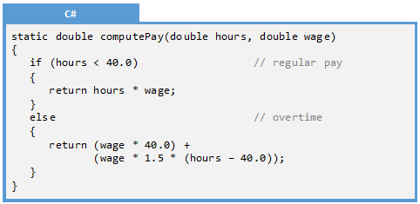
Level: Strong
Strong
The strongest and most desirable level of cohesion is where all the code in a function is directed to one purpose
Extraneous
Partial
Weak
All aspects of a function are directed to perform a single task, and the task is completely represented.
Helfrich, J. (2018). Measurements of Modularization CSEIT 2018 Singapore

Slide 8
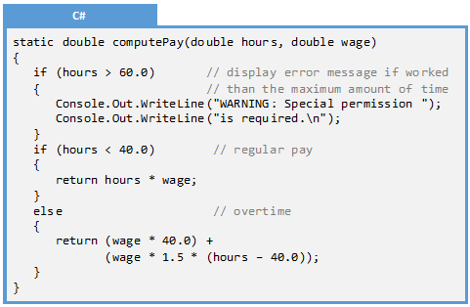
Level: Extraneous
Strong
The first weak form of cohesion is extraneous. Here exists something unnecessary in the unit of software. A political analogy would be a “rider” on a bill and a sports analogy would be a “bench warmer” on a team
Extraneous
Partial
Weak
At least one part of a function is not directed towards a single task. However, the principle task is completely represented
Helfrich, J. (2018). Measurements of Modularization CSEIT 2018 Singapore

Slide 9
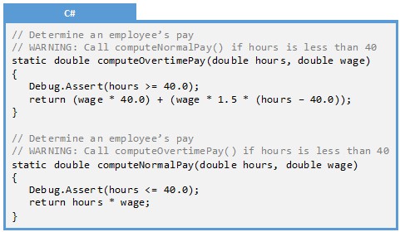
Level: Partial
Strong
A weak form of cohesion is where a task is left incomplete. In other words, additional data or work needs to be stored or completed elsewhere for the concept or task to be completed
Extraneous
Partial
Weak
All aspects of a function are directed to perform a single task, but the task is not completely represented by the function
Helfrich, J. (2018). Measurements of Modularization CSEIT 2018 Singapore

Slide 10
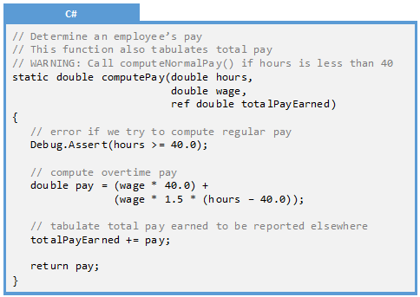
Level: Weak
Strong
The worst form of cohesion is weak. One should never design for weak cohesion; it is a state that is to be avoided. Weak cohesion is a combination of extraneous and partial.
Extraneous
Partial
Weak
Helfrich, J. (2018). Measurements of Modularization CSEIT 2018 Singapore

Slide 11
Classical Cohesion
Functional
All the elements are related to the performance of a single function
The output data (or results) from one processing element serve as input data for the next processing element
Elements are related by a reference to the same set of input and/or output data
Associate[ing] processing elements on the basis of their procedural or algorithmic relationships
Some logical relationship exists and the elements are related by time
Some logical relationship between the elements of a module
There is no meaningful relationship among the elements in a module
Sequential
Communicational
Procedural
Temporal
Logical
Coincidental
Constantine, L. (1968). The Programming Profession, Programming Theory, and Programming Education

Slide 12
Examples
Example 12.1: Partial Cohesion
Example 12.2: Extraneous Cohesion
Example 12.3: Designing for Cohesion

Slide 13
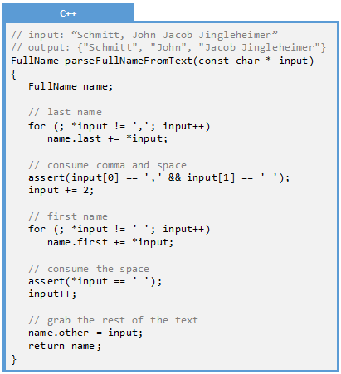
Example 12.1: Partial Cohesion
Q: Identify the level of cohesion:
A: Partial
On the surface, this may appear to be strong cohesion. It does one thing and one thing only. We can see that the program only generates a name from the provided name, and it does that task completely. Or does it!
Notice that the function assumes that the input string is in a certain format. If the input string is empty, missing the comma or space, missing a first name, or even missing the middle name, then it will malfunction. In debug mode, it will assert. In the release mode, it will walk off the end of the string and crash. We therefore expect the caller to do work to prepare the input string for our function. Any time we rely on another part of the program to do part of our task, we are a good candidate for partial cohesion.

Slide 14
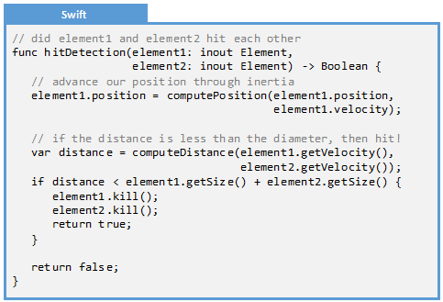
Example 12.2: Extraneous Cohesion
Q: Identify the level of cohesion:
A: Extraneous
The first step is to identify the purpose of the function: to see if element1 and element2 hit each other in a video game.
The two blocks of code do different things, and only the second is related to the purpose of the function. Computing inertia for one of the two elements is extraneous.

Slide 15
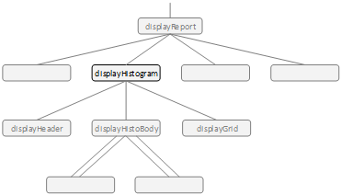
Example 12.3: Designing for Cohesion
Q: Optimize the cohesion for the following program, focusing on the displayHistogram() function
A: To make the function strongly cohesive, two things must happen:
Keep displayHistogram() from doing anything different than the name suggests.
Ensure that displayHistogram() completely fulfills its intended purpose, relying on no other function to do part of its task.

Slide 16
Exercises
Exercise 12.1: Levels of Cohesion
Exercise 12.2: Fact or Fiction
Exercise 12.3: Identify Cohesion Level
Exercise 12.4: Identify Cohesion Level
Exercise 12.5: Identify Cohesion Level

Slide 17
Exercise 12.1: Levels of Cohesion
Match the level of cohesion name with the definition
One task is performed as well as other stuff
Extraneous
Parts of multiple tasks are performed
Partial
Only one task is performed and it is performed completely
Weak
Strong
Only one task is performed but it is not quite done completely

Slide 18
Exercise 12.2: Fact or Fiction
For each of the following, identify whether it is a fact or whether it is fiction
Fact or Fiction
Cohesion is a measure of how much code is in a function
Weak cohesion maps closely to Constantine’s coincidental cohesion
Cohesion is a modularization metric
Strong cohesion maps closely to Constantine’s sequential cohesion
Weak cohesion is the worst combination of partial and extraneous
Fiction. Cohesion is a measurement of how well a unit of software represents one concept or performs one task
Fact. Both Weak and Coincidental describe essentially the same concept
Fact. There are two modularization metrics: cohesion and coupling
Fiction. Strong cohesion maps closely with Constantine’s Functional cohesion
Fact. Weak takes the worst parts of partial and extraneous. Strong takes the best parts of partial and extraneous

Slide 19
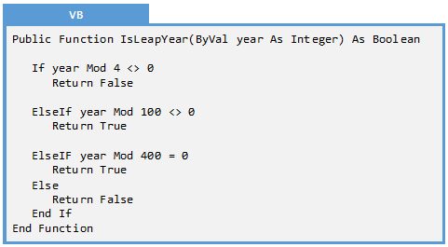
Exercise 12.3: Identify the Level of Cohesion
Q: Identify the level of cohesion for the following function:
Is the cohesion extraneous?
Every aspect of the function is directed towards a single task: to determine if a given year is a leap year. No line of code does anything else. Verdict: Not extraneous
Is the cohesion partial?
The task is completely performed, assuming that we are in the Gregorian calendar. One could argue that this is partial if we consider the years before 1752 (Julian calendar) or even before that (no leap years were before 46 BC). Verdict: Not partial
Strong

Slide 20
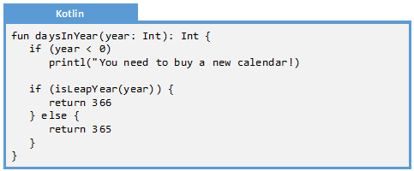
Exercise 12.4: Identify the Level of Cohesion
Q: Identify the level of cohesion for the following function:
Is the cohesion extraneous?
The error message at the beginning of the function is not directly related to the task of determining the number of days in a given year. Verdict: extraneous
Is the cohesion partial?
The task is completely performed, assuming that we are in any year besides 1752. That year had only 355 days. If we consider that case, then this task is not completely performed, and we are partial. Verdict: not partial
Extraneous

Slide 21
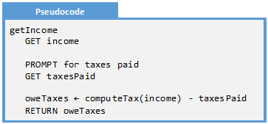
Exercise 12.5: Identify the Level of Cohesion
Q: Identify the level of cohesion for the following function:
Is the cohesion extraneous?
The function does more than one thing. It has two prompts and a calculation. The second prompt and calculation is beyond what the function advertises what it should do. Thus, the function is extraneous at best. Verdict: extraneous
Is the cohesion partial?
The function does not complete a single task. The name of the function is getIncome() but it does not do that. It instead determines the amount of taxes owed. Thus, the function is partial at best. Verdict: partial
Weak

Slide 22
Problems
Problem 12.1: Cohesion of Compute Tax
Problem 12.2: Cohesion of Authenticate
Problem 12.3: Cohesion of
Encode
Problem 12.4: Cohesion of Execute Jobs
Problem 12.5: Cohesion of Read Board
Problem 12.6: Cohesion of Is X’s Turn
Problem 12.7: Cohesion of Get Month v1
Problem 12.8: Cohesion of Get Month v2
Problem 12.9: Cohesion of Is Valid Month
Challenge 12.1: Sudoku
Challenge 12.2: Yahtzee
Challenge 12.3: Card Game

Slide 23
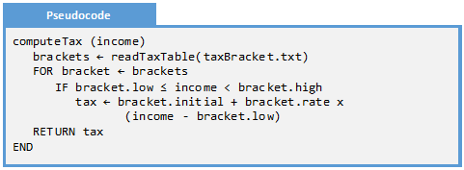
Problem 12.1: Cohesion of Compute Tax
Identify the level of cohesion of the following pseudocode:
Is the cohesion partial?
The taxes are completely determined based on the bracket. Verdict: not partial
Is the cohesion extraneous?
This function does only one thing: it computes tax brackets. Nothing else is done. However, one could argue that the reading of the tax table is not core to the purpose of the function. We could strengthen our claim to be not extraneous by accepting the brackets as a parameter rather than reading it in this function. Verdict: not extraneous.
Verdict: Strong

Slide 24
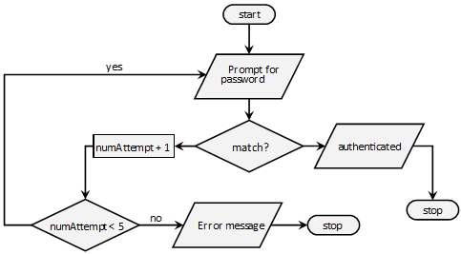
Problem 12.2: Cohesion of Authenticate
Identify the level of cohesion of the following flowchart:
Is the cohesion partial?
The authentication process is completely performed. Verdict: not partial
Is the cohesion extraneous?
This code does only one thing: authenticate the user. We could strengthen our case that it is not extraneous by leaving the two message (authenticated or error message) to another function. Verdict: not extraneous.
Verdict: Strong

Slide 25
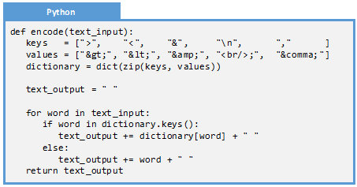
Problem 12.3: Cohesion of Encode
Identify the level of cohesion of the following Python function
Is the cohesion partial?
The code completely swaps keys (>,&,etc.) with html-entities. Verdict: not partial
Is the cohesion extraneous?
Only html-entities are replaced. It does nothing else. We could strengthen our cohesion claims by passing the dictionary in as a parameter. Verdict: not extraneous.
Verdict: Strong

Slide 26
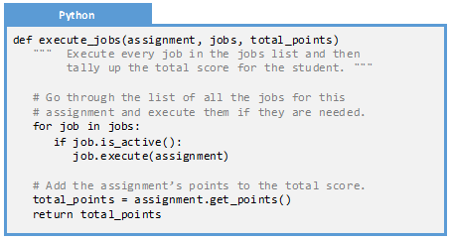
Problem 12.4: Cohesion of Execute Jobs
Identify the level of cohesion of the following Python function
Is the cohesion partial?
This function does do what the name implies. It executes all the jobs on a given assignment. We have no indication it does less. Verdict: not partial
Is the cohesion extraneous?
The “and” in the function comment block is an indication it might be extraneous. Note that the point tally also not part of the function name. This function does two things (execute jobs and tally points), not one. Verdict: extraneous.
Verdict: Extraneous

Slide 27
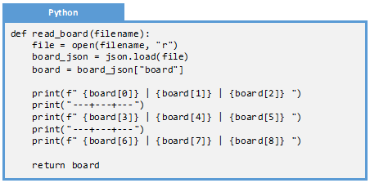
Problem 12.5: Cohesion of Read Board
Identify the level of cohesion of the following Python function
Is the cohesion partial?
The board is read from a file into a format that is useful to the rest of the program. Verdict: not partial
Is the cohesion extraneous?
Note that the board is also displayed on the screen. This is not core to the mission of the function – which is to just read a board. Verdict: extraneous.
Verdict: Extraneous

Slide 28
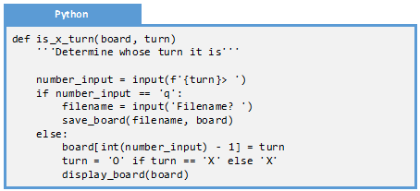
Problem 12.6: Cohesion of Is X’s Turn
Identify the level of cohesion of the following Python function
Is the cohesion partial?
The second to last line of code does swap O’s turn for X’s so it does complete the task. However, the function name implies it will return whether it is X’s turn. The function fails to do that. Verdict: partial
Is the cohesion extraneous?
The function modifies the board, saves the board, displays the board, and prompts the user. These are not part of the core mission of the function. Verdict: extraneous.
Verdict: Weak

Slide 29
Problem 12.7: Cohesion of Get Month Version 1
Identify the level of cohesion of the following Python function
Is the cohesion partial?
The function completely prompts the user for the month. Note that some more robust error checking should be done, but that is not cohesion. Verdict: not partial
Is the cohesion extraneous?
The function also prompts for a year. This is not implied by the function name and is a separate task. This should be a second function. Verdict: extraneous.
Verdict: Extraneous

Slide 30
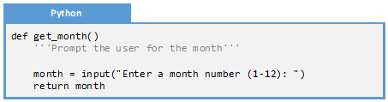
Problem 12.8: Cohesion of Get Month Version 2
Identify the level of cohesion of the following Python function
Is the cohesion partial?
On the surface, it appears to do exactly what it says it will. It prompts the user for a month. That it fails to perform error checking is not a cohesion issue. However, it returns a string month when the program clearly expects an integer month. This requires the rest of the program to do the conversion. Verdict: partial
Is the cohesion extraneous?
This function does nothing but prompt for a month. Verdict: not extraneous.
Verdict: Partial

Slide 31
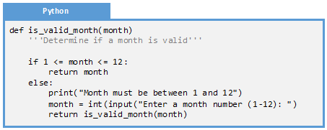
Problem 12.9: Cohesion of Is Valid Month
Identify the level of cohesion of the following Python function
Is the cohesion partial?
The function name and comment suggests the function should return whether a month is valid. It turns out, the function does not do that. It instead returns a valid month. One could make the case it is not partial because it does accomplish a task (the wrong task!). One could make the case that it is partial because the main task is not performed. The partial argument is stronger. Verdict: partial
Is the cohesion extraneous?
The IF statement is on task. Everything else is not part of the mission of the function. Taking that into account, most of the function is extraneous. Verdict: extraneous.
Verdict: Weak

Slide 32
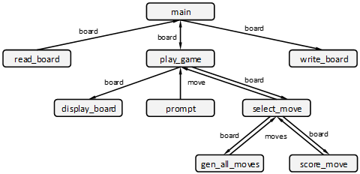
Problem 12.10: Cohesion of Tic-Tac-Toe
Identify the level of Cohesion for each function in the following structure chart. Can any be improved?

Slide 33
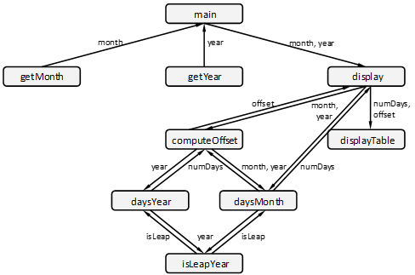
Problem 12.11: Cohesion of Calendar
Identify the level of Cohesion for each function in the following structure chart. Can any be improved?

Slide 34
Challenge 12.1: Sudoku
Create a structure chart for the game of Sudoku. If you have already created a structure chart for this in Challenge 10.1, please use that one.
Sudoku is a numbers game played on a 9x9 grid. The object of the game is to fill in the 9x9 grid while honoring certain constraints. The constraints are: 1) There is no more than one instance of a given number on a given row. 2) There is no more than one instance of a given number on a given column. 3) There is no more than one instance of a given number on an inside square (the 3x3 squares embedded in the 9x9 grid. 4) Every square can consist of a single digit between 1 and 9 exclusively, or can be blank. This program will read a user-specified board from a file, allow the user to interact with the game while enforcing the rules, and then write an unfinished board to the file.
Determine the level of cohesion for every function in the structure chart. If any function is less than strongly cohesive, then refactor the design.

Slide 35
Challenge 12.2: Yahtzee
Consider the dice game Yahtzee:
Yahtzee is a multi-round game of dice. The user throws five dice each turn, and tallies points on a scorecard. Each category has a set of rules, describing the set of numbers on the dice necessary to complete the category. Every round requires a category to be filled, even if the current roll yields zero points for that category. The game is continued until every category has a score.
Create a structure chart to describe a program that allows a single-user to play the game Yahtzee. For each function in the structure chart, identify the corresponding level of cohesion. If any function is less than strong cohesion, re-work the design until the cohesion weakness if fixed.

Slide 36
Challenge 12.3: Card Game
Create a structure chart to describe a program that plays a card game of your choice. For each function in the structure chart, identify the corresponding level of cohesion. If any function is less than strong cohesion, re-work the design until the cohesion weakness if fixed.

