Slide 1
Week 05: Coupling
Lab 04 was due on Saturday
Chapter 13 reading is due
Lab 05 is due this Saturday
Review the solution to Lab 04
Answer questions about the reading
Go through the reading quiz
Answer questions about Lab 05
Work through some problems
Jeremiah 18:2-6
D&C 35:14

Slide 2
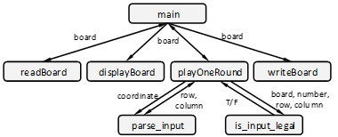
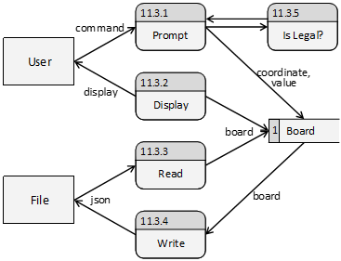
Lab 04: Solution – Structure Chart & DFD
Structure Chart
Data Flow Diagram

Slide 3
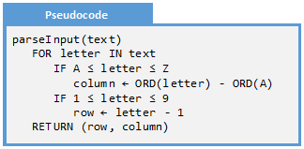
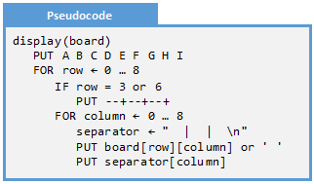
Lab 04: Solution – Algorithm
Parse Input
Display
This function will turn the textual coordinates “A4” into column = 0, row = 3
This function put the board on the screen in a user-friendly way

Slide 4
Lab 05: Sudoku Draft
Write a Python program that plays the game of Sudoku but does not enforce the rules.
A B C D E F G H I
1 7 2 3| |1 5 9
2 6 |3 2| 8
3 8 | 1 | 2
-----+-----+-----
4 7 |6 5 4| 2
5 4|2 7|3
6 5 |9 3 1| 4
-----+-----+-----
7 5 | 7 | 3
8 4 |1 3| 6
9 9 3 2| |7 1 4
Specify a coordinate to edit or 'Q' to save and quit
> B2
What number goes in B2? 9
A B C D E F G H I
1 7 2 3| |1 5 9
2 6 9 |3 2| 8
3 8 | 1 | 2
-----+-----+-----
4 7 |6 5 4| 2
5 4|2 7|3
6 5 |9 3 1| 4
-----+-----+-----
7 5 | 7 | 3
8 4 |1 3| 6
9 9 3 2| |7 1 4
> Q

Slide 5
Content
Levels of Coupling
Levels:
Trivial
Levels: Encapsulated
Levels:
Simple
Levels:
Complex
Levels:
Document
Levels:
Interactive
Levels:
Superfluous
Classical
Coupling

Slide 6
Levels of Coupling
Coupling is a measurement of the complexity of the interface between units of software. In other words, how much does the programmer need to know to successfully use a given function? Our goal is the make the interface as simple as possible.
Trivial
No information interchange exists
Encapsulated
Parameters are convenient and always valid
Simple
Parameters are easy to select and interpret
Complex
At least one parameter is difficult
Document
A rich language is utilized
Interactive
Non-trivial dialog
Superfluous
Any unnecessary parameters
Helfrich, J. (2018). Measurements of Modularization. CSEIT 2018

Slide 7

Level: Trivial
Trivial
Trivial is the weakest or best form of coupling. Here the client of a unit of software needs to provide no information and receives no information from another unit of software
Encapsulated
Simple
Trivial functions are easy to use: no parameters are passed and no side effects can result.
Complex
Document
Interactive
Superfluous
Helfrich, J. (2018). Measurements of Modularization. CSEIT 2018

Slide 8
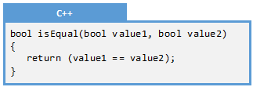
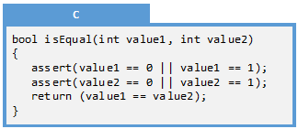
Level: Encapsulated
Trivial
Encapsulated is a very weak form of coupling defined by all of the parameters being in a trusted and accessible state. In other words, there are logical checks in place to ensure that no invalid data is sent between modules.
Encapsulated
Encapsulated
Not Encapsulated
Simple
Always in a trusted or valid state; the client does not need to manage it
The client needs to worry about how the parameter is set exactly
Complex
Document
Interactive
Superfluous
Helfrich, J. (2018). Measurements of Modularization. CSEIT 2018

Slide 9
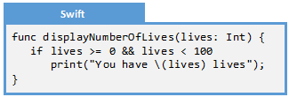

Level: Simple
Trivial
All the information exchanged between units of software is easy to select, interpret, and validate. Parameters consisting of built-in data-types such as integers or characters are often simple, assuming that the use of the parameter is easily specified.
Encapsulated
Simple
Encapsulated
Simple
Easy validation is required
The Lives class handles validation for the client
Complex
Document
Interactive
Superfluous
Helfrich, J. (2018). Measurements of Modularization. CSEIT 2018

Slide 10
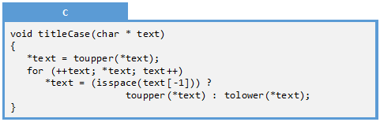
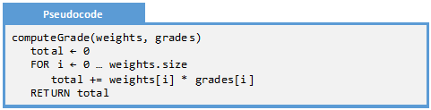
Level: Complex
Trivial
At least one piece of information is non-trivial to create, validate, or interpret. Here the participants need to know a great deal about the parameters in order to make a connection. The greater knowledge the participants need to have and the more work the participants need to accomplish to make sure the connection is done correctly, the more complex the level of coupling.
Encapsulated
Simple
Complex
Document
Interactive
Superfluous

Slide 11
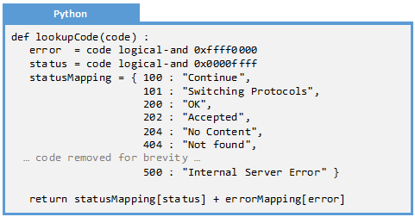
Level: Document
Trivial
At least one piece of information contains a rich language including syntactic and/or semantic rules. Here data conforming to some language is passed from a producer to a consumer. Note that the producer could be the caller or the callee, depending on the direction of information flow. The important thing to note is that both the producer and the consumer need to fully understand the intricacies of the shared language.
Encapsulated
Simple
Complex
Document
Interactive
Superfluous
Helfrich, J. (2018). Measurements of Modularization. CSEIT 2018

Slide 12
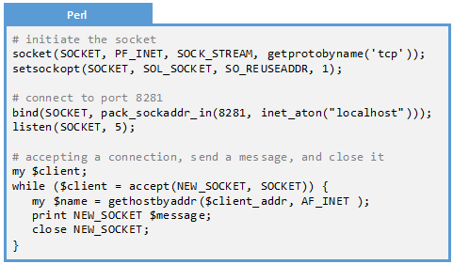
Level: Interactive
Trivial
There exists a communication avenue between units of software involving non-trivial dialogs, sessions, or interactions. It involves an ongoing communication between components, not a single one-time message event. Interactive coupling is usually characterized by a session where conversations begin, the participants react to each other, and conversations are terminated. .
Encapsulated
Simple
Complex
Document
Interactive
Superfluous
Helfrich, J. (2018). Measurements of Modularization. CSEIT 2018

Slide 13
Level: Superfluous
Trivial
At least one piece of data or information is passed between units of software unnecessarily. The scope is larger than necessary.
Scope Level | Accessible to…
Block | … only a small number of statements
Local Variable | … all statements in a single function
One-way Parameter | … two functions, writable by only one of them
Two-way Parameter | … two functions, writable by either of them
Function Static | … all instances of a function
Private Member | … all methods in a single classes
Inherited Member | … all methods in multiple related classes
Public Member | … any who have access to an object
Class Static | … all objects of the class
Global | … the entire run-time environment
File System | … any program on the system
Protected Network | … all entities on a private network.
Global Network | … the world!
Encapsulated
Simple
Complex
Document
Interactive
Superfluous
Helfrich, J. (2018). Measurements of Modularization. CSEIT 2018

Slide 14
Classical Coupling
Common
A group of modules that reference a global data structure
A group of modules are not content or common coupled and they reference a homogeneous global data item
If one module explicitly controls the logic of the other
Two functions refer to the same non-global data structure
The modules directly communicate with one another and if all interface data between the modules are homogeneous data items
A function takes no parameters and returns no data
External
Control
Stamp
Data
No Direct
Myers, G. (1978). Composite/Structured Design. Litton Educational Publishing, Inc

Slide 15
Examples
Example 13.1:
Document
Coupling
Example 13.2:
Interactive
Coupling
Example 13.3:
Design for
Coupling

Slide 16
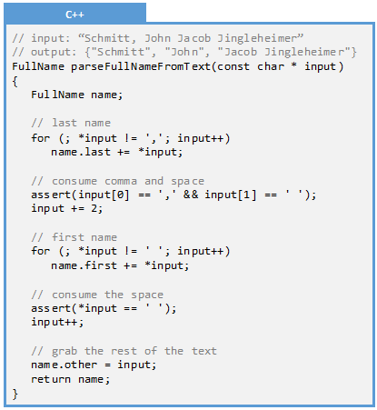
Example 13.1: Document Coupling
Q: Identify the level of coupling:
A: Document
  We can rule out trivial because there is a parameter. It is not encapsulated because the parameter is of a primitive data-type that does not provide any guarantee of validation. It is not simple because the client needs to understand details of c-strings to use the input parameter. It may be complex or document. It cannot be interactive because there is no state or session maintained between function calls. Finally, the input parameter is utilized so it is not superfluous.

Slide 17
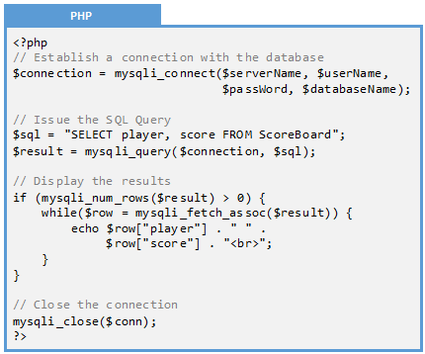
Example 13.2: Interactive Coupling
Q: Identify the level of coupling
A: Interactive
  Notice that there are multiple steps involved in making the SQL connection. First, the connection is established through the mysqli_connection() function call. Next, the query is sent through mysqli_query(). After that, the results are parsed through mysqli_num_rows() and mysqli_fetch_assoc(). The final step is to close the connection through mysqli_close(). This interaction is complex, involves many steps, and involves maintaining state (through $connection and $result). This is therefore interactive coupling

Slide 18
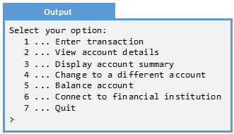
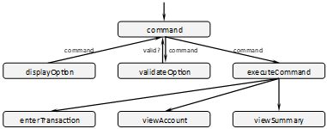
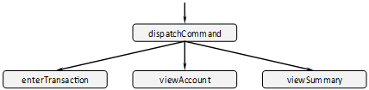
Example 13.3: Design for Coupling
Q: A program displays a selection of options to
the user. Improve the coupling of command
A: The problem with this design is that three functions (displayOption(), validateOption(), and executeCommand()) all have to complete understand the command language. If an option is added, removed, or changed, then all three functions would need to be updated. This is an example of document coupling. We can simplify the interface by combining these three functions into command(). Note that this will not reduce the cohesion of command() because it still does one thing and one thing only: dispatch a command.

Slide 19
Exercises
Exercise 13.1:
Levels of Coupling
Exercise 13.2:
Fact or Fiction
Exercise 13.3:
Level of Coupling
Exercise 13.4:
Level of Coupling
Exercise 13.5:
Level of Coupling

Slide 20
Exercise 13.1: Levels of Coupling
Match the name of the level of coupling with the definition.
A rich language is utilized
Document
Parameters are easy to select and interpret
Trivial
Non-trivial dialog
Simple
No information interchange exists
Interactive
Any unnecessary parameter
Encapsulated
At least one parameter is difficult
Superfluous
Complex
Parameters are convenient and always valid

Slide 21
Exercise 13.2: Fact or Fiction
For each of the following, identify if it is fact or if it is fiction:
Fact or Fiction
Coupling is a modularization metric
Coupling is a measure of how many parameters are passed between functions
Simple coupling is more desirable than encapsulated coupling
Trivial coupling maps closely to Constantine’s No Direct coupling
Interactive coupling requires each client to maintain session state
Fact: There are two modularization metrics: cohesion and coupling
Fiction: Coupling is a measure of the information interchange between functions, not how many parameters are passed
Fiction: Encapsulation is superior to simple, but inferior to trivial
Fact: Both trivial and no direct refer to the case were no parameters are passed between two functions
Fact: Interactive coupling implies a conversation is transpiring

Slide 22
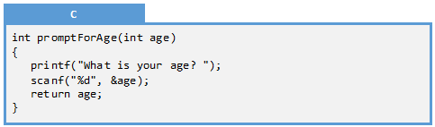
Exercise 13.3: Level of Coupling
Q: Identify the level of coupling for the following function:
Trivial
No There are both input and output parameters so it cannot be trivial
Encapsulated
No Some trivial verification is needed on the input and the output parameter.
Simple
Maybe The input parameter is easy to verify, as is the output. Do we even need the input parameter?
Complex
No The input and output parameters are easy to verify and understand.
Document
No There is no rich language to be parsed, that both the caller and the callee need to understand.
Superfluous
Yes The input parameter is not needed here. Therefore, it is extraneous.

Slide 23
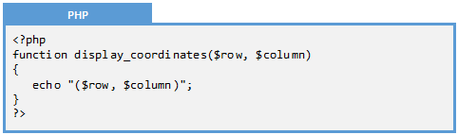
Exercise 13.4: Level of Coupling
Q: Identify the level of coupling for the following function
Trivial
No Though there are no output parameters, there are two input parameters.
Encapsulated
No Built-in integers are used, so some validation is needed.
Simple
Yes Some validation is needed, but the validation is easy to perform.
Complex
No Some validation is needed, but the validation is easy to perform
Document
No There is no rich language to be parsed, that both the caller and the callee need to understand.
Superfluous
No Both the input parameters are used, and the scope of the input parameters is correct.

Slide 24
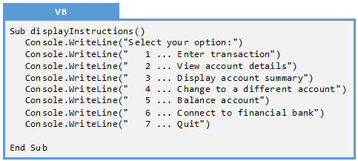
Exercise 13.5: Level of Coupling
Q: Identify the level of coupling for the following function:
Trivial
Yes There are no input or output parameters and no reference to global variables.
Encapsulated
No There are no input or output parameters and no reference to global variables.
Simple
No There are no input or output parameters and no reference to global variables.
Complex
No There are no input or output parameters and no reference to global variables.
Document
No There are no input or output parameters and no reference to global variables.
Superfluous
No There are no input or output parameters and no reference to global variables.

Slide 25
Problems
Problem 13.1:
Coupling for
isPunctuation
Problem 13.2:
Coupling for idFromTag
Problem 13.3:
Coupling for playAgain
Problem 13.4:
Coupling for wordWrap
Problem 13.5:
Coupling for
isCoordinateValid
Problem 13.6:
Coupling for
printf()
Challenge 13.1:
Sudoku Design
Challenge 13.2:
Yahtzee Design
Challenge 13.3:
Card Game Design
Challenge 13.4:
SMTP Design

Slide 26
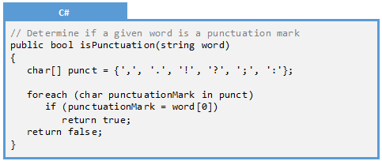
Problem 13.1: Identify Coupling of isPunctuation
Q: Identify the level of coupling for the following C# function:
Trivial
No There is both an input and an output parameter.
Encapsulated
No The output parameter is encapsulated, but the input parameter requires some validation.
Simple
Maybe The input parameter does require some validation, but notice that most of it is ignored…
Complex
No Any validation is easy to perform, so this is not complex coupling.
Document
Maybe Perhaps this is document coupling because the punctuation language must be shared…
Superfluous
Yes Notice how only the first character of the word is used. The rest are ignored!!!
To make this simple, only pass a single character and not a string.

Slide 27
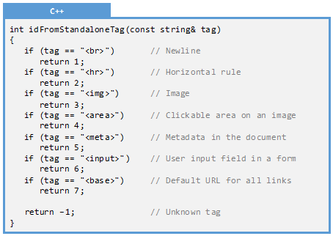
Problem 13.2: Identify the Coupling of idFromTag
Q: Identify the level of coupling of the following C++ function:
Trivial
No There is both an input and an output parameter.
Encapsulated
No Both the input and the output parameter must be validated.
Simple
Maybe Validation of the output parameter is easy. What is the list of input parameters?
Complex
Maybe Validation of the input parameter is tricky. One needs to know the list of all the tags.
Document
Yes Both the caller and the callee need to fully understand the shared language!
Superfluous
No All the parameters are utilized and all have the appropriate scope.

Slide 28
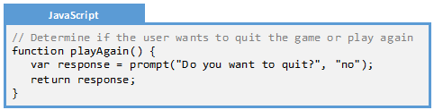
Problem 13.3: Coupling of playAgain
Q: Identify the level of coupling of the following JavaScript function:
Trivial
No There is an output parameter: whether the user wants to quit or not.
Encapsulated
No Some validation needs to be performed on the output parameter.
Simple
Yes Validation of the output parameter is easy: either “yes” or “no”.
Complex
No Validation of the output parameter is easy.
Document
Maybe There is not a rich language shared by the caller and the callee, unless we allow “si” and “yep.”
Superfluous
No All the parameters are utilized and all have the appropriate scope.
To make this encapsulated, return a Boolean rather than a string.

Slide 29
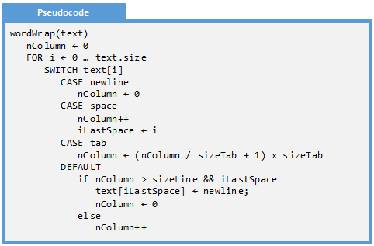
Problem 13.4: Coupling of wordWrap
Q: Identify the level of coupling of the following pseudocode function:
This function takes a string as input and performs word-wrap. This means, it replaces a space with a newline so, when display on the screen, the text wraps on multiple lines.
Trivial
No There is both an input and an output parameter.
Encapsulated
No Both the input and the output parameter are non-trivial.
Simple
No Both the input and the output parameter are non-trivial.
Complex
No Both the input and the output parameter are non-trivial.
Document
Yes Both the caller and the callee need to fully understand the shared language: \n, \t, etc.
Superfluous
No All the parameters are utilized and all have the appropriate scope.

Slide 30
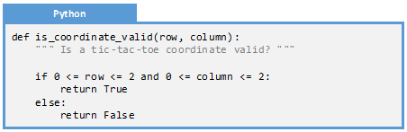
Problem 13.5: Coupling of isCoordinateValid
Q: Identify the level of coupling of the following Python function.
Trivial
No There are both input and output parameters.
Encapsulated
No The output parameter is encapsulated (a Boolean), but the input must be validated.
Simple
Yes Validation of the input parameter is trivial. In fact, that is what the function does!
Complex
No Validation of the input parameter is trivial.
Document
No There is not a shared language understood by both the caller and the callee.
Superfluous
No All the parameters are utilized and all have the appropriate scope.

Slide 31
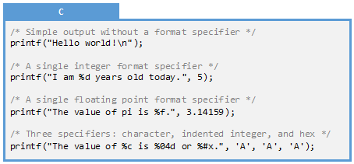
Problem 13.6: Coupling of printf()
Q: Identify the level of coupling printf()
There format specifiers:
%[flags][width][.precision][length]
Common specifiers are:
d Signed decimal integer
f Decimal floating point
x Hexadecimal integer
c Character
s String of characters
Trivial
No There is an input parameter.
Encapsulated
No The input parameter needs to be carefully specified and validated.
Simple
No Validation of the input parameter is non-trivial.
Complex
No Validation of the input parameter requires understanding the shared language.
Document
Yes Both the caller and the callee need to fully understand the shared language: %d %f %c, etc.
Superfluous
No All the parameters are utilized and all have the appropriate scope.

Slide 32
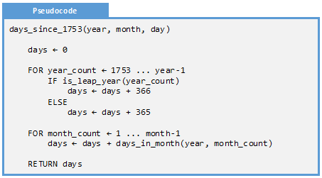
Problem 13.7: Coupling of days_since_1753
Q: Identify the level of coupling of the following pseudocode function:
This function will return how many days have passed since the 1st of January 1753.
Trivial
No There is both an input and an output parameter.
Encapsulated
No Both the input and the output parameters need to be validated.
Simple
Maybe Each of the parameters (input and output) can be easily validated, but…
Complex
No Validation is very easy.
Document
No There is no rich language passed between the caller and the callee.
Superfluous
Yes Notice that we never use the day parameter! This extra parameter makes it superfluous.

Slide 33
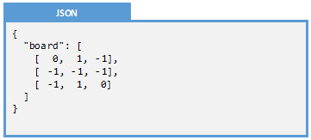
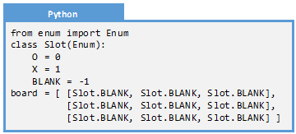
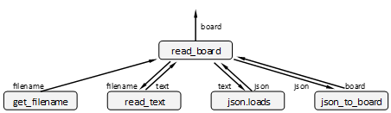
Problem 13.8: Read Board
Consider the following structure chart for the following part of a Tic-Tac-Toe program. This part of the program reads the board from a file. Identify the level of coupling for each function. Note that a board is a 3x3 list of Slots:

Slide 34
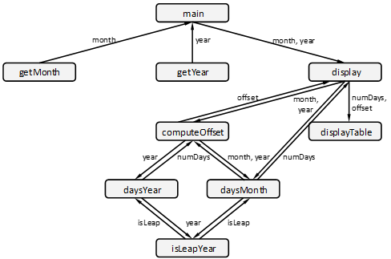
Problem 13.9: Calendar Coupling
Consider the following structure chart for a program which displays a calendar on the screen.
Determine the level of coupling for every function in the structure chart. If any function could be improved, then suggest a new design.

Slide 35
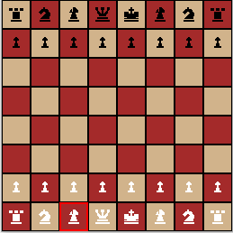
Challenge 13.1: Chess Design
Chess is a turn-based game consisting of two sides (black and white), each of which initially has a collection of 16 pieces. One moves a piece using Smith Notation: b7b5 will move the white pawn forward two squares.
Create a structure chart for a program which allows two users to play each:
Each move is specified in Smith Notation
A game can be saved and loaded from a file. The file format is a list of moves in Smith Notation.
For each function, identify the level of cohesion and coupling.
a b c d e f g h
1
2
3
4
5
6
7
8

Slide 36
Challenge 13.2: Sudoku
Create a structure chart for the game of Sudoku. If you have already created a structure chart for this in Challenge 10.1, please use that one.
  Sudoku is a numbers game played on a 9x9 grid. The object of the game is to fill in the 9x9 grid while honoring certain constraints. The constraints are: 1) There is no more than one instance of a given number on a given row. 2) There is no more than one instance of a given number on a given column. 3) There is no more than one instance of a given number on an inside square (the 3x3 squares embedded in the 9x9 grid. 4) Every square can consist of a single digit between 1 and 9 exclusively, or can be blank. This program will read a user-specified board from a file, allow the user to interact with the game while enforcing the rules, and then write an unfinished board to the file.
Determine the level of coupling for every function in the structure chart. If any function is less than simple cohesion, then refactor the design.

Slide 37
Challenge 13.3: Yahtzee
Create a structure chart for the game of Yahtzee. If you have already created a structure chart for this in Challenge 12.2, please use that one :
  Yahtzee is a multi-round game of dice. The user throws five dice each turn and tallies points on a scorecard. Each category has a set of rules, describing the set of numbers on the dice necessary to complete the category. Every round requires a category to be filled, even if the current roll yields zero points for that category. The game is continued until every category has a score.
Determine the level of coupling for every function in the structure chart. If any function is worse than simple coupling, then refactor the design..

Slide 38
Challenge 13.4: Card Game
Create a structure chart to describe a program that plays a card game of your choice. For each function in the structure chart, identify the corresponding level of coupling. If any function is less than simple coupling, re-work the design until the coupling problem if fixed.

Slide 39
Challenge 13.5: SMTP
Research the SMTP e-mail protocol. What level of coupling would be required when two entities communicate through this protocol? If you were to design this protocol from scratch, how could you simplify it so it exhibits looser coupling?

