Slide 1
Week 07: Drivers
Lab 06 was due on Saturday
Chapter 15 reading is due
Lab 07 is due this Saturday
Review the solution to Lab 06
Answer questions about the reading
Go through the reading quiz
Answer questions about Lab 07
Work through some problems
D&C 58:27
D&C 53:2

Slide 2
Lab 06: Solution
def play_one_round(board):
'''Play one round of Sudoku. Return False if we are finished with the game'''
# Prompt for input.
coordinate = input("> ")
# Quit if the user said to quit.
if coordinate == "Q":
return False
# Determine if the coordinate is valid.
(row, column, valid) = parse_input(coordinate)
if not valid:
print("ERROR: Square", coordinate, "is invalid")
return True
# See if the square is already filled.
if board[row][column] != 0:
print("ERROR: Square", string_from_coordinate(row, column), "is filled")
return True
# Prompt for the number.
number = int(input("What number goes in " + string_from_coordinate(row, column) + "? "))
if 0 >= number or 9 < number:
print("ERROR: The value", number, "is invalid")
return True
# Determine if the input is legal.
if is_input_legal(board, row, column, number):
board[row][column] = number
return True
# A blank Sudoku board, only used if there is not a valid one to work with
blank_board = [
[0,0,0,0,0,0,0,0,0],
[0,0,0,0,0,0,0,0,0],
[0,0,0,0,0,0,0,0,0],
[0,0,0,0,0,0,0,0,0],
[0,0,0,0,0,0,0,0,0],
[0,0,0,0,0,0,0,0,0],
[0,0,0,0,0,0,0,0,0],
[0,0,0,0,0,0,0,0,0],
[0,0,0,0,0,0,0,0,0]
]
def is_input_legal(board, row, column, number):
'''Determine if NUMBER can go into BOARD[ROW][COLUMN]'''
assert(0 <= row < 9)
assert(0 <= column < 9)
assert(1 <= number <= 9)
assert(board[row][column] == 0)
# Check that the column is unique.
for r in range(9):
if board[r][column] == number:
print("ERROR:", number, "is already present on that column")
return False
# Check that the row is unique.
for c in range(9):
if board[row][c] == number:
print("ERROR:", number, "is already present on that row")
return False
# Check the inside square.
for r in range(3):
for c in range(3):
if board[row // 3 + r][column // 3 + c] == number:
print("ERROR:", number, "is already present in that inside square")
return False
return True
# Read input and display the board.
board = read_board(input("Where is your board located? "))
display_board(board)
# Play the game until the user says he/she is done.
print("Specify a coordinate to edit or 'Q' to save and quit")
while play_one_round(board):
display_board(board)
# Save the board.
write_board(board, input("What file would you like to write to? "))
def read_board(filename):
'''Read the previously existing board from the file if it exists'''
# Read the file if it exists.
try:
file = open(filename, "r")
board_text = file.read()
board_json = json.loads(board_text)
return board_json['board']
# Generate a blank board otherwise.
except:
return blank_board
def display_board(board):
'''Display a Sudoku board on the screen'''
# Print the header on the screen
print(" A B C D E F G H I")
# For each row in the range...
for row in range(9):
if row == 3 or row == 6:
print(" -----+-----+-----")
print(row + 1, " ", end='')
# For each column in the range...
for column in range(9):
separator = [' ', ' ', '|', ' ', ' ', '|', ' ', ' ', '\n']
print(board[row][column] if board[row][column] != 0 else ' ',
end=separator[column])
def parse_input(coordinate):
'''Turn "A3" into (2, 0, True) where the third value is whether it is valid'''
row = column = -1
for letter in coordinate.upper():
if 'A' <= letter <= 'I': # We got a letter!
column = ord(letter) - ord('A')
if '1' <= letter <= '9': # We got a number!
row = int(letter) - 1
return (row, column, True if row != -1 and column != -1 else False)
def write_board(board, filename):
'''Write the board to a file'''
with open(filename, "w") as file:
board_json = {}
board_json['board'] = board
board_text = json.dumps(board_json)
file.write(board_text)
def string_from_coordinate(row, column):
'''Get the friendly location from the input string'''
return chr(column + ord('A')) + chr(row + ord('1'))

Slide 3
Lab 07: Sub-List Sort Design
Algorithm in Plain English
A teacher is trying to alphabetize a collection of papers. She picks up the papers in her hand and, starting at the top of her stack, works her way down until she finds the first paper out of order. That sub-stack is sorted and is set aside. The does the same thing to find the next sorted sub-stack. These two sub-stacks are then combined into a single sorted stack that she places on the table. She continues through the original stack in her hand, combining pairs of sorted sub-stacks and putting the results on top of the stack on the table. When she is finished, only the stack on the table remains. Now she picks up the stack on the table and again searches for sorted sub-stacks. When she finds a pair of these, they are combined and placed on the table again. This process continues until again all the papers are on the table. When she picks the stack up off the table and everything is sorted (there is only one sorted sub-stack), then she is done!

Slide 4
Lab 07: Deliverables
The following is needed to turn this in:
Structure Chart
Please create a structure chart for a program which will prompt the user for the list of names or numbers, will sort them using the fancy sort design, and then display the sorted list on the screen.
Pseudocode
Please create the pseudocode for the functions you are using for the fancy sort. Do not create pseudocode for the file reading or list displaying code.

Slide 5
Content
Overview of Drivers
Types of Drivers
Type: Ad-Hoc
Type:
Commandeer
Type:
Driver Function
Type:
Automation
Type: Test Runner

Slide 6
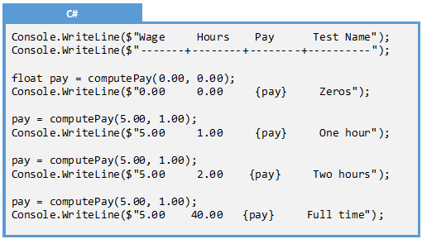
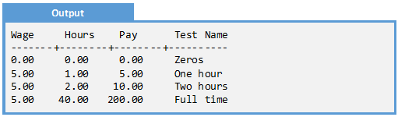
Overview of Drivers
A driver is a simple function or program designed to test another function or program by generating input parameters and validating output parameters. This makes it possible to easily run through a large number of test cases

Slide 7
Types of Drivers
There are five types of drivers, presented in increasing order of sophistication:
Ad- Hoc
Ad hoc drivers are a few lines of code added to a program to prompt the user for the parameters, call the function, and display the output
Commandeer
A commandeer driver is code putting in main to manually execute test cases
Driver Function
A driver function is a manual driver placed in a function making it easy to re-test a given function
Automation
Automation is a function used to automatically execute test cases
Test Runner
Test runners are functions used to execute all or part of the automation in a project

Slide 8
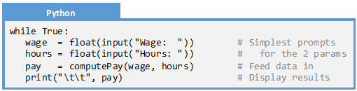
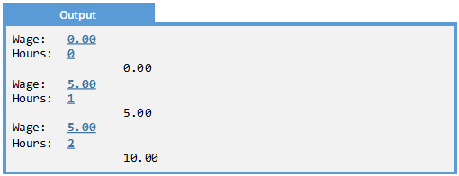
Type: Ad Hoc
Ad Hoc
Ad hoc drivers are a few lines of code added to a program to prompt the user for the parameters, call the function, and display the output
Commandeer
Driver Function
Automation
Test Runner

Slide 9
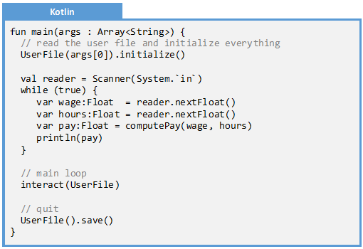
Type: Commandeer
Ad Hoc
A commandeer driver is code putting in main to manually execute test cases
Commandeer
Driver Function
Automation
Test Runner

Slide 10
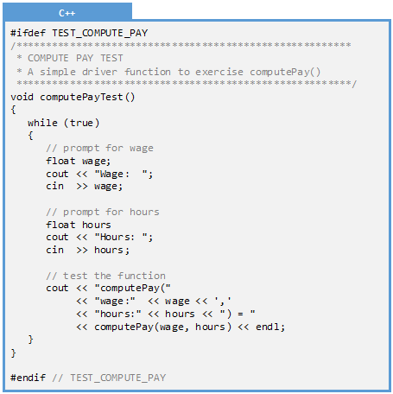
Type: Driver Function
Ad Hoc
A driver function is a manual driver placed in a function making it easy to re-test a given function
Commandeer
Driver Function
Automation
Test Runner

Slide 11
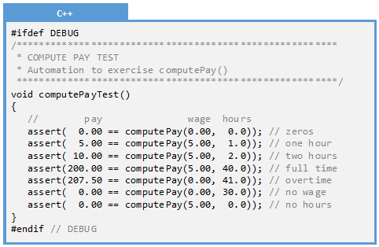
Type: Automation
Ad Hoc
Automation is a function used to automatically execute test cases
Commandeer
Driver Function
Automation
Test Runner

Slide 12
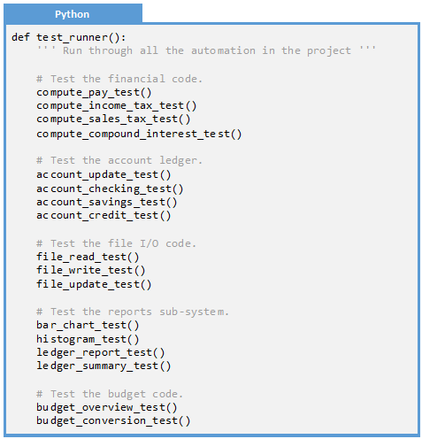
Type: Test Runner
Ad Hoc
Test runners are functions used to execute all or part of the automation in a project
Commandeer
Driver Function
Automation
Test Runner

Slide 13
Examples
Example 15.1: Driver Function
Example 15.2: Automation
Example 15.3: Automation

Slide 14

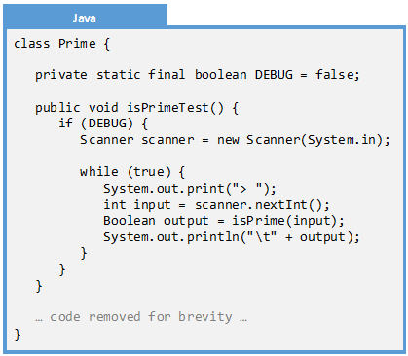
Example 15.1: Driver Function
Q: Create a driver program to facilitate testing the isPrime() function:
A: Couple properties:
Since this is a manual driver, we will be prompting the user for input to the function. Our function takes one input so a single prompt will be used
Note that drivers should be debug-only. Since Java does not have pre-compiler directives, we will surround the driver code in a static constant called DEBUG. This will inform the interpreter that the code is to be skipped when DEBUG is set to false

Slide 15
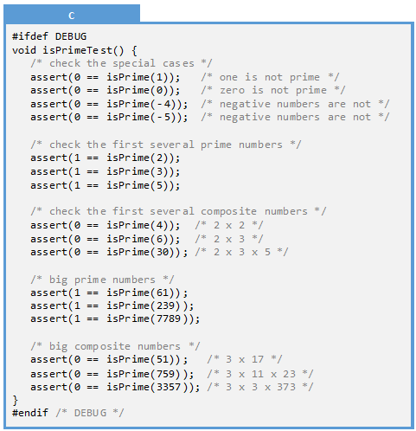
Example 15.2: Automation
Q: Create a driver program to facilitate testing the isPrime() function
A: The function has the following properties:
Our automation will perform an exhaustive test through the first 50 primes. It will run through all the values from -239 to 239

Slide 16
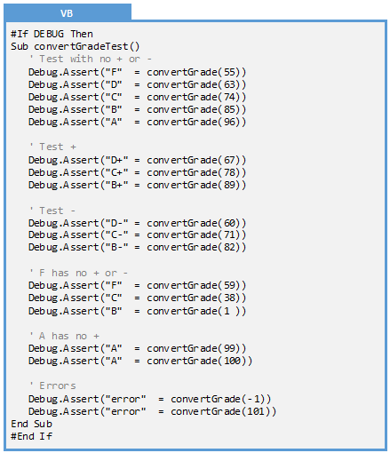

Example 15.3: Automation
Q: Create a driver program to facilitate testing the convertGrade() function:
A: We are going to perform an exhaustive test on all the valid grades in the range. To do this, we will enumerate the letter grade and sign of all the grades between 0% and 100%, then all the negative values, then all the numbers greater than 100%.

Slide 17
Exercises
Exercise 15.1: Types of Drivers
Exercise 15.2: Scenarios
Exercise 15.3: Type of Driver
Exercise 15.4: Fact or Fiction

Slide 18
Exercise 15.1: Types of Drivers
Match the driver name with the definition.
Executes test cases without human intervention
Driver Function
Manual test code in its own function
Ad hoc
A simple while loop, prompt, and function call
Automation
Code used to launch many automation functions
Commandeer
Code added to main() to test a function
Test Runner

Slide 19
Exercise 15.2: Scenarios
In each of the following scenarios describe the type of driver that would best be utilized.
Scenario
I am writing a new function and, before I get it to work, I would like to write a function that will be used to manually exercise it
Before beginning work on a given function, I would like to call an existing driver function once to make sure everything works
I would like to execute all the automation before I release my code to the client
I would like to add some quick code to validate one small part of a function before I write the rest
I would like to encode all my test cases in a single function so I can easily verify that this function works as expected
Driver Function: This code is written before the main function, so it appears to be somewhat permanent. This would rule out Ad-Hoc. There is no indication it is automation of any kind
Commandeer: It is easy to call a given driver function or automation: just add the function call to the beginning of main().
Test Runner: Execution of the test runner is the easiest way to execute all the automation in the system (assuming there is a test suite!)
Ad Hoc: This can be added even in the middle of the function that is currently under development.
Automation: All the test cases are enumerated in our function, making it easy to run through them all

Slide 20
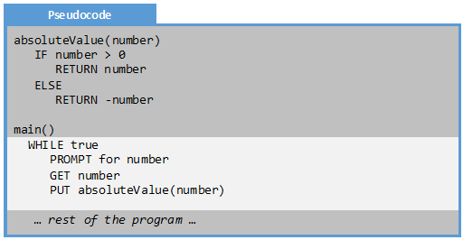
Exercise 15.3: Type of Driver
What type of driver is utilized in the highlighted code?
A: Commandeer
Code is added to main that will execute the ad-hoc driver and prevent the rest of the program from executing.

Slide 21
Exercise 15.4: Fact or Fiction
For each of the following, identify whether it is fact or whether it is fiction
Fact or Fiction
Ad hoc drivers are very complicated and expensive to implement
Driver functions should not exist in shipping code; only debug code!
Automation is a form of manual driver
A test runner executes many automation driver functions
The commandeer technique is used in conjunction with ad hoc drivers
Fiction: Ad hoc drivers should take only a few moments to implement
Fact: When technology allows, remove driver code from the shipping executable. This can be done with pre-compiler directives or by putting driver code in separate files
Fiction: Automation does not involve user input whereas manual drivers do
Fact: A test suite is just a simple function that executes all the automation in the project
Fact: The commandeer technique takes over the normal execution of the program. This is done using a WHILE loop in an ad hoc driver.

Slide 22
Problems
Problem 15.1: Dollar From Euro
Problem 15.2: Is Leap Year
Problem 15.3: Compute Tax
Problem 15.4: Search
Challenge 15.1: Insertion Sort
Challenge 15.2: Fibonacci
Challenge 15.3: Sudoku

Slide 23

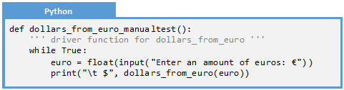
Problem 15.1: Dollar from Euro Manual
Create a manual driver for this function which converts euros to dollars.
Run the following test cases and report any bugs:
Name | Inputs | Outputs | Rationale
Typical whole number | €1 | $1.13 | Typical easy number
Round down | €0.88 | $0.99 | 0.9944 rounds down to 0.99
Round up at 0.5 | €0.50 | $0.57 | 0.565 rounds up to 0.57
Round up | €0.89 | $1.01 | 1.0056999 rounds up to 1.01
Typical negative number | -€1 | -$1.13 | Typical easy number, no rounding
Negative round up | -€.50 | -$0.56 | -0.565 rounds to -0.56
Zero | €0 | $0 | zero
Very small | €0.01 | $0.01 | smallest common unit: 0.0113 rounds to 0.01
Very very small | €0.00000001 | $0.00 | Should go to zero: 0.0000000113 rounds to 0.00
negative large | -€0.01 | -$0.01 | largest negative common unit
negative approaching zero | -€0.00000001 | -$0.00 | Should go to zero
Max number of euro cents | €19,004,280.06 | $21,474,836.47 | Enough dollars to yield max euro assuming signed integer for cents
Max number of cents | €21,474,836.47 | $24,266,565.21 | Max dollars assuming signed integer for cents. Euro is bigger
Max long int euro cents | €81,622,761,388,095,350.00 | $92,233,720,368,547,728.00 | To max euro assuming a long number of cents
Notes:
def dollars_from_euro(euro):
''' Convert dollars from euros ''''
return round(euro * 1.13, 2)

Slide 24
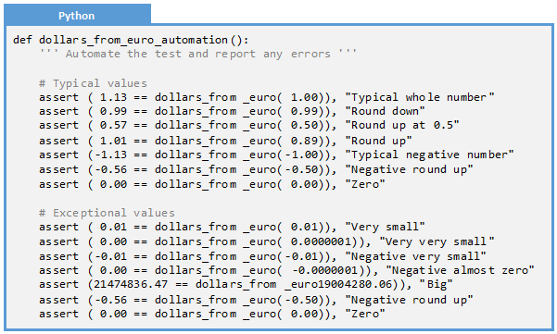
Problem 15.1: Dollar from Euro Automation
Create automation for our currency conversion program. Run the automation and report any errors.
Name | Inputs | Outputs | Rationale
Typical whole number | €1 | $1.13 | Typical easy number
Round down | €0.88 | $0.99 | 0.9944 rounds down to 0.99
Round up at 0.5 | €0.50 | $0.57 | 0.565 rounds up to 0.57
Round up | €0.89 | $1.01 | 1.0056999 rounds up to 1.01
Typical negative number | -€1 | -$1.13 | Typical easy number, no rounding
Negative round up | -€.50 | -$0.56 | -0.565 rounds to -0.56
Zero | €0 | $0 | zero
Very small | €0.01 | $0.01 | smallest common unit: 0.0113 rounds to 0.01
Very very small | €0.00000001 | $0.00 | Should go to zero: 0.0000000113 rounds to 0.00
negative large | -€0.01 | -$0.01 | largest negative common unit
negative approaching zero | -€0.00000001 | -$0.00 | Should go to zero
Max number of euro cents | €19,004,280.06 | $21,474,836.47 | Enough dollars to yield max euro assuming signed integer for cents
Max number of cents | €21,474,836.47 | $24,266,565.21 | Max dollars assuming signed integer for cents. Euro is bigger
Max long int euro cents | €81,622,761,388,095,350.00 | $92,233,720,368,547,728.00 | To max euro assuming a long number of cents

Slide 25
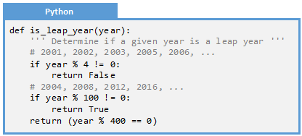
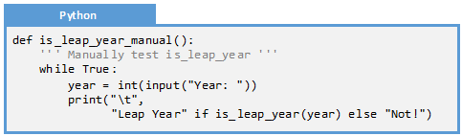
Problem 15.2: Is Leap Year
Create a manual driver for this function which determines if a given year is a leap year.
Run the following test cases and report any bugs
Name | Inputs | Outputs | Rationale
Typical non-leap year | 2001 | False | Between quad years
Typical leap year | 2004 | True | On the quad year
Typical century | 2100 | False | On the century
Quad century | 2000 | True | On the quad century
First Gregorian year | 1753 | False | Between quad years
Last Julian year | 1752 | Error | Not covering that year, out of range
Zero year | 0 | Error | Not covering that year, out of range
Negative year | -1 | Error | Not covering that year, out of range
Notes:
def is_leap_year(year):
''' Determine if a given year is a leap year '''
# 2001, 2002, 2003, 2005, 2006, ...
if year % 4 != 0:
return False
# 2004, 2008, 2012, 2016, ...
if year % 100 != 0:
return True
return (year % 400 == 0)

Slide 26
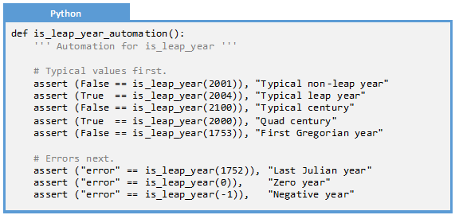
Problem 15.2: Is Leap Year Automation
Create automation for our leap year function. Run the automation and report any errors.
Name | Inputs | Outputs | Rationale
Typical non-leap year | 2001 | False | Between quad years
Typical leap year | 2004 | True | On the quad year
Typical century | 2100 | False | On the century
Quad century | 2000 | True | On the quad century
First Gregorian year | 1753 | False | Between quad years
Last Julian year | 1752 | Error | Not covering that year, out of range
Zero year | 0 | Error | Not covering that year, out of range
Negative year | -1 | Error | Not covering that year, out of range

Slide 27
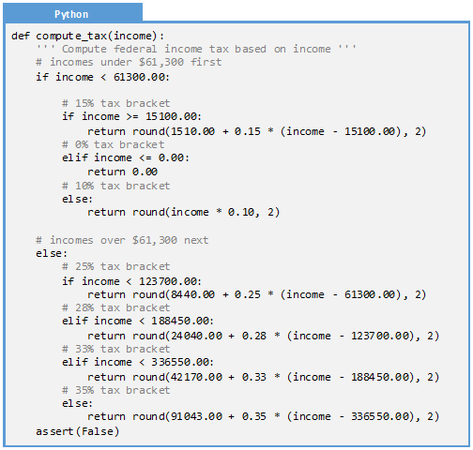
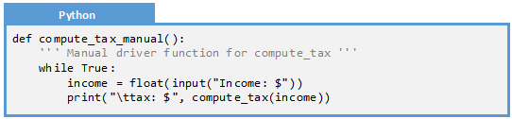
Problem 15.3: Compute Tax
Create a manual driver for this function which computes tax burden based on income.
Notes:
def compute_tax(income):
''' Compute federal income tax based on income '''
# incomes under $61,300 first.
if income < 61300.00:
# 15% tax bracket.
if income >= 15100.00:
return round(1510.00 + 0.15 * (income - 15100.00), 2)
# 0% tax bracket.
elif income <= 0.00:
return 0.00
# 10% tax bracket.
else:
return round(income * 0.10, 2)
# incomes over $61,300 next.
else:
# 25% tax bracket.
if income < 123700.00:
return round(8440.00 + 0.25 * (income - 61300.00), 2)
# 28% tax bracket.
elif income < 188450.00:
return round(24040.00 + 0.28 * (income - 123700.00), 2)
# 33% tax bracket.
elif income < 336550.00:
return round(42170.00 + 0.33 * (income - 188450.00), 2)
# 35% tax bracket.
else:
return round(91043.00 + 0.35 * (income - 336550.00), 2)
assert(False)

Slide 28
Problem 15.3: Compute Tax Manual
Run the following test cases through your driver:
Name | Inputs | Outputs | Rationale
Zero | $0 | $0 | No income, no tax
Dime | $.10 | $.01 | Penny tax for a dime
Typical 10% | $10,000 | $1,000 | 10%
Top end of 10% | $15,099.99 | $1,510.00 | $1,509.999 rounds to $1,510.00
On the 10-15% boundary | $15,100.00 | $1,510.00 | Should be the same if computed as 10% or 15% bracket
Bottom of 15% | $15,100.01 | $1,510.00 | $1,510.0015 rounds to $1,510.00
Typical 15% | $50,000.00 | $6,745.00 | No rounding of any kind
Top end of 15% | $61,299.99 | $8,440.00 | $8,439.9985 rounds to $8,400.00
On the 15%-25% boundary | $61,300.00 | $8,440.00 | Should be the same if computed as 15% or 25% bracket
Bottom of 25% | $61,300.01 | $8,440.00 | $8,440.0025 rounds to $8440.00
Typical 25% | $100,000.00 | $18,115.00 | No rounding of any kind
Top end of 25% | $123,699.99 | $24,040.00 | $24,039.9975 rounds to $24,040.00
On the 25%-28% boundary | $123,700.00 | $24,040.00 | Should be the same if computed as 25% or 28% bracket
Very small negative | -$0.01 | $0 | No tax for those who loose money
Typical negative | -$10,000 | $0 | No tax for those who loose money

Slide 29
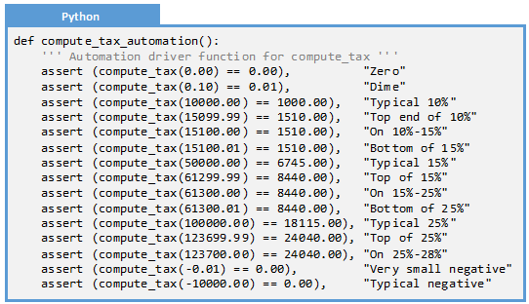
Problem 15.3: Compute Tax Automation
Create an automation driver function with the following test cases:
Name | Inputs | Outputs | Rationale
Zero | $0 | $0 | No income, no tax
Dime | $.10 | $.01 | Penny tax for a dime
Typical 10% | $10,000 | $1,000 | 10%
Top of 10% | $15,099.99 | $1,510.00 | $1,509.999 rounds to $1,510.00
On the 10-15% boundary | $15,100.00 | $1,510.00 | Should be the same if computed as 10% or 15% bracket
Bottom of 15% | $15,100.01 | $1,510.00 | $1,510.0015 rounds to $1,510.00
Typical 15% | $50,000.00 | $6,745.00 | No rounding of any kind
Top of 15% | $61,299.99 | $8,440.00 | $8,439.9985 rounds to $8,400.00
On the 15%-25% boundary | $61,300.00 | $8,440.00 | Should be the same if computed as 15% or 25% bracket
Bottom of 25% | $61,300.01 | $8,440.00 | $8,440.0025 rounds to $8440.00
Typical 25% | $100,000.00 | $18,115.00 | No rounding of any kind
Top of 25% | $123,699.99 | $24,040.00 | $24,039.9975 rounds to $24,040.00
On the 25%-28% boundary | $123,700.00 | $24,040.00 | Should be the same if computed as 25% or 28% bracket
Very small negative | -$0.01 | $0 | No tax for those who loose money
Typical negative | -$10,000 | $0 | No tax for those who loose money

Slide 30
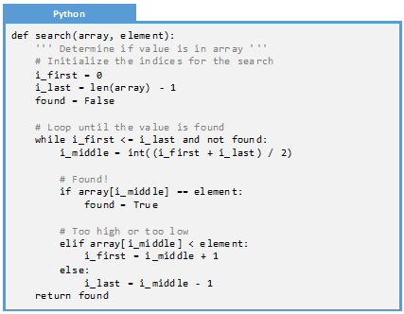
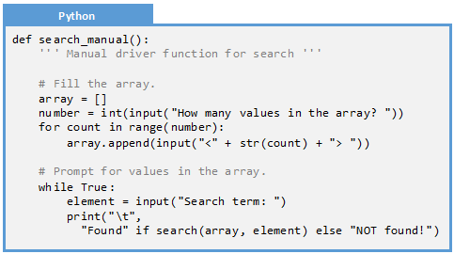
Problem 14.4: Search
Create a manual driver for a function that determines if a given element is in an array. This utilizes the “advances search” algorithm from Challenge 02.1
Notes:
def search(array, element):
''' Determine if value is in array. '''
# Initialize the indices for the search.
i_first = 0
i_last = len(array) - 1
found = False
# Loop until the value is found.
while i_first <= i_last and not found:
i_middle = int((i_first + i_last) / 2)
# Found!
if array[i_middle] == element:
found = True
# Too high or too low.
elif array[i_middle] < element:
i_first = i_middle + 1
else:
i_last = i_middle - 1
return found

Slide 31

Problem 14.4: Search Manual
Execute manual tests on the search function using the following test cases:
Name | Inputs | Outputs | Rationale
Empty list | {}, 0 | False | Empty list always returns false
Trivial list, not found | {0}, 1 | False | Number not in the trivial list
Trivial list, found | {0}, 0 | True | Number in the trivial list
Even number, too big | {0, 2}, 4 | False | Not in the range
Even number, in between | {0, 2}, 1 | False | Between the numbers
Even number, too small | {0, 2}, -1 | False | Not in the range
Even number, first element | {0, 2}, 0 | True | Beginning of the list
Even number, second element | {0, 2}, 2 | True | End of the list
Odd number, too big | {0, 2, 4}, 6 | False | Not in the range
Odd number, in between | {0, 2, 4}, 3 | False | Between the numbers
Odd number, too small | {0, 2, 4}, -1 | False | Not in the range
Odd number first element | {0, 2, 4}, 0 | True | Beginning of the list
Odd number second element | {0, 2, 4}, 2 | True | Middle of the list
Odd number last element | {0, 2, 4}, 4 | True | End of the list
List out of order | {4, 2, 0}, 5 | Error | List is not sorted, but it should be!

Slide 32
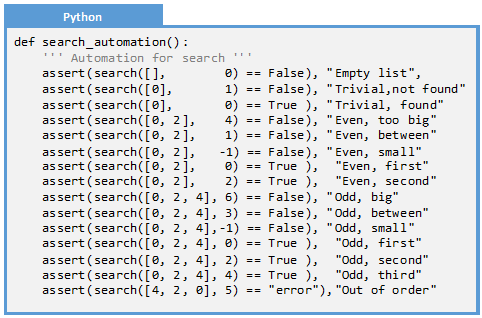
Problem 14.4: Search Automation
Create automation to exercise the search function using the following test cases:
Name | Inputs | Outputs | Rationale
Empty list | {}, 0 | False | Empty list always returns false
Trivial list, not found | {0}, 1 | False | Number not in the trivial list
Trivial list, found | {0}, 0 | True | Number in the trivial list
Even number, too big | {0, 2}, 4 | False | Not in the range
Even number, in between | {0, 2}, 1 | False | Between the numbers
Even number, too small | {0, 2}, -1 | False | Not in the range
Even number, first element | {0, 2}, 0 | True | Beginning of the list
Even number, second element | {0, 2}, 2 | True | End of the list
Odd number, too big | {0, 2, 4}, 6 | False | Not in the range
Odd number, in between | {0, 2, 4}, 3 | False | Between the numbers
Odd number, too small | {0, 2, 4}, -1 | False | Not in the range
Odd number first element | {0, 2, 4}, 0 | True | Beginning of the list
Odd number second element | {0, 2, 4}, 2 | True | Middle of the list
Odd number last element | {0, 2, 4}, 4 | True | End of the list
List out of order | {4, 2, 0}, 5 | Error | List is not sorted, but it should be!

Slide 33
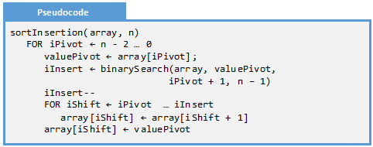
Challenge 15.1: Insertion Sort
A sort is an algorithm which converts an un-ordered array of values into a sorted array. Each element in the sorted array a_{i}, we know that a_{i} ≤ a_{i+1}. The following algorithm performs the insertion sort.
Implement this function in the programming language of your choice.
Create a list of test cases for this function. Use what you created from Challenge 14.1 if you previously completed that problem.
Create a manual driver function to facilitate testing this function. Test this function with your test cases.
Create an automated driver function to run through your test cases.

Slide 34
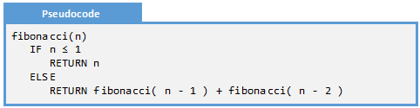
Challenge 15.2: Fibonacci
The Fibonacci value for a given number can be computed by adding the previous two values in the sequence:
Implement this function in the programming language of your choice.
Create a list of test cases for this function. Use what you created from Challenge 14.2 if you previously completed that problem.
Create a manual driver function to facilitate testing this function. Test this function with your test cases.
Create an automated driver function to run through your test cases.

Slide 35

Challenge 15.3: Sudoku
Consider the game of Sudoku:
Sudoku is a numbers game played on a 9x9 grid. The object of the game is to fill in the 9x9 grid while honoring certain constraints: 1) There is no more than one instance of a given number on a given row, 2) There is no more than one instance of a given number on a given column, and 3) There is no more than one instance of a given number on an inside square (the 3x3 squares embedded in the 9x9 grid)
We are particularly interested in the function which determines whether a given value is legal in a given square in the grid
Implement this function in the programming language of your choice.
Create a list of test cases for this function. Use what you created from Challenge 14.3 if you previously completed that problem.
Create a manual driver function to facilitate testing this function. Test this function with your test cases.
Create an automated driver function to run through your test cases.

