Slide 1
Week 08: Recursion
Lab 07 was due on Saturday
Chapter 16 reading is due
Lab 08 is due this Saturday
Review the solution to Lab 07
Answer questions about the reading
Go through the reading quiz
Answer questions about Lab 08
Work through some problems
D&C 53:2
D&C 46:33

Slide 2
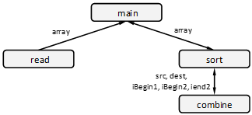
Lab 07: Sub-List Sort Design – Structure Chart

Slide 3
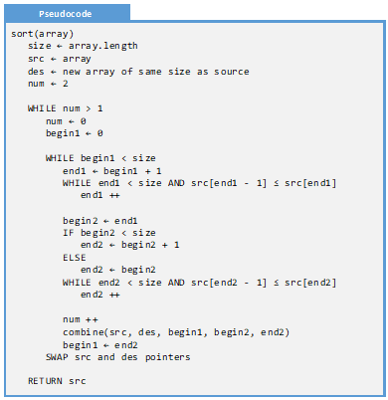
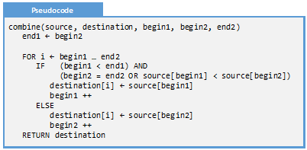
Lab 07: Sub-List Sort Design – Pseudocode

Slide 4
Lab 08: Sub-List Sort Analysis
Verify the algorithm we designed last week to conduct a sub-list sort:
Modularization Metrics
Include a copy of the structure chart you are working off of. This could be the structure chart you produced last week, or it could be the key presented by the instructor. For every function in the structure chart, determine the cohesion and coupling level
Algorithmic Metrics
Include a copy of the pseudocode you are working off of. Determine the algorithmic efficiency of the sorting component of the algorithm.
Test Cases
Identify a collection of test cases for your program. For each test case, identify the provided input and expected output.
Trace Verification
Conduct a program trace on two representative test cases

Slide 5
Content
Overview of Recursion
Recursion’s Two Parts
Recursion Dissected
Recursion and the Call Stack
Head and Tail Recursion
Functional Decomposition
Program Trace

Slide 6
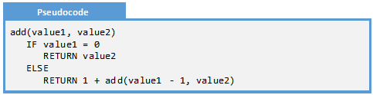

Overview of Recursion
Recursion is a problem-solving technique where a solution is reached by subdividing a large problem into smaller ones. These smaller problems are then fed back on the original function
Recursion is easy to spot on a structure chart: A function call circles back on itself.

Slide 7
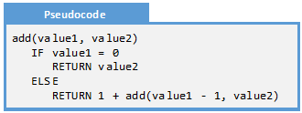
Recursion’s Two Parts
In most looping problems, there are two fundamental questions: how do you know when to stop and how to you progress towards the solution. These two steps are also present in every recursive algorithm: the end condition and the progress step
Part | Description
End Condition | How the function knows that it has found the solution. Typically, the end condition is trivial: when the return value for a given input is obvious
Progress Step | The process of taking the larger problem and breaking it into a smaller pieces, each of which are closer to the end condition

Slide 8


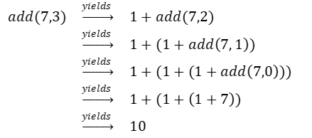
Recursion Dissected
Now let’s say, for the sake of argument, that we do not have the plus operator defined for all numbers. In fact, we can only add by one and subtract by one. This forces us to write a loop:
This means there are two cases: the end condition when one size is zero, and the progress condition
When we add 7 and 3, the following progression occurs:

Slide 9

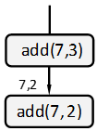
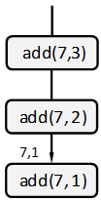
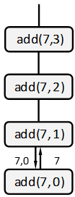
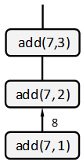
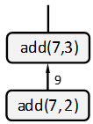

Recursion and the Call stack
When a recursive function gets called, there are two distinct phases: when all the function calls get added to the call-stack and when the function returns, and the call-stack is emptied. With recursion, we have the choice: do we do most of the work when items are being added to the call-stack or when the function is returning from the call-stack?
Time

Slide 10
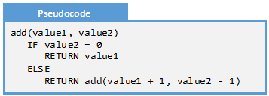
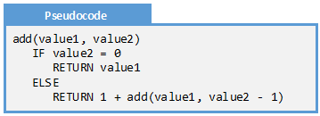
Head and Tail Recursion
Head Recursion
Tail Recursion
Head recursion first builds the call-stack and then does the computation as the functions are returned. This is characterized by operations done on the result of the recursive call. By the time the end condition is reached, no work has yet been done
Tail recursion performs the most expensive operation in the parameters being passed into the recursive function. By the time the end condition is reached, the solution is found and the only remain task is to unwind the call-stack.
add(7,3) = 1 + add(7, 2)
= 1 + 1 + add(7, 1)
= 1 + 1 + 1 + add(7, 0)
= 1 + 1 + 1 + 7
add(7,3) = add(7 + 1, 2)
= add(7 + 1 + 1, 1)
= add(7 + 1 + 1 + 1, 0)
= 10

Slide 11
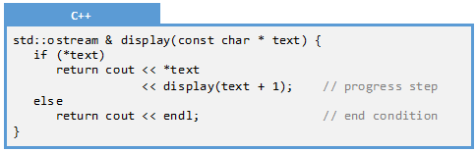
Functional Decomposition
Functional decomposition is the process of substituting a function call for the results of a function. With a traditional function call, this is a one-step process. With recursion, there are many: one step is required for every recursive call.
Functional Decomposition
display({'H', 'e', 'l', 'l', 'o', '\0'});
cout << 'H' << display({'e', 'l', 'l', 'o', '\0'});
cout << 'H' << 'e' << display({'l', 'l', 'o', '\0'});
cout << 'H' << 'e' << 'l' << display({'l', 'o', '\0'});
cout << 'H' << 'e' << 'l' << 'l' << display({'o', '\0'});
cout << 'H' << 'e' << 'l' << 'l' << 'o' << display({'\0'});
cout << 'H' << 'e' << 'l' << 'l' << 'o' << endl;

Slide 12
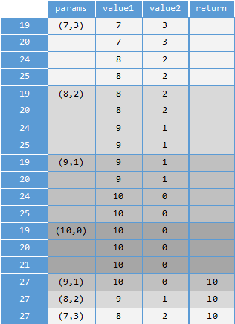
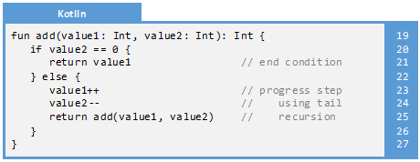
Program Trace
Since recursion completely maintains state through the input parameters, we can capture the state by adding a column representing the input parameters.

Slide 13
Examples
Example 16.1: List Traversal
Example 16.2: Factorial
Example 16.3: Decimal to Binary
Decomposition
Example 16.4: Decimal to Binary
Trace

Slide 14
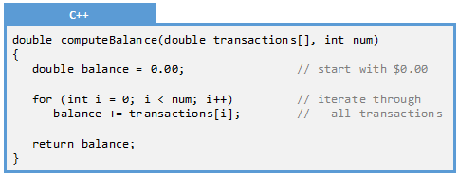
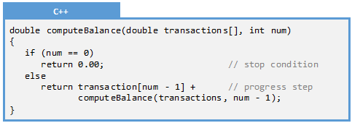
Example 16.1: List Traversal
Q: Convert the following loop into a recursive solution
A: Two parts:
End condition is when num == 0
Progress: add a transaction and decrease the value of num

Slide 15
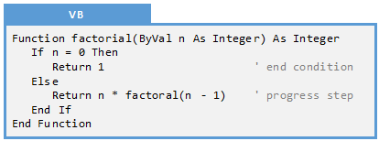
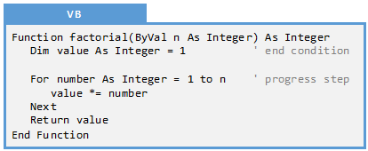
Example 16.2: Factorial
Q: Create an iterative solution from the following recursive one:
A: We are counting from 1 to n.

Slide 16
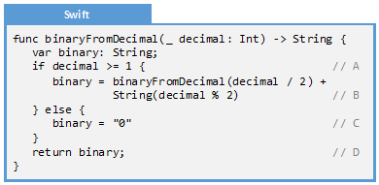
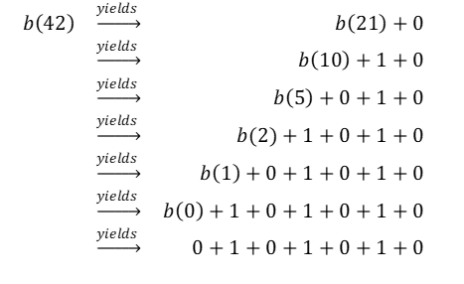
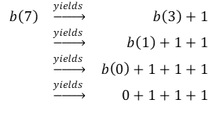
Example 16.3: Functional Decomposition
Q: Consider the following recursive solution to compute the binary values for a decimal number
Create a functional decomposition for two values: 7 and 42

Slide 17
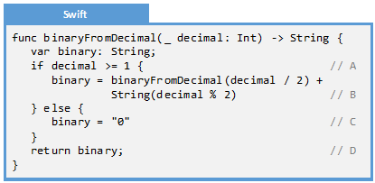
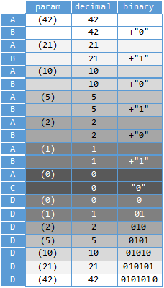
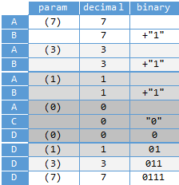
Example 16.4: Trace
Q: Create two trace for the values: 7 and 42

Slide 18
Exercises
Exercise 16.1: Define Recursion
Exercise 16.2: Fact or Fiction
Exercise 16.3: Name the Algorithm
Exercise 16.4: Name the Algorithm
Exercise 16.5: Name the Algorithm

Slide 19
Exercise 16.1: Define Recursion
Q: In your own words, define “recursion” in a way that a non-technical person could understand it. Hint: do not use the word “function.”
A: Many possible answers:
Recursion is the process of breaking a large problem into smaller ones. Each smaller problem is solved by performing the same operation we used to solve the larger one.
The repeated application of a procedure or operation, each time operating on a smaller version of the larger problem.
A method of solving a problem where the solution depends on solutions to smaller instances of the same problem (as opposed to iteration).
In the recursive program, the solution to the base case is provided and the solution of the bigger problem is expressed in terms of smaller problems.
The process of defining a problem (or the solution to a problem) in terms of (a simpler version of) itself.

Slide 20
Exercise 16.2: Fact or Fiction
For each of the following, determine whether it is fact or whether it is fiction.
Fact or Fiction
All recursive solutions need to have an end condition
Tail recursion does most of the work as functions are removed from the call-stack
Multi-recursion is generally a good programming practice
Any iterative algorithm can be turned into a recursive algorithm
Recursive solutions are generally as fast as iterative solutions
Indirect recursion is generally a good programming practice
Fact: If not, then the program will never stop. The end condition is an essential step.
Fiction: Head recursion works this way. Tail recursion is when most of the work is done as stuff is put on the call stack
Fiction: Multi-recursion often results in O(2^{n}) which is extremely expensive for very small n
Fact: Most of the time, the iterative solution is faster though sometimes the recursive solution can be more elegant
Fiction: There is a lot of overhead for recursive solutions. They tend to be slower than iterative ones
Fiction: Indirect recursion is often unintentional and not obvious. It should generally be avoided.

Slide 21
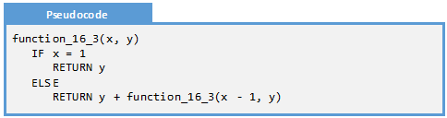
Exercise 16.3: Name the Algorithm
Q: What would be the best name for the following recursive algorithm:
A: multiply
function_16_3(4,3) = 3 + function_16_3(3, 3) = 3 + 3 + function_16_3(2, 3) = 3 + 3 + 3 + function_16_3(1, 3) = 3 + 3 + 3 + 3 = 12
Notice that we add ‘y’ a total of ‘x’ times.
x * y

Slide 22
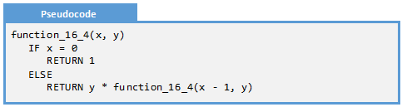
Exercise 16.4: Name the Algorithm
Q: What would be the best name for the following recursive algorithm:
A: exponent
function_16_4(4,3) = 3 * function_16_4(3, 3) = 3 * 3 * function_16_4(2, 3) = 3 * 3 * 3 * function_16_4(1, 3) = 3 * 3 * 3 * 3 * function_16_4(0, 3) = 3 * 3 * 3 * 3 * 1 = 81
Notice that we multiply ‘y’ to itself a total of ‘x’ times.
Y^{x}

Slide 23

Exercise 16.5: Name the Algorithm
Q: What would be the best name for the following recursive algorithm:
A: addition
function_16_5(4,3) = 1 + function_16_5(3, 3) = 1 + 1 + function_16_5(2, 3) = 1 + 1 + 1 + function_16_5(1, 3) = 1 + 1 + 1 + 1 + function_16_5(0, 3) = 1 + 1 + 1 + 1 + 3 = 7
Notice that we increment ‘y’ a total of ‘x’ times.
x + y

Slide 24
Problems
Problem 16.1: Find Highest
Problem 16.2: Sum of Powers of 2
Problem 16.3: Display Names
Problem 16.4: Sum Digits
Problem 16.5: Reverse String
Problem 16.6: Fibonacci
Problem 16.7: Sum Digits
Problem 16.8: Reverse String
Problem 16.9: Fibonacci
Challenge 16.1: Search
Challenge 16.2: GCD

Slide 25
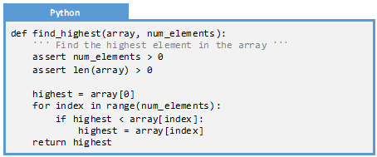
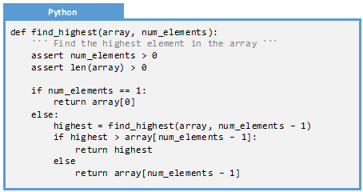
Problem 16.1: Find Highest
Given the following algorithm written iteratively, generate a recursive solution.

Slide 26
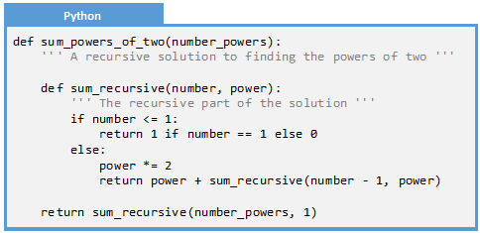
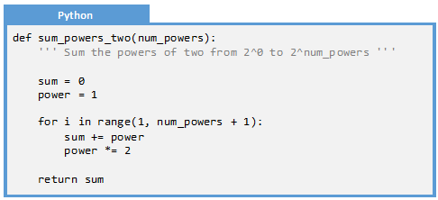
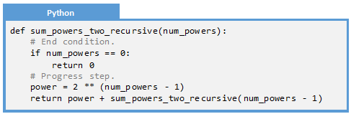
Problem 16.2: Sum Powers of Two
Given the following algorithm written iteratively, generate a recursive solution using a programming language of your choice

Slide 27
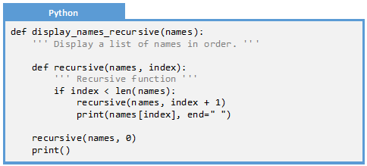
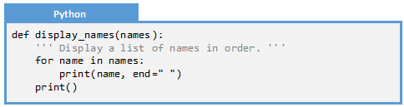
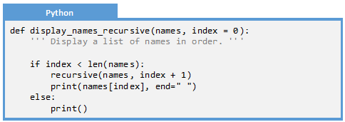
Problem 16.3: Display Names
Given the following algorithm written iteratively, generate a recursive solution.

Slide 28
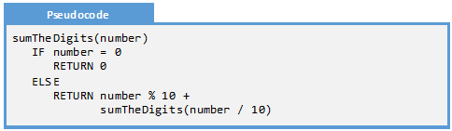
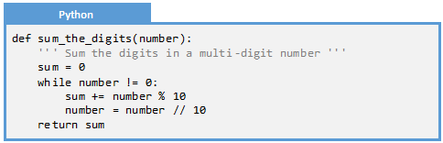
Problem 16.4: Sum The Digits
Given the following recursive algorithm, generate an iterative solution using a programming language of your choice.

Slide 29
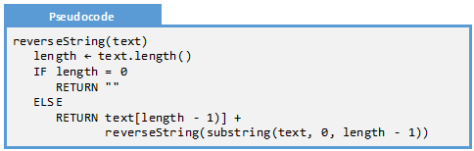
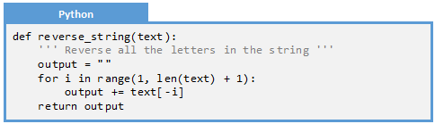
Problem 16.5: Reverse a String
Given the following recursive algorithm, generate an iterative solution using a programming language of your choice.

Slide 30
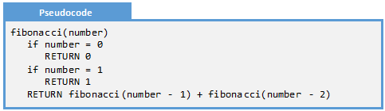
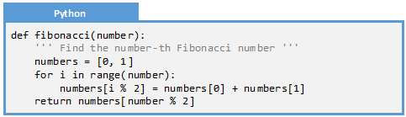
Problem 16.6: Fibonacci
Given the following recursive algorithm, generate an iterative solution using a programming language of your choice.

Slide 31
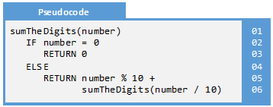
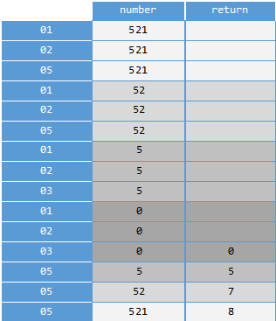
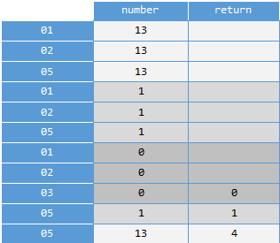
Problem 16.7: Sum The Digits
Using this algorithm compute the values sumTheDigits(13) and sumTheDigits(521) using the program trace method.

Slide 32
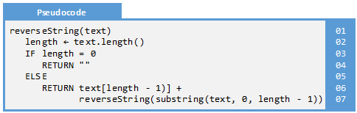
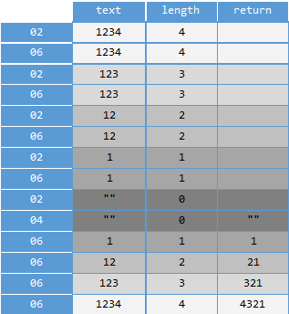
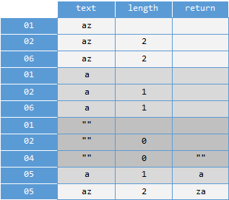
Problem 16.8: Reverse a String
Using this algorithm compute the values reverseString("az") and reverseString("1234") using the program trace method

Slide 33
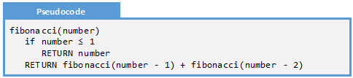
Problem 16.9: Fibonacci
Using this algorithm compute the values fibonacci(5) and fibonacci(6) using the functional decomposition method.
f(5) = f(4) + f(3)
= f(3) + f(2) + f(2) + f(1)
= f(2) + f(1) + f(1) + f(0) + f(1) + f(0) + 1
= f(1) + f(0) + 1 + 1 + 0 + 1 + 0 + 1
= 1 + 0 + 1 + 1 + 0 + 1 + 0 + 1
= 5
f(6) = f(5) + f(4)
= f(4) + f(3) + f(3) + f(2)
= f(3) + f(2) + f(2) + f(1) + f(2) + f(1) + f(1) + f(0)
= f(2) + f(1) + f(1) + f(0) + f(1) + f(0) + 1 + f(1) + f(0) + 1 + 1 + 0
= f(1) + f(0) + 1 + 1 + 0 + 1 + 0 + 1 + 1 + 0 + 1 + 1 + 0
= 1 + 0 + 1 + 1 + 0 + 1 + 0 + 1 + 1 + 0 + 1 + 1 + 0
= 8

Slide 34
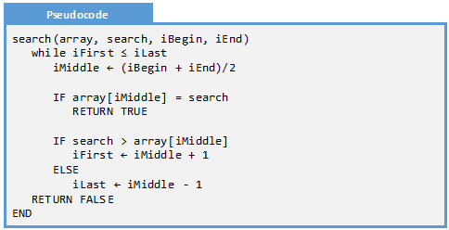
Challenge 16.1: Search
Consider the following search algorithm written as a loop:
First, generate a recursive solution in the programming language of your choice.
Second, based on the two solutions (the loop solution written in pseudocode and the recursive one you just completed), compare and contrast the solutions. Which is better from an efficiency and maintainability perspective

Slide 35


Challenge 16.1: Solution

Slide 36

Challenge 16.2: GCD
The greatest common divisor between two numbers is the largest positive integer that divides the two numbers without a remainder. Euclid developed an algorithm to describe this:
First, generate a recursive solution in the programming language of your choice.
Second, generate an iterative solution in the programming language of your choice.
Third, compare and contrast the two solutions. Which is better from an efficiency and maintainability perspective?

Slide 37


Challenge 16.2: Solution

