Slide 1
Week 09: Top-Down
Lab 08 was due on Saturday
Chapter 17 reading is due
Lab 09 is due this Saturday
Review the solution to Lab 08
Answer questions about the reading
Go through the reading quiz
Answer questions about Lab 09
Work through some problems
D&C 58:42
D&C 58:26

Slide 2
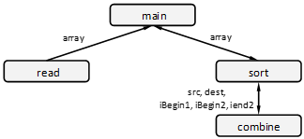
Lab 08: Sub-list Sort Analysis – Modularization
Read
Cohesion: Strong (only reads a file and does it completely).
Coupling: Encapsulated (no validation possible, convenient format)
Sort
Cohesion: Strong (only sorts numbers and it does that completely).
Coupling: Encapsulated (no validation possible, convenient format)
Combine
Cohesion: Strong (combines sub-lists and does it completely).
Coupling: Simple (parameter validation is required, but is easy to do)

Slide 3
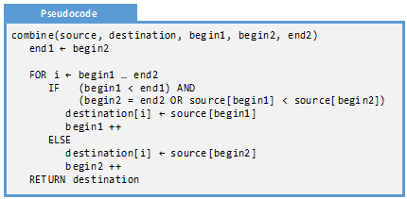
Lab 08: Sub-list Sort Analysis – Algorithm
O(1) : Takes one unit of time regardless of the size of the array
O(n) : Every element in the sub-arrays are visited once. If sub arrays double in size, then this loop takes twice as long
O(n) : Once per iteration of the loop
O(n) : This, combined with the ELSE, is executed once per iteration of the loop. Each statement itself is O(1)
O(1) : Since we are not making a copy, instead just returning a reference, this takes constant time.

Slide 4
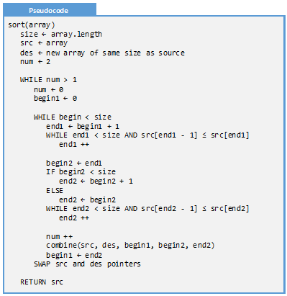
Lab 08: Sub-list Sort Analysis – Algorithm
O(1) : Just copying a reference
O(1) : Creating a blank array takes constant time
O(log n): Since the size of the sub-arrays basically double with every iteration, this is executed O(log n) times
O(n log n) : These three loops work together to visit every element in the array exactly once. Notice how end1 and end2 start at index 0 and stop when the end of the array is reached.
O(n log n) : This function is called several times per outer loop. If you add up the total cost per outer loop, you will see that every element is visited exactly once
O(n) : Return the results, in the source array

Slide 5
Lab 08: Sub-list Sort Analysis – Test Cases
Name | Input | Output
Empty | [] | []
Singular | [99] | [99]
Small sorted | [3, 6] | [3, 6]
Small unsorted | [6, 3] | [3, 6]
Sorted-even | [3, 12, 26, 38, 49, 59, 64] | [3, 12, 26, 38, 49, 59, 64]
Reversed-even | [64, 59, 49, 38, 26, 12, 3] | [3, 12, 26, 38, 49, 59, 64]
Sorted-odd | [3, 12, 26, 38, 49, 59, 64, 79] | [3, 12, 26, 38, 49, 59, 64, 79]
Reversed-odd | [79, 64, 59, 49, 38, 26, 12, 3] | [3, 12, 26, 38, 49, 59, 64, 79]
Duplicates | [31, 55, 99, 31, 49, 49] | [31, 31, 49, 49, 55, 99]

Slide 6
Lab 08: Sub-list Sort Analysis – Trace
Name | Input | Output
Two sorted sub-lists | [0, 2, 4, 6, 1, 3, 5, 7] | [0, 1, 2, 3, 4, 5, 6, 7]
Pseudocode
Line | begin1 | source[begin1] | begin2 | source[begin2] | i | destination
A | 0 | 0 | 4 | 1 | ? | ?, ?, ?, ?, ?, ?, ?, ?
B | 0 | 0 | 4 | 1 | 0 | ?, ?, ?, ?, ?, ?, ?, ?
C | 0 | 0 | 4 | 1 | 0 | ?, ?, ?, ?, ?, ?, ?, ?
D | 1 | 2 | 4 | 1 | 0 | 0, ?, ?, ?, ?, ?, ?, ?
B | 1 | 2 | 4 | 1 | 1 | 0, ?, ?, ?, ?, ?, ?, ?
C | 1 | 2 | 4 | 1 | 1 | 0, ?, ?, ?, ?, ?, ?, ?
E | 1 | 2 | 5 | 3 | 1 | 0, 1, ?, ?, ?, ?, ?, ?
B | 1 | 2 | 5 | 3 | 2 | 0, 1, ?, ?, ?, ?, ?, ?
C | 1 | 2 | 5 | 3 | 2 | 0, 1, ?, ?, ?, ?, ?, ?
D | 2 | 4 | 5 | 3 | 2 | 0, 1, 2, ?, ?, ?, ?, ?
B | 2 | 4 | 5 | 3 | 3 | 0, 1, 2, ?, ?, ?, ?, ?
C | 2 | 4 | 5 | 3 | 3 | 0, 1, 2, ?, ?, ?, ?, ?
E | 2 | 4 | 6 | 5 | 3 | 0, 1, 2, 3, ?, ?, ?, ?
B | 2 | 4 | 6 | 5 | 4 | 0, 1, 2, 3, ?, ?, ?, ?
C | 2 | 4 | 6 | 5 | 4 | 0, 1, 2, 3, ?, ?, ?, ?
D | 3 | 6 | 6 | 5 | 5 | 0, 1, 2, 3, 4, ?, ?, ?
combine(source, destination, begin1, begin2, end2)
end1 ← begin2 // A
FOR i ← begin1 … end2 // B
IF (begin1 < end1) AND
(begin2 = end2 OR
source[begin1] < source[begin2]) // C
destination[i] ← source[begin1]
begin1 ++ // D
ELSE
destination[i] ← source[begin2]
begin2 ++ // E
RETURN destination // F

Slide 7
Lab 09: Sub-list Program
Implement in Python the sub-list sort algorithm we designed two weeks ago and verified last week. The following is needed to turn this in:
Your source code
A demonstration video

Slide 8
Content
Top-Down
Design Process
Producing Structure Charts Iteratively
Steps in the Design Process
Step 0:
The System is a Component
Step 1:
Name the Component
Step 2:
Identify the Interfaces
Step 3:
Describe the Component
Step 4:
Identify the Sub-Components
Depth-First and Breadth-First
Stubs

Slide 9
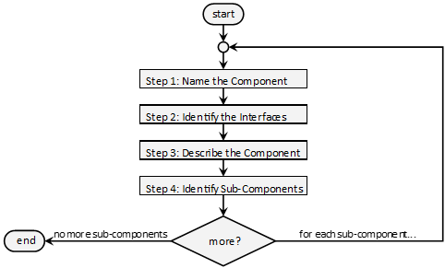
Top-Down Design Process
The top-down design process is a design algorithm where the system is described generally, then the main components are identified, and the sub-components are identified, and so on until base elements are described. This algorithm is inherently recursive.

Slide 10



Producing Structure Charts Iteratively
Structure charts are developed from the top down. Start with main(), then work to the functions main() calls direct, and so on until base elements are identified.

Slide 11
Steps in the Design Process
The top-down design process has four steps and a hidden step in the beginning.
Step 0: The system is a component
Step 1: Name the component
Step 2: Identify the interfaces
Step 3: Describe the component
Step 4: Identify the sub-components

Slide 12
Step 0: System Is A Component
Start with the overall system design. Usually this is represented with the function main() or whatever the starting function is with your programming language of choice.
The recursive top-down design process starts with main() and progresses until all the sub-systems are fully described.
Step 0: System
Step 1: Name
Step 2: Interfaces
Step 3: Describe
Step 4: Subs

Slide 13


Step 1: Name the Component
The adage goes “if you can’t name it, you don’t understand it.” This applies to all levels of software design. In the case of top-down design, naming a component or function is the first step towards understanding its purpose.
When naming a component, think cohesion. The function should do one thing and one thing only, and that one thing should be captured in the function name.
Step 0: System
Step 1: Name
Step 2: Interfaces
Structure Chart
Data Flow Diagram
Step 3: Describe
Step 4: Subs

Slide 14


Step 2: Identify the Interfaces
Identify the interfaces. The inputs into the component need to be listed and characterized. The outputs need to also be listed and characterized.
When doing this, think coupling. Is there a way that the interfaces can be simplified?
Step 0: System
Step 1: Name
Step 2: Interfaces
Structure Chart
Data Flow Diagram
Step 3: Describe
Step 4: Subs

Slide 15
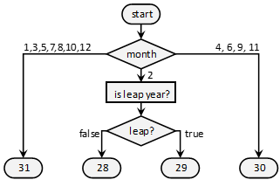
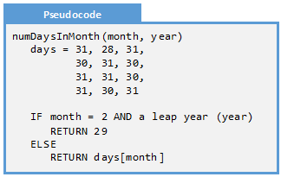
Step 3: Describe the Component
Figure out how the algorithm will work that the function/component represents. Start asking algorithmic efficiency questions and maintainability questions. Identify test cases, think about asserts, and even think about drivers.
Step 0: System
Step 1: Name
Flowchart
Pseudocode
Step 2: Interfaces
Step 3: Describe
Step 4: Subs

Slide 16
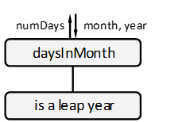
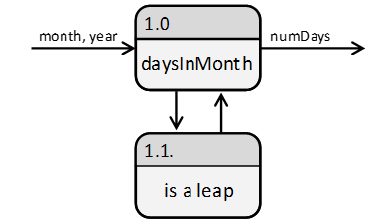
Step 4: Identify the Sub-Components
identify the sub-components that a given component may need in order to complete its task. While finishing this component, we will only have a vague idea about the sub-component. In fact, we can consider them to be “black boxes:” things that just work. These things will be worked out when we iterate on it.
Step 0: System
Step 1: Name
Structure Chart
Data Flow Diagram
Step 2: Interfaces
Step 3: Describe
Step 4: Subs

Slide 17
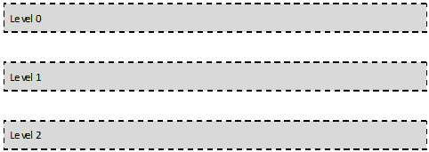









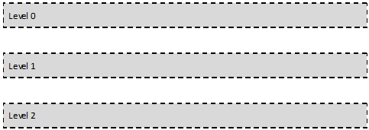









Breadth-First and Depth-First
Breadth-first means finishing level 1 before moving on to level 2.
Depth-first means finishing one branch before moving on to the next one.

Slide 18
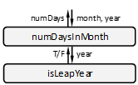
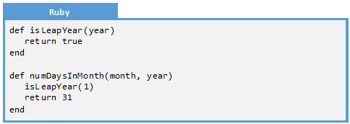
Stubs
A stub is a placeholder for a forthcoming replacing promising to be more complete. It is a tool enabling us to put placeholders in the codebase for all the functions in our structure chart.
Consider this structure chart:
The stubs would look something like this:

Slide 19
Examples
Example 17.1:
Stubs From Structure Chart
Example 17.2:
Stubs from
DFD
Example 17.3:
Top-Down Design
Example 17.4:
Top-Down Design

Slide 20
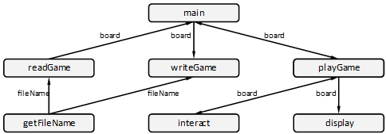
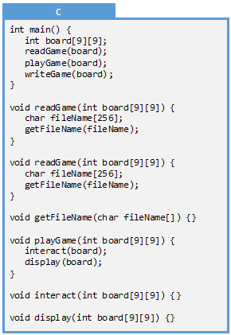
Example 17.1: Stubs from Structure Chart
Q: Create stubs for the following structure chart for a Sudoku program

Slide 21
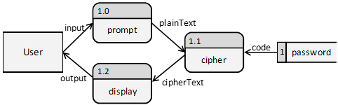
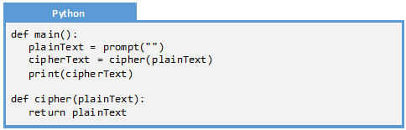
Example 17.2: Stubs from DFD
Q: Create stub functions for the following DFD for an encrypting program:
A: Every element in a structure chart is a function. The same is not true with DFDs. Note only are some things variables (such as the password item), but even process elements might not be functions

Slide 22

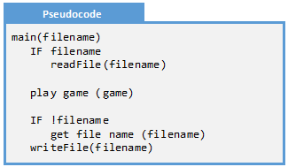
Example 17.3: Top-Down Design
Q: Perform the first iteration of top-down design for a program to play chess
A: There are four steps in a single iteration
  Name the Component: Since this component is the program, it is main()
  Identify the Interfaces: We need to accept the filename as a parameter
  Describe the Component:
  Identify the Sub-Components: There are four: 1) read the file, 2) write the game, 3) play the game, and 4) get the file name

Slide 23
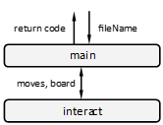
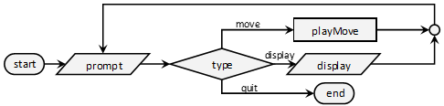
Example 17.4: Top-Down Design
Q: Perform the second iteration of top-down design for a program to play chess
A: There are four steps in the process
  Name the Component: This function is the main interactive element. We will call it interact()
  Identify the Interfaces:
  Describe the Component:
  Identify the Sub-Components: From our pseudocode, it is apparent there are sub-components: 1) prompt for a move, 2) play a move with updates the board and records the history, and 3) display the game

Slide 24
Exercises
Exercise 17.1:
Top-Down Steps
Exercise 17.2:
Fact or Fiction
Exercise 17.3:
Stub from Structure Chart
Exercise 17.4:
Stub from Structure Chart
Exercise 17.5:
Stub from DFD
Exercise 17.6:
Stub from DFD

Slide 25
Exercise 17.1: Top-Down Steps
Q: Order the steps in the top-down design process
Create the pseudocode or flow chart for the function
Recognize that the entire system is a component
Determine the input and output parameters
Figure out which functions will be called from this one
Name the function

Slide 26
Exercise 17.2: Fact or Fiction
For each of the following, identify whether it is fact or whether it is fiction
Fact or Fiction
The top-down process is recursive
A stub is a placeholder for a function to be written later
Bottom-up is for design (not development) activities
Design for cohesion in step 2 of the process
Larger project should be built iteratively involving the client
Top-down is for development (not design) activities
Fact: We perform one iteration per function/component that we are focusing on
Fact: Once all the function in the design have stubs in the program, we can develop the functions in any order we want
Fiction: Bottom-up is for development activities, top-down is for design activities
Fiction: Design for cohesion in step 1, design for coupling in step 2
Fact: For large projects, it is rare for the design team to know enough to completely design the entire project. Involve the client
Fiction: Bottom-up is for development activities, top-down is for design activities

Slide 27


Exercise 17.3: Stub from Structure Chart
Q: Write a stub for the function isPrime():
A:

Slide 28
Exercise 17.4: Stub from Structure Chart
Q: Write a stub for main() corresponding to the following structure chart:
A:

Slide 29


Exercise 17.5: Stub from DFD
Q: In the programming language of your choice, create a stub for computeTax() in the following DFD
A:

Slide 30


Exercise 17.6: Stub from DFD
Q: What would be the best stub for the getIncome() function in the following DFD?
A:

Slide 31
Problems
Problem 17.1:
Tic-Tac-Toe
Problem 17.2:
Calendar
Problem 17.3:
MadLib
Problem 17.4:
Sudoku
Challenge 17.1:
Tic-Tac-Toe
Challenge 17.2:
Calendar
Challenge 17.3:
MadLib
Challenge 17.1:
Sudoku

Slide 32
Problem 17.1: Tic-Tac-Toe
Consider the game Tic-Tac-Toe.
  The game of Tic-Tac-Toe is played in a 3x3 grid where players alternate putting X’s and O’s in the squares. The game in won when there are three X’s or three O’s in a horizontal, vertical, or diagonal row. The game allows the players to store and retrieve their game from a file. When a game is won or when all the squares are filled with an X or O, then the game is over and the program begins anew with an empty board.
For the game Tic-Tac-Toe, please do the following:
  Create a structure chart and pseudocode using the top-down design process
  For each function, identify the level of cohesion
  For each function, identify the level of coupling
  Create stubs for your design in the programming language of your choice

Slide 33
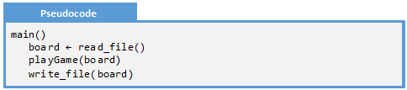

Problem 17.1: Round 1
Round 1
Round 1: the “system” is the entire program.
Round 2
Step 1: Name the Component
main(). It has strong cohesion by definition.
Step 2: Identify the Interfaces
Trivial coupling because there are no interfaces
Round 3
Step 3: Describe the Component
Round 4
Finish
Step 4: Identify the Sub-Components

Slide 34

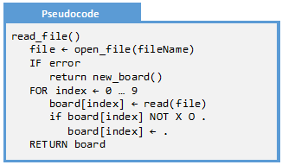
Problem 17.1: Round 2
Round 1
Round 2: the read a board component.
Round 2
Step 1: Name the Component
read_file(). It has strong cohesion because it does one thing
Step 2: Identify the Interfaces
Complex coupling because some validation needed for board
Round 3
Round 4
Finish
Step 3: Describe the Component
Step 4: Identify the Sub-Components
new_board()

Slide 35
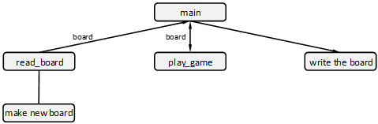
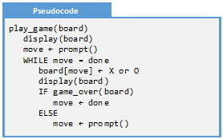

Problem 17.1: Round 3
Round 1
Round 3: the play game component
Step 1: Name the Component
play_game(). It has strong cohesion because it does one thing
Round 2
Step 2: Identify the Interfaces
Complex coupling because
some validation
needed
for
board
Round 3
Round 4
Step 3: Describe the Component
Finish
Step 4: Identify the Sub-Components

Slide 36
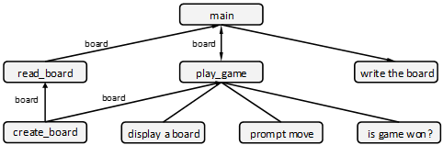
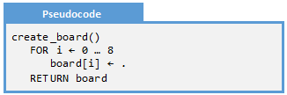
Problem 17.1: Round 4
Round 1
Round 4: the new board component
Step 1: Name the Component
create_board(). It has strong cohesion because it does one thing
Round 2
Step 2: Identify the Interfaces
Complex coupling because
some validation
needed
for
board
Round 3
Round 4
Step 3: Describe the Component
Finish
Step 4: Identify the Sub-Components
None

Slide 37
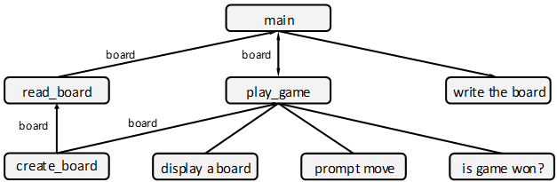
Problem 17.1: Final Rounds
Round 1
Can you complete the design process for the Tic-Tac-Toe game:
Round 2
Round 3
Round 4
Finish

Slide 38
Problem 17.2: Calendar
Consider the following problem definition.
  The “calendar” application places a calendar on the screen corresponding to a given month and year. The program will first prompt the user for the month and year, making sure the user input is within the accepted range (year greater than 1753 and month between 1 and 12). The program will then compute how many days there are in the month and the day of the week that the month begins on. The latter is computed by counting the number of days since 1/1/1753 which is a Monday. If the number of days is evenly divisible by 7, then it is a Monday.
For the calendar application, please do the following:
  Create a structure chart and pseudocode using the top-down design process
  For each function, identify the level of cohesion
  For each function, identify the level of coupling
  Create stubs for your design in the programming language of your choice

Slide 39
Problem 17.3: MadLib
Consider the game MadLib.
  Mad Libs is a word game where one player prompts another for a list of words to substitute for blanks in a story; these word substitutions have a humorous effect when the resulting story is then read aloud. The program will prompt the user for the file that describes the Mad Lib, and then prompt him for all the substitute words. When all the prompts are complete, the program will display the completed story on the screen.
For the MadLib application, please do the following:
  Create a structure chart and pseudocode using the top-down design process
  For each function, identify the level of cohesion
  For each function, identify the level of coupling
  Create stubs for your design in the programming language of your choice

Slide 40
Problem 17.4: Sudoku
Consider the following problem definition.
  Sudoku is a numbers game played on a 9x9 grid, subdivided into nine 3x3 inside squares. The game begins when a board is loaded from a file. The user is allowed to specify the number in a given location in the board by specifying the coordinates (such as “D3”) and the value. If a number does not fit, then an error is presented to the user and the board remains unchanged. This board consists of several numbers between 1 and 9 on the 9x9 grid with many spaces left blank. The objective of the game is to fill in the blanks so the Sudoku constraint is met. The Sudoku constraint is that there is no more than one instance of every number on each row, column, or inside square.
For the Sudoku application, please do the following:
  Create a structure chart and pseudocode using the top-down design process
  For each function, identify the level of cohesion
  For each function, identify the level of coupling
  Create stubs for your design in the programming language of your choice

Slide 41
Challenge 17.1: Shopping List
A shopping list application is described in the following way:
  The shopping list mobile application allows the user to create a shopping list and check off items when at the grocery store. The application can accommodate any number of shopping lists, each of which has a name, a short description, and the list itself. The user can add, duplicate, edit, check-off, and delete shopping lists. When the program begins, the user is presented with the current collection of shopping lists. Each list has a duplicate, edit, use, and delete icon. At the bottom of the list is an “add list” icon.
This shopping list application should consist of a couple dozen functions. For this application, please:
  Create a structure chart and pseudocode using the top-down design process
  For each function, identify the level of cohesion
  For each function, identify the level of coupling
  Create stubs for your design in the programming language of your choice

Slide 42
Challenge 17.2: Credit Card Transaction
A personal finance application is described in the following way:
  The personal finance application allows the user to store credit card transactions. When the application begins, the current account information is loaded and the user will be presented with an option of entering a transaction, reconciling an account, or displaying a report. The “enter a transaction” option prompts the user for a single transaction (date, name, category, amount) and adds it to the account. The “reconcile” option allows the user to update the status of a transaction from “Open” to “Reconciled”. The “report” option will display a summary of all the transactions within a given time period, collected by category.
This credit card transaction application should consist of a couple dozen functions. For this application, please:
  Create a structure chart and pseudocode using the top-down design process
  For each function, identify the level of cohesion
  For each function, identify the level of coupling
  Create stubs for your design in the programming language of your choice

Slide 43
Challenge 17.3: Maze
A maze game is described in the following way:
  The Maze game is a 2D game where the object is for a ship to navigate a maze without hitting a wall or running out of time/fuel. The game begins when a maze is loaded from a file and the ship is placed at the beginning. The user is able to turn the ship and apply thrusters. This game will obey the laws of motion so, in order to stop, the ship must turn around and apply counter thrusters. The game is over when the user has hit a wall, runs out of fuel, or reaches the end of the maze.
This maze game should consist of a couple dozen functions. For this application, please:
  Create a structure chart and pseudocode using the top-down design process
  For each function, identify the level of cohesion
  For each function, identify the level of coupling
  Create stubs for your design in the programming language of your choice

