Slide 1
Week 10: Bottom-Up
Lab 09 was due on Saturday
Chapter 18 reading is due
Lab 10 is due this Saturday
Review the solution to Lab 09
Answer questions about the reading
Go through the reading quiz
Answer questions about Lab 10
Work through some problems
D&C 51:19
Jeremiah 29:12-13

Slide 2
Lab 09: Solution
def sort(array):
'''Conduct a Sub-List sort on the passed data'''
# Copy the array into the destination.
src = array # Source array: copy of the address
des = array[:] # Destination array: copy of the values
num_iterations = 2 # Any number bigger than 1 will do
# While we still have more passes to do: we have done a combination!
while num_iterations > 1:
num_iterations = 0
i_begin1 = 0
assert(len(src) == len(des) == len(array))
# Look for pairs to be combined.
while i_begin1 < len(array):
# The first sorted sub-array.
i_end1 = find_sub_list(i_begin1, src)
# The second sorted sub-array. This could be empty (i_begin2 = i_end2).
i_begin2 = i_end1
i_end2 = find_sub_list(i_begin2, src)
assert(0 <= i_begin1 < i_begin2 <= i_end2 <= len(array))
# Combine or just move to the destination array.
num_iterations += 1
combine(src, des, i_begin1, i_begin2, i_end2)
i_begin1 = i_end2
# Swap source and destination pointers.
(src, des) = (des, src)
# Copy the results as necessary.
return src
# Some numbers to be sorted
numbers = [
[], # 1. Empty
[99], # 2. Singular
[3, 6], # 3. Pair, sorted
[6, 3], # 4. Pair, reversed
[3, 12, 26, 38, 49, 59, 64], # 5. Medium, sorted
[64, 59, 49, 38, 26, 12, 3], # 6. Medium, reversed
[31, 72, 32, 10, 95, 50, 25, 18], # 7. Medium, random
[11, 85, 19, 86, 59, 49, 26, 85, 89, 90, 3, 6, 79, 52, 64, 73, 67, 93] # 8. Large
]
# Menu
menu = """Select from the following menu:
1. Empty
2. Singular
3. Pair, sorted
4. Pair, reversed
5. Medium, sorted
6. Medium, reversed
7. Medium, random
8. Large, random
> """
selection = int(input(menu))
if 1 <= selection <= 8:
array = numbers[selection - 1]
print("Before:", array )
array = sort(array)
print("After:", array)
def read_collection(filename):
'''Read the previously existing board from the file if it exists'''
# Read the file if it exists
try:
file = open(filename, "r")
collection_text = file.read()
collection_json = json.loads(collection_text)
return collection_json['collection']
# Generate a blank board otherwise
except:
return collection_default
def combine(source, destination, i_begin1, i_begin2, i_end2):
'''Combine two sub-arrays from source[i_begin1...i_begin2...i_end2 into destination.
Note that the the first sub-array is source[i_begin1...i_begin2-1] and
the second is source[i_begin2...i_end2-1]. Thus, i_end2 is the first element
that is not part of the second sub-array; it is off the end!'’’
assert(i_begin1 <= i_begin2)
assert(i_begin2 <= i_end2)
assert(i_begin1 >= 0)
assert(i_end2 <= len(source))
assert(len(source) == len(destination))
i_end1 = i_begin2
# For each slot in the destination array...
for i_destination in range(i_begin1, i_end2):
# If we take from the first array...
if i_begin1 < i_end1 and (i_begin2 == i_end2 or source[i_begin1] < source[i_begin2]):
destination[i_destination] = source[i_begin1]
i_begin1 += 1
# Otherwise, take from the second array.
else:
destination[i_destination] = source[i_begin2]
i_begin2 += 1
return destination
def find_sub_list(i_begin, array):
''' Find i_end, the first item off the end of the current sorted sub-list'''
assert(0 <= i_begin)
# Search for the first element that is out of order.
i_end = i_begin + 1 if i_begin < len(array) else i_begin
while i_end < len(array) and array[i_end - 1] <= array[i_end]:
i_end += 1
# The resulting indices should be in order
assert(0 <= i_begin <= i_end <= len(array))
return i_end

Slide 3
Lab 10: Crazy Sort Design
Algorithm in Plain English
A teacher is trying to sort a collection of names and decides to try another divide-and-conquer technique. She picks a random paper out of the pile and calls that paper the pivot. She then divides the pile into two: on the left goes papers that are smaller than the pivot, on the right are papers larger than the pivot. Keeping these two piles separate, she then does the same on the smaller piles by picking new pivots from within. As she continues, the number of piles increases and the size of each pile decrease. When a pile reaches size 2, it is either declared sorted or its papers are swapped and it becomes sorted. Now she simply collects the piles from left to right as a single sorted pile of papers.
Demonstration…

Slide 4
Content
Bottom-Up Development
Top-Down vs. Bottom Up
Top vs. Bottom:
Elicitation
Top vs. Bottom:
Design
Top vs. Bottom:
Development
Top vs. Bottom:
Test
Development Process
Process:
Step 1 - Design
Process: Step 2 - Stub
Process:
Step 3 - Select
Process: Step 5 - Implement
Process: Step 6 - Test

Slide 5
Bottom-Up Development
Bottom-up development a code-writing process beginning with the smallest and simplest components, gradually working to the most complex and interconnected ones. Using this methodology, main() is often the last function written.
A bottom-down development minimizes the number of errors present in the project at a given moment in time.
It involves implementing functions one at a time, starting with the simplest and gradually working to the most complex. At every stage of the process, functions are implemented, compiled, and tested before moving on to the next.

Slide 6
Top-Down vs. Bottom-Up
Top-down is the process of working form the general and large down to the detailed and specific. Bottom-up is starting with the most detailed and specific and gradually working towards the large and general. Which is the better practice?
It depends on the activity one is participating in:
Requirements Elicitation
Learn what the client needs from the software
Design
Figure out how the software is to be built
Development
The process of actually writing the code
Testing
Finding defects and fixing bugs

Slide 7
Top vs. Bottom: Requirements Elicitation
The requirements elicitation activity involves learning what the client needs from the software
Elicit
Design
Top-Down
Bottom-Up
Develop
How: Start very general and gradually drill down to the details. Only after understanding the system generally does one move down to the next level of questions.
Recommendation: Top-down requirements elicitation can be very effective when the client has a holistic understanding of the system.
How: Start with very specific features and gradually build them up to the overall system. Begin with a well-understood piece and ask the client how it is used. When that piece is fully described, move up.
Recommendation: Bottom-up works well when the client does not understand the overall system but knows about specific pieces
Test
Best Practice 18.1
Use top-down or bottom-up elicitation depending on the needs of the client

Slide 8
Top vs. Bottom: Design
Software design is the process of gaining an understanding of the organization and functionality of the system before it is built
Elicit
Design
Top-Down
Bottom-Up
Develop
How: Start general and gradually work to the more specific components.
Recommendation: The top-down methodology tends to produce the most and elegant cohesive design. It allows for a deeper understanding of how components interoperate and what they need to accomplish before specifying details
How: Start on the smallest feature and gradually work up.
Recommendation: Tends to produce “ball-of-mud” designs, making the entire design feel less cohesive and difficult to manage.
Test
Best Practice 18.2
Top-down design is better than bottom-up in most scenarios

Slide 9
Top vs. Bottom: Development
Development is the process of converting a high-level design into working code.
Elicit
Design
Top-Down
Bottom-Up
Develop
How: Start at the highest-level function (usually main()) and word down to leaf-level functions.
Recommendation: Often results in a large number of expensive re-writes. Also makes it difficult to test.
How: Begin with the simplest and most independent function. This function is written and tested before working on the next simplest and most independent.
Recommendation: Avoids unnecessary rewrites, the project is always in a semi-complete and stable state
Test
Best Practice 18.3
Bottom-up development is easier, has less wasted effort, and takes less time

Slide 10
Top vs. Bottom: Testing
Testing is the process of finding and fixing defects in the code-base. Though many testing activities are traditionally completed by specialists, software developers carry a large burden in making code testable, conducting unit and integration tests, and fixing defects.
Elicit
Design
Top-Down
Bottom-Up
Develop
How: Top-down testing involves starting with system testing and working down to unit testing.
Recommendation: Results in unnecessary delays in testing, difficult to isolate defects, difficult to fix defects.
How: Start with the smallest unit of software and gradually work up to larger components.
Recommendation: Testing can begin earlier in the process, bugs are more isolated, and buts are generally easier to fix.
Test
Best Practice 18.4
Implement bottom-up testing in most software development processes

Slide 11
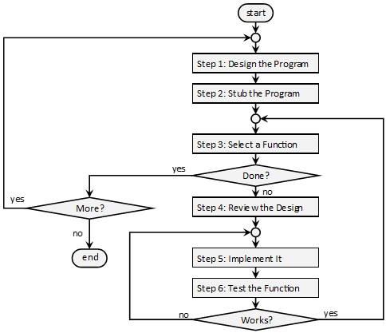
Development Process
The bottom-up design process begins with a completed design and stub functions. From there, developer proceeds one function at a time until the program is done.

Slide 12
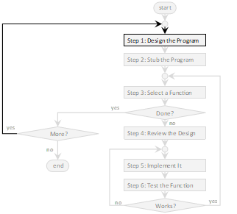
Development Process: Step 1 – Design the Program
Step 1 Design
You cannot start coding without a design. Note that the design does not need to be complete. In fact, it often cannot be complete due to uncertainty in the requirements and the technology. It does, however, need to be complete enough to move forward.
When we have worked through this design as far as we can, then we return to this step and design a bit more.
Step 2 Stub
Step 3 Select
Step 4 Review
Step 5 Build
Step 6 Test

Slide 13
Development Process: Step 2 – Stub the Functions
Step 1 Design
Before the bottom-up development process can begin (step 3-6), it is necessary to have each function stubbed out. This means that every function in the structure chart should have a stub.
Recall that stubs are created in a three-step process:
Create a trivial function definition using the name from the structure chart or the DFD.
If there is a return type, return something trivial or typical. It doesn’t matter what is returned, as long as the function compiles.
If the function calls another function, then make sure the stub calls it in a trivial way.
Step 2 Stub
Step 3 Select
Step 4 Review
Step 5 Build
Best Practice 18.5
Keep the structure chart up to date so it faithfully represents the project
Step 6 Test

Slide 14
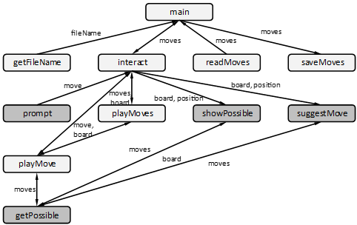
Development Process: Step 3 – Select a Function
Step 1 Design
A function should be selected with the smallest number of dependencies. This could include a leaf-level function that calls no other, or it could include a function that calls others which are already implemented. The most important thing is to avoid functions that calls stubs.
Step 2 Stub
Step 3 Select
Step 4 Review
Step 5 Build
Step 6 Test
Which of the above would be candidates to implement next?

Slide 15
Development Process: Step 4 – Review the Design
Step 1 Design
There is often a considerable delay between the design of a function and the function’s implementation. The design could have been done by another engineer, make assumptions about the customer’s requirements that are incorrect, or it could depend on technology that is not implemented as we expect it to be. Even if the design is flawless, it is still necessary to get the design “in your heads” before you write the code. All these things mean that we need to carefully review the design before we begin development.
Step 2 Stub
Step 3 Select
Step 4 Review
Step 5 Build
Step 6 Test

Slide 16
Development Process: Step 5 – Implement Function
Step 1 Design
With the design for a function hashed out (step 1), stubbed (step 2), and reviewed (step 4), it is now time to write the code.
Notes:
Some development methodologies have you write drivers before you implement a function. One such methodology is called Test Driven Development (TDD).
Do not let yourself be interrupted from your work when the code is in a state where it is not compiling. Mostly this means that you should make sure you have time to finish a function before starting to write code. If this absolutely cannot be avoided, comment out the incomplete code and begin the process anew the next day.
Step 2 Stub
Step 3 Select
Step 4 Review
Step 5 Build
Step 6 Test

Slide 17
Development Process: Step 6 – Test the Function
Step 1 Design
The final step in the bottom-up development process is to test functions. This includes:
Enumerate test cases
Sometimes these test cases were previously developed. For example, when the need for a function is uncovered in Step 1 or when the design is reviewed/refined in step 4, it is not uncommon to enumerate the test cases at this point in time.
Create a driver function
Sometimes the driver is created before or during step 5. This is commonly the case in test driven development
Run through the test cases
Whether this is done manually or with automation, it matters not. Make sure that all the bugs are fixed before “signing off” on this function.
Step 2 Stub
Step 3 Select
Step 4 Review
Step 5 Build
Step 6 Test

Slide 18
Examples
Example 18.1: Step 3
Example 18.2: Step 4
Example 18.3: Step 5
Example 18.4: Step 6

Slide 19
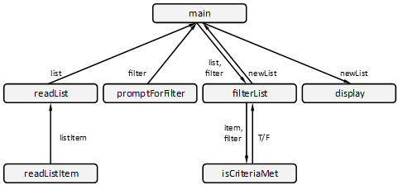
Example 18.1: Step 3
Q: Given the following structure chart, which function should be developed?
Function | Reason for selection
readListItem() | When readListItem() is completed, then we can do readList() which will make testing other functions much easier.
promptForFilter() | This can certainly be done at any time.
isCriteriaMet() | Can certainly be done, but completing it does not enable filterList() to be developed next due to its dependencies.
display() | Hard to test without a mechanism to easily create a variety of different lists.

Slide 20

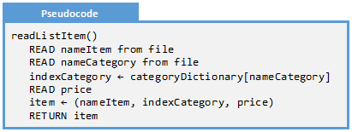
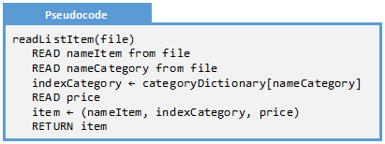

Example 18.2: Step 4
Q: Given the following structure chart fragment and pseudocode, complete step 4
A: Notice how the pseudocode requires a filename but one is not passed…

Slide 21
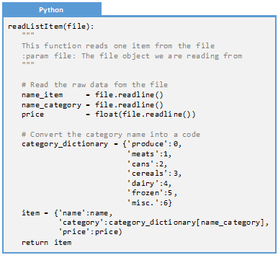

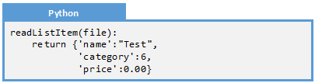
Example 18.3: Step 5
Q: Conduct step 5 by implementing the design from step ¼ in the stub created from step 2.

Slide 22
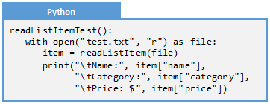
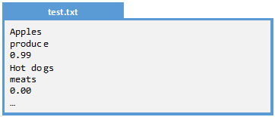
Example 18.4: Step 6
Q: Test the readListItem() function from Example 18.3.
A: We need three things: test cases, a driver, and a test case file.
Name | Inputs | Outputs
Produce | Apples, produce, 0.99 | Apples, 0, $0.99
Meats | Hot dogs, meats, 0.00 | Hot Dogs, 1, $0.00
Cans | Spicy salsa, cans, 100000 | Spicy salsa, 2, $100,000.00
Cereals | Life, cereals, -1.00 | Cereals, 3, -$1.00
Error | Banana, nothing!, 0 | Error

Slide 23
Exercises
Exercise 18.1: Activities
Exercise 18.2: Development Steps
Exercise 18.3: Fact or Fiction
Exercise 18.4: Eligible Functions

Slide 24
Exercise 18.1: Types of Activity
For each of the following software engineering activities, classify it as begin requirements elicitation, design, development, or testing.
Generate test cases
Create a structure chart
Create automation representing test cases
Requirements Elicitation
Ask the client what is needed from the software
Write code
Design
Create a DFD
Development
Observe the client at work to understand the needs
Create a flowchart
Testing
Create a manual driver program
Create pseudocode for an algorithm
Execute test cases

Slide 25
Exercise 18.2: Steps in the Process
Order the steps in the bottom-up development process
Look at the design to make sure it is understood and has no defects
Create a design of the program as far as is possible given our understanding
Determine which function is to be implemented and tested next
Implement the function using a programming language
Create stubs of the design as far as it has been designed
Run through test cases and fix any defects that are encountered

Slide 26
Exercise 18.3: Top-Down or Bottom-Up
For each of the following, identify whether it is better to pursue this software engineering activity as top-down or bottom-up
Activity
Requirements Elicitation
Design
Development
Testing
Either: When the client has a holistic understanding, use top-down. Otherwise, utilize bottom-up
Top-Down: Top-down designs generally produce more cohesive designs with less risk of over-engineering
Bottom-up: Bottom-up development is easier, has less wasted effort, and takes less time
Bottom-up: Testing can occur earlier, provide timely feedback, and involves less wasted effort

Slide 27
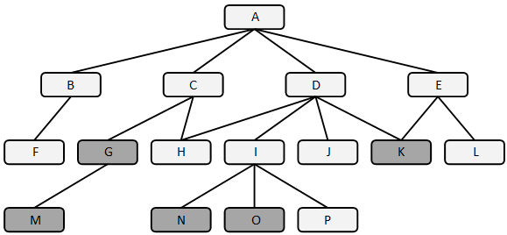
Exercise 18.4: Eligible Functions
In the following structure chart, which functions are completed, which are eligible for development, and which are not ready?
Completed
Eligible
Not Ready

Slide 28
Problems
Problem 18.1: Tip Calculator
Problem 18.1: Round 1
Problem 18.1: Round 2
Problem 18.1: Round 3
Problem 18.1: Round 4
Problem 18.1: Final rounds
Problem 18.2: Convert Number
Challenge 18.1: Shopping List
Challenge 18.2: Credit Card Transactions
Challenge 18.3: Maze

Slide 29
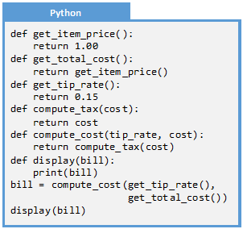

Problem 18.1: Tip Calculator
Consider a simple application to determine the prices of a meal. It will prompt the user for the individual item prices and tabulate them for the total cost. It will then prompt the user for the quality of the service: excellent=20%, average=15%, and poor=10%. It will compute the tax (assume 7.8%) and then display the predicted cost of the meal. The following is step 1 (design) and step 2 (stubs).

Slide 30
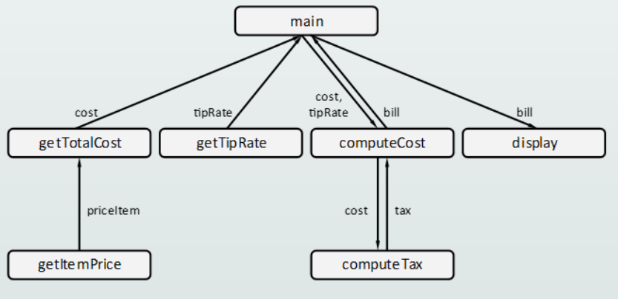
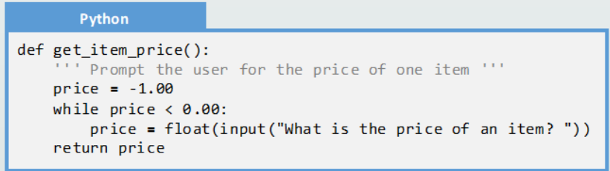
Problem 18.1: Round 1
Step 3: Select a Function:
getItemPrice() will facilitate easy testing
Round 1
Step 4: Review the Design:
There is no pseudocode or flowchart because this function is trivial
Round 2
Step 5: Implement the Function:
Round 3
Round 4
Finish
Step 6: Test the function:
The following test cases are used. Notice the bug that needs to be fixed
Name | Input | Output
Valid | 1 | 1.00
Negative | -1 | re-prompt
Zero | 0 | 0.0
Round | 1.005 | 1.01

Slide 31
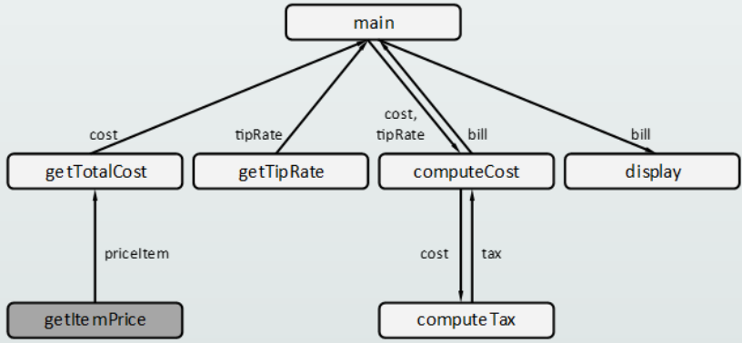
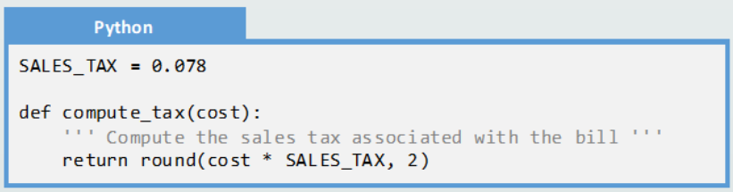

Problem 18.1: Round 2
Step 3: Select a Function:
computeTax() will is easy to test and is eligible
Round 1
Step 4: Review the Design:
There is no pseudocode or flowchart because this function is trivial
Round 2
Step 5: Implement the Function:
Round 3
Round 4
Finish
Step 6: Test the function:
We will create an ad-hoc commandeer driver to test this:

Slide 32
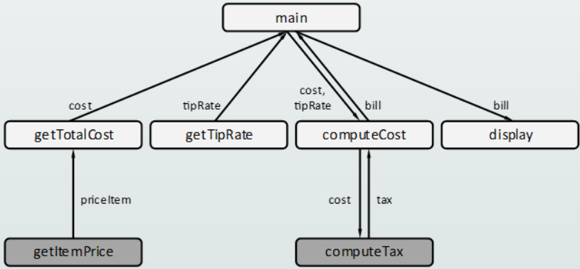
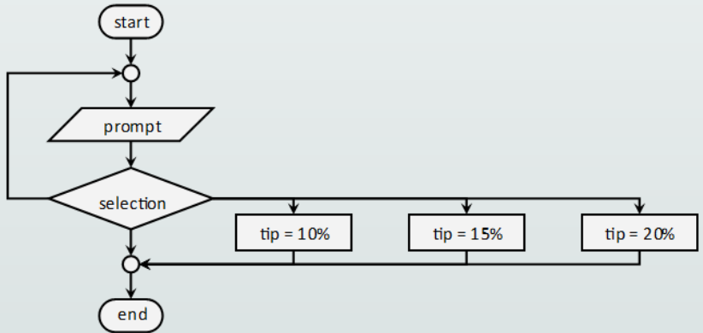
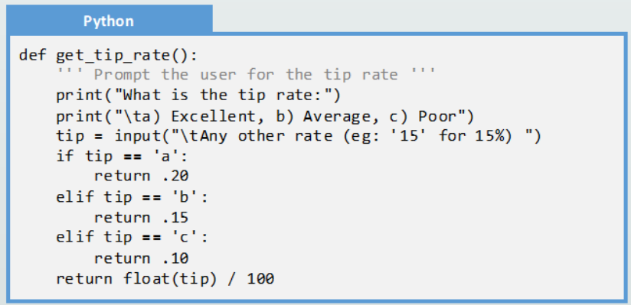
Problem 18.1: Round 3
Step 3: Select a Function:
getTipRate() will is easy to test and is eligible
Round 1
Step 4: Review the Design:
This function is not trivial so we will need to flush out the design a little:
Round 2
Step 5: Implement the Function:
Round 3
Round 4
Finish
Step 5: Implement the Function:
Step 6: Test the function:
We will create an ad-hoc commandeer driver to test this…
Note that there is a bug when a non-number is selected. This is fixed…

Slide 33
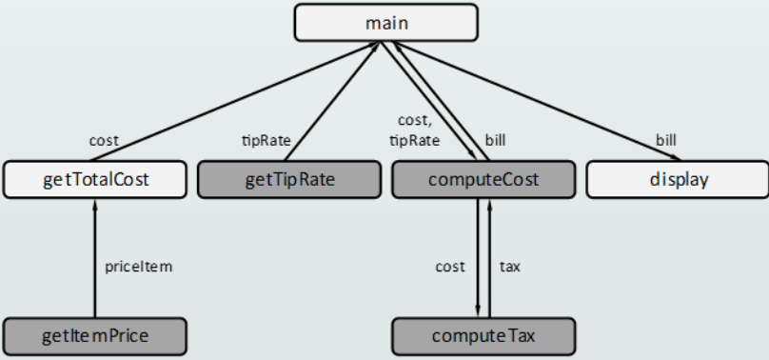
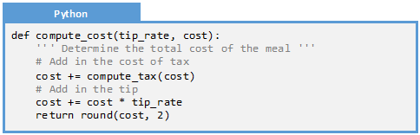
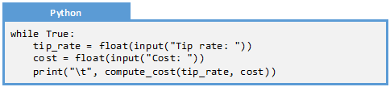
Problem 18.1: Round 4
Step 3: Select a Function:
computeCost() will facilitate easy testing
Round 1
Step 4: Review the Design:
There is no pseudocode or flowchart because this function is trivial
Round 2
Step 5: Implement the Function:
Round 3
Round 4
Finish
Step 6: Test the function:
A simple manual driver will be created to test this function

Slide 34
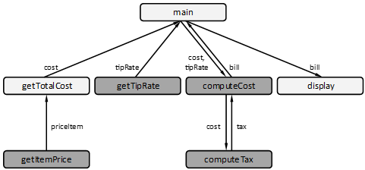
Problem 18.1: Additional Rounds
Round 1
Complete this process three more rounds until this code is finished. Which will be the next function?
Round 2
Round 3
Round 4
Finish

Slide 35
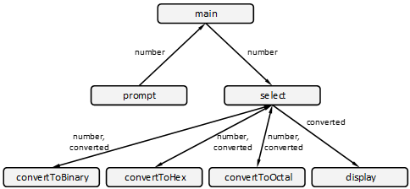
Problem 18.2: Convert Number
Consider a simple application to convert a decimal number (such as “42”) into a binary number (b101010), hexadecimal (0x2a), or octal (o52). The structure chart is the following:
In the programming language of your choice, implement this application using the bottom-up development process.

Slide 36
Challenge 18.1: Shopping List
Consider the shopping list application from Challenge 17.1:
The shopping list mobile application allows the user to create a shopping list and check off items when at the grocery store. The application can accommodate any number of shopping lists, each of which has a name, a short description, and the list itself. The user can add, duplicate, edit, check-off, and delete shopping lists. When the program begins, the user is presented with the current collection of shopping lists. Each list has a duplicate, edit, use, and delete icon. At the bottom of the list is an “add list” icon.
Implement this application in the programming language of your choice using the bottom-up development methodology.

Slide 37
Challenge 18.2: Credit Card Transactions
Consider the personal finance application from Challenge 17.2:
The personal finance application allows the user to store credit card transactions. When the application begins, the current account information is loaded and the user will be presented with an option of entering a transaction, reconciling an account, or displaying a report. The “enter a transaction” option prompts the user for a single transaction (date, name, category, amount) and adds it to the account. The “reconcile” option allows the user to update the status of a transaction from “Open” to “Reconciled”. The “report” option will display a summary of all the transactions within a given time period, collected by category.
Implement this application in the programming language of your choice using the bottom-up development methodology

Slide 38
Challenge 18.3: Maze
Consider the maze game from Challenge 17.3:
The Maze game is a 2D game where the object is for a ship to navigate a maze without hitting a wall or running out of time/fuel. The game begins when a maze is loaded from a file and the ship is placed at the beginning. The user is able to turn the ship and apply thrusters. This game will obey the laws of motion so, in order to stop, the ship must turn around and apply counter thrusters. The game is over when the user has hit a wall, runs out of fuel, or reaches the end of the maze.
Implement this application in the programming language of your choice using the bottom-up development methodology

