Slide 1
Welcome to grad school
Professor Alonzi
UVA Data Science

Slide 2
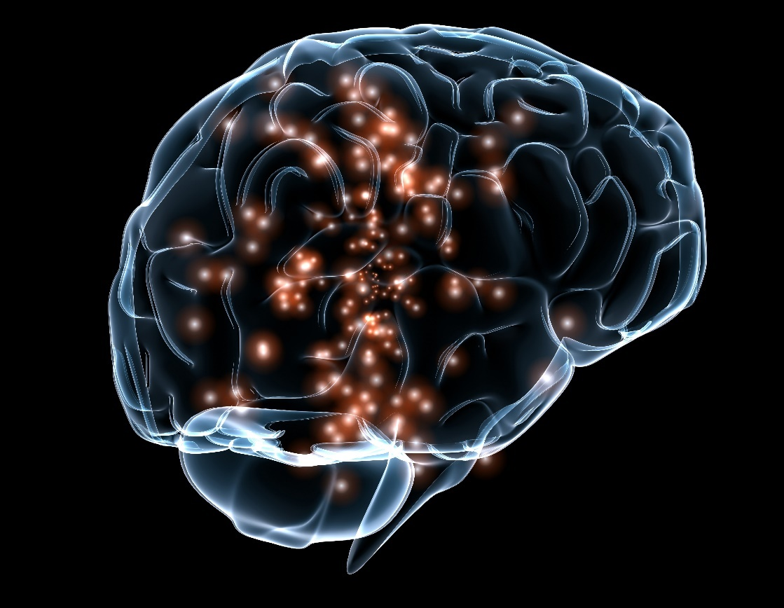
Scientific Research Flowchart
Shoulders of giants
Eureka!
New Data
Notes:
http://www.darpa.mil/

Slide 3
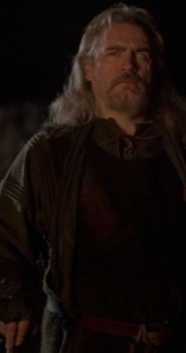
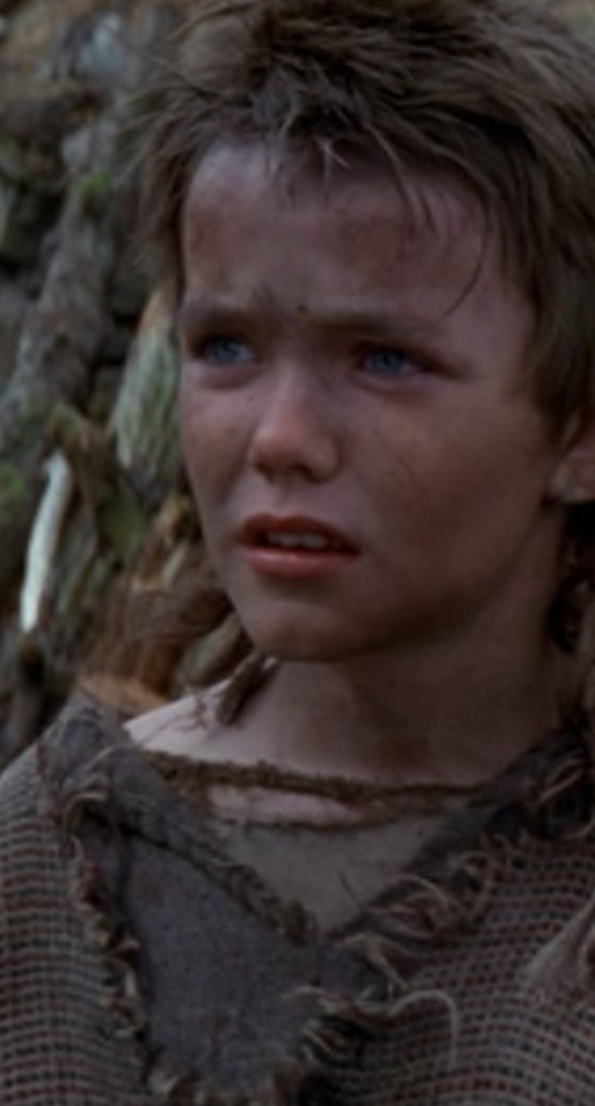
Dramatis Personae
Young William
Uncle Argyle

Slide 4
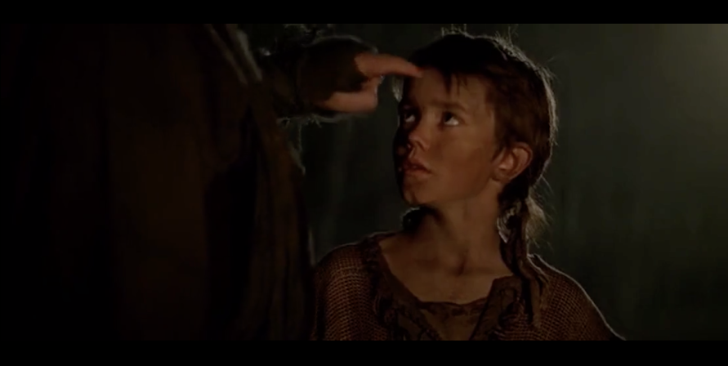
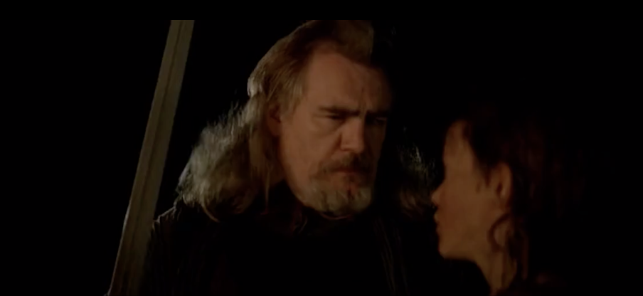
First, learn to use this,
then I'll teach you to use this.

Slide 5
Neural Network
First, learn to use this,
Artificial
Neural Network
then I'll teach you to use this.

Slide 6
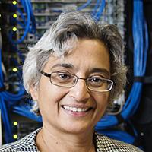
Scientific Research Flowchart
Understand what is known
Shoulders of giants
Eureka!
New Data
‘Do not chase fame or money, pursue knowledge.’
Upload new data into human memory
Malathi Veeraraghavan
aka MV
Notes:
http://www.darpa.mil/
Uva engineering

