Slide 1
App Presentation
Ben Roberts
Notes:
- Before I start, I would just like to say, thank you very much for this opportunity to work here over the summer. I’ve learnt a lot from this experience.

Slide 2
How I wrote it
Swift 2.2
Transactions From CSV
SQL Lite
Libraries (Objective-C)
Charts 2.0
SWReveal
Notes:
My main inspiration during the design was to develop an app which would also work well as an android
During writing the code, I made sure that the code was well-documented, clean and performance effective, which was achieved through constant thinking and refactors.
The main programming language during development was Swift as it is the newer and more powerful language
SQL Lite was used to fetch from the core data containing all the csv transactions
The two libraries used are Charts which gave the ability to create charts and SWReveal which gave the ability to create a reveal menu. Both these libraries are written in Objective-C

Slide 3
Development Process
Test Driven Development
Test Cases
Version Control
GitHub
Unit Tests
User Documentation
Note: Shown at the end
Notes:
At the beginning the development was Test Driven which I did before developing a page. Afterwards it was more update after changes

Slide 4
Features Implemented
Login
Home
Search
Results
Contact
Notes:
The pages that are currently implemented are:
Login, Home, Search, Results and Contact.
I will go into more detail in the following slides.

Slide 5
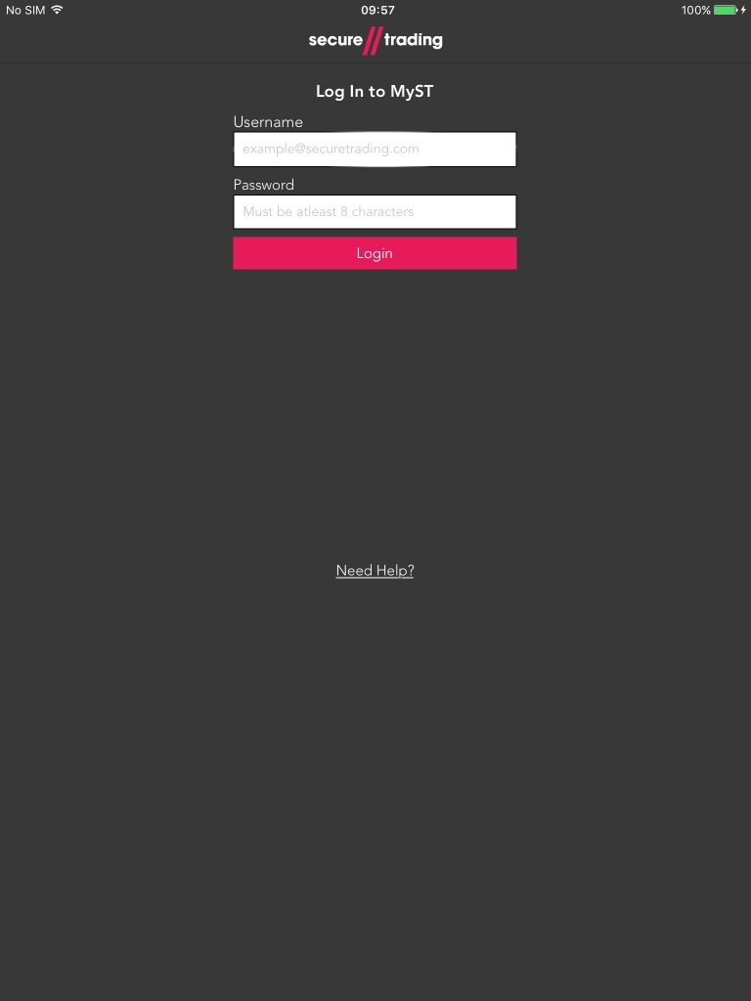
Login
Inspiration MyST
Linked To Contact Page
Notes:
My main inspiration during development of the login page was the MyST login page as I believe the app should have a close resemblance to MyST.
If the user has forgotten their login credentials they would press the ‘Need help?’ text which would direct the user to the contacts page.
The iPhone has slightly different functionality, the login page is only available in portrait and when the keyboard appears it pushes the textfield up.
I’ve also implemented appreciate alerts if the user were to insert incorrect credentials into the textfield.

Slide 6
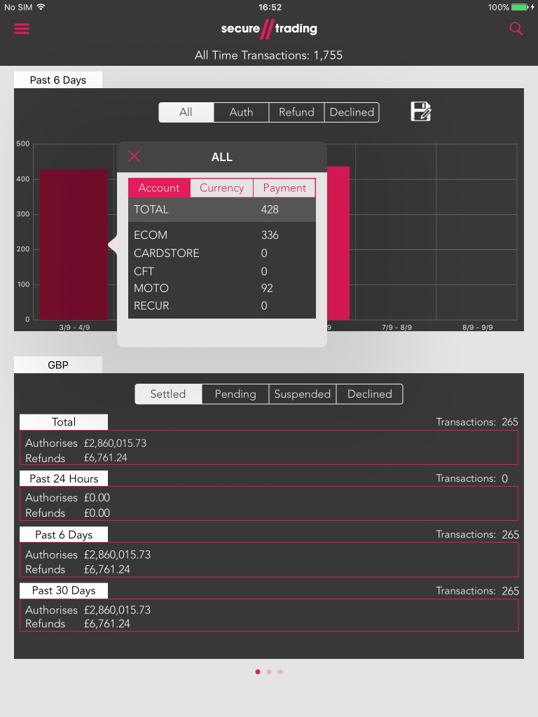
Home
Interactive Graphs Types
Bar
Line
Transaction Count
Sorted By Settled Status
Change currency types
Notes:
This home page has the most functionality:
First being the bar graph which display different transaction types depending on the segmented control selected.
If you wanted to see a line chart

Slide 7
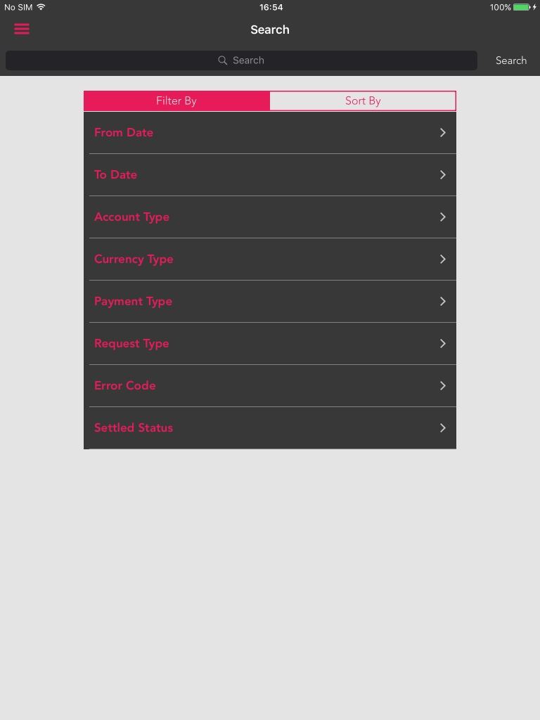
Search
Search By
Transaction Reference
Amount
Amount Settled
Filter By
Types of transactions
Settle Status
Error Codes
Date Range
Sort By
Same details as above
Notes:
The search page works similar to MyST.
The search itself can be performed on three different attributes: transaction reference, amount and amount settled. These are selectable while typing in the search bar
Filters can be applied to the search such as error code, date range, settled status and types of transaction. These can be applied by clicking the desired field choosing the desired options and pressing set.
Sorts can be applied by pressing the ‘Sort By’ segmented control and tapping the sorts you’d like to apply

Slide 8
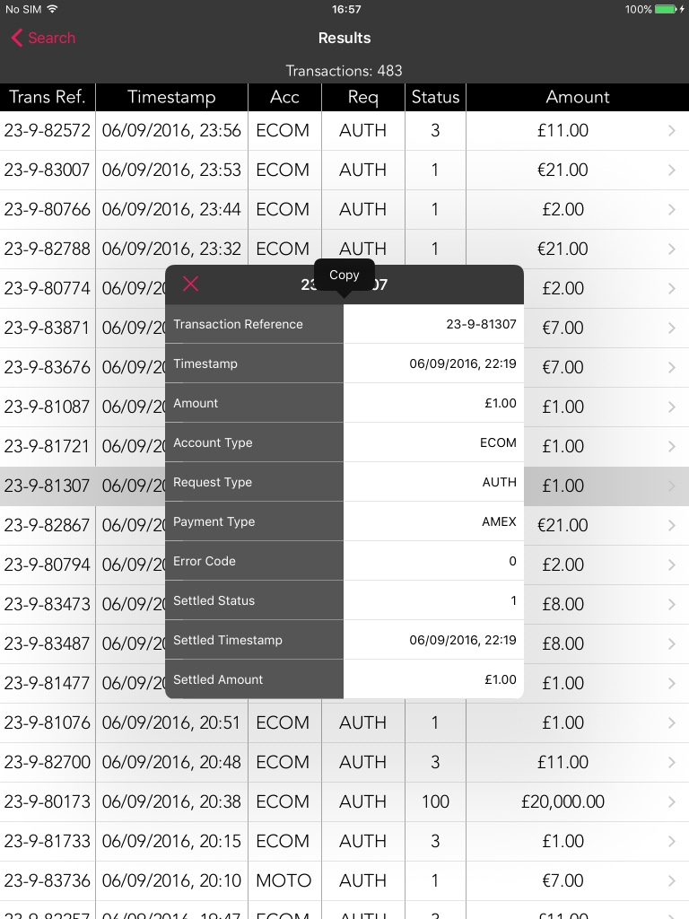
Results
Sort by column name
Ascending
Descending
Detailed transaction
Copy field data
Notes:
The results page displays a reduced amount of transaction columns to provide a quick overview without compromising the device display.
The results page can provide more detail on a transaction by tapping a transaction and a new view will appear with more details on the tapped transaction.
To get a copy of a transaction reference for example press and hold on that row in the detailed view and a copy button will appear to copy the contents of that row.

Slide 9
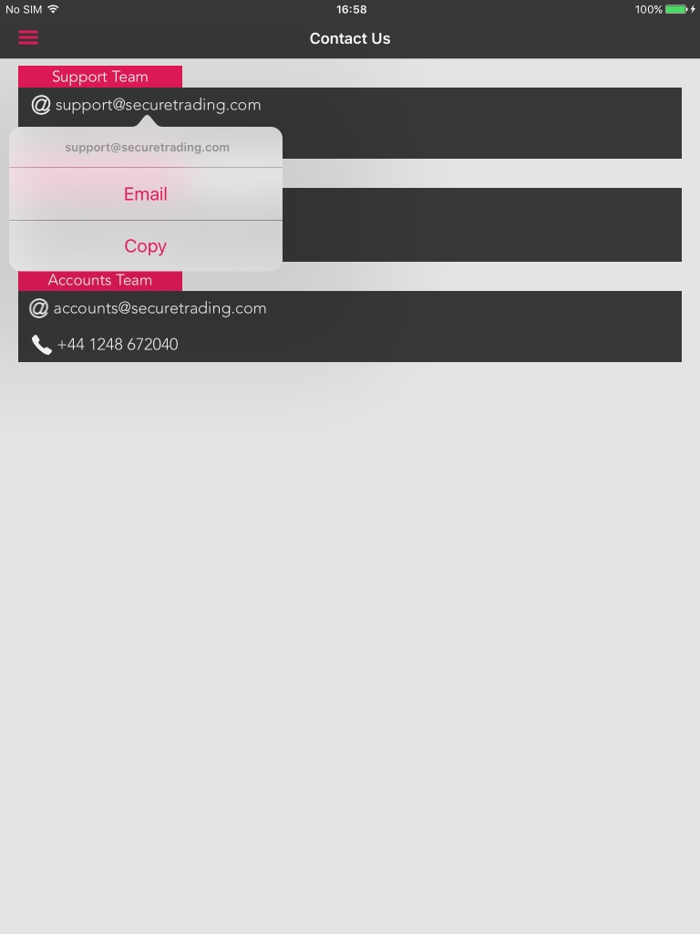
Contact Us
Email
Copy Email
Send Email
Call
Copy Number
Call Number
Notes:
The contact page contains all the essential contact details for secure trading.
If you wanted email or copy one of the emails on this page, simple tap the desired email and a menu will appear to select either email or copy which will prompt the selected option.
Similar, the phone number provide the same functionality however, the ability to phone the number will only appear as an option on the iPhone as it has the phone capability.

Slide 10

Future Features
CSV Requests
Pull Down to Refresh
Accounts
Session Time-Out
User Settings
Save Searches
Currency Conversion
Display Total Revenue
Notes:
These are some of the feature that I would of liked to have done if I had the time.

Slide 11
Q&A
Notes:
Thank you for listening, any questions?

