Slide 1

CHAPTER 2: HTML Advanced Features
CLO2: Create rich web-based user interfaces using current standards-compliant client-side web technologies

Slide 2
HTML semantics

Slide 3
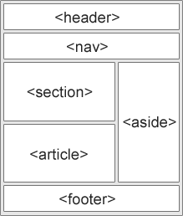
HTML Semantic Tags (1-2)
HTML5 offers semantic elements to define different parts/areas of a web page. Below are some popular semantic elements:
<article>
<aside>
<footer>
<header>
<main>
<nav>
<section>
Notes:
Instructor Notes:
Student Notes:

Slide 4
HTML Semantic Tags (2-2)
A semantic element clearly describes its meaning to both the browser and the developer.
Examples of non-semantic elements:
<div> and <span> - Tells nothing about its content.
Examples of semantic elements:
<form>, <table>, and <article> - Clearly defines its content.

Slide 5
forms

Slide 6
The <form> Element
The HTML <form> element defines a form that is used to collect user input
The form element has different attributes:
Method
Action
<form action= “…..“ method=“…..">
…..
</form>

Slide 7
The Action and Method Attributes
Action Attribute
Method Attribute
The action attribute defines the action to be performed when the form is submitted
Normally, the form data is sent to a web page on the server when the user clicks on the submit button
The method attribute specifies the HTTP method (GET or POST) to be used when submitting the form data
The form-data can be sent as
URL variables (with method="get")
or HTTP post transaction (with method="post“)
<form action="/action_page.php" method="get">
OR
<form action="/action_page.php" method="post">

Slide 8
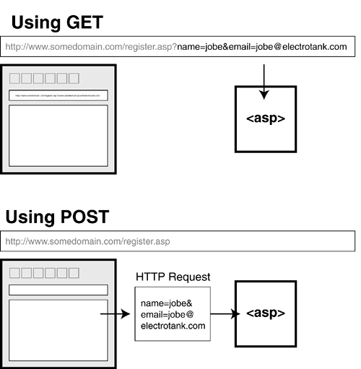
GET and post methods
Method=῎get ῎ appends the form data directly to the end of the URL of the script in name/value pairs
/action_page.php?firstname=Mickey&lastname=Mouse
Method=῎post ῎ appends form-data inside the body of the HTTP request (data is not shown is in URL)

Slide 9
When to use GET and POST?
GET | POST
The length of a URL is limited (about 3000 characters) | POST has no size limitations, and can be used to send large amounts of data
Never use GET to send sensitive data! (will be visible in the URL) | Use POST to send sensitive or personal data
GET is better for non-secure data, like query strings in Google
Useful for form submissions where a user want to bookmark the result | Form submissions with POST cannot be bookmarked

Slide 10
The <input> Form Element
The <input> element is the most important form element.
The <input> element can be displayed in several ways, depending on the type attribute.
Here are some examples:
Type | Description
<input type="text"> | Defines a one-line text input field
<input type="radio"> | Defines a radio button (for selecting one of many choices)
<input type="submit"> | Defines a submit button (for submitting the form)

Slide 11
The Name Attribute
Each input field must have a name attribute to be submitted.
If the name attribute is omitted, the data of that input field will not be sent at all.
This example will only submit the "Last name" input field:
<form action="/action_page.php“ method=“get”> First name:<br> <input type="text" ><br> Last name:<br> <input type="text" name="lastname"><br> <input type="submit" value="Submit"> </form>

Slide 12
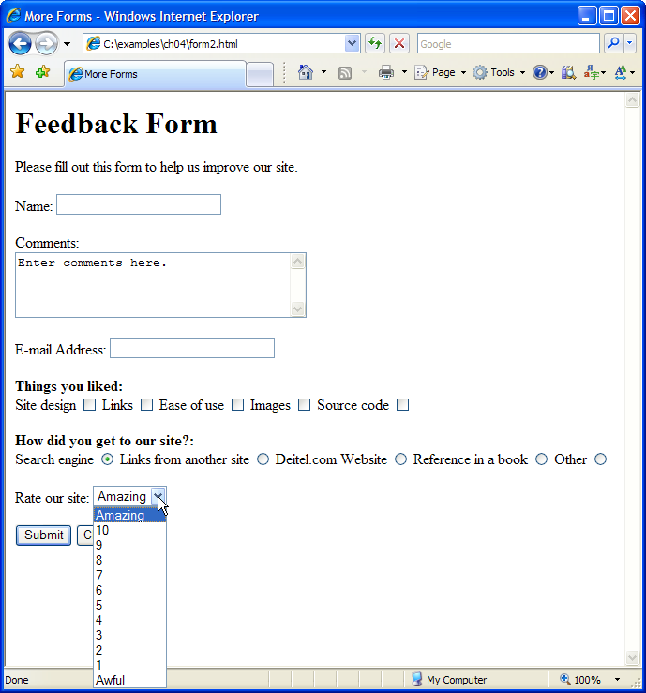
Exercise

Slide 13
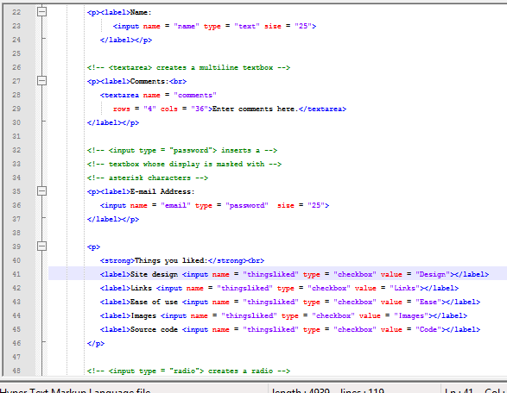
Exercise continued
Inserts a text area with 4 rows and 36 columns, whose initial text is “Enter comments here.”
Inserts an input field that displays entered text as asterisks (or another character)
Inserts several checkboxes with different labels
13

Slide 14
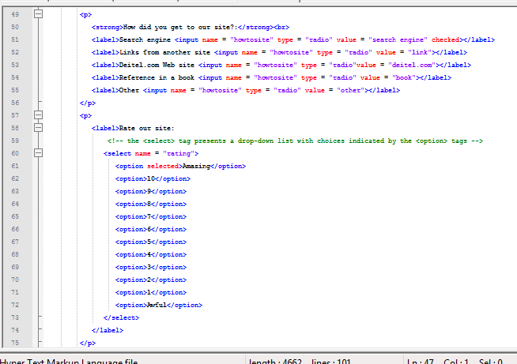
Exercise continued
Initially sets this radio button as selected
Inserts a group of radio buttons, only one of which can be selected
Create a drop-down list named “rating”
Sets “Amazing” as the initially selected option
14

Slide 15
Cascading style sheets (CSS)

Slide 16
Introduction
Cascading Style Sheets (CSS)
Used to specify the presentation of elements separately from the structure of the document
CSS validator
jigsaw.w3.org/css-validator/
Different ways to define styles
Inline Styles
Embedded Style Sheets
External Style Sheets

Slide 17
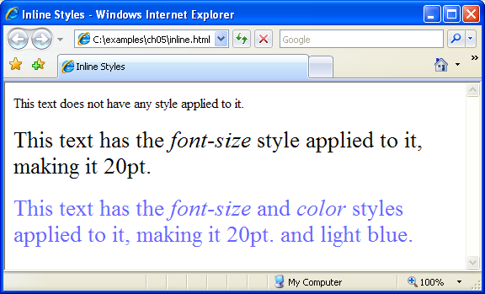
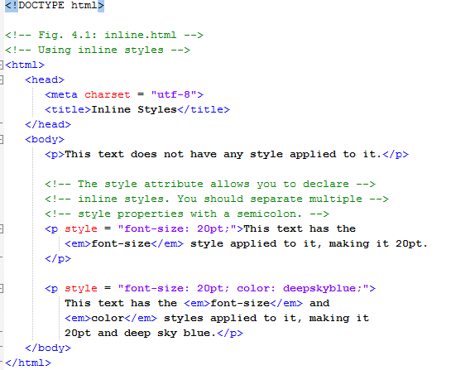
Inline Style
Inline style
Declare a style for an individual element by using the style attribute in the element’s start tag
Syntax
<HTML_Element
style=“property1:value1; property2:value2;…”>
Each CSS property is followed by a colon and the value of the attribute
Multiple property declarations are separated by a semicolon
For example: color property sets text color
Color names and hexadecimal codes may be used as the value

Slide 18
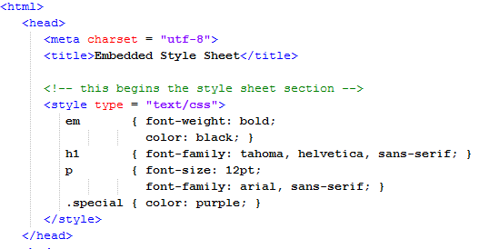
Embedded style sheets
Defined in the head of the HTML document

Slide 19
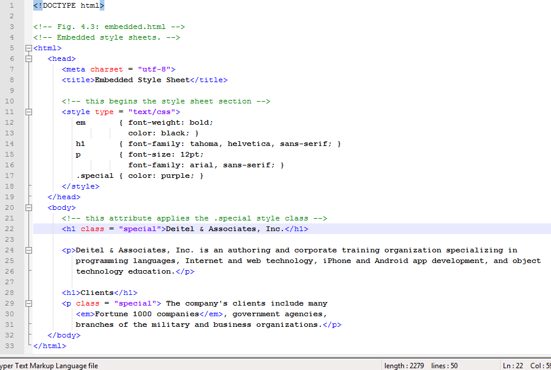
Embedded Style Sheets…
Sets the MIME type to text/css
Style sheet begins
Sets the properties for all elements in the document within em tags
Sets the properties for all h1 elements in the document
Sets the properties for all p elements in the document
Style sheet ends
Creates a special class
The special class is applied to this p element

Slide 20

Embedded Style Sheets

Slide 21
Linking External Style Sheets…
External style sheets are separate documents that contain only CSS rules
Help create a uniform look for a website
Separate pages can all use the same styles
When changes to the styles are required, you need to modify only a single CSS file to make style changes across all the pages that use those styles
This concept is known as skinning

Slide 22
Linking External Style Sheets…
How to use External style sheets?
You should define a CSS file (a.css) that contains all styles
In your HTML script, you refer to CSS’s file by using
link element
Uses rel attribute to specify a relationship between two documents
rel attribute declares the linked document to be a stylesheet for the document
type attribute specifies the MIME type of the related document
href attribute provides the URL for the document containing the style sheet
a.css
b.html
Rule1
Rule2
rulen
<head>
<link rel=“stylesheet”
type=“text/css”
href=“a.css”>
</head>

Slide 23
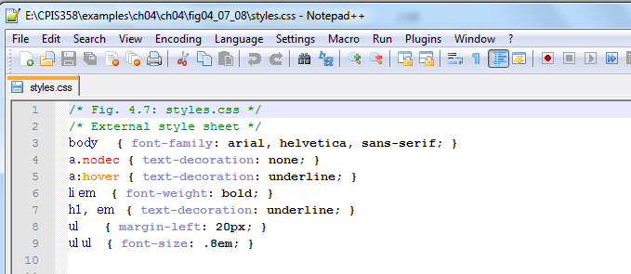
Example of External style sheet: CSS file

Slide 24
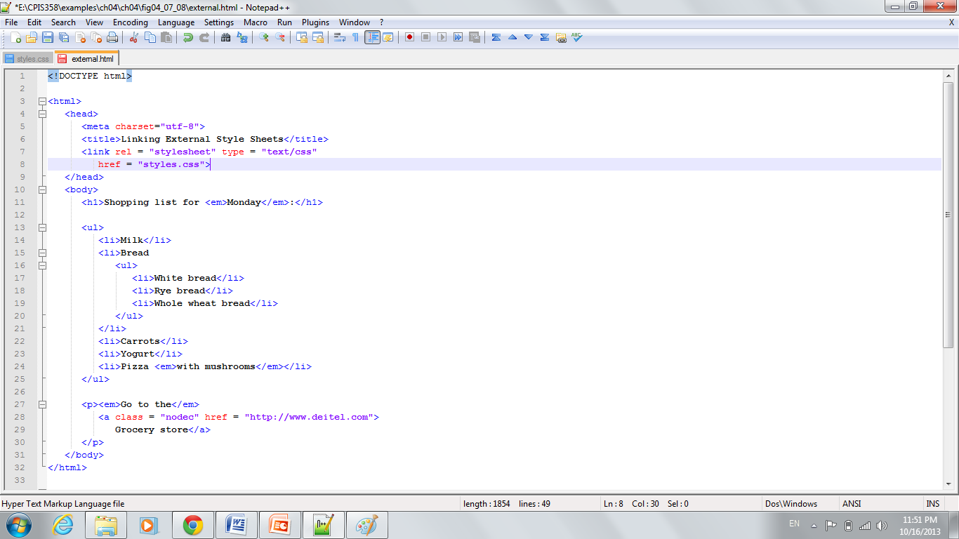
External Style Sheet linked into the document
The linked document is declared to be the current one’s stylesheet
The linked document’s MIME type is text/css
The linked document’s URL is styles.css

Slide 25
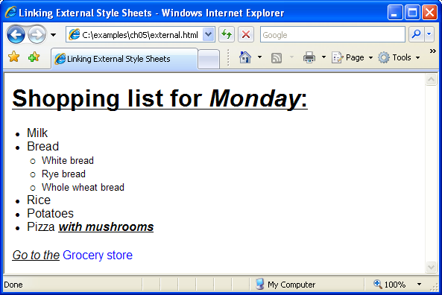
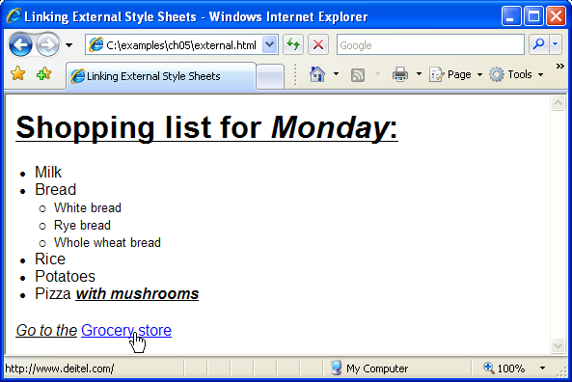
Example of External style sheet: HTML document

Slide 26
CSS Selectors
Selector | Example | Example description
.class | .intro | Selects all elements with class="intro"
#id | #firstname | Selects the element with id="firstname"
* | * | Selects all elements
element | p | Selects all <p> elements
element,element | div, p | Selects all <div> elements and all <p> elements
element element | div p | Selects all <p> elements inside <div> elements
element>element | div > p | Selects all <p> elements where the parent is a <div> element
element+element | div + p | Selects all <p> elements that are placed immediately after <div> elements
https://www.w3schools.com/cssref/css_selectors.asp

Slide 27
Inline Vs. Embedded Vs. External style
Inline | Embedded style | External style sheets
Inline styles do not truly separate presentation from content | Embedded and External style sheets separate content from presentation
 |  | External style sheets are reusable. Creating them once and reusing them
Cannot be used to apply similar styles to multiple elements or documents | Can be used to apply similar styles to multiple elements | Can be used to apply similar styles to multiple elements and documents
 |  | Reduce programming effort
Increase page loading time |  | Reduce load time and bandwidth usage on a server, since the style sheet can be downloaded once, stored by the web browser, and applied to all pages on a website

Slide 28
RESPONSIVE WEB DESIGN

Slide 29
What is Responsive Web Design?
In modern technology users able to browse the Internet via multiple devices, such as desktop monitors, mobile phones, tablets, and more. Devices of different screen sizes.
Question:
How can we ensure that a website is readable and visually appealing across all devices, regardless of screen size?
Answer: responsive design!
Responsive design refers to the ability of a website to resize and reorganize its content based on:
The size of content on the website.
The size of the screen the website is being viewed on.
There are HTML attributes and CSS properties that could be used to achieve RWD

Slide 30
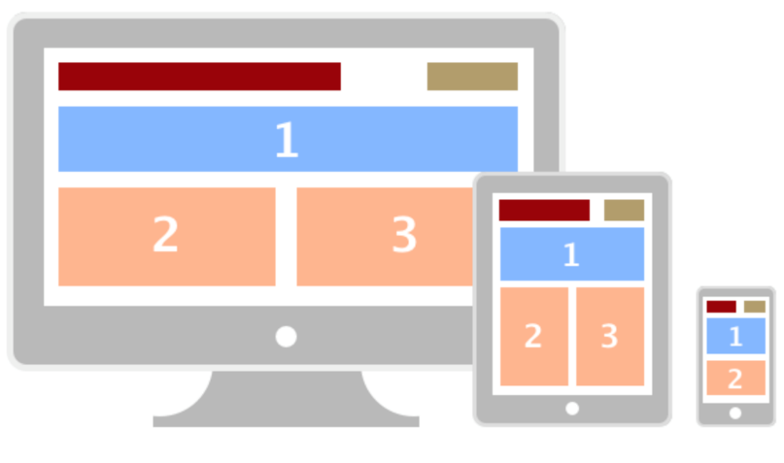
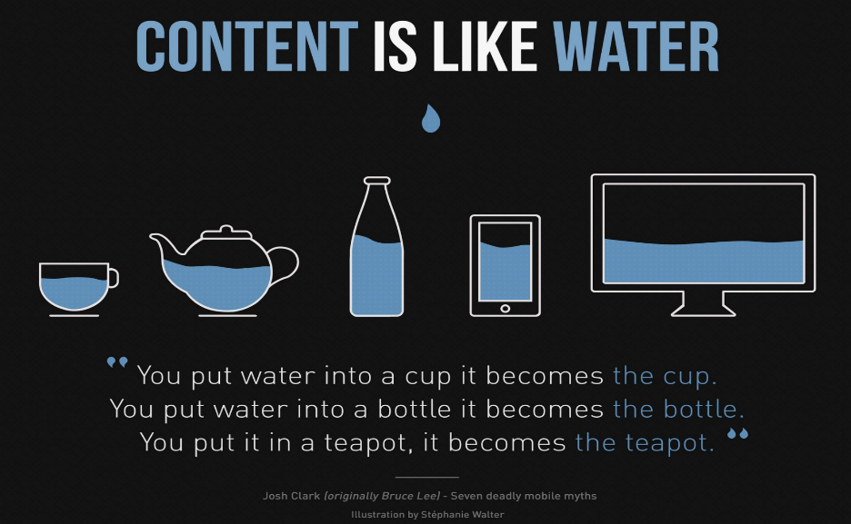
What is Responsive Web Site
Web pages should not leave out information to fit smaller devices, but rather adapt its content to fit any device:
Responsive web design use CSS and HTML to resize, hide, shrink, enlarge, or move the content to make it look good on any screen

Slide 31
Advantages of RWD
One single HTML document to be maintained
One single CSS file to be maintained
The site is easily accessible on any type of device.
Better user experience.
Users will have a similar experience using the site when they access the site from different devices.
Responsive Web is flexible and adaptable
Maintaining a RWD is:
Easier than maintaining several website for different devices
We can keep the same SEO strategy

Slide 32
Viewport
The viewport is the user's visible area of a web page. The viewport varies with the device, and will be smaller on a mobile phone than on a computer screen.
HTML5 introduced a method to let web designers take control over the viewport, through the <meta> tag.
It is used to set the viewport of your page, which will give the browser instructions on how to control the page's dimensions and scaling

Slide 33
Setting The Viewport
When making responsive web pages, add the following <meta> element into the header in all of your web pages:
<meta name="viewport" content="width=device-width, initial-scale=1.0">
This will set the viewport of your page, which will give the browser instructions on how to control the page's dimensions and scaling.
Viewport is the browser window size.
width=device-width – sets the width of the viewport to the width of the device.
initial-scale=1.0 – sets the zoom of the page. This is set to “1.0” in the example. Although not recommended, you may increase this number. Setting it to “1.0” establishes a 1:1 relationship between CSS pixels and device independent pixels.

Slide 34
Responsive Images
Responsive images are images that scale nicely to fit any browser size.
Using the width Property
If the width property is set to 100%, the image will be responsive and scale up and down
<img src=“my_picture.jpg" style="width:100%;">
Using the max-width Property
If the max-width property is set to100% and the height to auto, the image will scale down if it has to, but never scale up to be larger than its original size
<img src=“my_picture.jpg” style="max-width:100%; height:auto;">

Slide 35
Responsive Images
Show Different Images Depending on Browser Width
The HTML <picture> element allows you to define different images for different browser window sizes.
Other reasons may be to display the correct image for any device. This could be due to screen resolutions.
The markup for the picture element is as shown below.
<picture>
<source srcset=”bird_low_res.jpg" media="(max-width: 480px)">
<source srcset=”bird_mid_res.jpg" media="(max-width: 960px)">
<source srcset=”bird_hi_res.jpg” media=“max-width: 1500px”>
<img src=”bird.jpg" alt=”Bird">
</picture>

Slide 36
Responsive Images (cont)
Picture Markup
<picture>
<source srcset=”bird_low_res.jpg" media="(max-width: 480px)">
<source srcset=”bird_mid_res.jpg" media="(max-width: 960px)">
<source srcset=”bird_hi_res.jpg” media=“max-width: 1500px”>
<img src=”bird.jpg" alt=”Bird">
</picture>
The source contains tow attributes as follows.
The srcset attribute indicates the image to be load.
The media attribute defines the viewport breakpoints or pixels for which the appropriate image is loaded.
The traditional img tag is also used to load a default image if the browser does not support picture or source tag.

Slide 37
Responsive Text Size
The text size can be set with a "vw" unit, which means the "viewport width".
That way the text size will follow the size of the browser window
<h1 style="font-size:10vw">Hello World</h1>
1vw = 1% of viewport width, 2vw = 2% of viewport width, etc.
If the viewport is 600px wide, 1vw is 6px and 2vw is 12px.

Slide 38
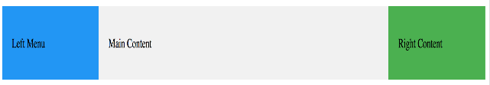
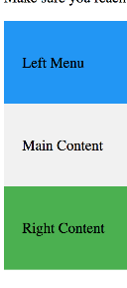
Media Queries
Media queries used to define completely different styles for different browser sizes.
The above code will display the three div elements horizontally on large screens and stacked vertically on small screens:
<style>
.left, .right {
float: left;
width: 20%; /* The width is 20%, by default */
}
.main {
float: left;
width: 60%; /* The width is 60%, by default */
}
/* Use a media query to add a breakpoint at 800px: */
@media screen and (max-width: 800px) {
.left, .main, .right {
width: 100%; /* The width is 100%, when the viewport is 800px or smaller */
}
}
</style>
Display when width above 800px
Display when width bellow 800px

Slide 39
Using Frameworks
There are many existing CSS Frameworks that offer Responsive Design.
They are free, and easy to use.
Example: W3.CSS (https://www.w3schools.com/w3css/default.asp),
Bootstrap. (https://getbootstrap.com/)
They have built in class that styles the web pages easily and effectively.
They come with free ready made template with different responsive web design styles.
https://www.w3schools.com/w3css/w3css_templates.asp
https://www.w3schools.com/bootstrap/bootstrap_templates.asp

Slide 40
Using Bootstrap
In the next lecture we will work on Web Development using Bootstrap.

Slide 41
References
For more information, visit the below URL:
https://www.w3schools.com/

Slide 42
KEY TERMS
Frameworks
Media Query
Template
Inline Style
Responsive Image
Responsive Text
Selectors
Notes:
Instructor Notes:
Student Notes:

