Slide 1
CHAPTER 1: Introduction to Web Application Development
CLO1: Discuss technologies, languages, and frameworks to implement web applications

Slide 2
LECTURE OUTLINE
Introduction
How does the web work?
What Does a Web Server/Web Client Do?
Key Terms
GET vs. POST
The URL
HTTP REQUEST
The Web Server Job
Web Application Technologies
ADVANTAGES AND DISADVANTAGES OF CLIENT-SIDE SCRIPTING
ADVANTAGES AND DISADVANTAGES OF SERVER-SIDE SCRIPTING

Slide 3
INTRODUCTION
Objectives
At the end of this chapter, the student should be able to:
Understand the difference between Internet and Web
Explain how the Web works
Identify what a web server does
Identify what a web client does
Understand the advantages and disadvantages of Client-Side and Server-Side Scripting
Identify differences between current and emerging Web Technologies
Notes:
Instructor Notes:
Student Notes:

Slide 4
INTRODUCTION
The World Wide Web (WWW)
A huge, globally distributed collection of information and data that can be accessed via the Internet with the help of HTTP (Hypertext Transfer Protocol)
The WWW has made the Internet the most important communication medium of our days
WWW documents are interconnected by hyperlinks and in this way form an information network
WWW documents are distributed worldwide, stored at WWW servers
Notes:
Instructor Notes:
Student Notes:

Slide 5
InTRO- Internet vs. web
Web is an information-sharing model that is built on top of the Internet
HTTP Protocol : to transmit data
HTML Language
Browser
Server
Application Layer
FTP
(FTP)
Usenet
(NNTP)
Mail
(SMTP)
WWW
(HTTP)
Freenet,
Gnutella, etc.
Internet
(TCP/IP)
Network Layer
The Web and the Internet terms are not synonyms and should not be confused
Notes:
Many people use the terms Internet and World Wide Web (aka. the Web) interchangeably, but in fact the two terms are not synonymous. The Internet and the Web are two separate but related things.
What is The Internet?
The Internet is a massive network of networks, a networking infrastructure. It connects millions of computers together globally, forming a network in which any computer can communicate with any other computer as long as they are both connected to the Internet. Information that travels over the Internet does so via a variety of languages known as protocols.
What is The Web (World Wide Web)?
The World Wide Web, or simply Web, is a way of accessing information over the medium of the Internet. It is an information-sharing model that is built on top of the Internet. The Web uses the HTTP protocol, only one of the languages spoken over the Internet, to transmit data. Web services, which use HTTP to allow applications to communicate in order to exchange business logic, use the the Web to share information. The Web also utilizes browsers, such as Internet Explorer or Firefox, to access Web documents called Web pages that are linked to each other viahyperlinks. Web documents also contain graphics, sounds, text and video.
The Web is just one of the ways that information can be disseminated over the Internet. The Internet, not the Web, is also used for e-mail, which relies on SMTP, Usenet news groups, instant messaging and FTP. So the Web is just a portion of the Internet, albeit a large portion, but the two terms are not synonymous and should not be confused.

Slide 6
InTRO.- Internet vs. web
Can we use the Internet without Web? (Yes)
Does the Web function without Internet? (No)
Web uses HTTP protocol (Hyper Text Transfer Protocol)
Internet uses TCP/IP Protocol (Transmission Control Protocol/Internet Protocol)
Web is an European invention.
In1991, Tim-Berners Lee, a researcher in CERN has created the Hypertext system (HTML)
Internet is an American invention beginning with the development of electronic computer in 1950

Slide 7
How does the Web Work?

Slide 8

HOW THE WEB WORKS?...
DNS server
www.mysite.com --> 201.10.12.54
http browser
102.89.10.1
http server
HTTP request
HTTP response
html
client machine
102.89.01.178
html
server
www.mysite.com
201.10.12.54

Slide 9
From Developer Perspective
1. The developer writes a script. The later is interpreted
2.The developer must deploy the website. For that, he should find an Internet Service Provider (ISP)
3. The developer chooses a Universal Resource Locator (URL) for his web site
Choose URL
Check in DNS Server
Free
Not Free

Slide 10
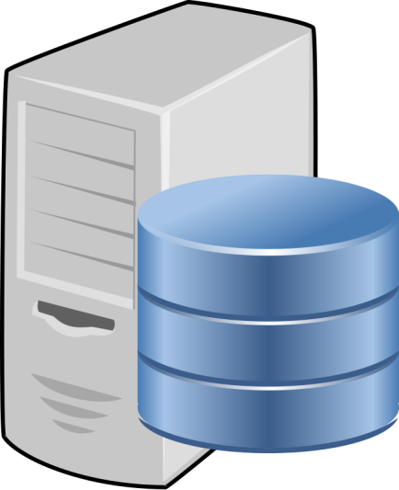

From Developer Perspective –contd.
4. The developer pays to store the script
5. ISP provides an FTP account, a username and a password to the developer to be able to upload his script
ISP Server
Developer
FTP
Space to store the script

Slide 11
From User Perspective according to the Client/Server principle
1. User requests a Web document over the Web client browser (entering a URL or on a mouse click)
2. Browser checks the DNS Server to get back the IP address of the Web Server
3. Browser contacts the Web server specified by the URL and requests the desired document
Server accesses its local file system and sends the file specified in the URL through HTTP response to the requesting host
Browser receives the document, interprets the document and displays it

Slide 12
What Does a Web Server/Web Client Do?

Slide 13
What does a Web Server do?
First a user will request a resource, the web server will attempt to find the resource and returns/sends it back to the user
This resource can be an HTML page, a picture, a sound file, a PDF document, or a video file.
What if the resource is not available or is not where the web server is expecting it to be? You are familiar with the “404 Not Found” error
What does a Web Client do?
The web client lets the user request something on the server, and shows the user the result of the request.
What is the piece of software that represents the web client?

Slide 14
How do Web clients and Web Servers communicate?
Web clients and web servers talk to each other using HTTP (Hyper Text Transfer Protocol)
The web server sends responses in HTML (Hyper Text Markup Language)
HTML tells web clients how to display the content to the user
HTTP requests can be triggered
by an explicit user action (clicking on a hyperlink, entering an URL)
or implicitly by the browser to load embedded resources (e.g. images)

Slide 15

HTTP Requests & Responses made between Client and Server
HTTP method
The resources to access (a URL)
Form parameters (if applicable)
HTML is part of what?
HTTP Request
http://www.myserver.com
Client
Server
HTTP Response
Status code (200 for OK, 404 for Not Found, etc.)
Content-type (text, picture, html, etc.)
The actual content (the actual HTML, image, etc.)

Slide 16
What is the HTTP Protocol?
HTTP is web specific protocol (rule) that depends on TCP/IP stack of protocols to enable servers to receive requests from browsers and send responses
TCP makes sure that a file sent from one network node to another ends up as complete file in the destination
IP is responsible for routing packets through routers/hosts till they arrive to destination

Slide 17
HTML is returned to the client as part of the HTTP Response
http://www.myserver.com
HTTP Request
HTTP Response
Client
Server
HTTP header
HTTP Header info
<html>
<head>
…
</head>
<body>
<img src=“…” />
</body>
</html>
HTTP body
When the browser finds an image tag, it generates another HTTP request to get the image

Slide 18
What about the HTTP Request/Response?
The HTTP request contains a method, the URL for the resource, and possibly form parameters
The method tells the type of request being made. The most used methods are GET and POST methods
Most HTTP requests use GET method
POST method is used with forms
HTTP Requests as well as HTTP Responses have a header and a body section in their message format
HTTP Responses always have a Status, e.g. 200 OK or 404 Resource not found

Slide 19
GET vs. POST

Slide 20
GET vs. POST
GET is simple request. Its sole purpose is to ask a server to get a resource.
GET method can send little data to the server
POST is much powerful request. It can send user data.
POST requests can ask the server to send back a resource and at the same time send user data to the server
See comparison of Get and Post methods:
HTTP GET | HTTP POST
The total number of characters is limited (depends on the server). | Large amounts of data can be sent using the POST method.
The data you send will be appended to the URL | The data is send inside the HTTP body.

Slide 21
HTTP REQUEST

Slide 22
Example of GET Request (Sent by the client)
Parameters appended to the GET request. Sometimes called Query String.
The path to the resource.
Protocol version.
HTTP method.
The request line.
GET /register.jsp?firstName=ali&lastName=ahmed HTTP/1.1
Host: www.mystore.com
User-Agent: Mozilla/4.0 (compatible; MSIE 6.0; …)
Accept: text/xml, application/xml, …
Accept-Language: en-us, en
Accept-Encoding: gzip, deflate
Accept-Charset: ISO-8859, UTF-8
The request headers

Slide 23
Example of a POST Request (Sent by the client)
- Data value pairs added inside the message body)
The path to the resource.
Protocol version.
HTTP method.
The request line.
POST /register.jsp HTTP/1.1
Host: www.mystore.com
User-Agent: Mozilla/4.0 (compatible; MSIE 6.0; …)
Accept: */*
Accept-Language: en-us, en
Accept-Encoding: gzip, deflate
Accept-Charset: ISO-8859, UTF-8
firstName=ali&lastName=ahmed
The request headers
The message body, sometimes called the “payload”

Slide 24
HTTP RESPONSE

Slide 25
Example of HTTP Response (Sent by the server)
Status Code
Text version of the status code
HTTP/1.1 200 OK
Set-Cookie: SessionID=0AB6D7FCBA30F…
Content-Type: text/html
Content-Length: 397
Date: Wed, 5 Sept 2022 04:25:00 GMT
Server: Tomcat
<html>
…
</html>
Response headers.
The body holds the HTML, or other content.

Slide 26
HTTP defines different classes of status codes
1xx –Informational Messages
Provisional response just for information. Example: 101 Switching Protocols Client asks to switch protocol, server acknowledges to do so
2xx –Success
Codes indicate that the server could receive and process the request successfully. Example: 200 OK
3xx –Redirection
Codes indicate that clients must perform an additional action(e.g. additional request) to receive the actual resource
Example: 301 Moved Permanently
4xx –Client Error
Codes indicate that the client request is erroneous, i.e. mal-formed or requesting a non-existent or unauthorized resource
Example: 400 Bad Request The client’s request was syntactically malformed
5xx –Server Error
The client’s request was valid, but the server was not able to fulfill the request –and knows that the reason is server-side
Example: 503 Service Unavailable - Server could (temporarily) not answer request, e.g. due to overload

Slide 27
The URL

Slide 28
URL stands for Uniform Resource Locator.
Every resource on the web has its own address in the URL format.
resource
Protocol
Server
Port
Path
http://www.mystore.com:80/products/index.jsp
Optional: A query string could be appended to the end of the resource after the “?” character with name/value pairs separated by ampersand character “&”. For example catalog.aspx?cat=sports&productId=3

Slide 29
THE WEB SERVER JOB

Slide 30

Web Servers know how to serve static content.
2 things web servers can’t do:
Serve dynamic content
Save data on the server
Extending Web Server Functionality
To serve dynamic content and save data, web servers need Helper Applications
.
Client Server Machine
Helper Application
Web Server
Web Server Machine
HTTP
CGI
(Common Gate Interface)

Slide 31
When to use Client-side and Server-side Scripting
A site such as Google, Amazon, and Facebook…etc. ,will use both types of scripting:
Server-side handles logging in, personal information and preferences and provides the specific data which the user wants (and allows new data to be stored).
Client-side makes the page interactive, sorting data in different ways if the user asks for that by clicking on elements with event triggers.

Slide 32
Advantages and Disadvantages of Client-side Scripting

Slide 33
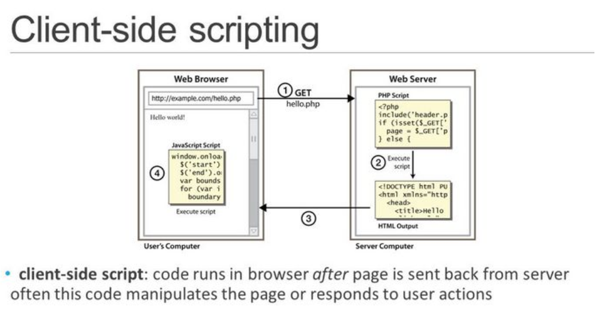
Developers might consider using client-side scripts for many reasons, but they might have also have some legitimate reasons not to use them.

Slide 34
Advantages
Client-side scripts offer numerous advantages, including:
More interactivity by immediately responding to users’ actions.
Execute commands quickly without needing a trip back and forward to the server.
May improve the usability of Web sites for users whose browsers support scripts.
Client-side scripts do not require additional software on the server (making them popular).
Can give developers more control over the look and behavior of their Web widgets.
Can be substituted with alternatives (for example, HTML) if users’ browsers do not support scripts
Scripts are reusable and obtainable from many free resources such as HotScripts.com and JavaScript.com

Slide 35
Disadvantages
Client-side scripts also create additional worries which include:
If browser is out of date then website may not appear correctly.
Not all browsers support scripts, so, users might experience errors if no alternatives have been provided.
Not secure as anyone can look at the code in the page source
Some browsers may disable the active content of the script and inform the user it could be harmful.
Different browsers and browser versions support scripts differently, thus more quality assurance testing is needed.
More development time and effort might be required (if the scripts are not already available through other resources).
Developers have more control over the look and behavior of their Web widgets; however, usability problems can exist if a Web widget looks like a standard control but behaves differently or vice-versa.

Slide 36
Advantages and Disadvantages of server-side Scripting

Slide 37
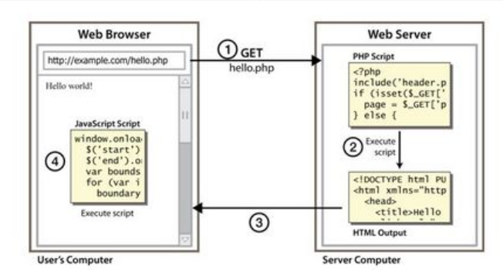
Server Side Scripting

Slide 38
Advantages
A user can create one template for the entire website
The site can use a content management system which makes editing simpler.
Generally quicker to load than client-side scripting
User is able to include external files to save coding.
Scripts are hidden from view so it is more secure.
Users will only see the HTML output.
User does not need to download plugins like Java or Flash.

Slide 39
Disadvantages
Many scripts and content management systems tools require databases in order to store dynamic data.
It requires the scripting software to be installed on the server.
The nature of dynamic scripts creates new security concerns, in some cases making it easier for hackers to gain access to servers exploiting code flaws.

Slide 40
Web Application Technologies

Slide 41
Client-side Programming
Hypertext Markup Language (HTML) needed to describe the structure of WWW documents CLO2
HTML documents are displayed by a browser that must additionally have access to a HTML interpreter to be able to identify the individual structural elements and assign them certain formats
Cascading Stylesheets (CSS), Bootstrap – are responsible for the description of the presentation (layout) of HTML documents CLO2
Also, different types (client-side & server-side) of web programming required to develop web applications
Executable / interpretable program code is transferred from the WWW server within the requested HTML document to the WWW browser (client) and processed at the client computer
WWW client needs an interpreter (if required as a plugin) which, together with the client, can interpret and execute the transferred program code
JavaScript program, JQuery program (or scripts) CLO3
Microsoft Silverlight and Adobe Flash
Java Applets

Slide 42
Server-Side Programming
The Application Program is activated by the WWW browser (client) via the WWW server at the server computer and executed there
Processed results are returned to the client as a dynamically generated HTML document
Standardized interface between WWW server and application programs at the server side: CGI (Common Gateway Interface)
Application programs at the server side can be written in desired programming language, like
script languages (Node.js, JQuery, JavaScript, ASP, PHP, Perl, Python…) CLO4
Java (Servlets, Server Pages, Beans)
today: Web frameworks (Express, Ruby on Rails, Spring, Django, …)

Slide 43
Summary
Please complete the Lab 1 exercise related to CLO1
Lab Exercises
Home Work Task

