Slide 1

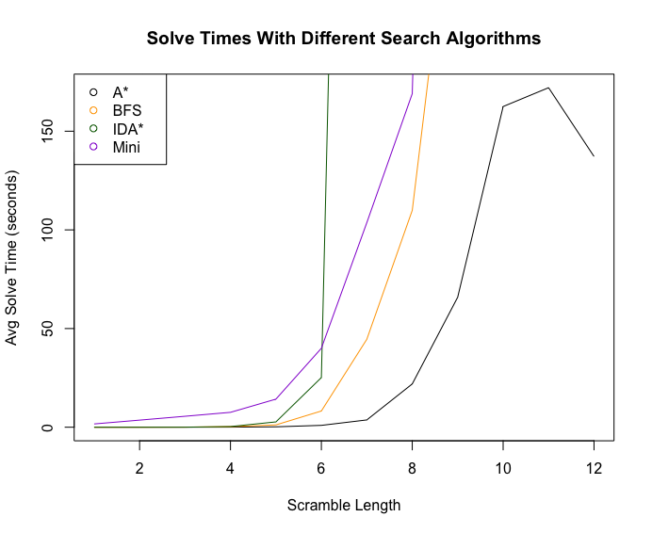
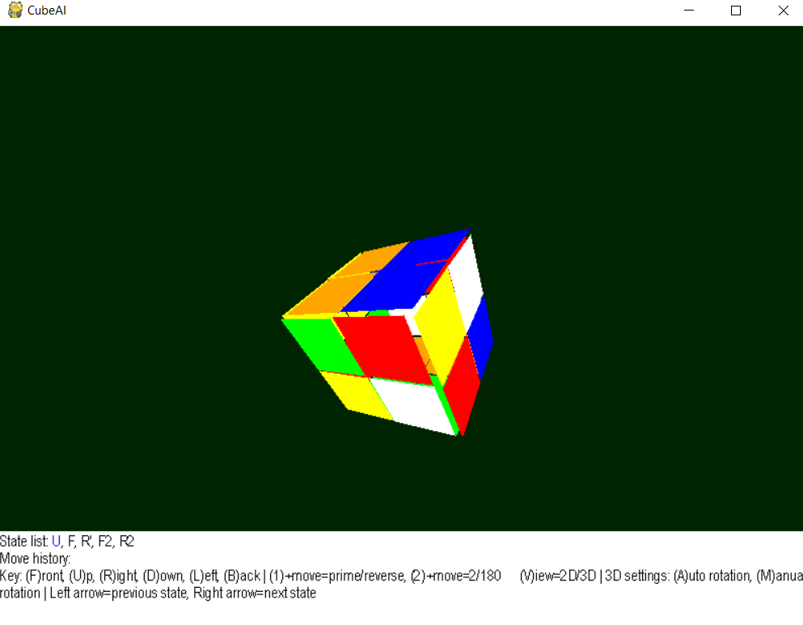
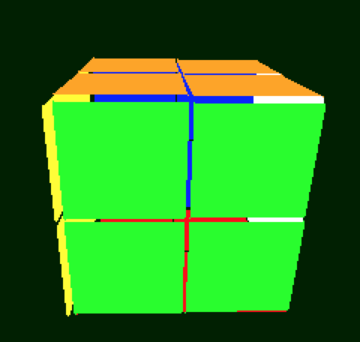
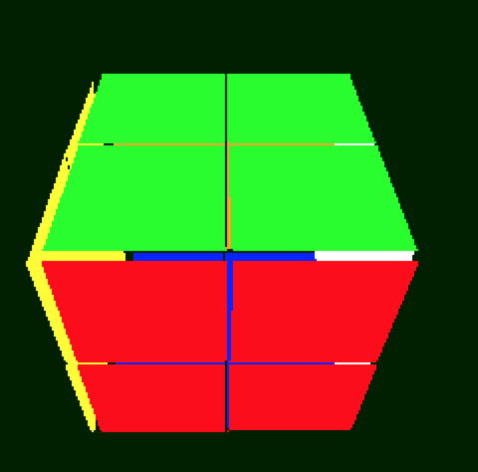
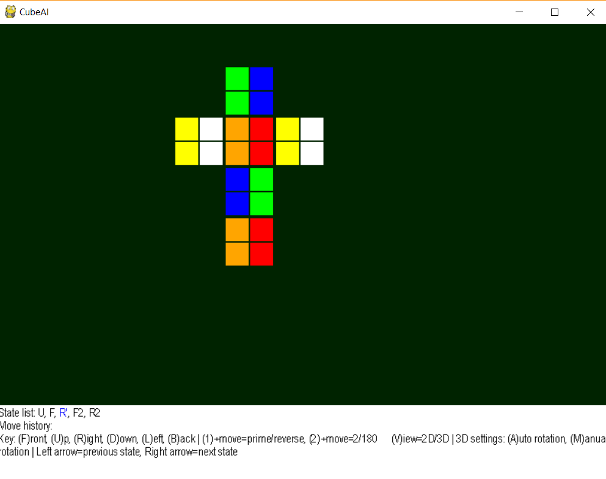
Team 4: CubeAI
Ben S. Duggan¹; Connor Altic¹
Indiana University Bloomington: Computer Science¹
CSCI-B 351
Introduction
Rubik’s Cube is a popular puzzle-toy invented in 1974 by Erno Rubik
The common 3x3x3 Rubik’s has roughly 4.33 x 10e+19
Our project is to solve a 2x2x2 Rubik’s Cube quickly using AI
AI algorithms
BFS
Better BFS
A*
IDA*
Mini
Results
A* found the fastest solutions with an average solve time of 137 seconds with a scramble length of 12
With a scramble of 8 A* had an average time of 21.9 seconds, faster than average cubers.
Problem space
The problem space for the 2x2x2 Rubik’s cube is 3,674,160
Solving an NxNxN cube optimally is NP-Complete¹.
even layered cubes have no notion of fixed centers, therefore multiple states are solved
To solve this problem we limited moves to 3 of the 6 faces.
This eliminates the symmetry, every state is accessible but only in one orientation.
Heuristics
simpleHeuristic
A naive heuristic which only compares amount of matched colors on each face
hammingDistance
A hamming distance heuristic using the hash of the cube state
manhattanDistance
A 3d manhattan distance heuristic which sums how many moves a piece is from its ideal position, for each piece.
Algorithm | Scramble = 7 | Scramble=12
A* | 3.7 s | 137s
BBFS | 44.55 s | > 300 s
IDA* | 300 s | > 300 s
Mini | 103.6 s | > 300 s
2b
Figure 1: Two ways of viewing a solved cube
2a
conclusion
Anecdotally it seems improbably that these techniques would work well with a 3x3x3 Rubik’s Cube
Figure2a: 2D rendering of 2x2 cube in GUI 2b: 3D rendering of 2x2 cube in the GUI
LITERATURE CITED
¹Demaine, E.D., Eisenstat, S., Rudoy, M. Solving the Rubik’s Cube Optimally is NP-complete. Cornell University: Computer Science. 2018. https://arxiv.org/abs/1706.06708
FUTURE PLANS
Generalize Manhattan distance heuristic for any n
Explore the performance of bidirectional A*

