Slide 1

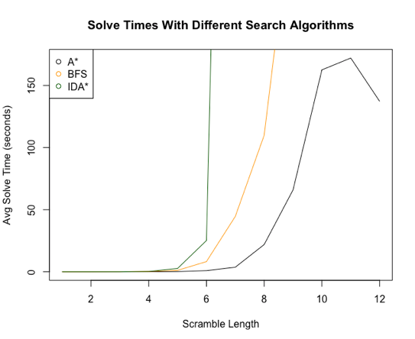
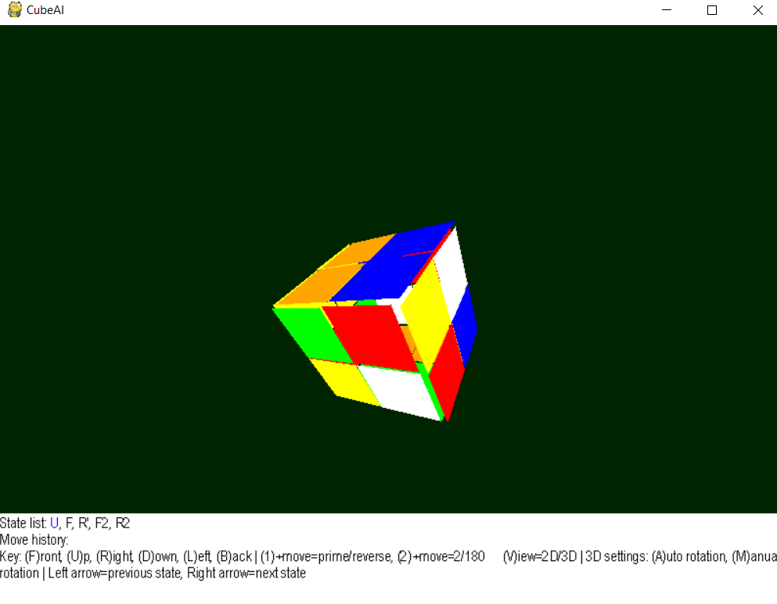
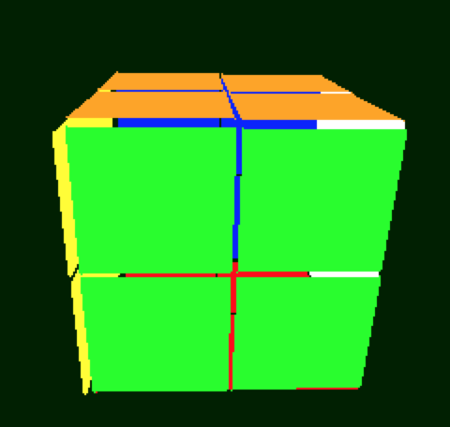
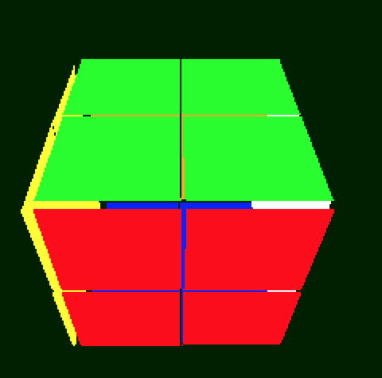
Team 4: CubeAI
Ben S. Duggan¹; Connor Altic¹
Indiana University Bloomington: Computer Science¹
CSCI-B 351
Introduction
Rubik’s Cube is a popular puzzle-toy invented in 1974 by Erno Rubik
The common 3x3x3 Rubik’s has roughly 4.33 x 10e+19
Our project is to solve a 2x2x2 Rubik’s Cube quickly using AI
AI algorithms
BFS
Better BFS
A*
IDA*
Mini
Results
d
Problem space
The problem space for the 2x2x2 Rubik’s cube is 3,674,160
Solving an NxNxN cube optimally is NP-Complete.
even layered cubes have no notion of fixed centers, therefore multiple states are solved
To solve this problem we limited moves to 3 of the 6 faces.
This eliminates the symmetry, every state is accessible but only in one orientation.
Figure 1: 3D rendering of 2x2 cube in the GUI
conclusion
Using Artificial Intelligence techniques, specifically A* with our heuristic, a computer can solve the 2x2x2 Rubik’s Cube quickly, that is to say quicker than a human trained to solve the puzzle.
FUTURE PLANS
Generalize Manhattan distance heuristic for any n
Explore the performance of bidirectional A*
Two ways of viewing a solved cube
Heuristics
simpleHeuristic
A naive heuristic which only compares amount of matched colors on each face
hammingDistance
A hamming distance heuristic using the hash of the cube state
manhattanDistance
A 3d manhattan distance heuristic which sums how many moves a piece is from its ideal position, for each piece.

