Slide 1

Sensor Network
Applied Energy Research

Slide 2

Applied Energy Research
Idea:
Instead of using independent monitoring modules.
Create an interconnected system of sensors with a central server and database, allowing access to any computer on the network

Slide 3
Applied Energy Research
Advantages:
Ability to monitor large number of sensors
Support for different sensor types
Remote monitoring
Ease of access - Network
Good user interface – web page
Data base storage
Cost

Slide 4
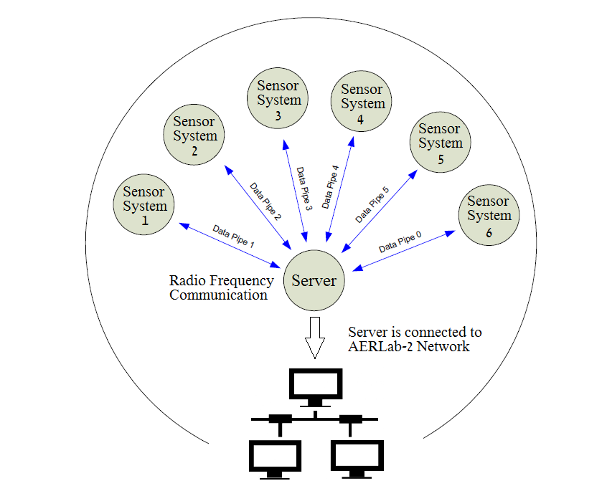

Slide 5
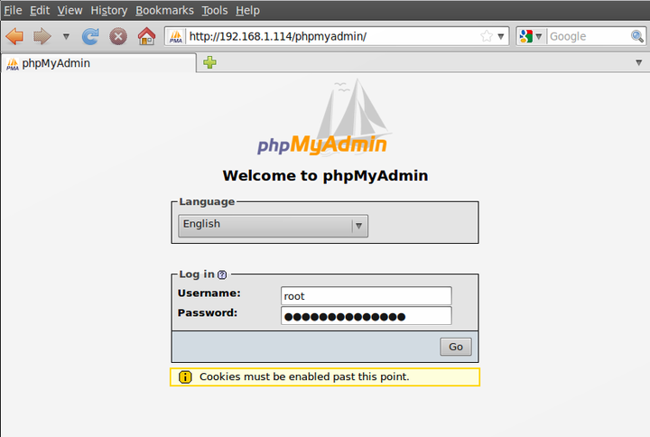
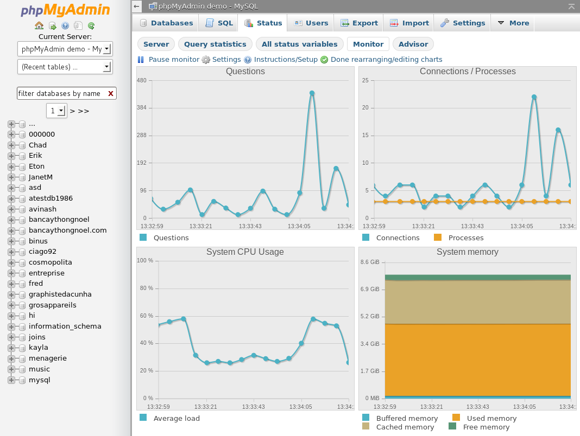
Applied Energy Research
Data Base:

Slide 6
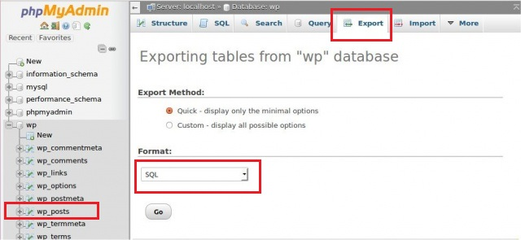
Applied Energy Research
Data Access:

Slide 7
Applied Energy Research
Technical Aspects: Hardware side
Microcontroller Programming
Hardware Interfacing
Radio Communications
Software Side
Linux Operating system configuration
Data base configuration
Web-Development

Slide 8
Applied Energy Research
Thank you!

