Slide 1
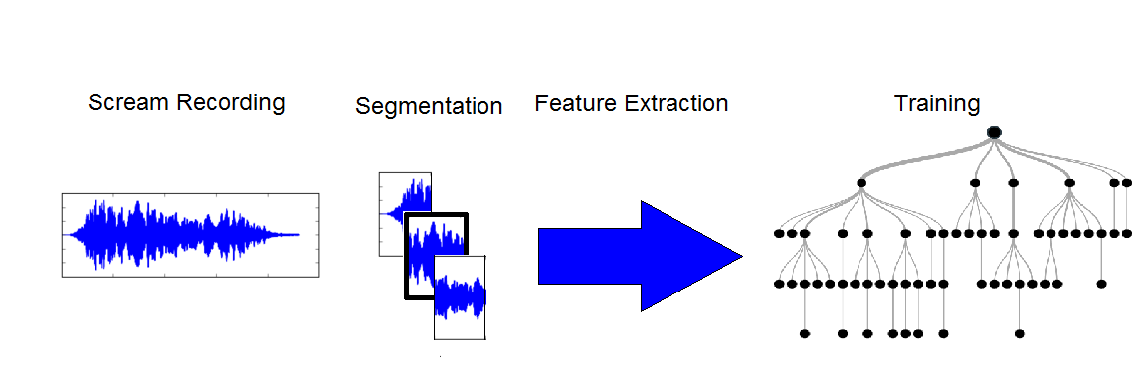
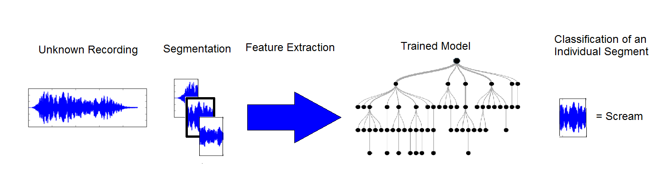
Feature Extraction
Surveillance Sound Classifier
By Juan David Dominguez, Gregory Leung, Ben Sandeen
Abstract
Decision Tree
Conclusion
We built a machine learning system to identify whether a recording of a sound has a human scream in it. This task is important as it may potentially allow for computerized surveillance systems to replace human-centric ones. Since this in the context of a surveillance system, so we trained and tested our system on sounds that would occur in a variety of surveillance situations, such as construction/manmade sounds, bird calls.
We used a decision tree because the algorithm used to train one implicitly ignores “useless” features (features that don’t immediately help decide a classification).
Using the decision tree model in the Scikit-Learn library along with 7-fold cross validation, our selected model had a depth of 5 and a minimum leaf population of 15% of the total population. During cross-validation, the correct classification rate was 0.8234 with a standard deviation of 0.0682
Given more time and resources, we would consider exploring more parameters on the decision tree, including testing on max depths of more than 10, trying different minimum populations of leaves, and further cross validation.
This also includes testing on different machine learning models, such as nearest neighbors, neural nets, etc.
Judging from the correct classification rate with 7-fold cross validation of 0.8234, the current model is successful especially given the limited computational resources.
Feature analysis is done on 40 millisecond windows with 20 milliseconds of overlap on 44100 Hz WAV recordings.
The current model uses 20 Mel Frequency Cepstral Coefficients, 1 root mean squared energy measure of window, 12 chroma bins, and 1 average and standard deviation of the chroma bins.
Process Graphic

