Slide 1

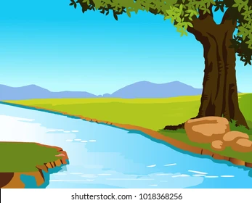
Story time
Margaret went to the bank
She had never gone there before, these were new waters for her
She finally got some credit, just because she did that.
60%
77%
66%
Margaret went to the bank
She had never gone there before, these were new waters for her
She finally got some credit, just because she did that.
7

