Slide 1
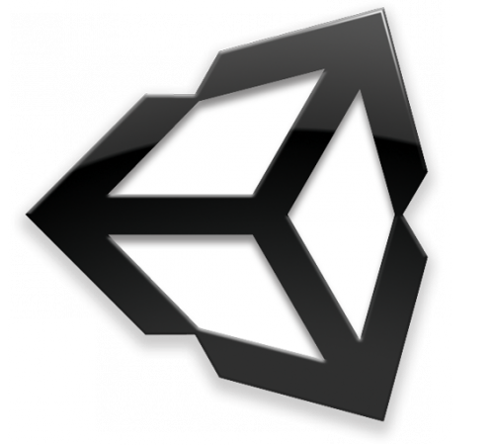
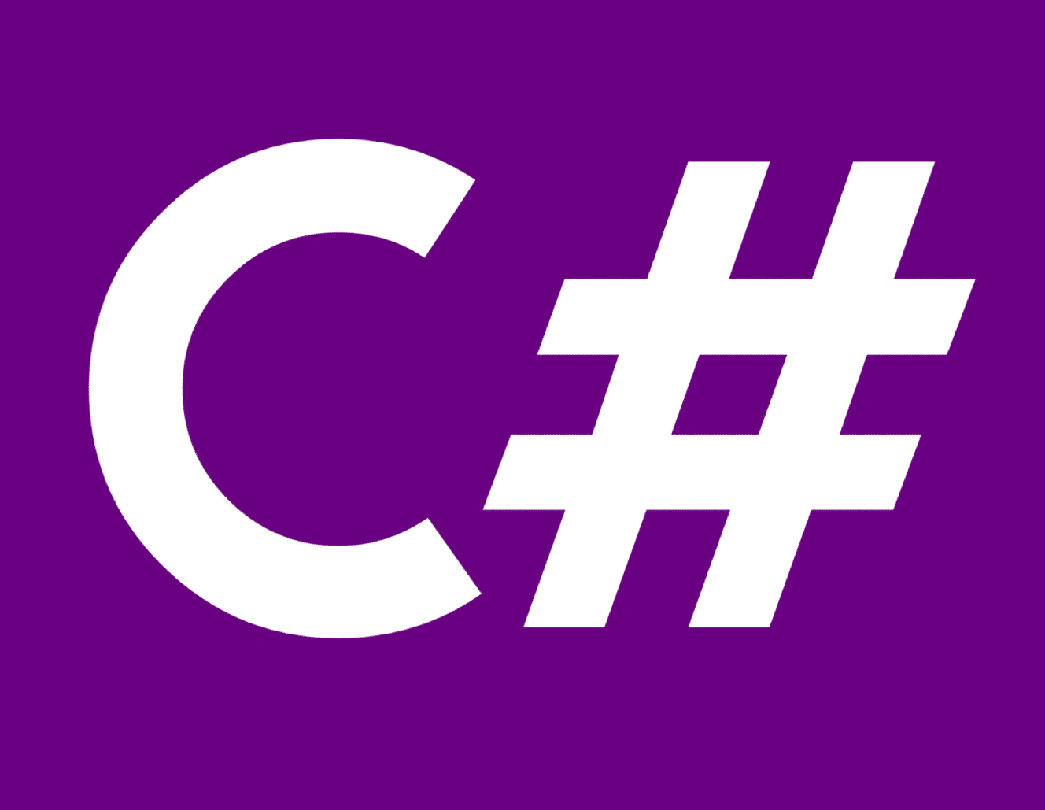
Developing Games with Unity & C# Part 2

Slide 2
Outline (cont)
Some useful unity tools and packages
New Input System
Unity UI
Layer mask and Raycast
Coroutines
Unity Execution Order

Slide 3
Layer Masks and Raycasts

Slide 4
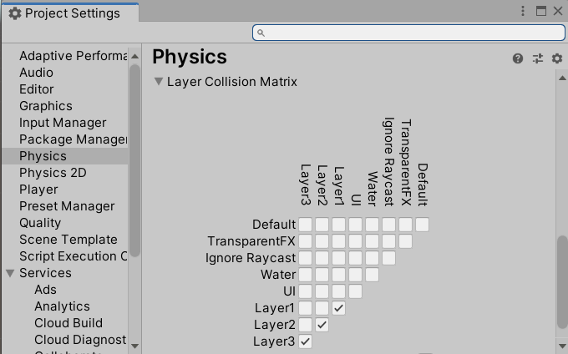

Layer-based Collision Detection
Edit > Project Settings, then select Physics category
Only GOs that belong to the same layer can collide

Slide 5
Physics.Raycast
public static bool Raycast ( Vector3 origin, Vector3 direction, out RaycastHit hitInfo, float maxDistance, int layerMask );
origin | Starting point of the ray in world coordinates.
direction | Direction of the ray.
hitInfo | If true is returned, hitInfo will contain information about where the closest collider was hit.
maxDistance | Max distance the ray should check for collisions.
layerMask | Layer mask that is used to selectively ignore Colliders when casting a ray.

Slide 6
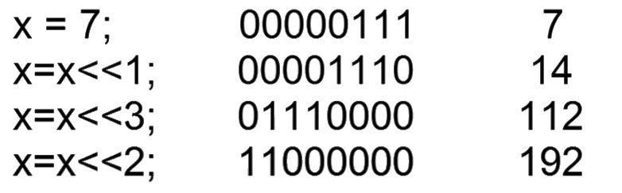
Lift Shift Operator

Slide 7
Layer Mask
Use LayerMask to check for multiple layers in Physics.Raycast
User Layer values of 10 and 11 return value 2^10 + 2^11 = 3072
using UnityEngine;
public class Example : MonoBehaviour
{
void Start()
{
Debug.Log(LayerMask.GetMask("UserLayerA", "UserLayerB"));
}
}

Slide 8
int layerMask = 1 << 8; //bit shift index of layer 8 to get a bitmask
layerMask = ~layerMask; //invert bitmask

Slide 9
void Update ()
{
int layerMask = 1 << 8; //bit shift index of layer 8 to get a bitmask
layerMask = ~layerMask; //inverts bitmask
RaycastHit hit;
if (Physics.Raycast(transform.position, transform.TransformDirection(Vector3.forward),
out hit, Mathf.Infinity, layerMask))
{
Debug.DrawRay(transform.position, transform.TransformDirection(Vector3.forward)
* hit.distance, Color.yellow);
Debug.Log("Did Hit");
}
else
{
Debug.DrawRay(transform.position, transform.TransformDirection(Vector3.forward) *1000,
Color.white);
Debug.Log("Did not Hit");
}
}

Slide 10
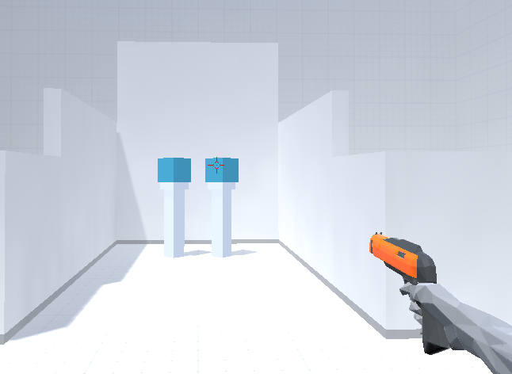
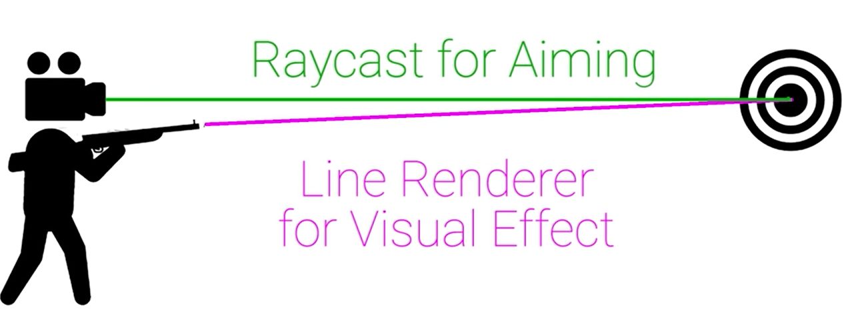
Raycast

Slide 11
public static bool Raycast ( Vector3 origin, Vector3 direction, RaycastHit hitInfo, float maxDistance, int layerMask )

Slide 12
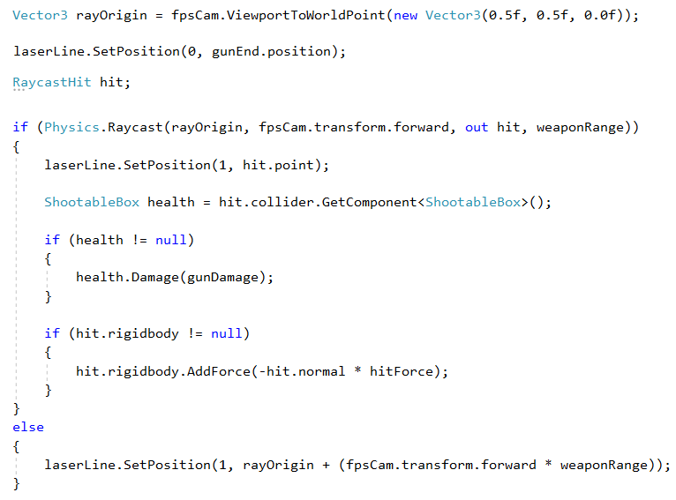

Slide 13
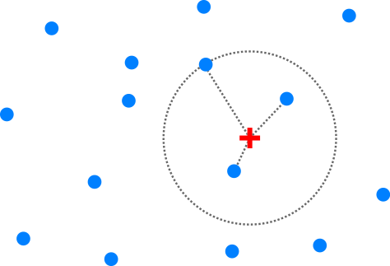
Finding Nearby GOs
Physics.OverlapSphere()
FindGameObjectsWithTag()
public static Collider[] OverlapSphere(Vector3 position, float radius, int layerMask);

Slide 14
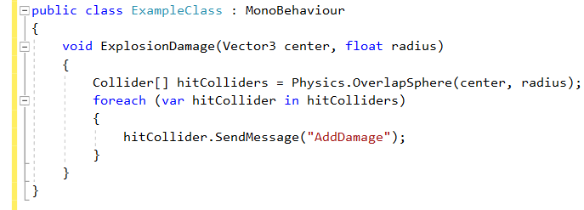
Finding Nearby Gos (cont)

Slide 15
void Update()
{
print("Closest Object is " + GetClosestObject("tagName").name);
}
GameObject GetClosestObject(string tag)
{
GameObject [] objectsWithTag = GameObject.FindGameObjectsWithTag(tag);
GameObject closestObj = null;
foreach (GameObject obj in objectsWithTag)
{
if (closestObj==null)
{
closestObj = obj;
}
if (Vector3.Distance(transform.position, obj.transform.position) < Vector3.Distance(transform.position, closestObj.transform.position))
{
closestObj = obj;
}
}
return closestObj;
}

Slide 16

Unity Coroutines

Slide 17
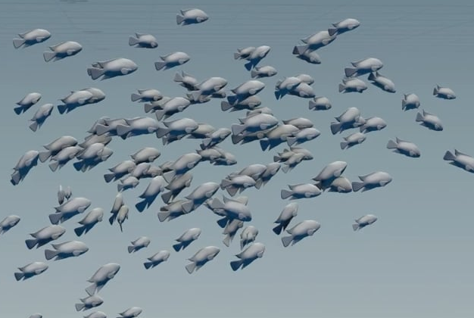
Coroutines
Work needs to occur over multiple frames
Animations
Long computations
Asynchronous code e.g. network requests
Executing tasks less frequently than frame rate (i.e. Update()) e.g. every 5 sec.

Slide 18
Coroutines (cont)
Function that can pause its execution
Resume from exact same point after a condition is met
Must return IEnumerator
Must use “yield” before “return”

Slide 19
Start/Stop Coroutines
2 ways to start Coroutines
StartCoroutine(string methodName)
e.g. StartCoroutine(“myCoroutine”)
StartCoroutine(IEnumerator e)
eg. StartCoroutine(myCoroutine())
StopCoroutine(string methodName), …

Slide 20
void Start()
{
StartCoroutine(MyCoroutine());
}
...
IEnumerator MyCoroutine()
{
for (float j = 1f; j >= 0; j -= 0.1f)
{
Color c = renderer.material.color;
c.a = j;
renderer.material.color = c;
yield return null;
}
}

Slide 21
Coroutines (cont)
Halt the coroutine execution for the given amount of time
public class Example : MonoBehaviour
{
void Start()
{
StartCoroutine(Example());
}
IEnumerator Example()
{
print(Time.time);
yield return new WaitForSeconds(5);
print(Time.time);
}
}

Slide 22
Resuming Execution of Coroutines
yield return null;
yield return new WaitForSeconds(t);
yield return new WaitForEndOfFrame();
yield return new WaitForFixedUpdate();
yield return new WWW(url);
yield return StartCoroutine(Coroutine2());

Slide 23
IEnumerator A()
{
...
// Waits for B to terminate
yield return StartCoroutine( B() );
...
}

Slide 24
bool ProximityCheck() {
for (int i = 0; i < enemies.Length; i++)
{
if (Vector3.Distance(transform.position, enemies[i].transform.position) < dangerDistance)
{
return true;
}
}
return false;
}

Slide 25
IEnumerator DoCheck()
{
for(;;)
{
if (ProximityCheck())
{
// Perform some action here
}
yield return new WaitForSeconds(.1f);
}
}

Slide 26
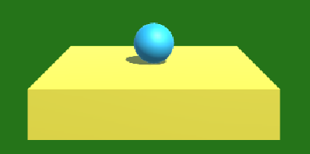
public class PropertiesAndCoroutines : MonoBehaviour
{
public float smooth = 7f;
public Vector3 Target
{
get
{ return target; }
set
{
target = value; StopCoroutine("Movement");
StartCoroutine("Movement", target);
}
}
private Vector3 target;
IEnumerator Movement(Vector3 target)
{
while (Vector3.Distance(transform.position, target) > 0.05f)
{
transform.position = Vector3.Lerp(transform.position, target, smooth*Time.deltaTime);
yield return null;
}
}
}

Slide 27
public class ClickSetPosition : MonoBehaviour
{
PropertiesAndCoroutines coroutineScript;
private void Start()
{
coroutineScript = GameObject.Find("Sphere").GetComponent<PropertiesAndCoroutines>();
}
public void OnClick()
{
Ray ray = Camera.main.ScreenPointToRay(Mouse.current.position.ReadValue());
Physics.Raycast(ray, out RaycastHit hit);
if (hit.collider && hit.collider.gameObject == gameObject)
{
Vector3 newTarget = hit.point + new Vector3(0, 0.5f, 0);
coroutineScript.Target = newTarget;
}
}
}

Slide 28
public class Updates : MonoBehaviour
{
private float update; void Awake()
{
Debug.Log("Updates: Awake");
update = 0.0f;
}
IEnumerator Start()
{
Debug.Log("Updates: Start1");
yield return new WaitForSeconds(2.5f);
Debug.Log("Updates: Start2");
}
void Update()
{
update += Time.deltaTime;
if (update > 1.0f)
{
update = 0.0f;
Debug.Log("Updates: Update");
}
}
}
Updates:Awake ()
Updates: Start1
Updates: Update
Updates: Update
Updates: Start2
Updates: Update
Updates: Update
Updates: Update
…

Slide 29
Readings
Coroutines (Unity Manual)
https://docs.unity3d.com/Manual/Coroutines.html
A tutorial
http://www.unitygeek.com/coroutines-in-unity3d

Slide 30
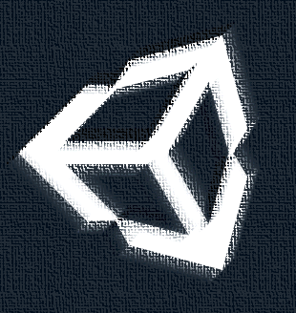
New Input System

Slide 31
New Input System (cont)
Decoupling input devices from actions and code
Game device compatibility
Better debugging
New devices at runtime
More customisable and extensible

Slide 32
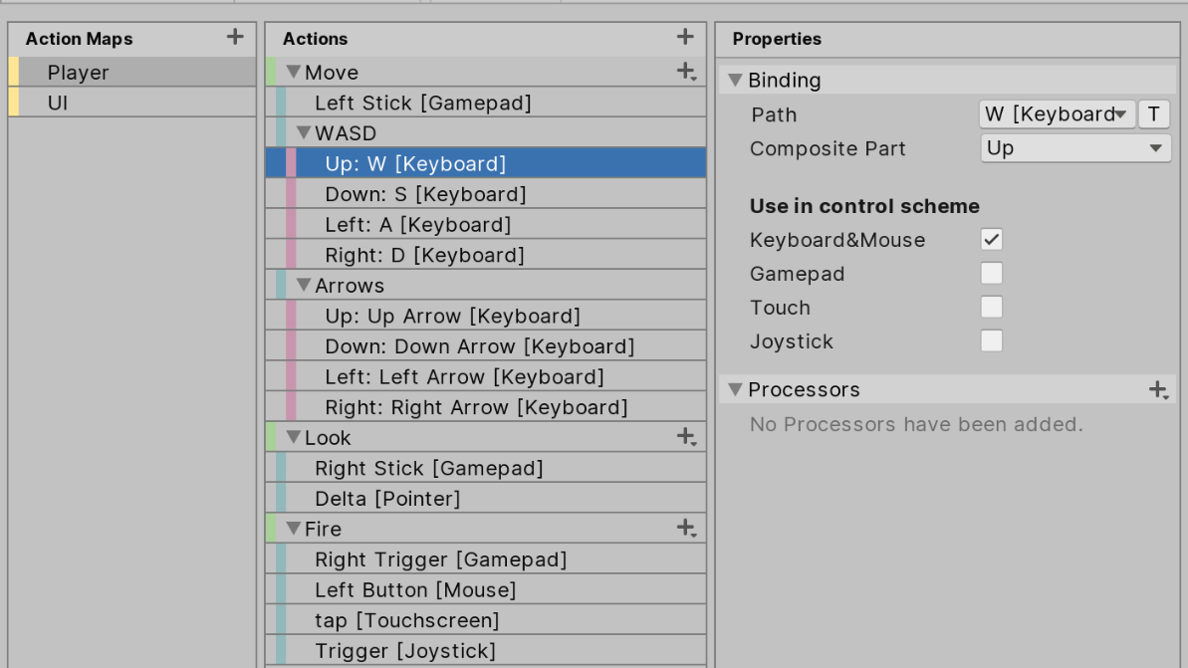

Slide 33
public void Update()
{
var mouse = Mouse.current;
if (mouse == null)
return;
var delta = mouse.delta.ReadValue();
Look(delta);
if (mouse.leftButton.wasPressedThisFrame)
{
m_Firing = true;
}
else if (mouse.leftButton.wasReleasedThisFrame)
{
m_Firing = false;
}
if (m_Firing)
{
Fire();
}
}
Polling Input State

Slide 34
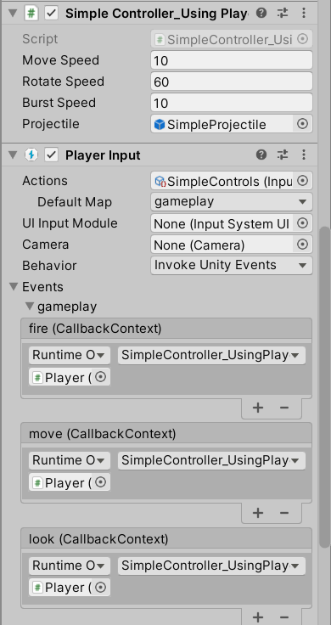
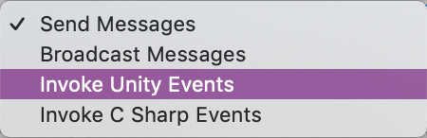
New Input System (cont)
To set input actions:
Add a PlayerInput component
Create Actions asset
Action maps, actions, bindings
Script Action responses
Messages, Unity events, C# events

Slide 35
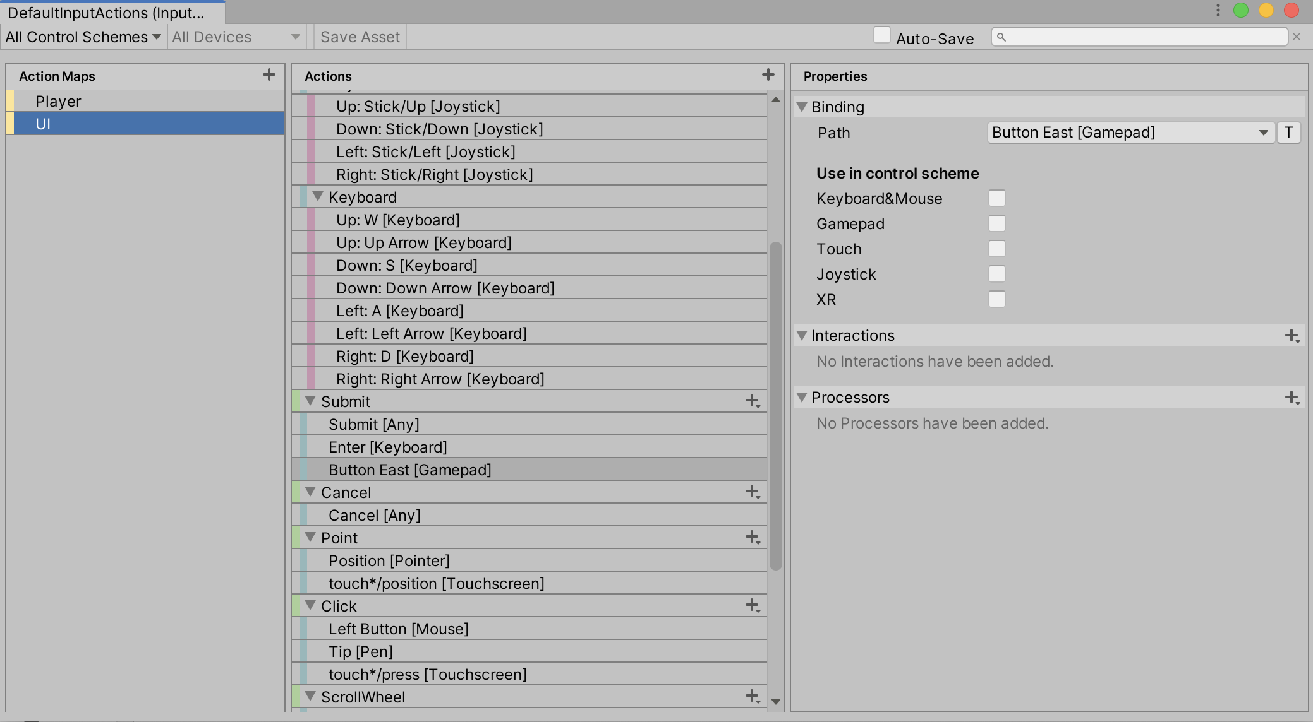

Slide 36
Sending and Broadcasting Messages
public class Example1 : MonoBehaviour
{
void Start()
{
gameObject.SendMessage("ApplyDamage", 5.0);
}
}
public class Example2 : MonoBehaviour
{
public void ApplyDamage(float damage)
{
print(damage);
}
}

Slide 37
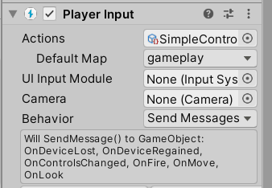
public class MyPlayerLogic : MonoBehaviour
{
public GameObject projectilePrefab;
private Vector2 m_Look;
private Vector2 m_Move;
private bool m_Fire;
public void OnFire()
{
Instantiate(projectilePrefab);
}
public void OnMove(InputValue value)
{
m_Move = value.Get<Vector2>();
}
public void OnLook(InputValue value)
{
m_Look = value.Get<Vector2>();
} }

Slide 38
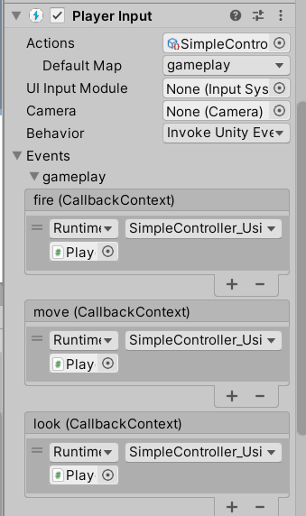
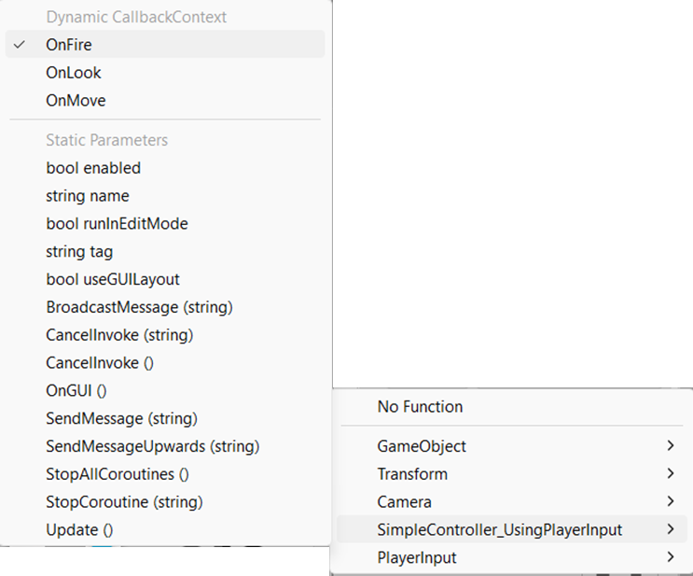
Using Unity Events
Callbacks instead of polling

Slide 39
...
using UnityEngine.InputSystem;
using UnityEngine.InputSystem.Interactions;
public class SimpleController_UsingPlayerInput : MonoBehaviour
{
public float moveSpeed;
public float rotateSpeed;
public float burstSpeed;
public GameObject projectile;
private bool m_Charging;
private Vector2 m_Rotation;
private Vector2 m_Look;
private Vector2 m_Move;
public void OnMove(InputAction.CallbackContext context)
{
m_Move = context.ReadValue<Vector2>();
}
public void OnLook(InputAction.CallbackContext context)
{
m_Look = context.ReadValue<Vector2>();
}
...

Slide 40
public void OnFire(InputAction.CallbackContext context)
{
switch (context.phase)
{
case InputActionPhase.Performed:
if (context.interaction is SlowTapInteraction)
{
StartCoroutine(BurstFire((int)(context.duration * burstSpeed)));
}
else
{
Fire();
}
m_Charging = false;
break;
case InputActionPhase.Started:
if (context.interaction is SlowTapInteraction)
m_Charging = true;
break;
case InputActionPhase.Canceled:
m_Charging = false;
break;
}
}

Slide 41
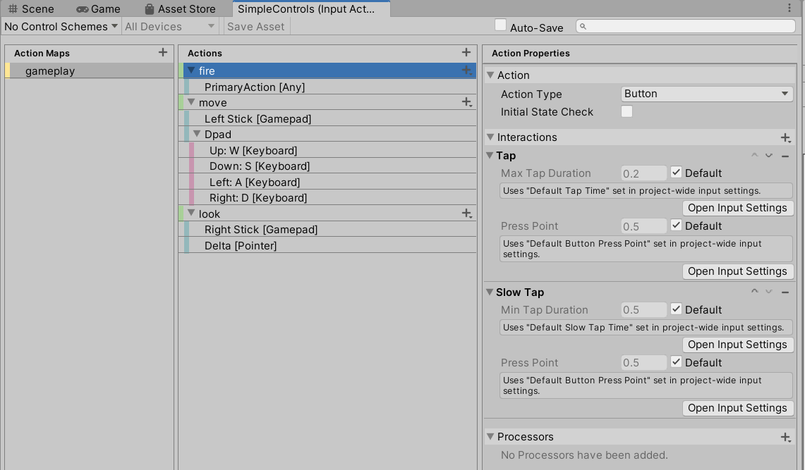

Slide 42
Using C# Events
C# Events
To subscribe to events e.g. mouse click
Callbacks
publisher.CustomEvent += HandleCustomEvent;
Subscriber1
Publisher
Events
Subscriber2
Subscriber3
More info:
https://docs.microsoft.com/en-us/dotnet/standard/events/

Slide 43
Lambda operator
public int sum(int a, int b) => a + b;
Shorthand for:
public int sum(int a, int b) {
return a + b;
}
More info:
https://docs.microsoft.com/en-us/dotnet/csharp/language-reference/operators/lambda-expressions

Slide 44
C# Coding Tips (cont)
Lambda Expressions
(input-parameters) => expression
(input-parameters) => { <sequence-of-statements> }
Allow us to use anonymous functions to handle events
source.event += (input-parameters) => expression

Slide 45
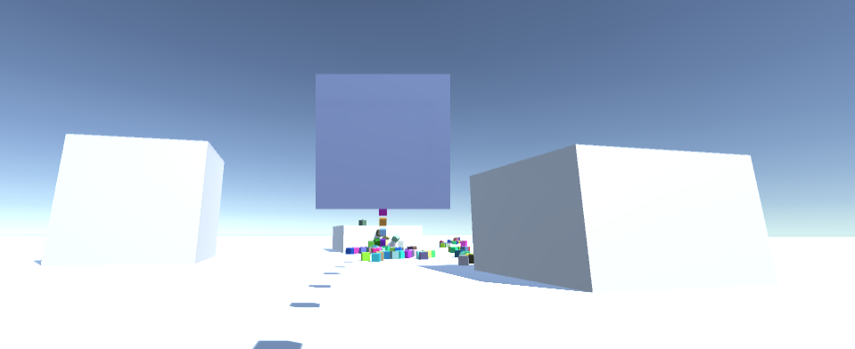
fireAction.performed += ctx => StartCoroutine(BurstFire(ctx.duration));
Event
Anonymous function with parameter ctx
Function statement
Event handler

Slide 46
public void Awake()
{ fireAction.performed += ctx => {
if (ctx.interaction is SlowTapInteraction)
{
StartCoroutine(BurstFire((int)(ctx.duration * burstSpeed)));
}
else
{
Fire();
}
m_Charging = false;
};
fireAction.started += ctx => {
if (ctx.interaction is SlowTapInteraction)
m_Charging = true;
};
fireAction.canceled += ctx => {
m_Charging = false;
};
}

Slide 47
private IEnumerator BurstFire(int burstAmount)
{
for (var i = 0; i < burstAmount; ++i)
{
Fire();
yield return new WaitForSeconds(0.1f);
}
}

Slide 48
public void Awake()
{ fireAction.performed += OnFireActionPerformed;
fireAction.started += OnFireActionStarted;
fireAction.canceled += OnFireActionCanceled;
}
private void OnFireActionPerformed (InputAction.CallbackContext ctx)
{
if (ctx.interaction is SlowTapInteraction)
{
StartCoroutine(BurstFire((int)(ctx.duration * burstSpeed)));
}
else
{
Fire();
}
m_Charging = false;
}
public void OnFireActionPerformed (InputAction.CallbackContext ctx)
{ ...

Slide 49
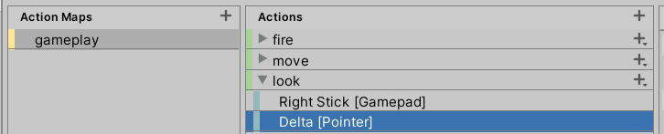
var look = new Vector2();
var gamepad = Gamepad.current;
if (gamepad != null)
look = gamepad.rightStick.ReadValue();
var mouse = Mouse.current;
if (mouse != null)
look = mouse.delta.ReadValue();
myControls.gameplay.look.performed +=
cxt => look = context.ReadValue<Vector2>();

Slide 50
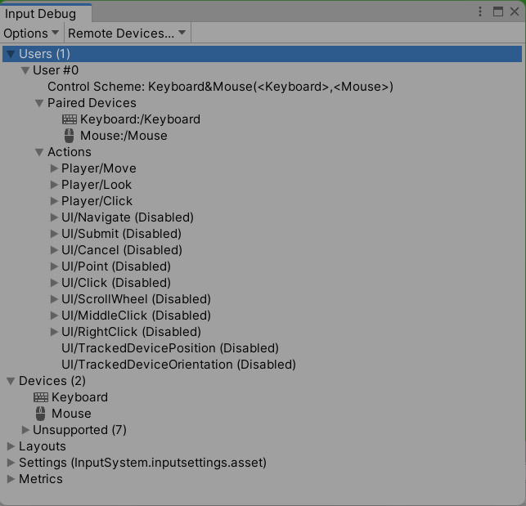
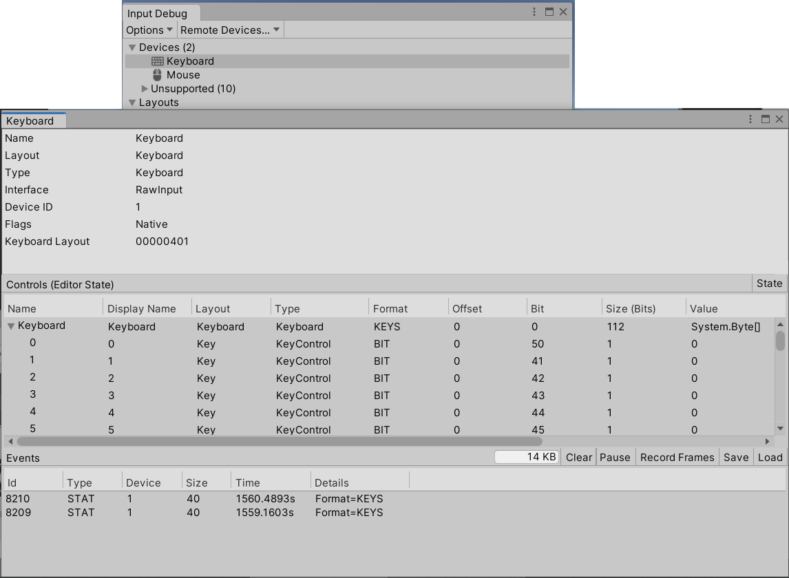
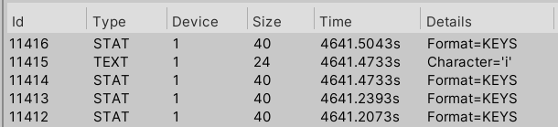
Window > Analysis > Input Debugger

Slide 51
Unity UI

Slide 52
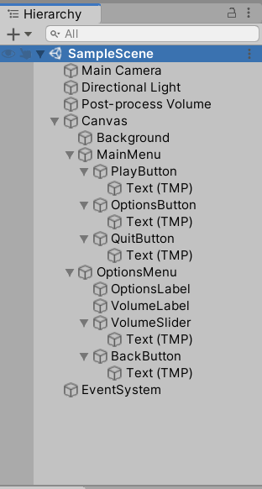
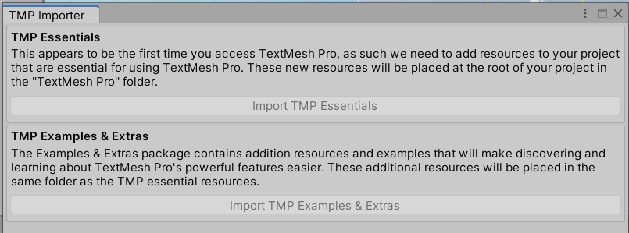
Unity UI

Slide 53
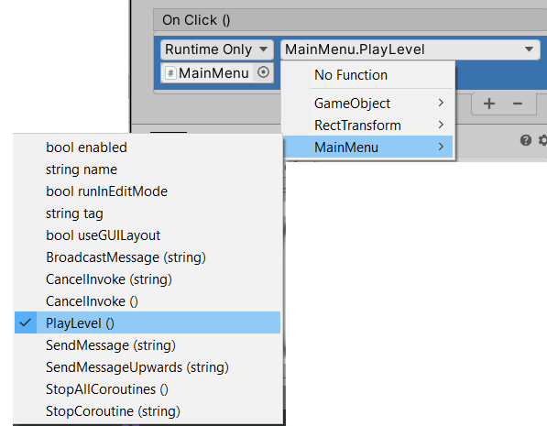
Unity UI (cont)

Slide 54
SceneManager.LoadScene
LoadScene(int sceneBuildIndex, SceneManagement.LoadSceneMode );
LoadScene(string sceneName, SceneManagement.LoadSceneMode);
mode = LoadSceneMode.Single | LoadSceneMode.Additive

Slide 55
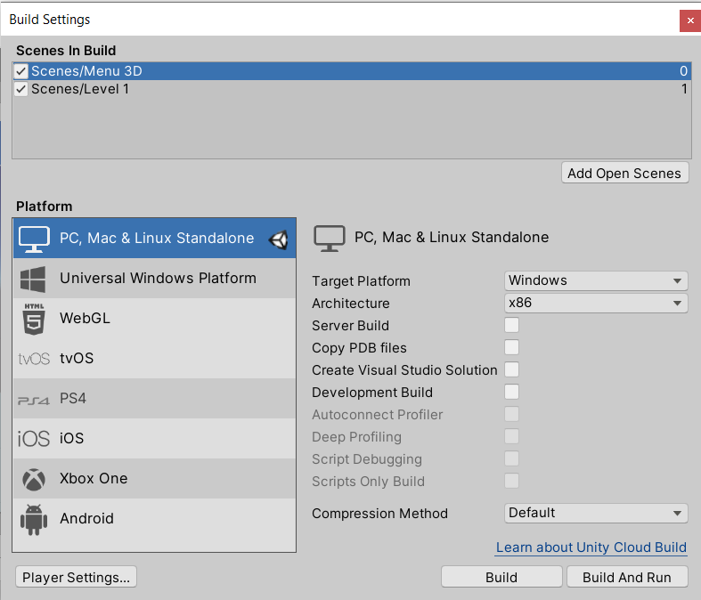
Loading Scene

Slide 56
public class Example : MonoBehaviour
{
void OnGUI()
{
if (GUI.Button(new Rect(20, 30, 150, 30), "Other Scene Single"))
{
SceneManager.LoadScene("YourScene", LoadSceneMode.Single);
}
if (GUI.Button(new Rect(20, 60, 150, 30), "Other Scene Additive"))
{
SceneManager.LoadScene("YourScene", LoadSceneMode.Additive);
}
}
}

Slide 57
Unity Execution Order

Slide 58
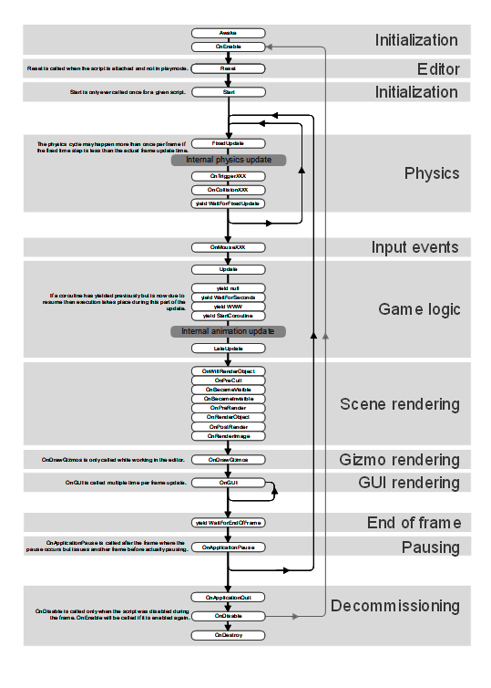

Slide 59
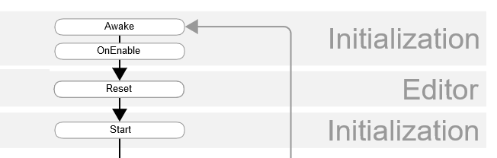

Slide 60
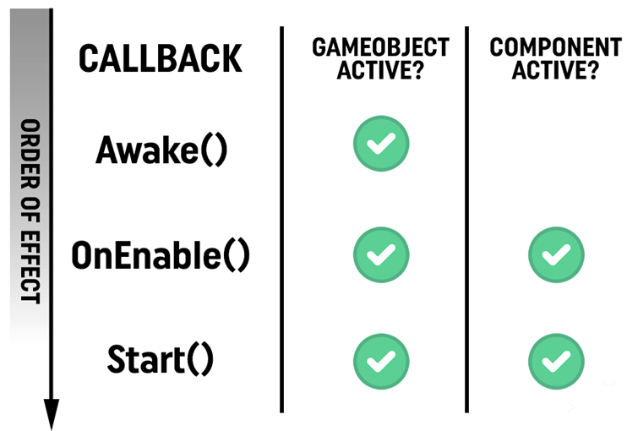
First Scene Load

Slide 61
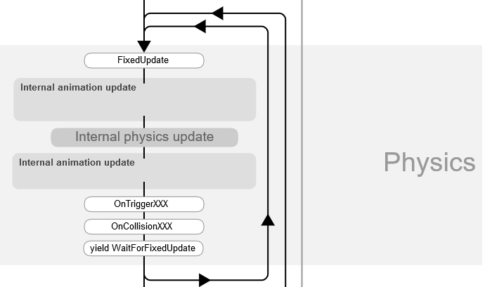

Slide 62
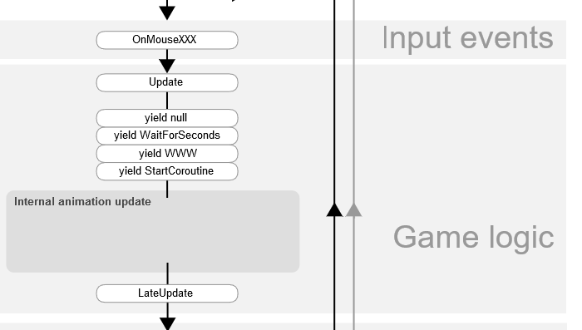

Slide 63
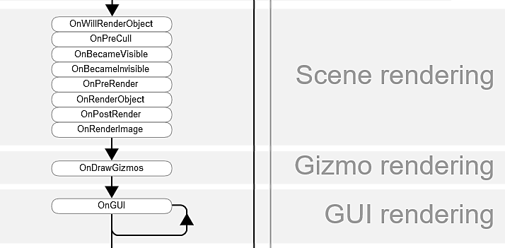

Slide 64
using UnityEngine;
using System.Collections;
public class ExampleClass : MonoBehaviour
{
void OnGUI()
{
if (GUI.Button(new Rect(10, 10, 150, 100), "I am a button"))
{
print("You clicked the button!");
}
}
}

Slide 65
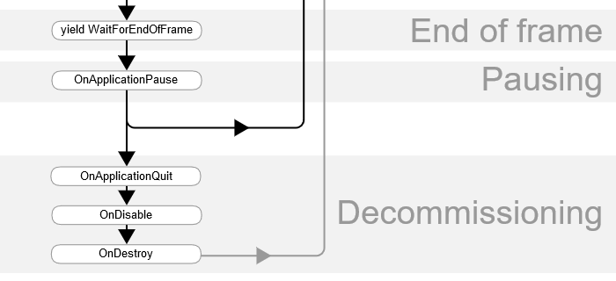
Called at the end of the frame where pause is detected between normal frame updates
Object.Destroy or at closure of scene

Slide 66
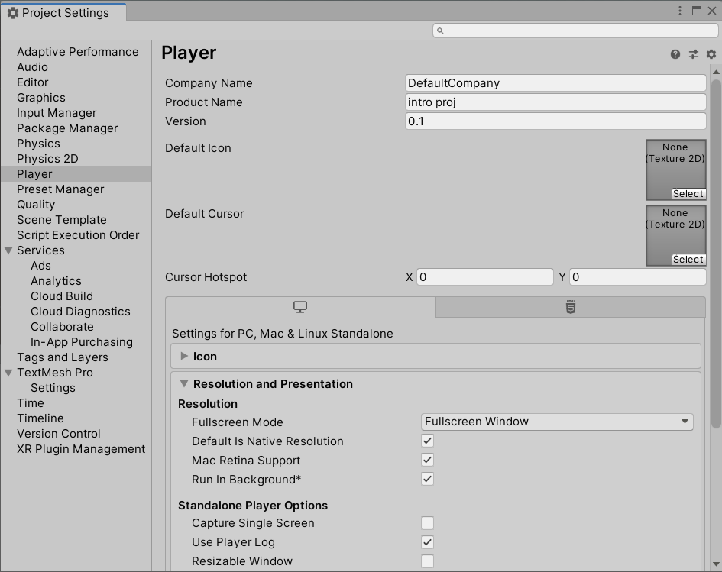

Slide 67
Reading
Execution Order of Event Functions
https://docs.unity3d.com/Manual/ExecutionOrder.html

Slide 68
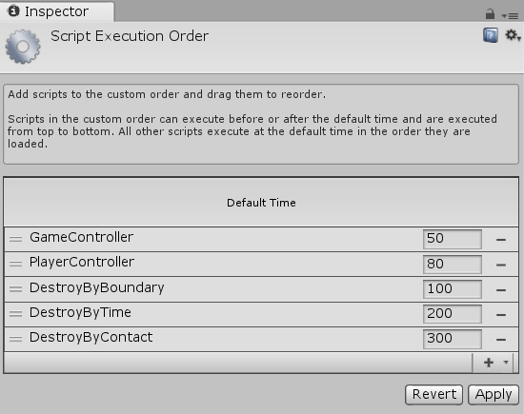
Script Execution Order
Edit > Project Settings > Script Execution Order
Applies to each category of event function separately

Slide 69
Topic Summary
Creating Unity C# scripts, namespaces, properties, …
C# collections; List, Dictionary, Queue, Stack, …
Some Unity built-in classes; Quaternion, ScriptableObject,…
Transform, renderer, materials, shaders, rigidbody, …
Instantiating GameObjects at runtime
Moving GameObjects with transform or physics
Referencing GameObjects and components
Constraints; position, scale, …
LayerMask, bitwise operations
Physics.OverlapSphere(), Physics.RayCast()
Configuring GameObject components
Debugging with Visual Studio, Studio Code
New input system, C# events, lambda expressions
UI, Scene Loading
SendMessage, BroadcastMessage, …
Coroutines
Unity event function execution order
Script execution order

